Slide 1
MINI PROJECT · PREDICTIVE TOXICOLOGY / AI IN DRUG DISCOVERY
MolRepBench
Interpretable Toxicity & ADMET Screening from Molecular Structure
Which molecular representation actually works
when the data is small and imbalanced —
and can the model show its reasoning?
12,063
9
4
3
molecules
models
datasets
scaffold splits
Shubham Gangwar · MS23BTECH11027
Domain: Predictive Toxicology / AI in Drug Discovery

Slide 2
THE PROBLEM
90% of drug candidates fail — toxicity is a leading cause
— Failure is late and expensive. A compound that reaches Phase II before a toxicity signal appears has already consumed years of work and hundreds of millions of dollars.
— Wet-lab screening cannot cover the space. Tox21 assayed ~8,000 compounds across 12 assays. Enumerable drug-like chemical space is ~10^60 molecules.
— ADMET decides viability, not just potency. A potent molecule that cannot cross the blood-brain barrier, or is insoluble, is not a drug.
— Regulatory pressure to reduce animal testing. The FDA Modernization Act 2.0 (2022) removed the blanket animal-testing requirement, raising the bar for computational evidence.
The opportunity
A model that reads a molecule's structure and flags risk in milliseconds lets a chemist triage thousands of candidates before any are synthesised.
The catch
A black-box flag is not actionable. A chemist needs to know WHICH part of the molecule is responsible to design the problem away — and needs to know when the model is guessing about chemistry it has never seen.
1

Slide 3
WHAT THIS PROJECT BUILDS
Problem statement and objectives
Build a system that predicts toxicity and ADMET risk from a molecule's SMILES string, establishes which molecular representation works better on small imbalanced data, and explains every prediction at the substructure level.
1. Benchmark
2. Evaluate honestly
Descriptor models (ECFP4 / RDKit + RF, XGBoost, DNN) against graph neural networks (GCN, GAT, Attentive FP) on Tox21, ClinTox, BBBP and ESOL.
Scaffold splits, not random splits. ROC-AUC with PR-AUC and MCC, because ROC-AUC flatters a model when 3% of compounds are active.
3. Explain
4. Deploy
SHAP on fingerprint bits mapped back onto atoms; attention attribution from the graph networks.
A Streamlit app: SMILES in, per-endpoint risk panel out, with a confidence flag for compounds outside the training chemical space.
2

Slide 4
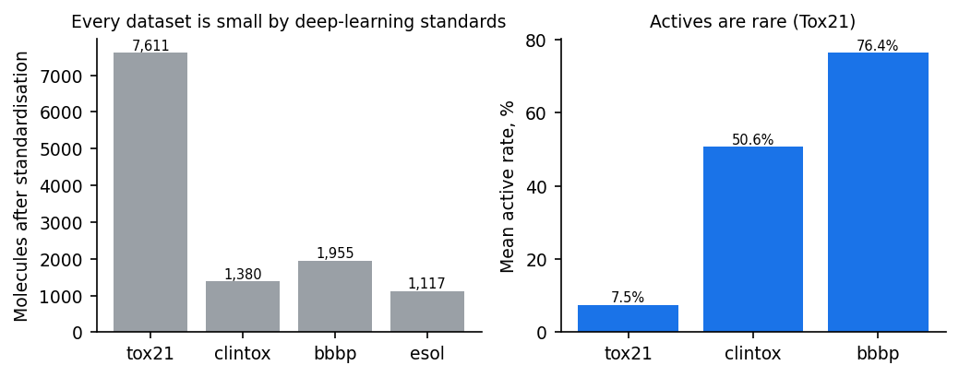
THE DIFFICULTY
Three things make this harder than a normal ML benchmark
Small data
Severe imbalance
Scaffold shift
After standardisation: 7,611 molecules for Tox21, 1,955 for BBBP, 1,380 for ClinTox, 1,117 for ESOL. Deep models are data-hungry; this is the regime where they historically lose.
Tox21 actives run 3–16% per assay. A model predicting 'safe' for everything scores 95% accuracy and is useless. ROC-AUC barely moves; PR-AUC and MCC expose it.
Real screening asks about NEW chemotypes. A random split leaks close analogues into the test set and inflates every score. Scaffold splits put whole Bemis-Murcko skeletons in test only.
3

Slide 5
DATASETS
Four MoleculeNet benchmarks covering toxicity and ADMET
Dataset | Category | Endpoint | Molecules | Tasks | Type
tox21 | Toxicity | 12 nuclear-receptor & stress-response assays | 7,611 | 12 | Classification
clintox | Toxicity | FDA-approved vs. failed clinical trials for toxicity | 1,380 | 2 | Classification
bbbp | ADMET — distribution | Blood-brain barrier penetration | 1,955 | 1 | Classification
esol | ADMET — solubility | Measured aqueous solubility, logS | 1,117 | 1 | Regression
Standardisation pipeline applied to every molecule: parse SMILES → keep the largest organic fragment (strips salts and counter-ions) → neutralise charges → canonicalise → merge duplicate structures (conflicting labels dropped). This removes 2–5% of each raw file and prevents the same compound appearing in train and test under two different SMILES strings.
Why these four
Tox21 is the standard multi-task toxicity benchmark (large, very imbalanced). ClinTox tests whether the model separates approved drugs from clinical toxicity failures. BBBP and ESOL are ADMET properties — one classification, one regression — so the benchmark covers both task types.
4

Slide 6
REPRESENTATIONS
Three ways to turn a molecule into numbers
ECFP4 fingerprint
RDKit 2D descriptors
Molecular graph
2048 bits, radius 2. Each bit = presence of a circular atom environment. Sparse, fast, and every bit maps back to a concrete substructure — which is what makes SHAP interpretable here.
~210 physicochemical and topological features: molecular weight, logP, TPSA, ring counts, fragment counts. Encodes decades of medicinal-chemistry knowledge as hand-designed features.
Atoms as nodes (58 features: element, degree, charge, hybridisation, aromaticity, chirality), bonds as edges (11 features). The network learns its own representation instead of being given one.
The central question: does a learned representation beat a hand-designed one at this data scale?
Family | Input | Why it is here
Random Forest | ECFP4 / RDKit | Strong, near-parameter-free baseline; the standard QSAR workhorse
XGBoost | ECFP4 / RDKit | Gradient boosting; handles imbalance via scale_pos_weight, exact TreeSHAP
DNN (MLP) | ECFP4 / RDKit | Tests whether depth alone helps without graph structure
GCN | Graph | Baseline message passing (Kipf & Welling)
GAT | Graph | Attention over neighbours; bond features enter the attention
Attentive FP | Graph | Molecule-specific architecture with attentive readout (Xiong 2019)
5

Slide 7
METHOD
Evaluation protocol: scaffold splits and imbalance-aware metrics
— Balanced scaffold split, 80/10/10. Molecules grouped by Bemis-Murcko scaffold; no scaffold appears in two subsets. Large generic scaffolds go to train first so they do not swamp the test set.
— Three splits (seeds 0–2). Seed 0 is the deterministic DeepChem ordering; seeds 1–2 shuffle the scaffold sets. Every number reported is mean ± s.d. over the three.
— Missing labels masked, not imputed. Tox21 has ~25% missing entries. The loss and every metric ignore them rather than assuming 'not measured' means 'not toxic'.
— Thresholds tuned on validation, frozen for test. The MCC cut-off is chosen on the validation split. A naive 0.5 cut-off is meaningless at a 3% active rate.
ROC-AUC
Ranking quality across all thresholds. Reported because it is the field standard — but it is insensitive to class imbalance.
PR-AUC
Precision-recall area. Baseline equals the active rate, so it collapses honestly when actives are rare. This is the metric that matters for screening.
MCC
Matthews correlation on the thresholded calls. Balanced across both classes; near zero means the model's actual yes/no decisions are no better than chance.
6

Slide 8
IMPLEMENTATION
System architecture
SMILES input
Standardise
Featurise
Scaffold split
Train 9 models
Evaluate
Raw string from CSV or the app
›
Largest fragment · uncharge · canonicalise · dedupe
›
ECFP4 bits · RDKit descriptors · atom/bond graph
›
Bemis-Murcko groups, 80/10/10, 3 seeds
›
RF · XGBoost · DNN · GCN · GAT · Attentive FP
›
ROC-AUC · PR-AUC · MCC · RMSE/R²
Interpretability layer
Applicability domain
Streamlit app
TreeSHAP on ECFP4 bits, redistributed over the atoms of each circular environment → per-atom heat map. Attentive FP readout attention → per-atom attention map.
Mean Tanimoto to the 5 nearest training molecules, thresholded at the 5th/25th percentile of the training set's own leave-one-out distribution, plus a descriptor-range check.
SMILES in → risk panel across 16 endpoints, confidence badge, nearest training neighbours, SHAP and attention maps, benchmark tab.
Code layout: molrepbench/{config, data, features, models, metrics, pipeline, explain, applicability, predict}.py · scripts/{prepare_data, run_benchmark, make_report_assets, make_presentation}.py · app/streamlit_app.py · tests/
7

Slide 9
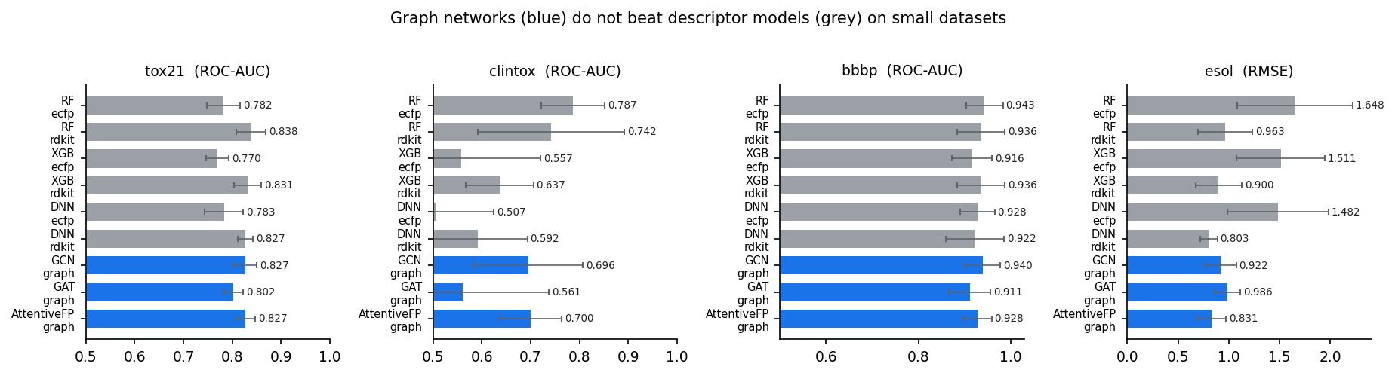
RESULTS
Descriptor models win on 4 of 4 datasets — but mostly inside the error bars
Dataset | Metric | Best descriptor model | Best graph network | Winner
tox21 | ROC-AUC | RF:rdkit (0.838) | AttentiveFP:graph (0.827) | Descriptor
clintox | ROC-AUC | RF:ecfp (0.787) | AttentiveFP:graph (0.7) | Descriptor
bbbp | ROC-AUC | RF:ecfp (0.943) | GCN:graph (0.94) | Descriptor
esol | RMSE | DNN:rdkit (0.803) | AttentiveFP:graph (0.831) | Descriptor
108 training runs: 9 configurations x 4 datasets x 3 scaffold splits. Three of the four margins sit inside one standard deviation — this is parity at lower cost, not superiority.
8

Slide 10
RESULTS
tox21 — full benchmark
Tox21 2014 challenge: 12 nuclear-receptor (NR) and stress-response (SR) assays.
Model | Representation | ROC-AUC | PR-AUC | MCC
RF + ecfp | ECFP4 fingerprint | 0.782 ± 0.034 | 0.447 ± 0.064 | 0.365 ± 0.064
RF + rdkit | RDKit descriptors | 0.838 ± 0.031 | 0.526 ± 0.082 | 0.427 ± 0.048
XGB + ecfp | ECFP4 fingerprint | 0.770 ± 0.023 | 0.428 ± 0.065 | 0.345 ± 0.057
XGB + rdkit | RDKit descriptors | 0.831 ± 0.027 | 0.515 ± 0.080 | 0.410 ± 0.048
DNN + ecfp | ECFP4 fingerprint | 0.783 ± 0.039 | 0.432 ± 0.058 | 0.363 ± 0.062
DNN + rdkit | RDKit descriptors | 0.827 ± 0.015 | 0.481 ± 0.042 | 0.415 ± 0.026
GCN + graph | Graph (GNN) | 0.827 ± 0.023 | 0.479 ± 0.046 | 0.386 ± 0.041
GAT + graph | Graph (GNN) | 0.802 ± 0.019 | 0.443 ± 0.054 | 0.361 ± 0.032
AttentiveFP + graph | Graph (GNN) | 0.827 ± 0.020 | 0.469 ± 0.050 | 0.387 ± 0.048
Mean ± s.d. over 3 scaffold splits. Metrics averaged over tasks within a seed first.
9

Slide 11
RESULTS
clintox — full benchmark
ClinTox: FDA-approved drugs vs. drugs that failed clinical trials for toxicity.
Model | Representation | ROC-AUC | PR-AUC | MCC
RF + ecfp | ECFP4 fingerprint | 0.787 ± 0.065 | 0.654 ± 0.089 | 0.146 ± 0.163
RF + rdkit | RDKit descriptors | 0.742 ± 0.150 | 0.651 ± 0.123 | 0.109 ± 0.168
XGB + ecfp | ECFP4 fingerprint | 0.557 ± 0.163 | 0.600 ± 0.089 | 0.072 ± 0.058
XGB + rdkit | RDKit descriptors | 0.637 ± 0.069 | 0.606 ± 0.089 | 0.094 ± 0.042
DNN + ecfp | ECFP4 fingerprint | 0.507 ± 0.118 | 0.587 ± 0.107 | 0.052 ± 0.131
DNN + rdkit | RDKit descriptors | 0.592 ± 0.101 | 0.619 ± 0.084 | 0.006 ± 0.048
GCN + graph | Graph (GNN) | 0.696 ± 0.111 | 0.627 ± 0.075 | 0.140 ± 0.090
GAT + graph | Graph (GNN) | 0.561 ± 0.176 | 0.587 ± 0.063 | 0.037 ± 0.042
AttentiveFP + graph | Graph (GNN) | 0.700 ± 0.063 | 0.571 ± 0.029 | 0.108 ± 0.129
Mean ± s.d. over 3 scaffold splits. Metrics averaged over tasks within a seed first.
10

Slide 12
RESULTS
bbbp — full benchmark
BBBP: blood-brain barrier penetration (1 = penetrant).
Model | Representation | ROC-AUC | PR-AUC | MCC
RF + ecfp | ECFP4 fingerprint | 0.943 ± 0.040 | 0.982 ± 0.012 | 0.706 ± 0.143
RF + rdkit | RDKit descriptors | 0.936 ± 0.052 | 0.977 ± 0.019 | 0.702 ± 0.182
XGB + ecfp | ECFP4 fingerprint | 0.916 ± 0.044 | 0.972 ± 0.012 | 0.621 ± 0.161
XGB + rdkit | RDKit descriptors | 0.936 ± 0.052 | 0.978 ± 0.015 | 0.684 ± 0.171
DNN + ecfp | ECFP4 fingerprint | 0.928 ± 0.037 | 0.974 ± 0.016 | 0.668 ± 0.157
DNN + rdkit | RDKit descriptors | 0.922 ± 0.064 | 0.974 ± 0.021 | 0.688 ± 0.180
GCN + graph | Graph (GNN) | 0.940 ± 0.039 | 0.981 ± 0.011 | 0.678 ± 0.168
GAT + graph | Graph (GNN) | 0.911 ± 0.045 | 0.969 ± 0.013 | 0.596 ± 0.064
AttentiveFP + graph | Graph (GNN) | 0.928 ± 0.031 | 0.973 ± 0.009 | 0.680 ± 0.088
Mean ± s.d. over 3 scaffold splits. Metrics averaged over tasks within a seed first.
11

Slide 13
RESULTS
esol — full benchmark
ESOL (Delaney): measured aqueous solubility, log10(mol/L).
Model | Representation | RMSE | MAE | R2
RF + ecfp | ECFP4 fingerprint | 1.648 ± 0.568 | 1.275 ± 0.420 | 0.287 ± 0.289
RF + rdkit | RDKit descriptors | 0.963 ± 0.269 | 0.720 ± 0.195 | 0.757 ± 0.074
XGB + ecfp | ECFP4 fingerprint | 1.511 ± 0.432 | 1.184 ± 0.304 | 0.402 ± 0.184
XGB + rdkit | RDKit descriptors | 0.900 ± 0.228 | 0.672 ± 0.157 | 0.785 ± 0.067
DNN + ecfp | ECFP4 fingerprint | 1.482 ± 0.496 | 1.145 ± 0.357 | 0.427 ± 0.218
DNN + rdkit | RDKit descriptors | 0.803 ± 0.085 | 0.605 ± 0.074 | 0.819 ± 0.073
GCN + graph | Graph (GNN) | 0.922 ± 0.152 | 0.681 ± 0.103 | 0.754 ± 0.125
GAT + graph | Graph (GNN) | 0.986 ± 0.129 | 0.741 ± 0.126 | 0.737 ± 0.075
AttentiveFP + graph | Graph (GNN) | 0.831 ± 0.142 | 0.629 ± 0.099 | 0.804 ± 0.099
Mean ± s.d. over 3 scaffold splits. Metrics averaged over tasks within a seed first.
12

Slide 14
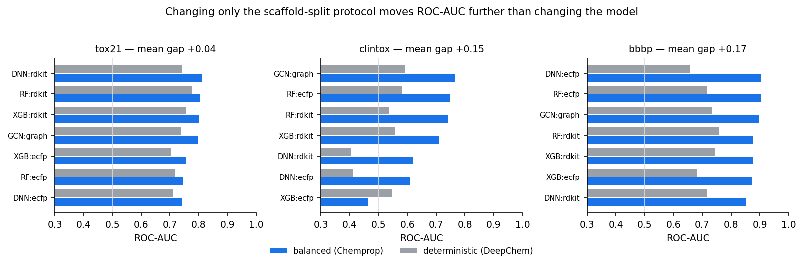
RESULTS — THE BIGGEST EFFECT WE MEASURED
The evaluation protocol moved scores more than the model did
— Two scaffold-split protocols are in common use. DeepChem sorts scaffold groups largest-first and is deterministic; Chemprop shuffles them with a seed. Identical models, nothing else changed.
— Mean difference: +0.120 ROC-AUC, reaching +0.168 on BBBP. On BBBP the best descriptor model beats the best graph network by 0.004 — the protocol is worth about forty times the architecture. Consistent in sign across almost every model family.
— The effect shrinks as the dataset grows. BBBP (1,955 molecules) +0.168 and ClinTox (1,380) +0.147, but Tox21 (7,611) only +0.042. With more scaffolds available, which ones land in test matters less. Protocol sensitivity is a small-data pathology.
— Neither protocol leaks. A Tanimoto audit puts near-duplicate rates at 0-4.4% in every split. The deterministic protocol simply asks a harder question — its test set is further from training (mean max similarity 0.43 vs 0.50) and differently balanced (53.6% positive in test vs 82.5% in train, against 77.6% vs 75.8% for the balanced protocol).
13

Slide 15
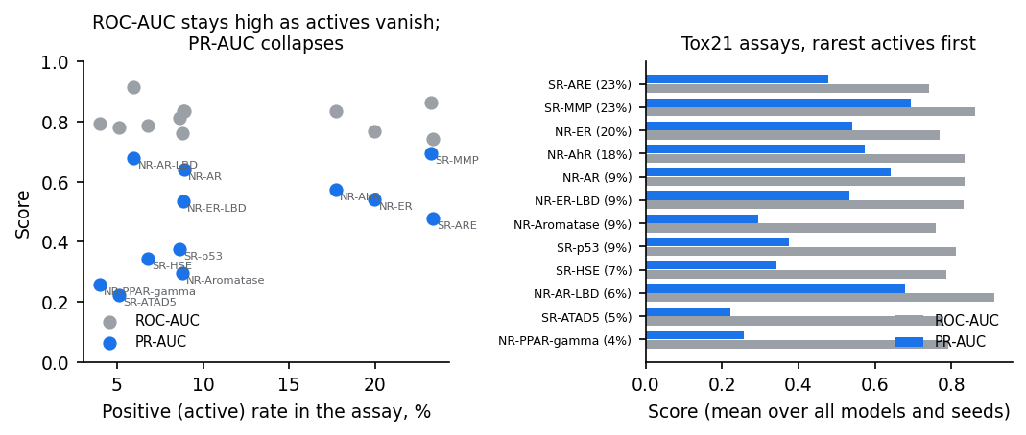
RESULTS
Why ROC-AUC alone would have misled us
— The gap between ROC-AUC and PR-AUC widens as actives get rarer. On the rarest assays a model with a respectable ROC-AUC has a PR-AUC near the random baseline.
— MCC exposes the decision quality. Several models reach ROC-AUC above 0.7 while their thresholded calls score an MCC near zero — ranking is fine, but the yes/no answer is not.
14

Slide 16
INTERPRETABILITY
Every prediction comes with the substructure that caused it
SHAP → atoms (fingerprint models)
Attention (graph networks)
TreeSHAP gives an exact contribution per ECFP4 bit. Each bit corresponds to a circular atom environment, so its SHAP value is spread over the atoms of that environment. Summing over all bits gives a per-atom score: red raises predicted risk, blue lowers it.
Attentive FP's readout step attends from a molecule-level node to every atom. Those attention weights are read directly off the final timestep and rendered as a per-atom map — the model's own account of where it looked.
— The two methods answer different questions. SHAP is attribution with respect to the prediction (counterfactual: what if this bit were absent). Attention is a weight inside the forward pass — it shows where the model looked, which is not the same as what drove the output.
— Agreement is evidence, not proof. Where SHAP and attention highlight the same ring or functional group, confidence in the explanation is higher. Neither is a causal claim about the underlying biology.
15

Slide 17
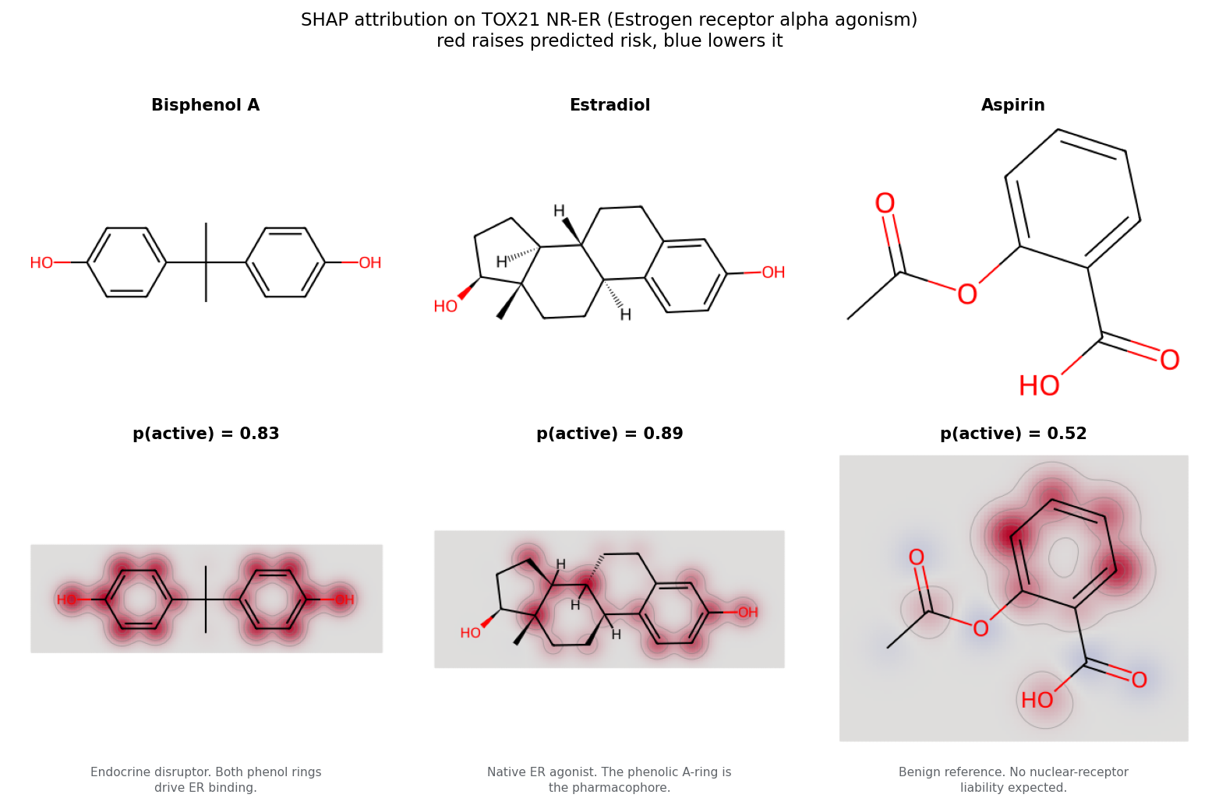
INTERPRETABILITY — EVIDENCE
SHAP independently recovers the known pharmacophore
— Bisphenol A (p=0.83) — both phenol rings red. Exactly the groups that mimic estradiol's hydroxyls and drive receptor binding. All 17 atoms carry positive attribution; the top bit is worth SHAP +0.88.
— Estradiol (p=0.89) — the phenolic A-ring. The textbook ER pharmacophore; the saturated D-ring contributes little. The two biggest bits (+0.72, +0.64) both describe that aromatic hydroxyl environment.
— Aspirin (p=0.52) — borderline, and the map says why. Ester and carboxyl render blue and the largest single bit is negative, but the benzene ring it shares with real ER ligands pulls back up. A genuine limitation, made legible.
16

Slide 18
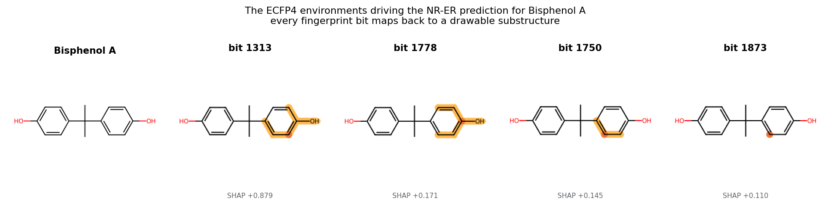
INTERPRETABILITY — EVIDENCE
Every fingerprint bit maps back to a drawable substructure
Why this matters for a screening tool
The explanation is not a saliency map that needs interpreting — it is a specific chemical motif. The dominant bit here carries SHAP +0.88 and is the hydroxyl-bearing aromatic environment: the ER pharmacophore. That is something a chemist can design away.
17

Slide 19
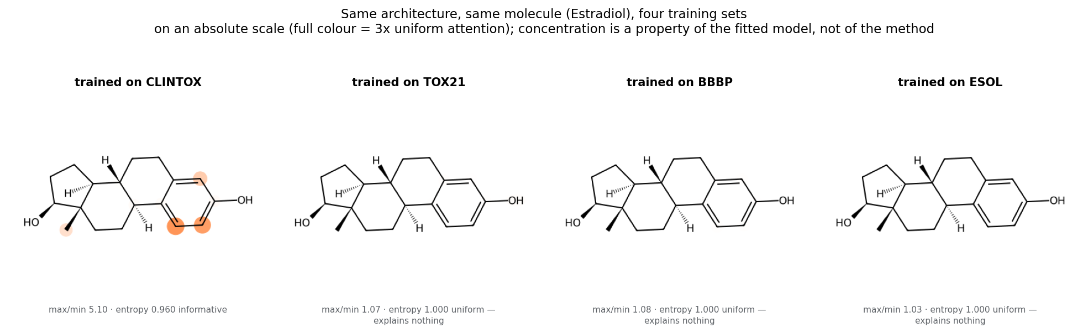
INTERPRETABILITY — WHAT DID NOT GENERALISE
Attention explained something on one model in four
— Same architecture, same molecule, four training sets. ClinTox: max/min 5.1-32.2, entropy 0.82-0.96 — sharply selective. Tox21, BBBP and ESOL: max/min 1.03-1.10, entropy 0.9999+ — indistinguishable from uniform.
— Our first explanation was wrong. The partial run saw flat attention on ClinTox and blamed its 1,104 training molecules, predicting Tox21 would fix it. The full GPU run inverted it exactly: ClinTox is now the sharp one. Training-set size does not explain the pattern.
— And the sharp model is the weakest classifier. ClinTox Attentive FP scores ROC-AUC 0.700. Concentrated attention is not evidence of a good model — so it cannot be assumed from the architecture, it has to be measured.
18

Slide 20
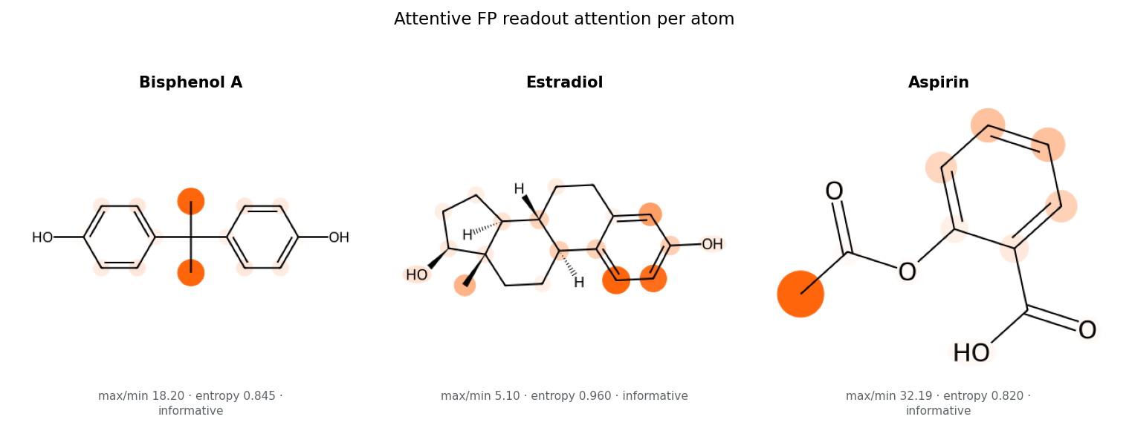
INTERPRETABILITY — THE HAZARD
An uninformative attention map does not look uninformative
— The usual drawing convention hides the problem. Normalising each molecule against its own min and max stretches whatever spread exists to fill the colour range — so a readout varying in the fourth decimal place renders as a vivid, structured, entirely convincing picture. We draw against an absolute reference instead: full colour = 3x uniform attention.
— So the app measures before it shows. Every attention map is scored for max/min ratio and normalised entropy. A map that fails is shown with an explicit warning pointing the user to the SHAP attribution — never presented as an explanation.
— Where SHAP and attention disagree, SHAP had the chemistry. On bisphenol A, SHAP picks both phenol rings — the real pharmacophore. ClinTox attention picks the central quaternary carbon: structurally central, causally irrelevant.
19

Slide 21
CONFIDENCE
The model says when it does not know
A QSAR model is only valid inside the chemical space it was trained on. Every prediction in the app carries a domain badge computed from two independent checks.
1 · Structural similarity
2 · Descriptor range
Mean Tanimoto similarity (ECFP4) to the 5 nearest training molecules. Thresholds are the 5th and 25th percentile of the same statistic computed leave-one-out on the training set, so they adapt to how diverse each dataset actually is.
Fraction of the ~210 RDKit descriptors falling outside the min/max range seen in training. Catches compounds that are structurally similar but physicochemically extreme.
In domain
Above the 25th percentile — predictions carry normal weight
Borderline
Between the 5th and 25th percentile — interpret with care
Out of domain
Below the 5th percentile — treat every number as unreliable
20

Slide 22
DEPLOYMENT
The deployed screening app
Risk panel
Confidence badge
16 endpoints scored from one SMILES: 12 Tox21 assays, 2 ClinTox tasks, BBB penetration and aqueous solubility — each with its tuned cut-off and call.
Domain level, Tanimoto to nearest neighbours, and the three most similar training compounds shown explicitly so the user can judge for themselves.
Why this prediction
Benchmark tab
Per-endpoint SHAP atom heat map, the most influential ECFP4 environments drawn as substructures, and the Attentive FP attention map.
The full results table and figures ship inside the app, so a user can see exactly how much to trust each model before using it.
Run it
pip install -r requirements.txt · python scripts/prepare_data.py · python scripts/run_benchmark.py · streamlit run app/streamlit_app.py
21

Slide 23
CONCLUSIONS
What the benchmark actually showed
— Descriptor models won on 4 of 4 datasets — three inside one s.d. At this data scale the hand-designed representation holds its own against learned graph representations. Only ClinTox separates the families cleanly, so the claim is parity at far lower training cost, not superiority.
— The split protocol beat the architecture by ~40x. Changing only the scaffold-split protocol moved ROC-AUC by 0.123 on average and 0.168 on BBBP, where the best descriptor model leads the best graph network by 0.004. The effect shrinks as datasets grow.
— Representation should match the endpoint, not the pipeline. On ESOL, RDKit descriptors and graph networks both land at RMSE 0.80-0.99 while every ECFP4 model sits at 1.48-1.65. Solubility is bulk physicochemistry, which a substructure fingerprint cannot encode.
— Scaffold splits cost every model real performance. Scores under scaffold splitting are substantially below the random-split numbers commonly quoted — generalising to new chemotypes is the hard part, and the honest protocol says so.
— Metric choice changes the conclusion. On the rarest Tox21 assays, ROC-AUC suggests a usable model while PR-AUC and MCC show the thresholded decisions are near chance.
— Variance across splits is large. Standard deviations over three scaffold splits often exceed the gap between model families — single-split comparisons in this field should be treated with suspicion.
— SHAP delivered; attention only sometimes. SHAP recovered the ER pharmacophore on every example. Attention was informative on 1 of 4 fitted models and flat on the rest — so the app measures each map's concentration before showing it as an explanation.
22

Slide 24
HONEST ASSESSMENT
Limitations and future work
Limitations
Future work
• Benchmark datasets carry their own assay noise and selection bias — ClinTox labels approval status, not toxicity per se.
• Hyperparameters were fixed per family rather than tuned per dataset, so a tuned GNN could close part of the gap.
• Attention is not causal explanation, and was informative on only 1 of 4 fitted models — which one cannot be predicted in advance.
• The protocol experiment covered the 6 descriptor models on all 4 datasets and GCN on 3; GAT and Attentive FP ran under the balanced protocol only.
• Three seeds bound the variance only loosely.
• Pretraining on large unlabelled corpora (ChemBERTa, GROVER, MolCLR) — the standard route to making graph models pay off on small datasets.
• Uncertainty estimates (deep ensembles, conformal prediction) rather than a domain badge alone.
• Multi-task transfer from Tox21's 12 assays into the smaller endpoints.
• Prospective validation on held-out compounds with new experimental measurements.
The headline result — hand-designed representations remaining competitive at this scale — is a statement about the data regime, not a claim that graph networks are the wrong tool. With 100× the labelled data the conclusion would likely reverse.
23

Slide 25
MolRepBench
Interpretable Toxicity & ADMET Screening from Molecular Structure
Benchmark · Interpretability · Applicability domain · Deployed app
Shubham Gangwar · MS23BTECH11027
Predictive Toxicology / AI in Drug Discovery

