Slide 1

Investigation of possible exits and window in an Indoor environment for Quadcopter Navigation
Garuda Control Station

Slide 2
Our Team
Project Team Members
Mr. Aaditya Hambarde
Mr. Ankit Kumar
Mr. D Yogendra Rao
Mr. Shubham Garg
Miss. Shuchi Sharma
Project Mentors
Mr. Sandesh Pati
Miss Maitreyee Mordekar
Mr. Sivakiran Kodali
Mr. Varun Madkaikar
Project In-Charge
Mr. Rajesh Kushalkar

Slide 3
Features
GPS Navigation
Video Streaming
Door detection
Ground Control Station on Aakash

Slide 4
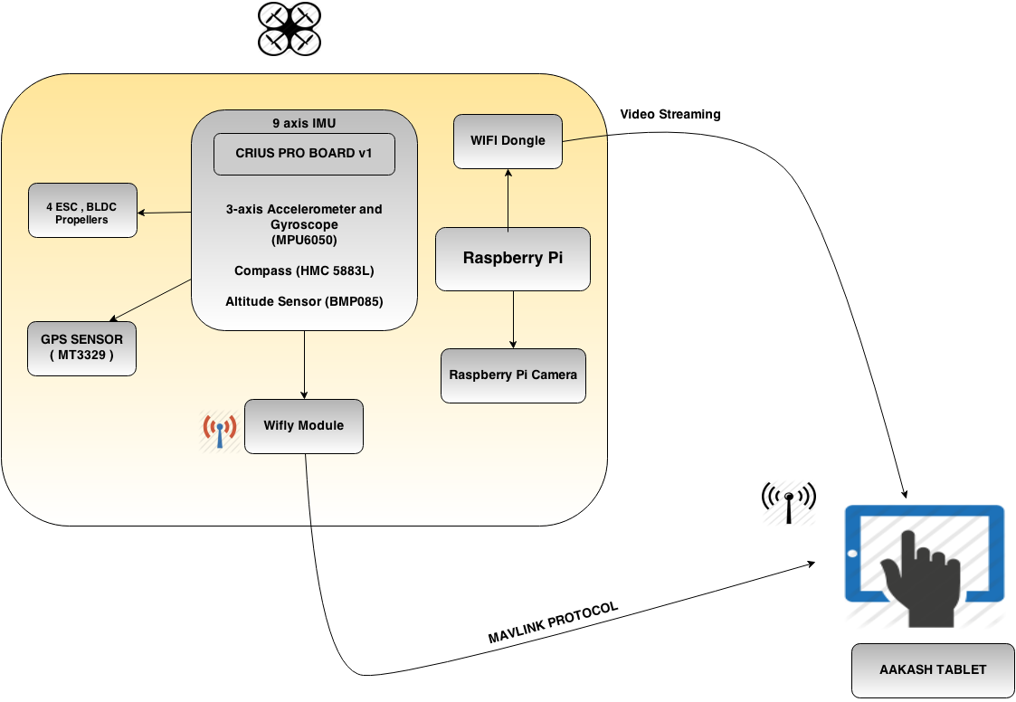
Project Overview

Slide 5
Yaw

Slide 6
Roll

Slide 7
Pitch

Slide 8
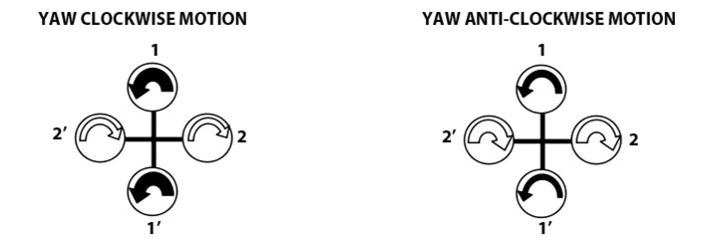
Yaw control

Slide 9
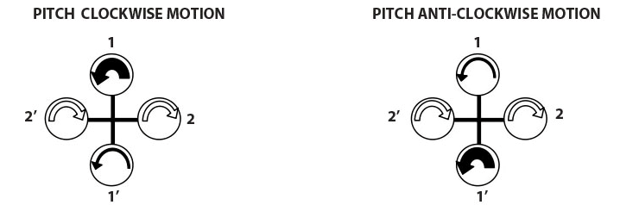
Roll/Pitch Control

Slide 10
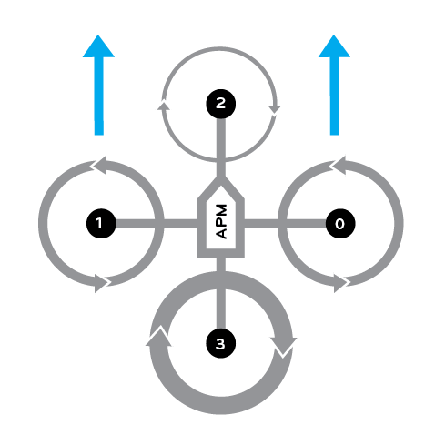
‘If you want to go forward, pitch forward’

Slide 11
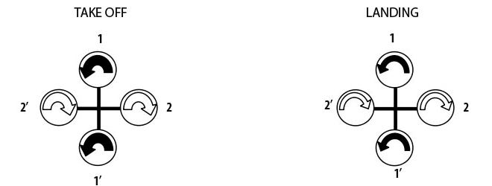
Altitude Control

Slide 12
“Motion-A beautiful combination of various degrees of freedom”

Slide 13
Accelerometer & Gyroscope
Accelerometer :Sensitivity to vibrations
Gyroscope : drift
Angular rate in three axes of space in deg/s

Slide 14
Magnetometer (HMC5883L)
Digital-output : angular movement , magnetic field intensity
reliable direction for magnetic north

Slide 15
Pressure Sensor (MS5611)
Altitude of quadcopter
Temperature of the environment

Slide 16
GPS Sensor
Location of quadcopter
NMEA Protocol

Slide 17
Sensor Fusion
Why?
Gyro Drift
Noisy Accelerometer and Magnetometer

Slide 18
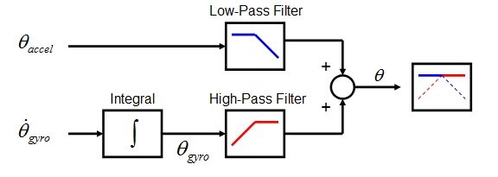
How?

Slide 19
DCM-What is it?

Slide 20
Error Correction

Slide 21
Inertial Navigation System

Slide 22
Navigation

Slide 23
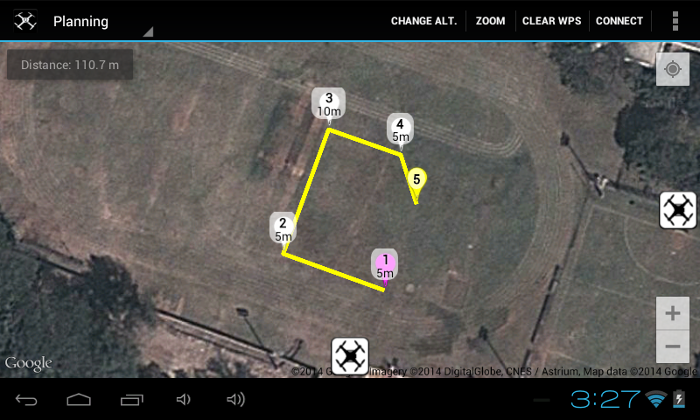
External Autonomous Navigation-GPS

Slide 24
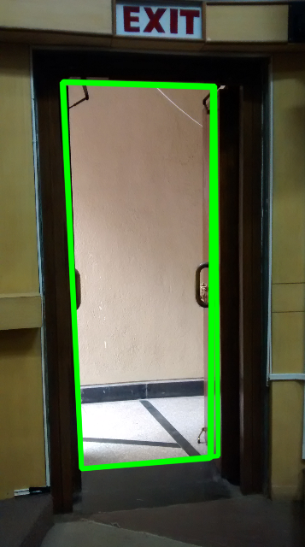
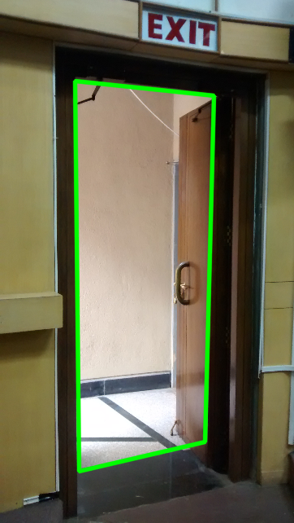
Autonomous
Internal
Navigation-
Door Detection

Slide 25
PID TUNING
Proportional(P)
Integral(I)
Derivative(D)

Slide 26
WHAT IS PID?
Closed loop feedback control system, used for process control.
Calculates error between the actual parameter and the desired parameter and generates control signal to manipulate the output, so as to minimize the error

Slide 27
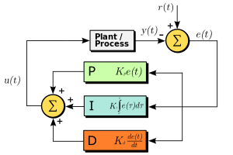
Block diagram of a PID feedback control mechanism
Reference: http://en.wikipedia.org/wiki/File:PID_en_updated_feedback.svg

Slide 28
WHY PID?
For a stable and smooth flight of the quadcopter.
To make the system stable, as well as get the optimum or desired behavior from it.
Without this, quad may topple, become sluggish or untamable

Slide 29
STEPS FOR PID TUNING IN QUAD
Read the sensors
Read the stick movement input
Compare the two
Calculate the error
Take necessary control action by sending corrections to ESCs.

Slide 30
PARAMETERS TUNED
Roll, Pitch and Yaw P, I and D parameters for the following modes :
Stabilize
Acro
Loiter
AltHold

Slide 31
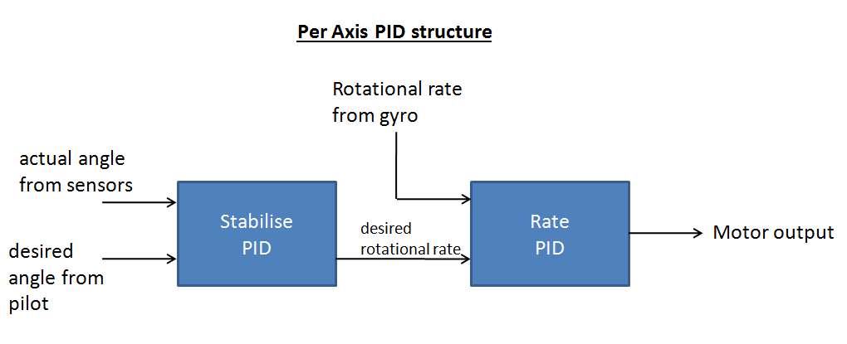
P parameter makes the quad reach desired position
I factor eliminates steady state error
D parameter increases the speed of response.

Slide 32
Communication Protocol : Mavlink
It is a protocol for communication between a Ground Control Station (GCS) and unmanned vehicles
Each MavLink packet has a length of 17 bytes
6 bytes header + 9 bytes payload + 2 bytes checksum

Slide 33
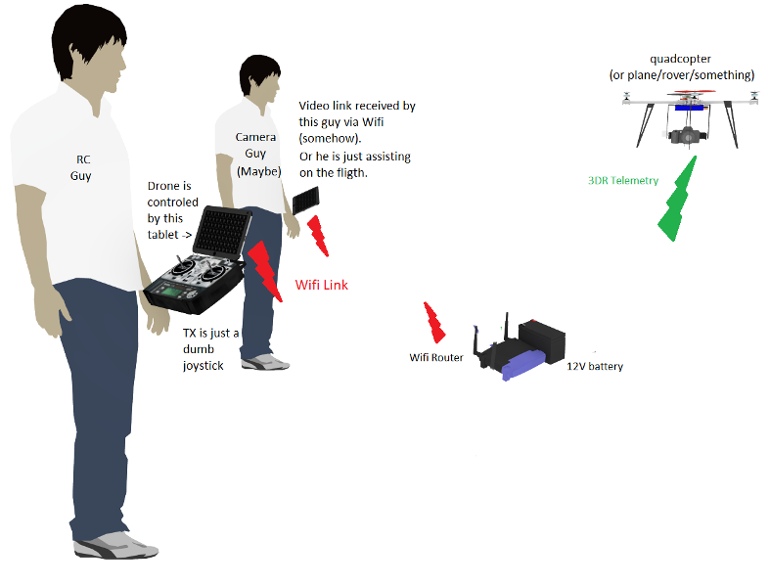
Communicating with the Quad

Slide 34
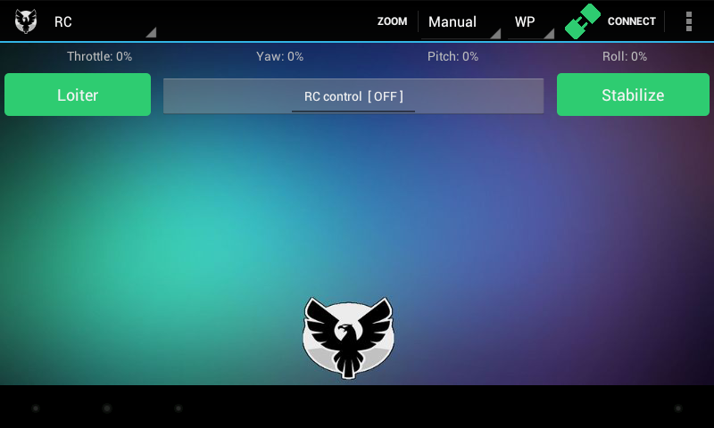
RC Interface
Navigation Menu
Connect Button to connect with the quad
Fast Mode Access
RC Control

Slide 35
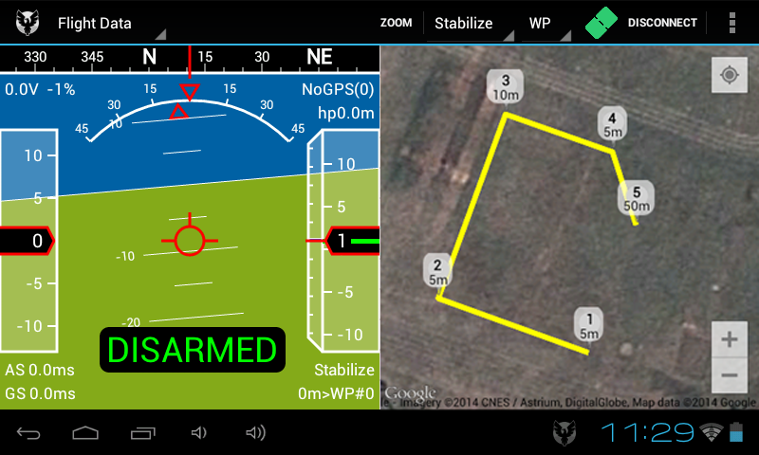
Interfaces
Planning Interface

Slide 36
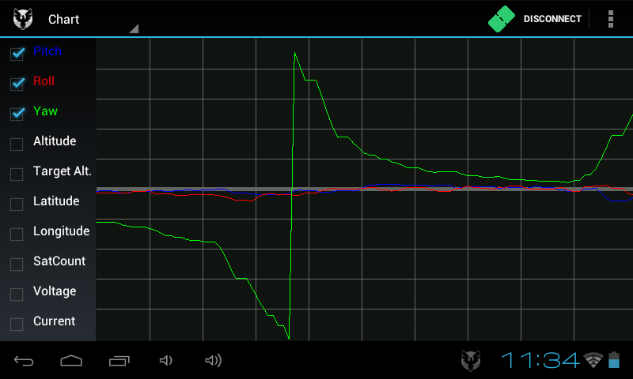
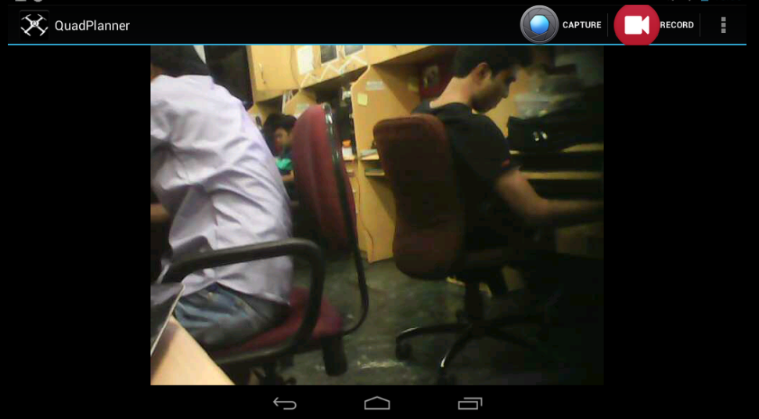
Interfaces
Camera Feeds
Charts Interface

Slide 37
Further Prospects
Vision based navigation in a GPS denied Environment.
Face Recognition in the Feed received at the Aakash end.

Slide 38
References
[1] : JoyStickView : https://code.google.com/p/mobile-anarchy-widgets/
[2] : MjpegStream : https://bitbucket.org/neuralassembly/simplewebcam
[3] : HUD : https://code.google.com/p/copter-gcs
http://helicopterforum.verticalreference.com/
Retrieved June 30, 2014 from Smithsonian National Air and Space Museum
https://howthingsfly.si.edu/flight-dynamics

Slide 39
Thank You

