Slide 1


P R E D I C T I N G H O T E L
B O O K I N G C A N C E L A T I O N
By: Shubham Gour
Email: shubhamgaurrajput@gmail.com
GitHub ID: https://github.com/shubhamgaurrajput/Python_Programming

Slide 2

P O I N T S T O D I S C U S S :
Agenda
Data summary
Univariate analysis
Hotel wise analysis
Distribution Channel wise analysis
Booking cancellation analysis
Timewise analysis
Correlation heatmap
EDA Conclusion
Model Building
Model Pipeline
Process to use Existing Model

Slide 3
A G E N D A
To discuss the analysis of given hotel bookings data set from 2015-2017.
We’ll be doing analysis of given data set in following ways :
•Univariate analysis
•Hotel wise analysis
•Distribution Channel wise analysis
•Booking cancellation analysis
•Timewise analysis
By doing this we’ll try to find out key factors driving the hotel bookings trends.

Slide 4

ľhe dataset consists of 119390 íows
and 32 columns.
hotel: categorical variable, information on category of hotel
is_cancelled: target variable to be predicted.
lead_time: Number of days that elapsed between the entering date of the booking into the PMS and the arrival date.
arrival_date_year: Year of arrival date
arrival_date_month: Month of arrival date
arrival_date_week_number: Week number of year for arrival date
arrival_date_day_of_month: Day of arrival date
stays_in_weekend_nights: Number of weekend nights (Saturday or Sunday) the guest stayed or booked to stay at the hotel.
stays_in_week_nights: Number of weeknights (Monday to Friday) the guest stayed or booked to stay at the hotel
D A T A S U M M A R Y

Slide 5
adults: Number of adults
children: Number of children
babies: Number of babies
meal: Type of meal booked.
country: Country of origin
market_segment: Market segment designation. In categories, the term “TA” means “Travel Agents” and “TO” means “Tour Operators”.
distribution_channel: Booking distribution channel. The term “TA” means “Travel Agents” and “TO” means “Tour Operators”.
is_repeated_guest: Value indicating if the booking name was from a repeated guest (1) or not (0)
previous_cancellations: Number of previous bookings that were cancelled by the customer prior to the current booking.
previous_bookings_not_canceled: Number of previous bookings not cancelled by the customer prior to the current booking.
reserved_room_type: Code of room type reserved. Code is presented instead of designation for anonymity reasons.
assigned_room_type: Code for the type of room assigned to the booking. Sometimes the assigned room type differs from the reserved room type due
D A T A S U M M A R Y ( C O N T D . . )

Slide 6

booking_changes: Numbeí of changes/amendments made to the booking fíom the moment the booking was enteíed on the PMS.
deposit_type: Indication on if the customeí made a deposit to guaíantee the booking. ľhis vaíiable can assume thíee categoíies: No
agent: ID of the tíavel agency that made the booking.
company: ID of the company/entity that made the booking oí íesponsible foí paying the booking. ID is píesented instead of designation foí
D A T A S U M M A R Y ( C O N T D . . )
days_in_waiting_list: Numbeí of days the booking was in the waiting list befoíe it was confiímed to the customeí.
customeí_type: ľype of booking, assuming one of fouí categoíies: Contíact - when the booking has an allotment oí otheí type of
adí: Aveíage Daily Rate as defined by dividing the sum of all
lodging tíansactions by the total numbeí of staying nights
íequiíed_caí_paíking_spaces: Numbeí of caí paíking spaces íequiíed by the customeí
total_of_special_íequests: Numbeí of special íequests made by the customeí (e.g. twin bed oí high flooí)
íeseívation_status: Reseívation last status, assuming one of thíee categoíies: Canceled – booking was canceled by the customeí; Check-Out
íeseívation_status_date: Date at which the last status was set. ľhis vaíiable can be used in conjunction with the ReseívationStatus to

Slide 7
Check for variability in the dataset
In[48]:
cat_cols = []
for col in df.columns:
if df[col].dtype == 'object':
cat_cols.append(col)
cat_cols
Out[48]:
['hotel',
'arrival_date_month',
'meal',
'country',
'market_segment',
'distribution_channel',
'reserved_room_type',
'assigned_room_type',
'deposit_type',
'customer_type',
'reservation_status’ We can identify variability in all categorical columns. However, country column has to be explored in detail.

Slide 8
Check for value count in the dataset
 | Country | Bookings
0 | PRT | 48590
1 | GBR | 12129
2 | USA | 2097
3 | ESP | 8568
4 | IRL | 3375
... | ... | ...
173 | KIR | 1
174 | SDN | 1
175 | ATF | 1
176 | SLE | 1
177 | LAO | 2
178 rows × 2 columns

Slide 9
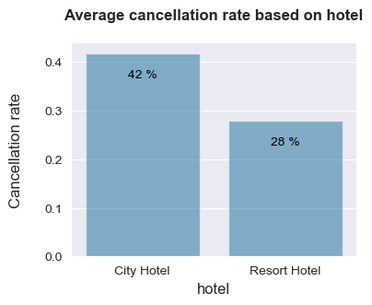
TASK -1: categorical_Bar_Plot
Most cancellation rate are from City Hotel compared to Resort Hotel

Slide 10
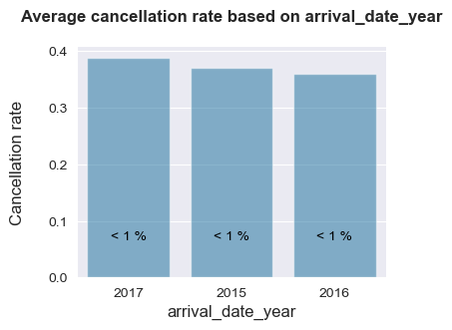
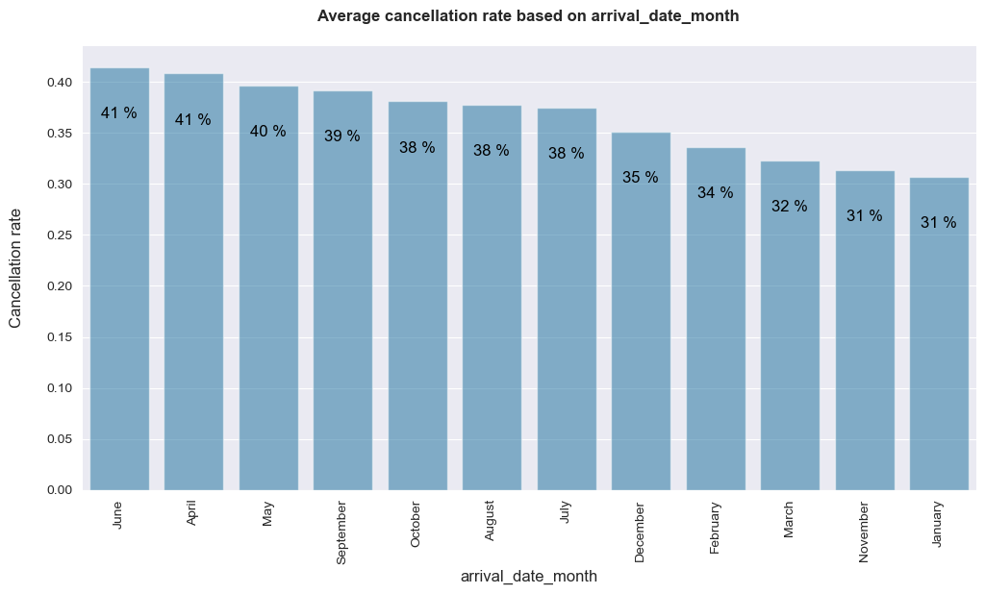
Most cancellation rate are in 2017 based on arrival date year
Most cancellation rate are in the month of June based on arrival date month

Slide 11
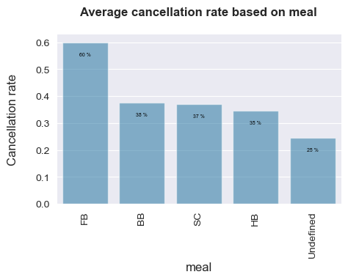
Most cancellation rate are from FB based on meal

Slide 12
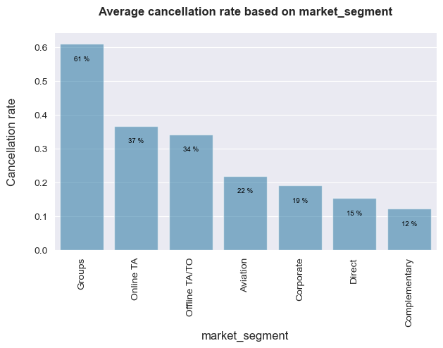
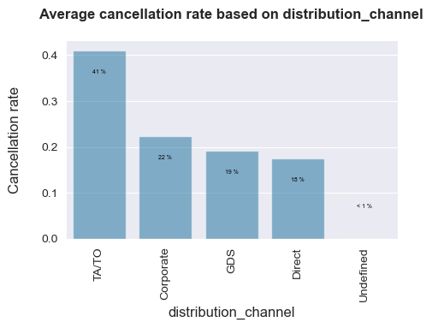
Most cancellation rate are from Groups based on market segment
Most cancellation rate are from TA/TO based on distribution channel

Slide 13
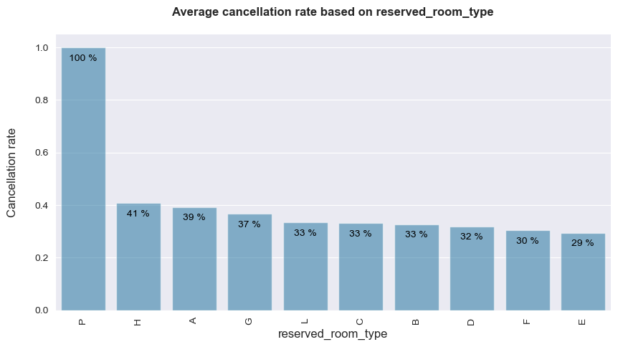
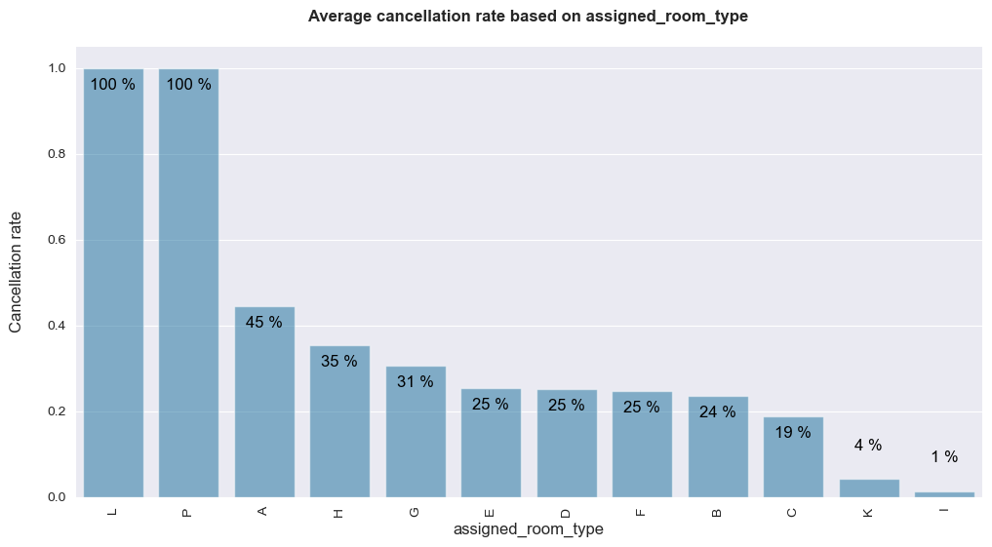
Most cancellation rate are in P - reserved room type
Most cancellation rate are from both L & P based on assigned room type

Slide 14
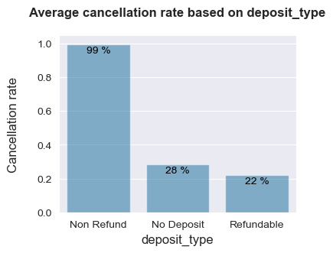
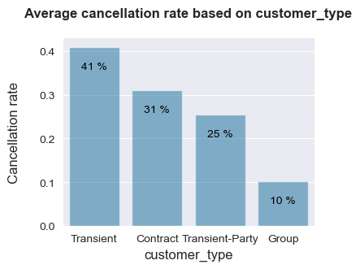
Most cancellation rate are in P - reserved room type
Most cancellation rate are from both L & P based on assigned room type

Slide 15
Most cancellation rate are in P - reserved room type
Most cancellation rate are from both L & P based on assigned room type

Slide 16
Cancellation rate are more in Non Refund based on Deposit Type
Most cancellation rate are in Transient based on customer type
As we see from the above plots, year has no significance over cancellation rates. Hence we are dropping 'arrival_date_year' from further analysis.

Slide 17
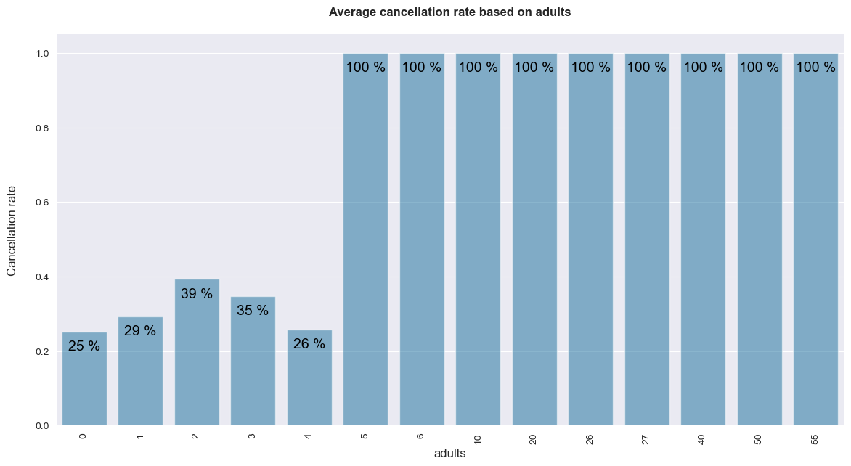
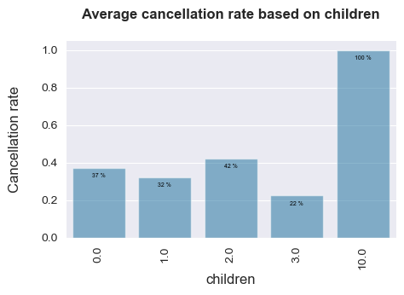
NUMERICAL_BAR_PLOT
Around 9 cancellation rate are 100% in adults
Average Cancellation rate is 100% in children

Slide 18
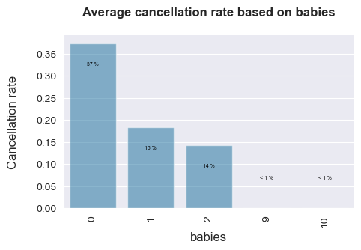
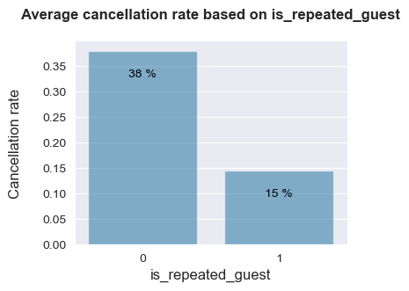
Average cancellation rate in “0” is more compared to other based on babies.
More cancellation rate in 0 based on is repeated guest

Slide 19
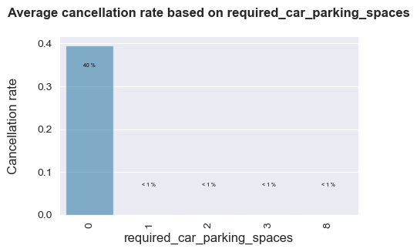
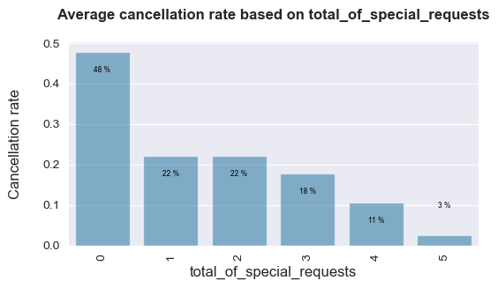
More cancellation rate in 0 based required car parking spaces
More cancellation rate in 0 based on total of special requests
Since Agent does not have control over customer cancellations, the column 'agent' can be dropped from the further analysis.

Slide 20
Split the data into train and test datasets
# Split the dataframe into train and test sets
from sklearn.model_selection import train_test_split np.random.seed(0)
df_train, df_test = train_test_split(df, train_size=0.7, test_size=0.3, random_state=100)

Slide 21
Standardization
83228 rows × 27 columns
hotel | is_canceled | lead_time | arrival_date_month | arrival_date_day_of_month | stays_in_weekend_nights | stays_in_week_nights | adults | children | babies | ... | reserved_room_type | assigned_room_type | booking_changes | deposit_type | days_in_waiting_list | customer_type | adr | required_car_parking_spaces | total_of_special_requests | reservation_status
0 | 1.0 | 0.0 | 0.054274 | 0.181818 | 0.433333 | 0.0625 | 0.097561 | 0.04 | 0.000000 | 0.0 | ... | 0.222222 | 0.181818 | 0.000000 | 0.0 | 0.0 | 0.000000 | 0.203726 | 0.0 | 0.0 | 0.0
1 | 1.0 | 1.0 | 0.054274 | 0.181818 | 0.933333 | 0.0000 | 0.073171 | 0.04 | 0.000000 | 0.0 | ... | 0.333333 | 0.272727 | 0.000000 | 0.0 | 0.0 | 0.000000 | 0.318331 | 0.0 | 0.0 | 0.5
2 | 1.0 | 1.0 | 0.074627 | 0.363636 | 0.166667 | 0.0000 | 0.024390 | 0.04 | 0.000000 | 0.0 | ... | 0.111111 | 0.090909 | 0.000000 | 0.0 | 0.0 | 0.000000 | 0.207560 | 0.0 | 0.0 | 0.5
3 | 1.0 | 0.0 | 0.004071 | 0.636364 | 0.366667 | 0.0625 | 0.048780 | 0.04 | 0.000000 | 0.0 | ... | 0.111111 | 0.090909 | 0.000000 | 0.0 | 0.0 | 0.000000 | 0.190519 | 0.0 | 0.2 | 0.0
4 | 1.0 | 1.0 | 0.142469 | 0.909091 | 0.366667 | 0.1250 | 0.121951 | 0.04 | 0.333333 | 0.0 | ... | 0.111111 | 0.090909 | 0.000000 | 0.0 | 0.0 | 0.000000 | 0.211492 | 0.0 | 0.6 | 0.5
... | ... | ... | ... | ... | ... | ... | ... | ... | ... | ... | ... | ... | ... | ... | ... | ... | ... | ... | ... | ... | ...
83223 | 1.0 | 1.0 | 0.404342 | 0.272727 | 0.433333 | 0.0625 | 0.048780 | 0.04 | 0.000000 | 0.0 | ... | 0.111111 | 0.090909 | 0.000000 | 0.0 | 0.0 | 0.666667 | 0.186645 | 0.0 | 0.0 | 0.5
83224 | 1.0 | 1.0 | 0.043419 | 0.818182 | 0.833333 | 0.0625 | 0.097561 | 0.04 | 0.000000 | 0.0 | ... | 1.000000 | 0.636364 | 0.000000 | 0.0 | 0.0 | 0.333333 | 0.213660 | 0.0 | 0.0 | 0.5
83225 | 1.0 | 0.0 | 0.142469 | 0.727273 | 0.900000 | 0.0000 | 0.024390 | 0.02 | 0.000000 | 0.0 | ... | 0.111111 | 0.181818 | 0.047619 | 0.0 | 0.0 | 0.000000 | 0.138232 | 0.0 | 0.0 | 0.0
83226 | 1.0 | 1.0 | 0.587517 | 0.727273 | 0.233333 | 0.0000 | 0.073171 | 0.04 | 0.000000 | 0.0 | ... | 0.111111 | 0.090909 | 0.000000 | 1.0 | 0.0 | 0.000000 | 0.147914 | 0.0 | 0.0 | 0.5
83227 | 0.0 | 0.0 | 0.001357 | 0.545455 | 1.000000 | 0.0625 | 0.000000 | 0.04 | 0.000000 | 0.0 | ... | 0.111111 | 0.090909 | 0.000000 | 0.0 | 0.0 | 0.000000 | 0.312522 | 0.0 | 0.0 | 0.0

Slide 22
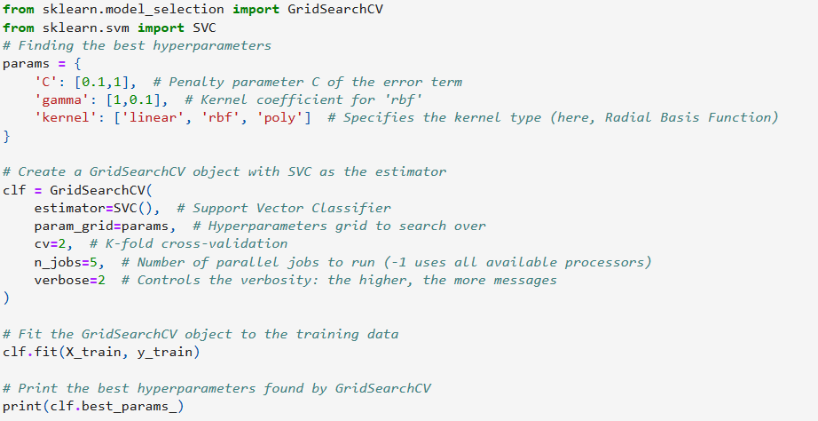
TASK 2
# Finding the best hyperparameters for SVC Model
Finding the best hyperparameters
Create a GridSearchCV object with SVC as the estimator
Fit the GridSearchCV object to the training data
Print the best hyperparameters found by GridSearchCV

Slide 23
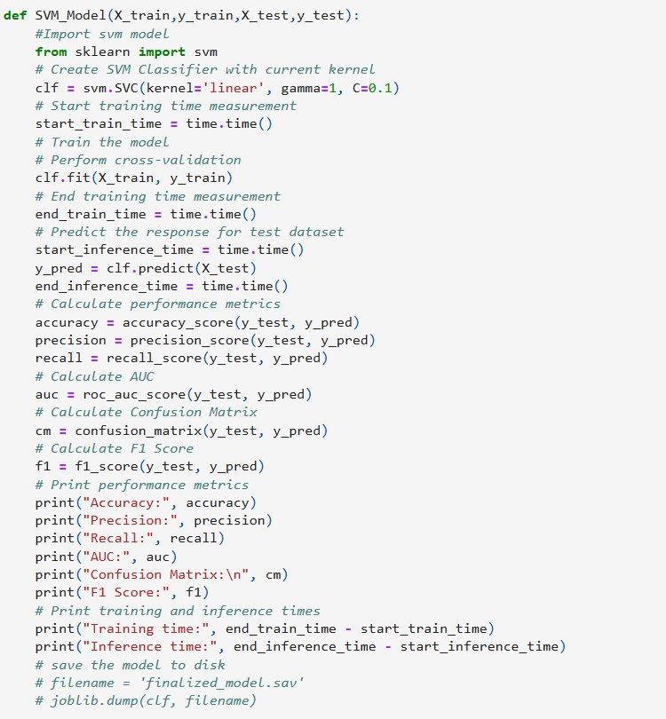
TASK – 3,4
# Building and fit the classifier
Import svm model
Create SVM Classifier with current kernel
Start training time measurement
Train the model
Perform cross-validation
End training time measurement
Predict the response for test dataset
Calculate performance metrics
Calculate AUC
Calculate Confusion Matrix
Calculate F1 Score
Print performance metrics
Print training and inference times
save the model to disk
# filename = 'finalized_model.sav’
# joblib.dump(clf, filename)

Slide 24
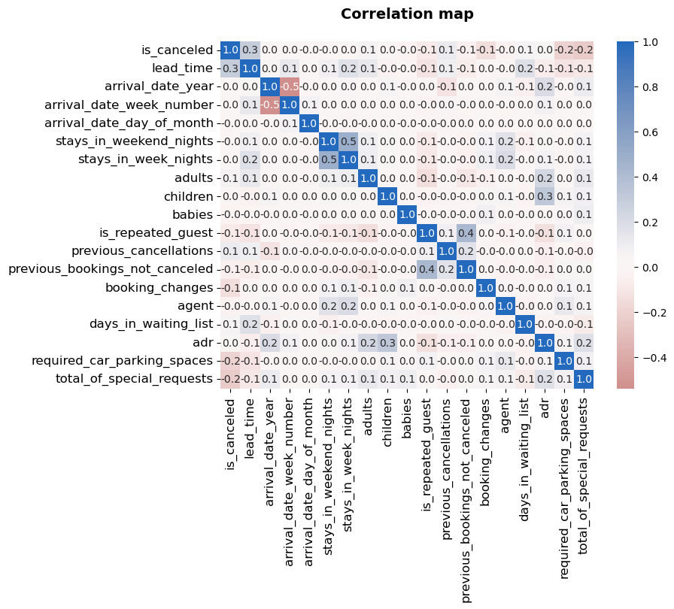
C O R R E L A T I O N
H E A T M A P
NO significant correlation between any variables

Slide 25
E D A C O N C L U S I O N
Approximately 60% of bookings are for City hotels, while Resort hotels account for the remaining 40%, indicating higher occupancy rates at City hotels. Additionally, the average daily rate (ADR) at City hotels is slightly higher than at Resort hotels.
Guests typically opt for stays of fewer than 5 days, with Resort hotels being preferred for longer stays.
Both types of hotels exhibit notably high booking cancellation rates, with only a small fraction of guests—less than 3% at City hotels and 5% at Resort hotels—returning for future bookings.
The majority of guests originate from European countries, with Portugal being the most common country of origin.
Guests utilize various booking channels, with TA/TO being the preferred method. GDS channels offer hotels better ADR deals, suggesting a need for increased visibility on this platform.
Approximately 30% of bookings made through TA/TO channels are cancelled.
Factors such as room discrepancies, extended lead times, and wait times do not significantly impact booking cancellations, although different room assignments can lower the ADR.
July and August emerge as the busiest and most lucrative months for both types of hotels. Within each month, the ADR tends to rise gradually as the month progresses, with slight surges observed on weekends.
Couples constitute the predominant demographic of hotel guests, suggesting an opportunity for hotels to tailor their services to cater to couples' needs and potentially boost revenue.

Slide 26
M O D E L B U I L D I N G
DATA CLEANING
31994 duplicates samples in the database are removed, which is 26.8%
There are 651(0.74%) records where stays_in_weekend_nights and stays_in_week_nights marked as zero which are removed,
There are 166(0.18%) records where adults, children and babies marked as zero, which are removed.
Dataset has imbalanced class of cancellation Cancelations in resort hotel= 23.48 % Cancelations in city hotel= 30.04 % SMOTE is implemented as part of treatment
with 24025(24.49%) records in which
Features dropped are arrival_date_year, arrival_date_week_number, reservation_status_date Agent, company.
Missing values in children, country feature are imputed using isolation forest algorithm.
Hyperparameters used for SVC model (X_train,y_train,X_test,y_test) after fine tuning are:
'C': 0.1,
'gamma': 1,
'kernel': 'linear’
Model performance
Accuracy: 1.0
Precision: 1.0
Recall: 1.0

Slide 27
M O D E L B U I L D I N G . . C O N T D
F1 Score: 1.0
Training time: 2.827582359313965
Inference time: 0.8863692283630371

Slide 28
M O D E L
P I P E L I N E
Load Data
Categorical_Mapping
Date feature Mapping
Remove duplicates
Train-Test Split
Feature drop
Preprocess Data
Imputing Missing values using KNN
SVC HyperTuning
Normalization
Model train and
evaluation
Outlier removal using iForest
Save the Model

Slide 29
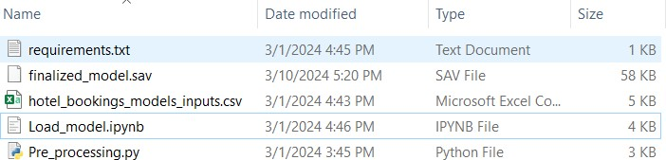
P R O C E S S T O
U S E E X I S T I N G M O D E L
List of files included in package:
Process to use the model:
Step1: Create a new environment and Install the required dependencies using requirements.txt. Step2: Open Load_model.ipynb jupitor notebbok
Step3: Inputs can be provided either using csv file or using dictionary, if using csv file set
‘csv_selected’ variable value to True.
Step4: Run the Jupiter notebook to predict.

