Slide 1
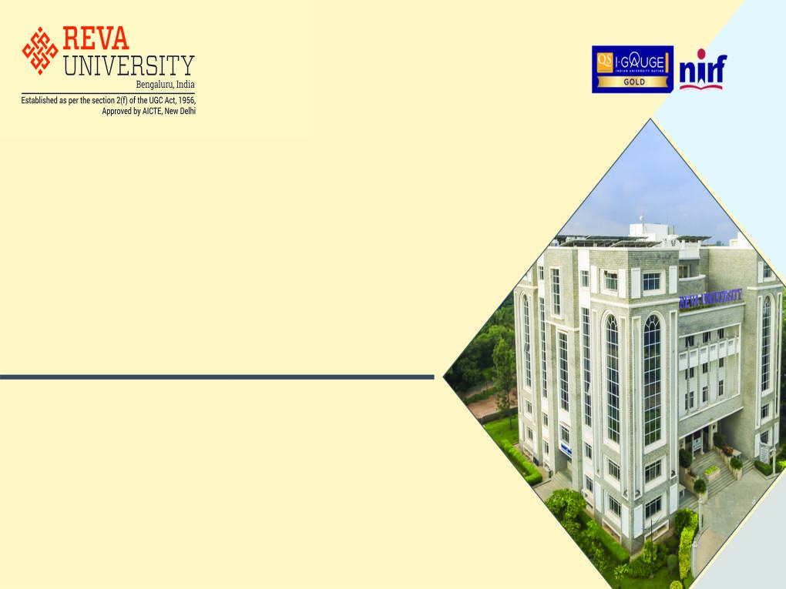
School of Computing and Information Technology
Course Delivery
B.Tech - VI Semester
VIRTUALIZATION AND CLOUD COMPUTING
(BTCS15F6200)
By
Prof. Kiran M
Assistant Professor
kiranm@reva.edu.in

Slide 2
Contents
Syllabus
Course Objectives and Outcomes
Prerequisites
Recommended Learning Resources
Unit - 1:
Introduction to Cloud Computing
Fundamental Concepts and Models

Slide 3
Syllabus
UNIT | SYLLABUS | WEIGHTAGE
1 | Introduction to Cloud Computing: Origins and Influences; Basic Concepts and Terminology; Goals and Benefits; Risks and Challenges. Fundamental Concepts and Models: Roles and Boundaries; Cloud Characteristics; Cloud Delivery Models; Cloud Deployment Models. | 25 Marks
2 | Cloud Computing Technologies: Broadband Networks and Internet Architecture; Data Center Technology; Virtualization Technology; Web Technology; Multitenant Technology; Service Technology; Case study. Cloud Infrastructure Mechanisms: Logical Network Perimeter; Virtual Server; Cloud Storage Device; Cloud Usage Monitor; Resource Replication; Ready-made Environment. | 25 Marks
3 | Specialized Cloud Mechanisms: Automated Scaling Listener; Load Balancer; SLA Monitor; Pay-per-use Monitor; Audit Monitor; Failover System; Hypervisor; Resource cluster; Multi-device Broker; State Management. Cloud Management Mechanisms: Remote Administration System; Resource Management System; SLA Management System; Billing Management System. | 25 Marks
4 | Virtualization: Implementation levels of virtualization; Virtualization structures/tools and mechanisms; Virtualization of CPU; Memory and I/O devices. | 25 Marks

Slide 4
Course Objectives and Outcomes
Course Objectives:
1. Describe the knowledge in different layers of cloud computing and Cloud delivery models.
2. Illustrate the functioning of cloud computing technologies.
3. Explain the use of various cloud computing mechanisms.
4. Elaborate the levels of Virtualization Techniques.
Course Outcomes:
By the end of this course, the student will be able to:
1. Distinguish the cloud computing delivery models.
2. Explore the working of cloud computing technologies like data center technology, virtualization technology, web technology, multitenant technology and service technology.
3. Interpret various cloud computing mechanisms like load balancer, automated scaled listener, failover system and more.
4. Apply the use of Virtualization techniques in Cloud services.

Slide 5
Prerequisites
Computer Networks
Operating Systems
Database Management System

Slide 6
Recommended Learning Resources
Textbooks:
1. Thomas Erl, Ricardo Puttini, Zaigham Mahmood, Cloud Computing: Concepts, Technology & Architecture PHI, 2013.
2. Kai Hwang, Geoffrey C. Fox, Jack J Dongarra, Distributed and Cloud Computing, MK, 2012.
References:
Dan C. Marinescu, Cloud Computing: Theory and Practice, MK.
Michael Miller, Cloud Computing: Web-Based Applications That Change the Way You Work and Collaborate Online, Que Publishing, August 2008.
Rajkumar Buyya, James Broberg, Andrzej Goscinski, Cloud Computing- Principles and Paradigms, Wiley.
Anthony T. Velte, Toby J. Velte, Robert Elsenpeter, Cloud Computing, A practical approach, TATA McGraw HILL.
Dharanipragada Janakiram, Grid and Cloud Computing, McGraw-Hill 2016.
Gautam Shroff, Enterprise Cloud Computing- Technology, Architecture, Applications, CAMBRIDGE.
David Marshall, Wade A. Reynolds and Dave McCrory, Advanced Server Virtualization-VMware and Microsoft Platforms in the Virtual Data Center, AUERBACH Publications.
Journal of Cloud Computing -Advances, Systems and Applications, Springer Open.
International Journal of Cloud Computing, INDERSCIENCE Publishers.
IEEE Cloud Computing.
International Journal of Cloud Applications and Computing (IJCAC), IGI Global.

Slide 7
VIRTUALIZATION AND CLOUD COMPUTING
(BTCS15F6200)
UNIT - 1
Introduction to Cloud Computing
Fundamental Concepts and Models

Slide 8
Introduction to Cloud Computing
Cloud Computing:
It is a specialized form of distributed computing that introduces utilization models for remotely provisioning scalable and measured resources.
Virtualization:
It is a technique in which a complete installation of one machine is run on another machine.
The result is a system in which all software running on the server is within virtual machine.

Slide 9
Introduction to Cloud Computing (Contd..)
Virtual Machine:
The fundamental idea behind a virtual machine is to abstract the hardware of a single computer (CPU, Memory, I/O, Network Interface Card and so on) into several different execution environments.
Thereby creating the illusion that each separate execution environment is running its own private computer.
Internet:
It is the global system of interconnected computer networks that use the Internet Protocol Suite (TCP / IP) to link devices worldwide.

Slide 10
Origins and Influences
A Brief History:
The idea of computing in a “cloud” traces back to the origins of Utility Computing in 1961.
Utility Computing: It is a service provisioning model in which a service provider makes computing resources and infrastructure management available to the customers as needed and charges them for specific usage.
The general public has been leveraging forms of Internet-based computer utilities since the mid-1990s through various incarnations of:
search engines (Yahoo!, Google)
e-mail services (Gmail)
open publishing platforms (MySpace, Facebook, YouTube)
other types of social media (Twitter, WhatsApp, LinkedIn).
Though consumer-centric, these services popularized and validated core concepts that form the basis of modern-day cloud computing.

Slide 11
Origins and Influences (Contd..)
In the late 1990s, Salesforce.com pioneered the notion of bringing remotely provisioned services into the enterprise.
In 2002, Amazon.com launched the Amazon Web Services (AWS) platform, a suite of enterprise-oriented services that provide remotely provisioned storage, computing resources, and business functionality.
A slightly different evocation of the term “Network Cloud” or “Cloud” was introduced in the early 1990s throughout the networking industry.
It referred to an abstraction layer derived in the delivery methods of data across heterogeneous public and semi-public networks that were primarily packet-switched.
(Refer to ATN: is a company that provides network equipment to telecommunications industries across the globe.)

Slide 12
Origins and Influences (Contd..)
In 2006, the term “Cloud Computing” emerged in the commercial arena.
During this time, Amazon launched its Elastic Compute Cloud (EC2) services that enabled organizations to “lease” computing capacity and processing power to run their enterprise applications.
Google Apps also began providing browser-based enterprise applications in the same year.
Three years later, the Google App Engine became another historic milestone.

Slide 13
Definitions of Cloud Computing
Gartner:
A style of computing in which massively scalable IT-enabled capabilities are delivered as a service to external customers using Internet technologies.
Forrester Research:
A standardized IT capability (services, software, or infrastructure) delivered via Internet technologies in a pay-per-use, self-service way.
National Institute of Standards and Technology (NIST):
Cloud computing is a model for enabling ubiquitous, convenient, on-demand network access to a shared pool of configurable computing resources (e.g., networks, servers, storage, applications, and services) that can be rapidly provisioned and released with minimal management effort or service provider interaction. This cloud model is composed of five essential characteristics, three service models, and four deployment models.”

Slide 14
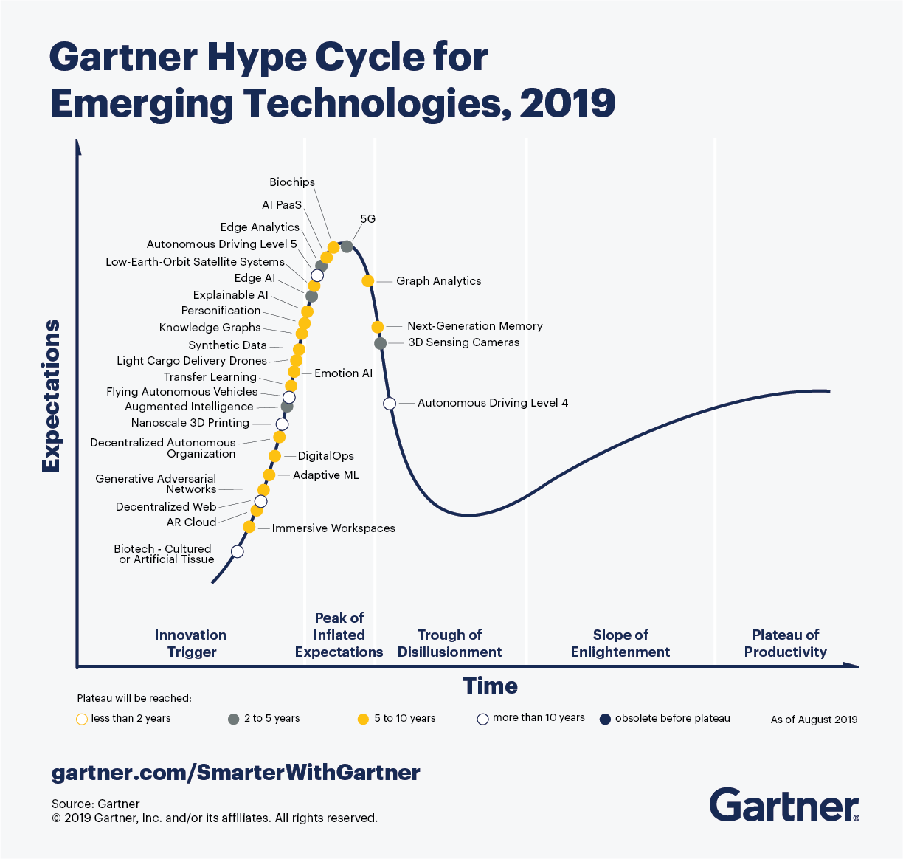
Gartner Hype Cycle

Slide 15
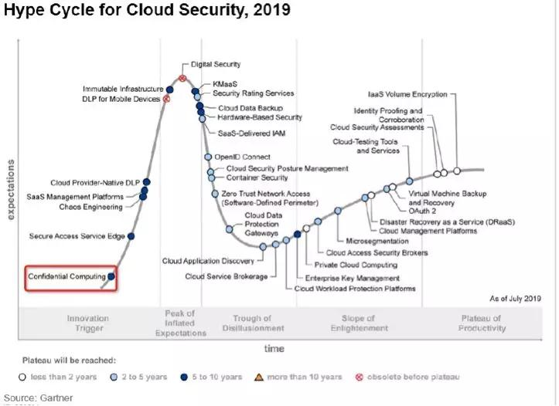
Gartner Hype Cycle

Slide 16
Business Drivers (Influences)
Business Drivers:
That fostered modern cloud-based technology.
These influences shaped clouds and the overall cloud computing market from both ends.
They have motivated organizations to adopt cloud computing in support of their business automation requirements.
They have correspondingly motivated other organizations to become providers of cloud environments and cloud technology vendors in order to create and meet the demand to fulfill consumer needs.
Capacity Planning
Cost Reduction
Organizational Agility

Slide 17
Business Drivers (Contd..)
Capacity Planning:
It is the process of determining and fulfilling future demands of an organization’s IT resources, products, and services.
Here, capacity represents the maximum amount of work that an IT resource is capable of delivering in a given period of time.
A discrepancy between the capacity of an IT resource and its demand can result in a system becoming either inefficient (over-provisioning) or unable to fulfill user needs (under-provisioning).
Capacity planning is focused on minimizing this discrepancy to achieve predictable efficiency and performance.
Different capacity planning strategies exist:
Lead Strategy – adding capacity to an IT resource in anticipation of demand
Lag Strategy – adding capacity when the IT resource reaches its full capacity
Match Strategy – adding IT resource capacity in small increments, as demand increases.

Slide 18
Business Drivers (Contd..)
Cost Reduction:
Two costs need to be accounted for:
the cost of acquiring new infrastructure.
the cost of its ongoing ownership.
Operational overhead represents a considerable share of IT budgets, often exceeding up-front investment costs.
Common forms of infrastructure-related operating overhead includes:
technical personnel required to keep the environment operational.
upgrades and patches that introduce additional testing and deployment cycles.
utility bills and capital expense investments for power and cooling.
security and access control measures that need to be maintained and enforced to protect infrastructure resources.
administrative and accounts staff that may be required to keep track of licenses and support arrangements.

Slide 19
Business Drivers (Contd..)
Organizational Agility:
Businesses need the ability to adapt and evolve to successfully face change caused by both internal and external factors.
Organizational Agility is the measure of an organization’s responsiveness to change.
For Example: VMware APPDEFENSE
(working towards to CYBER SECURITY)

Slide 20
Technology Innovations
Established technologies are often used as inspiration and, at times, the actual foundations upon which new technology innovations are derived and built.
pre-existing technologies considered to be the primary influences on cloud computing.
Clustering
Grid Computing
Virtualization
Clustering:
A cluster is a group of independent IT resources that are interconnected and work as a single system.

Slide 21
Technology Innovations (Contd..)
Grid Computing:
A computing grid (or “computational grid”) provides a platform in which computing resources are organized into one or more logical pools.
These pools are collectively coordinated to provide a high performance distributed grid, sometimes referred to as a “super virtual computer”.
Virtualization:
Virtualization represents a technology platform used for the creation of virtual instances of IT resources.
A layer of virtualization software allows physical IT resources to provide multiple virtual images of themselves so that their underlying processing capabilities can be shared by multiple users.

Slide 22
Technology Innovations (Contd..)
other areas of technology (cloud-enabling technologies) that continue to contribute to modern-day cloud-based platforms.
Broadband Networks and Internet Architecture
Data Center Technology
(Modern) Virtualization Technology
Web Technology
Multitenant Technology
Service Technology

Slide 23


Basic Concepts and Terminology
This section establishes a set of basic terms that represent the fundamental concepts and aspects pertaining to the insight of a cloud and its most primitive artifacts.
Cloud:
A cloud refers to a distinct IT environment that is designed for the purpose of remotely provisioning scalable and measured IT resources.
The symbol used to denote the boundary
of a cloud environment.
The symbol used to denote Internet.

Slide 24
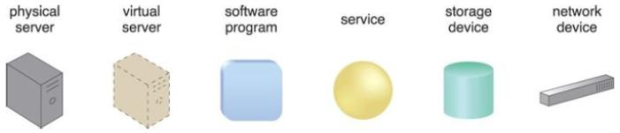
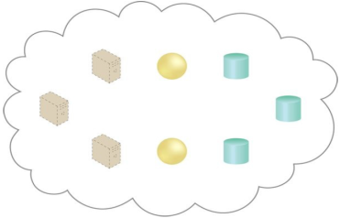
Basic Concepts and Terminology (Contd..)
IT Resource:
An IT resource is a physical or virtual IT-related artifact that can be either software-based (virtual server or a custom software program), or hardware-based (physical server or a network device).
A cloud is hosting eight IT resources:
three virtual servers,
two cloud services, and
three storage devices.

Slide 25
Basic Concepts and Terminology (Contd..)
On-Premise:
An IT resource that is hosted in a conventional IT enterprise within an organizational boundary (that does not specifically represent a cloud) is considered to be located on the premises of the IT enterprise, or on-premise for short.
Note the following key points:
An on-premise IT resource can access and interact with a cloud-based IT resource.
An on-premise IT resource can be moved to a cloud, thereby changing it to a cloud-based IT resource.
Redundant deployments of an IT resource can exist in both on-premise and cloud-based environments.

Slide 26
Basic Concepts and Terminology (Contd..)
Cloud Providers and Cloud Consumers:
The party / company that provides cloud-based IT resources is the cloud provider.
The party / company that uses cloud-based IT resources is the cloud consumer.
Scaling:
Scaling, from an IT resource perspective, represents the ability of the IT resource to handle increased or decreased usage demands.
The following are types of scaling:
Horizontal Scaling – scaling out and scaling in
Vertical Scaling – scaling up and scaling down

Slide 27
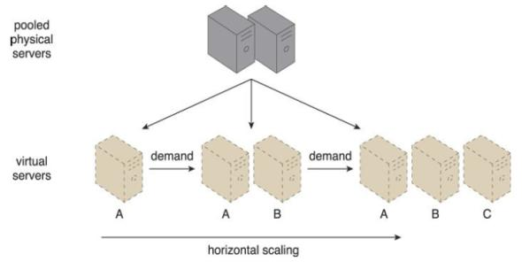
Basic Concepts and Terminology (Contd..)
Horizontal Scaling:
The allocating or releasing of IT resources that are of the same type is referred to as horizontal scaling.
The horizontal allocation of resources is referred to as scaling out.
The horizontal releasing of resources is referred to as scaling in.
Horizontal scaling is a common form of scaling within cloud environments.
An IT resource (Virtual Server A) is scaled out by adding more of the same IT resources (Virtual Servers B and C).

Slide 28
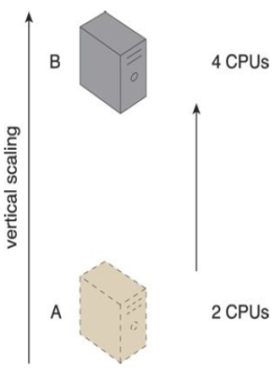
Basic Concepts and Terminology (Contd..)
Vertical Scaling:
When an existing IT resource is replaced by another with higher or lower capacity, vertical scaling is considered to have occurred.
The replacing of an IT resource with another that has a higher capacity is referred to as scaling up.
The replacing an IT resource with another that has a lower capacity is considered scaling down.
Vertical scaling is less common in cloud environments due to the downtime (stoppage) required while the replacement is taking place.
An IT resource (a virtual server with two CPUs) is scaled up by replacing it with a more powerful IT resource with increased capacity for data storage (a physical server with four CPUs).

Slide 29
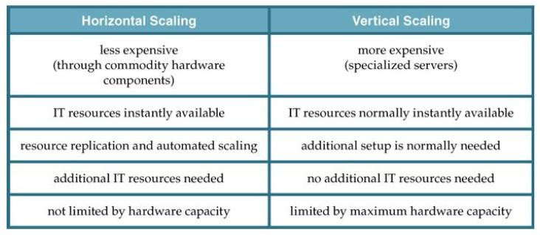
Basic Concepts and Terminology (Contd..)
Common pros and cons associated with horizontal and vertical scaling

Slide 30
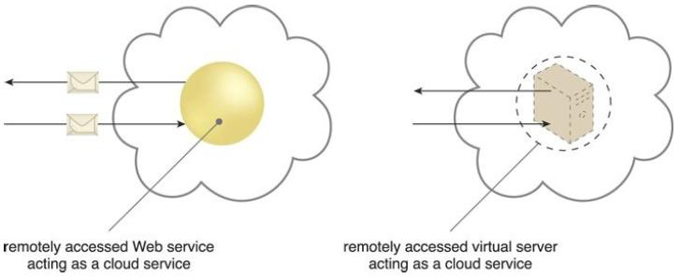
Basic Concepts and Terminology (Contd..)
Cloud Service:
A cloud service is any IT resource that is made remotely accessible via a cloud.

Slide 31
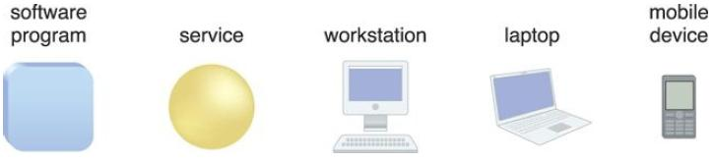
Basic Concepts and Terminology (Contd..)
Cloud Service Consumer:
The cloud service consumer is a temporary runtime role assumed by a software program when it accesses a cloud service.
Examples of cloud service consumers
Depending on the nature of a given diagram, an artifact labeled as a cloud service consumer may be a software program or a hardware device (in which case it is implied that it is running a software program capable of acting as a cloud service consumer).

Slide 32
Goals and Benefits
The common benefits associated with adopting cloud computing are explained in this section.
Reduced Investments and Proportional Costs
Increased Scalability
Increased Availability and Reliability
Reduced Investments and Proportional Costs:
Similar to a product wholesaler that purchases goods in bulk for lower price points,
– public cloud providers base their business model on the mass-acquisition of IT resources that are then made available to cloud consumers via attractively priced leasing packages.
This opens the door for organizations to gain access to powerful infrastructure without having to purchase it themselves.

Slide 33
Goals and Benefits (Contd..)
The most common economic way of investing in cloud-based IT resources is in the reduction or outright elimination of up-front IT investments (hardware & software purchases and ownership costs).
– This is referred to as Reduced Investments.
A cloud’s Measured Usage characteristic represents a feature-set that allows measured operational expenditures (i.e., directly related to business performance) to replace anticipated capital expenditures.
– This is referred to as Proportional Costs.
In its most basic form, opportunities to decrease costs are derived from the deployment and operation of large-scale data centers by major cloud providers.
Such data centers are commonly located in destinations where real estate, IT professionals, and network bandwidth can be obtained at lower costs, resulting in both capital and operational savings.

Slide 34
Goals and Benefits (Contd..)
Common measurable benefits to cloud consumers include:
On-demand access to pay-as-you-go computing resources on a short-term basis (such as processors by the hour), and the ability to release these computing resources when they are no longer needed.
The perception of having unlimited computing resources that are available on demand, thereby reducing the need to prepare for provisioning.
The ability to add or remove IT resources at a fine-grained level, such as modifying available storage disk space by single gigabyte increments.
Abstraction of the infrastructure so applications are not locked into devices or locations and can be easily moved if needed.

Slide 35
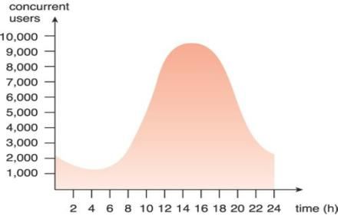
Goals and Benefits (Contd..)
Increased Scalability:
By providing pools of IT resources, along with tools and technologies designed to manage them collectively,
– clouds can instantly and dynamically allocate IT resources to cloud consumers, on-demand or via the cloud consumer’s direct configuration.
This empowers cloud consumers to scale their cloud-based IT resources to accommodate processing fluctuations and peaks automatically or manually.
An example of an organization’s changing demand for an IT resource over the course of a day (24 Hours).

Slide 36
Goals and Benefits (Contd..)
Increased Availability and Reliability:
The availability and reliability of IT resources are directly associated with noticeable business benefits.
A hallmark of the typical cloud environment is its key ability to provide extensive support for:
increasing the availability of a cloud-based IT resource to minimize or even eliminate outages.
increasing its reliability so as to minimize the impact of runtime failure conditions.
RAS: Reliability, Availability and Serviceability.
– First used by IBM for their Mainframes (only to hardware).

Slide 37
Risks and Challenges
Several of the most critical cloud computing challenges pertaining mostly to cloud consumers that use IT resources located in public clouds are presented and examined.
Increased Security Vulnerabilities
Reduced Operational Governance Control
Limited Portability Between Cloud Providers
Multi-Regional Compliance and Legal Issues

Slide 38
Risks and Challenges (Contd..)
Increased Security Vulnerabilities:
The moving of business data to the cloud means that the responsibility over data security becomes shared with the cloud provider.
The remote usage of IT resources requires an expansion of trust boundaries by the cloud consumer to include the external cloud.
It can be difficult to establish a security architecture that spans such a trust boundary without introducing vulnerabilities,
– unless cloud consumers and cloud providers happen to support the same or compatible security frameworks — which is unlikely with public clouds.
The overlapping of trust boundaries and the increased exposure of data can provide malicious cloud consumers (human and automated) with greater opportunities to attack IT resources and steal or damage business data.

Slide 39
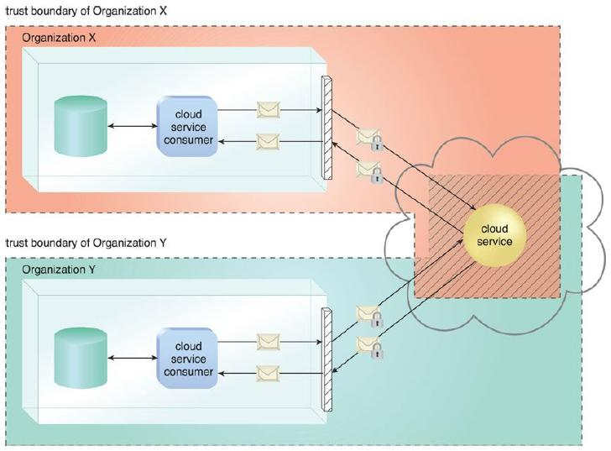
Risks and Challenges (Contd..)
The shaded area with diagonal lines indicates the overlap of two organizations’ trust boundaries.

Slide 40
Risks and Challenges (Contd..)
Reduced Operational Governance Control:
Cloud consumers are usually allotted a level of governance control that is lower than that over on-premise IT resources.
This can introduce risks associated with how the cloud provider operates its cloud, as well as the external connections that are required for communication between the cloud and the cloud consumer.
Consider the following examples:
An unreliable cloud provider may not maintain the guarantees it makes in the SLAs that were published for its cloud services. This can risk the quality of the cloud consumer solutions that rely on these cloud services.
Longer geographic distances between the cloud consumer and cloud provider can require additional network hops that introduce fluctuating latency and potential bandwidth constraints.

Slide 41
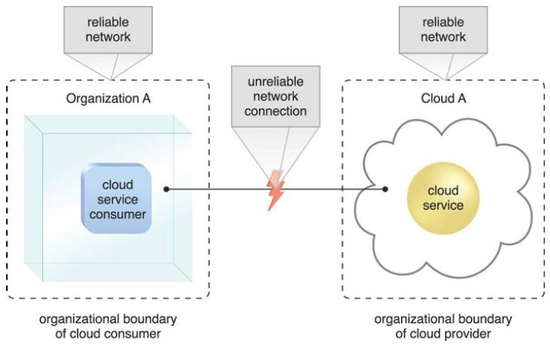
Risks and Challenges (Contd..)
An unreliable network connection compromises the quality of communication between cloud consumer and cloud provider environments.

Slide 42
Risks and Challenges (Contd..)
Limited Portability Between Cloud Providers:
Due to a lack of established industry standards within the cloud computing industry, public clouds are commonly exclusive to various extents.
For cloud consumers that have custom-built solutions with dependencies on these exclusive environments, it can be challenging to move from one cloud provider to another.
Portability is a measure used to determine the impact of moving cloud consumer IT resources and data between clouds.

Slide 43
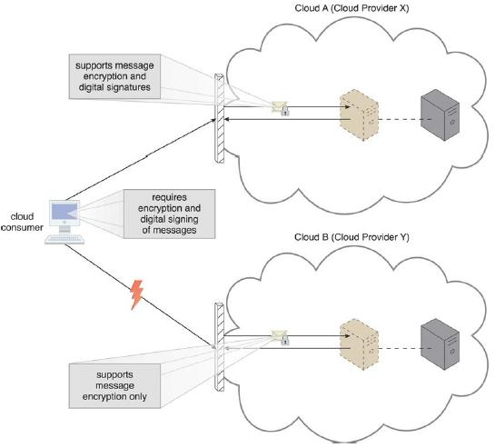
Risks and Challenges (Contd..)
A cloud consumer’s application has a decreased level of portability when assessing a potential migration from Cloud A to Cloud B, because the cloud provider of Cloud B does not support the same security technologies as Cloud A.

Slide 44
Risks and Challenges (Contd..)
Multi-Regional Compliance and Legal Issues:
Third-party cloud providers will frequently establish data centers in affordable or convenient geographical locations.
Cloud consumers will often not be aware of the physical location of their IT resources and data when hosted by public clouds.
For some organizations, this can pose serious legal concerns pertaining to industry or government regulations that specify data privacy and storage policies.
For example, some UK laws require personal data belonging to UK citizens to be kept within the United Kingdom.

Slide 45
Risks and Challenges (Contd..)
Another potential legal issue pertains to the accessibility and disclosure of data.
Countries have laws that require some types of data to be disclosed to certain government agencies or to the subject of the data.
For example, a European cloud consumer’s data that is located in the U.S. can be more easily accessed by government agencies (due to the U.S. Patriot Act) when compared to data located in many European Union countries.

Slide 46
UNIT - 1
Fundamental Concepts and Models

Slide 47
Roles and Boundaries
Organizations and Customers can assume different types of pre-defined roles depending on how they relate to and/or interact with a cloud and its hosted IT resources.
Each of the upcoming roles participates in and carries out responsibilities in relation to cloud-based activity.
The following sections define these roles and identify their main interactions.
Cloud Provider:
The organization that provides cloud-based IT resources is the cloud provider.
When assuming the role of cloud provider, an organization is responsible for making cloud services available to cloud consumers, as per agreed upon SLA guarantees.

Slide 48
Roles and Boundaries (Contd..)
The cloud provider is further tasked with any required management and administrative duties to ensure the on-going operation of the overall cloud infrastructure.
Cloud providers normally own the IT resources that are made available for lease by cloud consumers;
– However, some cloud providers also “resell” IT resources leased from other cloud providers.
Cloud Consumer:
A cloud consumer is an organization (or an individual) that has a formal contract or arrangement with a cloud provider to use IT resources made available by the cloud provider.
The cloud consumer uses a cloud service consumer to access a cloud service.

Slide 49
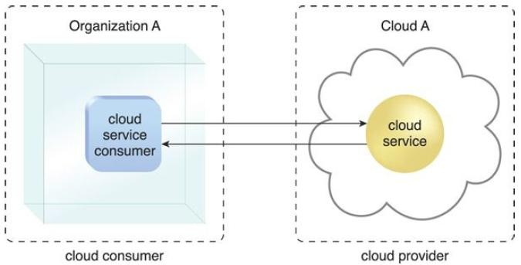
Roles and Boundaries (Contd..)
A cloud consumer (Organization A) interacts with a cloud service from a cloud provider (that owns Cloud A).
Within Organization A, the cloud service consumer is being used to access the cloud service.

Slide 50
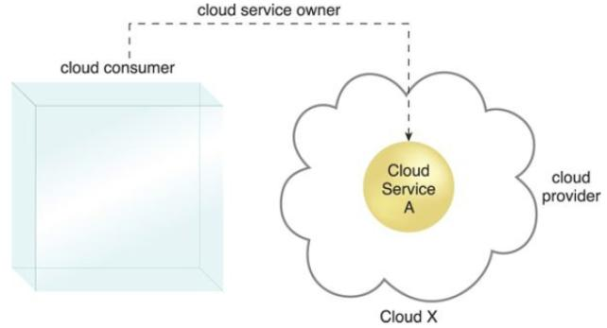
Roles and Boundaries (Contd..)
Cloud Service Owner:
The individual or organization that legally owns a cloud service is called a cloud service owner.
The cloud service owner can be the cloud consumer, or the cloud provider that owns the cloud within which the cloud service resides.
A cloud consumer can be a cloud service owner when it deploys its own service in a cloud.

Slide 51
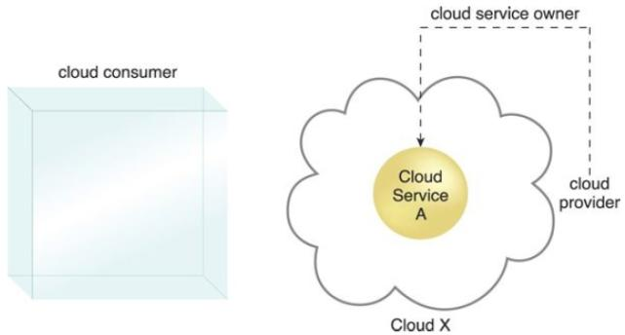
Roles and Boundaries (Contd..)
NOTE:
Several cloud consumer organizations develop and deploy cloud services in clouds owned by other parties for the purpose of making the cloud services available to the general public.
A cloud service owner is not called a cloud resource owner is because the cloud service owner role only applies to cloud services.
A cloud provider becomes a cloud service owner if it deploys its own cloud service, typically for other cloud consumers to use.

Slide 52
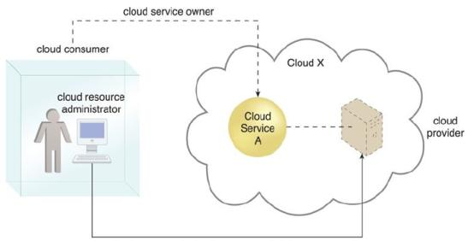
Roles and Boundaries (Contd..)
Cloud Resource Administrator:
A cloud resource administrator is the person or organization responsible for administering a cloud-based IT resource (including cloud services).
The cloud resource administrator can be (or belong to) the cloud consumer or cloud provider of the cloud within which the cloud service resides.
Alternatively, it can be (or belong to) a third-party organization contracted to administer the cloud-based IT resource.
The cloud consumer’s cloud resource administrator remotely accesses the virtual server hosting Cloud Service A (which is owned by the cloud consumer)

Slide 53
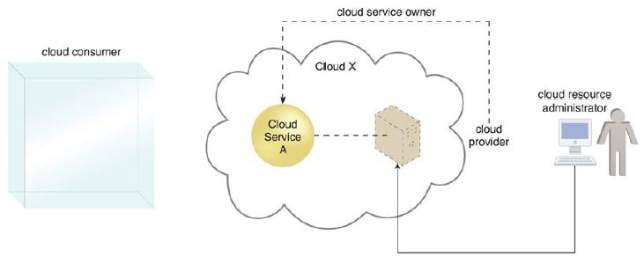
Roles and Boundaries (Contd..)
The cloud provider’s cloud resource administrator accesses the virtual server that’s hosting Cloud Service A (which is owned by the cloud provider)
The reason a cloud resource administrator is not referred to as a “cloud service administrator” is because this role may be responsible for administering cloud-based IT resources that don’t exist as cloud services.

Slide 54
Roles and Boundaries (Contd..)
Additional Roles:
The NIST Cloud Computing Reference Architecture defines the following supplementary roles:
Cloud Auditor:
A third-party (often accredited) that conducts independent assessments of cloud environments assumes the role of the cloud auditor.
The typical responsibilities associated with this role include the evaluation of security controls, privacy impacts, and performance.
The main purpose of the cloud auditor role is to provide an unbiased assessment (and possible certification) of a cloud environment to help strengthen the trust relationship between cloud consumers and cloud providers.

Slide 55
Roles and Boundaries (Contd..)
Cloud Broker:
This role is assumed by a party that assumes the responsibility of managing and negotiating the usage of cloud services between cloud consumers and cloud providers.
Mediation services provided by cloud brokers include service intermediation, aggregation, and arbitrage.
Cloud Carrier:
The party responsible for providing the wire-level connectivity between cloud consumers and cloud providers assumes the role of the cloud carrier.
This role is often assumed by network and telecommunication providers.

Slide 56
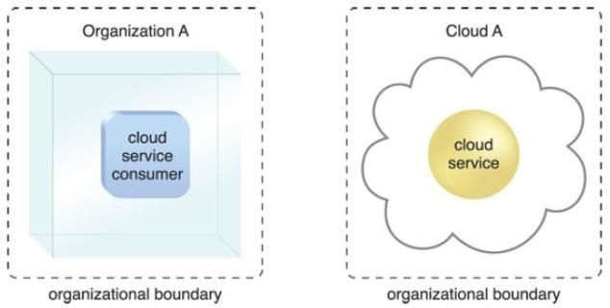
Roles and Boundaries (Contd..)
Organizational Boundary:
An organizational boundary represents the physical perimeter that surrounds a set of IT resources that are owned and governed by an organization.
The organizational boundary does not represent the boundary of an actual organization, only an organizational set of IT assets and IT resources.
Organizational boundaries of a cloud consumer (left), and a cloud provider (right), represented by a broken line notation.

Slide 57
Roles and Boundaries (Contd..)
Trust Boundary:
When an organization assumes the role of cloud consumer to access cloud-based IT resources, it needs to extend its trust beyond the physical boundary of the organization to include parts of the cloud environment.
A trust boundary is a logical perimeter that typically spans beyond physical boundaries to represent the extent to which IT resources are trusted.
When analyzing cloud environments, the trust boundary is most frequently associated with the trust issued by the organization acting as the cloud consumer.

Slide 58
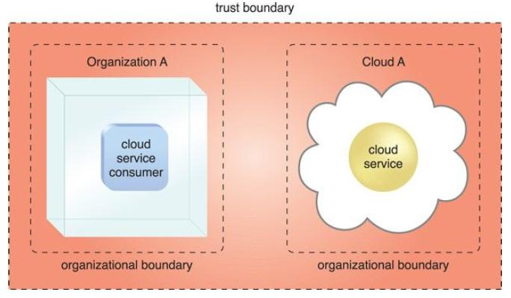
Roles and Boundaries (Contd..)
An extended trust boundary encompasses the organizational
boundaries of the cloud provider and the cloud consumer.

Slide 59
Cloud Characteristics
An IT environment requires a specific set of characteristics to enable the remote provisioning of scalable and measured IT resources in an effective manner.
The following six specific characteristics are common to the majority of cloud environments:
On-Demand Usage
Ubiquitous Access
Multitenancy (and Resource Pooling)
Elasticity
Measured Usage
Resiliency (or Resilient Computing)

Slide 60
Cloud Characteristics (Contd..)
On-Demand Usage:
A cloud consumer can individually access cloud-based IT resources giving the cloud consumer the freedom to self-provision these IT resources.
Once configured, usage of the self-provisioned IT resources can be automated, requiring no further human involvement by the cloud consumer or cloud provider.
– This results in an on-demand usage environment.
Also known as “on-demand self-service usage,” this characteristic enables the service-based and usage-driven features found in conventional clouds.
Ubiquitous Access:
Ubiquitous access represents the ability for a cloud service to be widely accessible.
Establishing ubiquitous access for a cloud service can require support for a range of devices, transport protocols, interfaces, & security methods.

Slide 61
Cloud Characteristics (Contd..)
Multitenancy (and Resource Pooling):
The characteristic of a software program that enables an instance of the program to serve different consumers (tenants) whereby each is isolated from the other, is referred to as multitenancy.
A cloud provider pools its IT resources to serve multiple cloud service consumers by using multitenancy models that frequently rely on the use of virtualization technologies.
Through the use of multitenancy technology, IT resources can be dynamically assigned and reassigned, according to cloud service consumer demands.
Resource Pooling allows cloud providers to pool large-scale IT resources to serve multiple cloud consumers.

Slide 62
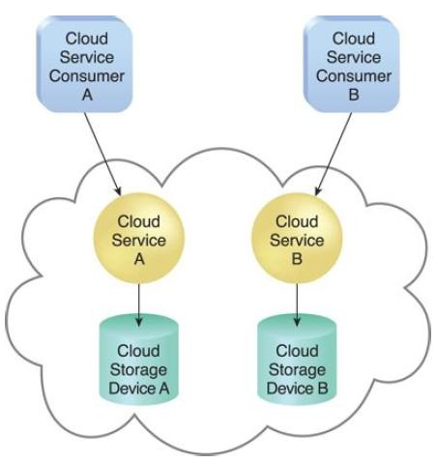
Cloud Characteristics (Contd..)
In a single-tenant environment, each cloud consumer has a separate
IT resource instance.

Slide 63
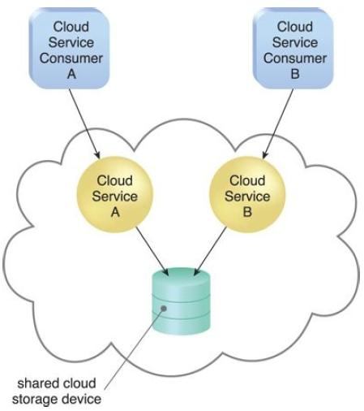
Cloud Characteristics (Contd..)
In a multitenant environment, a single instance of an IT resource,
such as a cloud storage device, serves multiple consumers.

Slide 64
Cloud Characteristics (Contd..)
Elasticity:
Elasticity is the automated ability of a cloud to transparently scale IT resources, as required in response to runtime conditions or as pre-determined by the cloud consumer or cloud provider.
Elasticity is often considered a core justification for the adoption of cloud computing, primarily due to the fact that it is closely associated with the Reduced Investment and Proportional Costs benefit.
Cloud providers with enormous IT resources can offer the greatest range of elasticity.
Measured Usage:
Represents the ability of a cloud platform to keep track of the usage of its IT resources, primarily by cloud consumers.

Slide 65
Cloud Characteristics (Contd..)
Resiliency:
Within cloud computing, the characteristic of resiliency can refer to redundant IT resources within the same cloud (but in different physical locations) or across multiple clouds.
Resilient Computing is a form of failover that distributes redundant implementations of IT resources across physical locations.
Cloud consumers can increase both the reliability and availability of their applications by utilizing the resiliency of cloud-based IT resources.

Slide 66
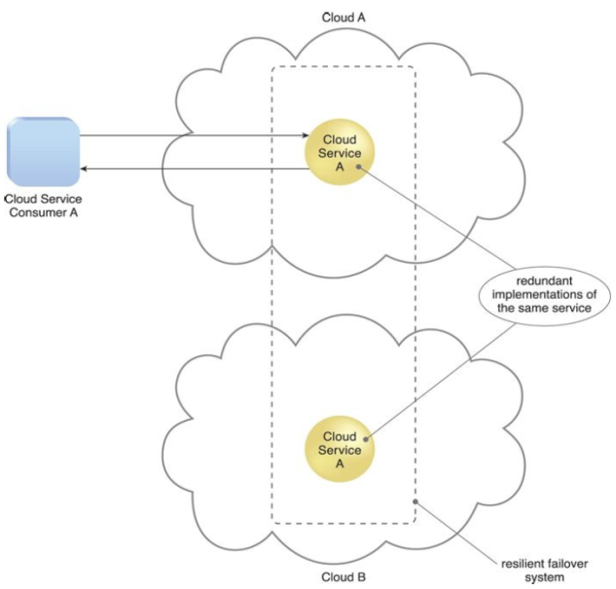
Cloud Characteristics (Contd..)
A resilient system in which Cloud B hosts a redundant
implementation of Cloud Service A to provide failover in case Cloud Service A
on Cloud A becomes unavailable.

Slide 67
Cloud Delivery Models
A cloud delivery model represents a specific, pre-packaged combination of IT resources offered by a cloud provider.
Also known as cloud service model / cloud utilization model.
Three common cloud delivery models have become widely established and formalized:
Infrastructure-as-a-Service (IaaS)
Platform-as-a-Service (PaaS)
Software-as-a-Service (SaaS)
NOTE:
Many specialized variations of the three base cloud delivery models have emerged, each comprised of a distinct combination of IT resources.
Some examples include: Storage-as-a-Service, Database-as-a-Service, Security-as-a-Service, Communication-as-a-Service, Integration-as-a-Service, Testing-as-a-Service, Process-as-a-Service.

Slide 68
Cloud Delivery Models (Contd..)
Infrastructure-as-a-Service (IaaS)
The IaaS delivery model represents a self-contained IT environment comprised of infrastructure-centric IT resources that can be accessed and managed via cloud service-based interfaces and tools.
This environment can include hardware, network, connectivity, operating systems, and other “raw” IT resources.
The general purpose of an IaaS environment is to provide cloud consumers with a high level of control and responsibility over its configuration and utilization.
The IT resources provided by IaaS are generally not pre-configured, placing the administrative responsibility directly upon the cloud consumer.
This model is therefore used by cloud consumers that require a high level of control over the cloud-based environment they intend to create.

Slide 69
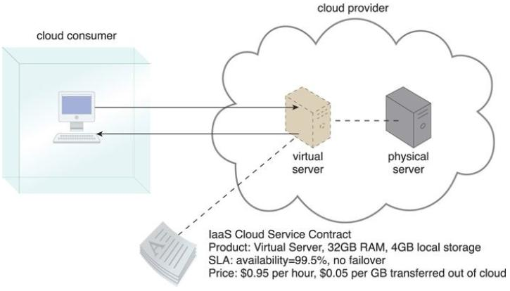
Cloud Delivery Models (Contd..)
A cloud consumer is using a virtual server within an IaaS
environment. Cloud consumers are provided with a range of contractual
guarantees by the cloud provider, pertaining to characteristics such as capacity,
performance, and availability.

Slide 70
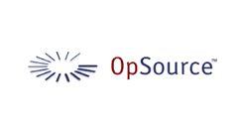



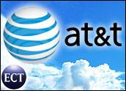
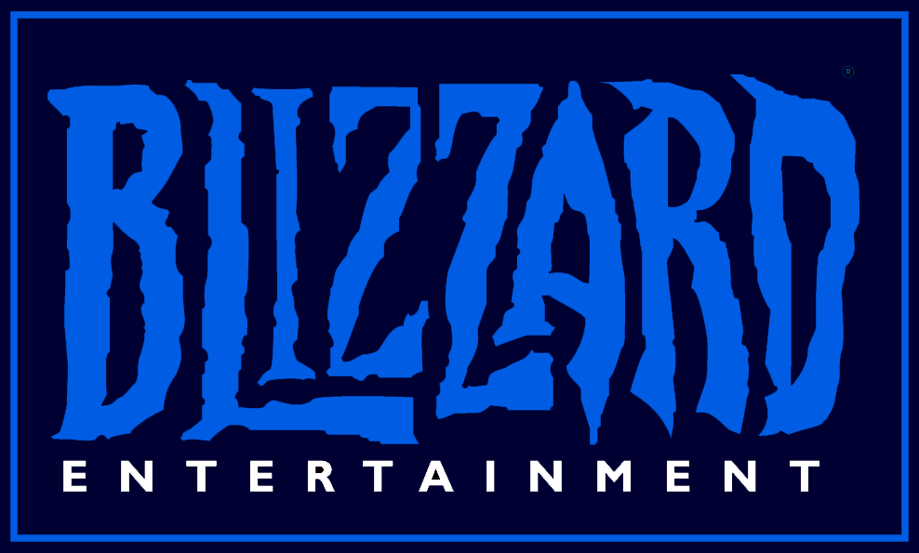
Cloud Delivery Models (Contd..)
IaaS Examples

Slide 71
Cloud Delivery Models (Contd..)
Platform-as-a-Service (PaaS)
The PaaS delivery model represents a pre-defined “ready-to-use” environment typically comprised of already deployed and configured IT resources.
PaaS relies on (and is primarily defined by) the usage of a ready-made environment that establishes a set of pre-packaged products and tools used to support the entire delivery lifecycle of custom applications.
Common reasons a cloud consumer would use and invest in a PaaS environment include:
The cloud consumer wants to extend on-premise environments into the cloud for scalability and economic purposes.
The cloud consumer uses the ready-made environment to entirely substitute an on-premise environment.

Slide 72
Cloud Delivery Models (Contd..)
The cloud consumer wants to become a cloud provider and deploys its own cloud services to be made available to other external cloud consumers.
The cloud consumer not requires administrative burden of setting up and maintaining the bare infrastructure IT resources provided via the IaaS model.
Ready-Made Environment:
Generally equipped with a complete software development kit (SDK) that provides cloud consumers with programmatic access to the development technologies that comprise their preferred programming stacks.
PaaS products are available with different development stacks.
For example, Google App Engine offers a Java and Python-based environment.

Slide 73
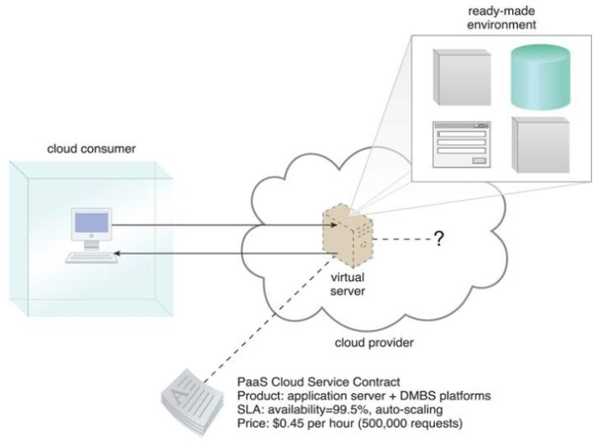
Cloud Delivery Models (Contd..)
A cloud consumer is accessing a ready-made PaaS environment.

Slide 74
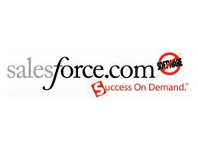

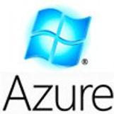


Cloud Delivery Models (Contd..)
PaaS Examples

Slide 75
Cloud Delivery Models (Contd..)
Software-as-a-Service (SaaS)
A software program positioned as a shared cloud service and made available as a “product” or generic utility represents the typical profile of a SaaS offering.
The SaaS delivery model is typically used to make a reusable cloud service widely available (often commercially) to a range of cloud consumers.
A cloud consumer is generally granted very limited administrative control over a SaaS implementation.
It is most often provisioned by the cloud provider, but it can be legally owned by whichever entity assumes the cloud service owner role.

Slide 76
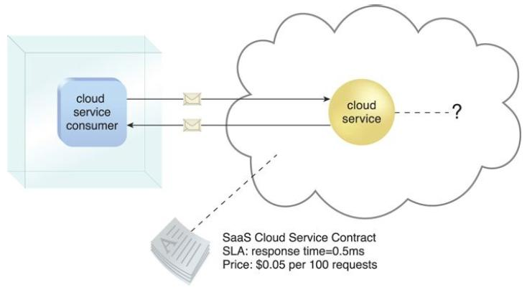
Cloud Delivery Models (Contd..)
The cloud service consumer is given access the cloud service
contract, but not to any underlying IT resources or implementation details.

Slide 77
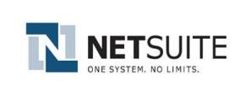
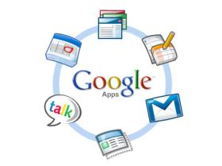

Cloud Delivery Models (Contd..)
SaaS Examples

Slide 78
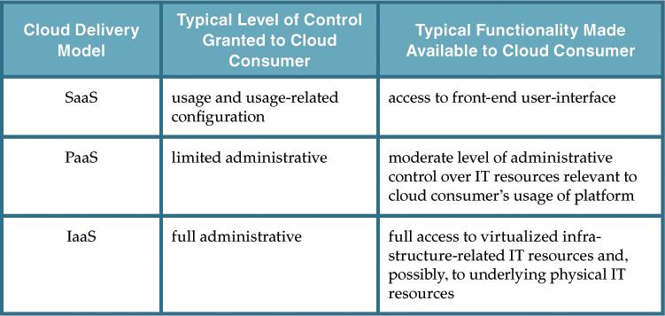
Comparing Cloud Delivery Models
A comparison of typical cloud delivery model control levels.

Slide 79
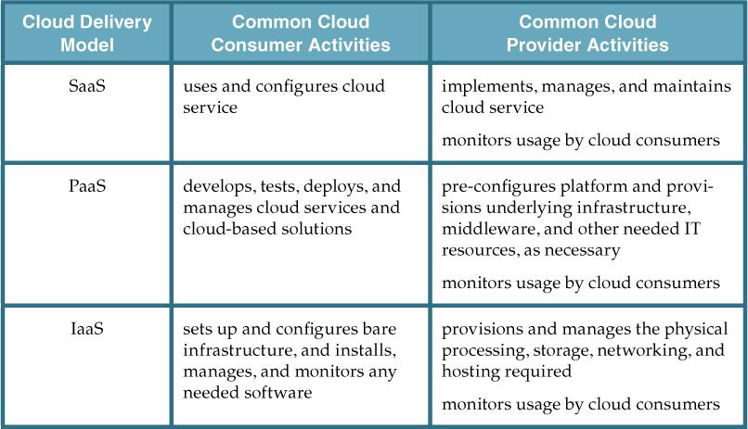
Comparing Cloud Delivery Models (Contd..)
Typical activities carried out by cloud consumers and cloud providers
in relation to the cloud delivery models.

Slide 80
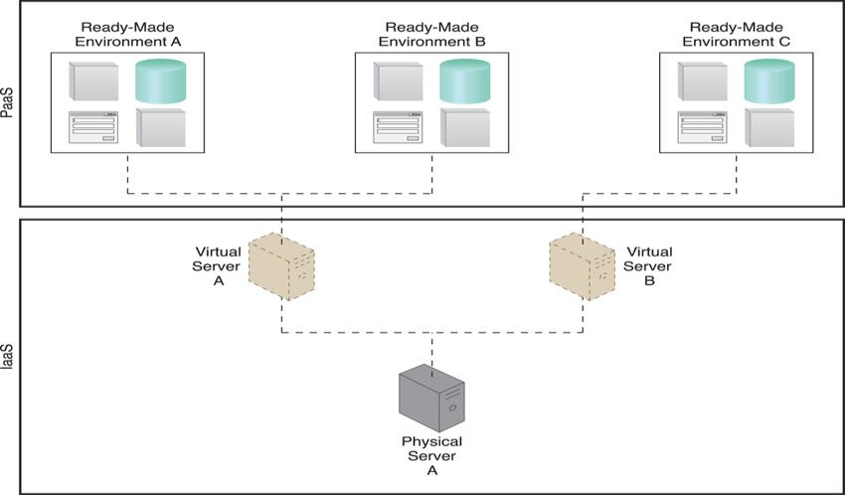
Combining Cloud Delivery Models
IaaS + PaaS
A PaaS environment based on the IT resources provided by an underlying IaaS environment.

Slide 81
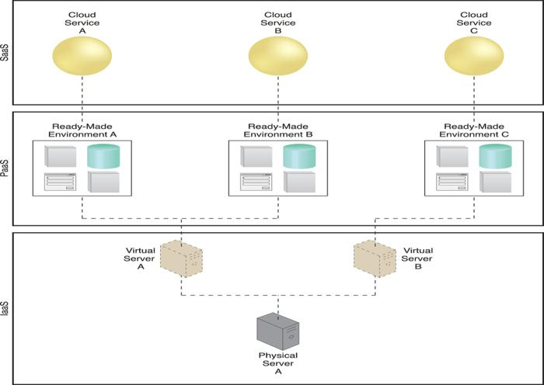
Combining Cloud Delivery Models (Contd..)
IaaS + PaaS + SaaS
A simple layered view of an architecture comprised of IaaS and PaaS environments hosting three SaaS cloud service implementations.

Slide 82
Cloud Deployment Models
A cloud deployment model represents a specific type of cloud environment, primarily distinguished by ownership, size, and access.
There are four common cloud deployment models:
Public Cloud
Community Cloud
Private Cloud
Hybrid Cloud

Slide 83
Cloud Deployment Models (Contd..)
Public Clouds
A public cloud is a publicly accessible cloud environment owned by a third-party cloud provider.
IT resources on public clouds are usually provisioned via the previously described cloud delivery models and are generally offered to cloud consumers at a cost or are commercialized via other avenues (such as advertisement).
The cloud provider is responsible for the creation and on-going maintenance of the public cloud and its IT resources.

Slide 84
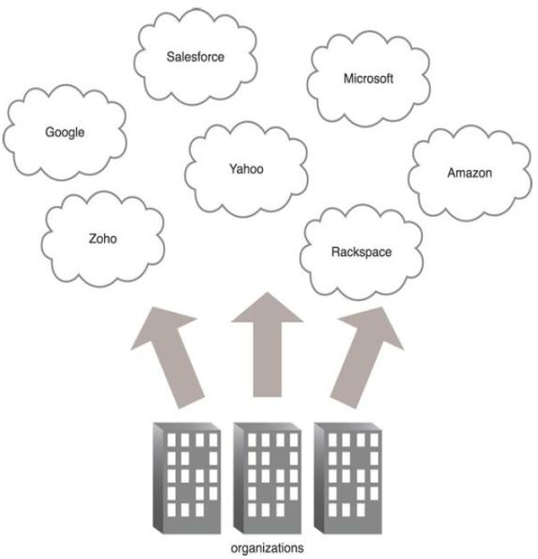
Cloud Deployment Models (Contd..)
Organizations act as cloud consumers when accessing cloud services and IT resources made available by different cloud providers.

Slide 85
Cloud Deployment Models (Contd..)
Community Clouds
A community cloud is similar to a public cloud except that its access is limited to a specific community of cloud consumers.
The community cloud may be jointly owned by the community members or by a third-party cloud provider that provisions a public cloud with limited access.
The member cloud consumers of the community typically share the responsibility for defining and evolving the community cloud.

Slide 86
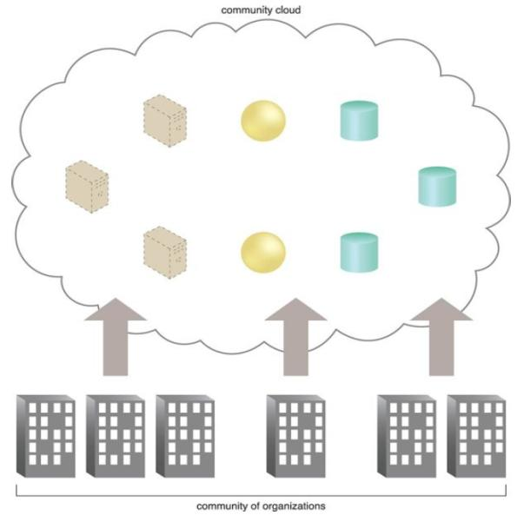
Cloud Deployment Models (Contd..)
An example of a “community” of organizations accessing IT resources from a community cloud.

Slide 87
Cloud Deployment Models (Contd..)
Private Clouds
A private cloud is owned by a single organization.
Private clouds enable an organization to use cloud computing technology as a means of centralizing access to IT resources by different parts, locations, or departments of the organization.
The actual administration of a private cloud environment may be carried out by internal or outsourced staff.
With a private cloud, the same organization is technically both the cloud consumer and cloud provider. In order to differentiate these roles:
a separate organizational department typically assumes the responsibility for provisioning the cloud (and therefore assumes the cloud provider role).
departments requiring access to the private cloud assume the cloud consumer role.

Slide 88
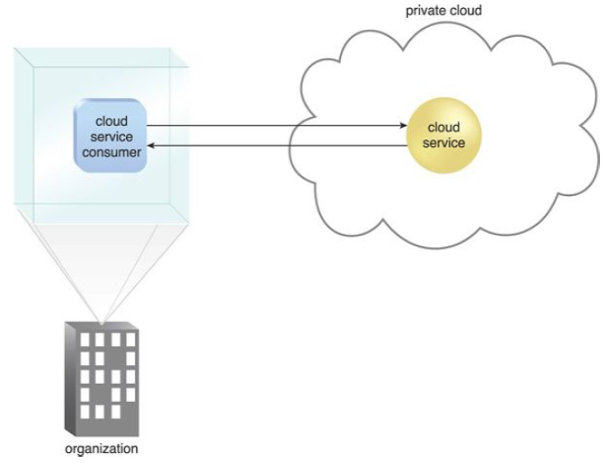
Cloud Deployment Models (Contd..)
A cloud service consumer in the organization’s on-premise environment accesses a cloud service hosted on the same organization’s private cloud via a virtual private network.

Slide 89
Cloud Deployment Models (Contd..)
Hybrid Clouds
A hybrid cloud is a cloud environment comprised of two or more different cloud deployment models.
For example, a cloud consumer may choose to deploy cloud services processing sensitive data to a private cloud and other, less sensitive cloud services to a public cloud.
– The result of this combination is a hybrid deployment model.
Hybrid deployment architectures can be complex and challenging to create and maintain
– due to the potential discrepancy in cloud environments and
– the fact that management responsibilities are typically split between the private cloud provider organization and the public cloud provider.

Slide 90
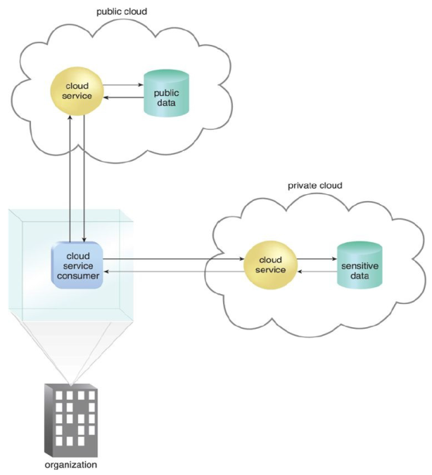
Cloud Deployment Models (Contd..)
An organization using a hybrid cloud architecture that utilizes both a private and public cloud.

Slide 91
End of UNIT - 1

