Slide 1
British Airways
Customer ratings analysis and insights
1st January 2023

Slide 2
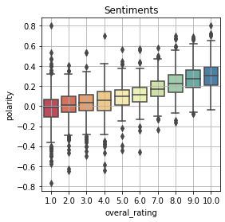
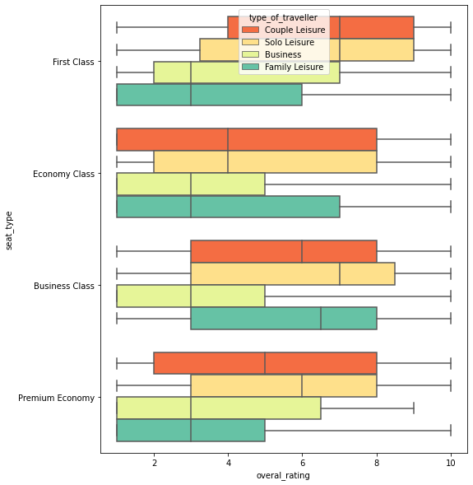
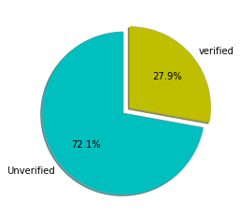
INSIGHTS
Total Reviews
3436
Average Overall Ratings
4.84 /10
The features that are taken into consideration are :
Type of Traveller and Seat Comfort.
Rated out of 5 stars with averages :
Seat comfort – (2.9/5)
Cabin staff service (3.27/5)
Food and beverages (2.73/5)
Ground service (2.87/5)
Along with subjective reviews.
Families travelling in Premium Economy rated cabin staff services the least amongst all type of travellers.
Business people did not like the ground services.
98.2% passengers Recommended to travel with the airlines.
Reviews contained frequent usages of following words:
cabin_crew_efficient_friendly, return_check_quick_security , new_club_europe_seat, cabin_crew_friendly_attentive, business_class_seat_economy
Out of all reviews following % are the verified and unverified ones
In First Class, positive reviews came from Couples and Solo travellers .
Business travellers aren’t happy with the business class. On Contrary Families and Solo travellers enjoyed it.
Premium Economy had good reviews from Solo passengers.
Food and beverages got the best rating amongst all.

