Slide 1
British Airways
Predictive model and its results
4th January 2023

Slide 2
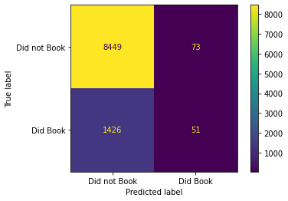
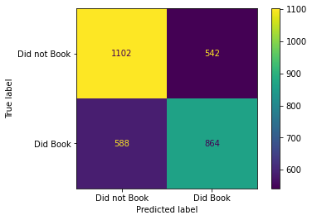
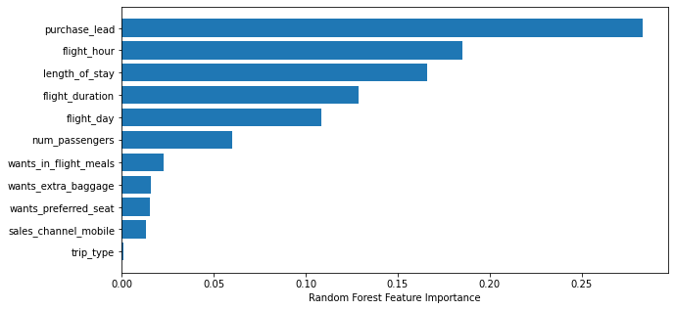
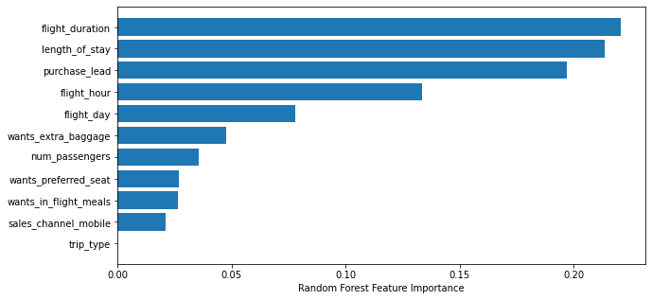
Predictive Analysis
IMBALANCED DATA | BALANCED DATA
Precision = 41.1%
Recall = 34.5 %
Accuracy= 85%
Precision = 61%
Recall = 59%
Accuracy = 62%
Here the need to create the balanced data is exposed as there are more tuples consisting unsuccessful bookings which affected the Precision and recall score.
Here by creating the balanced fields, the importance of features got enhanced resulting in the better precision and recall rate.
Top Features that drive successful flight bookings are more or less same for both the data

