Slide 1
Project on SURVEY ENGINE
Trainer Name-Mrs. Lata Verma
Team 01- Amandeep Rikhi
Nancy Hada
Ritu Gaba
Shubham Gosain
Umang Gupta

Slide 2
contents
Introduction
Login Page
Admin Views
User Views
Limitations
Summary
Conclusion
Queries

Slide 3
Introduction
Many desktop applications claim to provide a good survey engine. The different desktop applications functioning now a days promise their user’s (the registered ones) to provide them with limited surveys. There is no way to generate reviews about how the survey is going on. The users can go through the surveys which are held on limited issues.
Also, there exist no way that User may give views about the surveys. However, these reviews hold a high opinion for other new users who want to join the portal.
If any user want to create his/her own survey on any random topic then these portals can’t be able to provide this facility to the registered users.
SURVEYKSHAN is a user friendly desktop based application which provides solution to all these above stated problems from providing one-stop solution to provision of creating surveys by the users and any user can go through different types of surveys which are going on.

Slide 4

WELCOME Frame

Slide 5
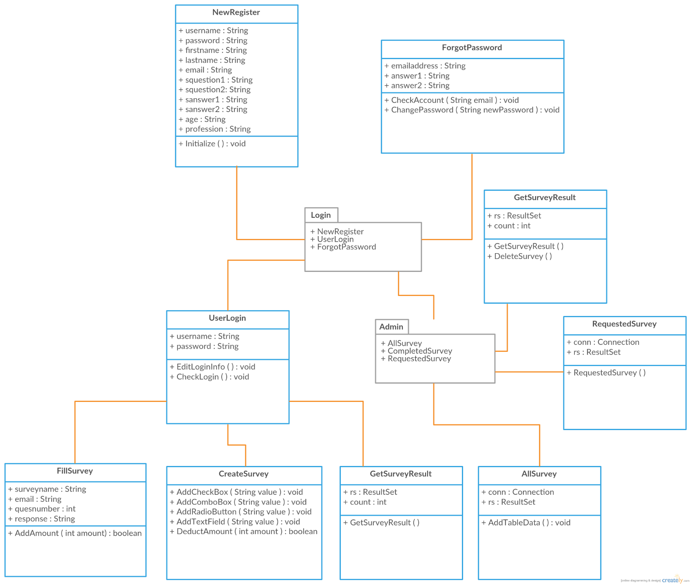
Class Diagram

Slide 6
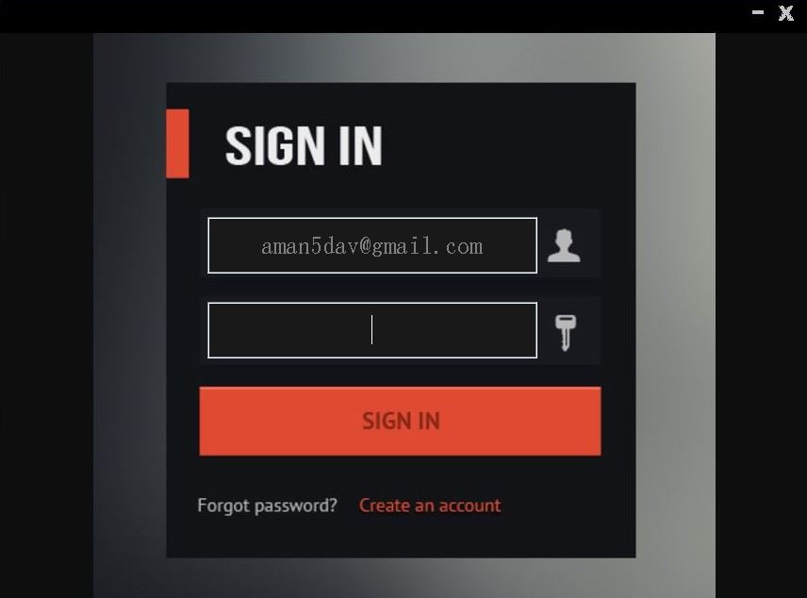
Login Frame

Slide 7
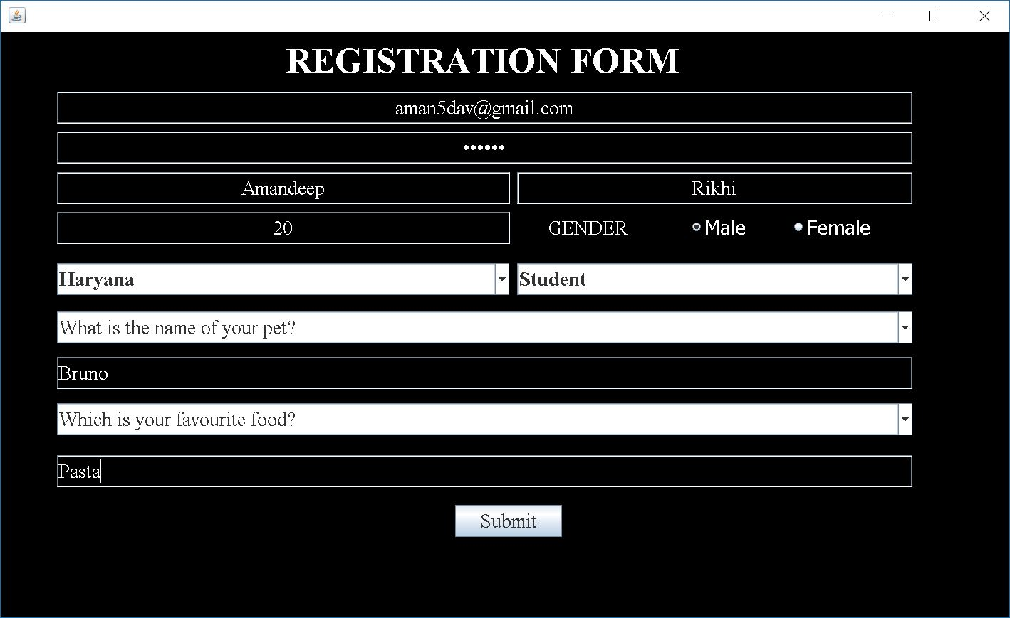
Registration Frame

Slide 8
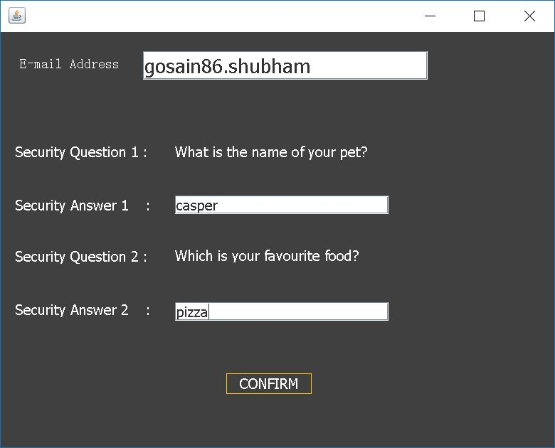
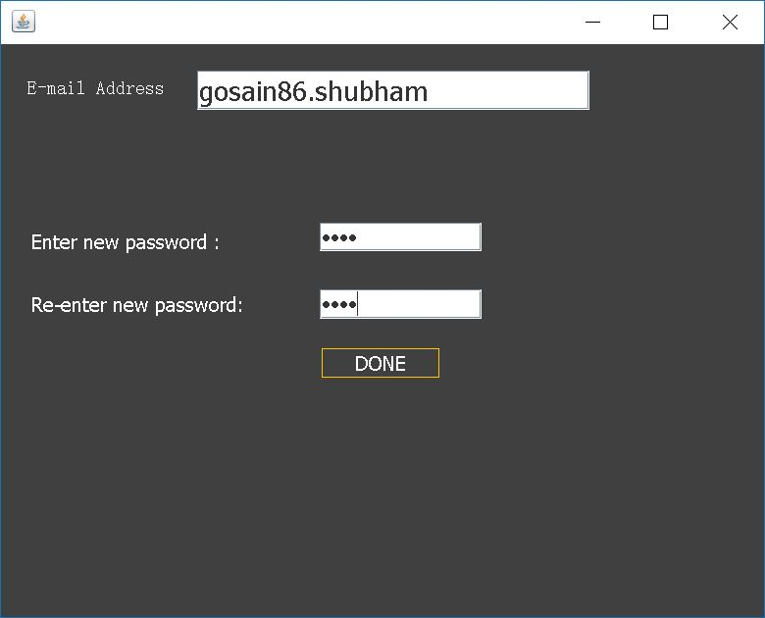
Change Password

Slide 9
Views
In this project views are divided into two parts.
Admin view
User View
According to login credentials Application will
show the respective view that is for User or Admin.

Slide 10
Administrator View
When Admin logs-in, admin will redirect to the admin home page where Admin will have different functionalities such as follows:-
1. Pass, Discard Survey Requests
2. View a list of all the Surveys
3. View the results for completed Surveys
4. Delete the completed Surveys

Slide 11
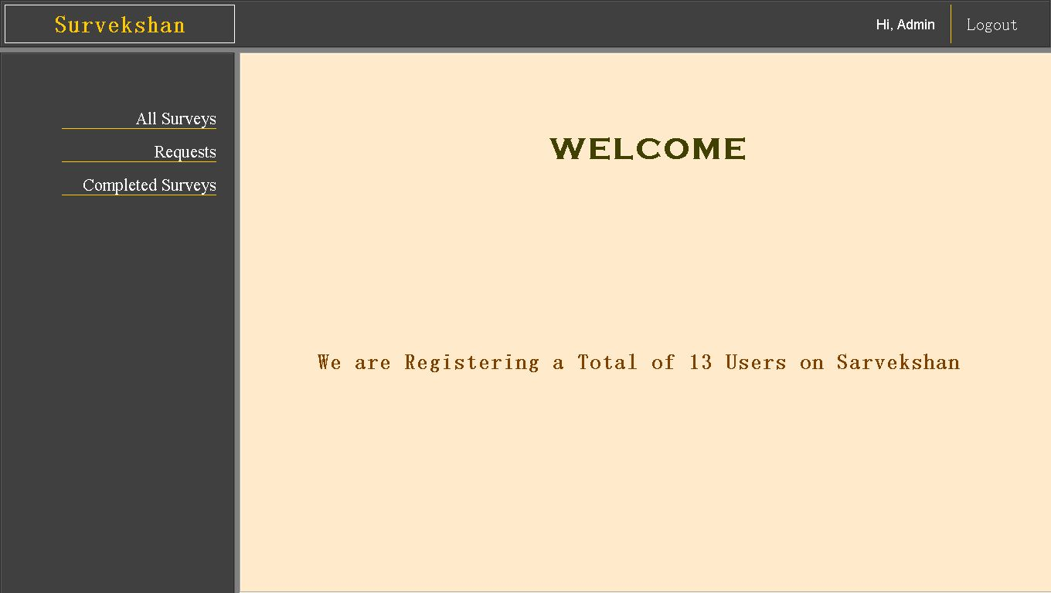
Admin DASHBOARD Frame

Slide 12
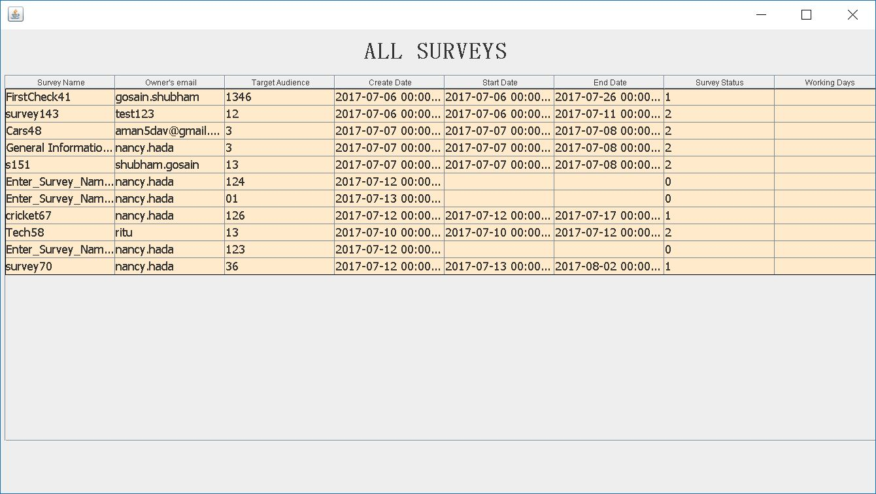
ALL SURVEYS FRAME

Slide 13
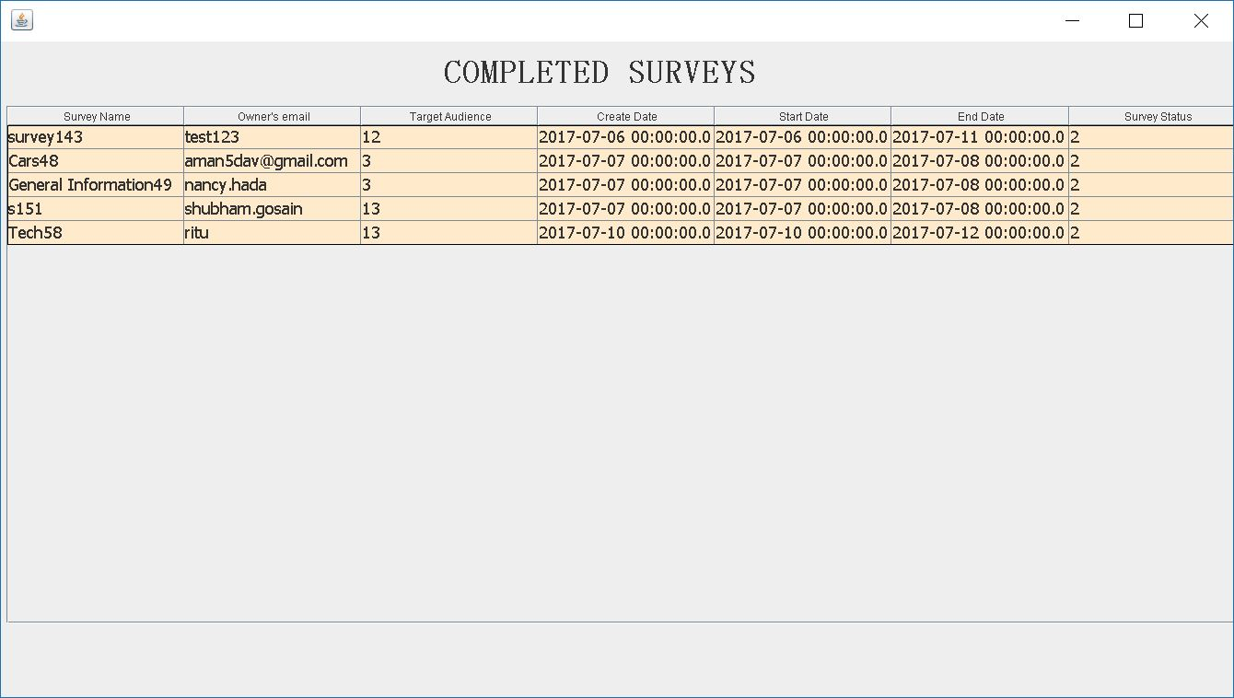
COMPLETED SURVEYS FRAME

Slide 14
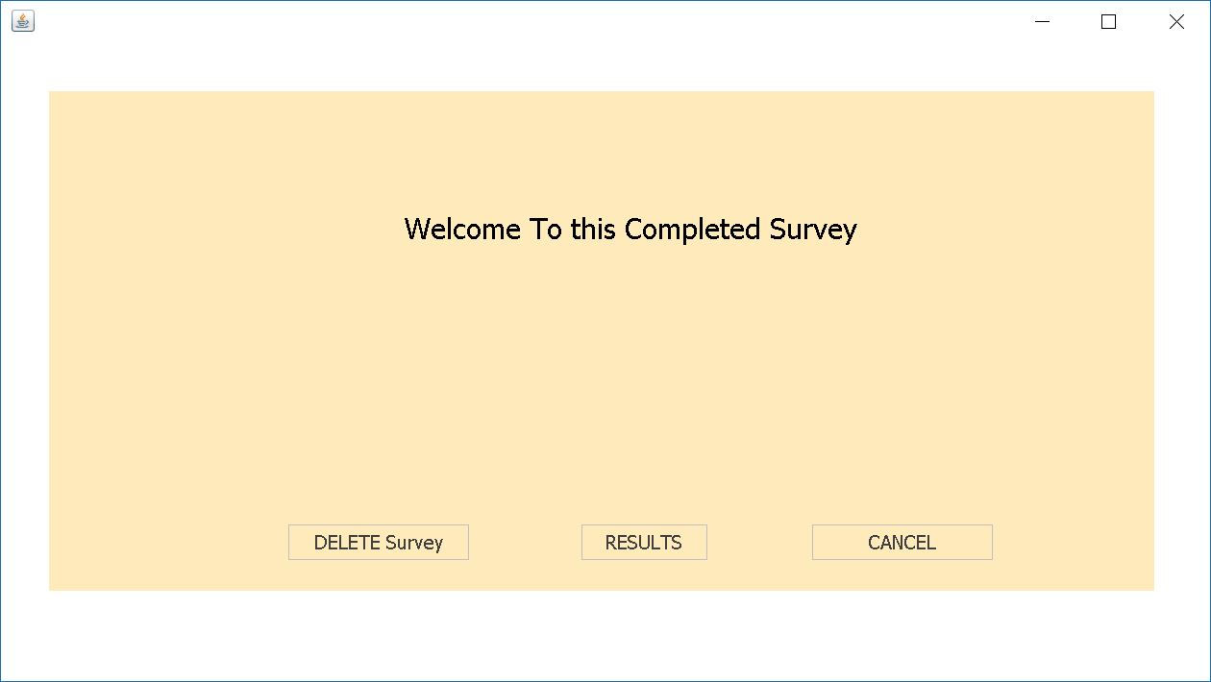
COMPLETED SURVEYS OPTIONS frame 1

Slide 15
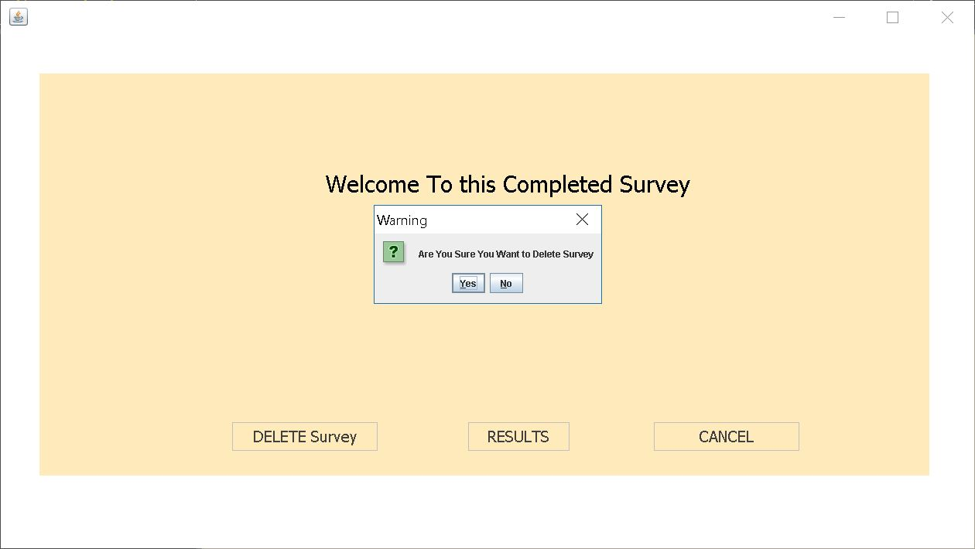
COMPLETED SURVEYS OPTIONS frame 2

Slide 16
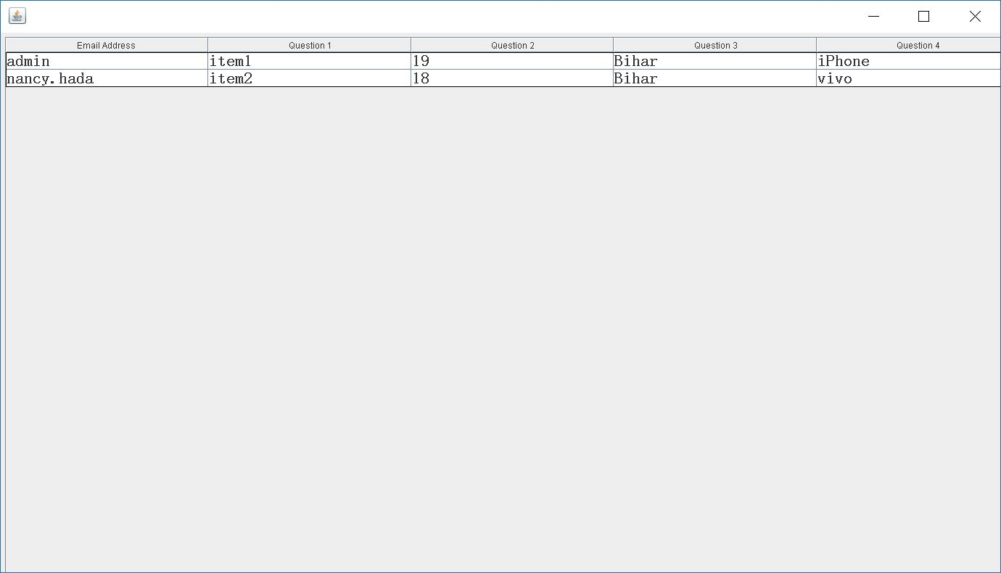
RESULT FRAME

Slide 17
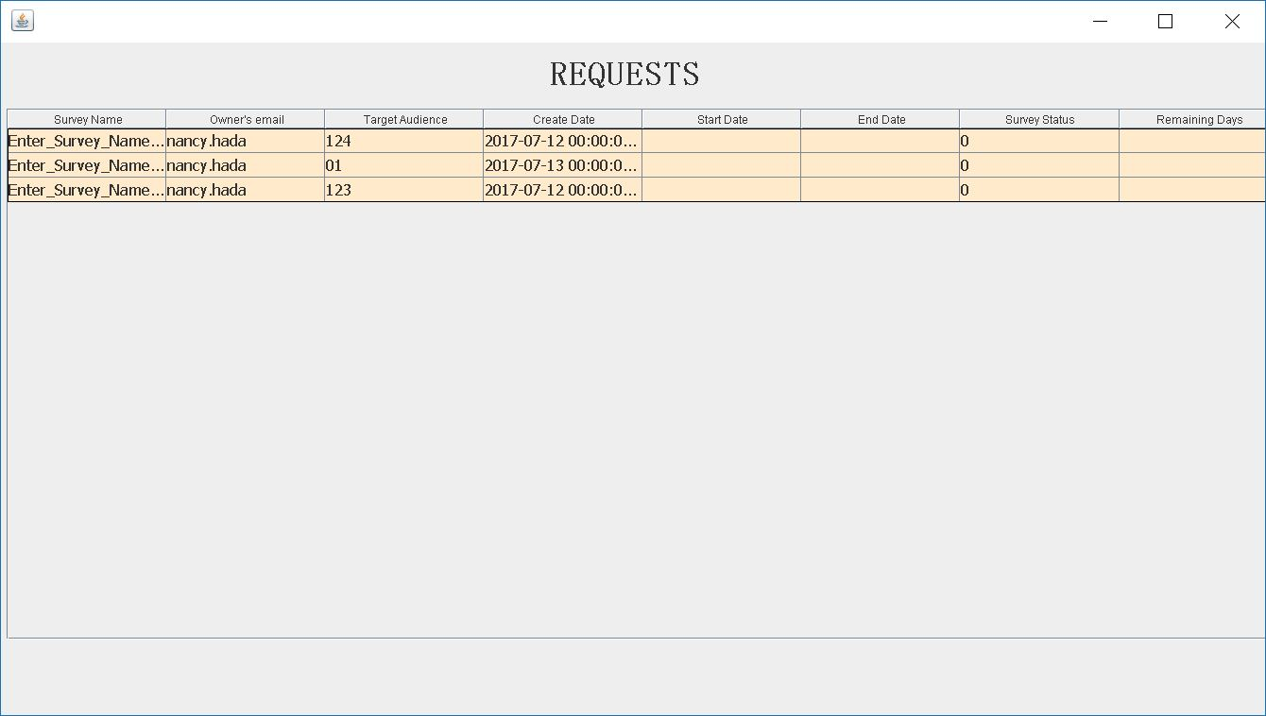
REQUESTS FRAME

Slide 18
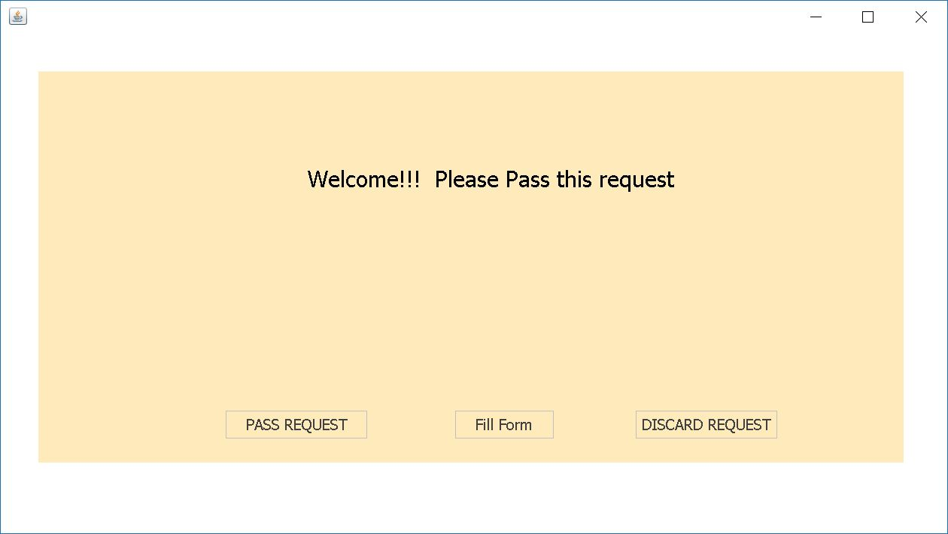
REQUEST OPTIONS FRAME

Slide 19
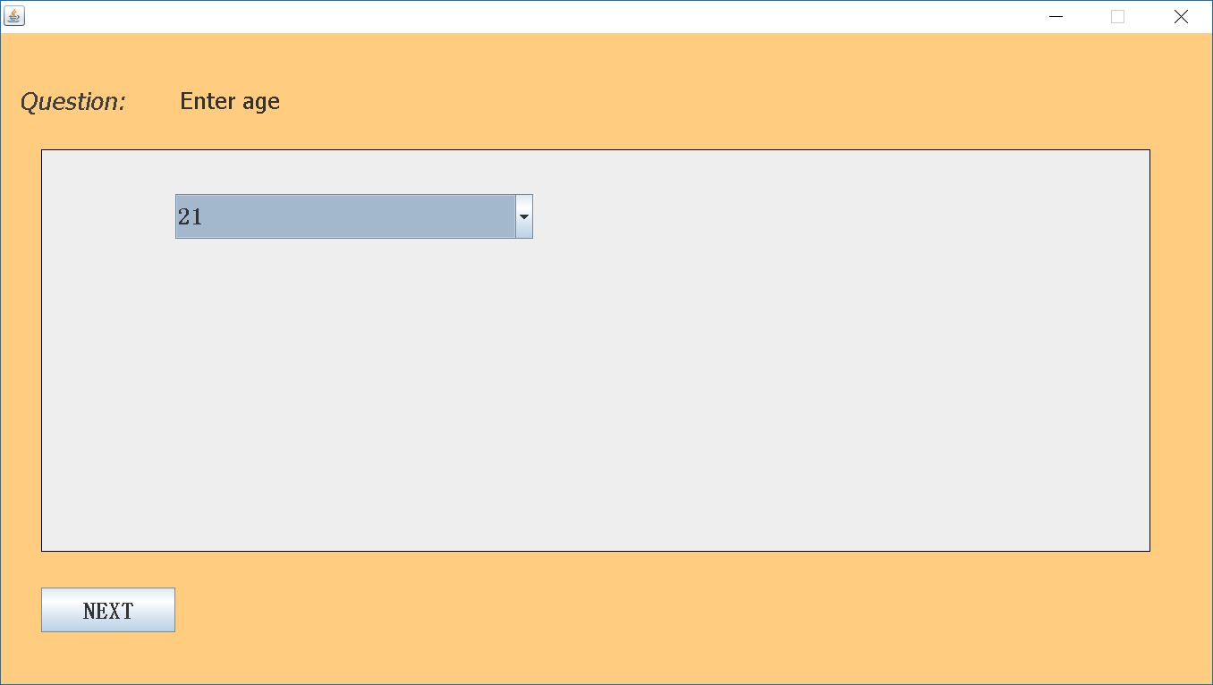
SURVEY VERIFICATION FRAME 1

Slide 20
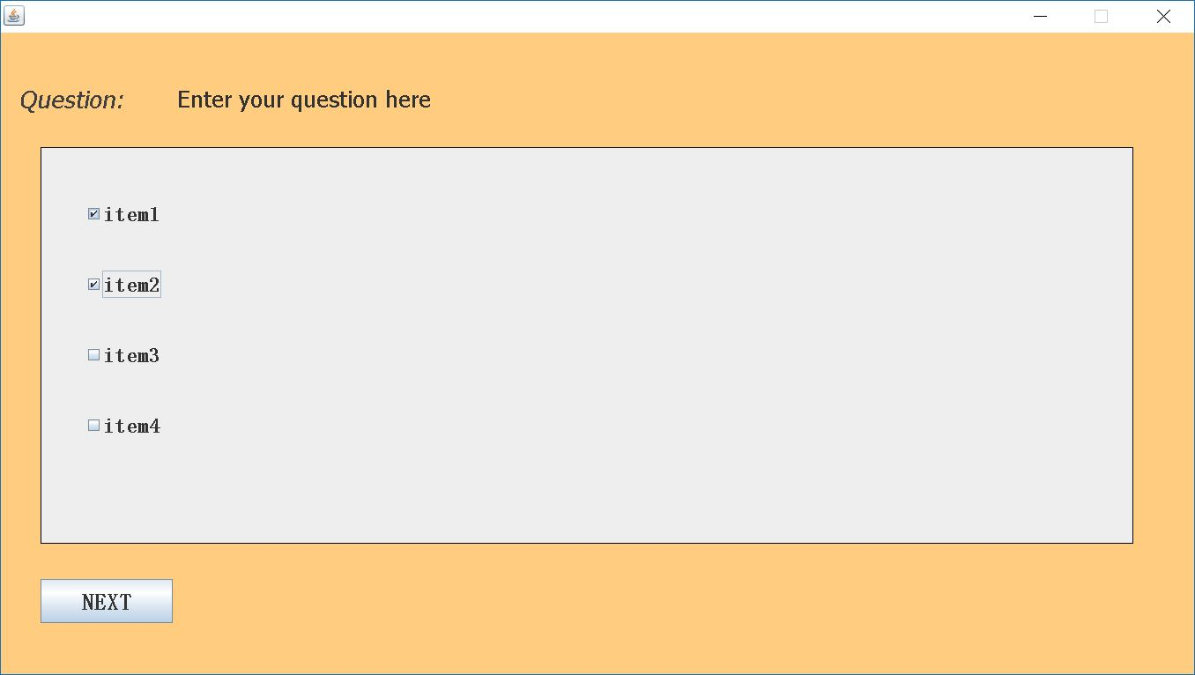
SURVEY VERIFICATION FRAME 2

Slide 21
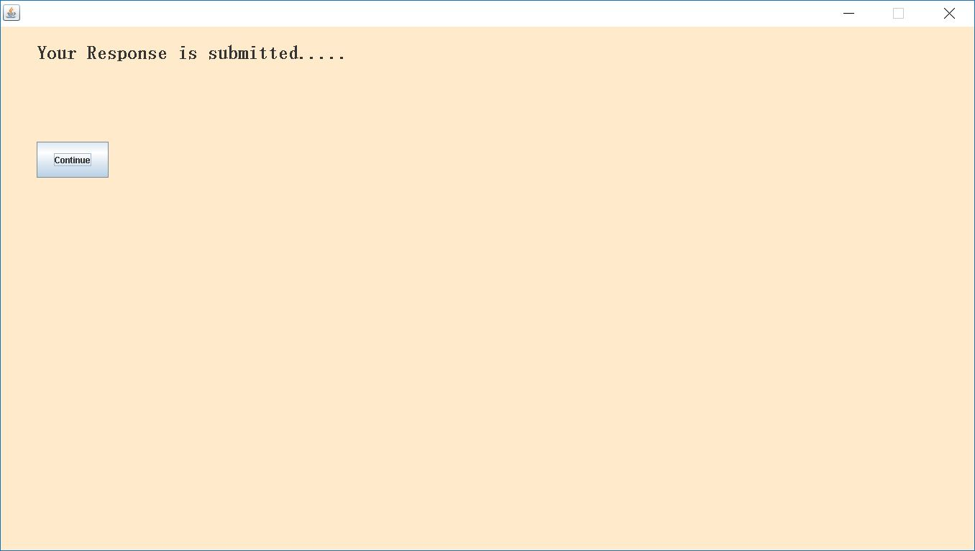
SURVEY VERIFICATION FRAME 3

Slide 22
User Views
When User logs in user will redirect to user home page where user will have different functionalities such as follows:-
1. Get information of the Surveys created by the User
2. Create a new Survey
3. Fill Surveys
4. Logout from the system

Slide 23
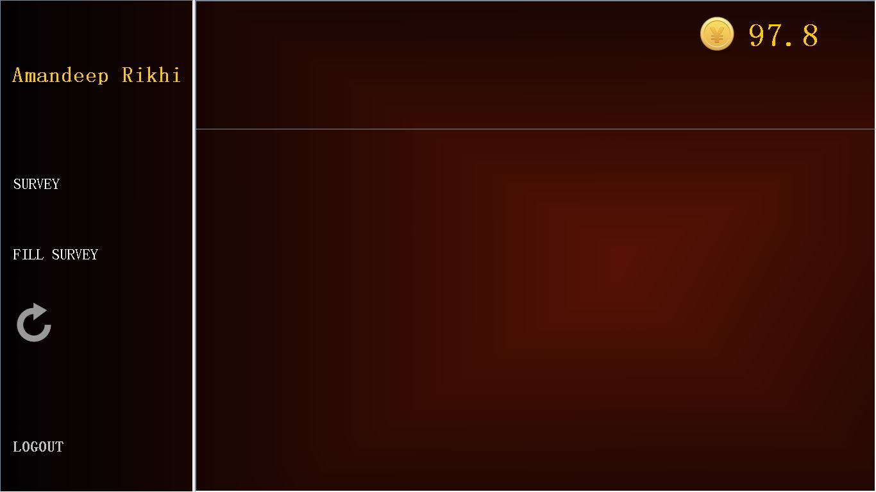
USER DASHBOARD FRAME

Slide 24
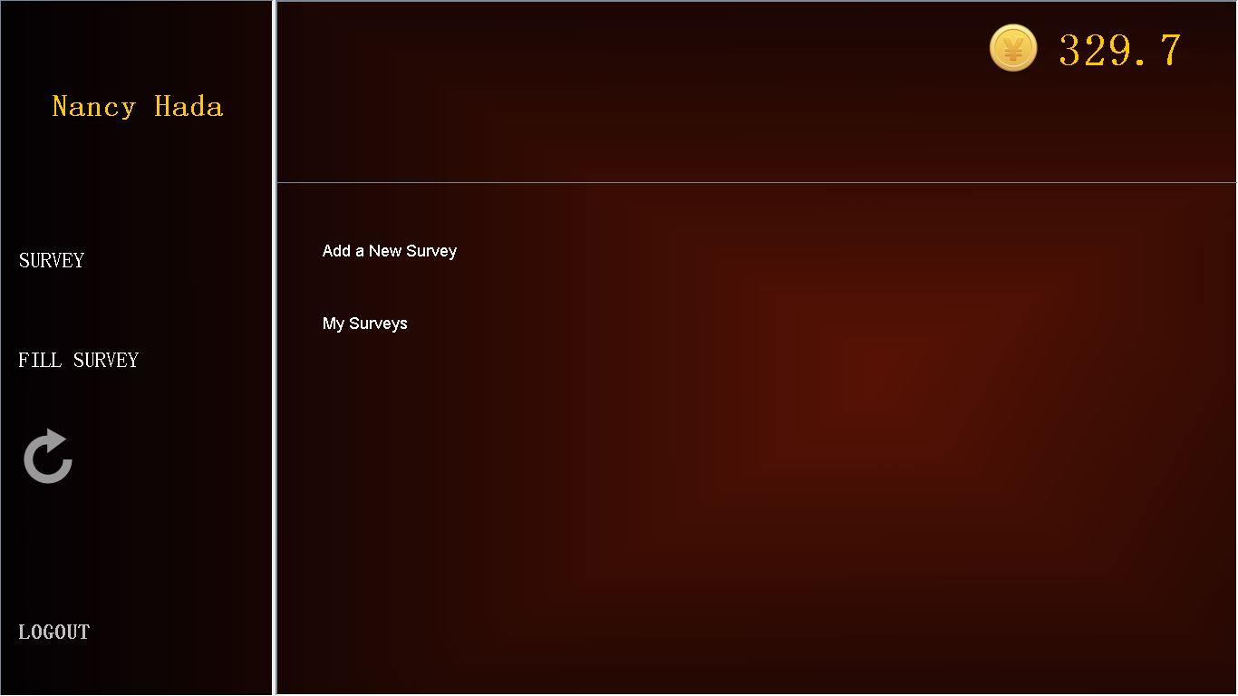
SURVEY FRAME

Slide 25
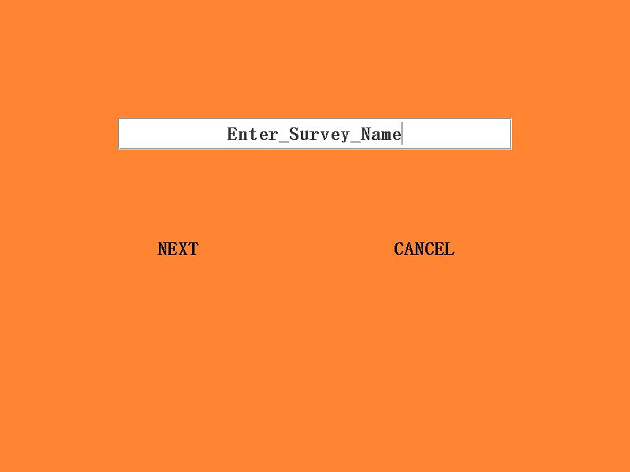
CREATE SURVEY FRAME 1

Slide 26
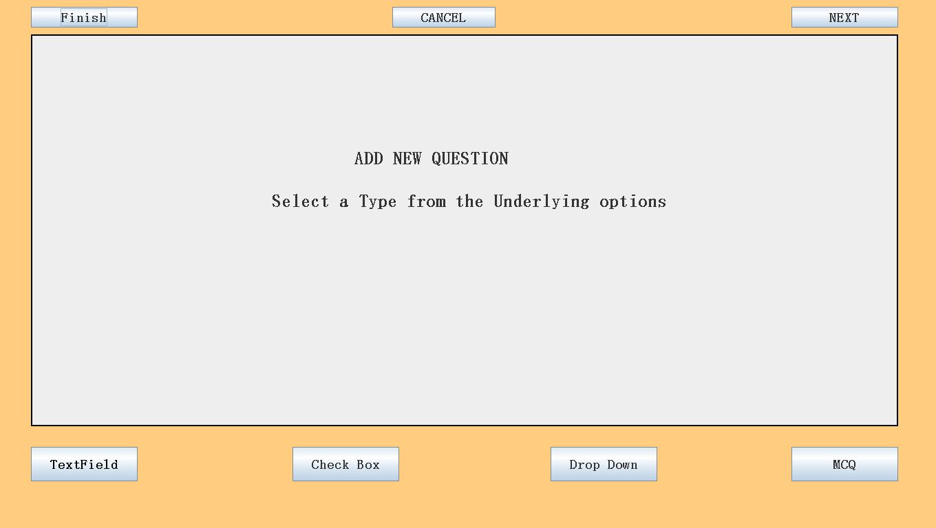
CREATE SURVEY FRAME 2

Slide 27
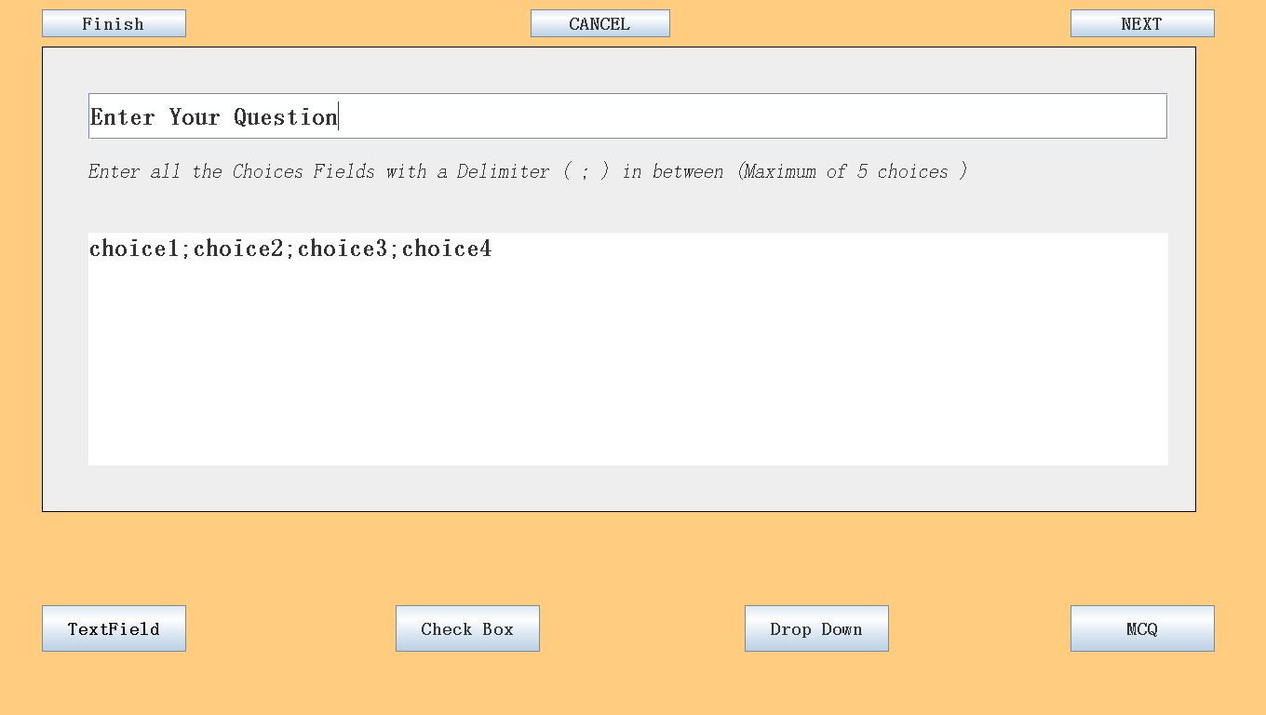
CREATE SURVEY FRAME 3

Slide 28
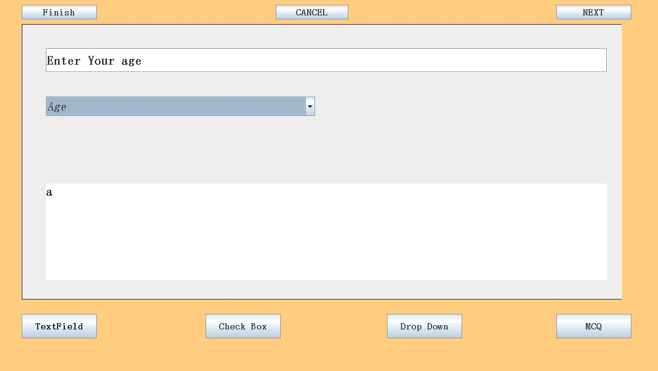
CREATE SURVEY FRAME 4

Slide 29
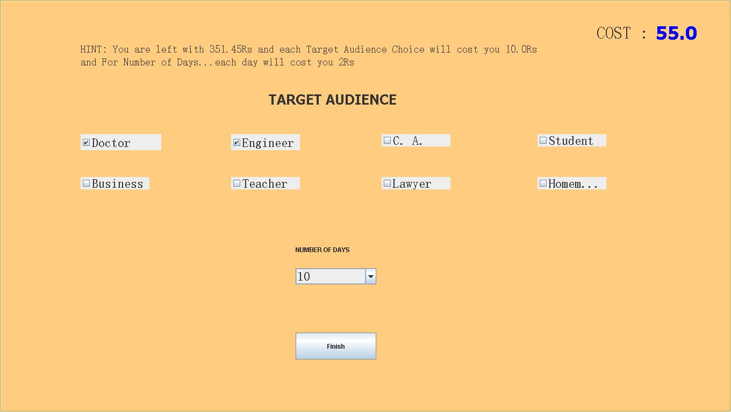
CREATE SURVEY FRAME 5

Slide 30
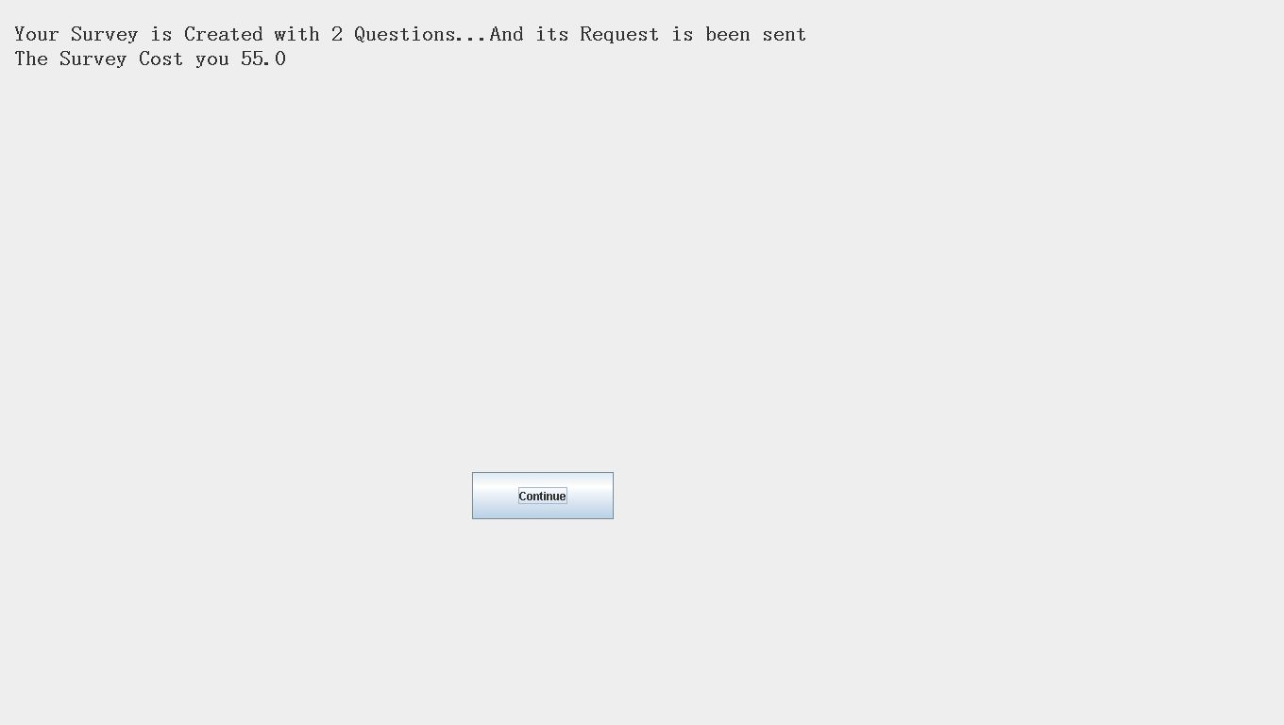
CREATE SURVEY FRAME 6

Slide 31
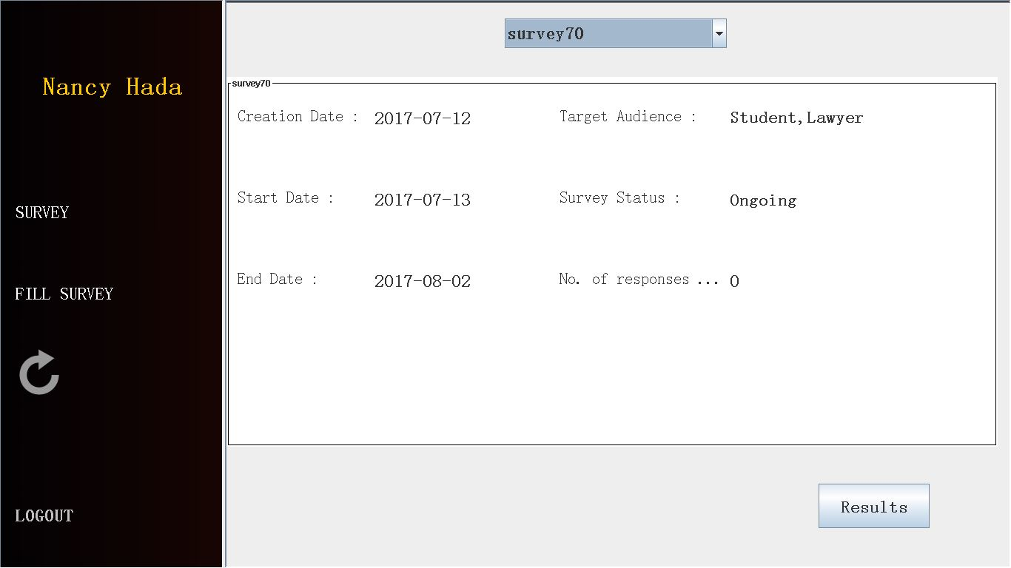
MY SURVEYS frame
In this user will able to see all the flights available from particular source and destination at a particular date . User have to enter source and destination and date and can book the ticket from available flights.
Step1: enter source ,destination & date and click on check , if flights are available at that date then below view will be displayed.

Slide 32
RESULTS FRAME

Slide 33
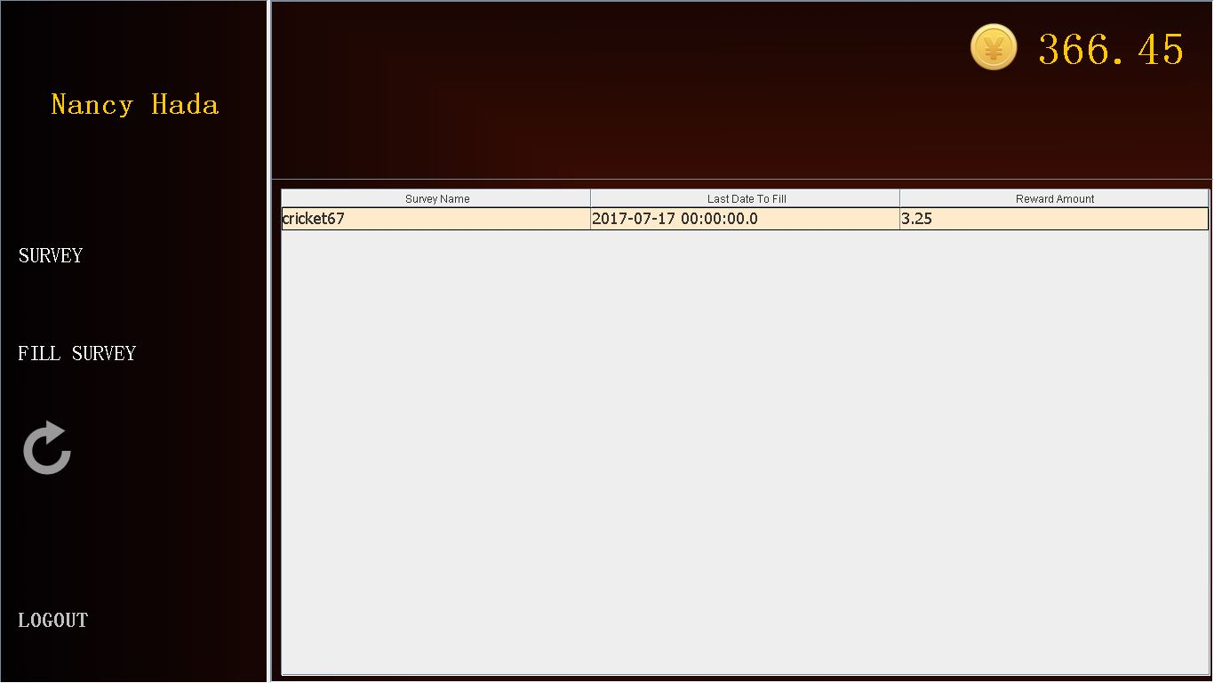
FILL SURVEY FRAME 1

Slide 34
FILL SURVEY FRAME 2

Slide 35
FILL SURVEY FRAME 3

Slide 36
FILL SURVEY FRAME 4

Slide 37
Limitations
1.Funds cannot be directly added to the User account i.e., we can only earn through filling surveys.
2.No support for image/graphic based surveys.

Slide 38
SUMMARY
We have done our best to understand the requirement of the customer and have put forward all the functionalities so as to develop and the design the expected software.
The project meets the customer requirements and is built in such a way that it can be updated as per the customer demands.
It has been developed using Core Java and Oracle Database.

Slide 39
Conclusion
From this TPL project we conclude that it was a lovely experience working with each other. We have gained concepts which we were unaware of.
We Team1 would like to thank our trainer “Mrs. Lata Verma” who is a substance of genius. Thanks for giving us a wonderful opportunity to work on this project, and for consistently guiding us under all circumstances as well as providing us the best knowledge which will be helpful in our future IT carrier.
THANK YOU
Amandeep Rikhi
Nancy Hada
Ritu Gaba
Shubham Gosain
Umang Gupta

Slide 40
THANK YOU !!!

Slide 41

Any Queries

