Slide 1
Kubernetes-DevOps-Assignment

Slide 2
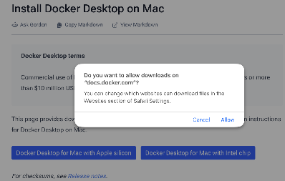
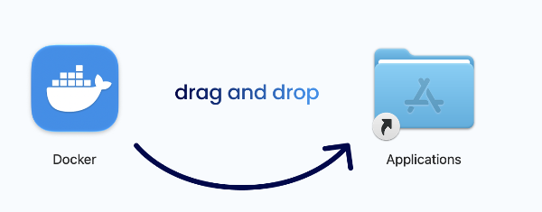
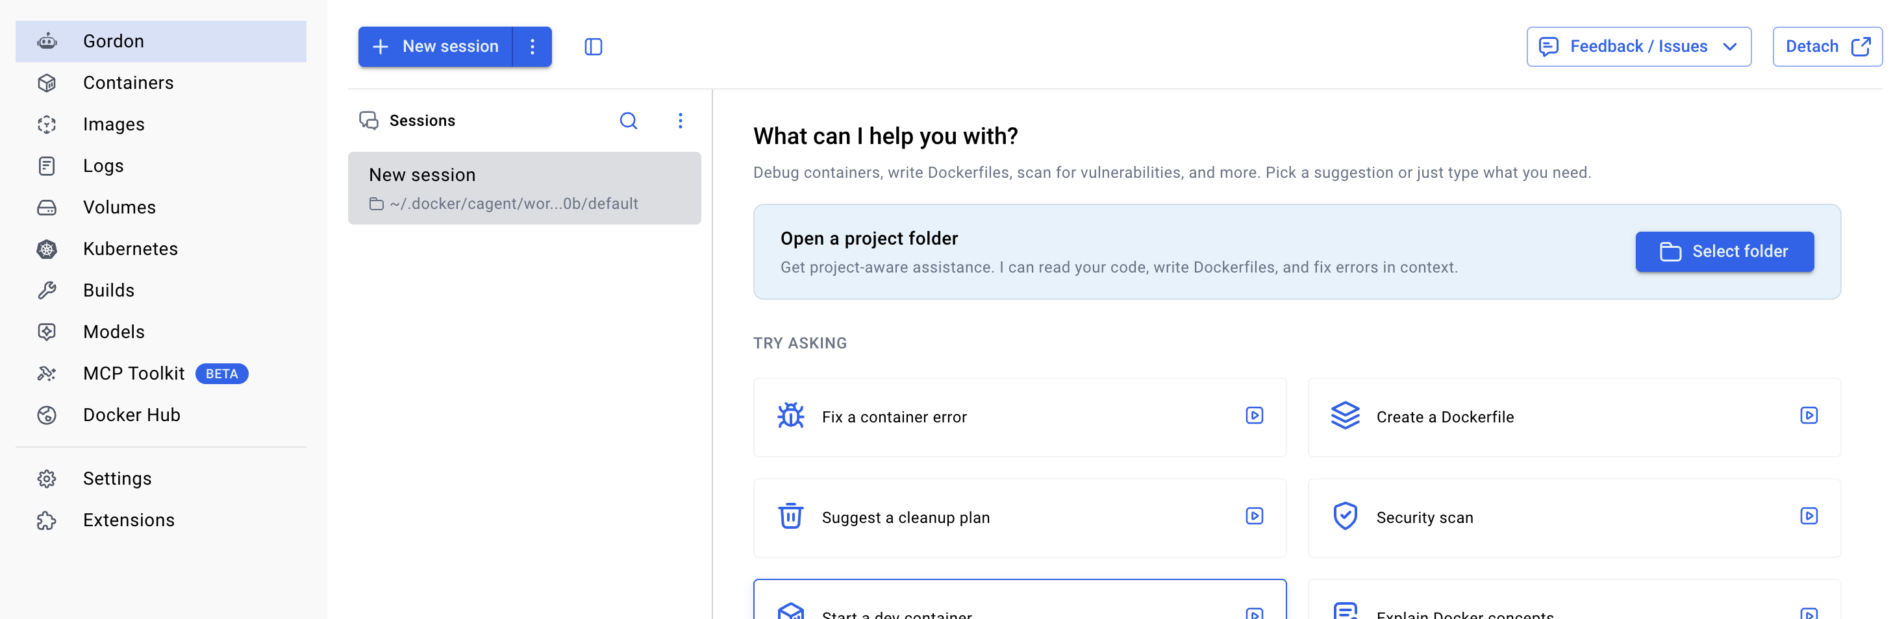
Phase 1: Install Docker Desktop and Kubernetes tools
1.1 - Install Docker Desktop
Open the official Docker Desktop for Mac installation page.
Download the version for Mac with Apple silicon (your M2 chip).
Docker Docs
Open the downloaded .dmg file.
Drag Docker into the Applications folder.
Open Applications → Docker and accept the terms.
Wait until Docker Desktop finishes starting.

Slide 3
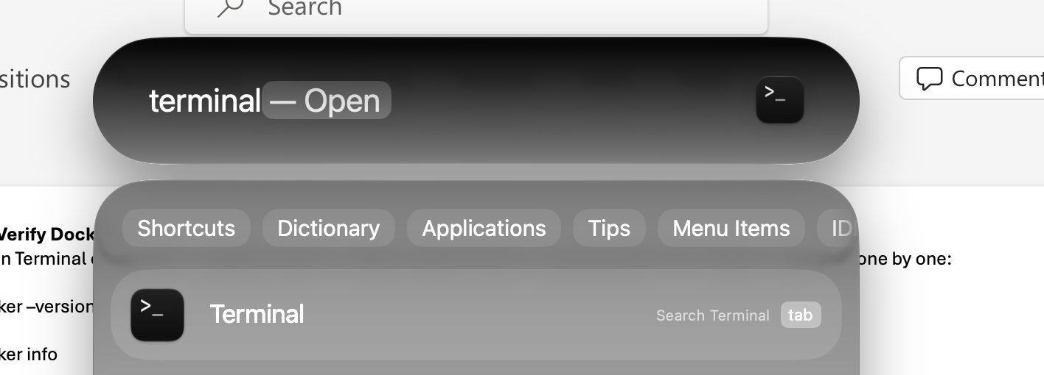
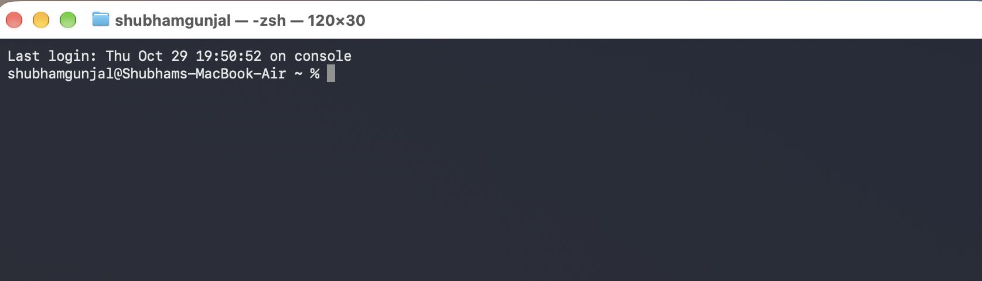
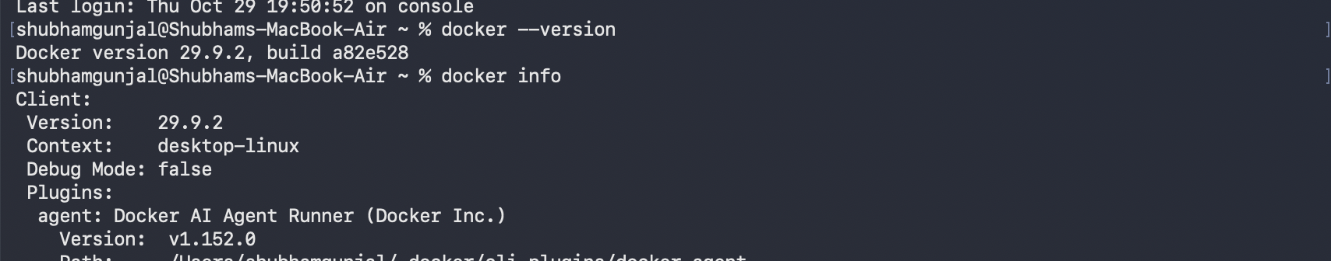
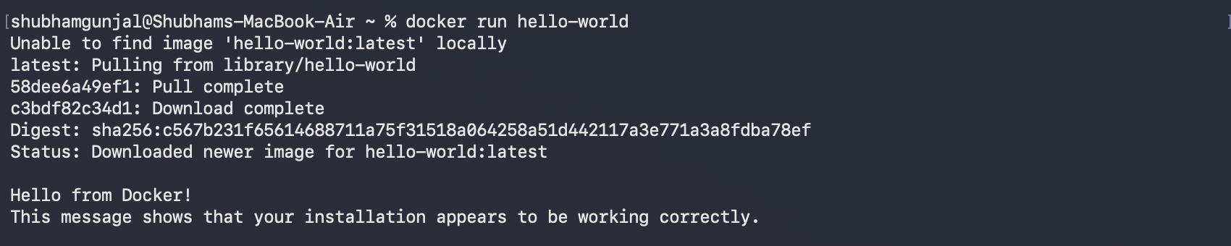
1.2 Verify Docker
Open Terminal on your Mac using Command + Space, type Terminal, and press Enter. Run these commands one by one:
docker –version
docker info
docker run hello-world --> Expected Output - Hello from Docker!

Slide 4
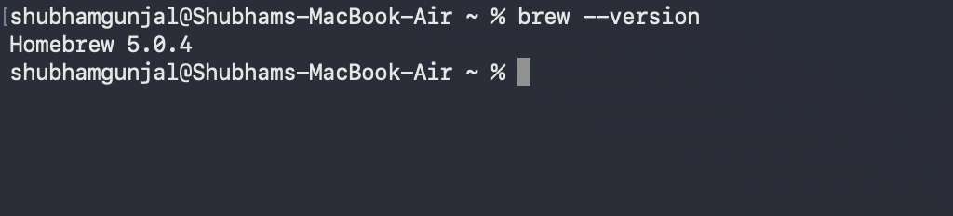
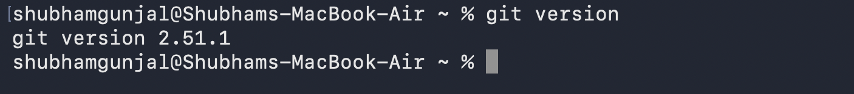
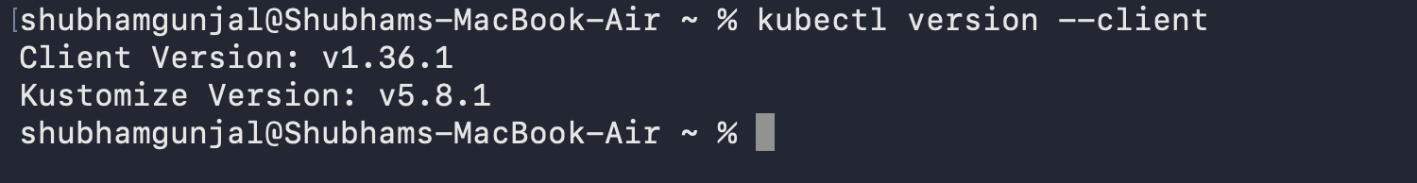
1.3 Install kubectl and Git
Check whether Homebrew is installed:
Install Homebrew first, if it is not installed
brew –version
Then use following commands to Install Kubectl and Git
git --version
brew install kubectl
kubectl version --client

Slide 5
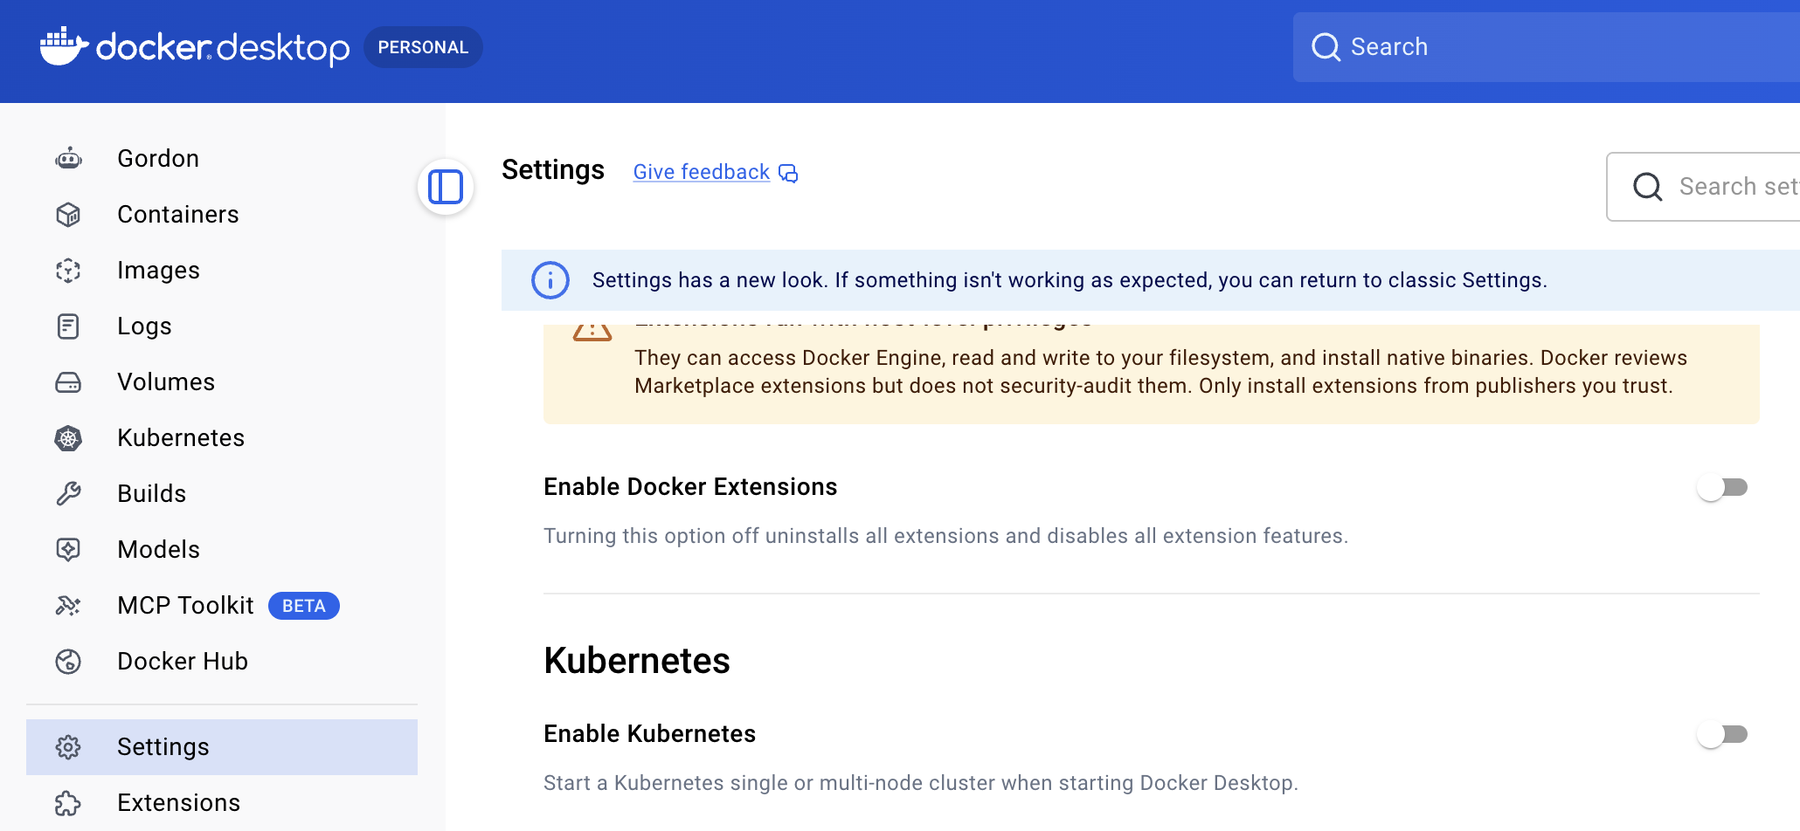
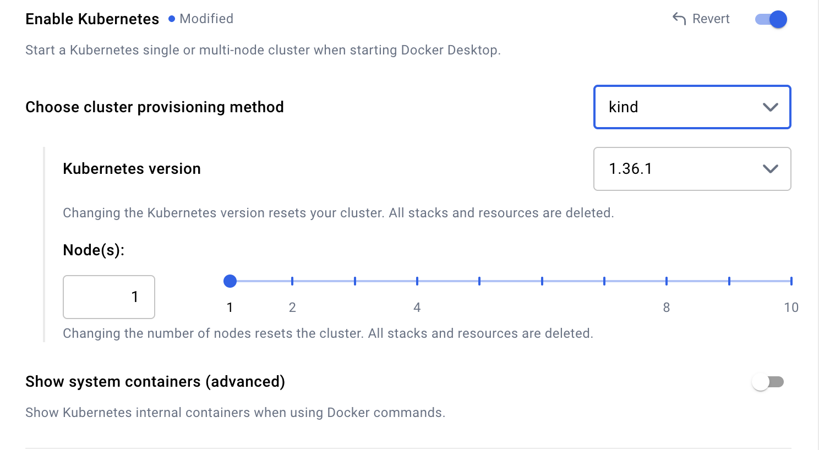
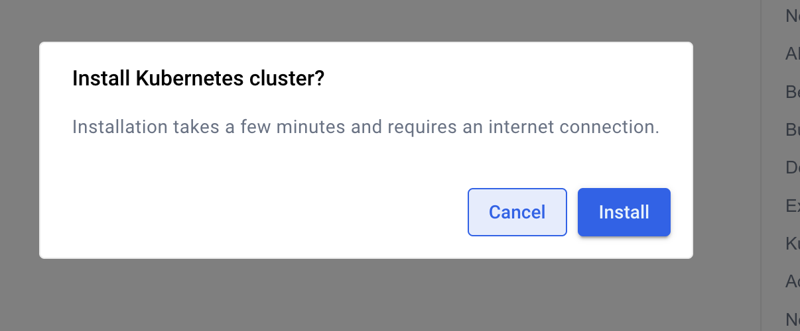
1.4 Enable Kubernetes in Docker Desktop
After Docker is running:
Open Docker Desktop.
Go to Settings → Kubernetes.
Enable Kubernetes using the option provided by your installed Docker Desktop version.
Apply the changes and wait until the cluster is ready.
Scroll down and click apply , click install and wait -->

Slide 6
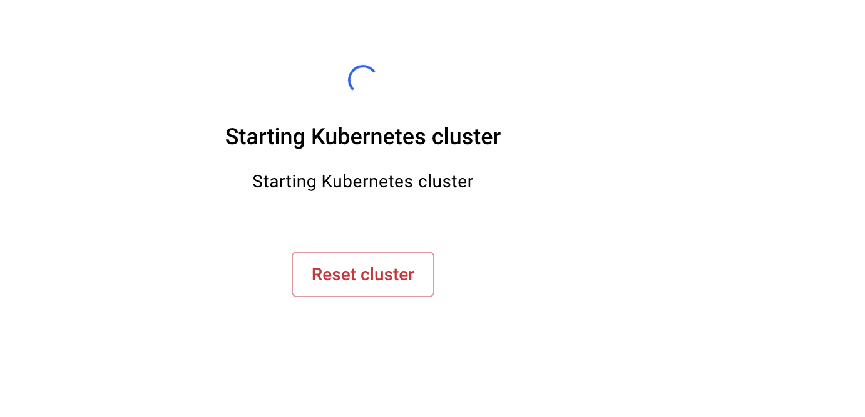
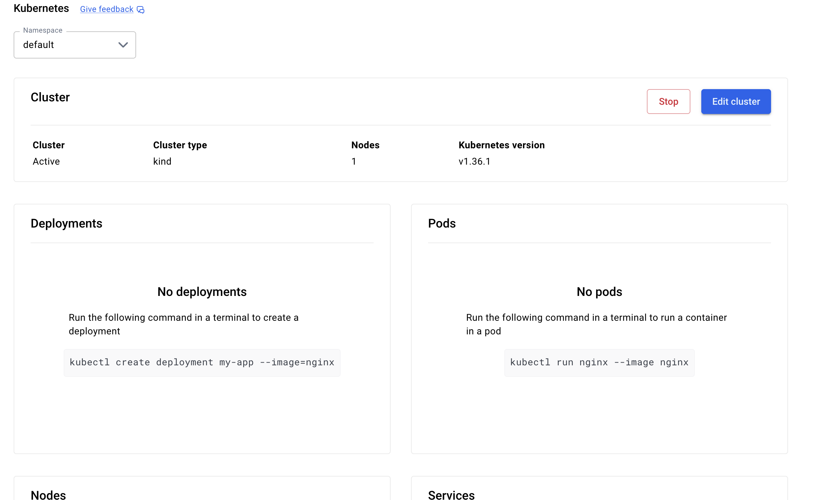
After it finished starting
So now our cluster is running

Slide 7
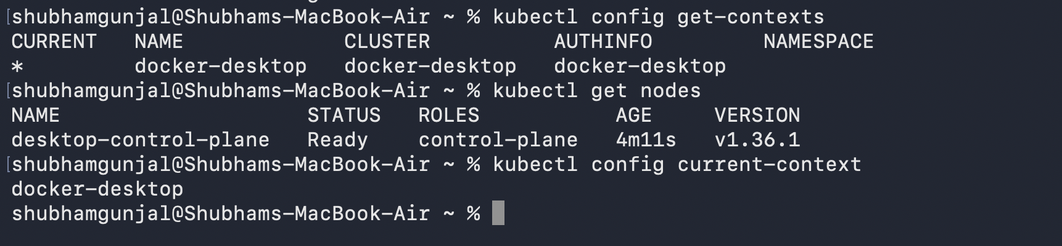
use following command to check nodes and setup
kubectl config current-context
kubectl get nodes
kubectl get pods -A

Slide 8
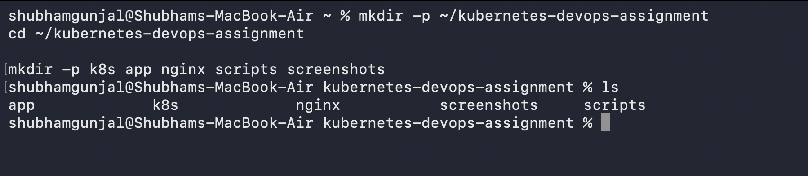
Phase 2: Create the project directory
mkdir -p ~/kubernetes-devops-assignment
cd ~/kubernetes-devops-assignment
mkdir -p k8s app nginx scripts screenshots
Label the Kubernetes node
Retrieve node name
kubectl get nodes
Now automatically capture the node name and add the database label:
NODE=$(kubectl get nodes -o jsonpath='{.items[0].metadata.name}')
kubectl label nodes "$NODE" workload=database –overwrite
Verify
kubectl get nodes --show-labels
Look for workload=database

Slide 9
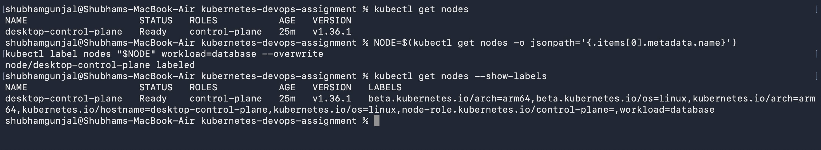
Why are we doing this now?
The database deployment will use this label to select its node. Because your cluster has one node, this
demonstrates the scheduling requirement without needing additional machines.

Slide 10
Phase 3: Create the Python API
We'll create a small, real application rather than deploying an unrelated demo container. This makes the assignment stronger because the API will actually connect to PostgreSQL
3.1: Create app/app.py
Run following cmnds
cd ~/kubernetes-devops-assignment
cat > app/app.py <<'EOF'
import os
import time
import psycopg2
from flask import Flask, jsonify, request
from psycopg2.extras import RealDictCursor
app = Flask(__name__)
DB_HOST = os.getenv("DB_HOST", "postgres")
DB_NAME = os.getenv("DB_NAME", "notesdb")
DB_USER = os.getenv("DB_USER", "appuser")
DB_PASSWORD = os.getenv("DB_PASSWORD", "change-me")
def get_connection():
return psycopg2.connect(
host=DB_HOST,
dbname=DB_NAME,
user=DB_USER,
password=DB_PASSWORD,
connect_timeout=3,
)
)
""")

Slide 11
def initialize_table():
with get_connection() as conn:
with conn.cursor() as cur:
cur.execute("""
CREATE TABLE IF NOT EXISTS notes (
id SERIAL PRIMARY KEY,
content TEXT NOT NULL,
created_at TIMESTAMP DEFAULT CURRENT_TIMESTAMP
@app.get("/health")
def health():
try:
initialize_table()
return jsonify(status="ok", database="connected")
except Exception:
app.logger.exception("Database health check failed")
return jsonify(status="error", database="unavailable"), 503
@app.get("/notes")
def list_notes():
try:
initialize_table()
with get_connection() as conn:
with conn.cursor(cursor_factory=RealDictCursor) as cur:
cur.execute(
"SELECT id, content, created_at FROM notes ORDER BY id"
)
rows = cur.fetchall()
return jsonify(rows)
except Exception:
app.logger.exception("Unable to read notes")
return jsonify(error="Database unavailable"), 503
@app.post("/notes")
def create_note():
body = request.get_json(silent=True) or {}
content = body.get("content")
if not isinstance(content, str) or not content.strip():​
return jsonify(error="Provide a non-empty content field"), 400​
​
try:​
initialize_table()​
with get_connection() as conn:​
with conn.cursor(cursor_factory=RealDictCursor) as cur:​
cur.execute(​
"INSERT INTO notes (content) VALUES (%s) "​
"RETURNING id, content, created_at",​
(content.strip(),),​
)​
row = cur.fetchone()​
return jsonify(row), 201​
except Exception:​
app.logger.exception("Unable to create note")​
return jsonify(error="Database unavailable"), 503​
​
​
if __name__ == "__main__":​
app.run(host="0.0.0.0", port=5000)​
EOF​
​

Slide 12
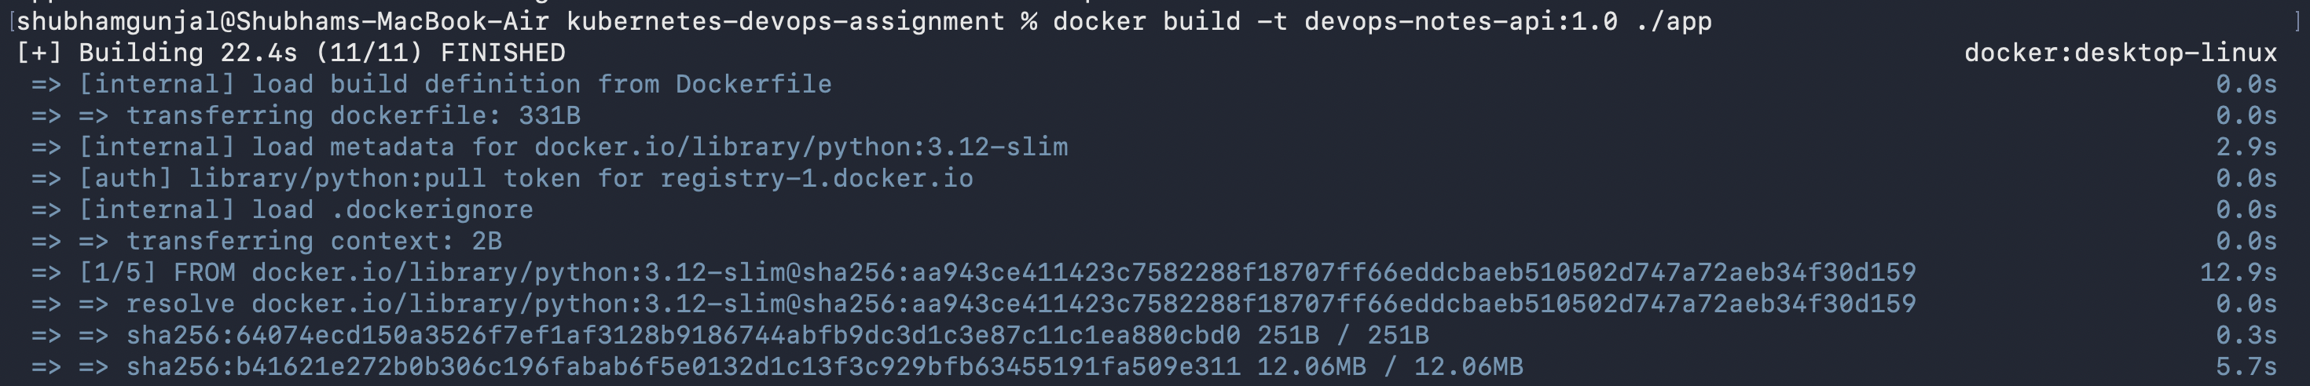
3.2 Create app/requirements.txt
cat > app/requirements.txt <<'EOF'
Flask>=3.1,<4
psycopg2-binary>=2.9,<3
gunicorn>=23,<24
EOF
3.3: Create app/Dockerfile
cat > app/Dockerfile <<'EOF'
FROM python:3.12-slim
ENV PYTHONDONTWRITEBYTECODE=1
ENV PYTHONUNBUFFERED=1
WORKDIR /app
COPY requirements.txt .
RUN pip install --no-cache-dir -r requirements.txt
COPY app.py .
EXPOSE 5000
CMD ["gunicorn", "--bind", "0.0.0.0:5000", "--workers", "2", "--access-logfile", "-", "app:app"]
EOF
3.4 Build the application image
Make sure Docker Desktop is running.
docker build -t devops-notes-api:1.0 ./app

Slide 13
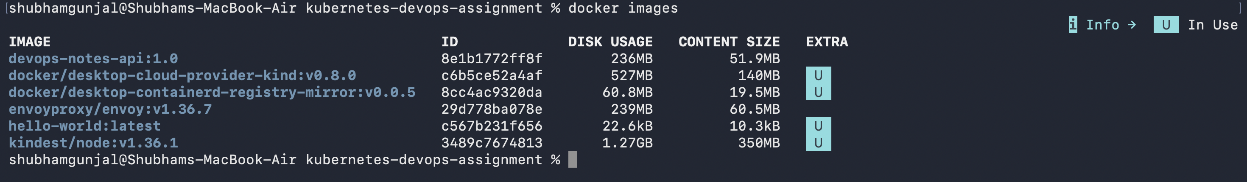
Check , images is created or not, using docker images, You should see devops-notes-api with tag 1.0
Phase 4: Create the Kubernetes namespace
A namespace keeps all assignment resources grouped together
cat > k8s/namespace.yaml <<'EOF'
apiVersion: v1
kind: Namespace
metadata:
name: devops-assignment
EOF

Slide 14
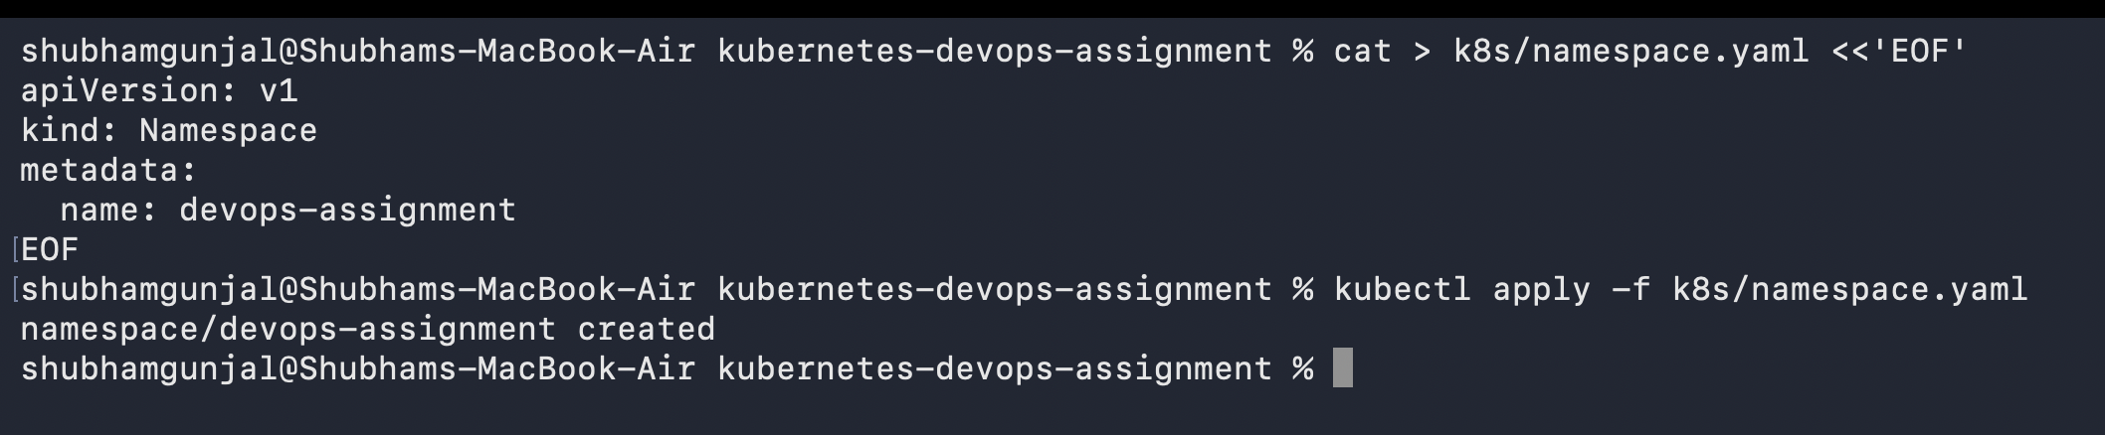
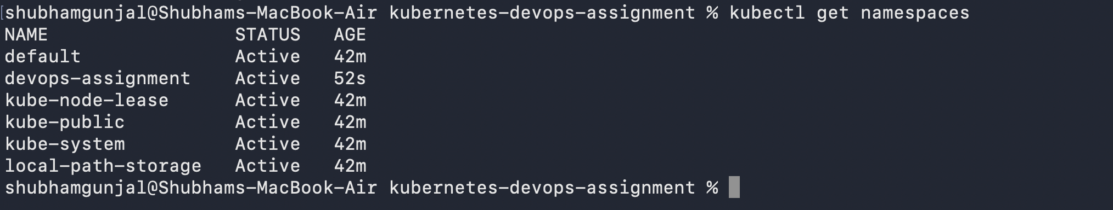
Apply it using kubectl apply -f k8s/namespace.yaml
Verify it

Slide 15
Phase 5: Configure persistent storage
This is the main part of Task 2
We'll explicitly create a StorageClass and a hostPath-backed PersistentVolume for your single-node development cluster. The directory is stored inside the Kubernetes node's filesystem, not directly on Mac.
It survives PostgreSQL Pod recreation, but it is not a substitute for production-grade storage or backups
5.1: Create k8s/storage.yaml
cat > k8s/storage.yaml <<'EOF'
apiVersion: storage.k8s.io/v1
kind: StorageClass
metadata:
name: postgres-local
provisioner: kubernetes.io/no-provisioner
volumeBindingMode: Immediate
reclaimPolicy: Retain
---
apiVersion: v1
kind: PersistentVolume
metadata:
name: postgres-pv
spec:
capacity:
storage: 1Gi
volumeMode: Filesystem
accessModes:
- ReadWriteOnce
persistentVolumeReclaimPolicy: Retain
storageClassName: postgres-local
hostPath:
path: /mnt/data/postgres
type: DirectoryOrCreate
---
apiVersion: v1
kind: PersistentVolumeClaim
metadata:
name: postgres-pvc
namespace: devops-assignment
spec:
accessModes:
- ReadWriteOnce
storageClassName: postgres-local
resources:
requests:
storage: 1Gi
EOF
StorageClass: defines the storage type and provisioning behavior.
PersistentVolume (PV): represents the 1 GiB storage resource.
PersistentVolumeClaim (PVC): requests storage for PostgreSQL.
The DirectoryOrCreate option allows Kubernetes to create the directory in the node if it doesn't exist.

Slide 16
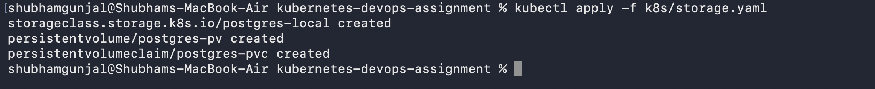
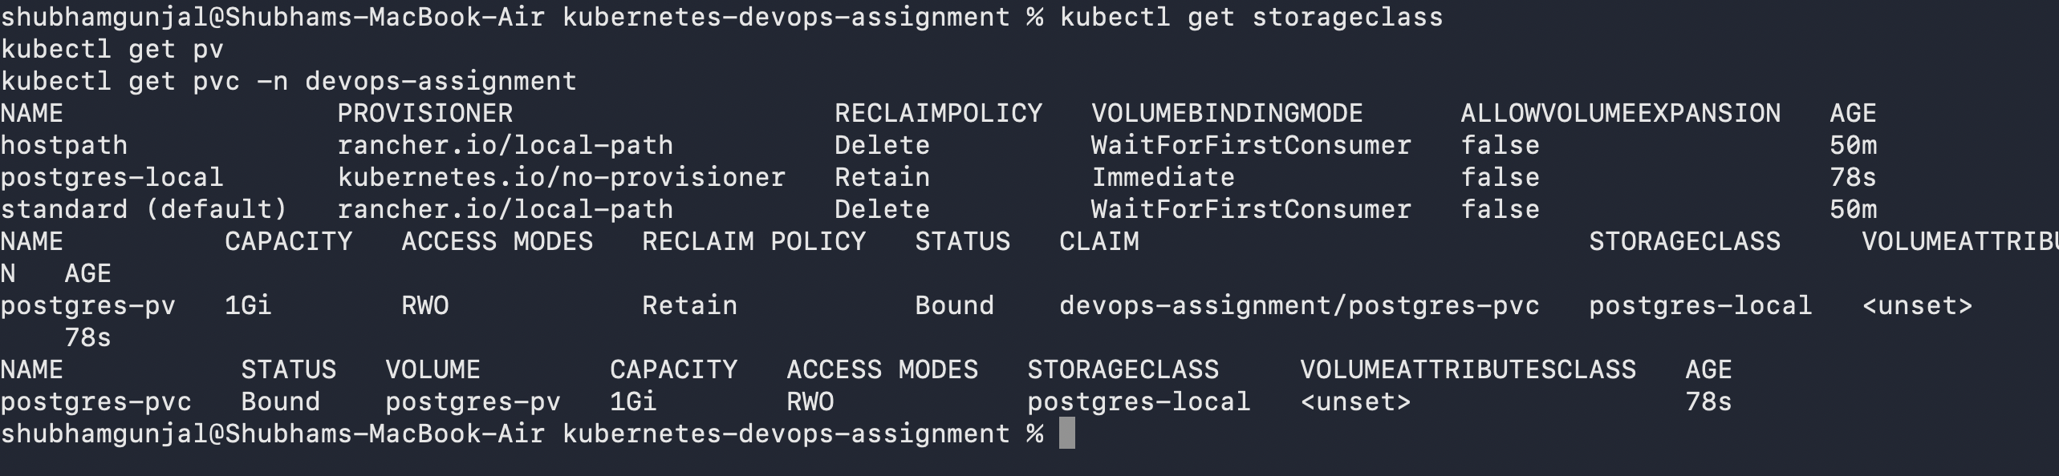
Apply manifest --> kubectl apply -f k8s/storage.yaml
Verify the PV and PVC:
kubectl get storageclass
kubectl get pv
kubectl get pvc -n devops-assignment

Slide 17
Phase 6: Deploy PostgreSQL
This completes the database deployment part and uses the storage created in Phase 5
6.1 Create k8s/postgres.yaml
cat > k8s/postgres.yaml <<'EOF'
apiVersion: v1
kind: Secret
metadata:
name: postgres-secret
namespace: devops-assignment
type: Opaque
stringData:
POSTGRES_DB: notesdb
POSTGRES_USER: appuser
POSTGRES_PASSWORD: local-dev-password-change-me
---
apiVersion: apps/v1
kind: Deployment
metadata:
name: postgres
namespace: devops-assignment
spec:
replicas: 1
selector:
matchLabels:
app: postgres
strategy:
type: Recreate
template:
metadata:
labels:
app: postgres
spec:
nodeSelector:
workload: database
containers:
- name: postgres
image: postgres:16
imagePullPolicy: IfNotPresent
ports:
- containerPort: 5432
env:
- name: POSTGRES_DB
valueFrom:
secretKeyRef:
name: postgres-secret
key: POSTGRES_DB
- name: POSTGRES_USER
valueFrom:
secretKeyRef:
name: postgres-secret
key: POSTGRES_USER
- name: POSTGRES_PASSWORD
valueFrom:
secretKeyRef:
name: postgres-secret
key: POSTGRES_PASSWORD
- name: PGDATA
value: /var/lib/postgresql/data/pgdata
volumeMounts:
- name: postgres-data
mountPath: /var/lib/postgresql/data
readinessProbe:
exec:
command:
- sh
- -c
- pg_isready -U "$POSTGRES_USER" -d "$POSTGRES_DB"
initialDelaySeconds: 10
periodSeconds: 5
livenessProbe:
exec:
command:
- sh
- -c
- pg_isready -U "$POSTGRES_USER" -d "$POSTGRES_DB"
initialDelaySeconds: 30
periodSeconds: 10
volumes:
- name: postgres-data
persistentVolumeClaim:
claimName: postgres-pvc
---
apiVersion: v1
kind: Service
metadata:
name: postgres
namespace: devops-assignment
spec:
type: ClusterIP
selector:
app: postgres
ports:
- name: postgres
port: 5432
targetPort: 5432
EOF

Slide 18
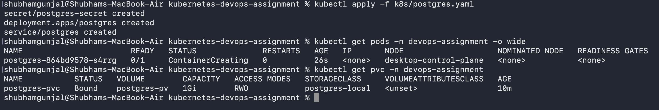
6.2: Deploy the database
kubectl apply -f k8s/postgres.yaml
Wait until the PostgreSQL Pod shows Running and 1/1 ready.

Slide 19
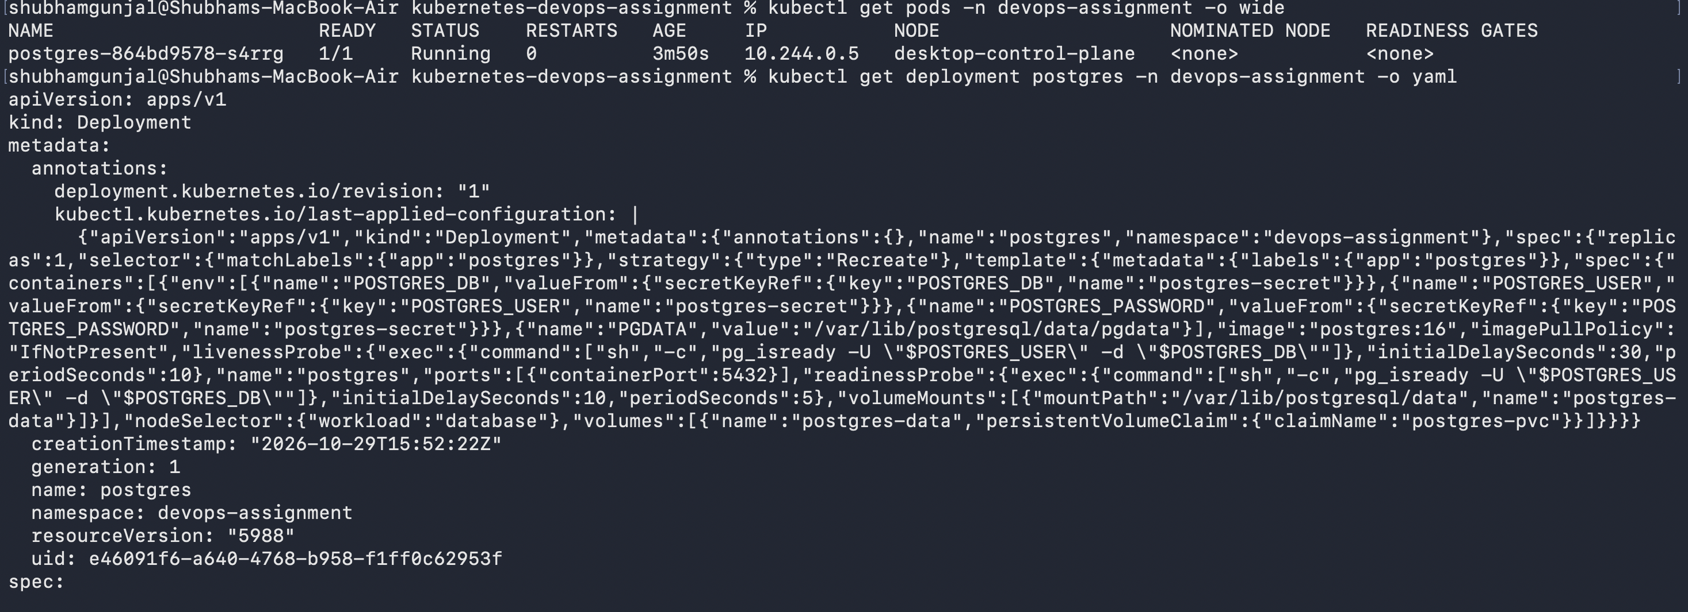
kubectl get pods -n devops-assignment -o wide
Check that the PostgreSQL Pod is running on your labelled node.
kubectl get pods -n devops-assignment -o wide
Inspect its scheduling configuration:
kubectl get deployment postgres -n devops-assignment -o yaml

Slide 20
Phase 7: Deploy the application and web backend
We'll create two internal Services:
api-service on port 5000, backed by your Python API.
web-service on port 5678, backed by a lightweight HTTP echo container.
Both will be accessible through NGINX, while PostgreSQL remains internal.
7.1 Create k8s/app.yaml
cat > k8s/app.yaml <<'EOF'
apiVersion: apps/v1
kind: Deployment
metadata:
name: notes-api
namespace: devops-assignment
spec:
replicas: 1
selector:
matchLabels:
app: notes-api
template:
metadata:
labels:
app: notes-api
spec:
containers:
- name: notes-api
image: devops-notes-api:1.0
imagePullPolicy: IfNotPresent
ports:
- containerPort: 5000
env:
template:
metadata:
labels:
app: web-backend
spec:
containers:
- name: web-backend
image: hashicorp/http-echo:1.0.0
args:
- "-listen=:5678"
- "-text=Web backend is working"
ports:
- containerPort: 5678
---
apiVersion: v1
kind: Service
metadata:
name: web-service
namespace: devops-assignment
spec:
type: ClusterIP
selector:
app: web-backend
ports:
- port: 5678
targetPort: 5678
EOF
- name: DB_HOST
value: postgres
- name: DB_NAME
valueFrom:
secretKeyRef:
name: postgres-secret
key: POSTGRES_DB
- name: DB_USER
valueFrom:
secretKeyRef:
name: postgres-secret
key: POSTGRES_USER
- name: DB_PASSWORD
valueFrom:
secretKeyRef:
name: postgres-secret
key: POSTGRES_PASSWORD
readinessProbe:
httpGet:
path: /health
port: 5000
initialDelaySeconds: 5
periodSeconds: 5
livenessProbe:
tcpSocket:
port: 5000
initialDelaySeconds: 20
periodSeconds: 10
---
apiVersion: v1
kind: Service
metadata:
name: api-service
namespace: devops-assignment
spec:
type: ClusterIP
selector:
app: notes-api
ports:
- port: 5000
targetPort: 5000
---
apiVersion: apps/v1
kind: Deployment
metadata:
name: web-backend
namespace: devops-assignment
spec:
replicas: 1
selector:
matchLabels:
app: web-backend

Slide 21
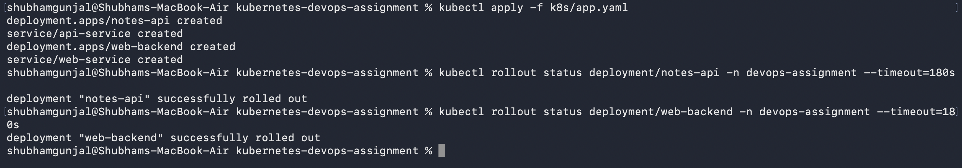
7.2 Apply the application manifest
kubectl apply -f k8s/app.yaml
Wait for the deployments
kubectl rollout status deployment/notes-api -n devops-assignment --timeout=180s
kubectl rollout status deployment/web-backend -n devops-assignment --timeout=180s

Slide 22
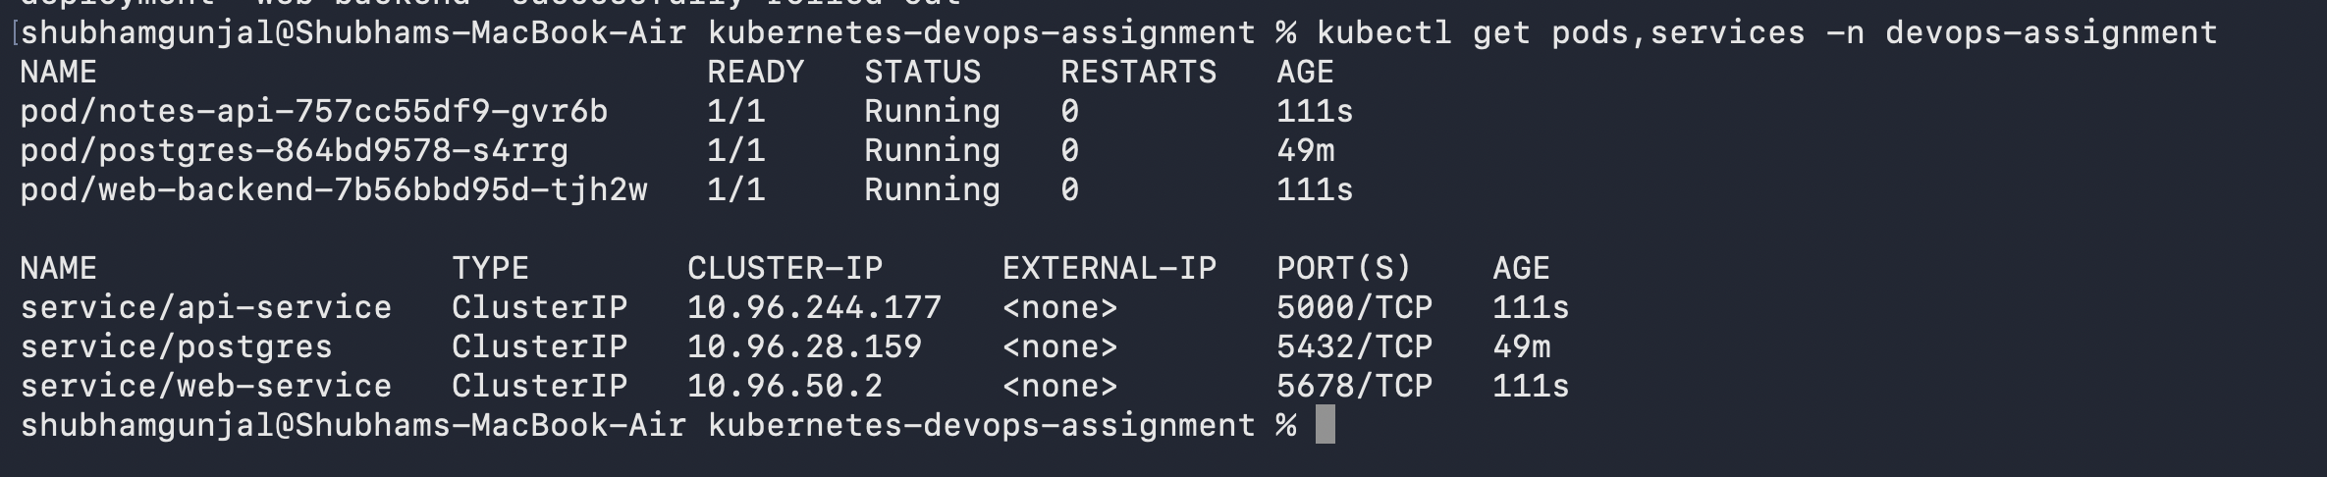
Check the Pods and Services:
The image devops-notes-api:1.0 must be available to the Kubernetes cluster. If Docker Desktop's cluster cannot see the image you built, we'll correct the image-loading configuration rather than rebuilding the application from scratch

Slide 23
Phase 8: Configure NGINX as a reverse proxy
NGINX will accept HTTP requests and route them according to the URL path:
Incoming path | Destination
/ | NGINX welcome response
/api/health | Flask API /health
/api/notes | Flask API /notes
/web/ | Web backend Service
8.1 Create nginx/nginx.conf
cat > nginx/nginx.conf <<'EOF'
server {
listen 80;
server_name _;
location = / {
default_type text/plain;
return 200 "Kubernetes DevOps Assignment - NGINX is working\n";
}
location /api/ {
proxy_pass http://api-service:5000/;
proxy_set_header Host $host;
proxy_set_header X-Real-IP $remote_addr;
proxy_set_header X-Forwarded-For $proxy_add_x_forwarded_for;
}
location /web/ {
proxy_pass http://web-service:5678/;
proxy_set_header Host $host;
proxy_set_header X-Real-IP $remote_addr;
}
}
EOF
slash in each proxy_pass URL. It makes NGINX remove the matching path prefix before sending the request to the backend

Slide 24
8.2: Create k8s/nginx.yaml
cat > k8s/nginx.yaml <<'EOF'
apiVersion: v1
kind: ConfigMap
metadata:
name: nginx-config
namespace: devops-assignment
data:
default.conf: |
server {
listen 80;
server_name _;
location = / {
default_type text/plain;
return 200 "Kubernetes DevOps Assignment - NGINX is working\n";
}
location /api/ {
proxy_pass http://api-service:5000/;
proxy_set_header Host $host;
proxy_set_header X-Real-IP $remote_addr;
proxy_set_header X-Forwarded-For $proxy_add_x_forwarded_for;
}
location /web/ {
proxy_pass http://web-service:5678/;
proxy_set_header Host $host;
proxy_set_header X-Real-IP $remote_addr;
}
}
---
apiVersion: apps/v1
kind: Deployment
metadata:
name: nginx-proxy
namespace: devops-assignment
spec:
replicas: 1
selector:
matchLabels:
app: nginx-proxy
template:
metadata:
labels:
app: nginx-proxy
spec:
containers:
- name: nginx
image: nginx:1.28-alpine
ports:
- containerPort: 80
volumeMounts:
- name: nginx-config
mountPath: /etc/nginx/conf.d/default.conf
subPath: default.conf
volumes:
- name: nginx-config
configMap:
name: nginx-config
---
apiVersion: v1
kind: Service
metadata:
name: nginx-proxy
namespace: devops-assignment
spec:
type: ClusterIP
selector:
app: nginx-proxy
ports:
- port: 80
targetPort: 80
EOF

Slide 25
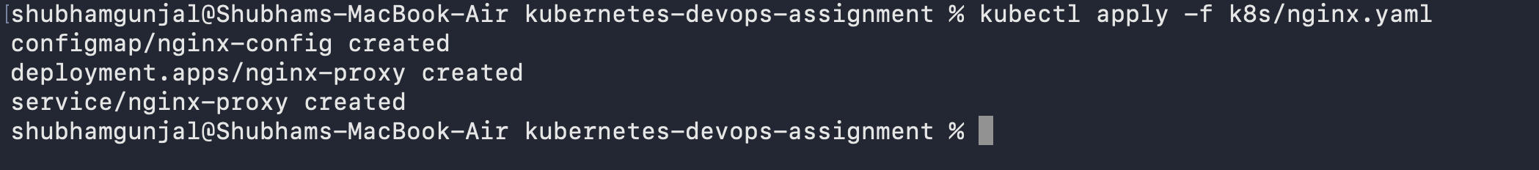
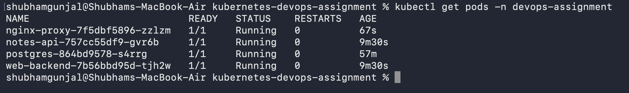
kubectl apply -f k8s/nginx.yaml
kubectl rollout status deployment/nginx-proxy -n devops-assignment --timeout=180s
kubectl get pods -n devops-assignment
You should have PostgreSQL, the API, the web backend and NGINX running

Slide 26
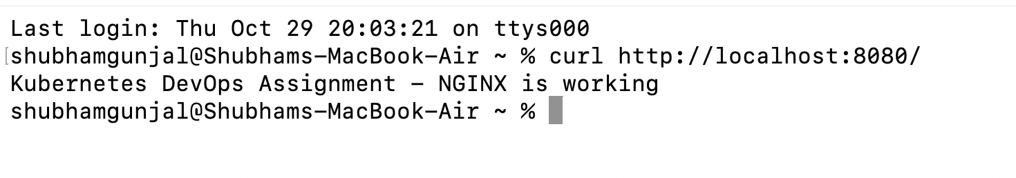
Phase 9: Test the complete project
Now we need evidence that the four tasks work, not just that the YAML files exist.
9.1: Start port forwarding
kubectl port-forward svc/nginx-proxy 8080:80 -n devops-assignment
9.2: Test NGINX
curl http://localhost:8080/

Slide 27
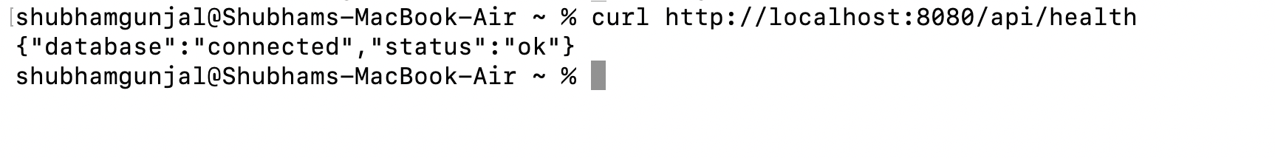
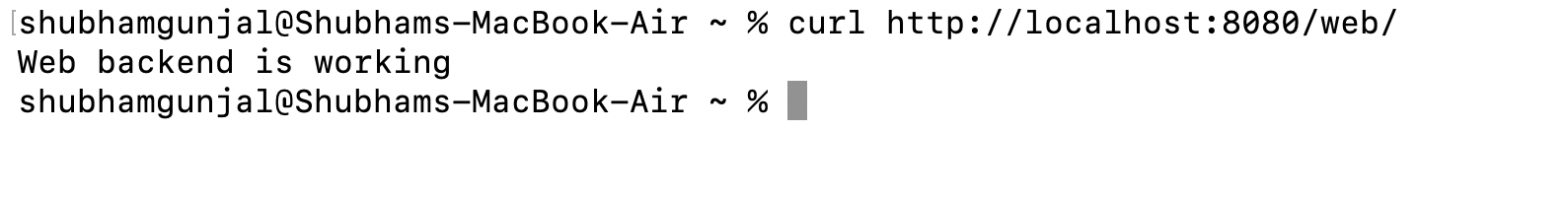
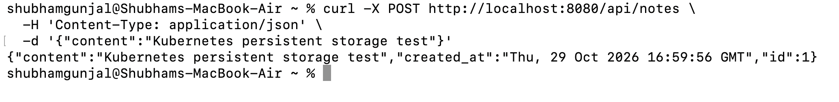
9.3: Test the API and database connection​
​
curl http://localhost:8080/api/health​
9.4: Test the web backend​
​
curl http://localhost:8080/web/​
9.5: Insert a database record​
​
curl -X POST http://localhost:8080/api/notes \​
-H 'Content-Type: application/json' \​
-d '{"content":"Kubernetes persistent storage test"}'​

Slide 28
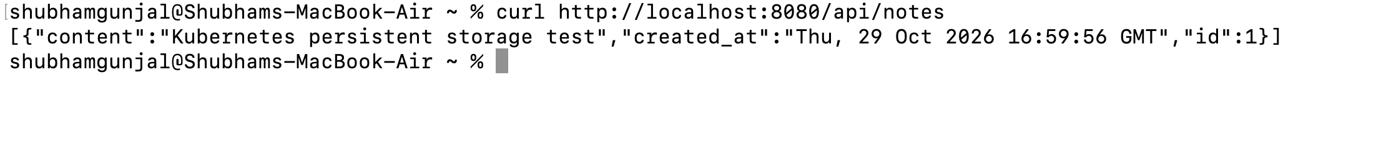
Read the record from databse
curl http://localhost:8080/api/notes
Phase 10: So now, we have to Prove that PostgreSQL data persists
This is one of the most important parts of the assignment. We will delete the PostgreSQL Pod, let Kubernetes recreate it, and verify that the record still exists
10.1: Record the current data
curl http://localhost:8080/api/notes

Slide 29
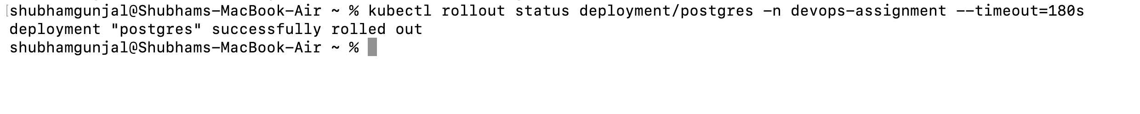
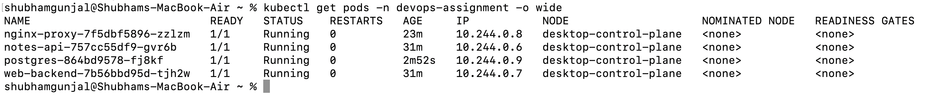
10.2 Delete only the PostgreSQL Pod
In a Terminal window other than the one running port forwarding, execute following comnds
kubectl delete pod -n devops-assignment -l app=postgres
This deletes the Pod, not the PersistentVolumeClaim or PersistentVolume.
10.3: Wait for PostgreSQL to restart
kubectl rollout status deployment/postgres -n devops-assignment --timeout=180s
As expected K8s created new pod for postgres, The new PostgreSQL Pod running on the labelled node.

Slide 30
Check the storage again:
kubectl get pv
kubectl get pvc -n devops-assignment
The PVC should still be Bound.
10.4: Verify the original record still exists
curl http://localhost:8080/api/notes

Slide 31
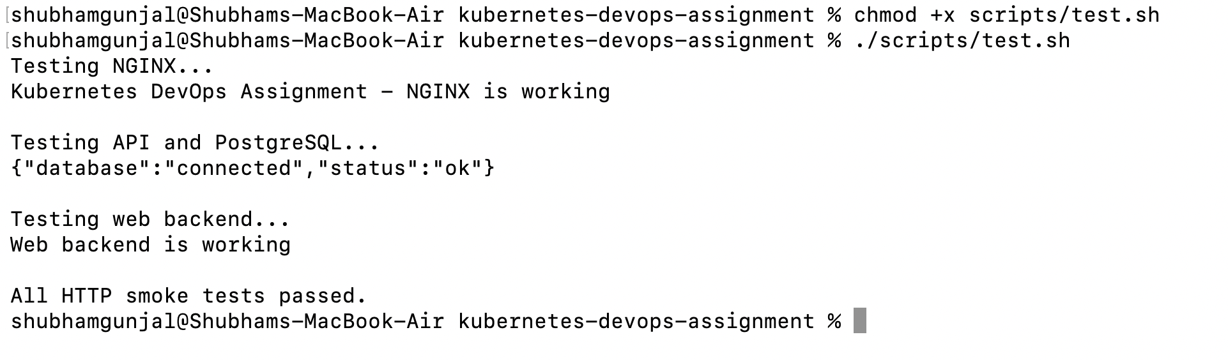
Phase 11: Create a validation script
cat > scripts/test.sh <<'EOF'
#!/bin/bash
set -e
BASE_URL="${BASE_URL:-http://localhost:8080}"
echo "Testing NGINX..."
curl -fsS "$BASE_URL/"
echo
echo "Testing API and PostgreSQL..."
curl -fsS "$BASE_URL/api/health"
echo
echo "Testing web backend..."
curl -fsS "$BASE_URL/web/"
echo
echo "All HTTP smoke tests passed."
EOF
Make this script executable
chmod +x scripts/test.sh

Slide 32
Phase 12: Now we are going to Create a deployment script
cat > scripts/deploy.sh <<'EOF'
#!/bin/bash
set -euo pipefail
cd "$(dirname "$0")/.."
echo "Checking Kubernetes..."
kubectl get nodes
NODE=$(kubectl get nodes -o jsonpath='{.items[0].metadata.name}')
kubectl label nodes "$NODE" workload=database --overwrite
echo "Building the API image..."
docker build -t devops-notes-api:1.0 ./app
echo "Creating namespace..."
kubectl apply -f k8s/namespace.yaml
echo "Configuring storage..."
kubectl apply -f k8s/storage.yaml
echo "Deploying PostgreSQL..."
kubectl apply -f k8s/postgres.yaml
kubectl rollout status deployment/postgres \
-n devops-assignment --timeout=180s
echo "Deploying application..."
kubectl apply -f k8s/app.yaml
kubectl rollout status deployment/notes-api \
-n devops-assignment --timeout=180s
kubectl rollout status deployment/web-backend \
-n devops-assignment --timeout=180s
echo "Deploying NGINX..."
kubectl apply -f k8s/nginx.yaml
kubectl rollout status deployment/nginx-proxy \
-n devops-assignment --timeout=180s
echo "Deployment complete."
kubectl get pods,services -n devops-assignment
kubectl get pv,pvc -n devops-assignment
EOF
chmod +x scripts/deploy.sh
This script documents the deployment order and can be reused. Run it from your project folder with
./scripts/deploy.sh

Slide 33
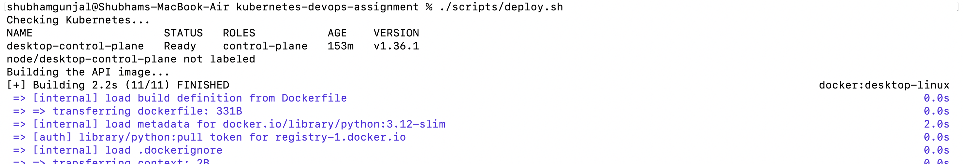
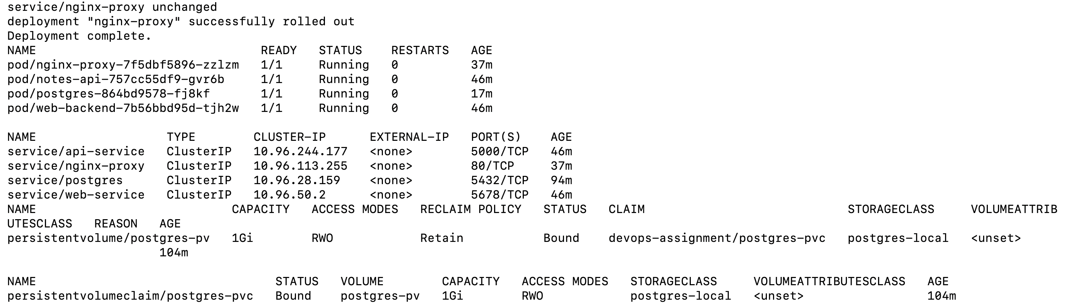

Slide 34
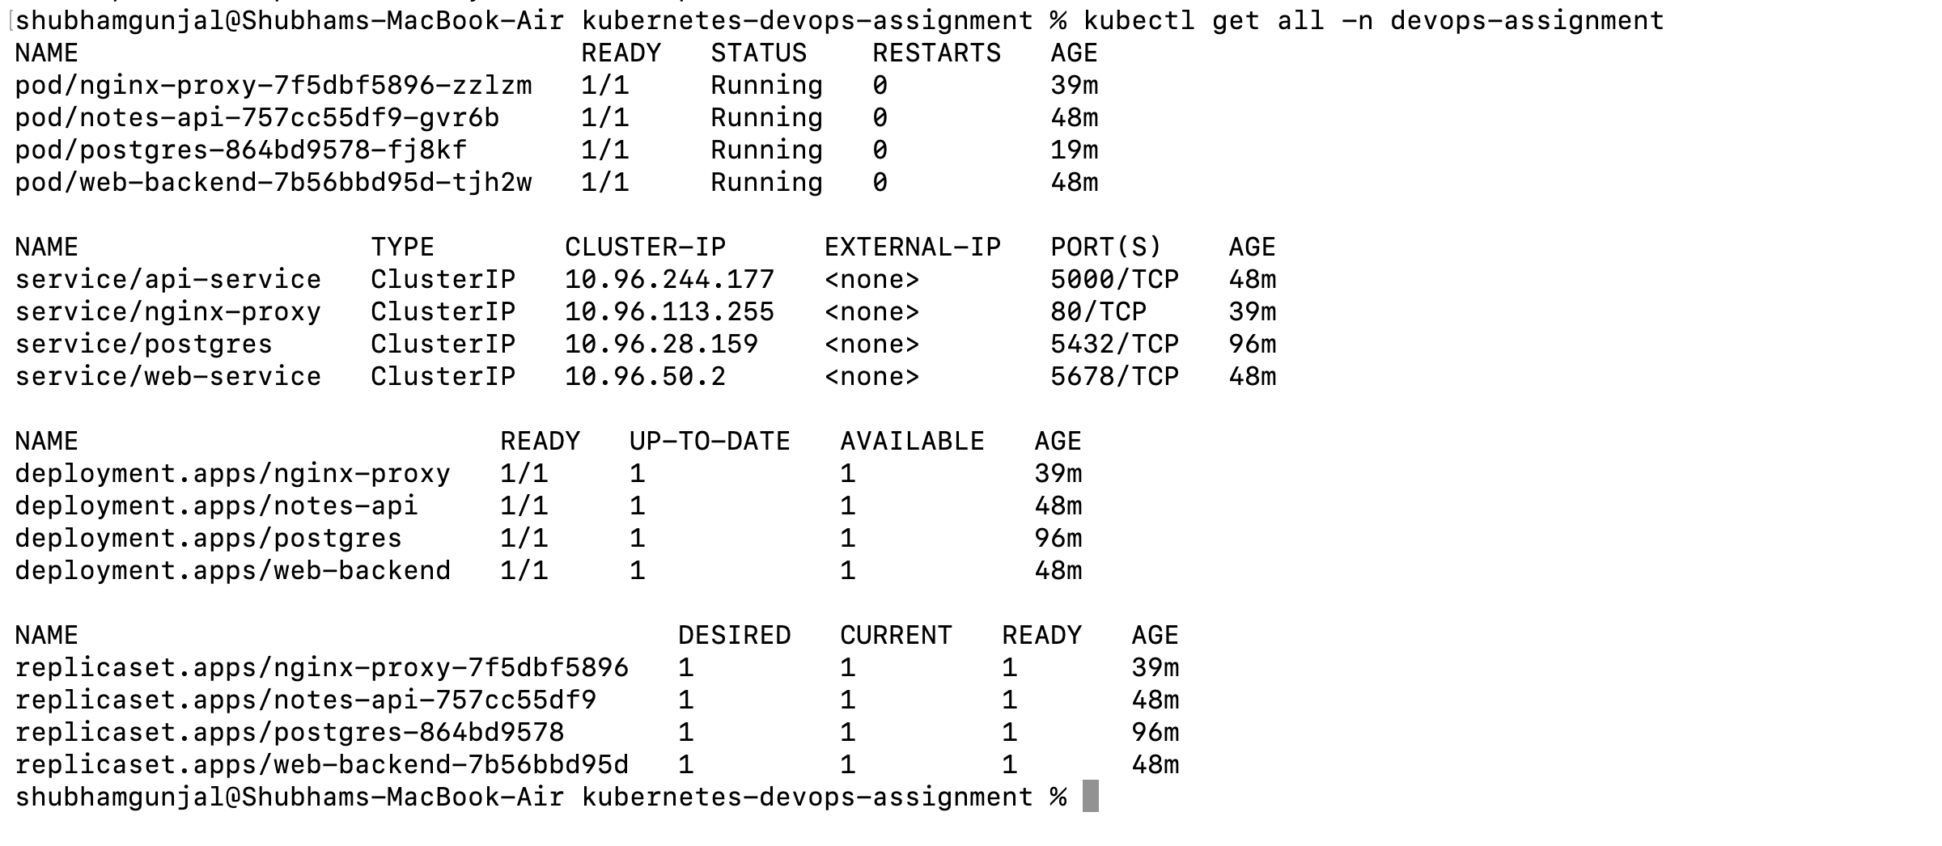
So, Now Check each and every thing we integrated
Kubectl get nodes
2. kubectl get all -n devops-assignment

Slide 35
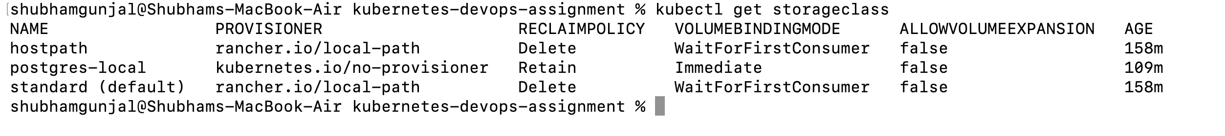
3. kubectl get storageclass
4. kubectl get pv
5. kubectl get pvc –n devops-assignment

Slide 36
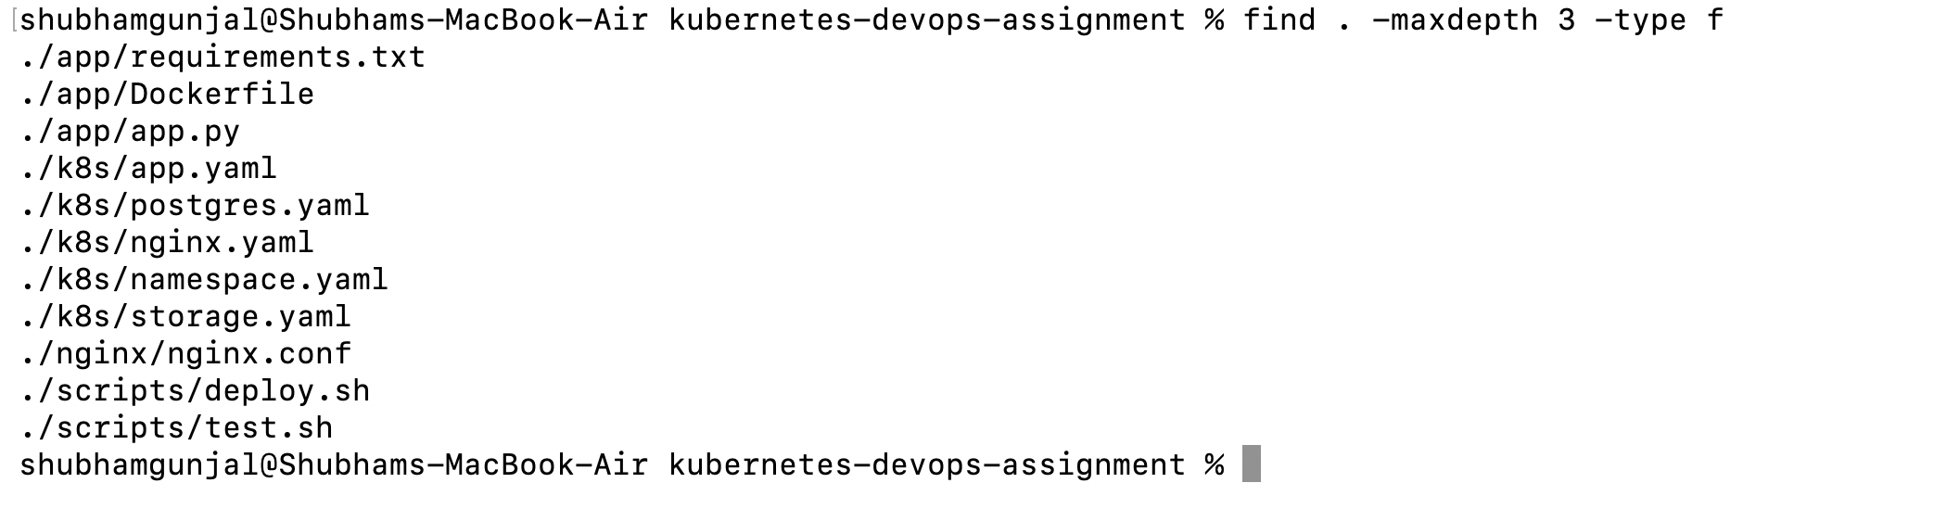
Check that your YAML files exists or not
find . -maxdepth 3 -type f

Slide 37
Phase 13: Save your project using Git, we are adding project in local repository
git init
git add README.md app k8s nginx scripts
git status
git commit -m "Complete Kubernetes DevOps assignment"
So we pushed files in Local repository
Go to finder
Shift+cmnd+G
And search ~/kubernetes-devops-assignment

Slide 38
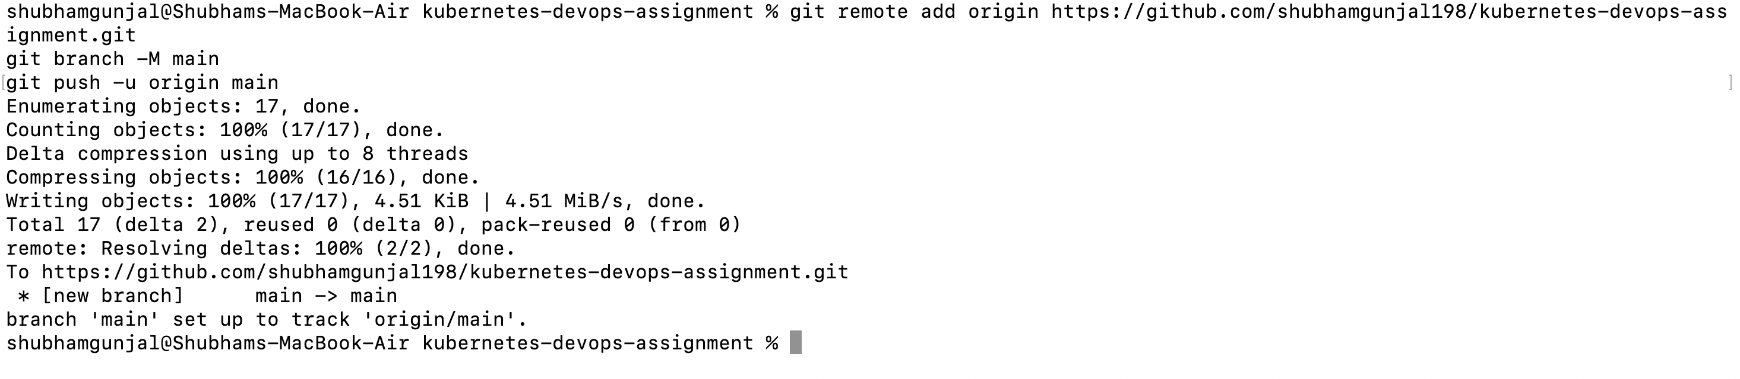
I also pushed project files in GitHub Repository

