Slide 1


Computer Fundamentals
Instructor
Satyam Thaper

Slide 2



Computer
A computer is a machine or device that performs processes, calculations and operations based on instructions provided by a software or hardware program. It has the ability to accept data (input), process it, and then produce outputs.
Copyright thinkcloudly, All rights reserved

Slide 3



RAM
Computer memory or random access memory (RAM) is your system’s short-term data storage; it stores the information your computer is actively using so that it can be accessed quickly.
Copyright thinkcloudly, All rights reserved

Slide 4
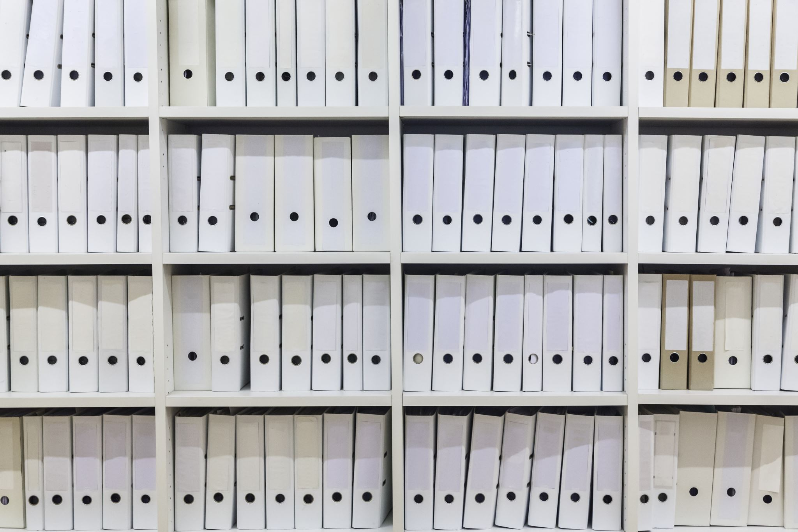

Storage
Storage is a process through which digital data is saved within a data storage device by means of computing technology.
Storage is among the key components of a computer system and can be classified into several forms, although there are two major types:
Volatile Storage (Memory)
Non-Volatile Storage
Copyright thinkcloudly, All rights reserved

Slide 5
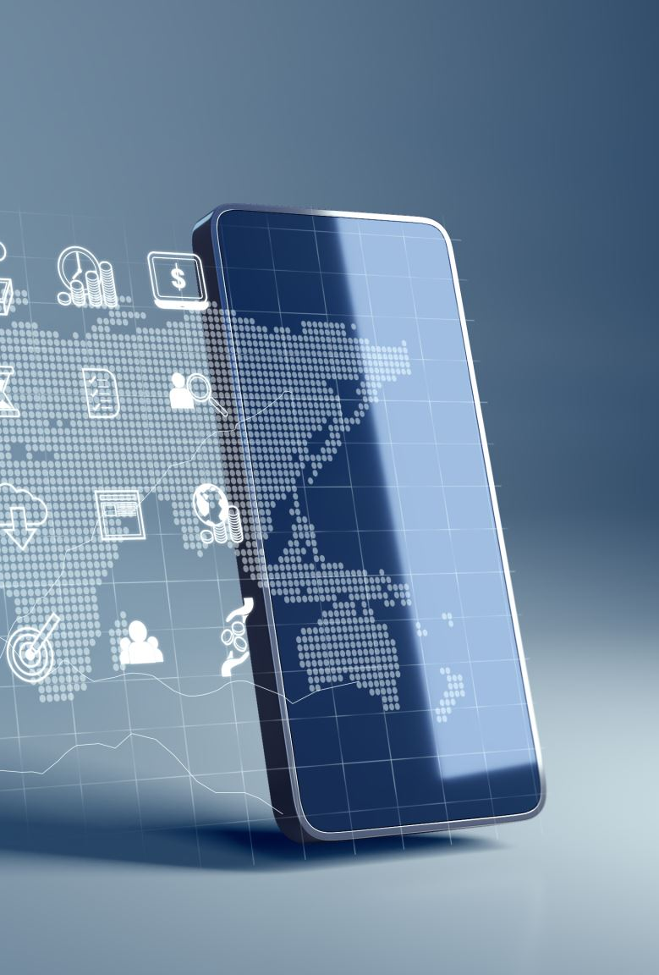

IP address
An IP address is a unique address that identifies a device on the internet or a local network.
IP stands for "Internet Protocol," which is the set of rules governing the format of data sent via the internet or local network.

Slide 6
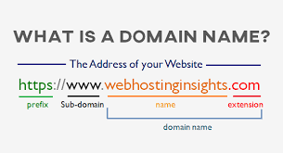

It's the destination you type into a web browser — such as www.google.com. Similar to how you would scroll to a contact in your phone rather than manually dialing a phone number, domain names make it easier for us to navigate the online world and avoid having to memorize long IP addresses.
Copyright thinkcloudly, All rights reserved

Slide 7

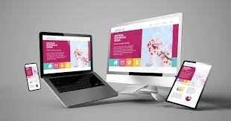

WEBSITE

Slide 8

Server
A web server is a computer that runs websites.
It's a computer program that distributes web pages as they are requisitioned.
Copyright thinkcloudly, All rights reserved

Slide 9
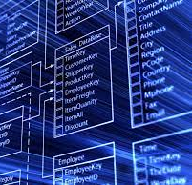
Database A database is a systematic collection of data. They support electronic storage and manipulation of data. Databases make data management easy.

Slide 10
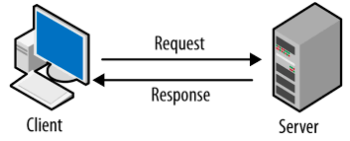


Client Server

