Slide 1
Unpaired Face Restoration via Latent Space Exploration
Presented By:
Shubham Harsh
MML2023004
Under the supervision of:
Dr. Shivram Dubey

Slide 2
Introduction
• Objective: Restore HQ face images from LQ images with unknown degradations.
• Motivation:
- Real-world face restoration is challenging due to unseen degradations.
- Paired data is often unavailable for supervision.
• Key Innovation:
- Leverages StyleGAN latent space for unpaired restoration via a learnable cross-quality shift.
- Proposes a two-branch framework to improve fidelity and handle unpaired datasets.

Slide 3
Key Concepts
• Paired vs. Unpaired Face Restoration:
- Paired: Requires aligned HQ and LQ images, limited to known degradation types.
- Unpaired: No need for paired data, making it robust to unseen degradations.
• StyleGAN Latent Space:
- HQ and LQ images naturally form separate subspaces.
- Transforms LQ → HQ via simple vector arithmetic using a learned cross-quality shift.

Slide 4
Methodology
• Learnable Cross-Quality Shift:
- A trainable latent-space transformation applied in StyleGAN's W space.
- Enables direct conversion between LQ and HQ representations.
- Provides adjustable restoration levels by scaling the shift.
• Two-Branch Framework:
- HQ Branch: Encodes HQ images and generates reconstructed HQ images.
- LQ Branch: Encodes LQ images with degradation estimation to map to HQ space.
- Cycle-Consistency: Ensures input and reconstructed outputs retain the same content.
• Degradation Modeling:
- Estimates degradations such as blur, noise, and compression directly in latent space.
- Generates synthetic degraded versions of HQ images to train robustly.

Slide 5
Dataset
• HQ Dataset:
- FFHQ (Flickr-Faces-HQ): 70,000 high-quality images at 1024×1024 resolution.
- Preprocessed to align faces and resized to 256×256.
• LQ Dataset:
- Derived from CelebAHQ.
- Simulated degradations:
- Mild: Downsample with Bicubic (factor 8) + JPEG compression (quality 90–95).
- Moderate: Downsample + Add Gaussian Noise (σ=20–25).
- Severe: Blur with Gaussian Kernel + Downsample + Gaussian Noise (σ=10–15).
- Ensures no overlap with FFHQ for unpaired training.

Slide 6
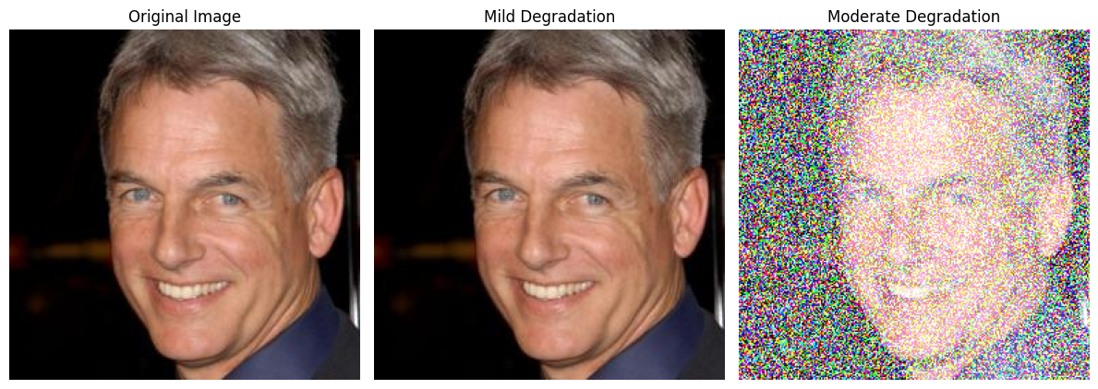

Slide 7
Architecture
• Core Components:
- Encoders: Extract latent codes.
- StyleGAN: Maps latent codes back to the image space.
- Discriminators: Ensure outputs resemble LQ and HQ distributions.
• Two-Branch Framework:
- Upper Branch: Encodes HQ images.
- Lower Branch: Encodes LQ images and estimates degradations with Edeg.
- Cycle Consistency: Adds constraints to maintain fidelity.

Slide 8
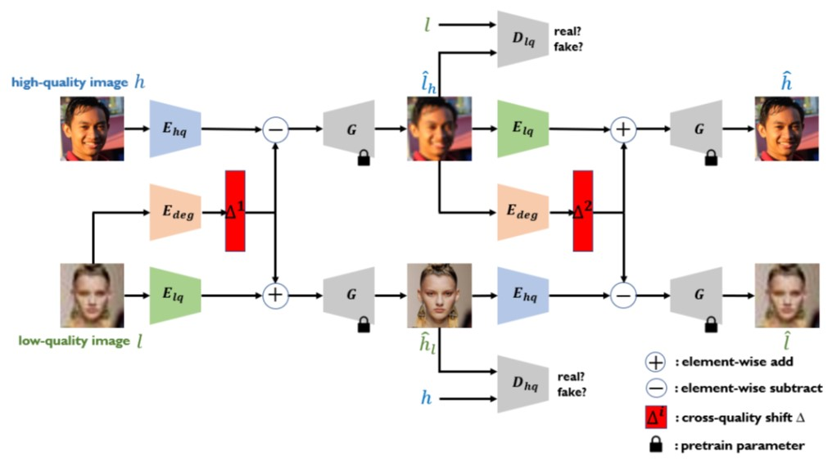
Dong, Yangyi, et al. ”Unpaired Face Restoration via Learnable Cross-Quality Shift.” Proceedings of the
IEEE/CVF International Conference on Computer Vision, 2023.

Slide 9
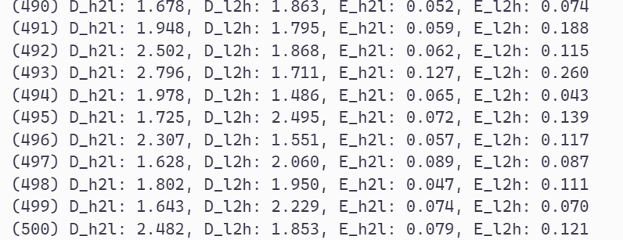
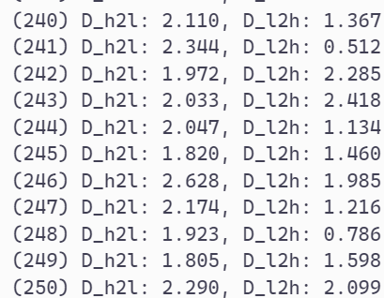
Training:
Used pre-trained encoder for high quality images.
Trained a resnet-34 backed encoder for synthetic low-quality images.
Pre- training of encoder done for 500 epochs.
Training of the whole architecture done for 250 epochs.
Training of encoders
Training of whole architecture

Slide 10
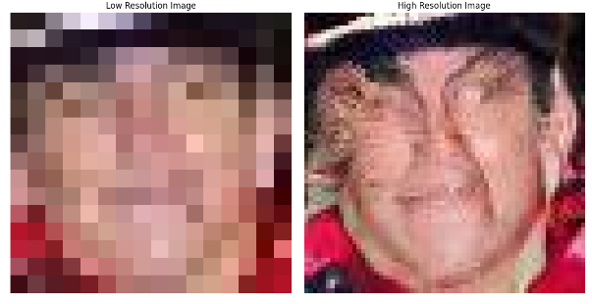
Test Instance:

Slide 11
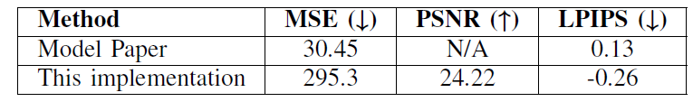
Experimental Results
Quantitative Results:
Metrics: MSE, PSNR, LPIPS
The LPIPS score of -0.26 indicates that the model is functioning as intended for the task; however, there is room for improvement to achieve the desired performance levels for optimal results.

Slide 12
Conclusion
Future Work:
Plan 1: Will to try to make this paper work, complete the implementation
Plan 2: Will move to a new model, more apt. for the problem statement.

Slide 13
References:
“Dong, Yangyi, et al. "Unpaired Face Restoration via Learnable Cross-Quality Shift." Proceedings of the IEEE/CVF Conference on Computer Vision and Pattern Recognition. 2022.”
Karras, Tero, Samuli Laine, and Timo Aila. "A style-based generator architecture for generative adversarial networks." Proceedings of the IEEE/CVF conference on computer vision and pattern recognition. 2019.
Shen, Yujun, et al. "Interpreting the latent space of gans for semantic face editing." Proceedings of the IEEE/CVF conference on computer vision and pattern recognition. 2020.
Karras, Tero. "Progressive Growing of GANs for Improved Quality, Stability, and Variation." arXiv preprint arXiv:1710.10196 (2017).

