Slide 1
Final assessment exl-credit-churn analysis
By:
Shubham harsh

Slide 2
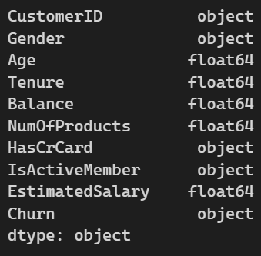
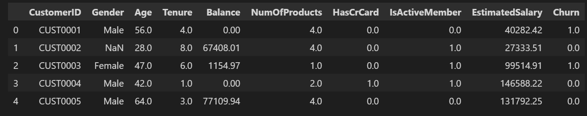
Data Understanding
Customer churn refers to when a customer stops using a company's product or service.
Dataset describes customer’s physical attributes, alongwith their financial attributes, signifying how person uses his/her Credit Card.
The goal of this project is to predict whether a Customer will churn or stay based on their characteristics and account activity.
This is a classic binary classification problem in machine learning:
Churn = 1 means customer left
Churn = 0 means customer stayed

Slide 3
Data Understanding
Columns were filled with NULL values.
Severe inconsistencies were there like:
Gender has inconsistent casing and spacing: 'Male', 'MALE', ' male ', 'Female', 'FEMALE', ' Female’.
HasCrCard includes mixed types and invalid value: '0.0', '1.0', '2.0', 'Yes'.
IsActiveMember contains unexpected values: '0.0', '1.0', '-1', 'No', '-1.0'.
Churn includes invalid entries: '1.0', '0.0', 'Maybe', '2.0', '2’.
Age column (numerical in nature), had max value of 120 and min value of -5, mean was appx. 43 years.

Slide 4
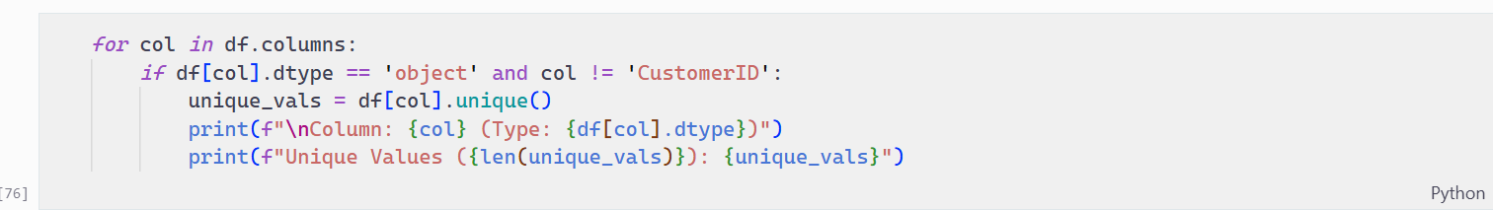
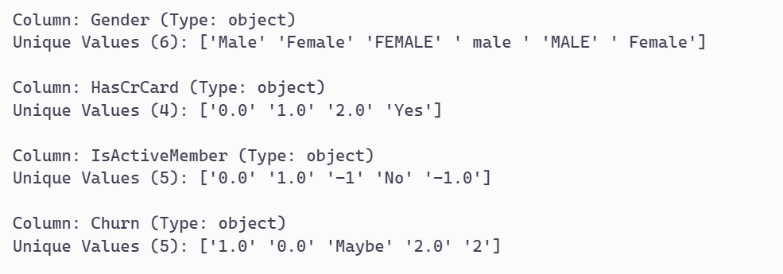

Slide 5
Data Cleaning
Upon observing, Gender column had whitespaces around them.
Replaced all instances of Male and Female with ‘Male’ and ‘Female’ respectively.
For ‘HasCrCard’ attribute, replaced all values > 0 as Yes, otherwise a No.
For ‘IsActiveMember’ attribute, for all the string having positive values were treated as Yes otherwise No.
For ‘Churn’ as it was target attribute, all the rows where values where not in terms of 0 or 1. All such rows were dropped.

Slide 6
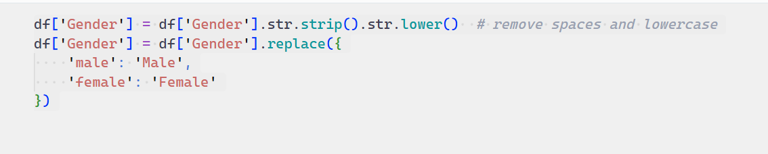
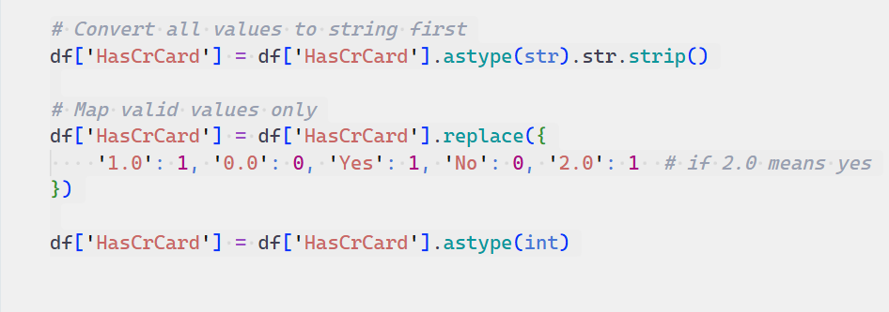
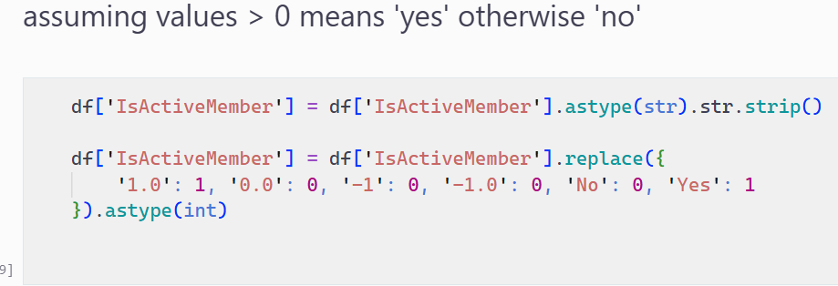

Slide 7
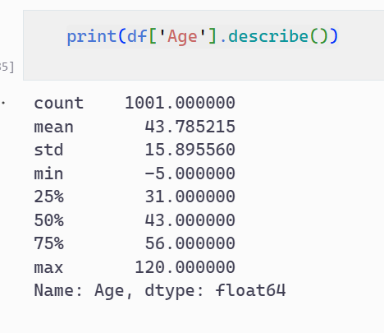
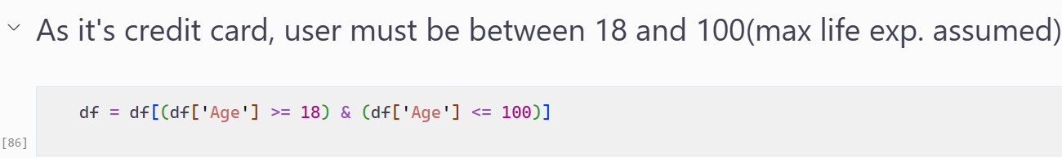
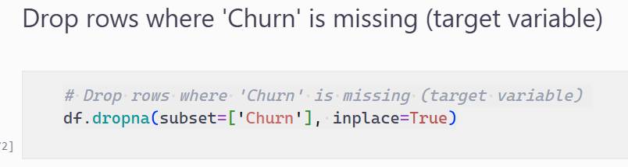

Slide 8
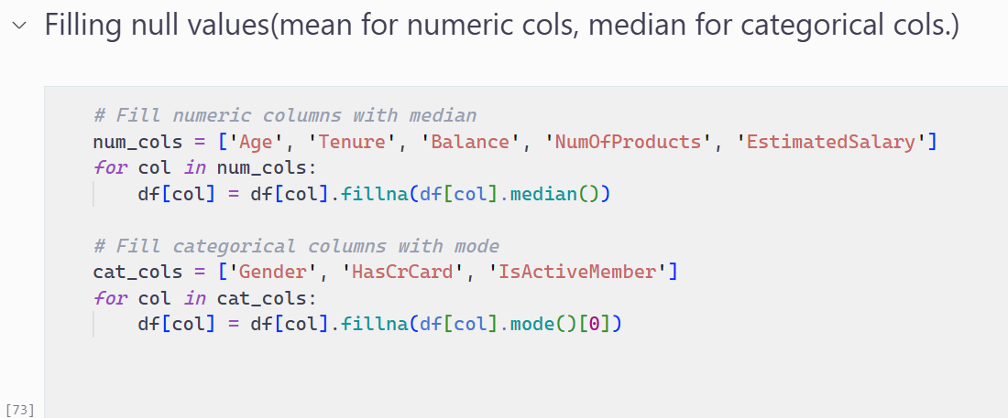
Data Preparation

Slide 9
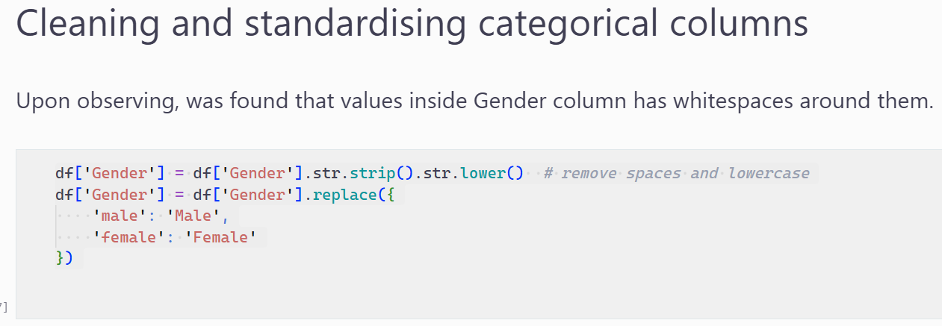
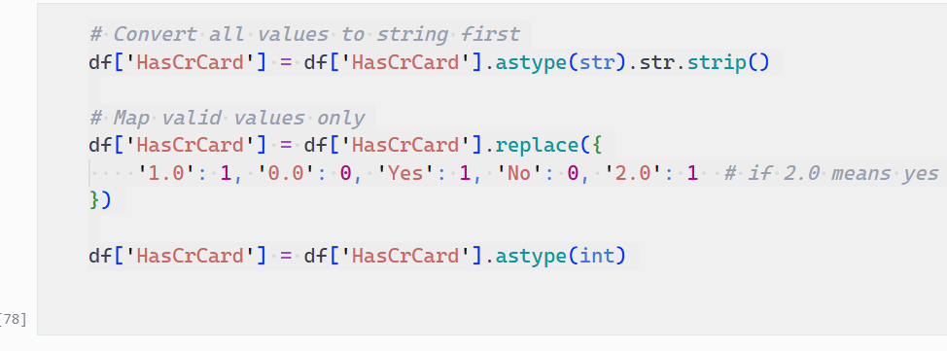

Slide 10
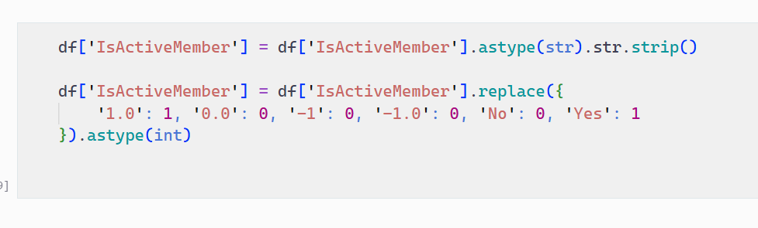
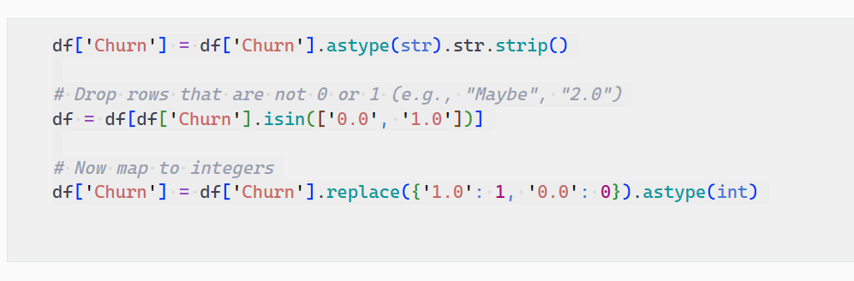
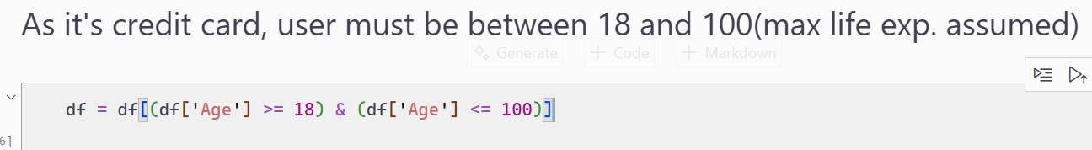

Slide 11
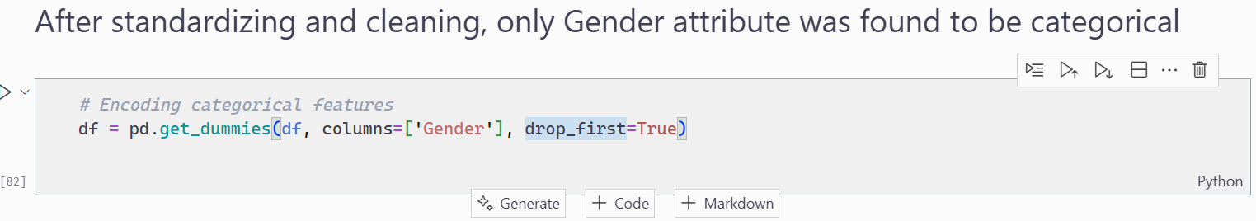
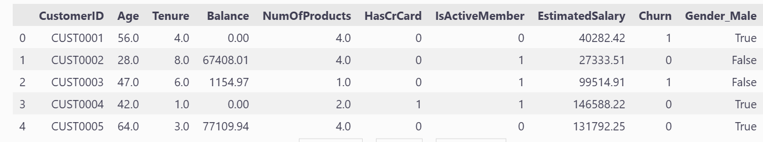
One hot Encoding
Gender was the only categorical column, left after all cleaning and preprocessing.

Slide 12
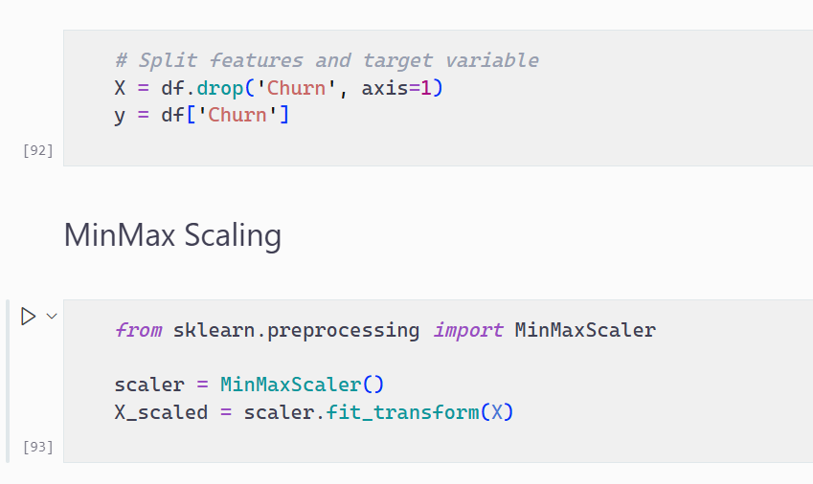
Min-Max Scaling
Applied Min-max scaling for better convergence of RandomForest Algorithm

Slide 13
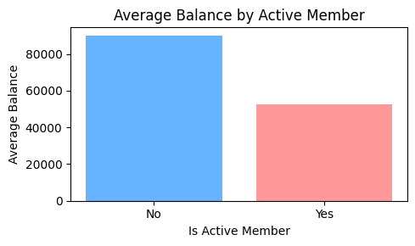
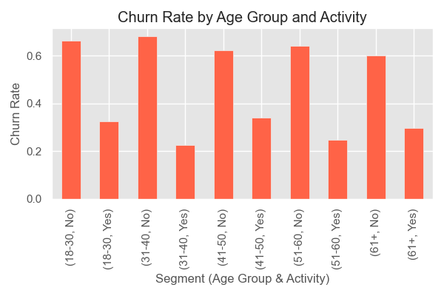
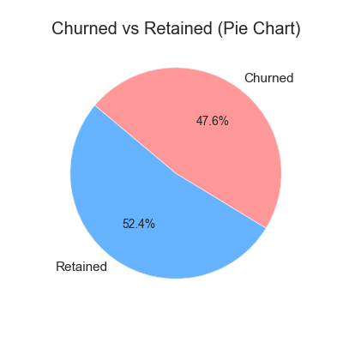
Visualisations

Slide 14
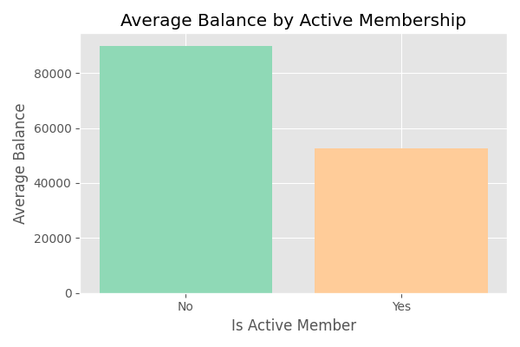
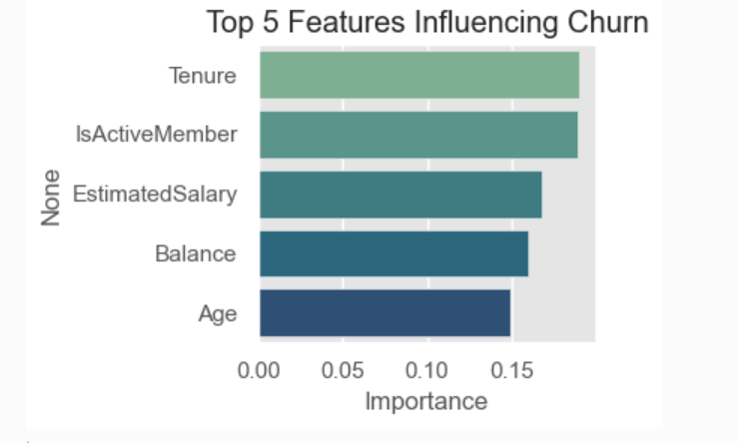
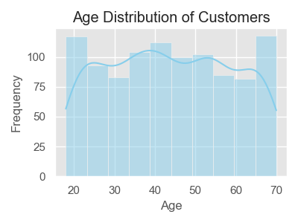
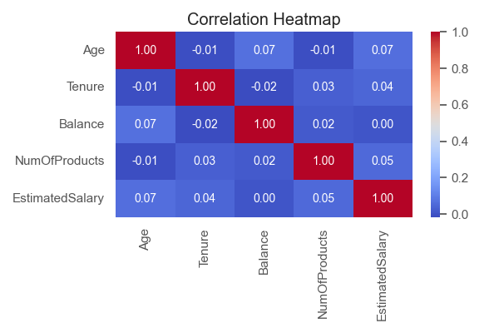

Slide 15
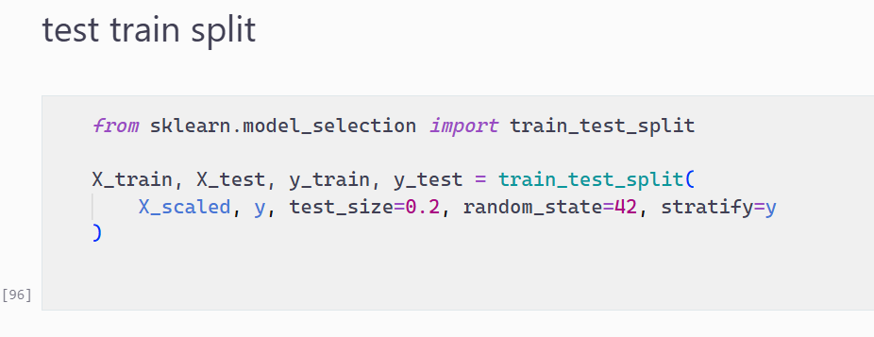
Test Train Split

Slide 16
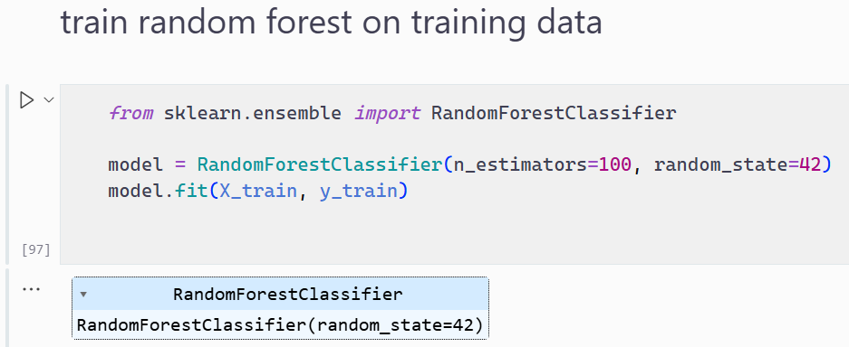
Train RandomForest on training data

Slide 17
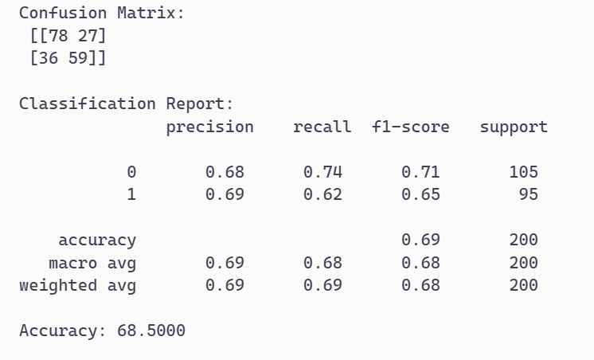
Result Analysis and Evaluation

Slide 18
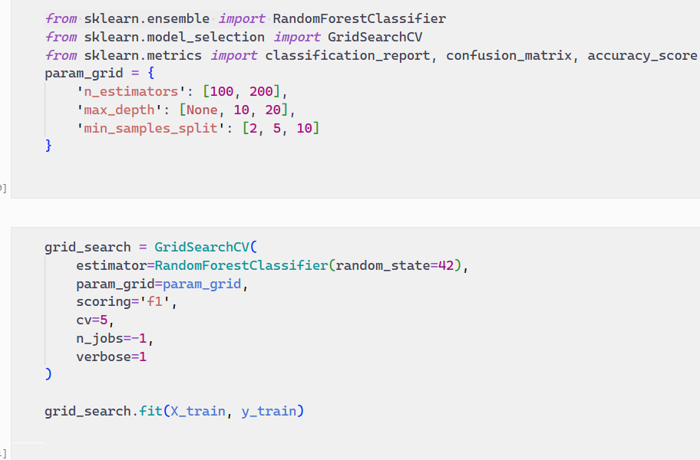
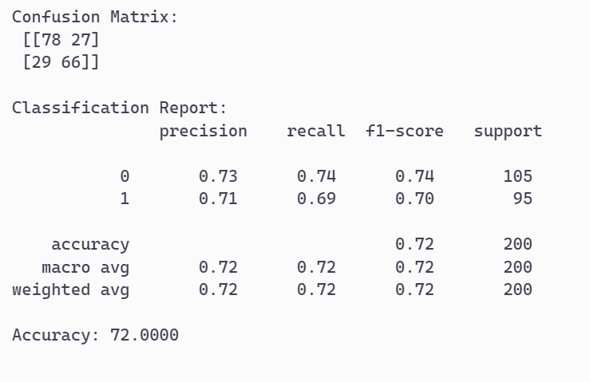
Applying Grid search CV with RandomForestClassifier

Slide 19
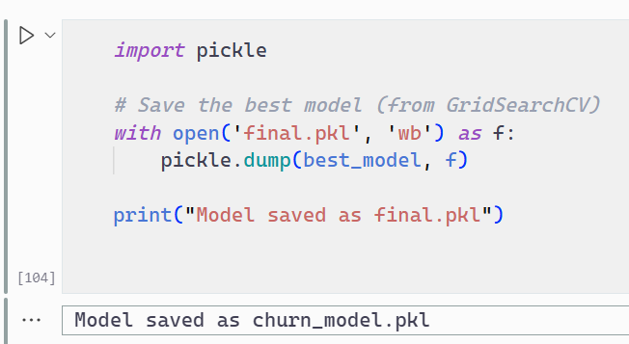
Saving the model

Slide 20
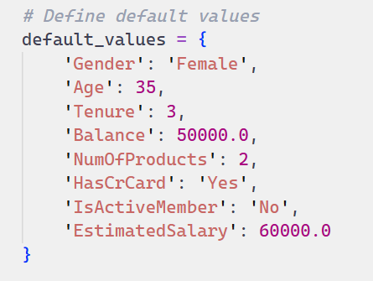
Testing on Single Instance

Slide 21
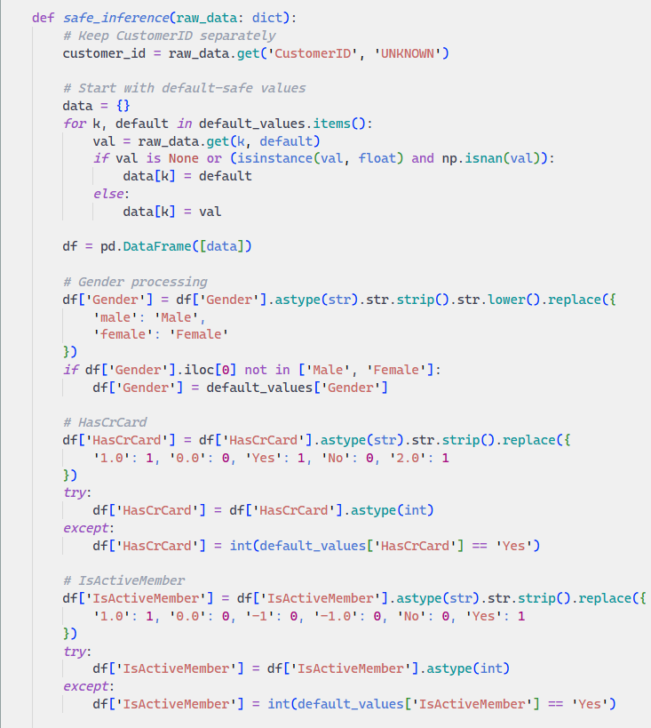
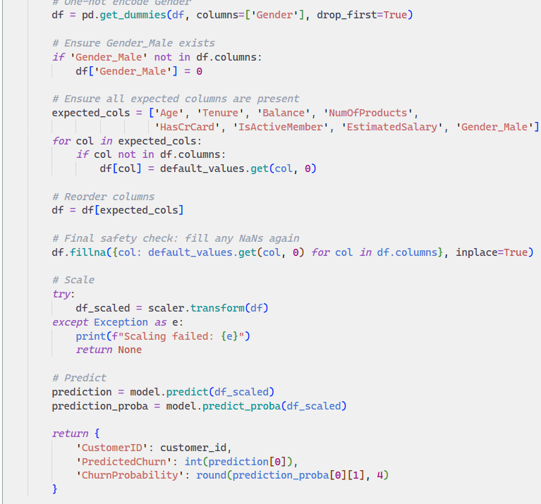

Slide 22
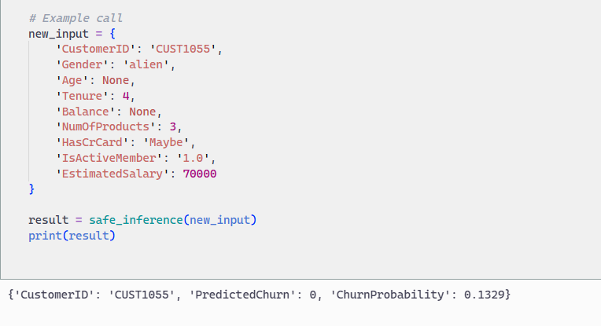

Slide 23
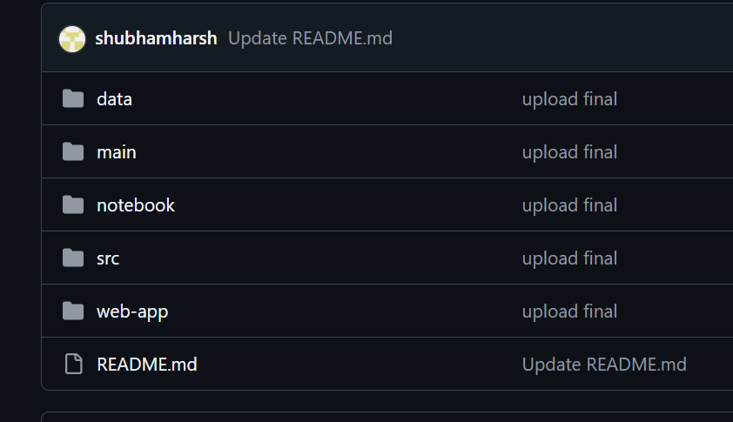
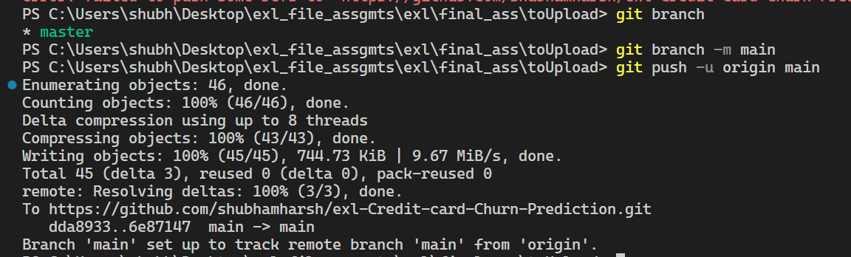
Git Workflow
Link to Repo.

Slide 24
Probable Insights
A significant portion of churned customers were inactive members.
Customers with fewer products were more likely to churn.
Younger customers showed higher churn tendencies compared to older ones.
Customers with lower tenure (newer customers) were more prone to churn.
High balance with low activity may indicate disengaged customers at risk.

Slide 25
THANK YOU

