Slide 1

E-Commerce Data Analysis
Team 3
Abbas Furniturewala - NUID 002193272
Harshit Parikh - NUID 001044838
Shrutika Salian - NUID 002142365
Shubham Idekar - NUID 002776415

Slide 2
Objectives
To analyze ecommerce data from Brazil and gain insights into consumer behavior and market trends
Comparing economic trends across different cities/states in Brazil
Analyzing customer satisfaction data to gain a better understanding of consumer sentiment towards e-commerce businesses in Brazil
To determine various factors influencing the growth of the business
Evaluate and compare trend-over-year growth to understand if business is improving, static, or declining
Estimating the distribution of payment values and payment types among customers
Determining the demographic data and product preferences of customers

Slide 3







Data Architecture Diagram
Refresh
&
Schedule
Source
Data Visualization
Data pipeline
Cosmos Document DB
Cosmos Graph DB

Slide 4
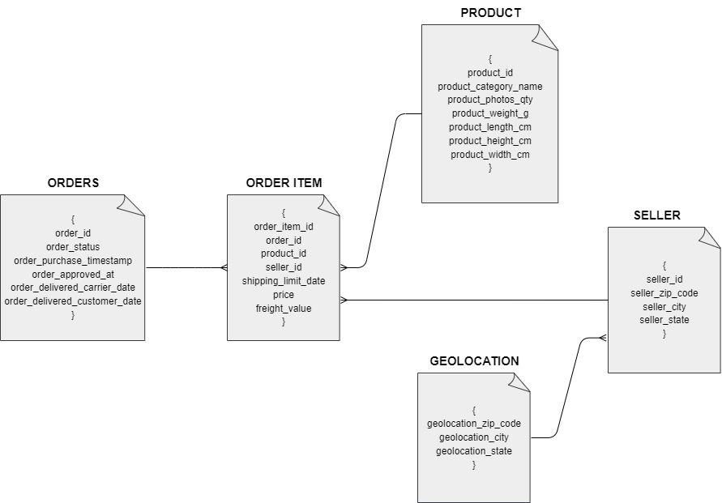
Document Data Model

Slide 5
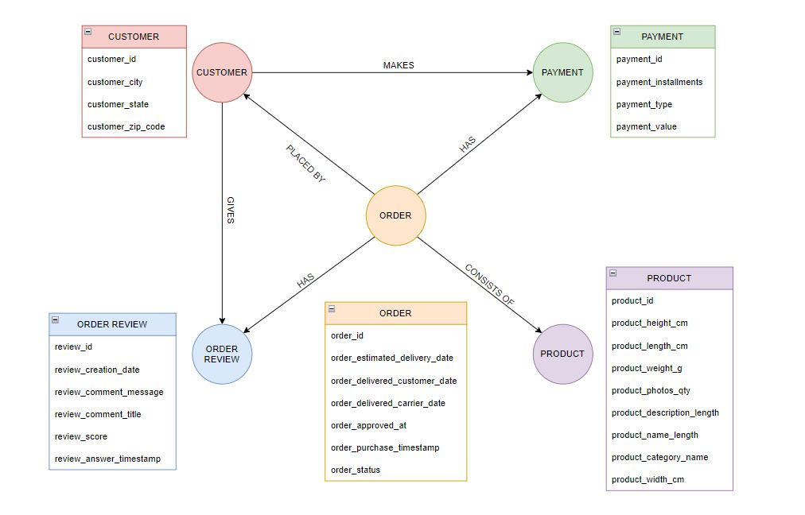
Graph Data Model

