Slide 1
CATCHQ
India's Clinic & Hospital Operating System
WhatsApp booking, AI-powered diagnosis, real-time queue management, digital billing, pharmacy integration, and hospital bed tracking - all in one platform for India's 10 Lakh+ clinics.
Platinum Jubilee Seed Fund Application
IIT Kharagpur
CATCHQ
Healthcare shouldn't start with waiting. It should start with CatchQ.

Slide 2
The Problem
India manages healthcare with WhatsApp messages, phone calls, and paper registers
1
Missed Calls
2
No Digital Booking
3
Zero Visibility
4
Paper Records
Clinics lose 30-40% of bookings to missed phone calls during consultation hours. No voicemail. No callback system.
90% of Indian clinics have no online booking. Patients must call during business hours or walk in and wait.
Patients have no idea how long the wait is. They call repeatedly or arrive early and waste hours in the waiting room.
Patient history on paper. Lab reports via WhatsApp. No digital trail. No analytics. Prescriptions lost.
5
No-Show Crisis
6
Billing Chaos
7
Staff Overload
8
Zero Intelligence
40% of booked appointments result in no-shows. Clinics lose Rs. 2-5 Lakh monthly with zero recovery mechanism.
Manual billing. Cash-only. No insurance integration. Patients get no digital receipt or summary.
Reception spends 60% of time on phone calls, confirmations, and scheduling. Zero time for patient care.
No patient analytics. No predictive insights. No automated follow-ups. Clinics run blind.
Impact: Indian clinics lose Rs. 5-10 Lakh per doctor per year to operational inefficiency. 10 Lakh+ clinics = Rs. 50,000 Cr+ addressable market.
CatchQ | IIT Kharagpur Platinum Jubilee Seed Fund Application
2 / 14

Slide 3
Our Solution
CatchQ replaces 7 disconnected tools with one unified platform
CLINIC SIDE
PATIENT SIDE
WhatsApp Booking Bot
WhatsApp Booking
Admin Dashboard
Mobile App (iOS/Android)
Real-time Queue Board
Real-time Queue Position
Smart TV Display
Digital Receipt
Digital Billing
Lab Report AI Analysis
Doctor Scheduling
Follow-up Reminders
Patient Database
7 core problems, 1 unified solution. Every feature is already built and operational.
STACK:
Next.js 15
NestJS
React Native
Firebase
Socket.io
PostgreSQL
Tailwind
CatchQ | IIT Kharagpur Platinum Jubilee Seed Fund Application
3 / 14

Slide 4
Platform Architecture
Full-stack system built for scale, security, and speed
PATIENT TOUCHPOINTS
BACKEND CORE
FEATURES
W
WhatsApp Bot
N
NestJS API
Q
Queue Management
Book via chat
6 modules
Live updates
M
Mobile App
F
Firebase Auth
B
Billing Engine
11 screens
JWT + OTP
Auto-invoice
W
Web Booking
S
Socket.io
A
AI Analytics
Landing page
Real-time
Smart insights
W
Walk-in
P
PostgreSQL
B
Bed Tracking
Clinic kiosk
7 tables
Real-time
TECHNOLOGY STACK
Next.js 15
NestJS
React Native
Firebase
Socket.io
PostgreSQL
Tailwind
TypeScript
PLATFORM SCALE
Python AI
WhatsApp API
30+
14
11
7
22
6
API Endpoints
Frontend Pages
Mobile Screens
Database Tables
Landing Parts
Backend Modules
CatchQ | IIT Kharagpur Platinum Jubilee Seed Fund Application
4 / 14

Slide 5
How It Works
8-step patient journey from booking to pharmacy refill
9:41
9:41
9:41
9:41
01
02
03
04
BOOK
CONFIRM
TRACK
VISIT
Patient sends WhatsApp or opens mobile app. AI suggests right doctor based on symptoms.
Instant booking confirmation. Calendar sync. Pre-visit questionnaire if needed.
Real-time queue position on phone. "You are #3. Est. wait: 15 minutes."
Smart queue display at clinic. Doctor sees live patient list. No paper, no chaos.
9:41
9:41
9:41
9:41
05
06
07
08
PAY
REPORT
FOLLOW
REFILL
Digital receipt via WhatsApp. Payment tracked: UPI/Card/Cash. Auto-billing.
AI reads lab report. Explains in simple language. Flags abnormal values.
Automated follow-up reminder. Next appointment auto-suggested.
Pharmacy alert when meds run low. Family notified. Auto-order option.
PATIENT JOURNEY
Every touchpoint is digital, real-time, and designed for zero friction
CatchQ | IIT Kharagpur Platinum Jubilee Seed Fund Application
5 / 14

Slide 6
Dashboard Features
Complete clinic management system - 8 modules, already built and operational
DASHBOARD
QUEUE
DOCTORS
APPOINTMENTS
D
6 KPIs
Q
Real-time
D
15+ Specs
A
Full CRUD
Real-time stats: Patients Today, Appointments, Queue, Performance. 7-day trend charts. Quick actions.
Per-doctor live queue. Status: waiting/serving/completed/skipped. Socket.io real-time updates.
CRUD for 15+ specialties. Weekly scheduling. Fees config. Availability windows per slot.
Full lifecycle: book, reschedule, cancel. Filter by doctor/date/status. Patient phone search.
BILLING
FOLLOW-UPS
PATIENT APP
LANDING PAGE
B
3 Modes
F
Automated
P
11 Screens
L
22 Parts
Invoice generation. Print receipts. Payment mode tracking: Cash/UPI/ Card. Discount management.
Cron-based daily reminders. Patient retention workflows. Family member booking support.
Phone OTP login. Browse doctors by specialty. Real-time queue. Appointment receipt on mobile.
22 marketing components. Pricing tiers. Feature showcase. WhatsApp widget. App download links.
CatchQ | IIT Kharagpur Platinum Jubilee Seed Fund Application
6 / 14

Slide 7
AI Innovation
Four AI capabilities that will transform Indian healthcare SaaS
SMART DOCTOR MATCHING
REPORT ANALYSIS (RAG)
VOICE HEALTH ASSISTANT
PRESCRIPTION DIGITIZER
Symptom -> Specialist
Lab Report -> Plain Language
Phone Call -> Triage -> Booking
Handwriting -> Digital -> Pharmacy
Patient describes symptoms AI analyzes and recommends right specialist immediately Example: "Chest pain + breath- lessness" -> Cardiologist Impact: Reduces wrong consultations by 40%
Lab report uploaded -> AI parses -> explains in patient language Example: "Cholesterol 240 mg/dL (high). Reduce fried food. Follow up in 3 months." Impact: 90% of patients understand their results
Patient calls clinic line. AI answers, triages symptoms, books appointment automatically. Handles FAQs, prescription refills, report delivery. Impact: 24/7 availability. Zero missed calls.
Doctor writes handwritten prescription. AI reads it, converts to digital format. Sends to pharmacy via app. Tracks medication adherence. Impact: 100% prescription accuracy. Zero errors.
Key Insight: AI in healthcare market will reach $45 Billion by 2030. CatchQ is building these capabilities from Day 1 - not as an afterthought.
CatchQ | IIT Kharagpur Platinum Jubilee Seed Fund Application
7 / 14

Slide 8
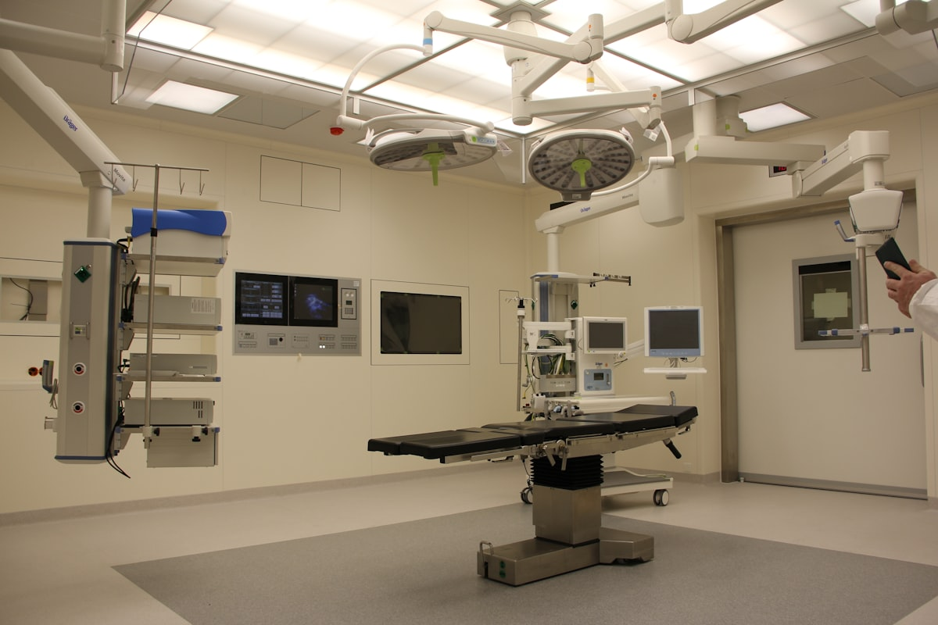
Hospital Bed Management
Real-time bed tracking for emergency and ward operations
48
31
12
3
Total Beds
Occupied (65%)
Available (25%)
Emergency Free
BED STATUS GRID
ICU
General A
Emergency
REAL-TIME BED TRACKING
Maternity
ICU, General, Emergency, Maternity, Pediatric Ward-wise status with equipment tracking
Pediatric
Legend:
Available
Occupied
Reserved
Ward Grid
Emergency Queue
Admission Track
Family Alerts
Equipment
Billing Link
Color-coded status
< 5 min allocation
Full lifecycle
Real-time notifications
Ventilator, monitor, O2
Auto daily charges
CatchQ | IIT Kharagpur Platinum Jubilee Seed Fund Application
8 / 18

Slide 9
Traction & Metrics
What we have built and the impact it delivers
WHAT WE HAVE BUILT
IMPACT METRICS
2,100+
Clinics registered in database
+40%
-60%
35+
Doctors across 15+ specialties
Revenue Increase
for Clinics
No-Show Rate
Reduction
180+
Weekly schedule slots
11
5 Hrs
99%
Mobile app screens
Staff Time Saved
Every Day
Patient Satisfaction
Target
8
Admin dashboard pages
30+
REST API endpoints
Socket.io
Real-time WebSocket gateway
Our patients love the WhatsApp booking. It has transformed how we operate.
22
Landing page components
"
CatchQ reduced our no-shows by 60% and increased monthly revenue by 40%.
CatchQ | IIT Kharagpur Platinum Jubilee Seed Fund Application
9 / 14

Slide 10
Competitive Landscape
Why CatchQ wins against existing solutions
FEATURE COMPARISON
OUR ADVANTAGES
Feature
CatchQ
Practo
ClinicPro
WhatsApp
*
Only Platform
WhatsApp + Queue + AI + Billing + Beds in one
WhatsApp Booking
Y
N
N
Y
AI-First
*
Real-time Queue
Y
N
N
N
Doctor matching, report analysis, voice assistant
AI Doctor Match
Y
N
N
N
*
India-Built
Designed for Indian clinics, not adapted from US
Lab Report AI
Y
N
N
N
Digital Billing
*
Affordable
Y
Y
Y
N
Rs. 2,999/month vs Rs. 10,000+ enterprise
Bed Management
Y
N
N
N
Complete
*
Mobile App
Y
Y
Y
N
30+ APIs, 14 pages, 11 screens already built
SaaS Pricing
Y
Y
Y
N
CatchQ is the only platform combining WhatsApp booking, AI diagnostics, real-time queue, and hospital bed management.
CatchQ | IIT Kharagpur Platinum Jubilee Seed Fund Application
14 / 18

Slide 11
Business Model
Multiple revenue streams for sustainable growth
MOST POPULAR
Starter
Professional
Enterprise
Rs. 2,999
Rs. 5,999
Rs. 9,999
/month
/month
/month
For small clinics (1-2 doctors)
For growing clinics (3-5 doctors)
For hospitals & chain clinics
+
WhatsApp booking
+
Everything in Starter
+
Everything in Pro
+
Up to 2 doctors
+
Up to 5 doctors
+
Unlimited doctors
+
Basic queue mgmt
+
Smart TV display
+
Multi-location
+
Digital receipts
+
Advanced analytics
+
API access
+
Email support
+
Auto reminders
+
Dedicated manager
+
Mobile app access
+
Priority support
+
24/7 phone support
REVENUE STREAMS
SaaS
PRIMARY
TXN
PER TXN
Pharmacy
COMMISSION
AI Add-on
ADD-ON
Bed Module
MODULE
Monthly subscriptions (recurring revenue)
1-2% per payment transaction
5-10% commission on medicine orders
Rs. 999/month premium AI features
Rs. 4,999/month hospital bed tracking
CatchQ | IIT Kharagpur Platinum Jubilee Seed Fund Application
10 / 14

Slide 12
Product Roadmap
Clear path from MVP to market leadership
DEVELOPMENT TIMELINE
Q2 2026
Q3 2026
Q4 2027
Q1 2027
MVP Launch
AI Integration
Scale Phase
Growth
Core booking, queue, billing. 10 pilot clinics onboarded.
Doctor matching, report analysis. 50 clinics live.
Pharmacy integration, bed mgmt. 200 clinics, 5 cities.
Voice assistant, multi-location. 500 clinics, 10 cities.
KEY MILESTONES
Month 3
10 pilot clinics, Rs. 3L MRR
Month 6
50 clinics, AI features live
Month 9
200 clinics, 5 cities
Month 12
500 clinics, Rs. 25L MRR
CatchQ | IIT Kharagpur Platinum Jubilee Seed Fund Application
15 / 18

Slide 13
Market Opportunity
Massive addressable market with clear product-market fit
INDIA (PRIMARY MARKET)
10 Lakh+
30,000+
Rs. 50K Cr+
90%
Clinics as total
addressable market
Hospitals needing
bed management
Healthcare IT
market by 2028
Patients prefer
WhatsApp
GLOBAL (EXPANSION MARKET)
$1.2 Billion
$8.4 Billion
$45 Billion
Queue Management
Market by 2028
Clinic Management
Market by 2028
AI in Healthcare
by 2030
MARKET SIZING
TAM
Rs. 50,000 Cr
Total clinic IT spend
SAM
Rs. 5,000 Cr
SaaS-able segment
SOM
Rs. 500 Cr
Year 3 target
CatchQ | IIT Kharagpur Platinum Jubilee Seed Fund Application
11 / 14

Slide 14
Revenue Projections
Conservative estimates based on market benchmarks
YEAR 1 PROJECTIONS
50
Rs. 3L
Rs. 36L
60%
85%
Rs. 7.2L
Clinics
MRR
ARR
Growth Rate
Retention
Avg/Clinic
3-YEAR FINANCIAL PROJECTIONS
Metric
Year 1
Year 2
Year 3
Clinics
50
200
1,000
MRR
Rs. 3L
Rs. 15L
Rs. 80L
ARR
Rs. 36L
Rs. 1.8 Cr
Rs. 9.6 Cr
Team Size
5
15
40
Cities
3
10
25
Conservative estimates. Based on Rs. 5,999 avg subscription, 85% retention, 60% YoY growth.
CatchQ | IIT Kharagpur Platinum Jubilee Seed Fund Application
16 / 18

Slide 15
Ask & Use of Funds
Investment to scale CatchQ across India
SEEKING: Rs. 30-35 LAKHS (SEED FUND)
USE OF FUNDS
Timeline:
Funds deployed over 12 months with quarterly milestone reviews. Expected ROI: 10x within 3 years.
Category
Alloc %
Description
AI Engine Development
30%
RAG, Computer Vision, Voice Agent
Sales & Marketing
25%
Pilot deployments, clinic onboarding
Pharmacy Integration
15%
Medicine alerts, delivery API
Hospital Bed Mgmt
15%
Ward tracking, emergency allocation
Infrastructure & Ops
10%
Hosting, domain, dev tools
Legal & Compliance
5%
HIPAA compliance, data protection
CatchQ | IIT Kharagpur Platinum Jubilee Seed Fund Application
13 / 14

Slide 16
Team
The people building India clinic operating system
TEAM
?
?
?
Founder & CEO
Co-founder & CTO
Advisor
[Your Name]
[Name]
[Name]
Business strategy, product vision, healthcare domain expertise
Full-stack development, system architecture, AI/ML engineering
Healthcare industry mentor, IIT KGP network, strategic partnerships
Add team credentials, logos, and photos here
CatchQ | IIT Kharagpur Platinum Jubilee Seed Fund Application
12 / 14

Slide 17
Healthcare shouldn't start with waiting.
It should start with CatchQ.
To become India's #1
Clinic & Hospital
Operating System
Making healthcare accessible by eliminating appointment friction, enabling AI-assisted diagnosis, connecting pharmacies to patients, and managing hospital beds efficiently - for 10 Lakh+ clinics and 50 Crore+ patients.
IIT Kharagpur Platinum Jubilee Seed Fund

