Slide 1

CATCHQ
India's Clinic & Hospital Operating System
WhatsApp booking, AI-powered diagnosis, real-time queue management, digital billing, pharmacy integration, and hospital bed tracking - all in one platform for India's 10 Lakh+ clinics.
Platinum Jubilee Seed Fund Application
IIT Kharagpur
CATCHQ
Healthcare shouldn't start with waiting. It should start with CatchQ.

Slide 2
The Problem
India manages healthcare with WhatsApp messages, phone calls, and paper registers
1
Missed Calls
2
No Digital Booking
3
Zero Visibility
4
Paper Records
Clinics lose 30-40% of bookings to missed phone calls during consultation hours. No voicemail. No callback system.
90% of Indian clinics have no online booking. Patients must call during business hours or walk in and wait.
Patients have no idea how long the wait is. They call repeatedly or arrive early and waste hours in the waiting room.
Patient history on paper. Lab reports via WhatsApp. No digital trail. No analytics. Prescriptions lost.
5
No-Show Crisis
6
Billing Chaos
7
Staff Overload
8
Zero Intelligence
40% of booked appointments result in no-shows. Clinics lose Rs. 2-5 Lakh monthly with zero recovery mechanism.
Manual billing. Cash-only. No insurance integration. Patients get no digital receipt or summary.
Reception spends 60% of time on phone calls, confirmations, and scheduling. Zero time for patient care.
No patient analytics. No predictive insights. No automated follow-ups. Clinics run blind.
Impact: Indian clinics lose Rs. 5-10 Lakh per doctor per year to operational inefficiency. 10 Lakh+ clinics = Rs. 50,000 Cr+ addressable market.
CatchQ | IIT Kharagpur Platinum Jubilee Seed Fund Application
2 / 14

Slide 3
Our Solution
CatchQ replaces 7 disconnected tools with one unified platform
CLINIC SIDE
PATIENT SIDE
WhatsApp Booking Bot
WhatsApp Booking
Admin Dashboard
Mobile App (iOS/Android)
Real-time Queue Board
Real-time Queue Position
Smart TV Display
Digital Receipt
Digital Billing
Lab Report AI Analysis
Doctor Scheduling
Follow-up Reminders
Patient Database
7 core problems, 1 unified solution. Every feature is already built and operational.
STACK:
Next.js 15
NestJS
React Native
Firebase
Socket.io
PostgreSQL
Tailwind
CatchQ | IIT Kharagpur Platinum Jubilee Seed Fund Application
3 / 14

Slide 4
Platform Architecture
Full-stack system built for scale, security, and speed
PATIENT TOUCHPOINTS
BACKEND CORE
FEATURES
W
WhatsApp Bot
N
NestJS API
Q
Queue Management
Book via chat
6 modules
Live updates
M
Mobile App
F
Firebase Auth
B
Billing Engine
11 screens
JWT + OTP
Auto-invoice
W
Web Booking
S
Socket.io
A
AI Analytics
Landing page
Real-time
Smart insights
W
Walk-in
P
PostgreSQL
B
Bed Tracking
Clinic kiosk
7 tables
Real-time
TECHNOLOGY STACK
Next.js 15
NestJS
React Native
Firebase
Socket.io
PostgreSQL
Tailwind
TypeScript
PLATFORM SCALE
Python AI
WhatsApp API
30+
14
11
7
22
6
API Endpoints
Frontend Pages
Mobile Screens
Database Tables
Landing Parts
Backend Modules
CatchQ | IIT Kharagpur Platinum Jubilee Seed Fund Application
4 / 14

Slide 5
How It Works
8-step patient journey from booking to pharmacy refill
9:41
9:41
9:41
9:41
01
02
03
04
BOOK
CONFIRM
TRACK
VISIT
Patient sends WhatsApp or opens mobile app. AI suggests right doctor based on symptoms.
Instant booking confirmation. Calendar sync. Pre-visit questionnaire if needed.
Real-time queue position on phone. "You are #3. Est. wait: 15 minutes."
Smart queue display at clinic. Doctor sees live patient list. No paper, no chaos.
9:41
9:41
9:41
9:41
05
06
07
08
PAY
REPORT
FOLLOW
REFILL
Digital receipt via WhatsApp. Payment tracked: UPI/Card/Cash. Auto-billing.
AI reads lab report. Explains in simple language. Flags abnormal values.
Automated follow-up reminder. Next appointment auto-suggested.
Pharmacy alert when meds run low. Family notified. Auto-order option.
PATIENT JOURNEY
Every touchpoint is digital, real-time, and designed for zero friction
CatchQ | IIT Kharagpur Platinum Jubilee Seed Fund Application
5 / 14

Slide 6
Dashboard Features
Complete clinic management system - 8 modules, already built and operational
DASHBOARD
QUEUE
DOCTORS
APPOINTMENTS
D
6 KPIs
Q
Real-time
D
15+ Specs
A
Full CRUD
Real-time stats: Patients Today, Appointments, Queue, Performance. 7-day trend charts. Quick actions.
Per-doctor live queue. Status: waiting/serving/completed/skipped. Socket.io real-time updates.
CRUD for 15+ specialties. Weekly scheduling. Fees config. Availability windows per slot.
Full lifecycle: book, reschedule, cancel. Filter by doctor/date/status. Patient phone search.
BILLING
FOLLOW-UPS
PATIENT APP
LANDING PAGE
B
3 Modes
F
Automated
P
11 Screens
L
22 Parts
Invoice generation. Print receipts. Payment mode tracking: Cash/UPI/ Card. Discount management.
Cron-based daily reminders. Patient retention workflows. Family member booking support.
Phone OTP login. Browse doctors by specialty. Real-time queue. Appointment receipt on mobile.
22 marketing components. Pricing tiers. Feature showcase. WhatsApp widget. App download links.
CatchQ | IIT Kharagpur Platinum Jubilee Seed Fund Application
6 / 14

Slide 7
Queue Management System
Real-time queue with live sync between Web App and Android App
RECEPTIONIST WEB APP (CatchQ Dashboard)
PATIENT ANDROID APP (CatchQ)
CatchQ Dashboard - Queue Management
9:41
#
Patient
Doctor
Time
Status
APPOINTMENT
YOUR QUEUE STATUS
1
Rahul Sharma
Dr. Patel (Cardio)
10:00 AM
COMPLETED
Dr. Patel
2
Priya Singh
Dr. Patel (Cardio)
10:15 AM
COMPLETED
>>
Cardiology
#4
10:45 AM
3
Amit Kumar
Dr. Patel (Cardio)
10:30 AM
SERVING
Today
4
Sneha Reddy
Dr. Patel (Cardio)
10:45 AM
WAITING
<<
5
Vikram Joshi
Dr. Patel (Cardio)
11:00 AM
WAITING
Serving Now: #3
6
Neha Gupta
Dr. Patel (Cardio)
11:15 AM
WAITING
Total in Queue: 8
7
Rajesh Verma
Dr. Patel (Cardio)
11:30 AM
SKIPPED
Est. Wait: 15 min
8
Kavita Nair
Dr. Patel (Cardio)
11:45 AM
WAITING
9
Sanjay Mehta
Dr. Patel (Cardio)
12:00 PM
WAITING
REAL-TIME SYNC: Status changes on web app instantly reflect on patient app via Socket.io WebSocket
10
Pooja Desai
Dr. Patel (Cardio)
12:15 PM
WAITING
NEXT PATIENT
SKIP
PAUSE
Flow: Patient books via App/Web -> Receptionist sees in queue -> Status updates in real-time -> Patient sees live position on phone
CatchQ | IIT Kharagpur Platinum Jubilee Seed Fund Application
1 / 20

Slide 8
Queue Status Flow
Patient journey through the queue system with real-time status updates
PENDING
WAITING
SERVING
COMPLETED
SKIPPED
Patient arrives or books online
In queue. Position visible.
Doctor is seeing patient.
Visit done. Patient leaves.
Patient did not arrive.
12
>
8
>
1
>
2
>
1
patients
patients
patients
patients
patients
Appointment created.
Added to queue.
Waiting for check-in.
Queue position #N.
Estimated wait time.
Real-time updates.
Currently with doctor.
Queue advances.
Socket.io live.
Receipt generated.
Follow-up scheduled.
Queue slot freed.
Auto-detected after
15 min. Queue skips.
+10 patients added.
SKIP LOGIC (Smart Queue)
WHY +10 PATIENTS?
When a patient doesn't arrive within 15 minutes of their slot:
1. System auto-marks as SKIPPED 2. Queue position shifts up
3. Next +10 patients get updated positions 4. Push notification sent to affected patients
Adding buffer of 10 patients below current position ensures:
Queue never appears empty | Reduces perceived wait time
Doctor always has patients ready | No idle gaps between consultations
CatchQ | IIT Kharagpur Platinum Jubilee Seed Fund Application
2 / 20

Slide 9
AI Innovation
Four AI capabilities that will transform Indian healthcare SaaS
SMART DOCTOR MATCHING
REPORT ANALYSIS (RAG)
VOICE HEALTH ASSISTANT
PRESCRIPTION DIGITIZER
Symptom -> Specialist
Lab Report -> Plain Language
Phone Call -> Triage -> Booking
Handwriting -> Digital -> Pharmacy
Patient describes symptoms AI analyzes and recommends right specialist immediately Example: "Chest pain + breath- lessness" -> Cardiologist
Lab report uploaded -> AI parses -> explains in patient language Example: "Cholesterol 240 mg/dL (high). Reduce fried food. Follow up in 3 months."
Patient calls clinic line. AI answers, triages symptoms, books appointment automatically. Handles FAQs, prescription refills, report delivery.
Doctor writes handwritten prescription. AI reads it, converts to digital format. Sends to pharmacy via app. Tracks medication adherence. .
Key Insight: AI in healthcare market will reach $45 Billion by 2030. CatchQ is building these capabilities from Day 1 - not as an afterthought.
CatchQ | IIT Kharagpur Platinum Jubilee Seed Fund Application
7 / 14

Slide 10
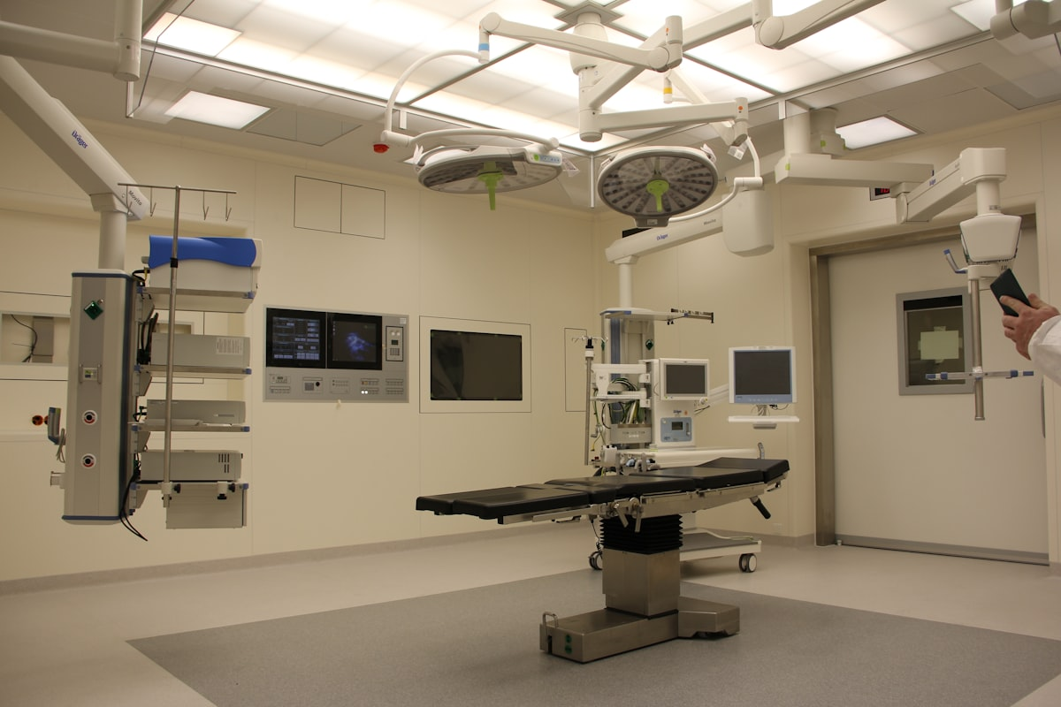
Hospital Bed Management
Real-time bed tracking for emergency and ward operations
48
31
12
3
Total Beds
Occupied (65%)
Available (25%)
Emergency Free
BED STATUS GRID
ICU
General A
Emergency
REAL-TIME BED TRACKING
Maternity
ICU, General, Emergency, Maternity, Pediatric Ward-wise status with equipment tracking
Pediatric
Legend:
Available
Occupied
Reserved
Ward Grid
Emergency Queue
Admission Track
Family Alerts
Equipment
Billing Link
Color-coded status
< 5 min allocation
Full lifecycle
Real-time notifications
Ventilator, monitor, O2
Auto daily charges
CatchQ | IIT Kharagpur Platinum Jubilee Seed Fund Application
8 / 18

Slide 11
Web App vs Android App
Dual interface - Receptionist controls queue, Patient views live status
RECEPTIONIST WEB APP
PATIENT ANDROID APP
Q
Queue Board
Q
Queue Position
View all patients for all doctors in one dashboard
See your exact position in queue (e.g., #4 of 8)
S
Status Control
S
Serving Number
Change status: Pending -> Waiting -> Serving -> Completed/Skipped
Current patient being served (e.g., #3)
S
Skip Patient
T
Total in Queue
One-click skip with auto-queue adjustment (+10 patients)
Total patients waiting for that doctor/slot
D
Doctor Filter
E
Estimated Wait
Filter queue by doctor, time slot, or date
AI-calculated wait time based on avg consultation
B
Bulk Actions
L
Live Updates
Mark multiple patients as completed or skipped
Real-time position changes via WebSocket push
R
Real-time Updates
P
Push Notifications
Socket.io pushes changes instantly to patient apps
Alerts when it's almost your turn
A
Analytics
A
Appointment Info
Daily queue stats, avg wait time, no-show rate
Doctor name, time slot, date, clinic address
P
Patient Search
D
Digital Receipt
Find patient by name, phone, or appointment ID
Payment receipt and summary after visit
SYNC: Web App status changes push to Android App via Socket.io in <100ms | Patient sees live queue position updates instantly
CatchQ | IIT Kharagpur Platinum Jubilee Seed Fund Application
3 / 20

Slide 12
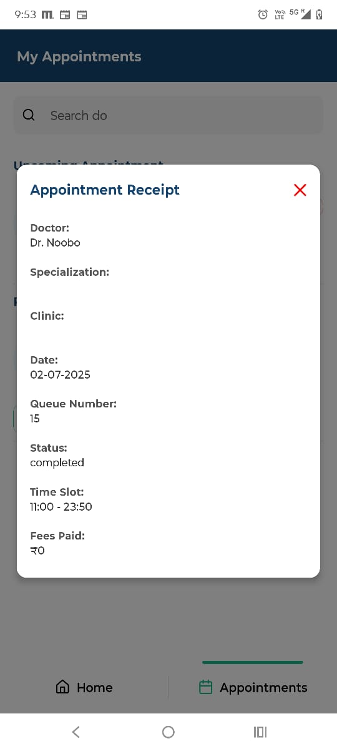
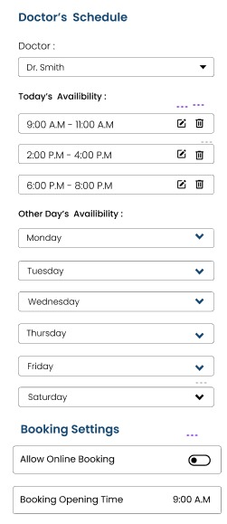
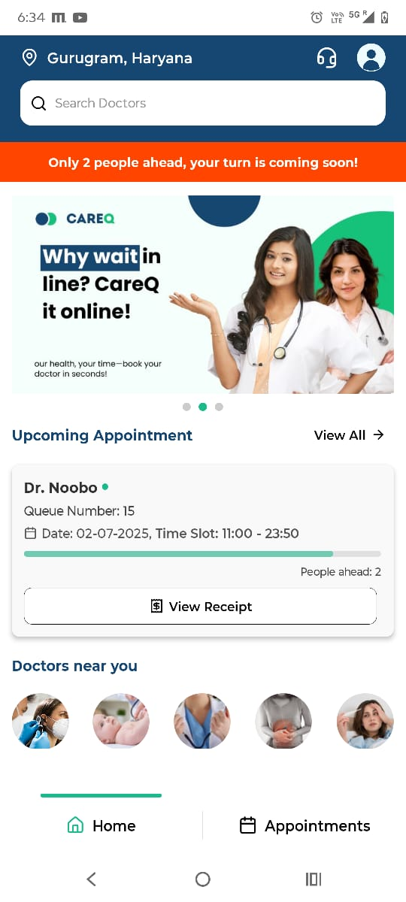
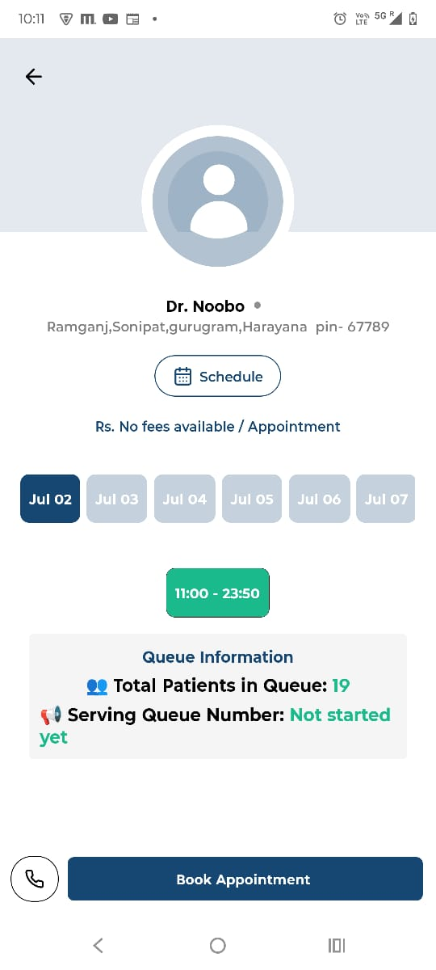
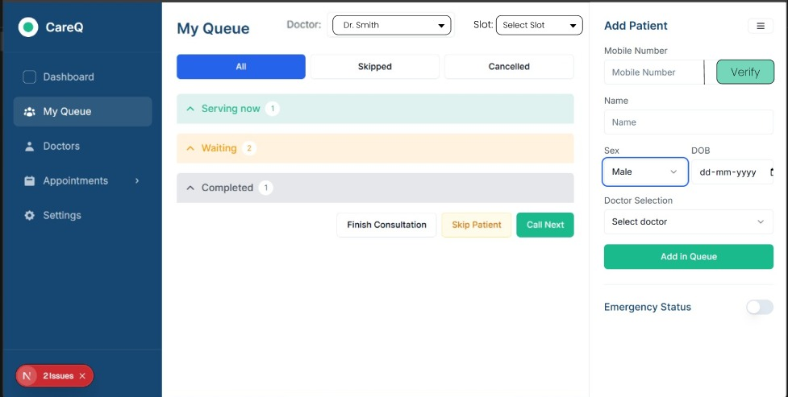
Web App & Android App Screens
Android App Screens
CATCHQ
CATCHQ
WebApp
CatchQ | IIT Kharagpur Platinum Jubilee Seed Fund Application
3 / 20

Slide 13
Partnerships & Integrations
Strategic partnerships to accelerate growth and credibility
Government & Policy
Technology Partners
Healthcare Partners
Channel Partners
Ayushman Bharat (PMJAY)
WhatsApp Business API
Practo (potential)
Doctor Associations
Integrate with 50Cr+ beneficiary database
Official tech partner for healthcare
API integration for referrals
IMA, IAP state chapters
In Discussion
Applied
Planned
In Discussion
ABDM (Ayushman Bharat Digital)
AWS Activate
PharmEasy
Medical Equip Vendors
Compliant with national health stack
$10K credits for startups
Medicine delivery integration
Bundle deals for clinics
Building
Approved
In Discussion
Planned
State Health Departments
Razorpay
Thyrocare
Insurance Companies
Pilot in West Bengal, Odisha, Jharkhand
Payment gateway integration
Lab test booking integration
Cashless claim processing
Planned
Live
In Discussion
Planned
IIT KGP Incubator
Google Maps API
1mg
Chartered Accountants
Mentorship, network, credibility
Clinic location services
Pharmacy integration
Referral network for billing
Active
Live
Planned
Planned
CatchQ | IIT Kharagpur Platinum Jubilee Seed Fund Application
8 / 31

Slide 14
Product Roadmap
Clear path from MVP to market leadership
DEVELOPMENT TIMELINE
Q2 2026
Q3 2026
Q4 2026
Q1 2027
MVP Launch
AI Integration
Scale Phase
Growth
Core booking, queue, billing.
Doctor matching, report analysis.
Pharmacy integration, bed mgmt.
Voice assistant, multi-location.
KEY MILESTONES
Month 3
MRR Increase
Month 6
AI features live
Month 9
Expansion of clinics
Month 12
Rs. 25L MRR
CatchQ | IIT Kharagpur Platinum Jubilee Seed Fund Application
15 / 18

Slide 15
Roadmap & Milestones
18-month execution plan tied to seed fund deployment
Month 1-3
Month 4-6
Month 7-9
Month 10-12
Month 13-18
MVP Launch
Product-Market Fit
Growth Engine
Scale
Expansion
Core queue management live
AI scheduling V1
Bed management launched
50 paying clinics
100+ clinics
5 beta clinics onboarded
100+ clinics in pipeline
25 active clinics
AI diagnostics V1
Tier-2 city launch
WhatsApp integration V1
NPS score > 50
Referral program live
Rs. 15L MRR
Rs. 30L MRR
Billing module complete
Rs. 3L MRR
Rs. 8L MRR
Series A readiness
Insurance integrations
Patient app launched
2000+ patients/month
10,000+ patients/month
25,000+ patients/month
Government partnerships
KEY METRICS
KEY METRICS
KEY METRICS
KEY METRICS
KEY METRICS
5 clinics try to onboard
15 clinics try to onboard
25 clinics try to onboard
50 clinics try to onboard
100+ clinics try to onboard
Rs. 1.5L MRR
Rs. 3L MRR
Rs. 8L MRR
Rs. 15L MRR
Rs. 30L MRR
80% activation
NPS > 50
40% referrals
Series A ready
Tier-2 launch
MILESTONES TIED TO FUNDING: Rs. 30-35L covers 18 months runway | Breakeven at Month 14 | Series A at Month 12-15
CatchQ | IIT Kharagpur Platinum Jubilee Seed Fund Application
5 / 31

Slide 16
Competitive Landscape
CatchQ vs alternatives - Only platform with queue + AI + bed management + WhatsApp
Feature
CatchQ
Practo
ClinicEase
qTest
Paper/WhatsApp
Real-time Queue
YES
NO
NO
NO
NO
AI Scheduling
YES
NO
NO
NO
NO
WhatsApp Integration
YES
Limited
NO
NO
YES
Bed Management
YES
NO
NO
NO
NO
Smart Billing
YES
YES
YES
NO
NO
Digital Prescriptions
YES
YES
YES
YES
NO
Patient App
YES
YES
NO
NO
NO
Multi-Doctor Support
YES
YES
YES
YES
NO
Analytics Dashboard
YES
YES
Basic
NO
NO
Offline Support
YES
NO
NO
NO
YES
Price/month
Rs.2,999
Rs.5,000+
Rs.4,000+
Rs.3,500
FREE
Setup Time
10 min
2-3 days
1 week
1 week
0
CATCHQ ADVANTAGE: Only all-in-one platform | WhatsApp-native (India-first) | AI from Day 1 | Rs. 2,999/mo (60% cheaper) | 10-min setup vs weeks
CatchQ | IIT Kharagpur Platinum Jubilee Seed Fund Application
1 / 31

Slide 17
Social Impact
Bridging the healthcare access gap for 500M+ Indians in tier-2/3 cities
500M+
70%
3x
45 min
2,100+
Indians in tier-2/3 cities lack quality healthcare access
Clinics still use paper registers and WhatsApp
Average wait time in non-metro clinics vs metro hospitals
Average consultation delay due to poor queue management
Clinics already in CatchQ database ready to onboard
IMPACT AREAS
UN SDG ALIGNMENT
H
Healthcare Access
SDG 3: Good Health
Makes quality clinic management affordable for small clinics in tier-2/3 cities
Ensure healthy lives and promote well-being for all at all ages
D
Digital India
SDG 8: Decent Work
Transforms paper-based clinics to digital-first, aligned with government vision
Promote sustained, inclusive economic growth and decent work
P
Patient Experience
Reduces wait times by 60%, eliminates paper prescriptions, enables digital payments
SDG 9: Innovation
D
Doctor Efficiency
Build resilient infrastructure, promote inclusive industrialization
Automates queue, billing, scheduling - doctors see 30% more patients daily
Employment
SDG 10: Reduced Inequality
E
Creates jobs: sales, support, development in tier-2 cities
Reduce inequality within and among countries
W
Women Health
SDG 11: Sustainable Cities
Special modules for maternal care, menstrual tracking, women-only clinics
Make cities inclusive, safe, resilient and sustainable
CatchQ | IIT Kharagpur Platinum Jubilee Seed Fund Application
6 / 31

Slide 18
Market Opportunity
Massive addressable market with clear product-market fit
INDIA (PRIMARY MARKET)
10 Lakh+
30,000+
Rs. 50K Cr+
90%
Clinics as total
addressable market
Hospitals needing
bed management
Healthcare IT
market by 2028
Patients prefer
WhatsApp
GLOBAL (EXPANSION MARKET)
$1.2 Billion
$8.4 Billion
$45 Billion
Queue Management
Market by 2028
Clinic Management
Market by 2028
AI in Healthcare
by 2030
MARKET SIZING
TAM
Rs. 50,000 Cr
Total clinic IT spend
SAM
Rs. 5,000 Cr
SaaS-able segment
SOM
Rs. 500 Cr
Year 3 target
CatchQ | IIT Kharagpur Platinum Jubilee Seed Fund Application
11 / 14

Slide 19
TAM / SAM / SOM
Market sizing for CatchQ - Total Addressable, Serviceable, and Obtainable Market
TAM - Total Addressable Market
SAM - Serviceable Addressable
SOM - Serviceable Obtainable
Rs. 50,000 Cr
Rs. 5,000 Cr
Rs. 500 Cr
Total clinic IT spend in India
SaaS-able segment
Year 3 target
WHO:
10 Lakh+ clinics across India
30,000+ hospitals
50 Crore+ patients visiting annually
WHAT:
Queue management software
Patient engagement platform
Billing & scheduling tools
Bed management systems
WHY:
90% clinics use paper/WhatsApp
Zero digital infrastructure
Massive inefficiency = massive opportunity
SEGMENT:
Clinics with 1-10 doctors
Urban & semi-urban areas
Tech-ready practices
PRICING:
Starter: Rs. 2,999/month
Pro: Rs. 5,999/month
Enterprise: Rs. 9,999/month
CHANNELS:
WhatsApp-first onboarding
Free trial (14 days)
Referral program
YEAR 1:
50 clinics | Rs. 36L ARR
3 cities | 5 team members
YEAR 2:
200 clinics | Rs. 1.8 Cr ARR
10 cities | 15 team members
YEAR 3:
1,000 clinics | Rs. 9.6 Cr ARR
25 cities | 40 team members
GROWTH: 60% YoY
RETENTION: 85%
LTV/CAC: 5x
CatchQ | IIT Kharagpur Platinum Jubilee Seed Fund Application
4 / 20

Slide 20
Go-to-Market Strategy
WhatsApp-first acquisition targeting 50 clinics in Year 1
PHASE 1: Month 1-3
PHASE 2: Month 4-6
PHASE 3: Month 7-9
PHASE 4: Month 10-12
Foundation
Validation
Scaling
Growth
Launch with 5 beta clinics
Referral program (1 month free)
Hire 2 sales executives
Channel partner program
IIT KGP alumni network
IIT KGP incubator demo day
Tier-2 city expansion
Clinic chain partnerships
Free 30-day trial
Healthcare conferences
WhatsApp broadcast campaigns
Media coverage (HealthTech)
WhatsApp onboarding flow
Google Ads (clinic keywords)
Doctor association partnerships
Series A preparation
Collect NPS feedback
YouTube tutorials
Insurance company tie-ups
1000+ clinic waitlist
Iterate on core features
Case studies from beta
Government scheme integration
Product market fit confirmed
TARGET: 10 Clinics
TARGET: 25 Clinics
TARGET: 40 Clinics
TARGET: 50+ Clinics
KEY CHANNELS: WhatsApp Business API | Google Ads | IIT KGP Network | Doctor Referrals | Healthcare Events | YouTube
CatchQ | IIT Kharagpur Platinum Jubilee Seed Fund Application
3 / 31

Slide 21
Business Model
Multiple revenue streams for sustainable growth
MOST POPULAR
Starter
Professional
Enterprise
Rs. 2,999
Rs. 5,999
Rs. 9,999
/month
/month
/month
For small clinics (1-2 doctors)
For growing clinics (3-5 doctors)
For hospitals & chain clinics
+
WhatsApp booking
+
Everything in Starter
+
Everything in Pro
+
Up to 2 doctors
+
Up to 5 doctors
+
Unlimited doctors
+
Basic queue mgmt
+
Smart TV display
+
Multi-location
+
Digital receipts
+
Advanced analytics
+
API access
+
Email support
+
Auto reminders
+
Dedicated manager
+
Mobile app access
+
Priority support
+
24/7 phone support
REVENUE STREAMS
SaaS
PRIMARY
TXN
PER TXN
Pharmacy
COMMISSION
AI Add-on
ADD-ON
Bed Module
MODULE
Monthly subscriptions (recurring revenue)
1-2% per payment transaction
5-10% commission on medicine orders
Rs. 999/month premium AI features
Rs. 4,999/month hospital bed tracking
CatchQ | IIT Kharagpur Platinum Jubilee Seed Fund Application
10 / 14

Slide 22
Unit Economics
Sustainable SaaS metrics with strong LTV/CAC ratio and healthy margins
Customer Acquisition Cost (CAC)
Lifetime Value (LTV)
LTV / CAC Ratio
Payback Period
Monthly Churn Rate
Gross Margin
Rs. 5,000
Rs. 1,80,000
36x
2 months
3.5%
82%
Blended
36-month
Target: >3x
Target: <12
Target: <5%
Target: >70%
REVENUE MODEL
CAC BREAKDOWN
70%
SaaS Subscription
WhatsApp Ads
30%
Rs. 2,999-9,999/mo per clinic
Rs. 1,500
15%
Transaction Fees
Google Ads
24%
2% on billing through platform
Rs. 1,200
Premium Features
Sales Team
20%
10%
Rs. 1,000
AI analytics, advanced reports
API & Integrations
Content Marketing
16%
5%
Rs. 800
Third-party plugin marketplace
Events/Demos
Rs. 500
10%
KEY INSIGHT: WhatsApp-first acquisition cuts CAC by 60% vs traditional sales | Referral program drives 40% of new clinics | 82% gross margin enables aggressive growth
CatchQ | IIT Kharagpur Platinum Jubilee Seed Fund Application
4 / 31

Slide 23
Revenue Projections
Conservative estimates based on market benchmarks
YEAR 1 PROJECTIONS
50
Rs. 3L
Rs. 36L
60%
85%
Rs. 7.2L
Clinics
MRR
ARR
Growth Rate
Retention
Avg/Clinic
3-YEAR FINANCIAL PROJECTIONS
Metric
Year 1
Year 2
Year 3
Clinics
50
200
1,000
MRR
Rs. 3L
Rs. 15L
Rs. 80L
ARR
Rs. 36L
Rs. 1.8 Cr
Rs. 9.6 Cr
Team Size
5
15
40
Cities
3
10
25
Conservative estimates. Based on Rs. 5,999 avg subscription, 85% retention, 60% YoY growth.
CatchQ | IIT Kharagpur Platinum Jubilee Seed Fund Application
16 / 18

Slide 24
Use of Funds
Detailed allocation of Rs. 30-35 Lakhs seed fund - every rupee mapped to growth
TOTAL SEED FUND
Rs. 30-35 Lakhs
Product Development
Sales & Marketing
Operations
Contingency
Working Capital
40%
25%
15%
10%
10%
Rs. 12-14L
Rs. 7.5-9L
Rs. 4.5-5L
Rs. 3-3.5L
Rs. 3-3.5L
Backend engineer (2): Rs. 8L
WhatsApp marketing: Rs. 3L
Office space: Rs. 2L
Emergency fund: Rs. 2L
Cash buffer: Rs. 2L
Frontend/Android (1): Rs. 4L
Sales team (2): Rs. 4L
Legal & compliance: Rs. 0.5L
Opportunity fund: Rs. 1L
Vendor payments: Rs. 1L
Cloud infra (AWS): Rs. 1.5L
Content & branding: Rs. 1L
Accounting: Rs. 0.5L
Market pivot: Rs. 0.5L
Insurance: Rs. 0.5L
AI/ML development: Rs. 1L
Events & demos: Rs. 1L
Misc ops: Rs. 1L
CatchQ | IIT Kharagpur Platinum Jubilee Seed Fund Application
2 / 31

Slide 25
Scalability Plan
From 50 to 1,000+ clinics - proven playbook with clear metrics
STAGE 1 Seed
STAGE 2 Series A
STAGE 3 Series B
STAGE 4 IPO
Month 1-6
Month 7-18
Month 19-36
Year 3-5
50 Clinics
200 Clinics
1,000 Clinics
5,000+ Clinics
Rs. 36L ARR
Rs. 1.8 Cr ARR
Rs. 9.6 Cr ARR
Rs. 50 Cr ARR
Annual Recurring Revenue
Annual Recurring Revenue
Annual Recurring Revenue
Annual Recurring Revenue
IIT KGP network
Sales team (5 people)
National expansion
Platform ecosystem
WhatsApp direct outreach
Channel partners
Enterprise chains
Insurance integration
Free trial conversion
Automated onboarding
API marketplace
Health data marketplace
Manual onboarding
Referral program
International (SE Asia)
Govt partnerships
Founder-led sales
Content marketing
AI diagnostics
Global expansion
50 clinics
200 clinics
1,000 clinics
5,000+ clinics
SCALABILITY: WhatsApp-first = zero marginal cost | Modular SaaS = easy expansion | Data network effects | Platform ecosystem at scale
CatchQ | IIT Kharagpur Platinum Jubilee Seed Fund Application
9 / 31

Slide 26
Risk Analysis
Key risks identified with mitigation strategies - showing maturity and preparedness
Competition
HIGH
Customer Churn
MEDIUM
Technical Scalability
MEDIUM
RISK: Practo, ClinicEase have funding & brand
RISK: Clinics may not adopt digital tools
RISK: System must handle 1000+ concurrent clinics
MITIGATION: Differentiate on WhatsApp-first, price, and all-in-one. Win on tier-2/3 where they are weak.
MITIGATION: WhatsApp onboarding (zero learning curve). Free trial. Dedicated support. Show ROI in 2 weeks.
MITIGATION: Cloud-native (AWS). Auto-scaling. Load testing. Modular architecture.
Regulatory
LOW
Team Risk
MEDIUM
Market Timing
LOW
RISK: Healthcare data privacy (ABDM compliance)
RISK: Key person dependency in early stage
RISK: Clinics may not be ready for digital
MITIGATION: Build ABDM-compliant from Day 1. Data encryption. Regular audits.
MITIGATION: Document everything. Cross-train team. Hire 2nd backend dev in Month 2.
MITIGATION: WhatsApp is already used by 90% of clinics. We are digitizing existing behavior, not creating new.
RISK MANAGEMENT: Monthly review | Contingency fund (10%) | Agile pivots | Diverse revenue streams | Strong unit economics
CatchQ | IIT Kharagpur Platinum Jubilee Seed Fund Application
7 / 31

Slide 27
Team
The people building India clinic operating system
CATCHQ TEAM
Harsh
Shubham Kumar
5TH YEAR UG STUDENT FROM THE DEPARTMENT OF METALLURLY
5TH YEAR UG STUDENT FROM THE DEPARTMENT OF ARCHITECTURE
CatchQ | IIT Kharagpur Platinum Jubilee Seed Fund Application
12 / 14

Slide 28
CATCHQ
To become India's #1
Healthcare shouldn't start with waiting.
It should start with CatchQ.
Clinic & Hospital
Operating System
Making healthcare accessible by eliminating appointment friction, enabling AI-assisted diagnosis, connecting pharmacies to patients, and managing hospital beds efficiently - for 10 Lakh+ clinics and 50 Crore+ patients.
IIT Kharagpur Platinum Jubilee Seed Fund

