Slide 1
Z21 STARTUP ACCELERATION PROGRAM | KGP FORGE
ONN-DETECT: Zero-Cloud AI Media Forensics
On-device deepfake, voice-clone, and cyber-fraud defense in under 180 ms.
Domain: AI & Deep Tech | Stage: Pre-Seed (TRL 6-7 Validated Prototype) | IIT Kharagpur

Slide 2
THE CORE PROBLEM
Cloud Costs, Privacy Laws, and Compression Break Legacy Detection
Live Voice & UPI Fraud
Voice-Clone Scams: Live AI voice calls and digital-arrest threats coerce instant UPI transfers.
Forged Screenshots: AI-edited payment receipts and fake invoices defraud merchants daily.
Zero In-Call Guard: Victims lack real-time verification while speaking on phone or WhatsApp calls.
AI Slop & KYC Spoofing
Short-Video Flooding: Unlabelled synthetic Reels and Shorts degrade consumer social feeds.
Video-KYC Injection: Deepfake faces and virtual cameras bypass bank and fintech onboarding.
Compression Collapse: Academic CNNs fail after WhatsApp JPEG Q85 or VoIP Opus re-encoding.
Cloud Unit Economics
Privacy Violations: Uploading calls and biometric KYC video violates DPDP Act and GDPR.
Unsustainable Cost: Cloud GPU APIs cost $0.02-$0.10 per scan, blocking continuous screening.
Offline Blindness: Server-dependent tools fail in low-connectivity field investigations.
ONN-DETECT | Problem Statement & Value Proposition | Slide 2

Slide 3
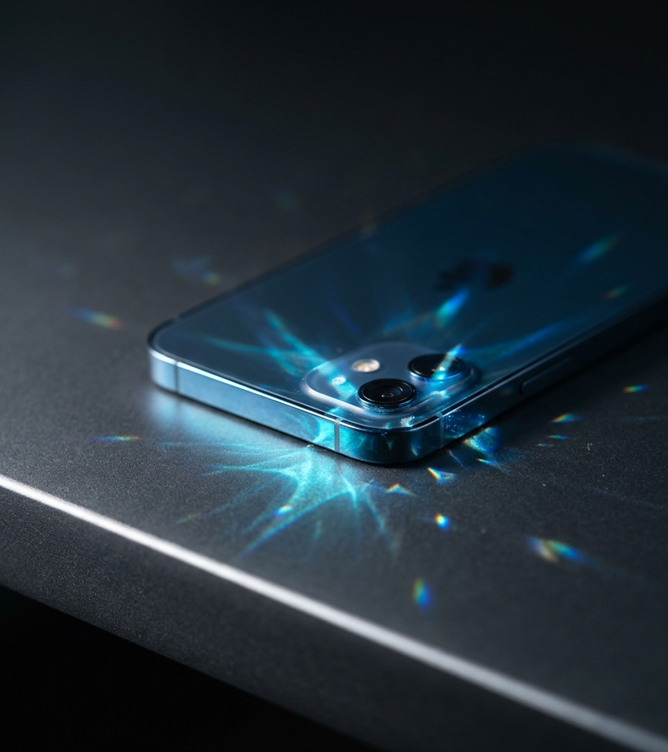
THE ONN-DETECT SOLUTION
Zero-Cloud Forensics at $0 Server Cost
Zero-Network Sandbox: Strips INTERNET permission at the OS manifest level; private calls and biometrics stay on-device.
Sub-180 ms Edge Cascade: Unifies INT8 SigLIP-B/16, 36-ch SRM/NPR CNN, LCNN-MFM speech anti-spoofing (<25 ms), and C2PA & AudioSeal verification.
B2B2C Dual Deployment: Reaches 0.894 image AUC (0.900 under Q85 laundering) across a consumer app and enterprise KYC SDK.
ONN-DETECT | Zero-Cloud Edge Architecture | Slide 3

Slide 4
CONSUMER SECURITY SUITE
Real-Time Consumer Protection Across Calls, UPI, and Social Feeds
Scam-Call & UPI Shield
Live 4s Scoring: LCNN-MFM (508 KiB) scores call windows in <25 ms.
UPI Coercion Alert: Detects simultaneous call + GPay/PhonePe launch.
Pre-Payment Block: Warns users of synthetic voices before PIN entry.
Family Voice Vault
15s Enrollment: Stores encrypted family voiceprints locally.
Dual Biometrics: Pairs SpeakerVerifier with LCNN anti-spoofing.
Clone Immunity: Blocks fake family emergency extortion calls.
AI Reel Filter & Forward Guard
Feed Automation: Uses Android 11+ Accessibility gesture APIs.
Auto-Swipe & HUD: Swipes past AI Reels or displays a live corner authenticity badge.
WhatsApp/Share Guard: 1-tap Share Sheet check on forwarded voice notes, viral videos, and QR scams.
ONN-DETECT | Consumer Viral Wedge & Daily Active Utility | Slide 4

Slide 5
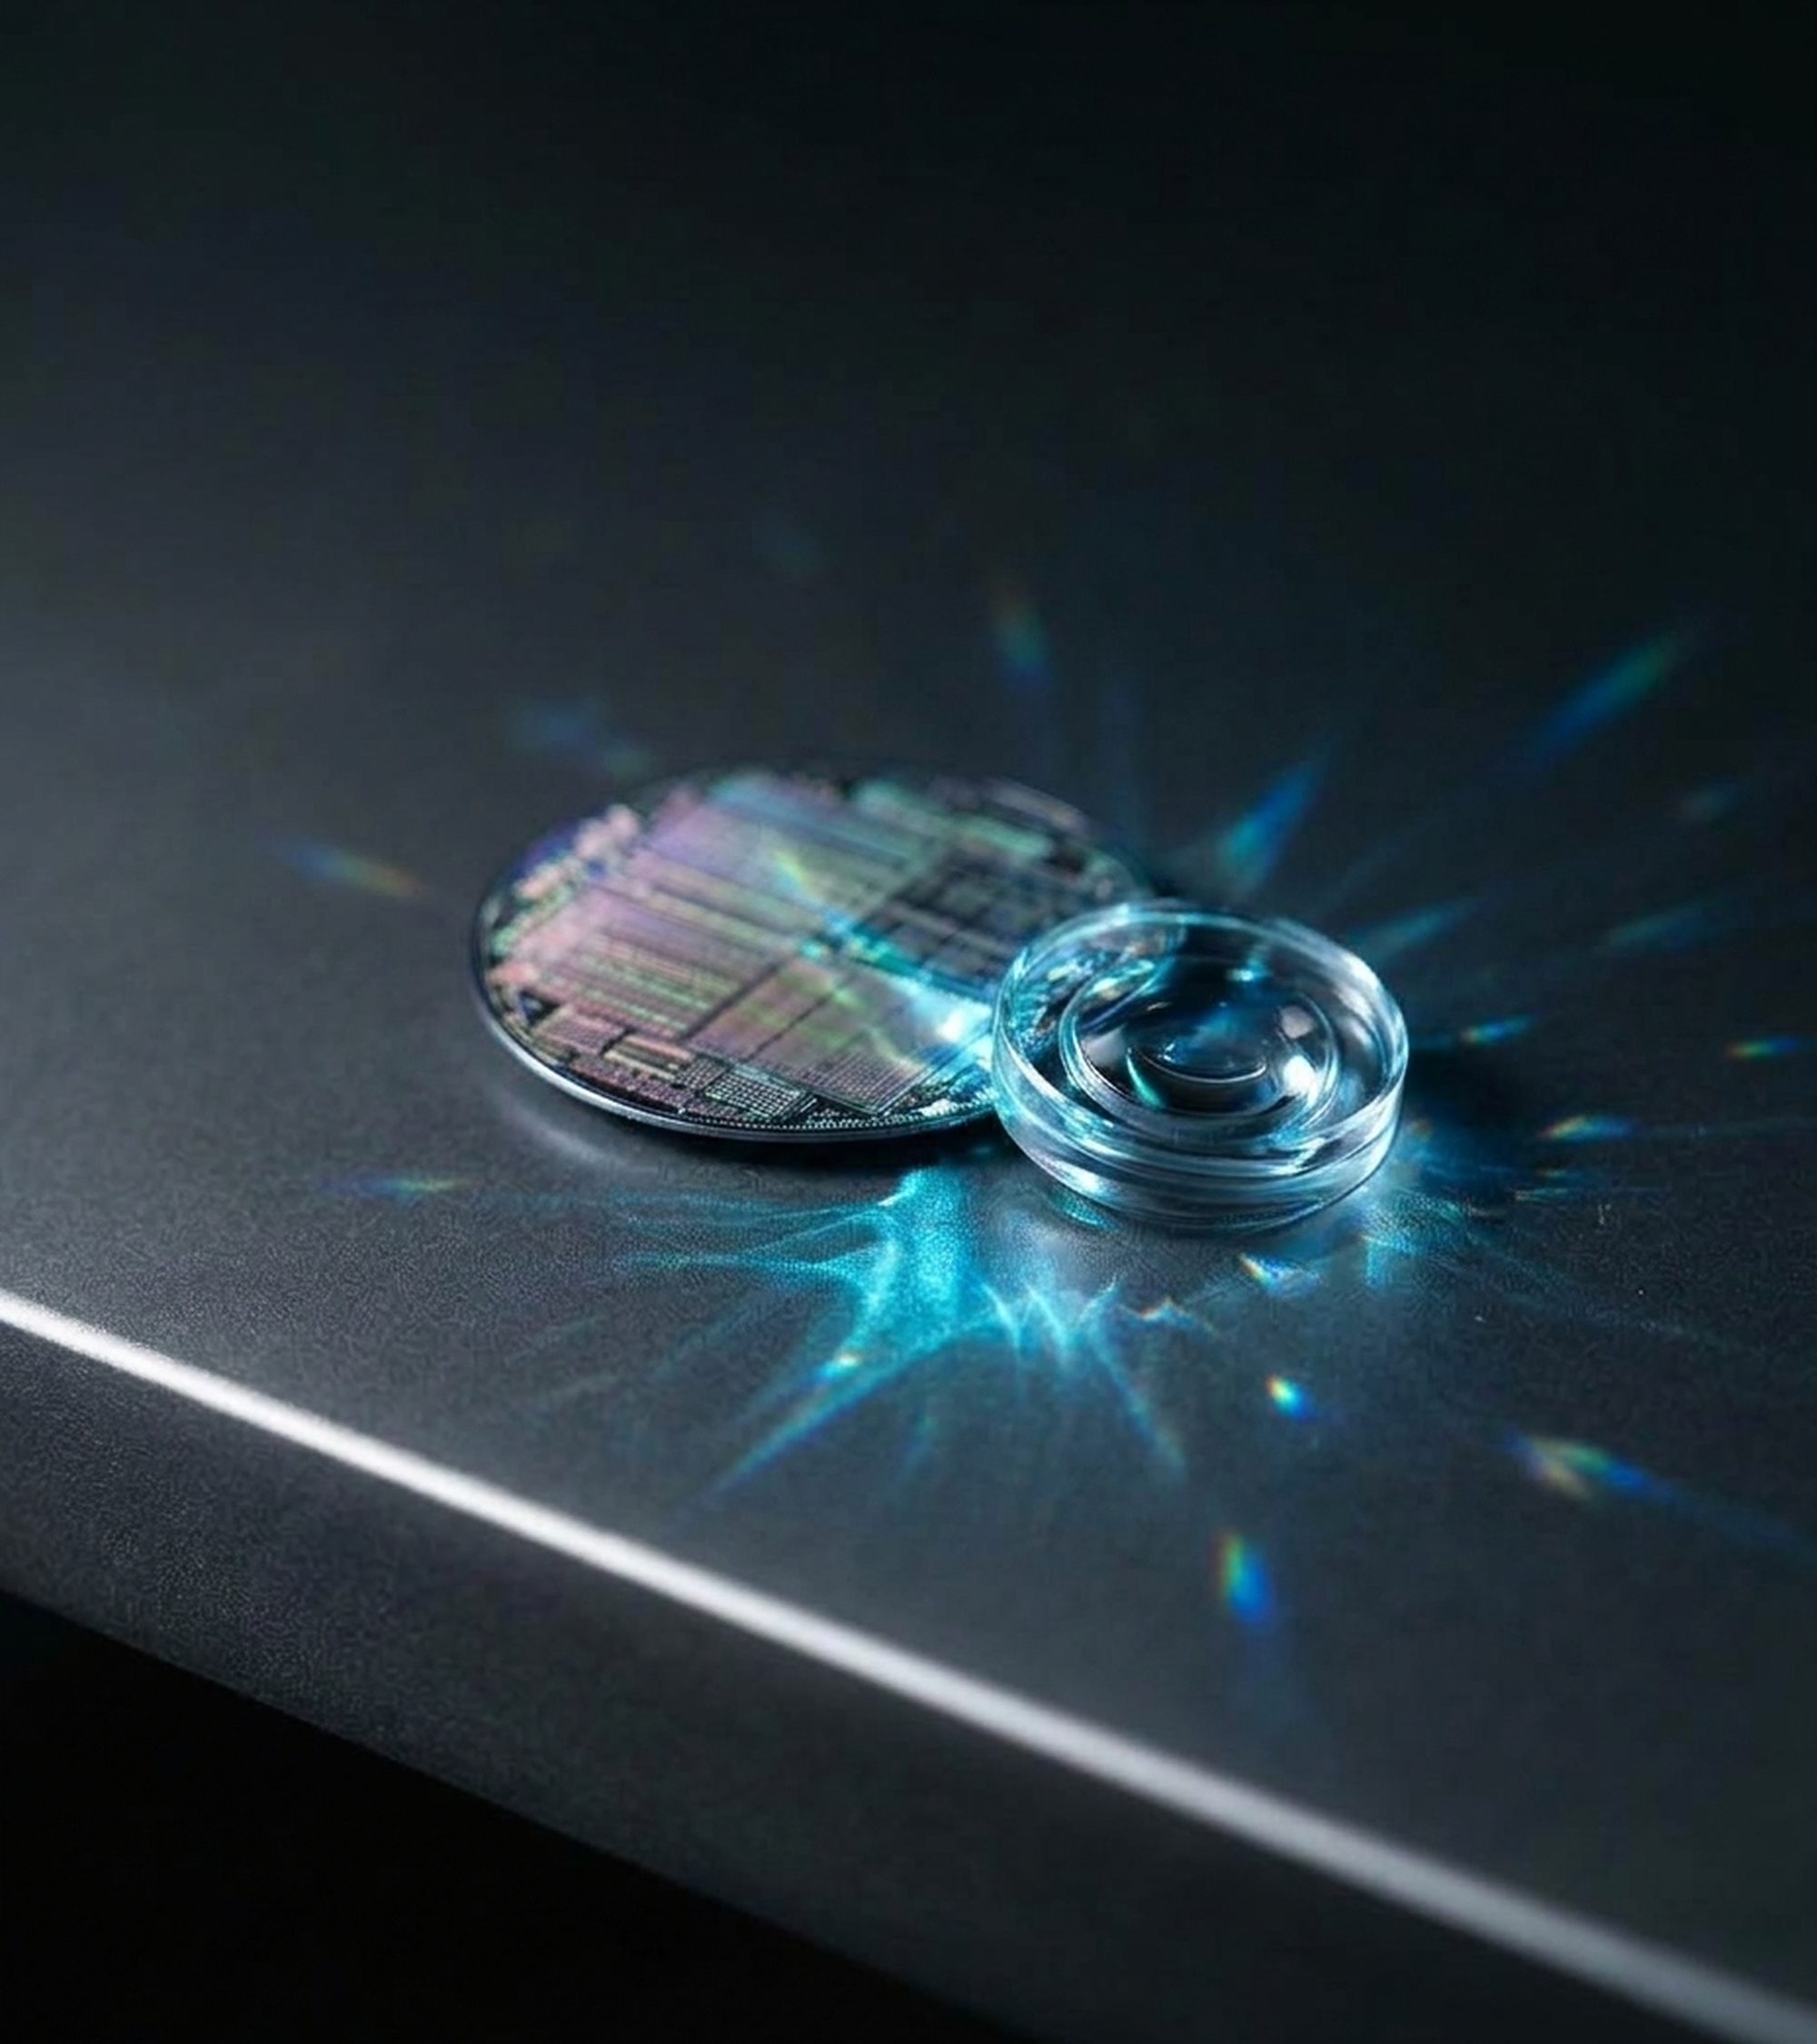
ENTERPRISE B2B MONETIZATION
Offline SDK for Video-KYC & Claims
Video-KYC Anti-Spoofing: Blocks face-swaps, voice clones, and virtual-camera injection for RBI V-CIP and SEBI compliance.
Hardware-Signed Receipts: Signs scan verdicts, media SHA-256, and model hashes inside Android StrongBox Keystore TEE.
Receipt & ID Forgery Guard: Pinpoints spliced amounts on UPI screenshots and saves enterprises $0.02-$0.10 per KYC scan.
ONN-DETECT | Enterprise B2B SDK Suite | Slide 5

Slide 6
CORE TECHNOLOGICAL INNOVATION
Four ML-Systems Breakthroughs Make ONN-DETECT Hard to Replicate
Base-Margin Cascade
Continuous Tail Order: Injects INT8 SigLIP-B/16 logit as XGBoost base_margin to prevent tree step-ties.
36-Ch SRM + NPR: Combines 30 locked 5x5 SRM high-pass filters with Neighboring Pixel Residuals.
Selective Arbitration: Escalation band maximizes selective accuracy under a >=85% classified-rate floor.
ViT-to-LiteRT Compiler
1.97e-06 FP32 Parity: Custom channels-last Keras mirror bypasses broken onnx2tf ViT shape inference.
Static MAP Queries: Pre-computes frozen attention-pooling queries, saving 589K weights at runtime.
Zero-Heap APK mmap: Maps the 89.96 MB INT8 tower into OS page cache with 0 MB Java heap bloat.
Keys-Bicubic & DCPT
Bit-Exact Resampler: Custom two-pass Keys-cubic (a=-0.5) filter with 8-bit clip matches Pillow +/-1.
DCPT Paired Loss: Symmetric Bernoulli KL + penultimate cosine alignment hardens Q85 accuracy.
Categorical Provenance: Treats cryptographic manifests (C2PA) and neural watermarks (AudioSeal) as positive proof.
ONN-DETECT | Proprietary Architecture & Trade Secret Toolchain | Slide 6

Slide 7
MEASURED BENCHMARK VALIDATION
v7 Tower Architecture Lifts Sealed Image AUC to 0.894 (+17.9 pts)
7x Low-FPR Recall Gain: Base-margin VFM fusion lifts image TPR@1%FPR from 4.0% to 28.0% and TPR@0.1%FPR to 25.0%.
0.900 Laundered AUC: Re-encoding test images to 512px JPEG Q85 raises v7 AUC to 0.900, proving social-feed resilience.
0.875 Speech & 309 Gates: LCNN-MFM reaches 59.5% TPR@1%FPR, backed by 309 automated Python and Kotlin parity tests.
Source: ONN-DETECT v7 Sealed Benchmark (3,600 Image / 68 Generators & 2,400 Audio Records) | Slide 7

Slide 8
COMPETITIVE LANDSCAPE & IP STATUS
TRL 6-7 System Prototype with Structural Privacy and Cost Moats
Capability / Metric | ONN-DETECT (v7) | Cloud Deepfake APIs | Academic CNNs
Execution & Privacy | 100% On-Device (0 Cloud) | Cloud Upload (DPDP Risk) | Desktop GPU Only
Marginal Cost / Scan | Rs 0.00 ($0 Server Cost) | Rs 1.70 - Rs 8.40 / Scan | N/A (Not Deployed)
512px JPEG Q85 Laundering | 0.900 AUC (Hardened) | 0.72 - 0.81 AUC | Collapses (<0.65 AUC)
Live Call & Reel Auto-Skip | Yes (<25 ms Audio / <180 ms) | Impossible (1-3s Network Lag) | No Mobile Runtime
Readiness & Provenance | TRL 6-7 | StrongBox TEE | IP Pipeline | Cloud SaaS | Server TLS only | TRL 2-3 Lab Papers | None
ONN-DETECT | TRL 6-7 Validated Prototype | IP: Trade Secret & Provisional Patent Pipeline | Slide 8

Slide 9
MARKET SIZE & COMMERCIAL MODEL
Targeting a Rs 6,800 Cr On-Device SAM and Rs 85 Cr 3-Year SOM
Global TAM (Rs 62,000 Cr): $7.4B global deepfake defense, Video-KYC anti-spoofing, and mobile voice-fraud market.
B2B SDK (Rs 52.5 Cr SOM): 35 fintech, NBFC, and insurance clients at Rs 1.5 Cr avg ACV (Rs 20-Rs 40 per KYC/claim).
B2C & Traction (Rs 32.5 Cr SOM): 1.1M users at Rs 299/yr; TRL 6-7 v7 APK validated on 6,000 samples, starting pilot outreach.
ONN-DETECT | B2B Enterprise SDK + B2C Consumer Subscription (B2B2C) | Slide 9

Slide 10
FUNDING ASK, RUNWAY & KGP FORGE SUPPORT
Rs 25 Lakh Seed Grant Fuels a 12-Month Runway to Enterprise Pilots
Rs 25.00L Ask & 12-Month Plan
Runway & Burn: Bootstrapped at Rs 15K-25K/mo; Rs 2.08L/mo post-grant burn for 12-month runway.
CapEx (35% / Rs 8.75L): GPU compute for B-Free twins (Rs 5.25L) + Android NPU test matrix (Rs 3.50L).
OpEx (65% / Rs 16.25L) & Support: Eng stipends (Rs 9.5L), pilots (Rs 3.5L), patents/audit (Rs 3.25L) + KGP Forge mentorship.
ONN-DETECT | Seed Grant Request: Rs 25,00,000 (Rs 25 Lakhs) | Slide 10

Slide 11
Authenticity at the Edge. Zero Cloud. Zero Compromise.
Thank You — ONN-DETECT | z21 Startup Acceleration Program (KGP Forge)
Founder: Shubham Kumar (IIT Kharagpur) | Repo: https://github.com/shubhamiitshk/Onn-Detect-

