Slide 1
Z21 STARTUP ACCELERATION PROGRAM | KGP FORGE
ONN-DETECT: Zero-Cloud AI Media Forensics
On-device deepfake, voice-clone, and KYC fraud defense in under 450 ms.
Release: onn-20261023-v8 | Stage: Pre-Seed (TRL 6-7) | IIT Kharagpur

Slide 2
THE CORE PROBLEM
Cloud Costs, Privacy Laws, and Compression Break Legacy Detection
Voice & Receipt Fraud
Voice-Clone Scams: Forwarded AI voice notes impersonate family members to extort instant UPI transfers.
Forged Screenshots: AI-edited payment receipts and fake invoices defraud merchants and insurers daily.
No Local Verification: Consumers lack offline identity + authenticity verification for shared media.
Video-KYC & HAL Spoofing
Virtual-Camera Hooks: Attackers inject pre-rendered deepfakes into bank Video-KYC (V-CIP) sessions.
Lip-Sync Synthesis: Audio-driven talking-head fakes bypass single-frame face liveness checks.
Compression Collapse: Academic CNNs fail after WhatsApp JPEG Q85 or VoIP Opus re-encoding.
Cloud Unit Economics
Privacy Violations: Uploading voiceprints and biometric KYC video violates DPDP Act and GDPR.
Unsustainable Cost: Cloud GPU APIs cost $0.02-$0.10 per scan, blocking high-volume screening.
Unverified Provenance: Stripped or forged C2PA metadata cannot be trusted without offline crypto checks.
ONN-DETECT | Problem Statement & Value Proposition | Slide 2

Slide 3
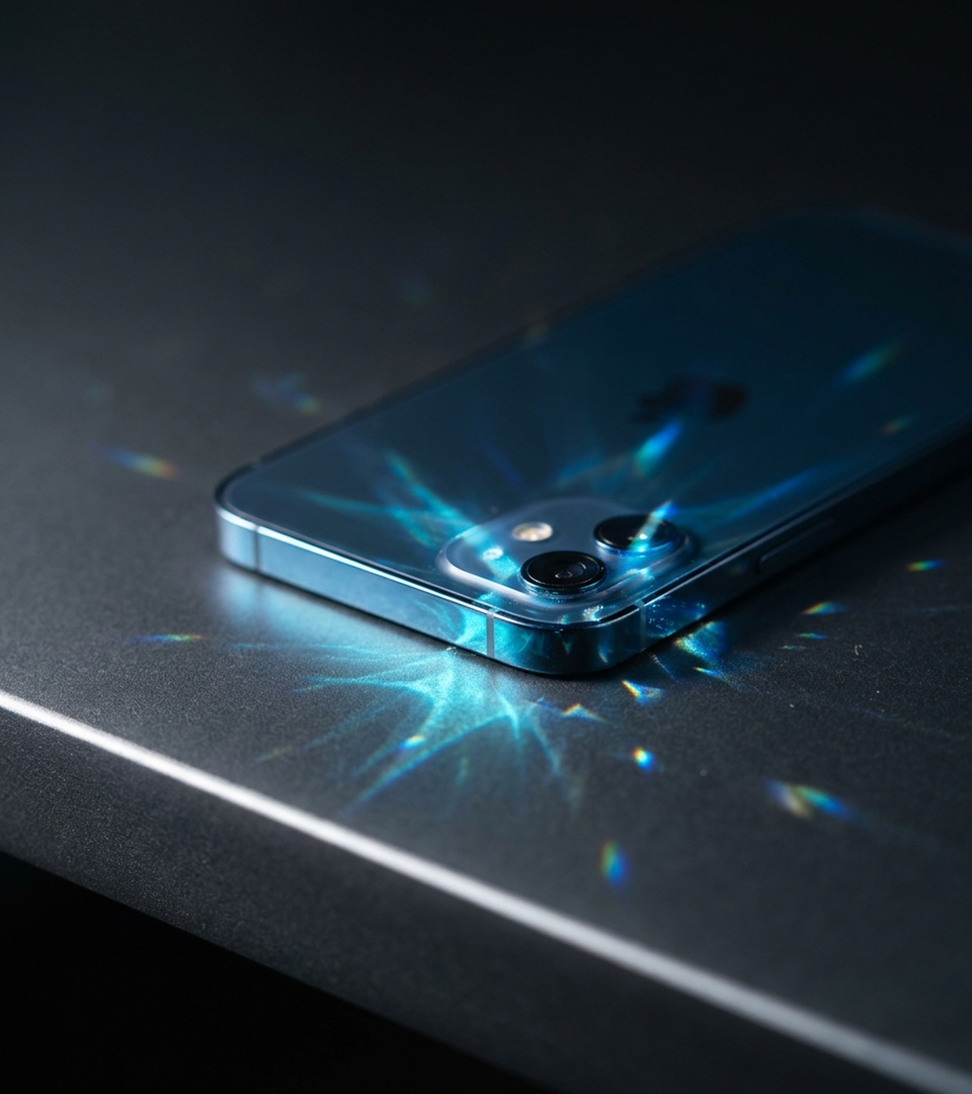
THE ONN-DETECT SOLUTION
Zero-Cloud Forensics at $0 Server Cost
Zero-Network Sandbox: Strips INTERNET permission at the OS manifest level; voiceprints and KYC media never leave the phone.
5-Layer Edge Cascade: Unifies INT8 SigLIP-B/16 (94.3 MB), 20-ch SRM/NPR/RGB CNN, LCNN-MFM audio, BioLip, and C2PA.
Play-Compliant B2B2C Suite: Runs in 282 ms (4 threads) across our consumer Forward Guard + Voice Vault app and enterprise KYC SDK.
ONN-DETECT | Zero-Cloud Edge Architecture (Release onn-20261023-v8) | Slide 3

Slide 4
CONSUMER & FORENSIC CAPABILITIES
Play-Compliant Consumer & Forensic Suite Verified by 220 JVM Tests
Family Safe-Voice Vault
Dual-Gate Verdict: Gates on LCNN-MFM (<0.375) + 3s/1.5s window voiceprints.
AES-256-GCM Sealed: Seals voiceprints in Room with Keystore AAD binding.
Clone Alert Path: Flags synthetic audio matching a relative (CAM++ next).
Instant Forward Guard
1-Tap Share Target: Handles ACTION_SEND & SEND_MULTIPLE for WhatsApp media.
32x32 ROI Heatmap: ResidualHeatmapExtractor pinpoints local tamper energy.
ELA Document Guard: DocumentForgeryAnalyzer catches spliced UPI receipts.
Offline Provenance
32 Production Roots: Verifies official C2PA anchors (Adobe, Google, DigiCert).
Full Container Walk: Reassembles JPEG APP11 (En, Z) & ISO-BMFF JUMBF boxes.
Fail-Closed Crypto: Requires chain + COSE_Sign1 + c2pa.hash.data match.
ONN-DETECT | 100% Google Play Policy Compliant (Zero Accessibility RPA) | Slide 4

Slide 5
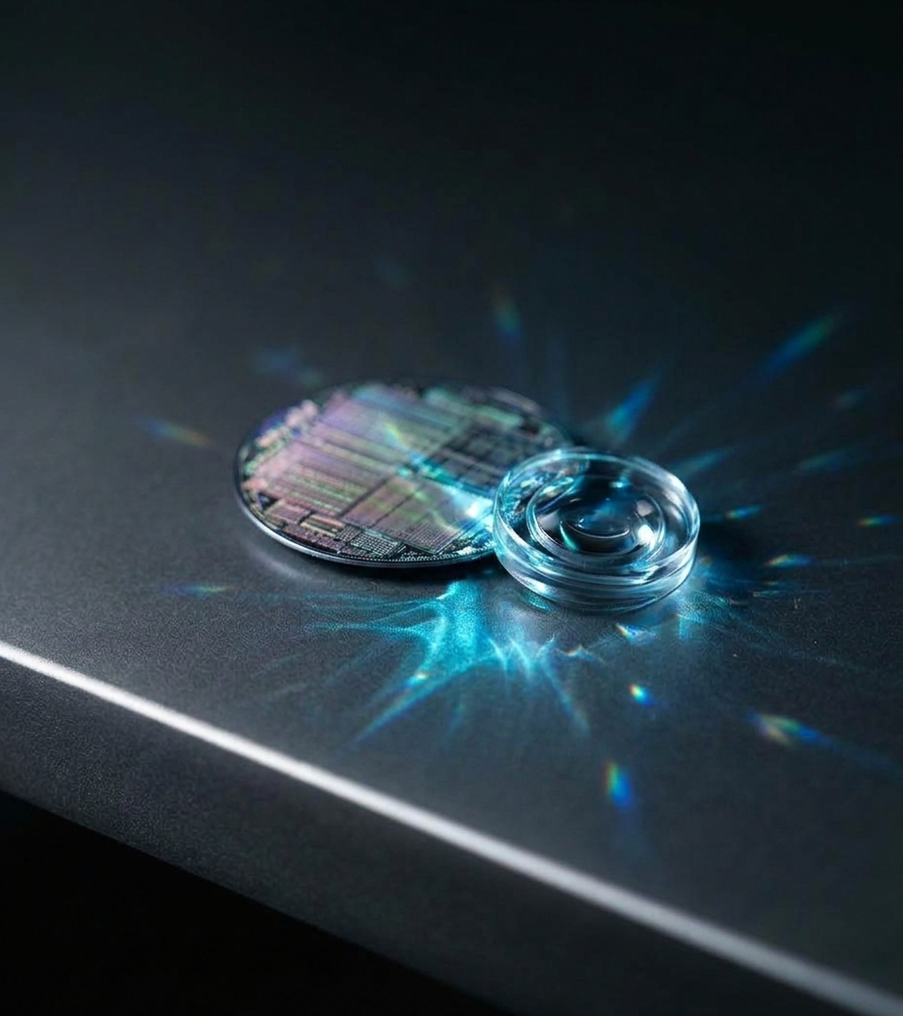
ENTERPRISE B2B MONETIZATION
Offline SDK for Video-KYC & Claims
V-CIP KYC Injection Shield: VirtualCameraDetector audits Camera2 HAL hardware levels, silicon sensor bounds, and Xposed hooks.
Hardware Forensic Receipts: StrongBoxReceiptSigner signs RFC 8785 canonical JSON + media SHA-256 via StrongBox/TEE ECDSA P-256.
BioLip 478-Pt Mesh Defense: MediaPipe FaceLandmarker extracts 64 perioral points (inter-ocular normalized) to catch lip-sync fakes.
ONN-DETECT | Enterprise B2B SDK Suite | Slide 5

Slide 6
CORE TECHNOLOGICAL INNOVATION
Four ML-Systems Breakthroughs Make ONN-DETECT Hard to Replicate
Base-Margin Cascade
Continuous Tail Order: Injects INT8 SigLIP-B/16 logit as XGBoost base_margin to prevent tree step-ties.
20-Ch SRM + NPR Stem: Combines 12 locked 5x5 SRM high-pass filters, 4 NPR kernels, and 4 RGB channels.
Selective Arbitration: Escalation band maximizes selective accuracy under a >=85% classified-rate floor.
ViT-to-LiteRT Compiler
1.97e-06 FP32 Parity: Custom channels-last Keras mirror bypasses broken onnx2tf ViT shape inference.
Static MAP Queries: Pre-computes frozen attention-pooling queries, saving 589K weights at runtime.
Zero-Heap APK mmap: Maps the 94.3 MB INT8 tower into OS page cache (282 ms @ 4 threads, 0 MB heap).
Keys-Bicubic & Crypto
Bit-Exact Resampler: Custom two-pass Keys-cubic (a=-0.5) filter with 8-bit clip matches Pillow +/-1.
DCPT Paired Loss: Symmetric Bernoulli KL + penultimate cosine alignment hardens Q85 accuracy.
Hardware Crypto Binding: StrongBox ECDSA P-256 + 32-anchor C2PA COSE_Sign1 + AES-256-GCM AAD vault.
ONN-DETECT | Proprietary Architecture & Trade Secret Toolchain | Slide 6

Slide 7
MEASURED BENCHMARK VALIDATION
v7 Tower Architecture Lifts Sealed Image AUC to 0.894 (+17.9 pts)
7x Low-FPR Recall Gain: Base-margin VFM fusion lifts image TPR@1%FPR from 4.0% to 28.0% and TPR@0.1%FPR to 25.0%.
0.900 Laundered AUC: Re-encoding test images to 512px JPEG Q85 raises v7 AUC to 0.900, proving social-feed resilience.
0.875 Speech & 365 Gates: LCNN-MFM reaches 59.5% TPR@1%FPR, backed by 220 JVM unit tests and 145 Python ML tests.
Source: ONN-DETECT Sealed Benchmark (3,600 Image / 68 Generators & 2,400 Audio Records) | Slide 7

Slide 8
COMPETITIVE LANDSCAPE & IP STATUS
TRL 6-7 System Prototype with Structural Privacy and Cost Moats
Capability / Metric | ONN-DETECT (v8) | Cloud Deepfake APIs | Academic CNNs
Execution & Privacy | 100% On-Device (0 Cloud) | Cloud Upload (DPDP Risk) | Desktop GPU Only
Marginal Cost / Scan | Rs 0.00 ($0 Server Cost) | Rs 1.70 - Rs 8.40 / Scan | N/A (Not Deployed)
512px JPEG Q85 Laundering | 0.900 AUC (Hardened) | 0.72 - 0.81 AUC | Collapses (<0.65 AUC)
Hardware Receipts & HAL KYC | StrongBox P-256 + Camera2 HAL | No Device Attestation | No Mobile Runtime
Readiness & IP Status | TRL 6-7 | Trade Secret + Patent | Commercial Cloud SaaS | TRL 2-3 Lab Papers
ONN-DETECT | TRL 6-7 Validated Prototype | IP: Trade Secret & Provisional Patent Pipeline | Slide 8

Slide 9
MARKET SIZE & COMMERCIAL MODEL
Targeting a Rs 6,800 Cr On-Device SAM and Rs 85 Cr 3-Year SOM
Global TAM (Rs 62,000 Cr): $7.4B global deepfake defense, Video-KYC anti-spoofing, and mobile voice-fraud market.
B2B SDK (Rs 52.5 Cr SOM): 35 fintech, NBFC, and insurance clients at Rs 1.5 Cr avg ACV (Rs 20-Rs 40 per KYC/claim).
B2C & Traction (Rs 32.5 Cr SOM): 1.1M users at Rs 299/yr (Safe-Voice Vault & Forward Guard); TRL 6-7 APK ready for pilots.
ONN-DETECT | B2B Enterprise SDK + B2C Consumer Subscription (B2B2C) | Slide 9

Slide 10
FUNDING ASK, RUNWAY & KGP FORGE SUPPORT
Rs 25 Lakh Seed Grant Fuels a 12-Month Runway to Enterprise Pilots
Rs 25.00L Ask & 12-Month Plan
Runway & P1-P3 Milestones: Rs 2.08L/mo burn (12 mos); ships CAM++ speaker encoder, 400-video calibration, & device gates.
CapEx (35% / Rs 8.75L): GPU compute for B-Free twins & 400-video split (Rs 5.25L) + Android NPU test matrix (Rs 3.50L).
OpEx (65% / Rs 16.25L) & Support: Eng stipends (Rs 9.5L), pilots (Rs 3.5L), patents/audit (Rs 3.25L) + KGP Forge mentorship.
ONN-DETECT | Seed Grant Request: Rs 25,00,000 (Rs 25 Lakhs) | Slide 10

Slide 11
Authenticity at the Edge. Zero Cloud. Zero Compromise.
Thank You — ONN-DETECT | z21 Startup Acceleration Program (KGP Forge)
Founder: Shubham Kumar (IIT Kharagpur) | Repo: https://github.com/shubhamiitshk/Onn-Detect-

