Slide 1
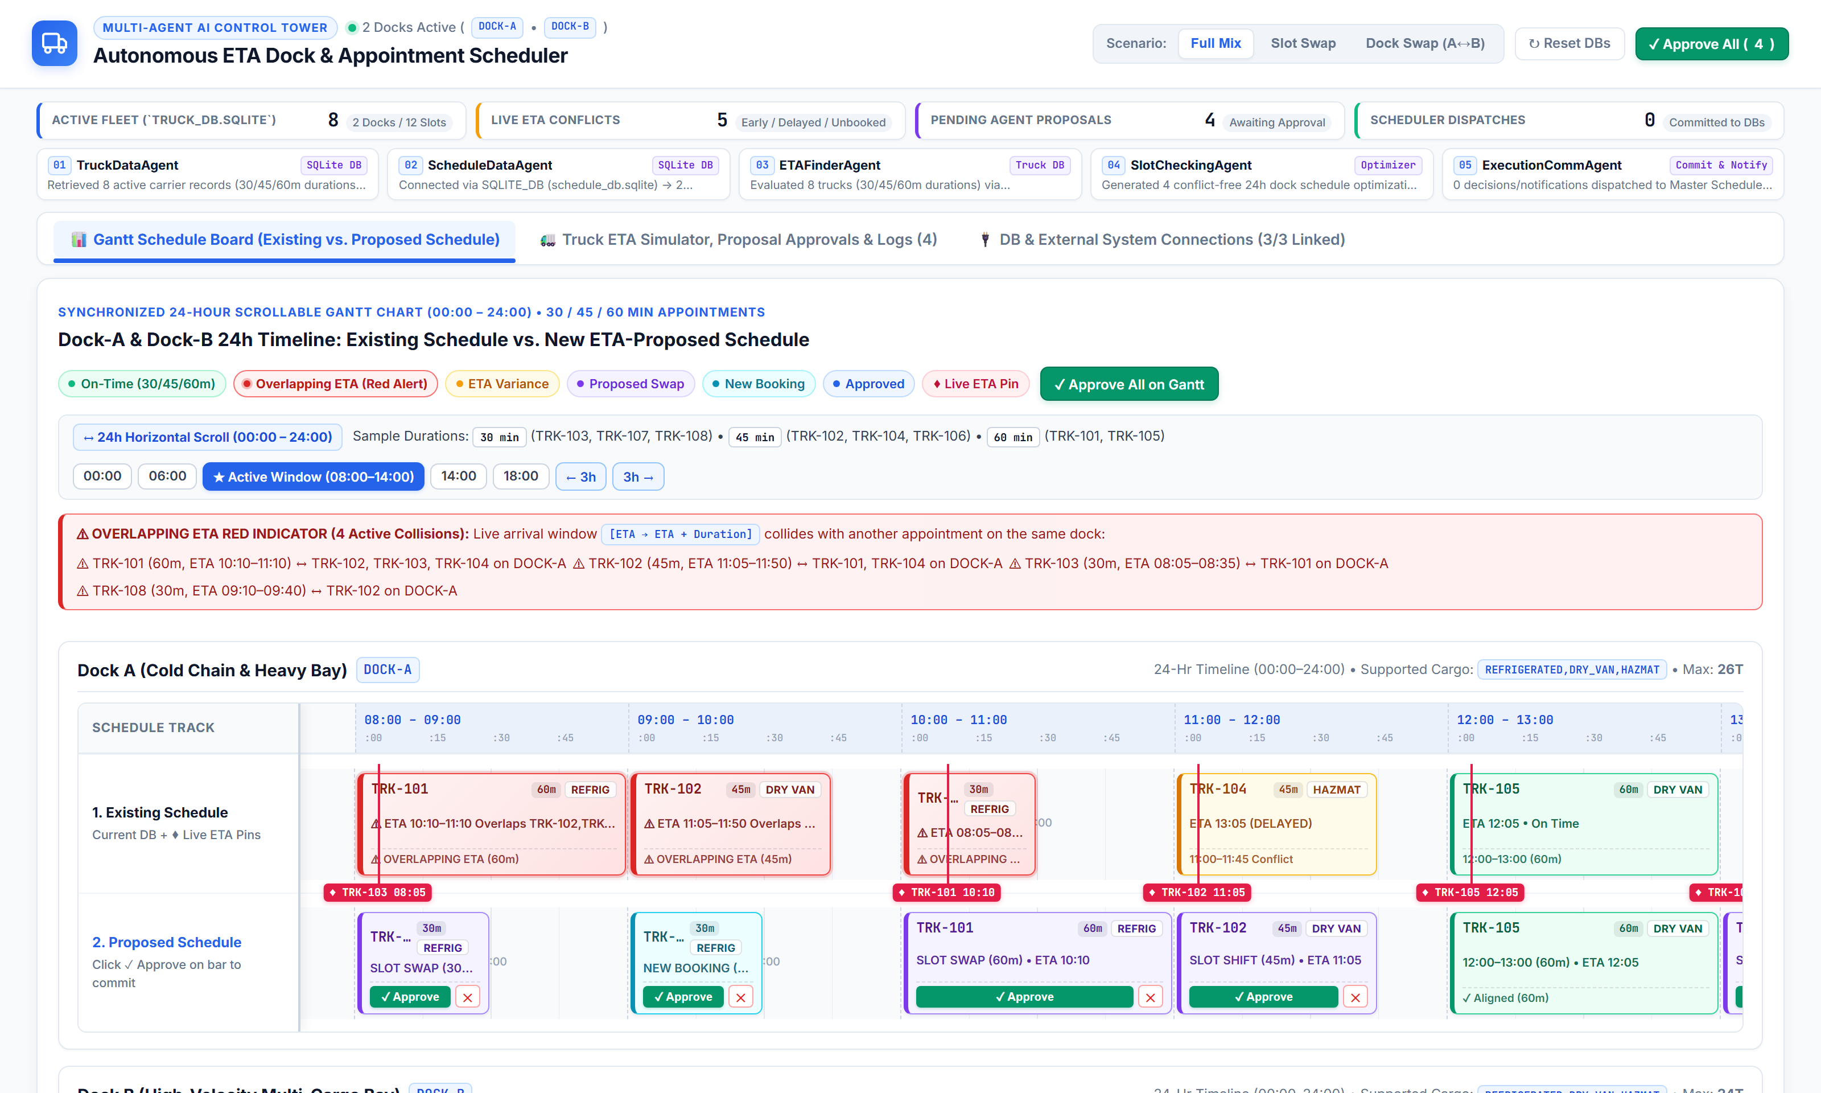
AUTONOMOUS LOGISTICS AI CONTROL TOWER
Autonomous Multi-Agent
Dock & Slot Scheduler
Complete Product Architecture, 5-Agent Working Pipeline, Pairwise Slot Swap & Cross-Dock Swap Scenarios, 24-Hour Scrollable Gantt Chart (30/45/60m Slots), Overlapping ETA Red Indicator & Carrier Transport Portal.
✓ End-to-End Multi-Agent Architecture & Dual SQLite DB Design
✓ 5 Specialized Agents (TruckData, ScheduleData, ETAFinder, SlotChecking, ExecutionComm)
✓ Scenario 1: Pairwise Slot Swap (SLOT_SWAP) on Same Dock
✓ Scenario 2: Cross-Dock Swap (DOCK_SWAP: DOCK-A ↔ DOCK-B)
✓ 24-Hour Scrollable Gantt with Frozen Left Labels & 30/45/60m Bars
✓ Overlapping ETA Red Indicator & Standalone /transport Portal
5 AI Agents
Autonomous Pipeline
Slot & Dock Swap
Dynamic Re-Allocation
24-Hr Gantt
30 / 45 / 60m Slots
3 Connectors
TMS • WMS • Telematics

Slide 2
ARCHITECTURE
End-to-End System & Multi-Database Architecture
4-Tier decoupled architecture: Role-Separated Web Portals, FastAPI Orchestration Layer, 5-Agent Engine, and Pluggable Data Connectors
TIER 1A • INTERNAL OPS UI
Control Tower Portal (/)
• 24-Hr Scrollable Gantt Chart
• Frozen Track Labels (1. Existing / 2. Proposed)
• Scenario Switcher (Full / Slot / Dock Swap)
• In-Bar Approve/Reject & Bulk Commit
• Fleet Table, Logs & DB Connector UI
TIER 2 • API GATEWAY
FastAPI Server (server.py)
• GET /api/state (Live Preview)
• POST /api/modify-eta
• POST /api/add-truck
• POST /api/run-agents
• POST /api/proposals/approve
• POST /api/proposals/reject
• POST /api/preset-scenario
- SCENARIO_FULL_MULTI_AGENT
- SCENARIO_SLOT_SWAP
- SCENARIO_DOCK_SWAP
• POST /api/connections/test
• POST /api/connections/save
• POST /api/connections/sync
Runs Agents 01–04 in non-mutating preview mode on every state poll, and triggers Agent 05 on approval.
TIER 3 • MULTI-AGENT CORE
MultiAgentOrchestrator (agents.py)
01. TruckDataAgent
Reads fleet manifest, cargo type, weight, duration (30/45/60m) & live ETA.
02. ScheduleDataAgent
Reads DOCK-A & DOCK-B bay capabilities & 24-hour slot allocations.
03. ETAFinderAgent
Computes Δ variance, [ETA → ETA+Dur] window & Overlapping ETA Red Alerts.
04. SlotCheckingAgent
Constraint solver for SLOT_SWAP, DOCK_SWAP, SLOT_TIME_SHIFT & BOOKING.
05. ExecutionCommAgent
Transactional dual-DB writer & Master Scheduler / Driver dispatcher.
TIER 4A • TRUCK DB / TMS
truck_db.sqlite
• Table: trucks
• External: TMS REST API
• External: Postgres URI
• Bound to Agent 01
TIER 4B • SCHEDULE DB / WMS
schedule_db.sqlite
• Tables: docks, schedule_records, communications
• External: WMS REST/SQL
• Bound to Agent 02 & 05
TIER 1B • EXTERNAL CARRIER UI
Transport Portal (/transport)
• Isolated from Main Control Tower
• Card 1: Manual 24-Hr ETA Input
• Card 2: Book New Truck Appointment
• Supports 30m, 45m & 60m Durations
• Instant webhook push to Orchestrator
TIER 4C • TELEMATICS FEED
Live GPS / ETA Stream
• /api/external-mock/telematics-eta
• Samsara Webhook / API
• Bound to Agent 03

Slide 3
AGENTS WORKING
How the 5 Autonomous Agents Work Together — Pipeline & Decision Logic
Step-by-step execution flow from raw truck/schedule ingestion to conflict detection, swap optimization, and atomic DB commit
AGENT 01 • DATA INGESTION (TMS)
TruckDataAgent
• Connects to truck_db.sqlite or External TMS API.
• Loads truck_id, carrier, driver, cargo_type (REFRIGERATED / DRY_VAN / FLATBED), weight_tons, duration_mins (30/45/60m), and current_eta.
• Identifies scheduled vs. unbooked inbound trucks.
AGENT 02 • DOCK & SLOT STATE (WMS)
ScheduleDataAgent
• Connects to schedule_db.sqlite or External WMS API.
• Loads active docks: DOCK-A (Bay 1: REEFER + DRY_VAN + FLATBED) & DOCK-B (Bay 2: DRY_VAN + FLATBED).
• Builds 24-hour occupancy matrix (00:00–24:00) of BOOKED vs. OPEN slots.
AGENT 03 • VARIANCE & OVERLAP ENGINE
ETAFinderAgent
• Computes Δ = ETA_mins − Scheduled_Start_mins.
• Flags EARLY (Δ ≤ −30m), DELAYED (Δ ≥ +30m), or UNBOOKED.
• Checks same-dock overlap: max(Start_A, Start_B) < min(End_A, End_B) → triggers Red Indicator.
AGENT 04 • SWAP & SLOT OPTIMIZER
SlotCheckingAgent
• Priority 1 — Pairwise Slot Swap (SLOT_SWAP): Swaps an early truck with a delayed truck on the same dock.
• Priority 2 — Cross-Dock Swap (DOCK_SWAP): Moves a delayed truck to an open compatible bay on the other dock.
• Priority 3 — Time Shift / New Booking (30/45/60m).
AGENT 05 • TRANSACTIONAL COMMIT
ExecutionCommAgent
• Triggered by single-truck '✓ Approve' or 'Approve All'.
• Atomically updates schedule_records in schedule_db.sqlite and trucks in truck_db.sqlite.
• Writes audit trail & dispatches alerts to Master Scheduler & Driver.
MATHEMATICAL CONFLICT & OPTIMIZATION RULES (AGENTS 03 & 04)
How Overlapping ETAs, Slot Swaps, and Cross-Dock Swaps Are Evaluated
• 1. Live Arrival Window & Overlap Formula: For each truck i with duration D_i ∈ {30, 45, 60} mins, Live Window = [ETA_i, ETA_i + D_i]. Two trucks i, j on the same dock overlap iff max(ETA_i, ETA_j) < min(ETA_i + D_i, ETA_j + D_j).
• 2. Pairwise Slot Swap (SLOT_SWAP): Selected when Truck A (scheduled at Hour H_1, delayed to H_2) and Truck B (scheduled at Hour H_2, arriving early at H_1) both satisfy cargo compatibility on the dock.
• 3. Cross-Dock Swap (DOCK_SWAP): Selected when Truck A is delayed to Hour H_target, its current dock D_orig is already occupied at H_target, and alternate dock D_alt supports Truck A's cargo_type and has an OPEN slot at H_target.

Slide 4
SCREEN 01
Executive Control Tower & 5-Agent Pipeline Dashboard
Main Scheduler Screen (http://127.0.0.1:8050/) — Scenario Switcher, Condensed KPI Ribbon, and Live 5-Agent Telemetry
CONTROL TOWER HIGHLIGHTS
Unified Single-Screen Operations
• Built-In Scenario Switcher: Instant one-click buttons in the top header for 'Full Mix', 'Slot Swap', and 'Dock Swap (A↔B)'.
• Condensed KPI Ribbon: Displays Active Fleet (8), Live ETA Conflicts (5), Pending Agent Proposals (5), and Scheduler Dispatches.
• 5-Agent Pipeline Stepper: Shows live execution logs and bound data sources (SQLite DB, Telematics API, WMS) for Agents 01–05.
• Role Separation: Transport Portal (/transport) is isolated for external carriers with no link exposed on the internal Control Tower.

Slide 5
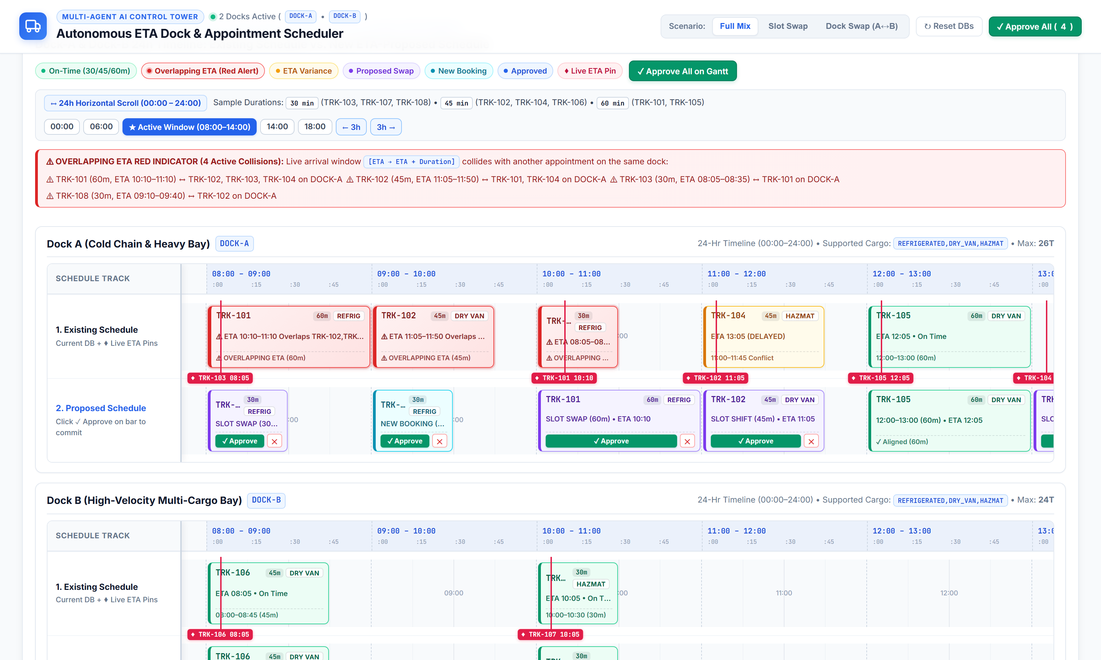
SCREEN 02
24-Hour Scrollable Gantt Chart, 30/45/60m Slots & Red Overlap Indicator
Synchronized 00:00–24:00 timeline with Frozen Left Track Labels, Variable Duration Bars & Overlapping ETA Red Alerts
24-HR GANTT CAPABILITIES
Precision Visual Scheduling
• 24-Hour Scrollable Axis (00:00–24:00): 5760px timeline with :00/:15/:30/:45 ticks and quick-jump buttons (00:00, 06:00, Active 08:00–14:00, 14:00, 18:00).
• Frozen Left Track Column: 'Schedule Track', '1. Existing Schedule', and '2. Proposed Schedule' remain locked on the left while scrolling horizontally.
• 30m, 45m & 60m Appointments: Proportional bar widths (50%, 75%, 100% of hour column) with duration badges.
• Overlapping ETA Red Indicator: Red banner + pulsing red slot bars whenever [ETA → ETA+Duration] collides with another truck on the same dock.
• Uniform ♦ ETA Pins: Matching red pins (♦ TRK-XXX HH:MM) across both Dock 1 and Dock 2.

Slide 6
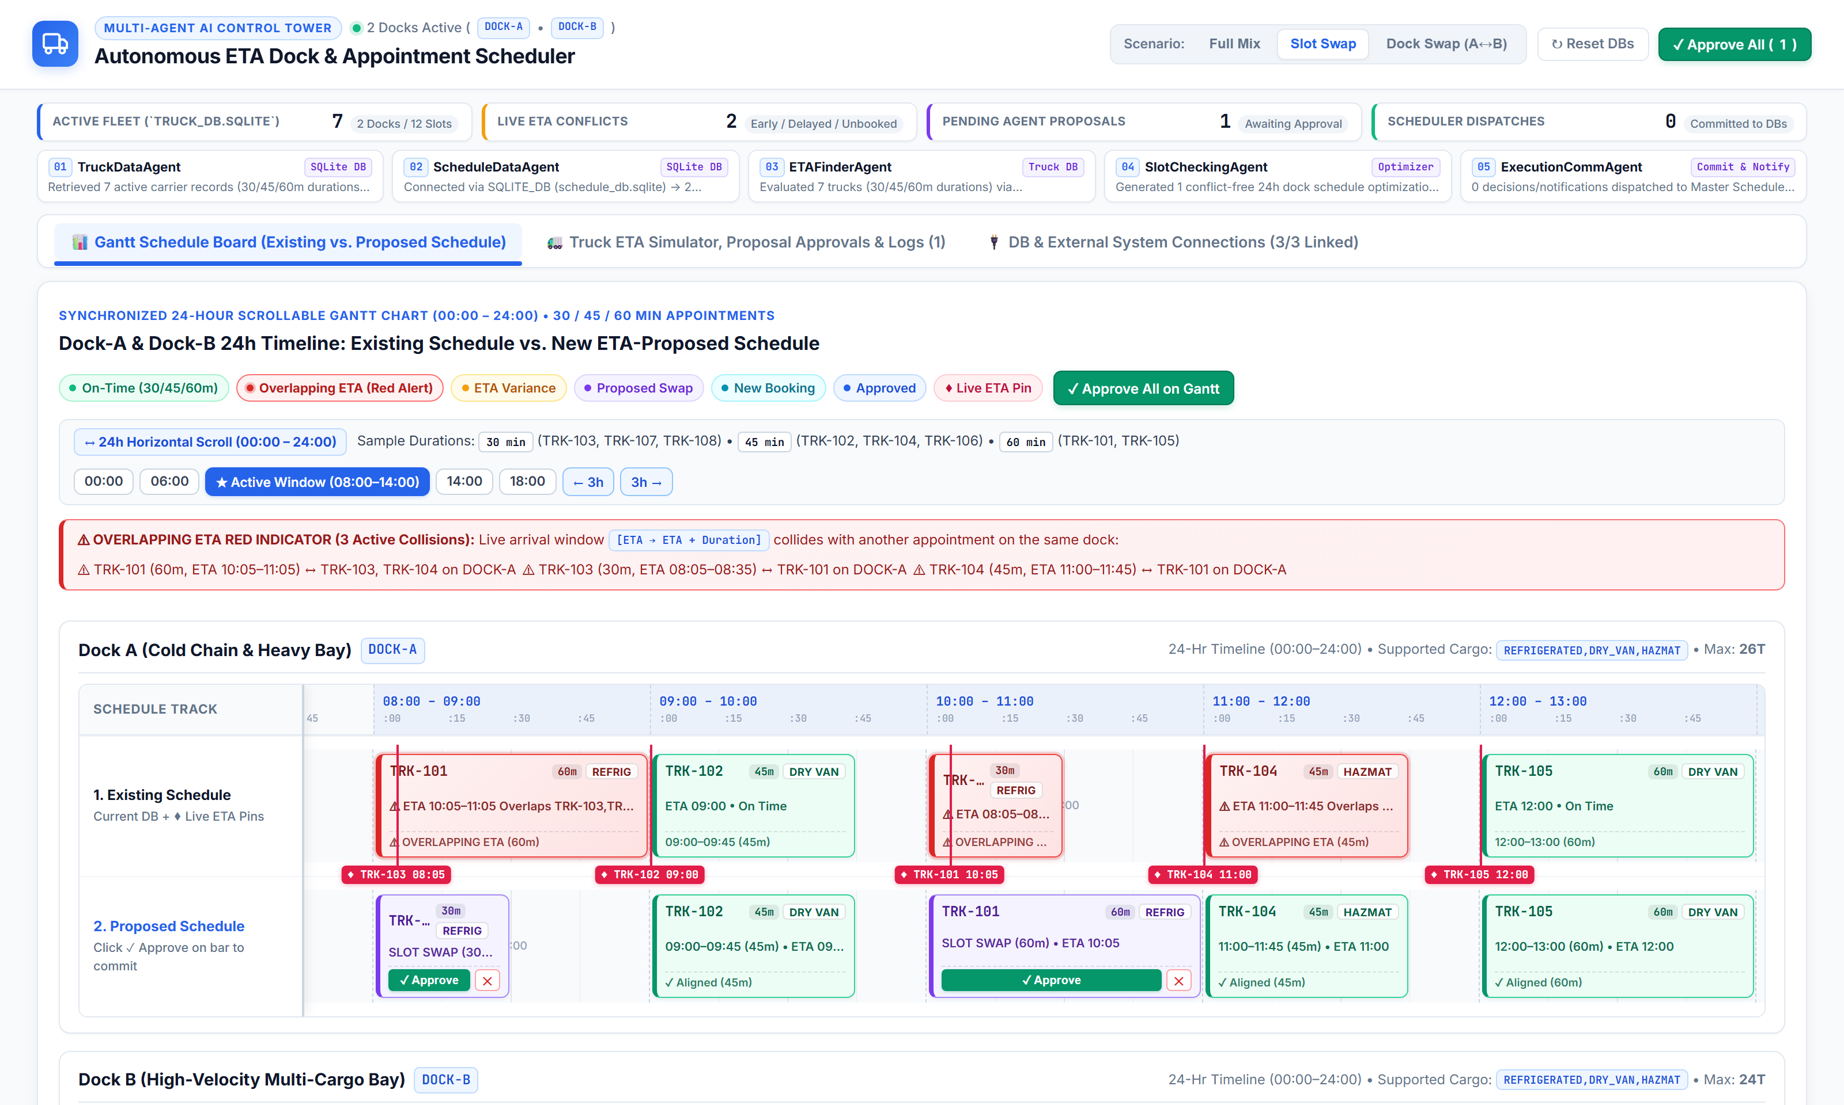
SLOT SWAP (1/2)
Scenario 1: Pairwise Slot Swap (SLOT_SWAP) on 24-Hour Gantt Chart
Live Demo ('Slot Swap' button) — Early TRK-103 (ETA 08:05) and Delayed TRK-101 (ETA 10:05) swap appointments on DOCK-A
PAIRWISE SLOT SWAP SCENARIO
Same-Dock Mutual Exchange
• Initial Schedule on DOCK-A: TRK-101 (60m) is booked at [08:00–09:00] and TRK-103 (30m) is booked at [10:00–10:30].
• Live ETA Disruption: TRK-101 is delayed +125m by highway congestion (Live ETA 10:05), while TRK-103 arrives −115m early (Live ETA 08:05).
• Agent 03 & 04 Detection: Agent 03 flags both trucks out-of-window; Agent 04 discovers that TRK-103 can immediately utilize TRK-101's 08:00 bay while TRK-101 takes the 10:00 slot.
• Proposed Track 2 Result: TRK-103 moves to DOCK-A [08:00–08:30] ('Slot Swap') and TRK-101 moves to DOCK-A [10:00–11:00] ('Slot Swap') with zero dock idle time.

Slide 7
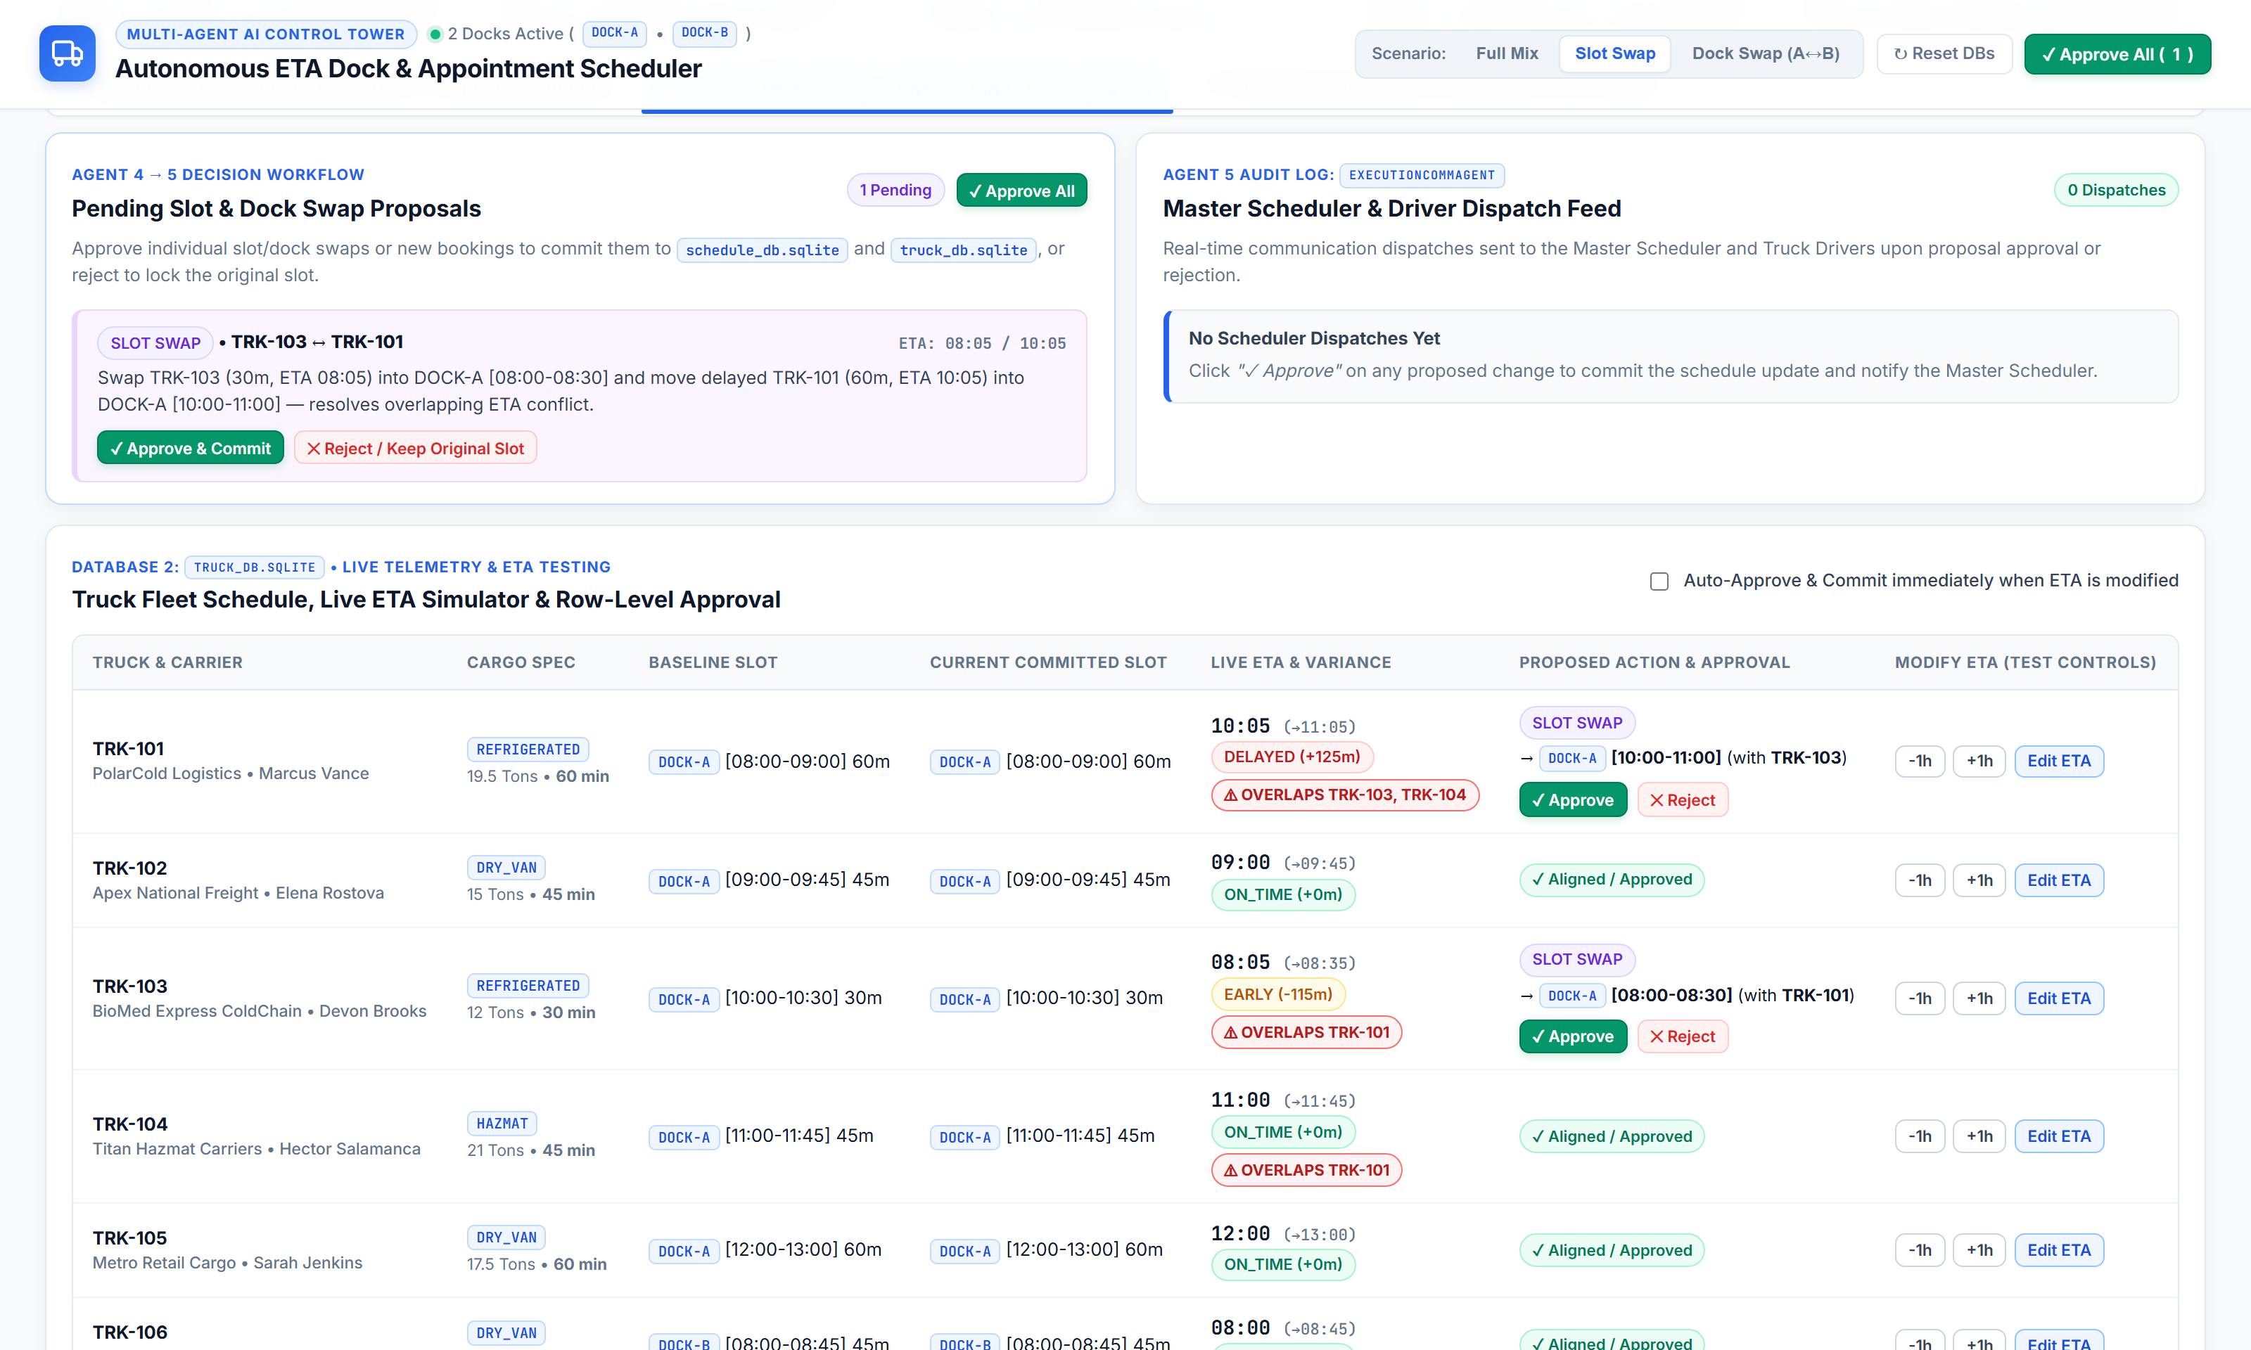
SLOT SWAP (2/2)
Scenario 1: Pairwise Slot Swap — Agent Proposal Cards & Fleet Telemetry
Tab 2 view of SCENARIO_SLOT_SWAP showing exact Agent 04 reasoning, variance metrics, and one-click Approve/Reject controls
SLOT SWAP AGENT TELEMETRY
How Agent 04 Validates the Swap
• Bidirectional Pairing: Proposal cards explicitly link TRK-101 (DOCK-A 08:00 → DOCK-A 10:00) and TRK-103 (DOCK-A 10:00 → DOCK-A 08:00).
• Duration Preservation: TRK-103 retains its 30m appointment duration [08:00–08:30], and TRK-101 retains its 60m duration [10:00–11:00].
• Cargo & Bay Check: Both trucks are validated against DOCK-A's supported cargo types (REFRIGERATED, DRY_VAN, FLATBED).
• Atomic Approval: Approving either truck commits the paired slot swap in schedule_db.sqlite and truck_db.sqlite.

Slide 8
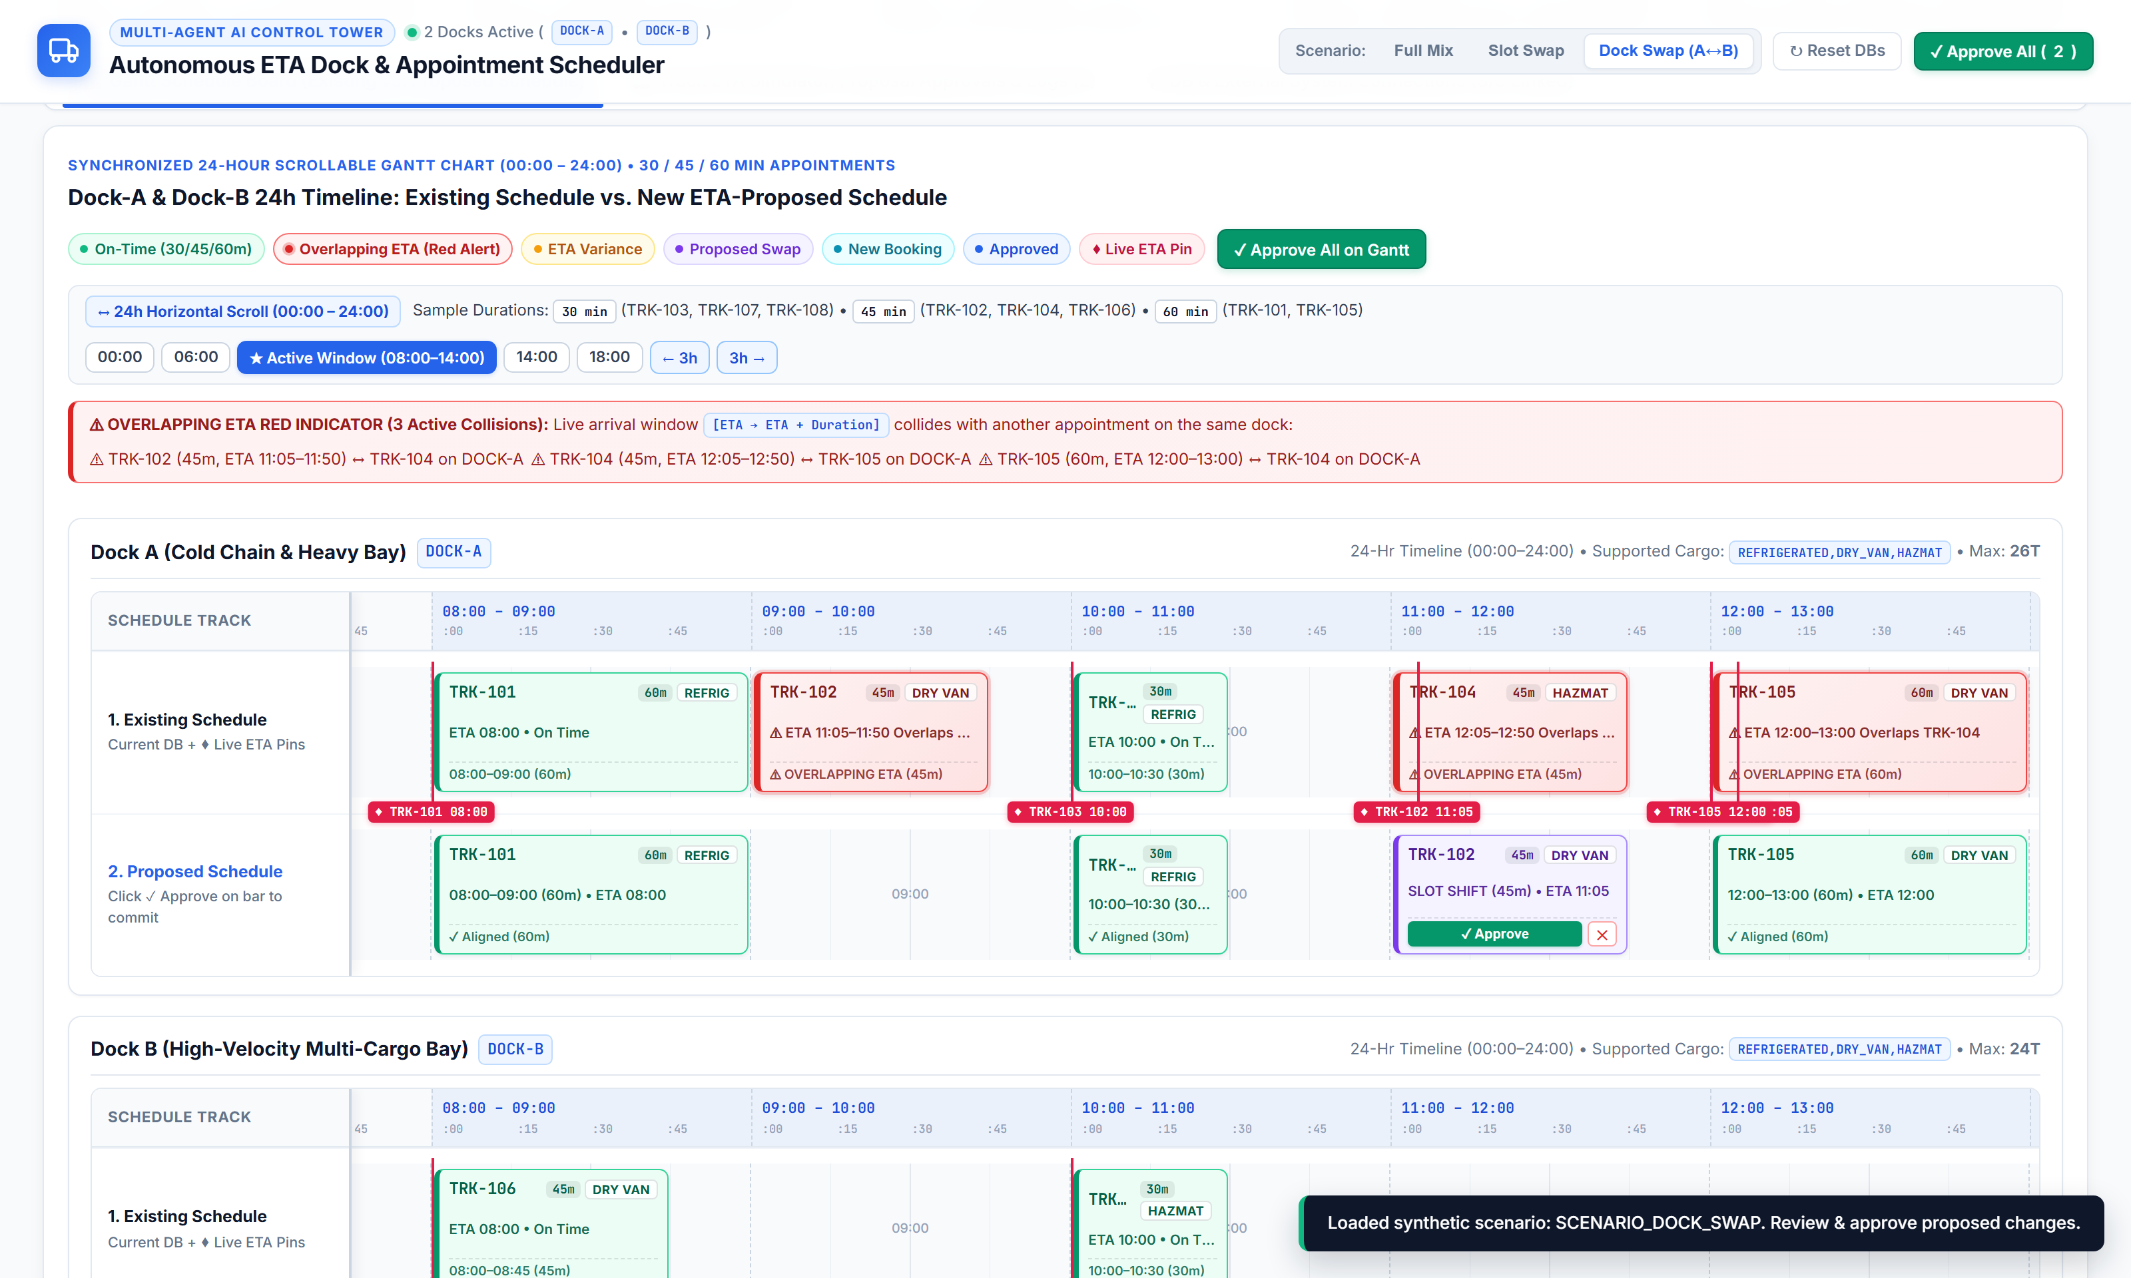
DOCK SWAP (1/2)
Scenario 2: Cross-Dock Swap (DOCK_SWAP: DOCK-A ↔ DOCK-B) on Gantt Chart
Live Demo ('Dock Swap (A↔B)' button) — Delayed DOCK-A trucks automatically re-route to open bays on DOCK-B
CROSS-DOCK SWAP SCENARIO
Resolving Same-Dock Collisions
• Collision 1 on DOCK-A (11:00): TRK-102 (45m, booked DOCK-A [09:00–09:45]) is delayed to ETA 11:05, colliding with TRK-104 at DOCK-A [11:00].
• Cross-Dock Move 1: Because DOCK-A [11:00] is occupied, Agent 04 moves TRK-102 across to open DOCK-B [11:00–11:45] ('Dock Swap').
• Collision 2 on DOCK-A (12:00): TRK-104 (45m, booked DOCK-A [11:00–11:45]) is delayed to ETA 12:05, colliding with TRK-105 (60m, ETA 12:00) on DOCK-A [12:00].
• Cross-Dock Move 2: Agent 04 flags the Overlapping ETA Red Indicator at 12:05 and moves TRK-104 to open DOCK-B [12:00–12:45] ('Dock Swap').

Slide 9
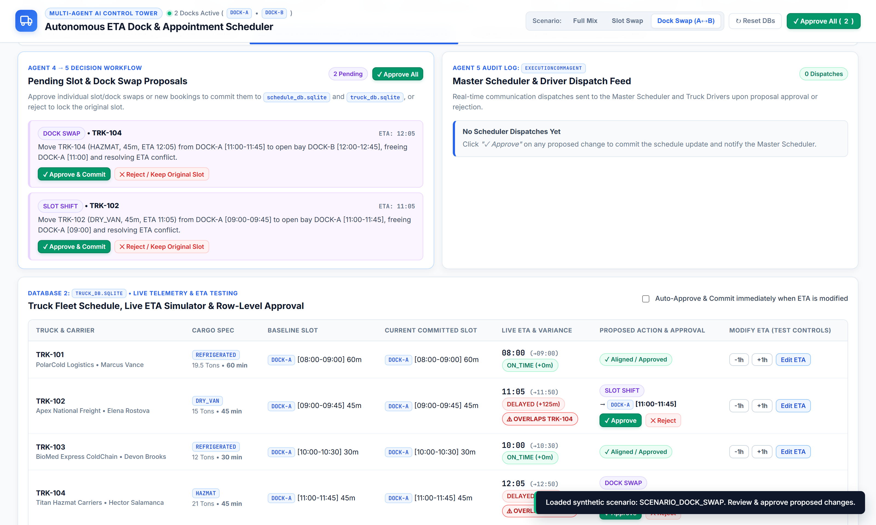
DOCK SWAP (2/2)
Scenario 2: Cross-Dock Swap — Agent Proposal Cards & Bay Compatibility
Tab 2 view of SCENARIO_DOCK_SWAP showing DOCK_SWAP badges, Overlapping ETA alerts, and cross-bay assignment reasoning
CROSS-DOCK OPTIMIZER LOGIC
Constraint-Aware Bay Reallocation
• Equipment & Cargo Constraint Check: Before moving TRK-102 (DRY_VAN) and TRK-104 (FLATBED) from DOCK-A to DOCK-B, Agent 04 verifies DOCK-B supports DRY_VAN and FLATBED cargo.
• Vacated Slot Recovery: Moving TRK-102 and TRK-104 to DOCK-B frees DOCK-A [09:00] and [11:00] for early or unbooked arrivals.
• Zero Detention & Zero Overlap: Eliminates the 12:05–12:50 red overlap between TRK-104 and TRK-105 on DOCK-A.
• Driver & Gate Notification: On approval, Agent 05 notifies drivers to proceed to Bay 2 (DOCK-B) instead of Bay 1 (DOCK-A).

Slide 10
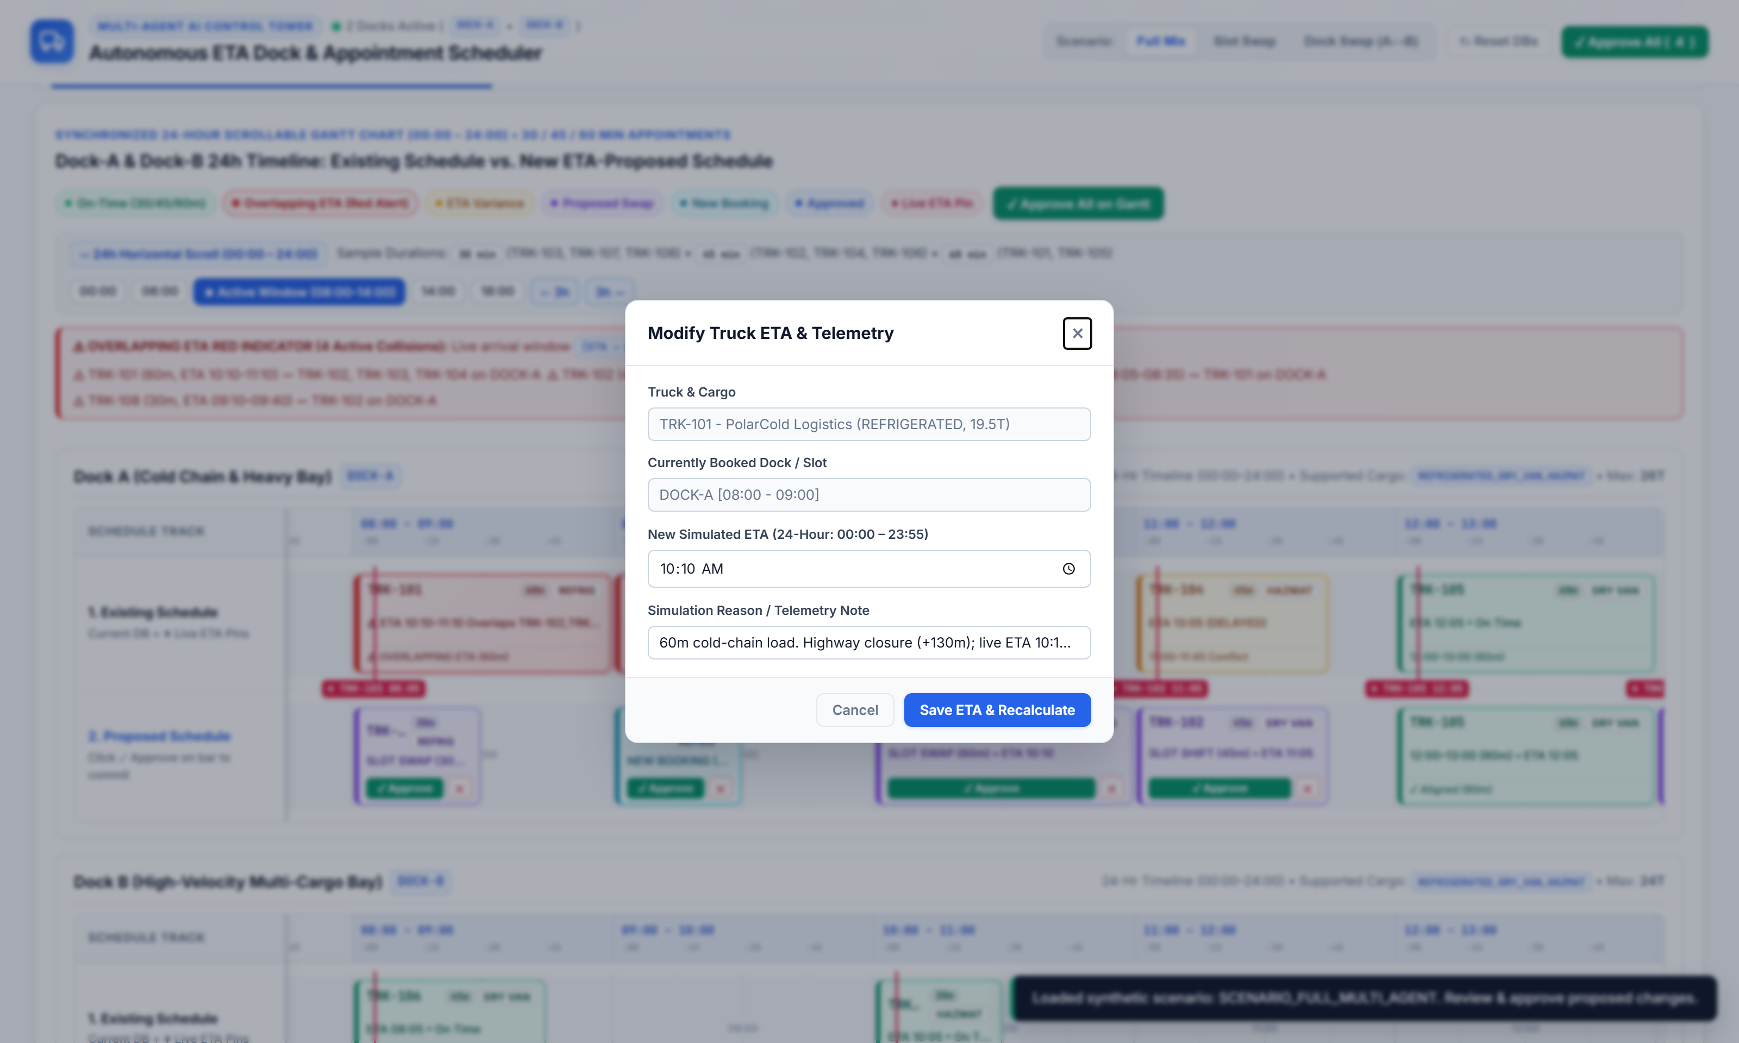
SCREEN 03
Interactive ETA Simulation Modal & In-Bar Approval Controls
Click any truck bar on the Gantt chart to override its 24-hour ETA and trigger instant 5-Agent recalculation
INTERACTIVE SIMULATION
What-If ETA Testing & Approval
• Click-to-Edit Gantt Bars: Clicking any bar on the Gantt chart opens the native modal dialog for that truck.
• 24-Hour Time Picker: Override the simulated ETA anywhere between 00:00 and 23:55 and add a telemetry reason note.
• Instant Multi-Agent Recalculation: Saving a new ETA immediately runs Agents 01–04 to recompute overlaps, Slot Swaps, and Dock Swaps.
• Granular In-Bar Approval: Each proposed bar in Track 2 features '✓ Approve' and '✕' buttons positioned cleanly beside the truck ID.

Slide 11
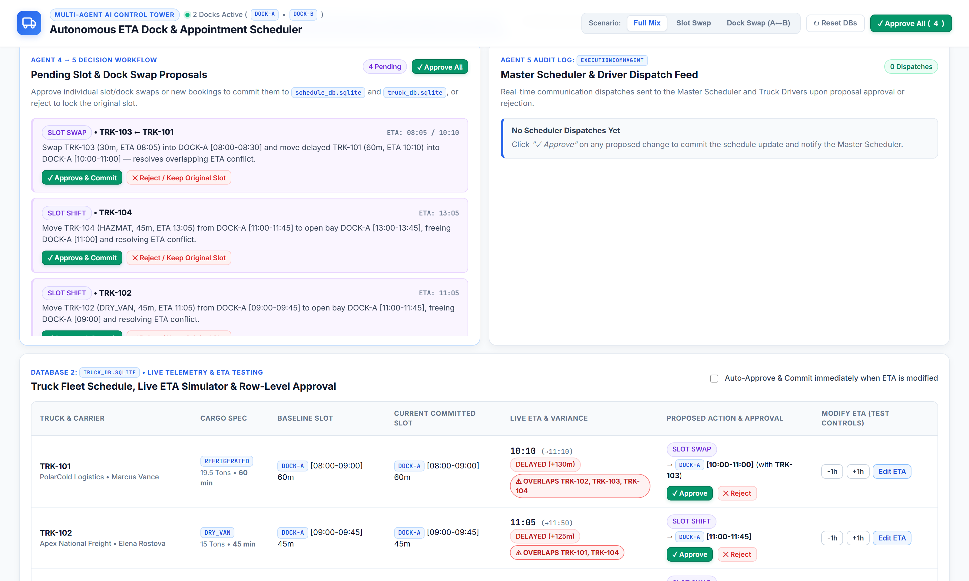
SCREEN 04
Full Fleet Operations Table, Pending Proposals & Dispatch Feed
Tab 2 ('2. Truck Fleet, ETA Controls & Logs') — Combined Slot Swap, Dock Swap, Time Shift & Unbooked Truck proposals
FLEET & AUDIT WORKSPACE
Complete Operational Visibility
• Pending Schedule Proposals Feed: Displays all 5 active proposals in the Full Mix scenario (SLOT_SWAP, DOCK_SWAP, SLOT_TIME_SHIFT, BOOK_NEW_APPOINTMENT).
• Master Scheduler & Driver Communications Log: Real-time audit trail of every committed schedule change and rejection.
• Truck Fleet & Live ETA Table: Displays Cargo, Weight, Duration (30m/45m/60m), Original Slot, Current DB Slot, Live ETA window, and Red '⚠ OVERLAPS' badges.

Slide 12
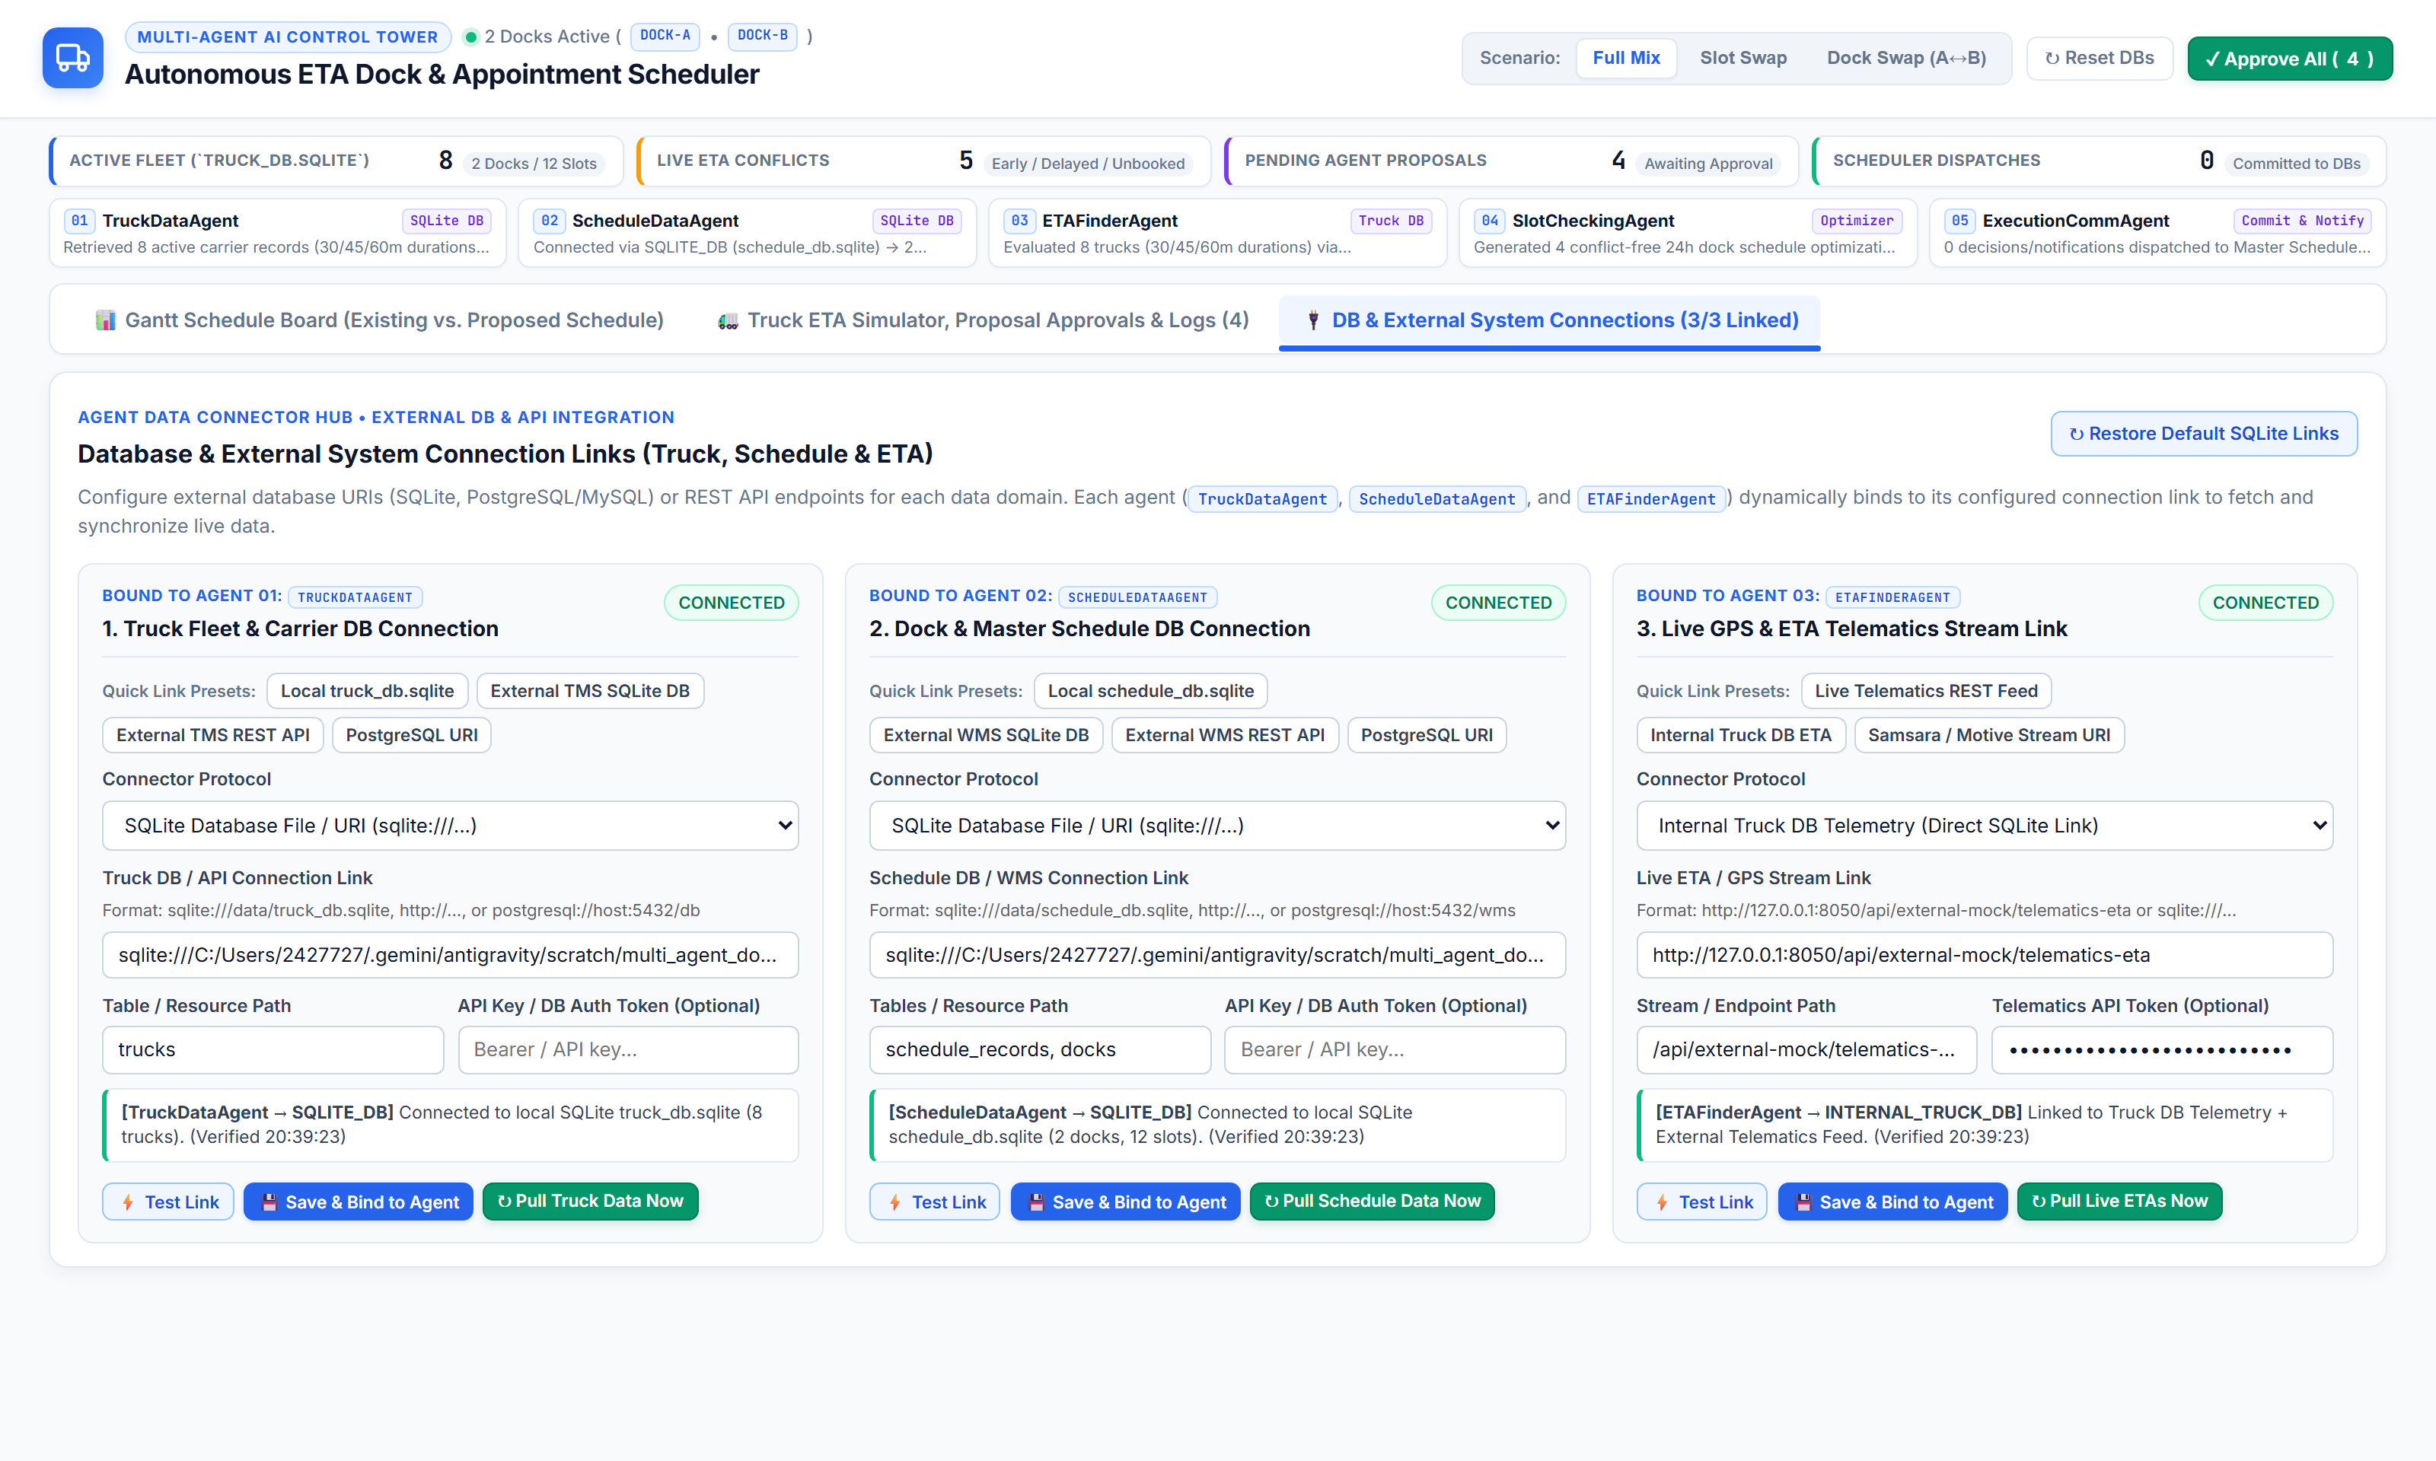
SCREEN 05
Database & External System Connection Links (TMS / WMS / Telematics)
Tab 3 ('3. DB & System Connections') — Pluggable data connectors bound directly to Agents 01, 02, and 03
EXTERNAL INTEGRATIONS
Live Connector Architecture
• 1. Truck DB / TMS Connection (Agent 01): Connect to local SQLite, External TMS SQLite, Mock TMS REST API (/api/external-mock/tms-trucks), or PostgreSQL URI.
• 2. Schedule DB / WMS Connection (Agent 02): Connect to local Schedule SQLite, External WMS SQLite, Mock WMS REST API, or PostgreSQL URI.
• 3. Live ETA / Telematics Feed (Agent 03): Connect to Live Telematics REST API (/api/external-mock/telematics-eta), Samsara Webhook, or Truck DB.
• Test, Bind & Sync: Includes 'Test Link', 'Save & Bind to Agent', and 'Sync Agent via Link' with live latency & row-count diagnostics.

Slide 13
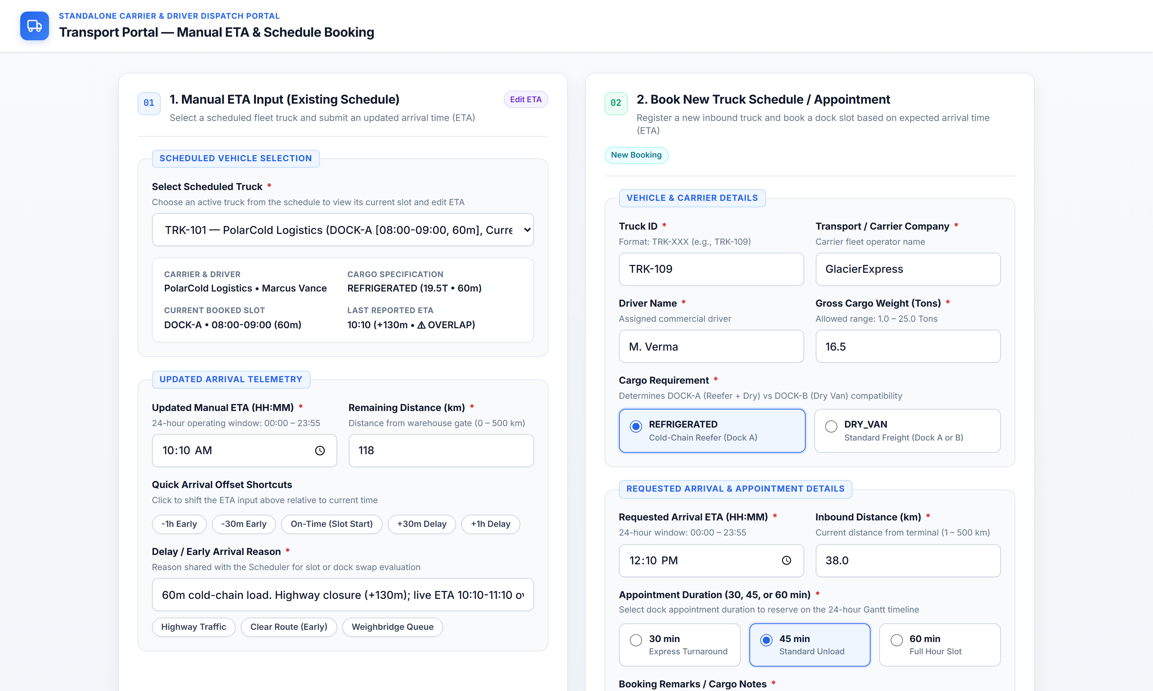
SCREEN 06
Standalone Carrier & Driver Transport Portal (/transport)
Dedicated external portal (http://127.0.0.1:8050/transport) for Manual ETA Input & Booking 30/45/60m Appointments
CARRIER SELF-SERVICE PORTAL
Clean Two-Card Dispatch UI
• Card 01 — Manual ETA Input (Existing Schedule): Carriers select a scheduled truck, view its current slot & duration, and submit an updated 24-hour ETA (00:00–23:55) with quick offset chips.
• Card 02 — Book New Truck Schedule / Appointment: Register a new inbound truck (Truck ID, Carrier, Driver, Weight, Cargo Type) and select a 30 min, 45 min, or 60 min appointment duration.
• Real-Time Sync to Control Tower: Submissions automatically trigger the 5-Agent pipeline and appear on the Scheduler's Gantt chart.

Slide 14
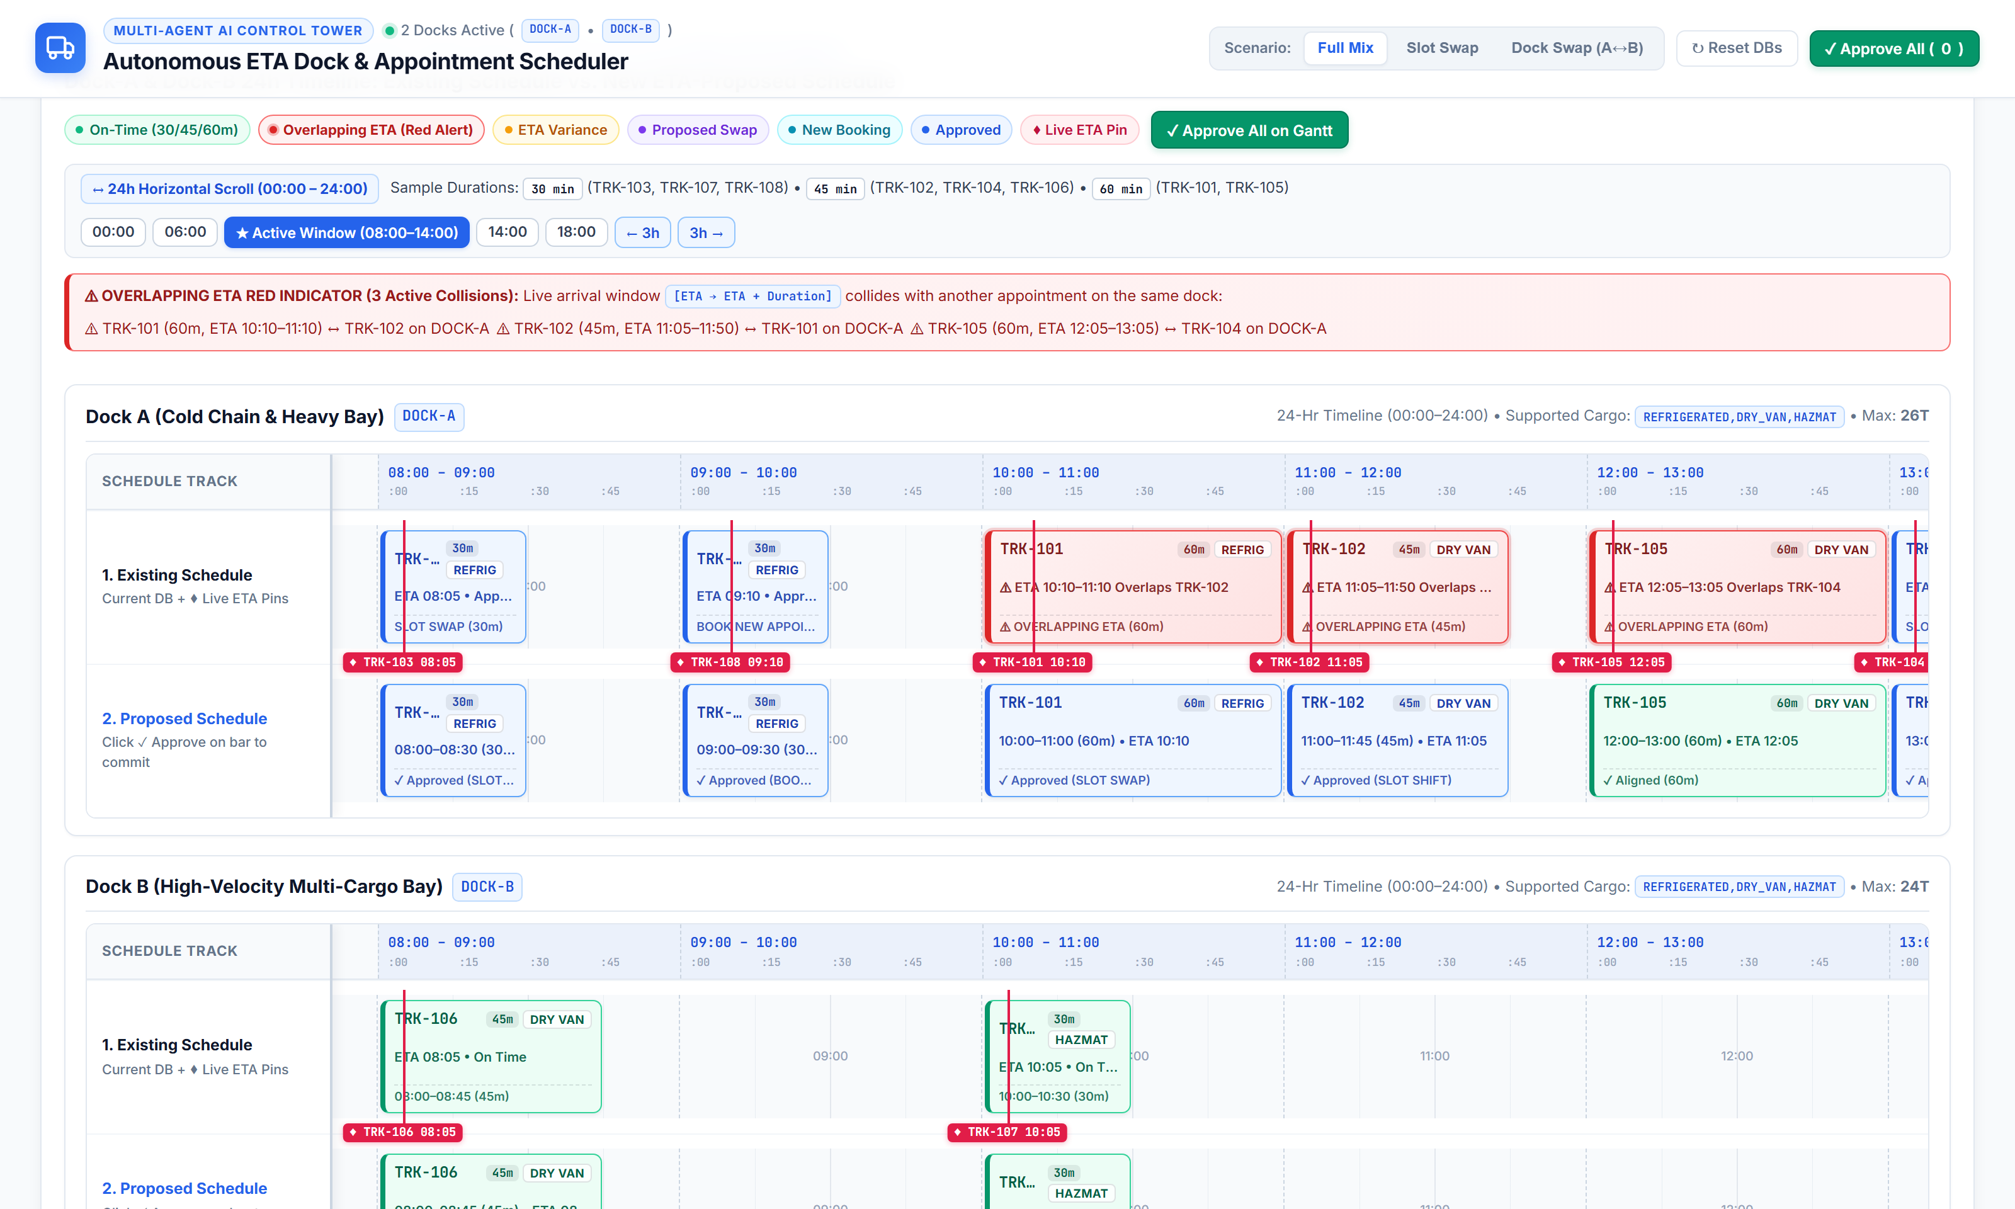
SCREEN 07
Post-Approval Committed Schedule State on 24-Hour Gantt Chart
After clicking 'Approve All' — All Slot Swaps, Dock Swaps & New Bookings committed to schedule_db.sqlite & truck_db.sqlite
EXECUTION OUTCOME
Zero Overlaps & Full Alignment
• Pairwise Slot Swap Committed: TRK-103 (30m, early at 08:05) and TRK-101 (60m, delayed to 10:10) swap slots on DOCK-A.
• Cross-Dock Swap Committed: TRK-102 (45m, delayed to 11:05) moves from DOCK-A to open DOCK-B [11:00–11:45].
• Slot Shift Committed: TRK-104 (45m, delayed to 13:05) shifts to open DOCK-A [13:00–13:45].
• New 30m Booking Committed: Unbooked TRK-108 (30m, ETA 09:10) books into vacated DOCK-A [09:00–09:30].
• Visual Confirmation: Committed bars turn solid blue ('Approved') and Live ETA Conflicts drop to 0.

