Slide 1
IEP Techathon Agentic AI 2026
Team Name: Agentic Logistics Pioneers
Idea Title: Autonomous Multi-Agent ETA Dock & Slot Scheduler
Jan 2026

Slide 2
Team Details
Idea Title : Autonomous Multi-Agent ETA Dock & Slot Scheduler
Account Name : Enterprise Supply Chain, Warehouse & Yard Operations
Theme : Agentic AI for Smart Logistics, Dock Scheduling & Real-Time ETA Optimization
Submitter ID | Submitter Name
2427727 | Shubham
Team Name | Team Members
 | <Name> | <ID> | <Name> | <ID>
 | <Name> | <ID> | <Name> | <ID>
 | <Name> | <ID> | <Name> | <ID>
 | <Name> | <ID> | <Name> | <ID>
 | <Name> | <ID> | <Name> | <ID>

Slide 3
Business Scenario
Why today's dock & yard operations fall short
Warehouse, Yard & Distribution Center Operations
Multi-dock appointment scheduling across TMS, WMS & Live GPS Telematics
Static dock schedules cannot adapt to live highway delays, early arrivals, or unbooked trucks
Overlapping arrival windows [ETA → ETA + Duration] cause severe bay collisions & yard congestion
Fragmented data silos across TMS (Truck DB), WMS (Schedule DB), GPS Telematics, and Carriers
Master schedulers spend critical hours manually negotiating slot swaps via phone & spreadsheets
Business impact
Dock bay collisions & overlapping ETAs
Delayed trucks collide with subsequent appointments on the same dock
High carrier detention & wasted bay capacity
Early trucks wait idle in the yard while vacated dock slots go unused
Delayed fulfillment & cold-chain SLA risk
Refrigerated & priority loads face unloading delays and manual bottlenecks

Slide 4
Opportunity
An autonomous 5-agent control tower for real-time dock & slot optimization
Transform dock operations from reactive manual firefighting into proactive, autonomous exception management—with five specialized AI agents orchestrated across Truck DB (TMS), Schedule DB (WMS), Live Telematics, and a Carrier Transport Portal.
01 TruckDataAgent
02 ScheduleDataAgent
03 ETAFinderAgent
04 SlotCheckingAgent
05 ExecutionCommAgent
Ingests fleet manifests, cargo types (Reefer, Dry Van, Flatbed), weights & 30/45/60m appointment durations from TMS.
Loads 24-hour (00:00–24:00) dock slot availability & bay capabilities (DOCK-A & DOCK-B) from WMS.
Calculates Δ arrival variance, live arrival windows [ETA → ETA+Dur] & flags Overlapping ETA Red Indicators.
Synthesizes Pairwise Slot Swaps (SLOT_SWAP), Cross-Dock Swaps (DOCK_SWAP), Time Shifts & New Bookings.
Atomically commits approved changes across Dual SQLite DBs & dispatches alerts to Master Scheduler & Drivers.
Built on a 24-hour scrollable Gantt chart (with frozen track headers & 30/45/60m slots), pluggable TMS/WMS/Telematics connectors, a standalone Carrier Transport Portal (/transport), and human-in-the-loop approval.

Slide 5
Solution Approach
SRADL multi-agent execution cycle
S | Sense
Ingests fleet manifests, 24-hr dock slots & live GPS/carrier ETAs via TMS, WMS & Telematics links
R | Reason
Computes Δ variance & detects same-dock collisions: max(Start_A, Start_B) < min(End_A, End_B)
A | Act
Proposes Pairwise Slot Swaps (SLOT_SWAP), Cross-Dock Swaps (DOCK_SWAP: A↔B) & 30/45/60m bookings
D | Decide
Human-in-the-loop single-bar or bulk approval on the 24-hr Gantt chart (or auto-execute mode)
L | Learn
Persists committed swaps, rejection reasons & dispatch audit trail in schedule_db.sqlite
Decoupled, 4-tier layered architecture
Control Tower & /transport
24-hr scrollable Gantt (frozen labels, red overlap alerts) + isolated Carrier Portal
FastAPI + 5-Agent Brain
MultiAgentOrchestrator (Truck, Schedule, ETA, Slot & Execution agents) + constraint solver
Dual SQLite + Connector Hub
truck_db.sqlite & schedule_db.sqlite with live REST API, SQL URI & Webhook bindings
Enterprise TMS / WMS / GPS
Pluggable links to external Fleet TMS, Warehouse WMS & Samsara/Telematics streams

Slide 6
Proposed Benefits
Up to 80%
faster conflict resolution
Overlapping ETAs, early arrivals, and delayed trucks are resolved in seconds via automated Slot & Dock Swaps while Master Schedulers stay in control of approvals.
Eliminates dock bay collisions & idle slots (Pairwise Slot Swap)
Swaps early-arriving trucks (e.g., TRK-103 at 08:05) with delayed trucks (e.g., TRK-101 at 10:05) on the same dock, turning idle bays into immediate throughput.
Dynamic Cross-Dock load balancing (DOCK-A ↔ DOCK-B)
Automatically re-routes delayed trucks whose target slot is occupied on DOCK-A to open, cargo-compatible bays on DOCK-B while enforcing Reefer/Dry Van/Flatbed rules.
Self-service Carrier Portal (/transport) & full audit trail
Carriers submit manual 24-hr ETAs and book 30m/45m/60m appointments without accessing the internal Control Tower, with every decision logged.

Slide 7
Cost & ROI (if available)
Cost of Creation
Return on Investment
Lightweight, zero-license architecture built for rapid deployment:
• Zero proprietary solver or external paid cloud dependencies
• Embedded Dual SQLite DBs (truck_db.sqlite & schedule_db.sqlite)
• Python FastAPI + Vanilla JS 24-Hr Gantt UI (30/45/60m appointments)
• Pluggable Connector Hub binds directly to TMS, WMS & Telematics APIs
• Up to 80% reduction in manual rescheduling effort for Master Schedulers
• Lower carrier detention & demurrage fees via proactive Slot & Dock Swaps
• Higher dock utilization across 24-hr horizon with 30m, 45m & 60m slots
• Zero cold-chain spoilage by enforcing Reefer bay rules on DOCK-A
• Complete audit trail of ETA overrides, approvals & driver dispatches

Slide 8
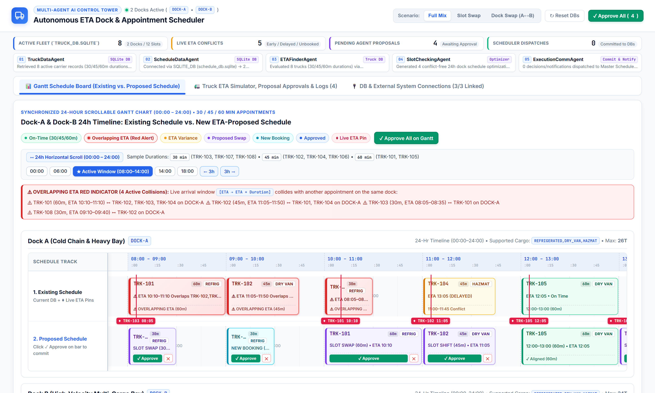
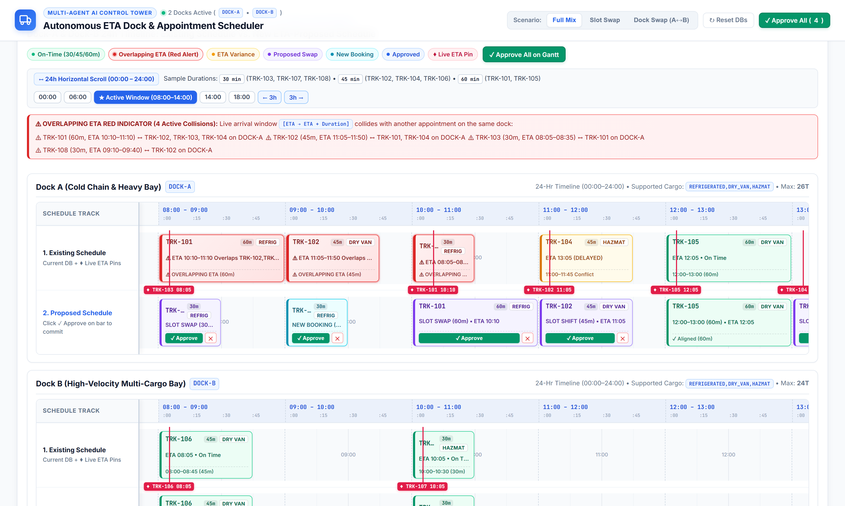
Product Walkthrough: Control Tower & 24-Hr Scrollable Gantt
Live Control Tower UI (/) with 5-Agent Pipeline, Frozen Left Track Headers, 30/45/60m Slots & Red Overlap Indicator
Executive Control Tower & 5-Agent Telemetry Strip
• Displays Active Fleet, Live ETA Conflicts, Pending Proposals & Dispatches.
• Instant Scenario Switcher: Full Mix, Slot Swap & Dock Swap (A↔B).
24-Hr Scrollable Gantt (00:00–24:00) & Overlapping ETA Red Indicator
• Frozen left column keeps '1. Existing Schedule' & '2. Proposed Schedule' pinned.
• Variable 30m/45m/60m bars + red collision alert when live ETAs overlap.

Slide 9
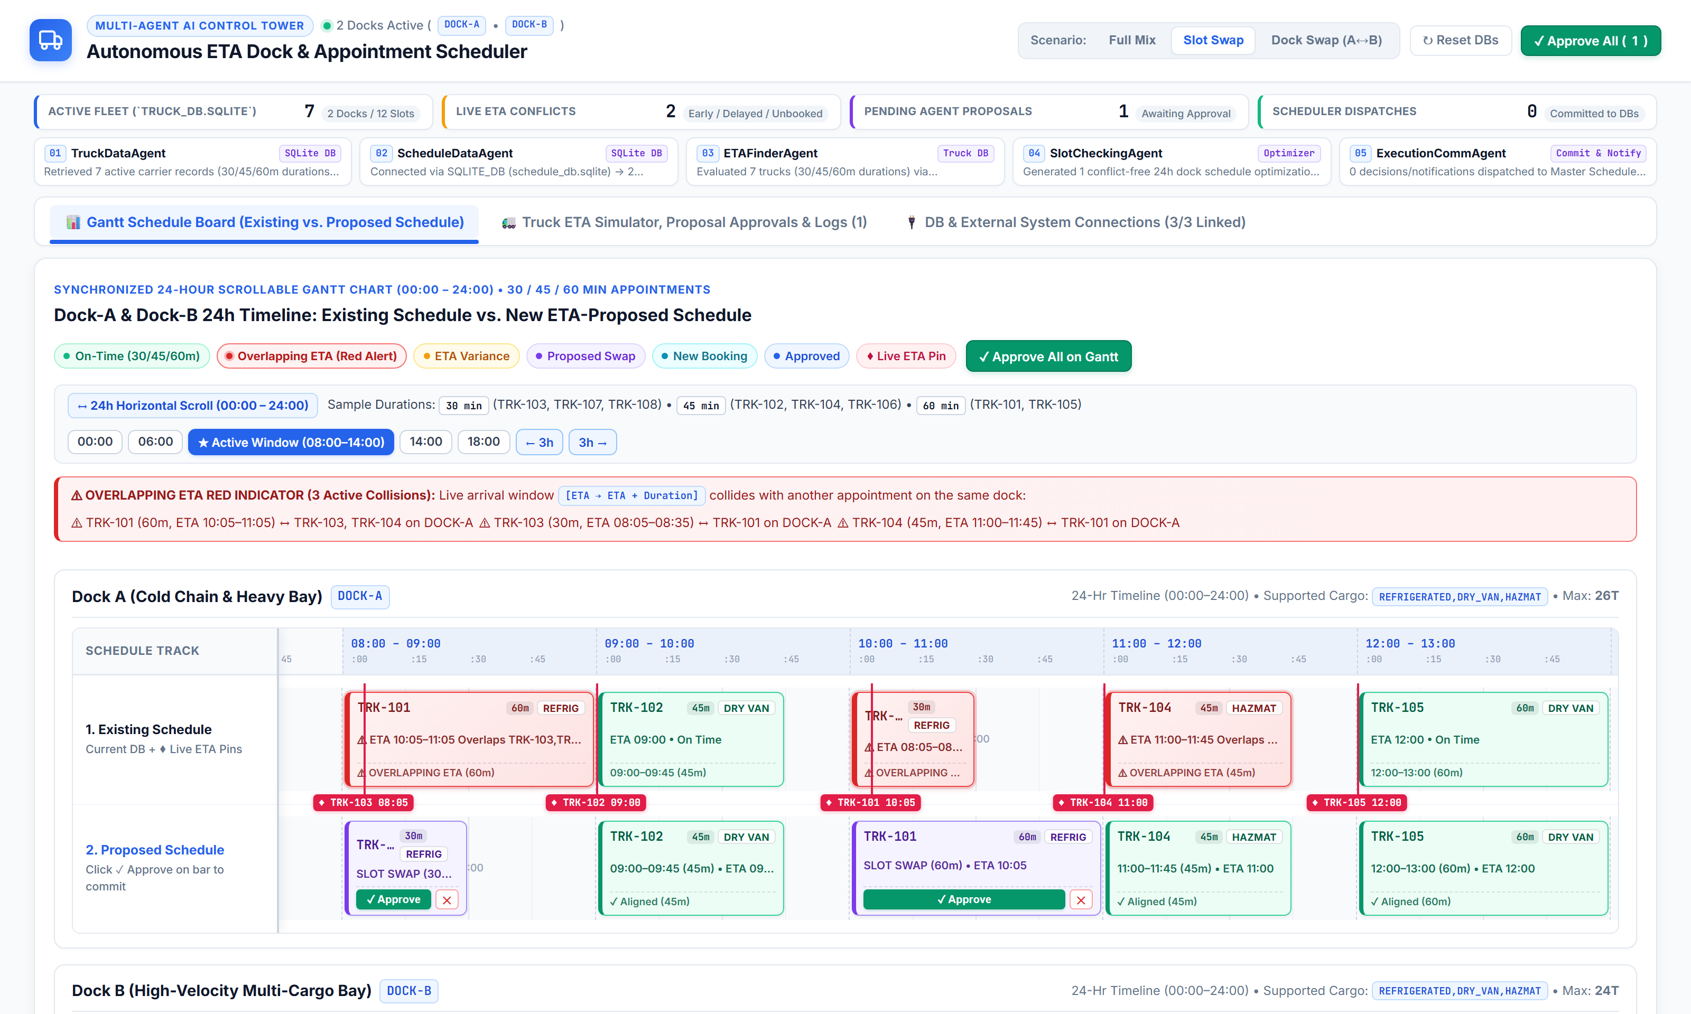
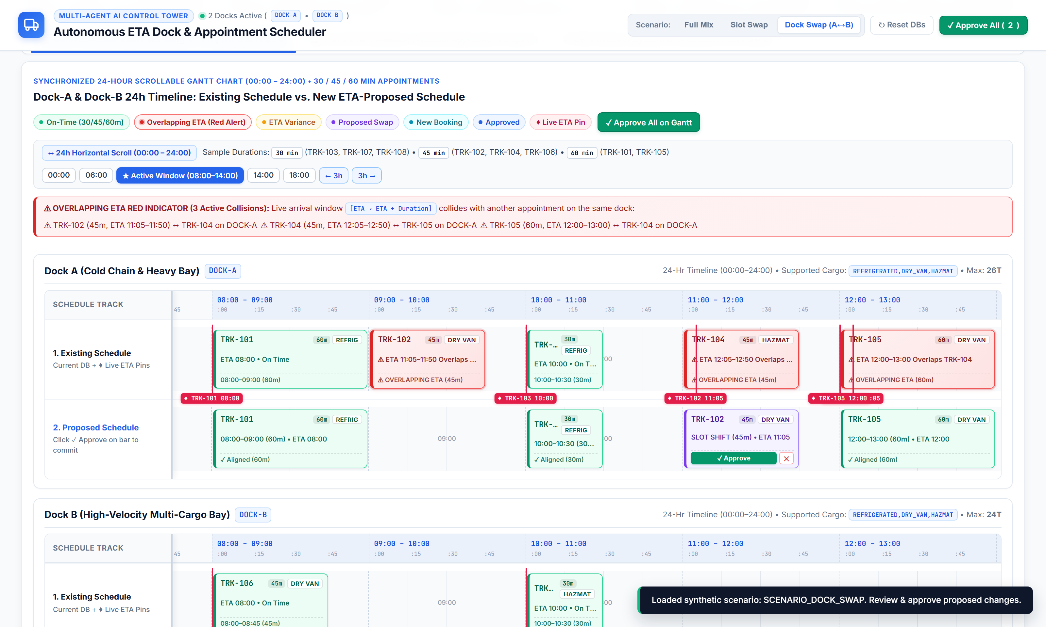
Live Scenarios: Pairwise Slot Swap & Cross-Dock Swap (A↔B)
Autonomous conflict resolution by Agent 03 (ETAFinderAgent) and Agent 04 (SlotCheckingAgent)
Scenario 1: Pairwise Slot Swap (SLOT_SWAP on DOCK-A)
• TRK-101 (60m, delayed to 10:05) and TRK-103 (30m, early at 08:05) mutually exchange slots on DOCK-A [08:00 ↔ 10:00] with zero bay idle time.
Scenario 2: Cross-Dock Swap (DOCK_SWAP: DOCK-A → DOCK-B)
• Delayed TRK-102 (ETA 11:05) & TRK-104 (ETA 12:05, overlapping TRK-105) automatically re-route from occupied DOCK-A to open bays on DOCK-B.

Slide 10
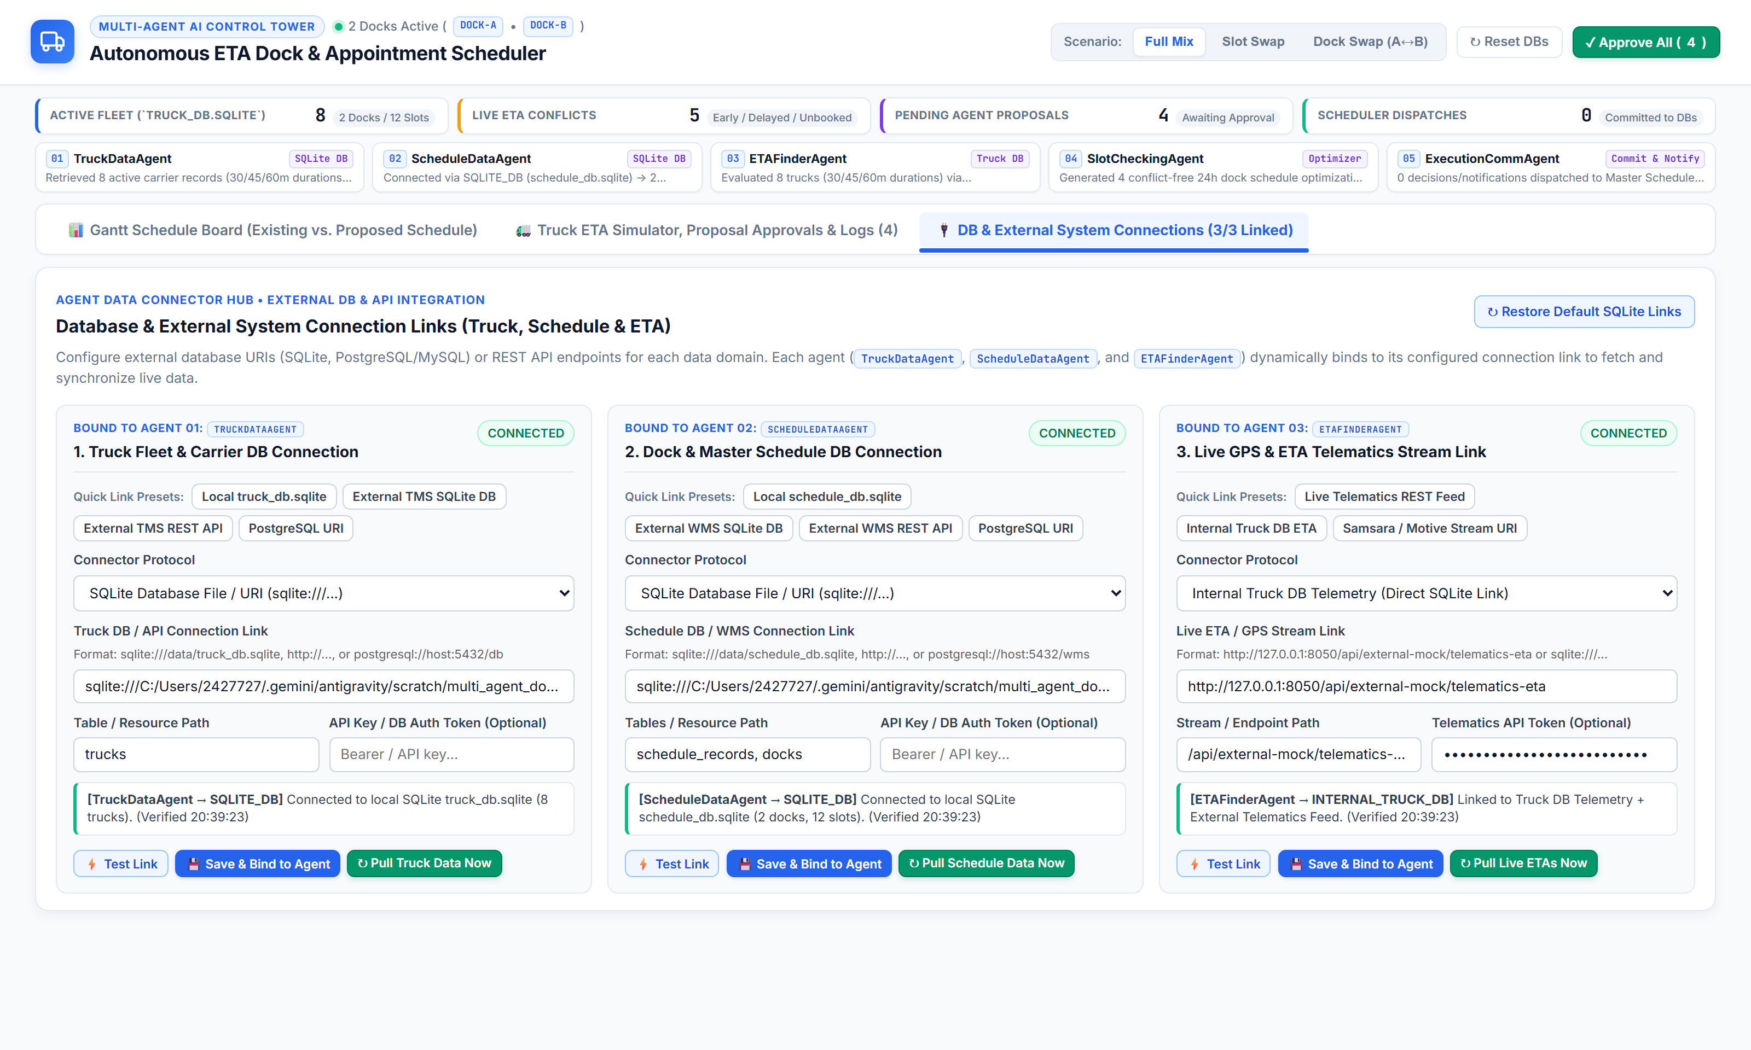
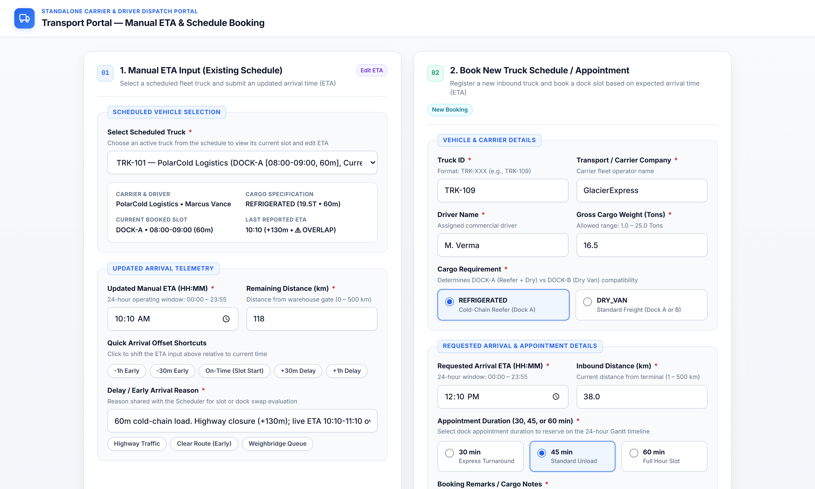
Enterprise Connectors & Standalone Transport Portal (/transport)
Pluggable TMS/WMS/Telematics integration links and role-separated Carrier Self-Service Portal
Pluggable DB & External System Connection Links
• Connects Agent 01 (TMS), Agent 02 (WMS) & Agent 03 (Telematics) to SQLite, REST APIs, PostgreSQL URIs or Webhooks with live test & sync.
Standalone Carrier & Driver Transport Portal (/transport)
• Isolated external UI with two cards: 1. Manual 24-Hr ETA Input (Existing Schedule) & 2. Book New Truck Appointment (30m, 45m, or 60m).

Slide 11
Thank you

