Slide 1
Web Crawler Project
Using Scrapy Framework in Python
Shubham Kumar Singh 15SCSE101020
Deep Anand 15SCSE101021

Slide 2

What is web crawler?
Internet bot that systematically browses the World Wide Web.
Sometimes called spider or spiderbot.
Web search engines use web crawling.
Web crawler download all the visited pages for later processing by search engines.
Also used to gather specific type of information from web pages.

Slide 3
Motivation
Widely used
Great future scope
Can be a unique product with extra features added
Can gather crucial information
A key motivation for designing Web crawlers has been to retrieve Web pages and add their representations to a local repository.

Slide 4

Basic crawler operation
Begin with known “seed” pages
Fetch and parse them
Extract URLs they point to
Place the extracted URLs on a Queue
Fetch each URL on a Queue and repeat

Slide 5
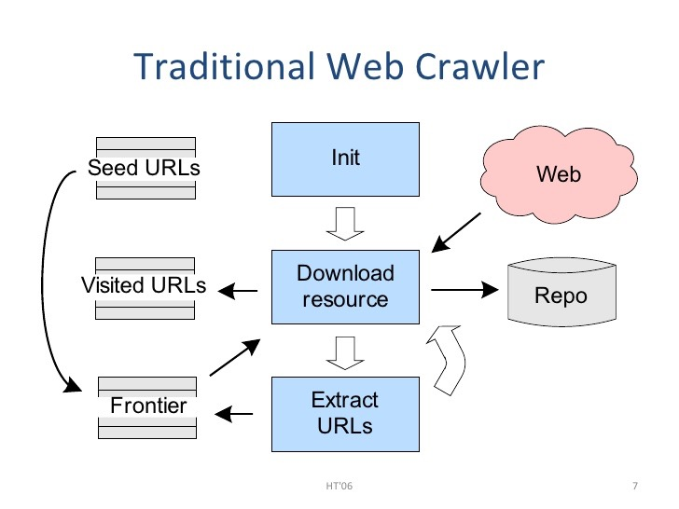

Slide 6
Uses for crawling :
Complete web search engine
Search Engine = Crawler + indexer searcher + GUI
Find Stuff
Gather stuff
Check stuff

Slide 7
The challenges of “Web Crawling”
There are three important characteristics of the web that makes crawling very difficult :
Its large volume
Its fast rate of change
Dynamic pages generation

