Slide 1
FINAL PROJECT REPORT Project: Bank Telemarketing - Term Deposit Prediction
Group - I:
Students: Aayush Kandhari, Shubham Jain, Vinayak Chaudhary, Palak Kumar, Mrinal Dhasmana, Shivam Goel
Mentor: Ms Anjana Agarwal

Slide 2
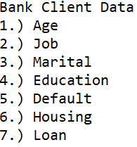
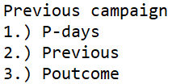
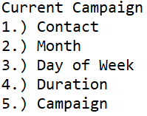
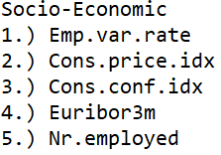
Problem Statement
To predict the success of telemarketing calls for selling bank long-term deposits. The data is related with direct marketing campaigns (phone calls) of a Portuguese banking institution. The classification goal is to predict if the client will subscribe a term deposit (variable y ‘yes‘ or ‘no‘.).
Predictors

Slide 3
Project Workflow
Data Cleaning
Taking Insights
Filling Missing Values
Imbalance Treatment
Feature Engineering
Model Selection
Feature Selection
Model Interpretation
Conclusion

Slide 4
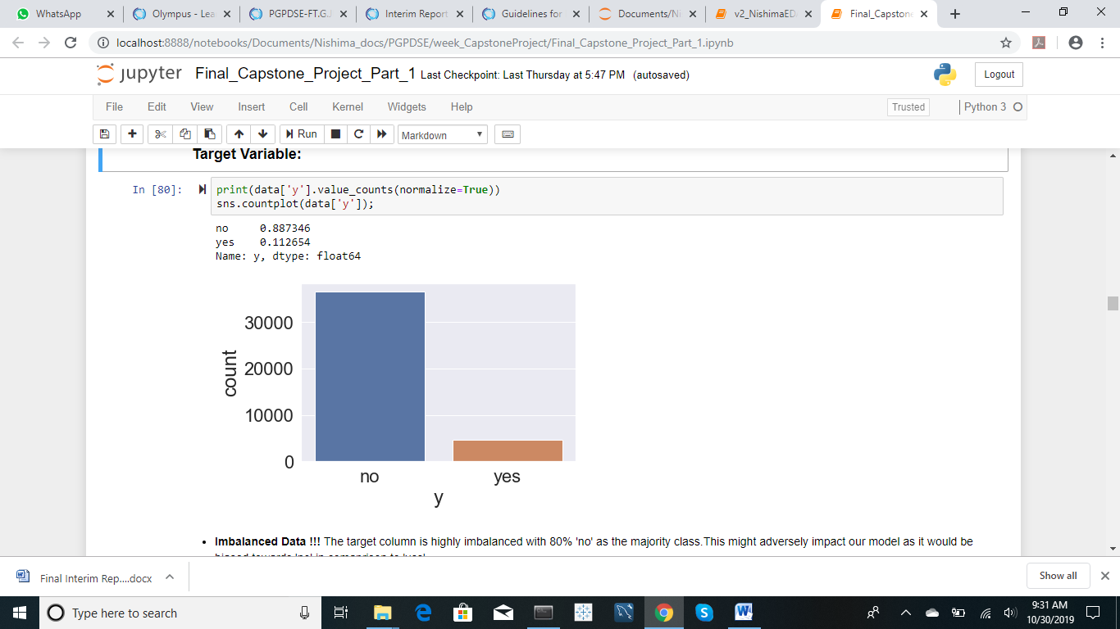
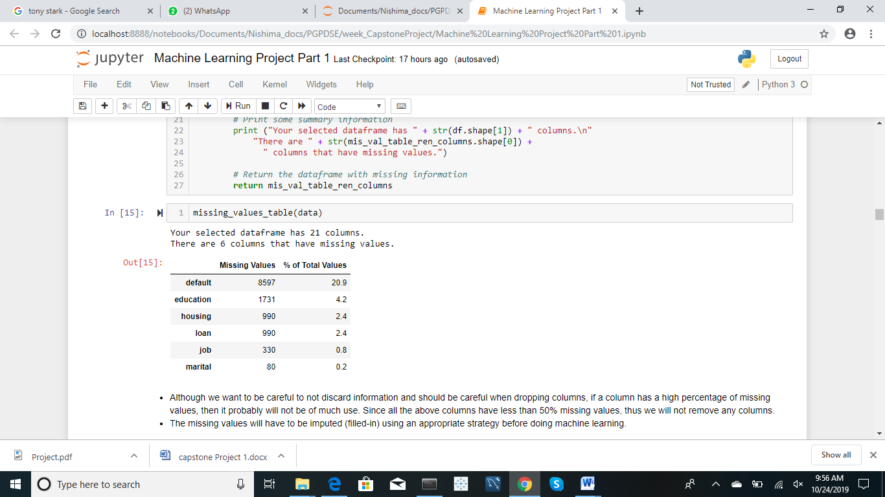
Challenges

Slide 5
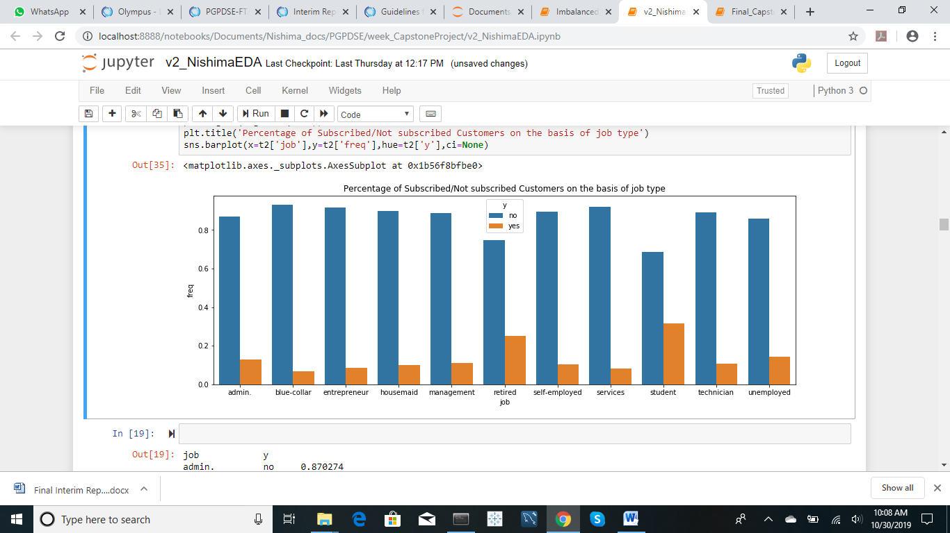
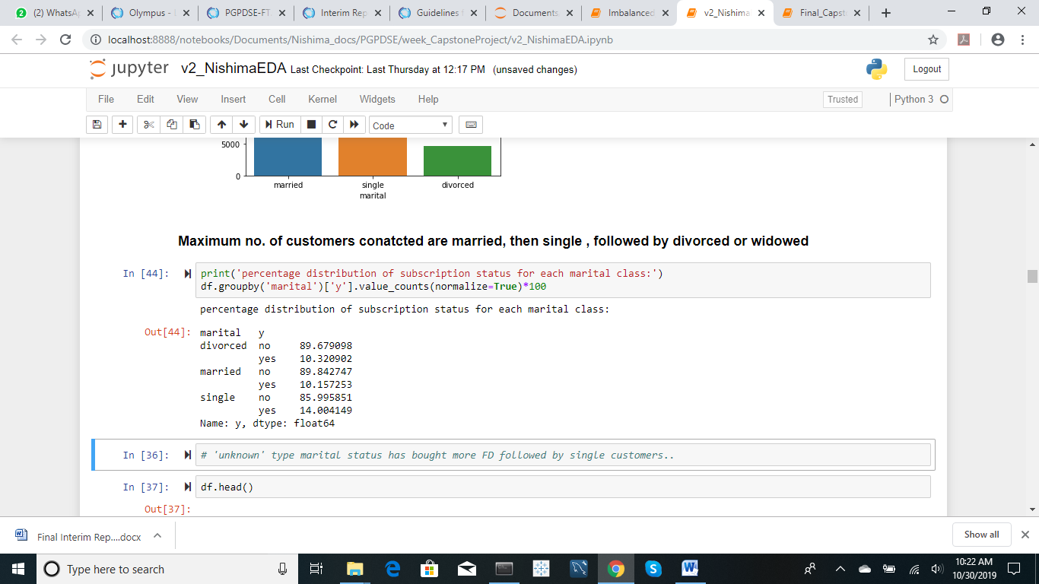
Insights
Notes:
Add job colum

Slide 6

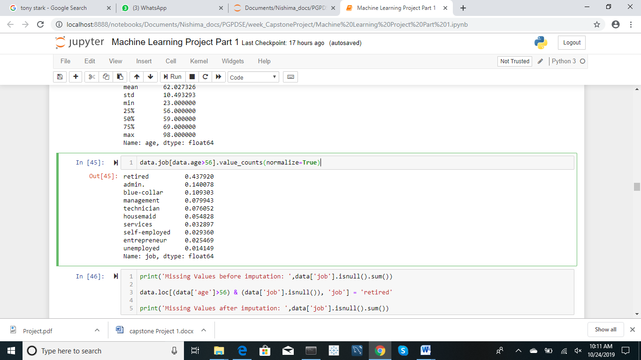
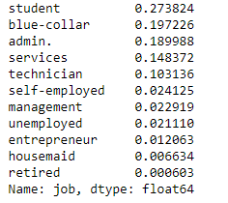
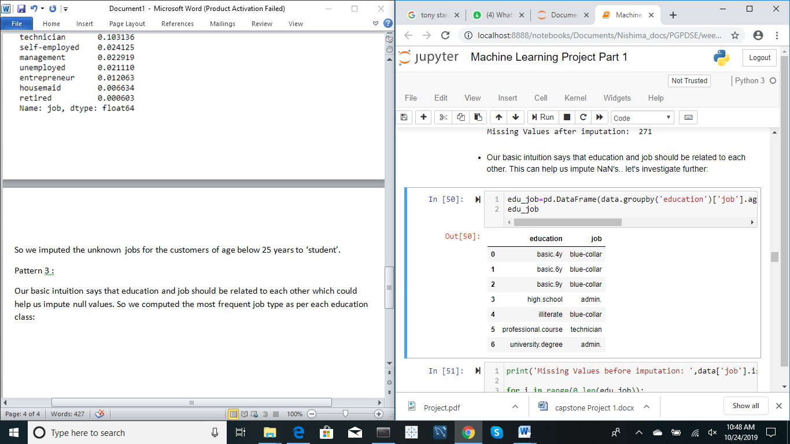
Filling Missing Values in ‘job’:
Pattern 1: Pattern 2
Pattern 3:
Pattern 4:
Impute remaining missing values by maintaining proportion of job classes as per data

Slide 7
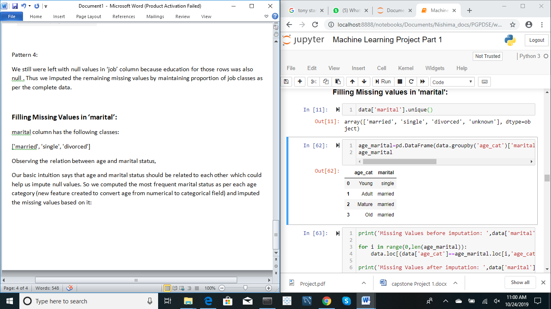
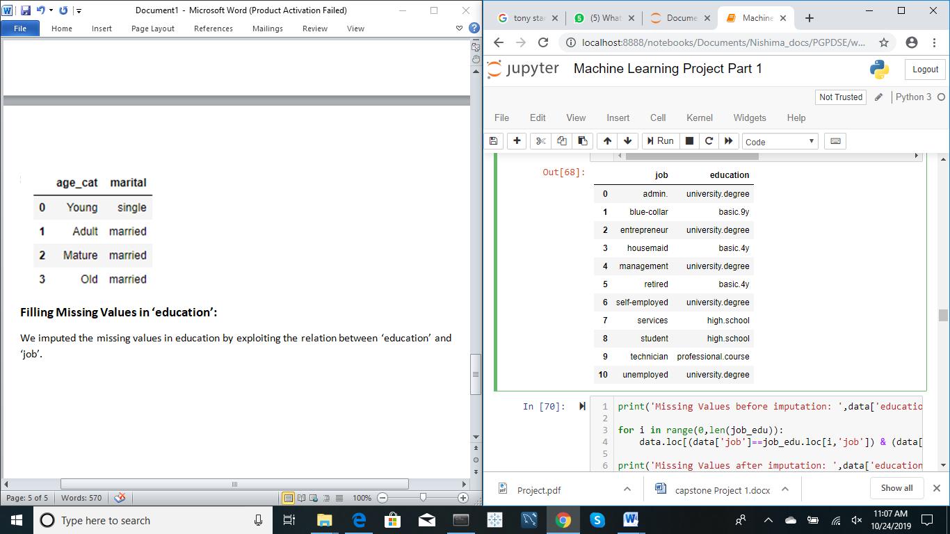
Filling Missing Values in ‘marital’:
Filling Missing Values in ‘education’:

Slide 8
Feature Engineering
Age binning : bin age into different age categories to generalize the data to get the more insights, namely as Young, Adult, Mature, and Old.
Duration conversion: conversion from seconds to minutes in order to reduce the bandwidth
P-Days: create a new generalized feature- whether the customer was contacted for previous campaign or not i.e., (if pdays=999 then 0 else 1)

Slide 9
Feature Selection
Findings of the Statistical Test with respect to Numerical Features- All numerical features have a significant effect on the target variable.
Findings of the Statistical Test with respect to Categorical Features- Except ‘default’ and ‘loan’, all categorical features have a significant effect on the target variable.
Selecting the important features through backward elimination.

Slide 10
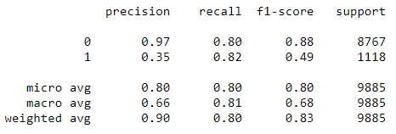
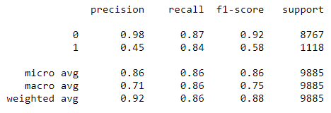

Imbalance Data Treatment
Under-Sampling(Near-Miss)-
Over-Sampling (SMOTE)-
Comparison-

Slide 11
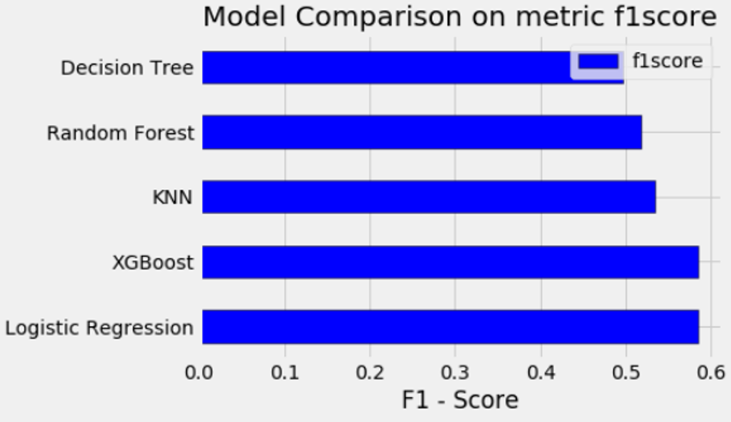
Model Comparison

Slide 12
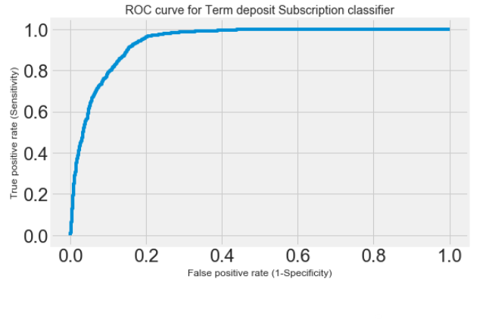
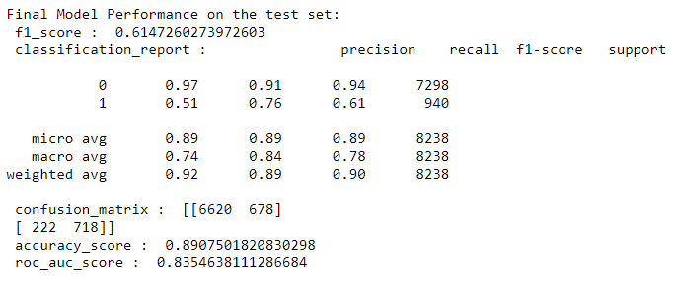
Further improving the model

Slide 13
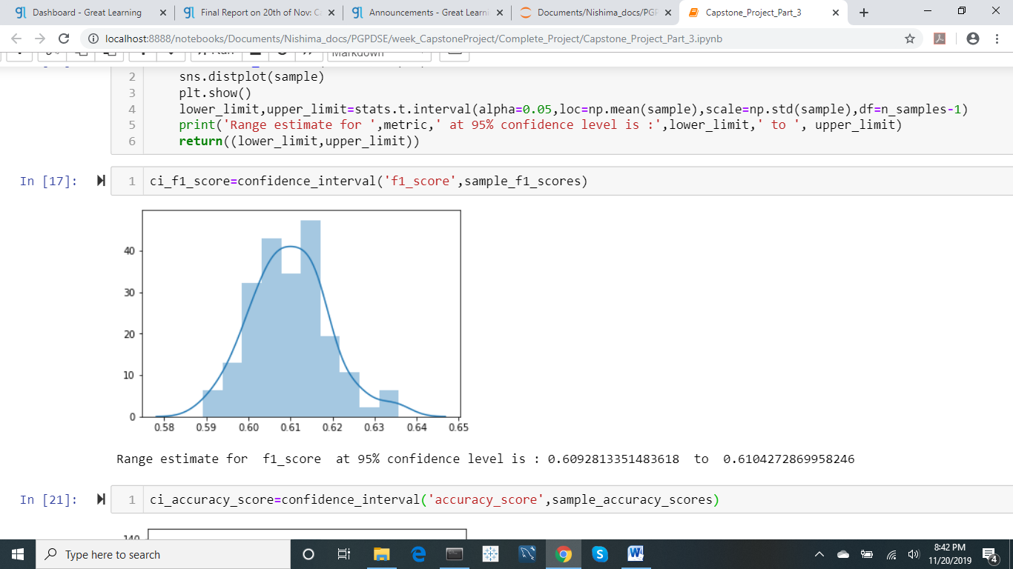
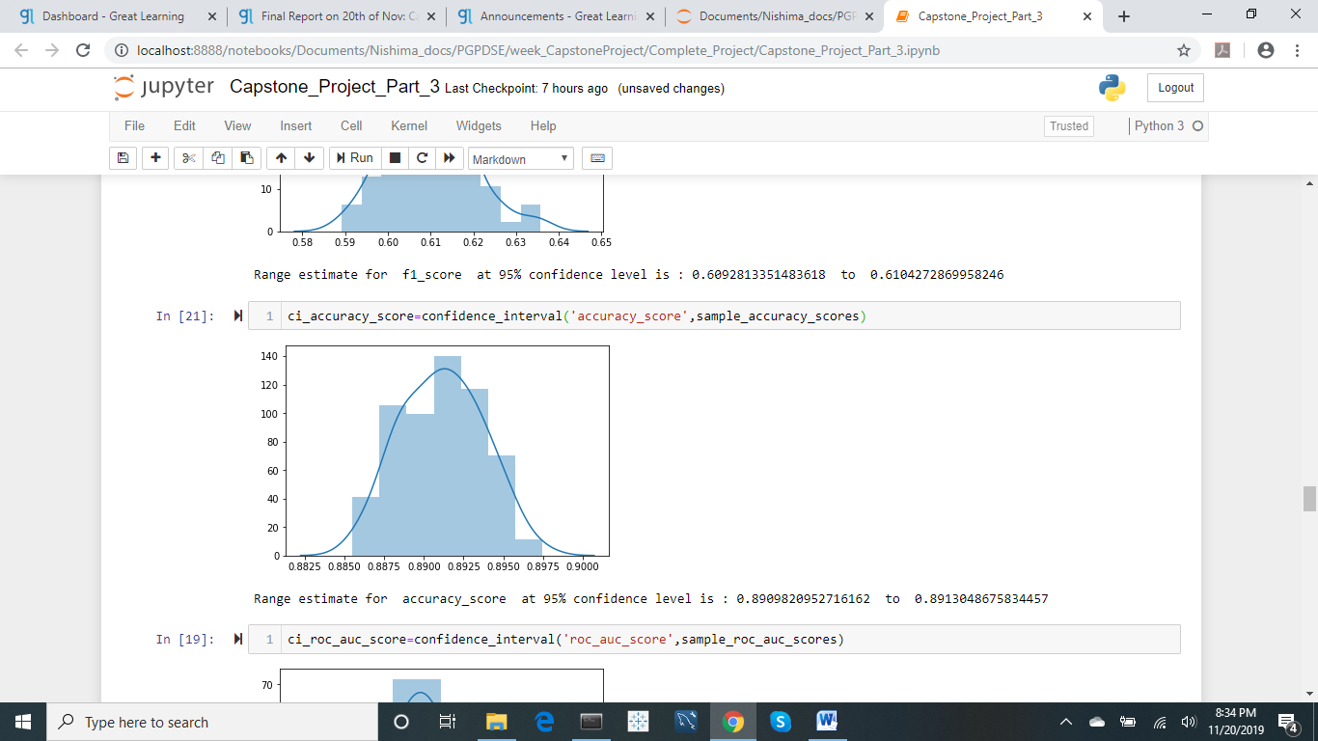
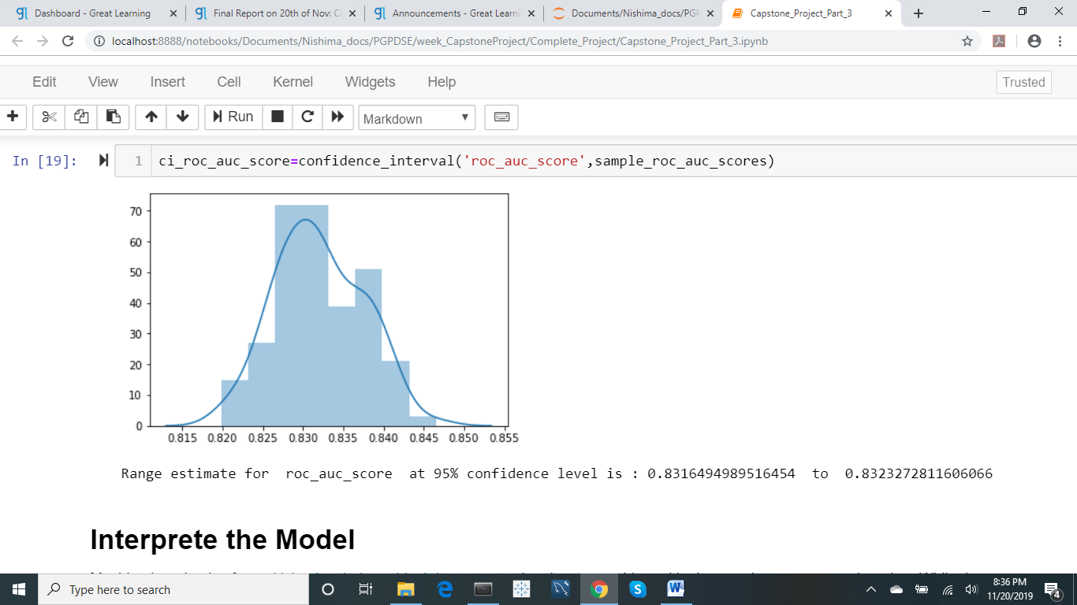
Range Estimate of Model Performance

Slide 14
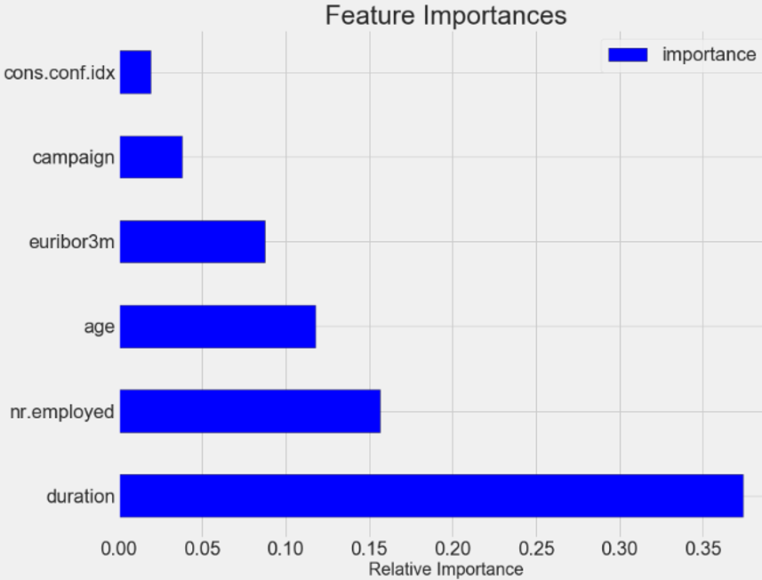
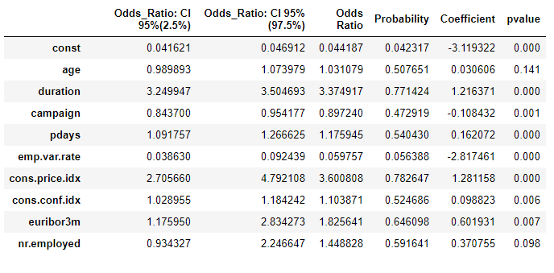
Model Interpretation

Slide 15
Conclusion: What Kind of Customers Will Subscribe to Bank’s Term Deposit
Job Type
Retired
Student
Marital Status
Single
Age Group
Young
Old
P outcome
Success
Day of Week
Tuesday
Thursday
Month
March
December
Contact
Cellular

Slide 16
Thank You!

