Slide 1
A Study on Interference Detection and Mitigation for FMCW RADARs
Shubham Jain
shubhamjainmml@gmail.com

Slide 2
Agenda
FMCW RADAR Overview
RADAR Interference:
  When does it happen?
  What does it do?
  How to Overcome it?
  Simulator
  Testbed
  Proposed Algorithm

Slide 3
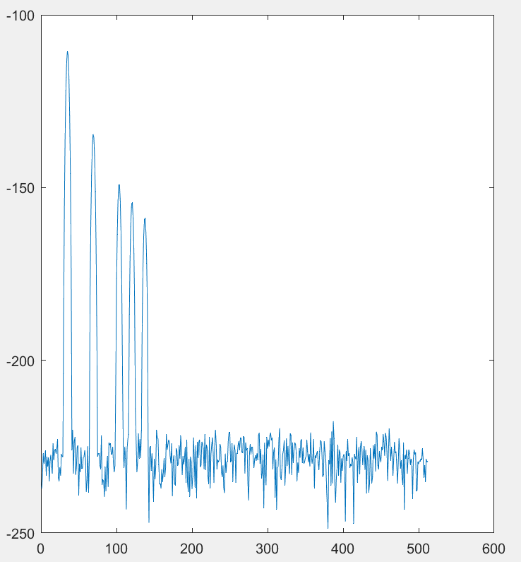

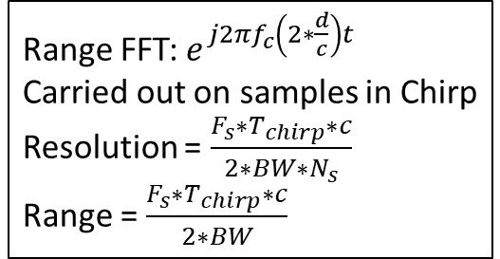
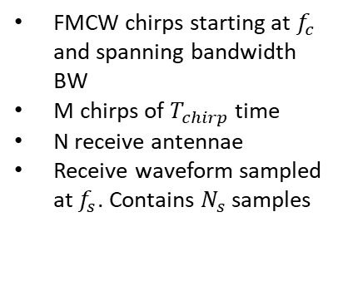


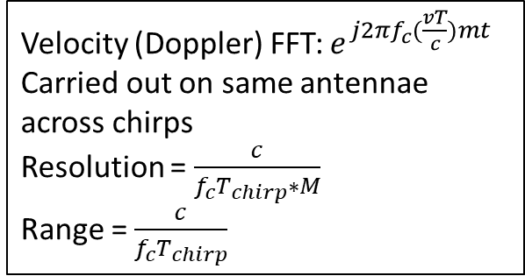
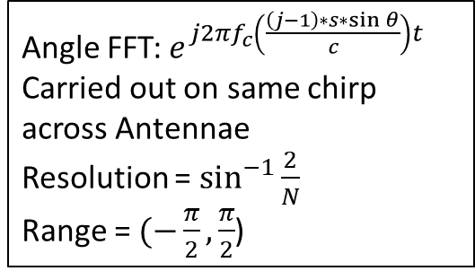
Velocity (Doppler) FFT: $e^{j2πf_{c}(\frac{vT}{c})mt}$
Carried out on same antennae across chirps
Resolution = $\frac{c}{f_{c}T_{chirp}∗M}$
Range = $\frac{c}{f_{c}T_{chirp}}$
$$τ=2\frac{d}{c}+\frac{\left(j−1\right)∗s∗\sin{θ}}{c}+\frac{vT}{c}$$
Angle FFT: $e^{j2πf_{c}\left(\frac{\left(j−1\right)∗s∗\sin{θ}}{c}\right)t}$
Carried out on same chirp across Antennae
Resolution = $\sin^{−1}{\frac{2}{N}}$
Range = $(−\frac{π}{2},\frac{π}{2}$)
Range FFT: $e^{j2πf_{c}\left(2∗\frac{d}{c}\right)t}$
Carried out on samples in Chirp
Resolution = $\frac{F_{s}∗T_{chirp}∗c}{2∗BW∗N_{s}}$
Range = $\frac{F_{s}∗T_{chirp}∗c}{2∗BW}$
$$τ$$
$$d_{1},θ_{1},v_{1}$$
Interferer!!
Echoes (Targets)
IF BW
FMCW chirps starting at $f_{c}$ and spanning bandwidth BW
M chirps of $T_{chirp}$ time
N receive antennae
Receive waveform sampled at $f_{s}$. Contains $N_{s}$ samples
Range FFT

Slide 4






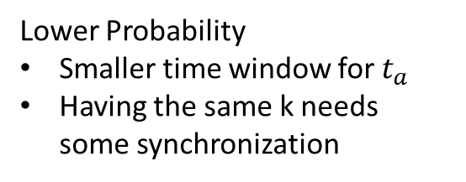
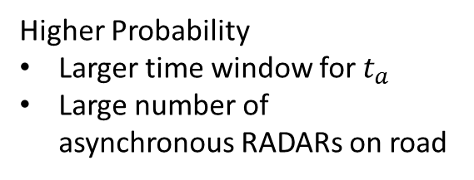
When Does it Happen?
f
f
f
$$BW$$
$$BW$$
$$k_{a}=k_{v}$$
$$BW$$
$$k_{a}<k_{v}$$
$$k_{a}>k_{v}$$
$$t_{1}$$
$$t_{2}$$
t
$$t_{a}$$
$$t_{1}$$
t
$$t_{v}$$
$$t_{a}$$
t
$$t_{a}$$
$$t_{v}$$
$$t_{v}$$
Higher Probability
Larger time window for $t_{a}$
Large number of asynchronous RADARs on road
Lower Probability
Smaller time window for $t_{a}$
Having the same k needs some synchronization

Slide 5
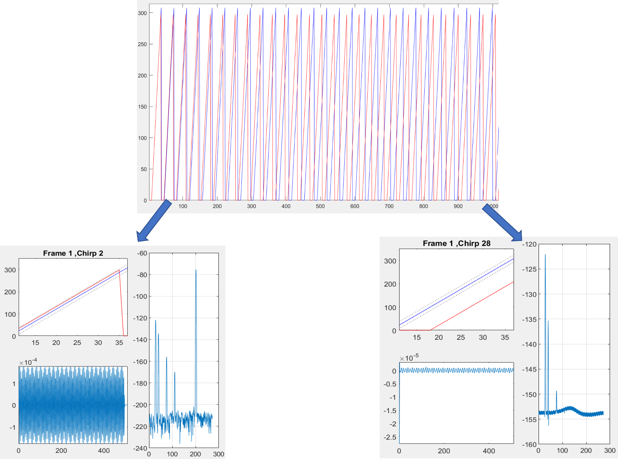
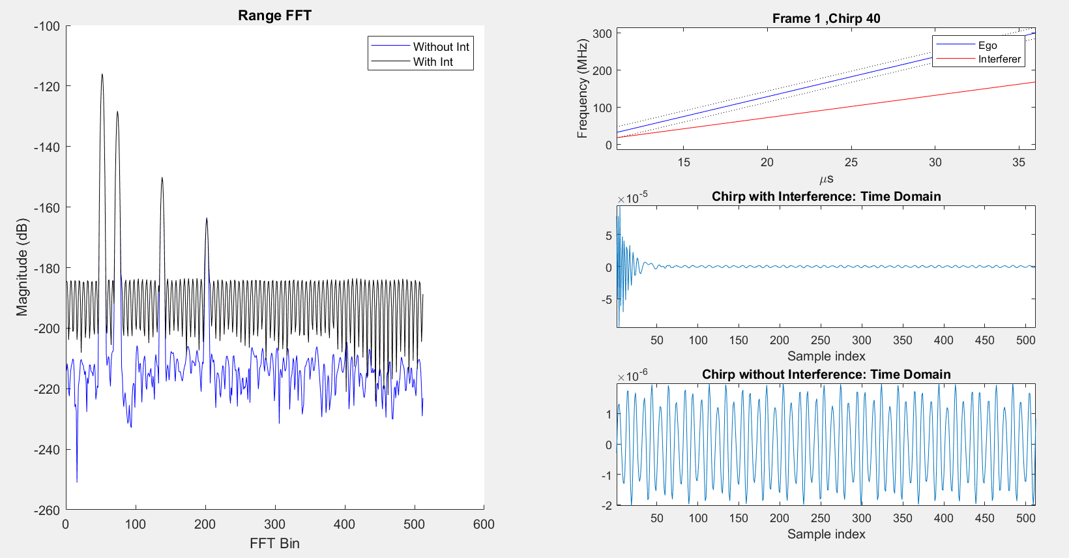
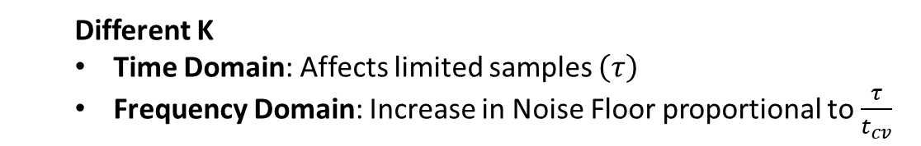
What Does it Do?
  Different K
  Time Domain: Affects limited samples $\left(τ\right)$
  Frequency Domain: Increase in Noise Floor proportional to $\frac{τ}{t_{cv}}$
  Same K
  Time Domain: Large superimposed Sine Wave
  Frequency Domain: Ghost Peak
Highly Probable
Noise Floor Increase can make it impossible to detect targets
FOCUS !!

Slide 6
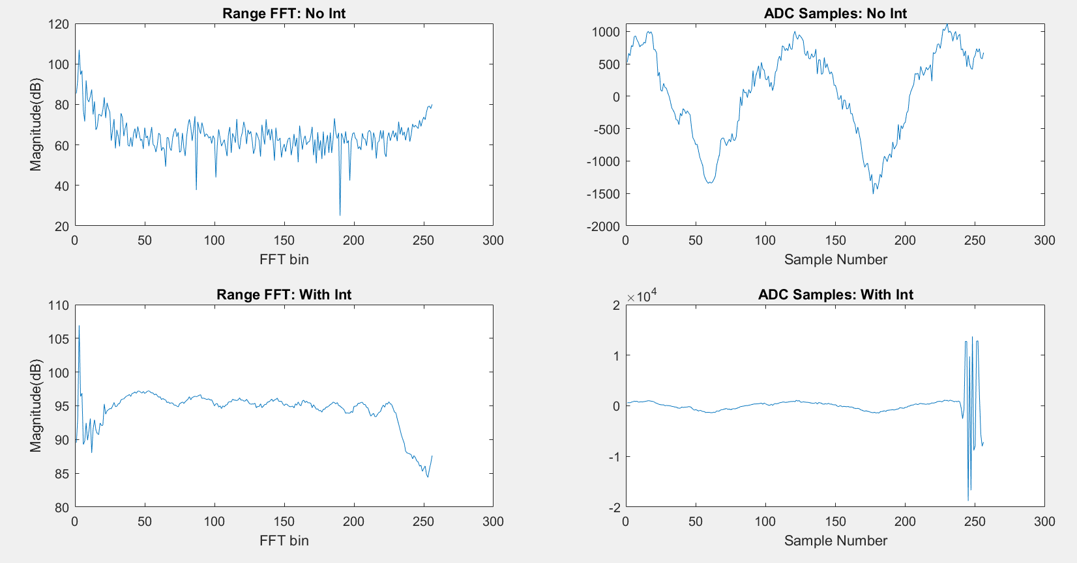

Slide 7
How to Overcome it?
Waveform Generation
HW
RADAR Data Post Processing
Avoidance Techniques
  Time Dithering
  Frequency Dithering
  Cooperative Dithering
Hardware Based
  Explore Diversity in Antennae
  Spread Spectrum RADARs
Mitigation Techniques
  Seek and Destroy
  Reconstruction
  Cancellation
Concerns about:
  Effectiveness
  Bandwidth
  Implementation
Difficult to Implement
Large Number of possibilities
Important to optimize compute time and resources

Slide 8

$$τ=2\frac{d}{c}+\frac{\left(j−1\right)∗s∗\sin{θ}}{c}+\frac{vT}{c}$$
Simulator
Values: 100s of ns
How: Implemented as Sample Delay and offset in waveforms
Why: To precisely simulate effects of Time Dithering
Values: <50 ps
How: Implemented as exponential phase delay
Why: Large array sizes otherwise would make simulations too time consuming
Values: <50 ps
How: Implemented as exponential phase delay
Why: Large array sizes otherwise would make simulations too time consuming

Slide 9
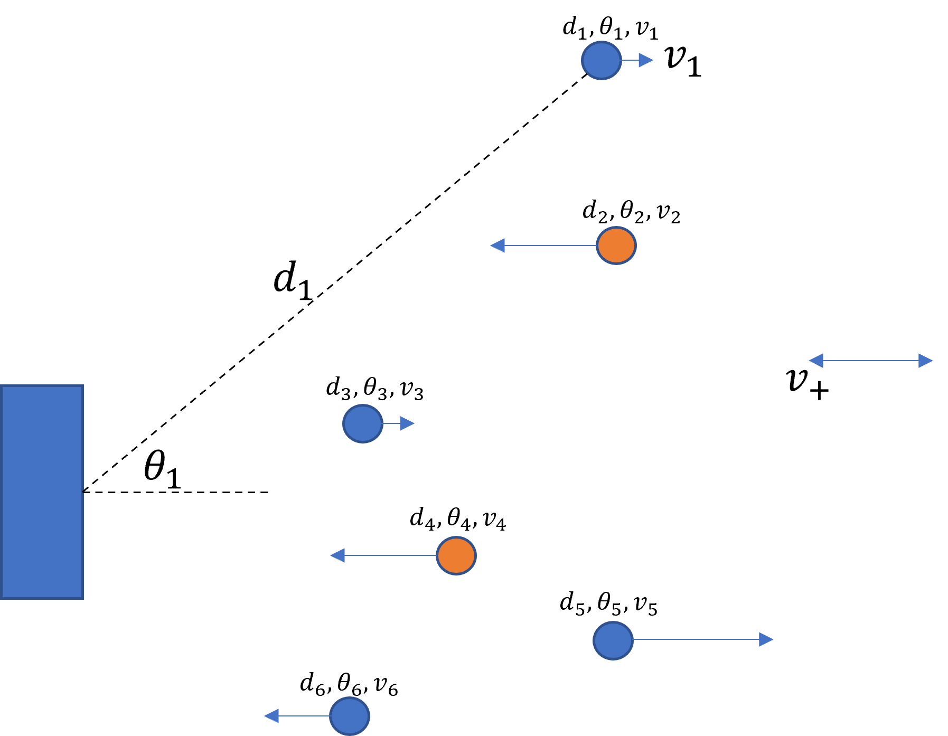
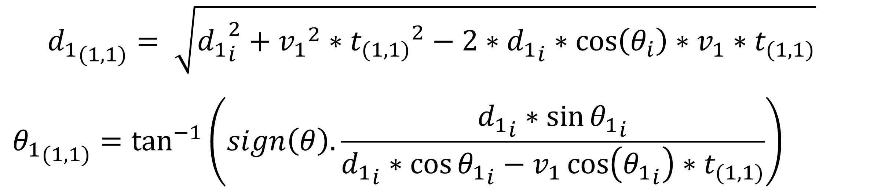



1
Simulator
Generate Scenario
Generate Target Reflections
Add Antenna and Doppler Offsets
Downconvert and Decimate
Add Antenna and Doppler Offsets
$$[N_{F}×N_{C}×N_{Rx}×N_{S}]$$
Generate Interferer Waveform
Analog Domain $≡$ High Sampling Rate
Decimate
Digital Domain $≡$ Low Sampling Rate

Slide 10
Simulator as a Testbed
Approach: Time Dithering
Methodology:
  Add varying Inter Frame Gaps for the Interferer and Ego Waveforms
Evaluation:
Tx_Start_Time+ Frame_Time
Frame: 1
Tx_Start_Time
Sim_Times(1,1)
Sim_Times(1,2)
Sim_Times(1,3)
Sim_Times(1,Chirps_Per_Frame)
Tx_Start_Time + Frame_Time + Inter_Frame_Gap [1]
Frame: 2
Sim_Times(2,1)
Sim_Times(2,2)
Sim_Times(2,3)
Sim_Times(2,Chirps_Per_Frame)
Tx_Start_Time + Frame_Time + Inter_Frame_Gap [N_f-1]
EoSim
Frame: N_f
Find All Peaks in RangeFFT
Sort and Filter by Prominence, Distance
Evaluate Number of True Positives and False Negatives

Slide 11
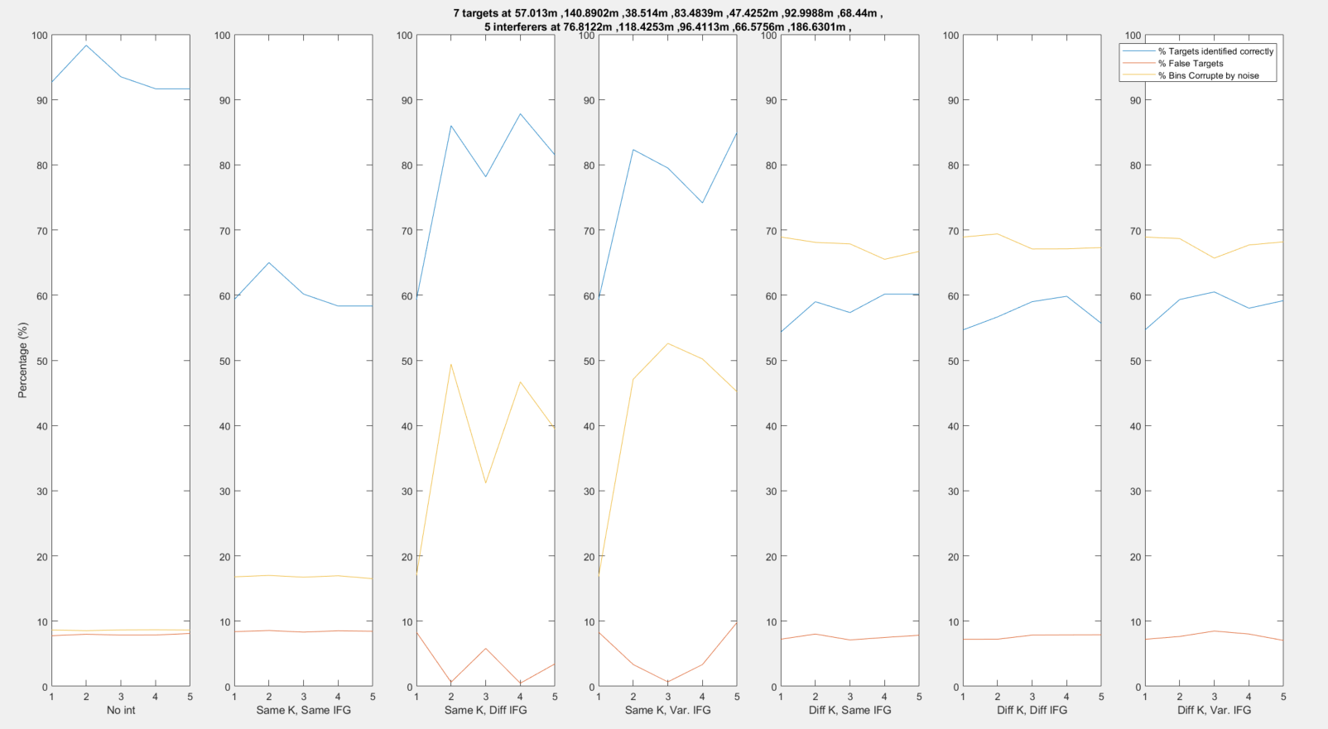
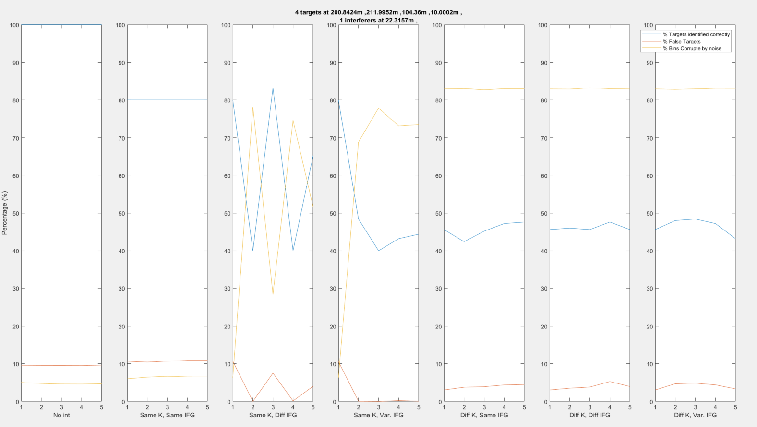
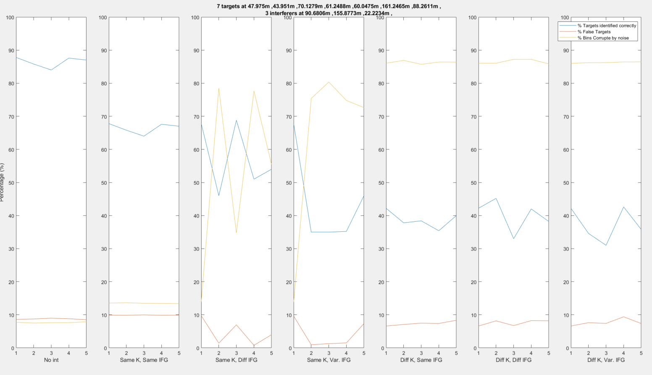
Does not work for Different K !!!
Can be used in Cooperative Dithering
2

Slide 12
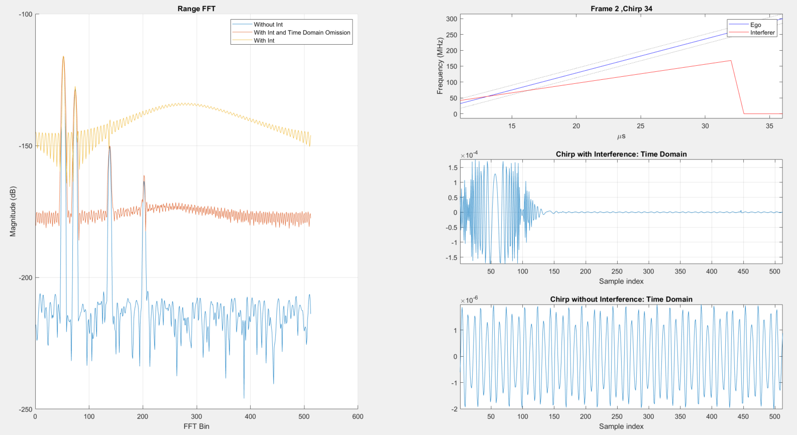
Simulator as a Testbed
Approach: Seek and Destroy
Methodology:
  Isolate parts of waveform which have been interfered with and remove them from time domain data
Evaluation:
  Compare Noise Floor before and after removal of interfered samples

Slide 13
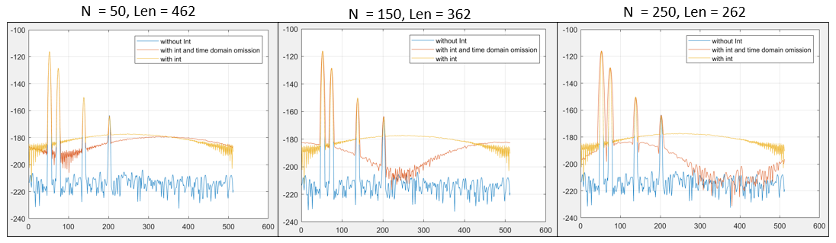
As number of excised samples increase, we lose information -> Resolution decreases
Fails with multiple interferes in one chirp !!!
Recreation of samples instead of excision might work better

Slide 14
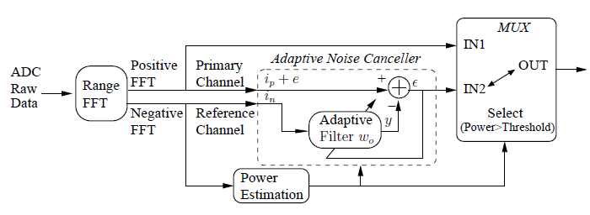
Simulator as a Testbed
Approach: Use Adaptive Noise Cancellation Algorithms on Range FFT
Methodology:
  Target Echoes only appear in positive FFT Bins
  Interference and Noise are uniformly spread and complex conjugates in the positive and negative bins

Slide 15
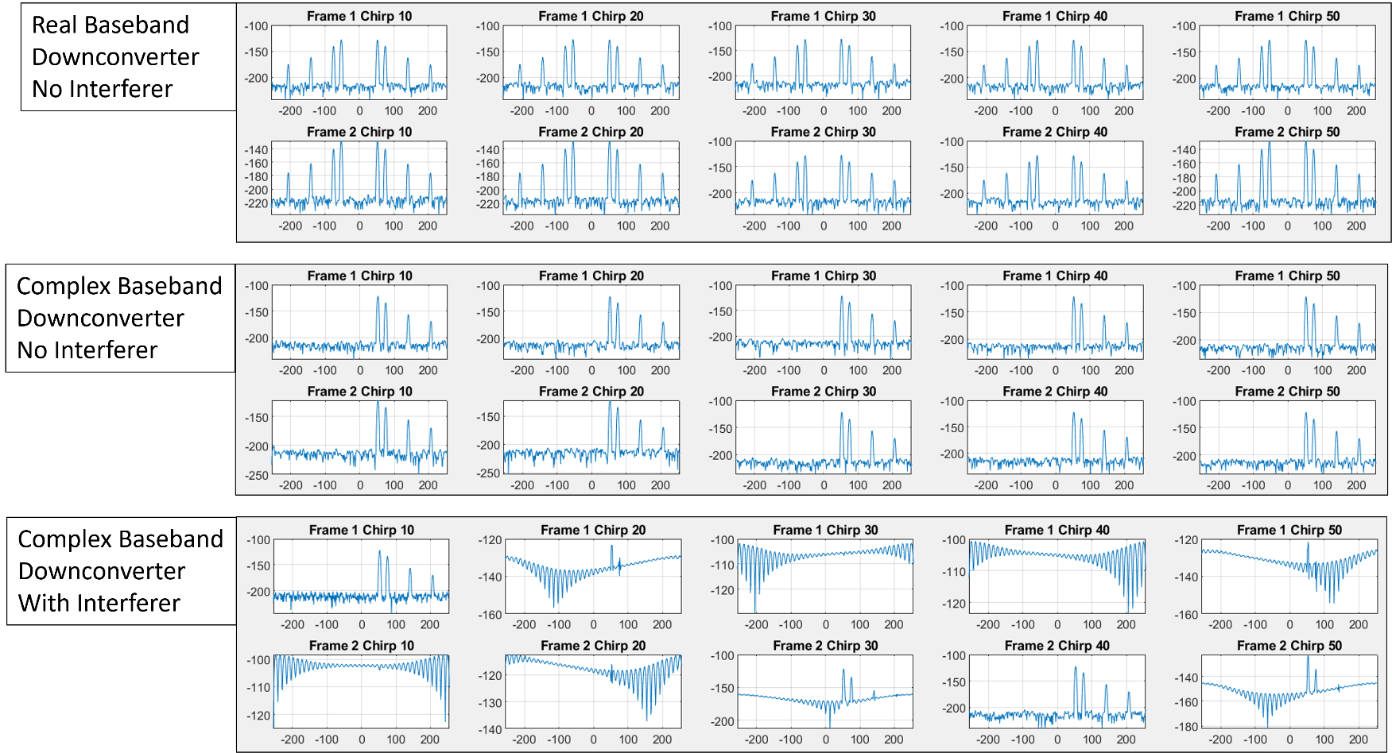
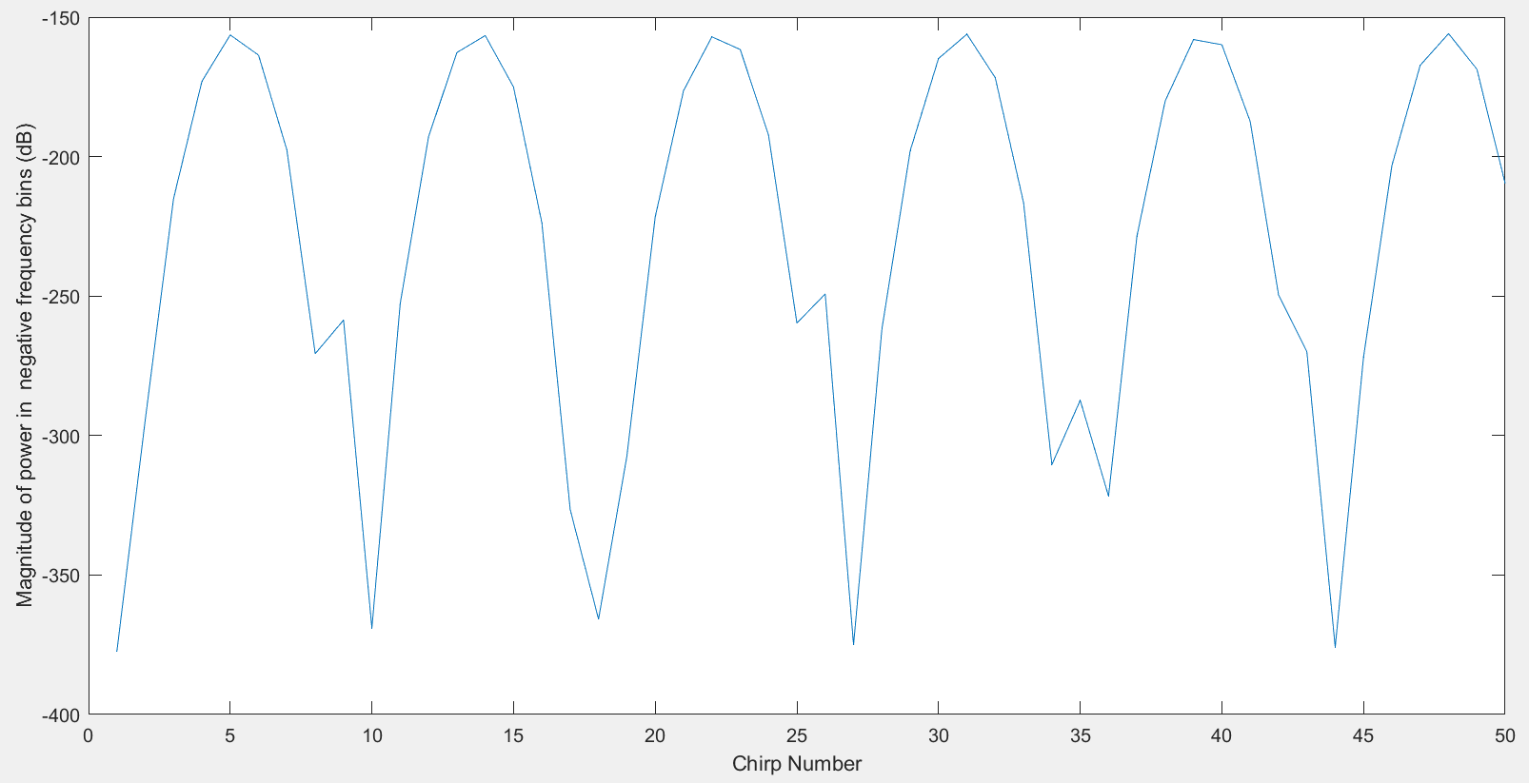
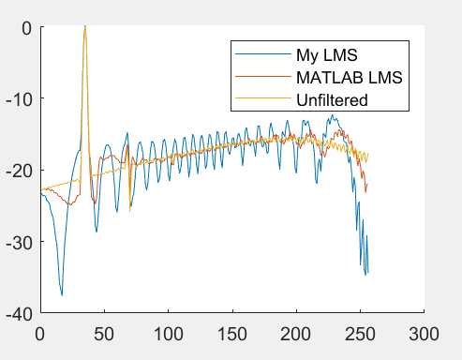
Results in reference paper could not be recreated
3

Slide 16
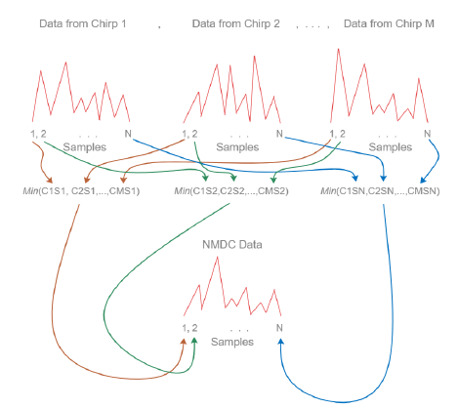
Proposed Algorithm
Find AoA
Find RangeFFT
Estimate Power (P) in
Negative FFT Bins
P> Threshold*?
Chirp
Accumulate
NDMC
(Best Case Range FFT)
Find Cleanest Chirp
Find AoA
Motivation:
  Most techniques improve only Range FFT
  Most techniques might not work with multiple interferers
  Most techniques are heavy on DSP
*Threshold based on Noise Floor Levels. Dominated by Instrument and Processing noise. Found using initial calibration.

Slide 17
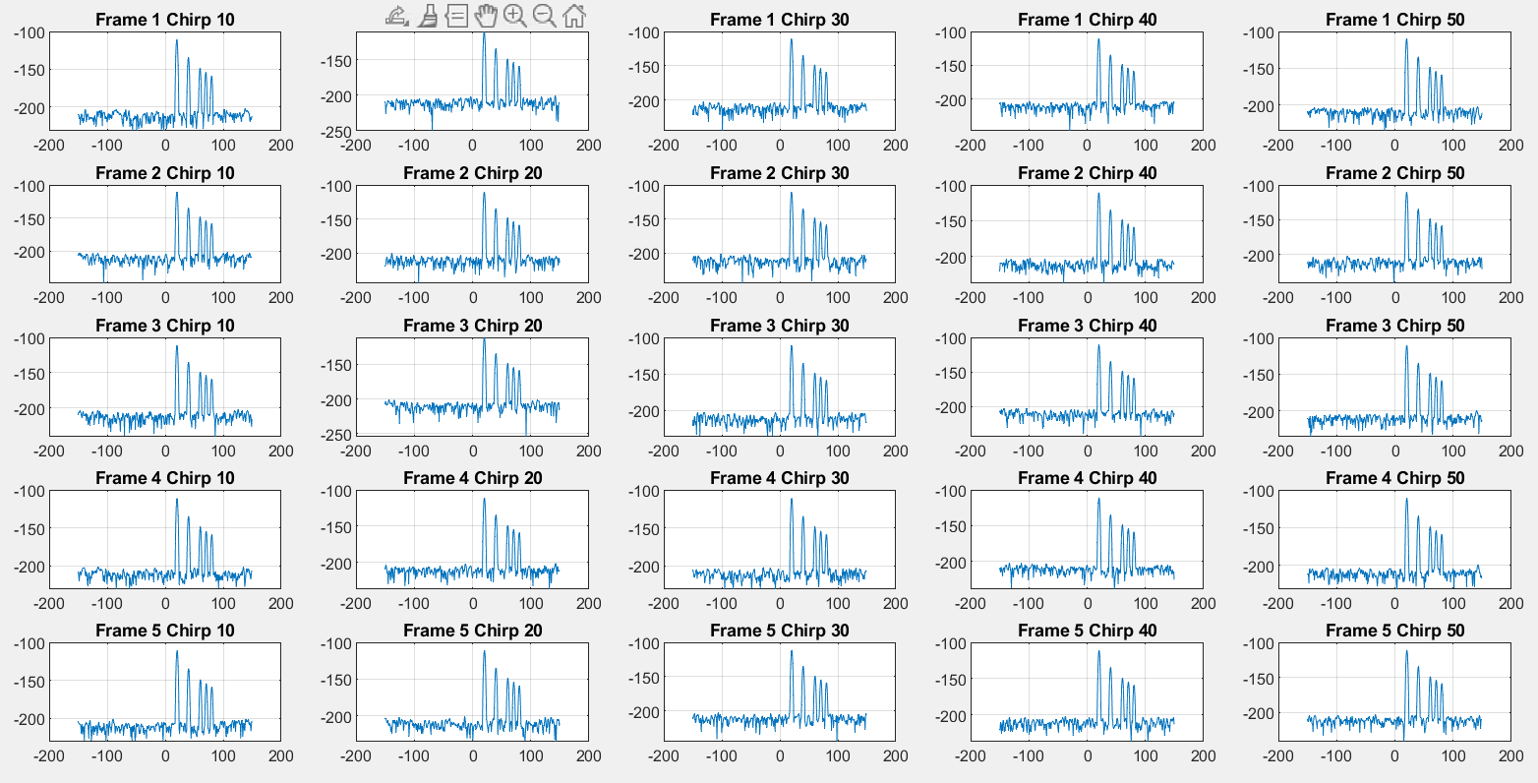
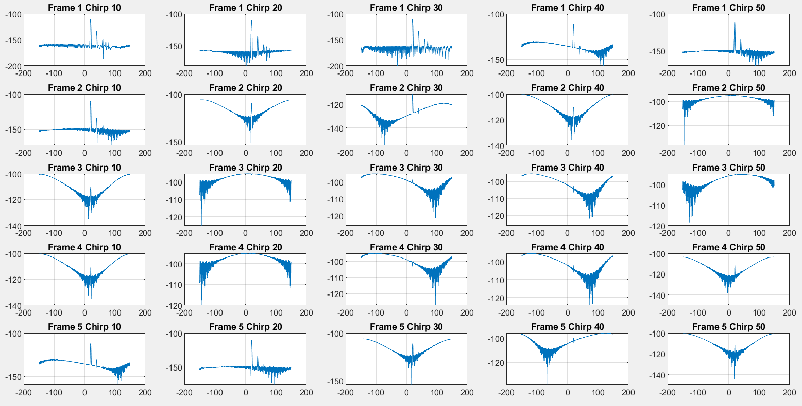
NDMC

Slide 18
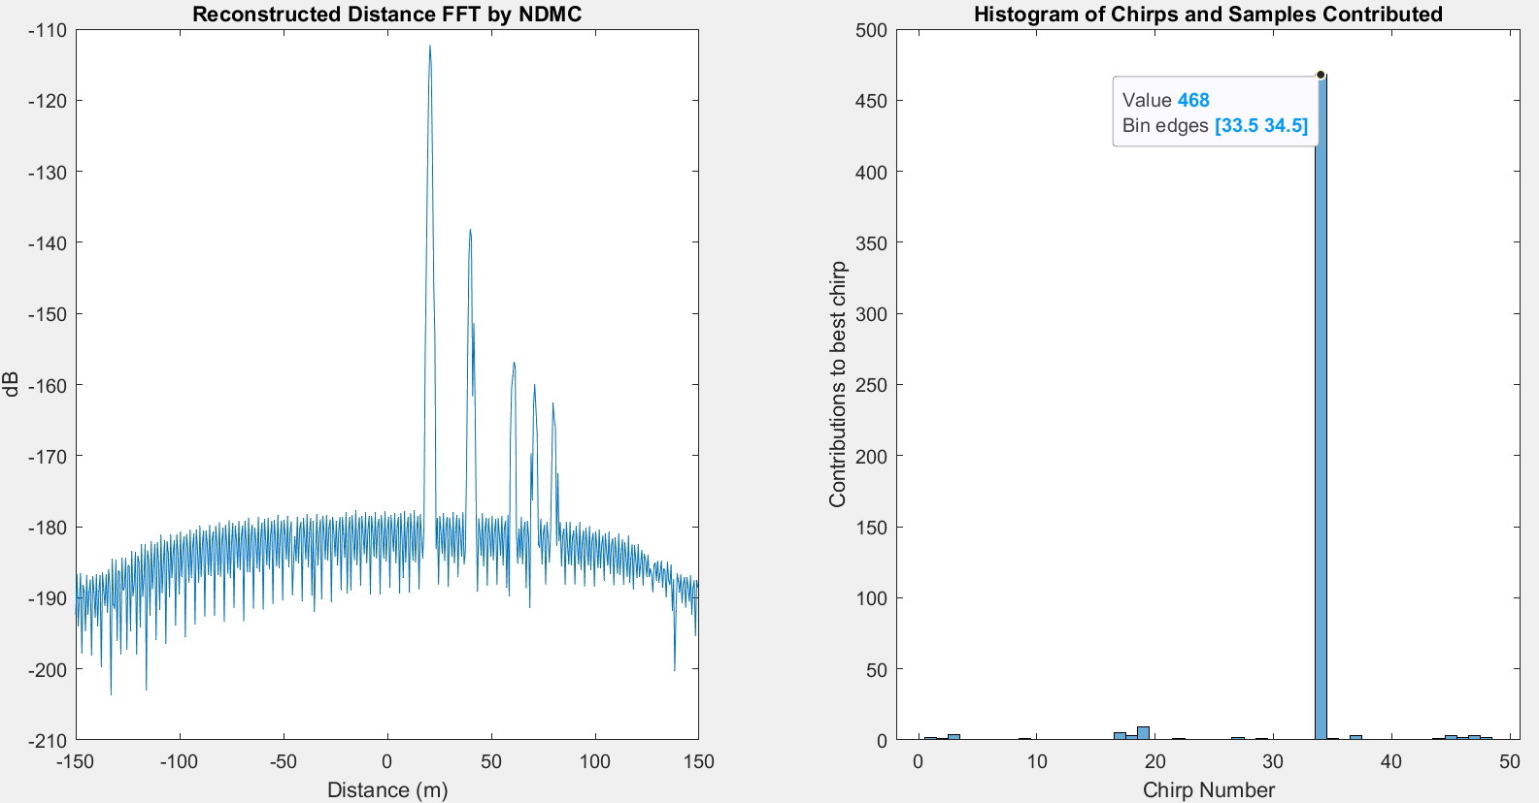
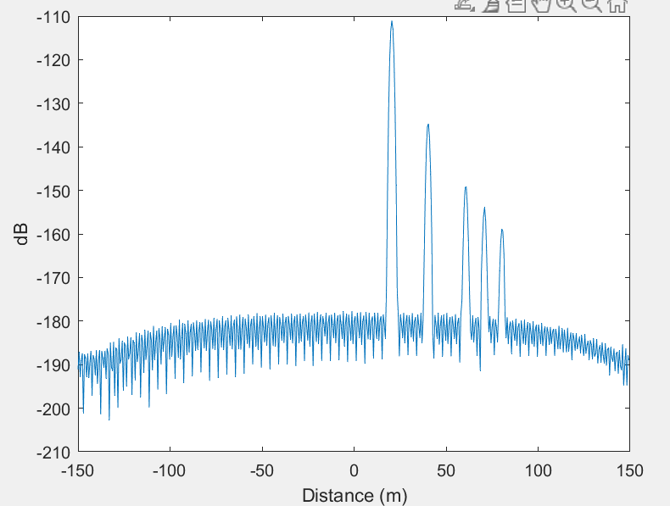
NDMC
4

Slide 19
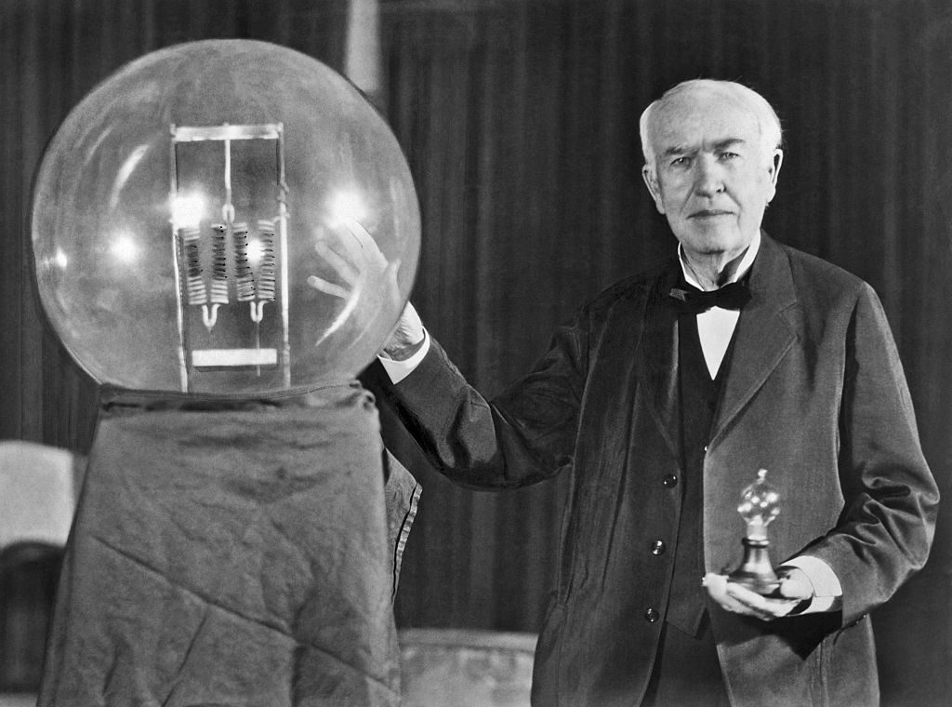
Next Steps
  Perform AngleFFT on the extracted chirp
  Put the system (1,2,3,4) together and compare results with no mitigation case
Drawback
  Does not provide Doppler FFT. Even if multiple good chirps are present, the resolution will be very low
Scope
  Since NDMC gives us the close to ideal pulse, can we use it cancel out the effect of targets and use the resultant to in turn predict and cancel out interference from other chirps

Slide 20
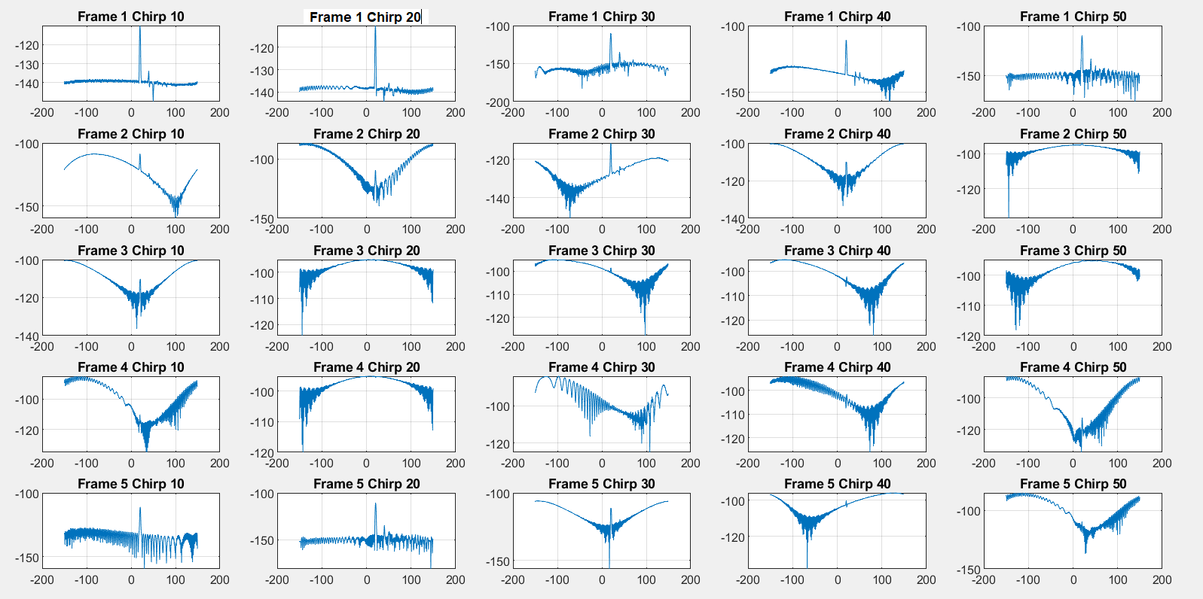
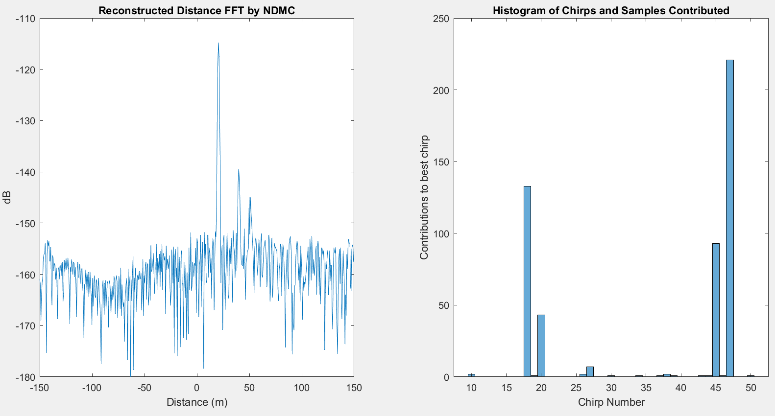
Explore using a combination of healthiest chirps to correlate and find the Angle FFT

Slide 21
Potential Variations
Find AoA
Use NUDFT to do Doppler Transform
Find RangeFFT
Estimate Power (P) in
Negative FFT Bins
P> Threshold*?
Chirp
Find AoA from every chirp and isolate peaks with highest correlations across
Accumulate
NDMC
(Best Case Range FFT)
Rate Chirps on Health

