Slide 1
Stock Price Prediction

Slide 2
TEAM MEMBERS :
Shubham Jain (2210992365)
Sneha Rani (2210992391)
Shubham (2210992360)
Sudeep Rohaj (2210992412)

Slide 3
CONTENT :
Problem Statement
Objective
Tools Used
Data Summary
Exploratory Data Analysis

Slide 4
PROBLEM STATEMENT :
Develop a predictive model to accurately forecast the future prices of a specific stock (or a set of stocks) using historical data and other relevant financial indicators.
The goal is to develop a reliable and accurate predictive model that can forecast future stock prices based on historical data and other relevant financial indicators. This model aims to assist investors , traders , and financial analysts in making informed decision to optimize their investment strategies , manage risks , and potentially increase profitability.
T

Slide 5
OBJECTIVE :
The objective of a stock price prediction is to develop an accurate machine learning model that forecasts future stock prices . It aims to enhance prediction accuracy using metrics like MAE and RMSE . Additionally , the project seeks to create a user-friendly interface for stakeholders and ensure ongoing model monitoring and retraining for better investment decisions and risk management.

Slide 6
TOOLS USED:-
Jupyter Notebook is used as IDE.
Pandas and NumPy are used for Data Manipulation & Pre-processing and Mathematical functions respectively.
Exploratory data analysis is automated by
data prep.
For visualization of the plots, Matplotlib, Seaborn, Plotty are used.
GitHub is used as version control system

Slide 7
DATA SUMMARY :
Numerical data
Date
Open
High
Low
Close
Adjacent close
Volume

Slide 8
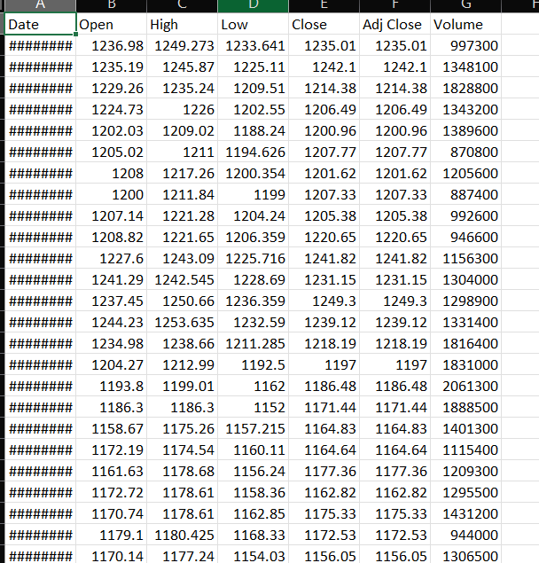
DATA :

Slide 9
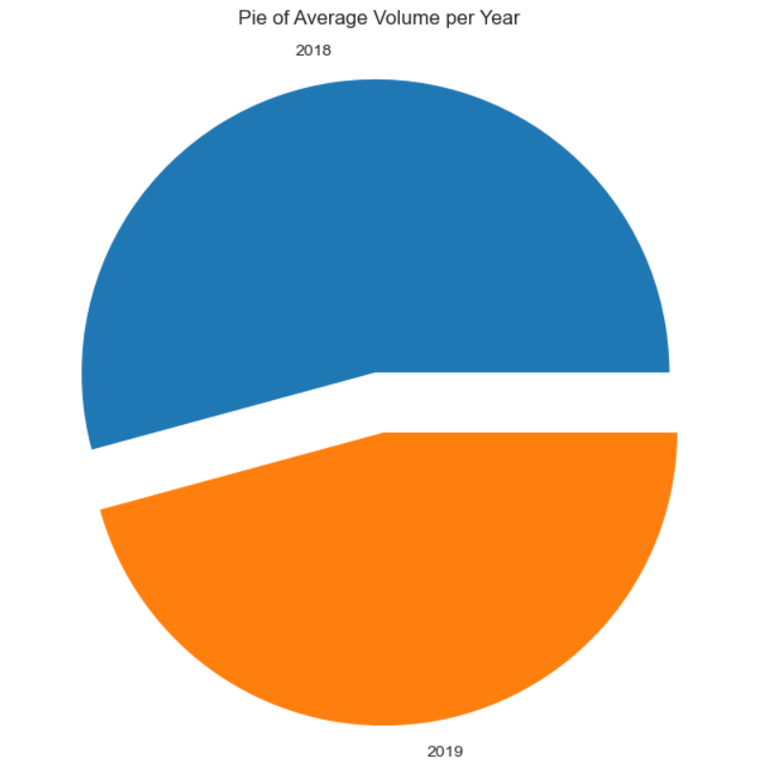
Pie of average volume per year :
This pie chart visualizes the average
trading volume per year

Slide 10
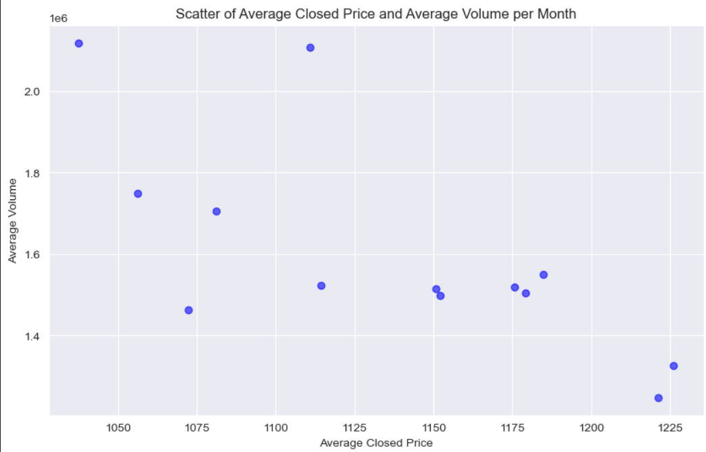
Scatter plot :
This scatter plot signifies the average closing price and average volume per month.

Slide 11
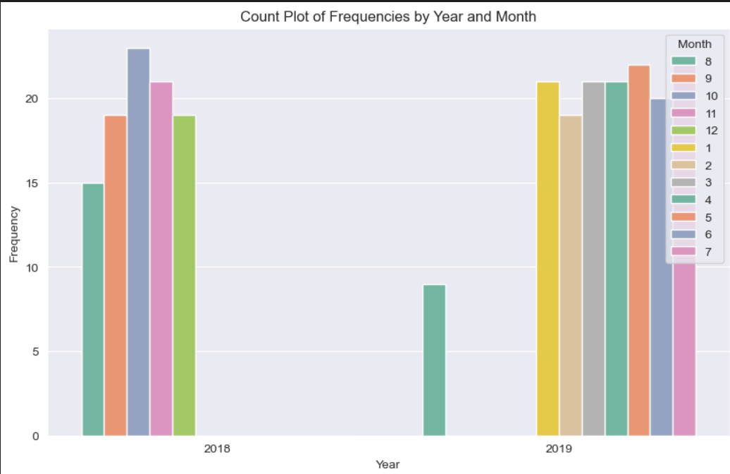
Count Plot :
This count plot signifies the frequencies by year and month.

Slide 12
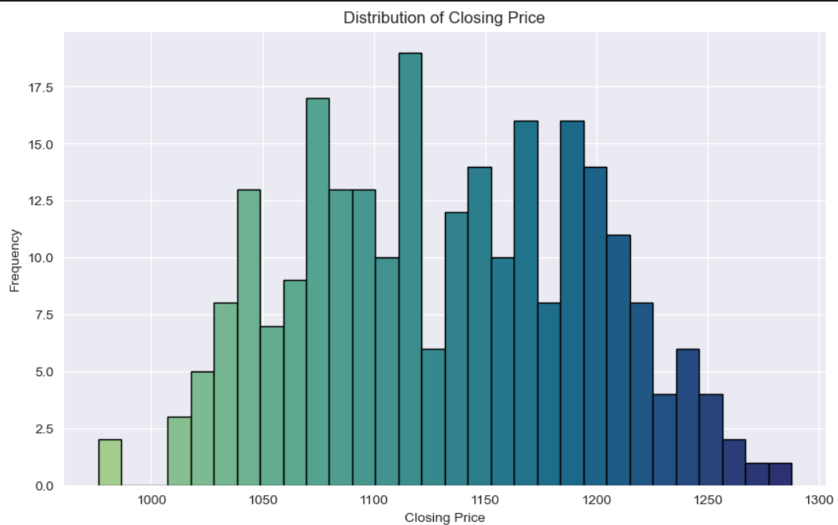
Histogram :
This histogram signifies the distribution of
closing price.

Slide 13
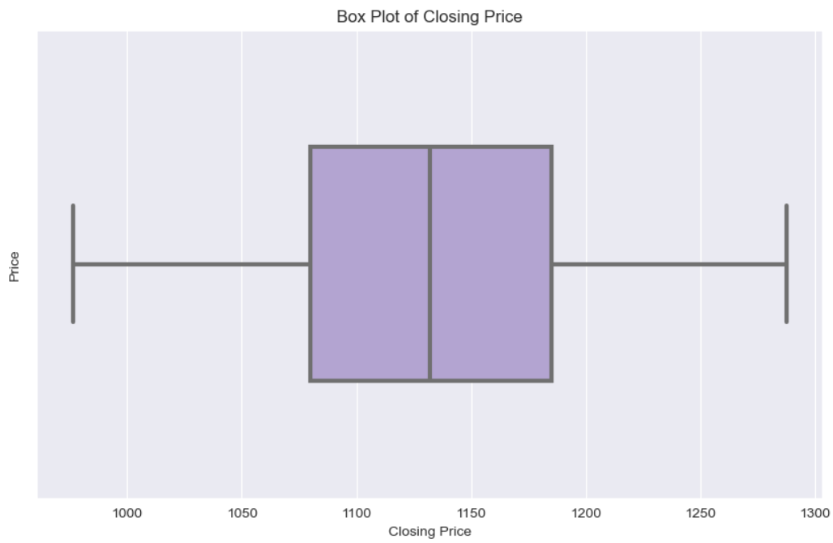
Box Plot :
This box plot shows the closing price of stock.

Slide 14
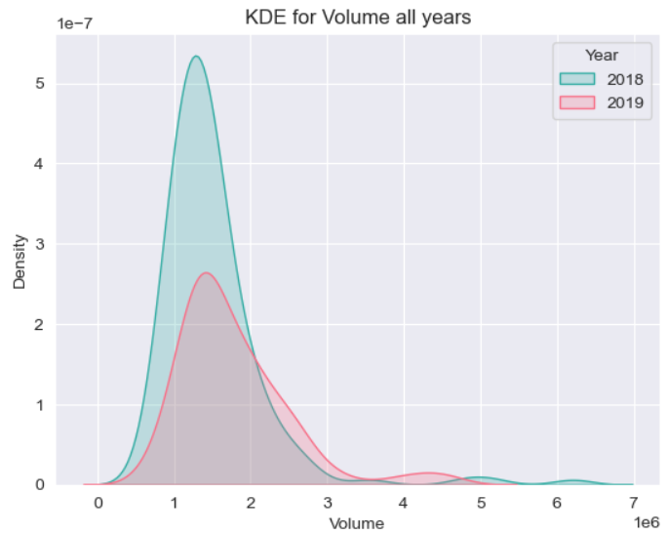
KDE for volume all years :
This plot is used to create KDE (kernel Density Estimate)
plot for volume column

Slide 15
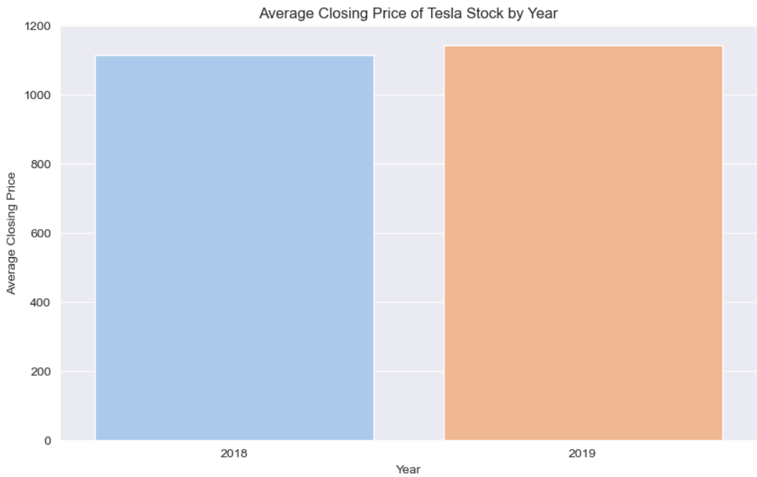
Average closing price :
This graph shows the average closing price of tesla
Stock by year.

Slide 16
LOGISTIC REGRESSION
Logistic regression is a method used in statistics and machine learning to predict the probability of a certain event happening. It's especially useful when the outcomes are binary, meaning there are only two possible results, like yes/no, true/false, or success/failure. It works by taking the input data (temperature, humidity, etc.) and applying a mathematical formula to produce a probability value between 0 and 1. This probability value indicates how likely it is that the event (rain) will occur.
In summary, logistic regression is a tool that helps you make predictions about binary outcomes by calculating probabilities based on input data

Slide 17
WHAT IS DATA SCALING
Data scaling involves adjusting the range of features in your dataset so that they are on a similar scale. This is important because many machine learning algorithms perform better when the features are on similar scales
WHY DATA SCALLING IS IMPORTANT?
Improves Algorithm Performance: Algorithms like gradient descent converge faster and more reliably with scaled data.
Prevents Feature Dominance: Ensures that features with larger scales do not dominate the learning process.
Enhances Accuracy: Models that depend on distance calculations, such as k-nearest neighbors (KNN) and support vector machines (SVM), perform better with scaled data.

Slide 18
WHEN TO USE DATA SCALLING
Algorithms Sensitive to Feature Scales: Algorithms like KNN, SVM, and neural networks require scaled features for optimal performance.
Gradient Descent-Based Algorithms: These algorithms, including linear and logistic regression, perform better with scaled features.
Features with Different Units: When your dataset has features with different units (e.g., height in centimeters and weight in kilograms), scaling ensures uniformity

Slide 19
TRAIN TEST SPLIT
Train-test split is a fundamental technique in artificial intelligence (AI) and machine learning (ML) used to evaluate the performance of a model.
2. It involves dividing the dataset into two parts: the training set and the testing set.
3. This process helps ensure that the model can generalize well to unseen data, which is crucial for building reliable.
.

Slide 20
WHY TRAIN TEST SPLIT IS IMPORTANT
Model Evaluation: It provides a straightforward way to assess how well the model performs on unseen data, helping to avoid overfitting (where the model performs well on training data but poorly on new, unseen data).
Generalization: It helps in understanding how well the model generalizes to an independent dataset, which is crucial for real-world applications.
Performance Metrics: By evaluating the model on a separate test set, you can calculate performance metrics (like accuracy, precision, recall, F1-score) that give a realistic estimate of the model's performance.

Slide 21
CLUSTERING AND THERE TECHNIQUES
Clustering is an unsupervised machine learning technique used to group similar data points into clusters. Unlike supervised learning, clustering does not rely on labeled data. Instead, it identifies patterns and structures within the data, making it useful for exploring and Understanding large datasets.
Why Clustering is Important:
Data Exploration: Helps in discovering natural groupings and patterns in data.
Data Compression: Reduces the dimensionality of data by grouping similar points together.
Anomaly Detection: Identifies outliers or unusual data points by finding points that do not fit well into any cluster.
Feature Engineering: Generates new features that can be used in other machine learning models.

Slide 22
COMMON CLUSTRING TECHNIQUES
K-Means Clustering: Partitions the data into K clusters, where each data point belongs to the cluster with the nearest mean.
Hierarchical Clustering: Builds a hierarchy of clusters by either merging small clusters into larger ones (agglomerative) or splitting large clusters into smaller ones (divisive).
Mean Shift Clustering: Iteratively shifts data points towards the mode (densest part) of the data distribution.

Slide 23
ADVANTAGES OF DECISION TREE
1.Easy to Understand and Interpret: The logic behind decision trees can be easily understood and visualized.
2.Little Data Preparation: Requires less data preprocessing compared to other algorithms (e.g., no need for feature scaling or centering).
3.Handles Both Numerical and Categorical Data: Can be used for both types of data.
4.Non-Parametric: Does not assume any distribution of the data

Slide 24
Challenges
Data Preprocessing: The dataset might have required significant preprocessing before it could be used for analysis and modeling. This could include handling missing values, outliers, or skewed data, which can significantly impact the performance of machine learning models.
Feature Selection: Determining which features are most relevant to the prediction of health insurance charges could have been a challenge. While age, BMI, and smoking status are likely important factors, there could be other variables not included in the dataset that also impact insurance charges.
Model Selection and Tuning: Choosing the right machine learning model for this type of prediction task, and tuning it for optimal performance, can be a complex and time-consuming process. It involves testing different models, selecting the right hyperparameters, and validating the model using appropriate metrics.

Slide 25
CONCLUSION :
In summary , the goal of our project is to apply predictive model to forecast stock market values. We used variety of variable from the dataset and modelling to create a solid prediction framework . The effectiveness of our model was assessed with suitable metrics and verified by comparing it with the test dataset.

Slide 26
Thank you

