Slide 1
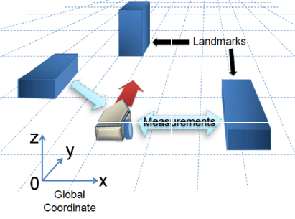
SLAM: Using Perception Systems

Slide 2
Agenda
What is my thesis about?
What have I done until now?
My contribution to SOTA.
What to be done in remaining time?
DEMO
Questions/Suggestions.

Slide 3
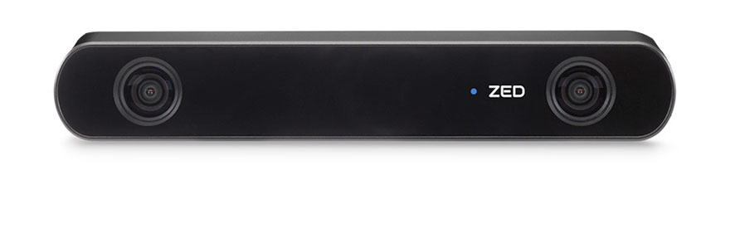
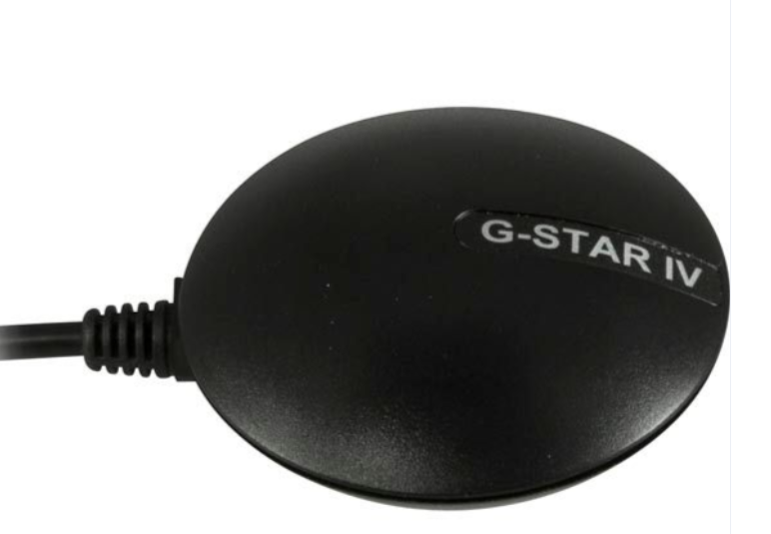
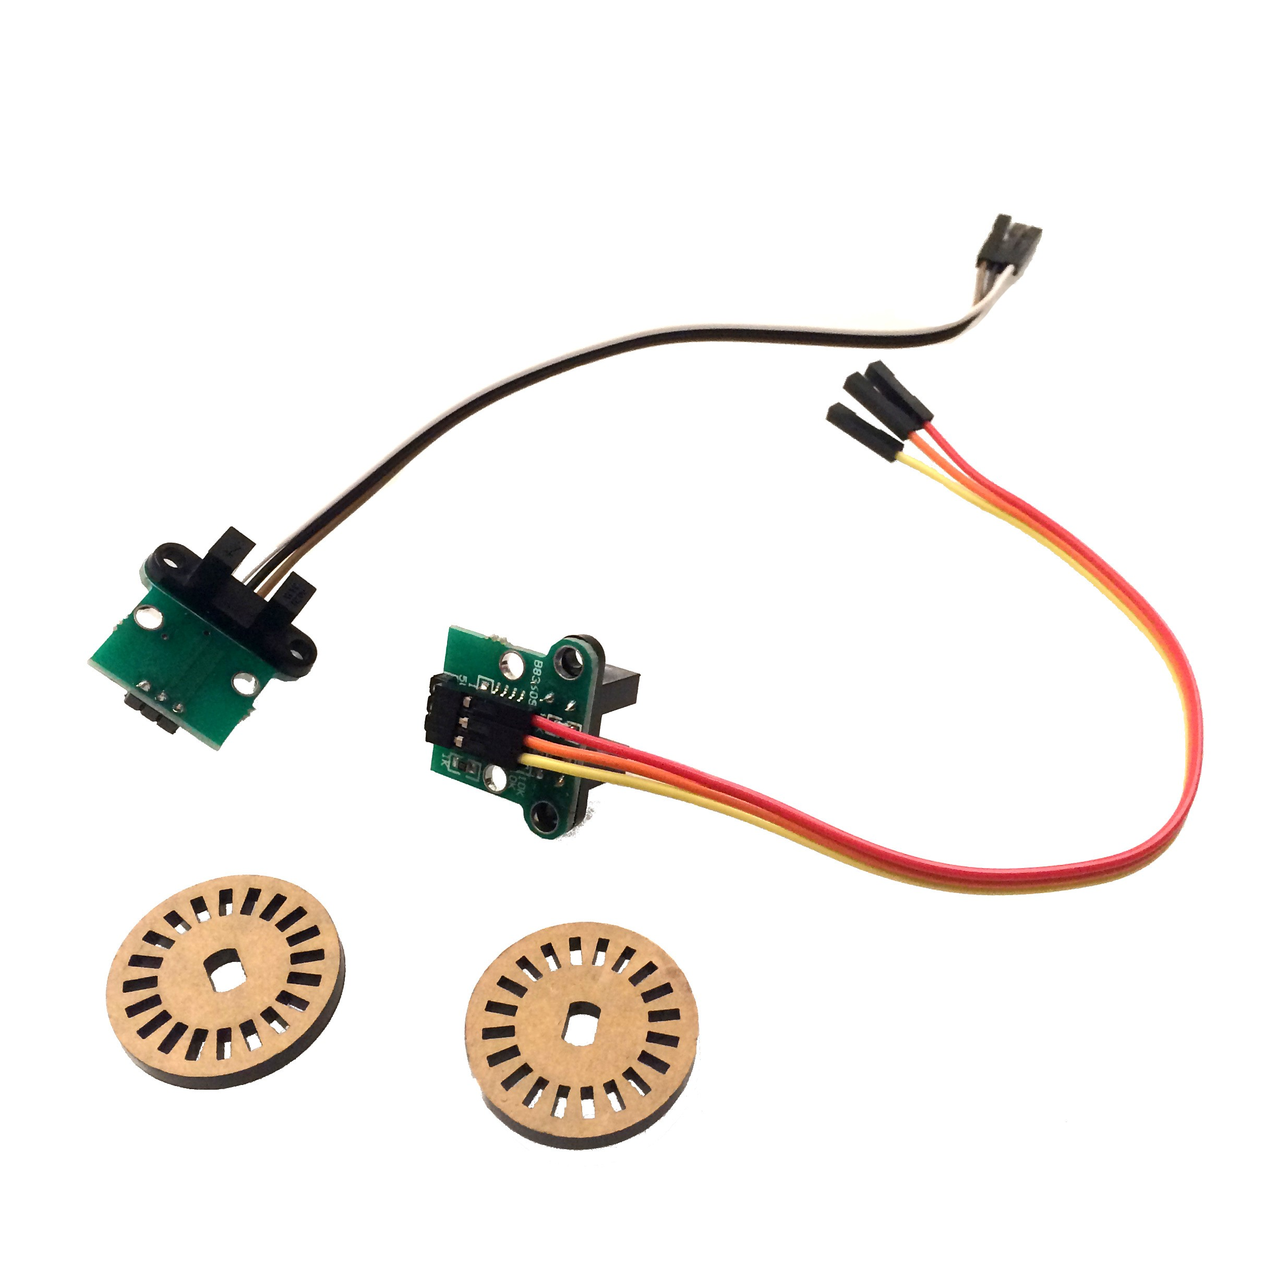
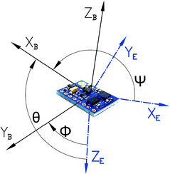
What is my thesis about?
SLAM: Simultaneous Localization and Mapping
Sensors:
Proprioceptive sensors: Wheel Encoders, IMU
Exteroceptive sensors: Camera and/or LIDAR and GPS
Ability to localize itself in an unknown environment
Simultaneously map the surrounding

Slide 4
Why we need SLAM?
Localization is required to know the present state of the machine so that path-planning can be performed.
Sensors are noisy and inaccurate.
Inaccuracy starts getting accumulated as machine moves.
We need a correction step which can reset this accumulation from time to time.
Looking at the outside world and update/correct your state is what SLAM do.

Slide 5
What have I done until now?
Extended Kalman Filter(EKF) SLAM:
Utilizes gaussian distribution for representing uncertainty of the state
Computes covariance matrix
Need to know the starting location.
Have prediction and correction step.
FAST SLAM a.k.a. Particle Filter SLAM:
Assumes multiple random location of machine
As machine move forward, landmarks assignment will reject most of the location
No need to know the starting location.
Have prediction and correction step.

Slide 6
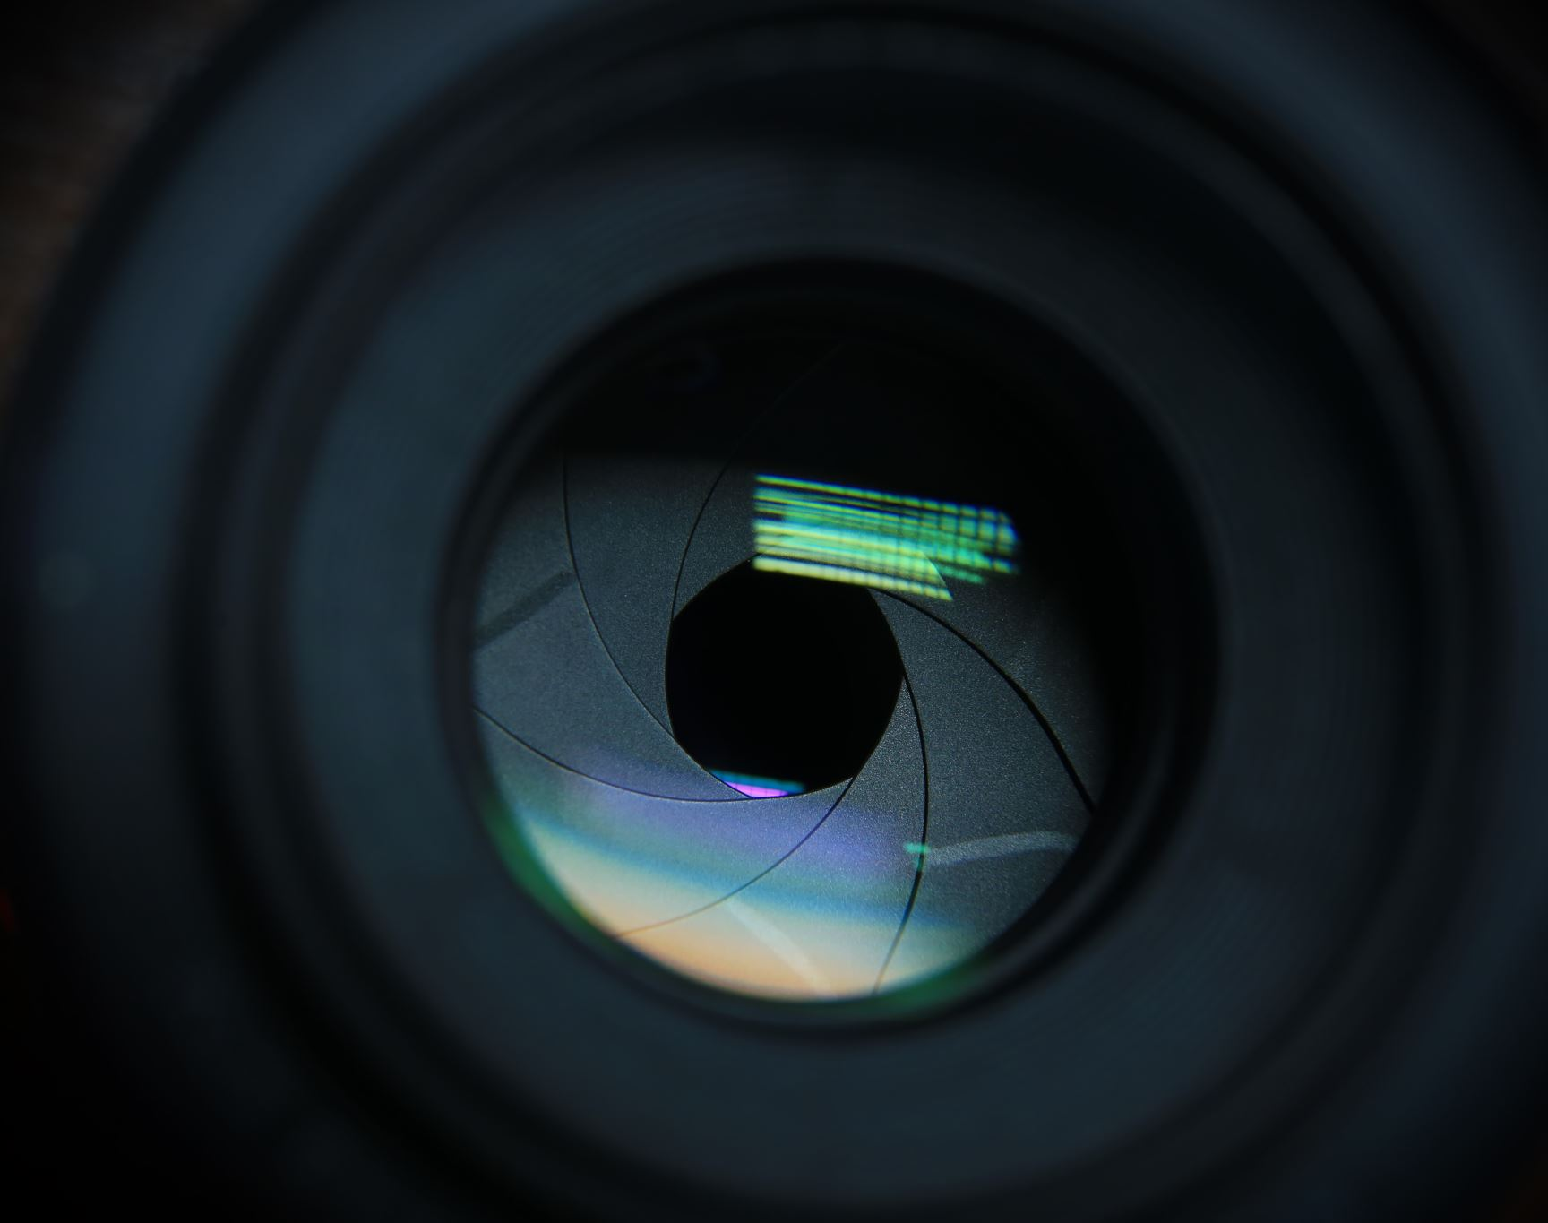
DEMO

Slide 7
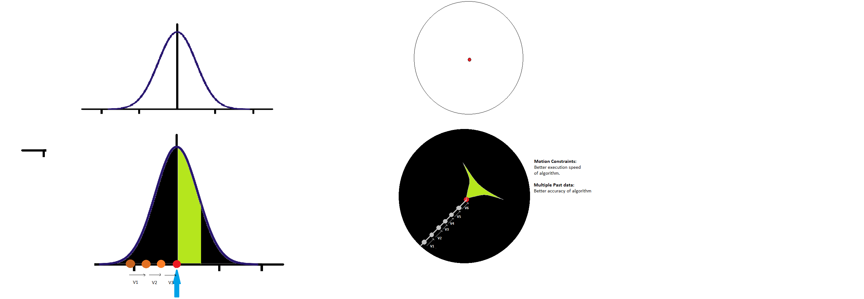
My contribution to SOTA.
Prediction
Correction

Slide 8
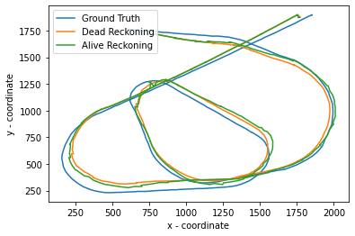
Dead Reckoning to Alive Reckoning
Alive Reckoning using Heuristics:
Utilizes 5 previous values.
Utilizes inertia.
-19.36% reduction in error

Slide 9
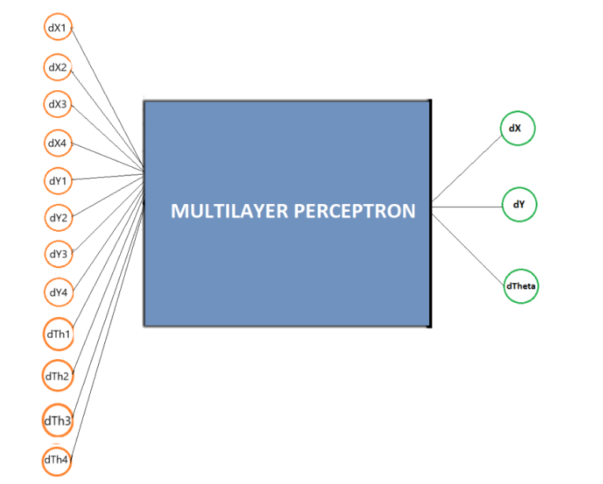
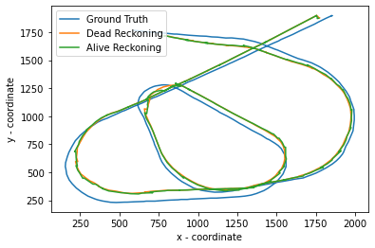
Dead Reckoning to Alive Reckoning
Alive Reckoning using Multi Layer Perceptron(Regression):
Utilizes 5 previous values of ground truth as input.
Utilizes 1 future value of ground truth as output.
Aim is to train model with ground truth data and run it live with real data.
Not able to reduce much error.

Slide 10
What to be done in remaining time?
Real time data using stereo camera, IMU and GPS: Visual SLAM
Visual Odometry instead of wheel odometry
IMU as Proprioceptive sensor
GPS and Camera as Exteroceptive sensor
DEMO from CARLA simulator

Slide 11

Questions/Suggestions.

