Slide 1

Predicting computer access

Slide 2



Created by
Kiran Dere (13)
Pooja Kadam (28)
Shubham Jakhete (26)

Slide 3
Project introduction
When an employee at any company starts work, they first need to obtain the computer access necessary to fulfil their role.
This access may allow an employee to read/manipulate resources through various applications or web portals.
We will build a model, that will determine an employee's access needs, such that manual access transactions (grants and revokes) are minimized as the employee's attributes change over time.
The model will take an employee's role information and a resource code and will return whether or not access should be granted.

Slide 4
Existing system
It is often the case that employees figure out the access they need as they encounter roadblocks during their daily work.
A knowledgeable supervisor then takes time to manually grant the needed access in order to overcome access obstacles.
As employees move throughout a company, this access discovery /recovery cycle wastes a nontrivial amount of time and money.

Slide 5
Proposed system
The objective of new system is to build a model, learned using historical data, that will determine an employee's access needs, such that manual access transactions (grants and revokes) are minimized as the employee's attributes change over time.
The model will take an employee's role information and a resource code and will return whether or not access should be granted.
These auto-access models seek to minimize the human involvement required to grant or revoke employee access.

Slide 6
Data description
The data consists of real historical data collected from 2010 and 2011.
Employees are manually allowed or denied access to resources over time.
We are creating an algorithm that are capable of learning from this historical data to predict approval/denial for an unseen set of employees.

Slide 7
File description
train.csv - The training set. Each row has the ACTION (ground truth), RESOURCE, and information about the employee's role at the time of approval.
test.csv - The test set for which predictions should be made. Each row asks whether an employee having the listed characteristics should have access to the listed resource.

Slide 8
WHAT’S INSIDE DATA
COLUMN NAME | DESCRIPTIONS
Action | ACTION is 1 if the resource was approved, 0 if the resource was not approved
RESOURCES | An ID for each resource
MGR_ID | The EMPLOYEE ID of the manager of the current EMPLOYEE ID record; an employee may have only one manager at a time
ROLE_ROLLUP_1 | Company role grouping category id 1 (e.g. US Engineer)
ROLE_ROLLUP_2 | Company role grouping category id 2 (e.g. US Retail)
ROLE_DEPTNAME | Company role department description (e.g. Retail)
ROLE_TITLE | Company role business title description (e.g. Senior Eng. Retail Manager)
ROLE_FAMILY_DESC | Company role family extended description (e.g. Retail Manager, Soft. Engineer)
ROLE_FAMILY | Company role family description (e.g. Retail Manager)
ROLE_CODE | Company role code; this code is unique to each role (e.g. Manager)

Slide 9
System requirement specifications
Functional Requirements
Storage and conversion of Excel and CSV files
Visualization of data
Python packages
Non Functional Requirements
Quality
Response Time
Security
Supportability

Slide 10
Operating Specifications
Minimum Hardware Configuration
System : 2.4GHz dual-core processor
Storage : 5GB of free disk space
Graphics : OpenGL support for GPU hardware for visualization
Peripherals : Mouse, keyboard and HD monitor for navigating UI
RAM : 8 GB
Minimum Software Configuration
Operating system : Windows, Linux, UNIX or MacOS with Anaconda 3.0
Coding Language : Python
Coding Ground : jupyterLab
File System : Excel File

Slide 11

Get Historical Data
Applying model
Data Pre-Processing
Evaluating Model
SYSTEM ADMIN
Univariate Analysis
Selecting Model
USER
(MANAGER)
Building Model
Result
USE CASE DIAGRAM

Slide 12
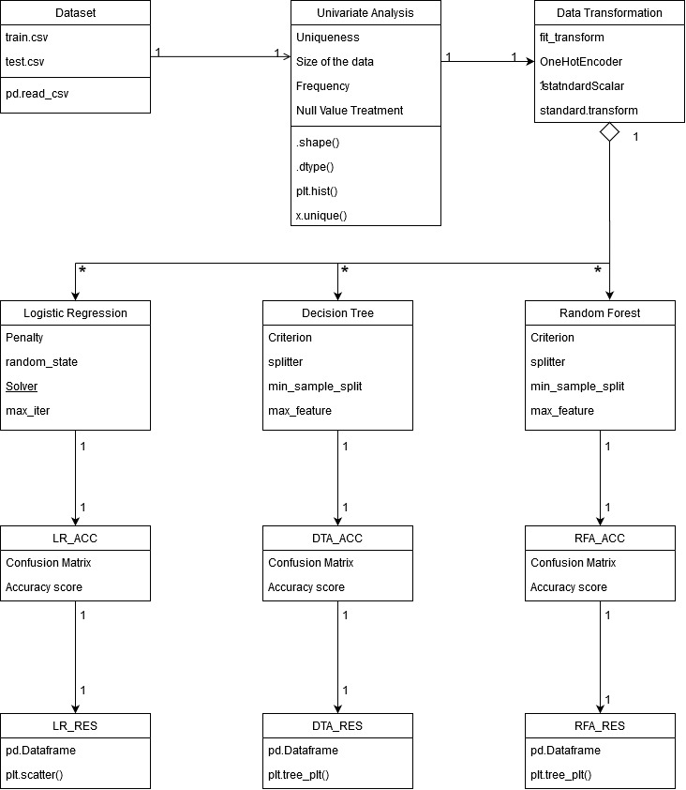
Class Diagram

Slide 13
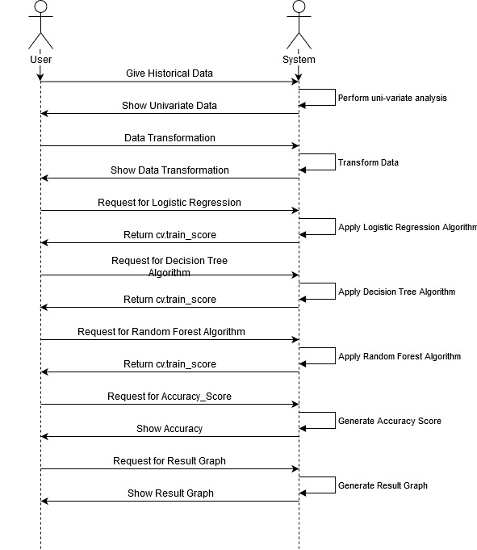
Sequence Diagram

Slide 14
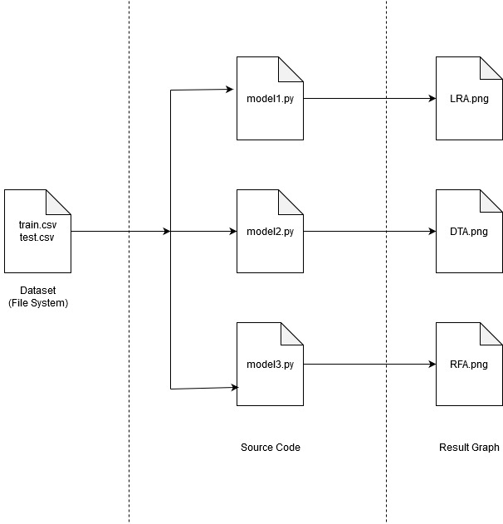
Artifact Diagram

Slide 15
SCREENS

Slide 16
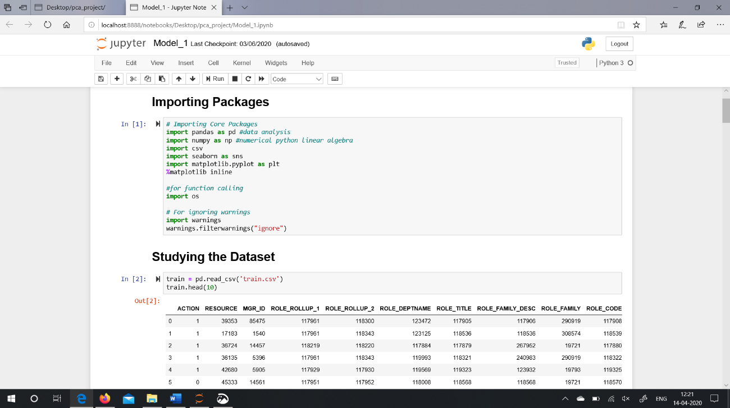
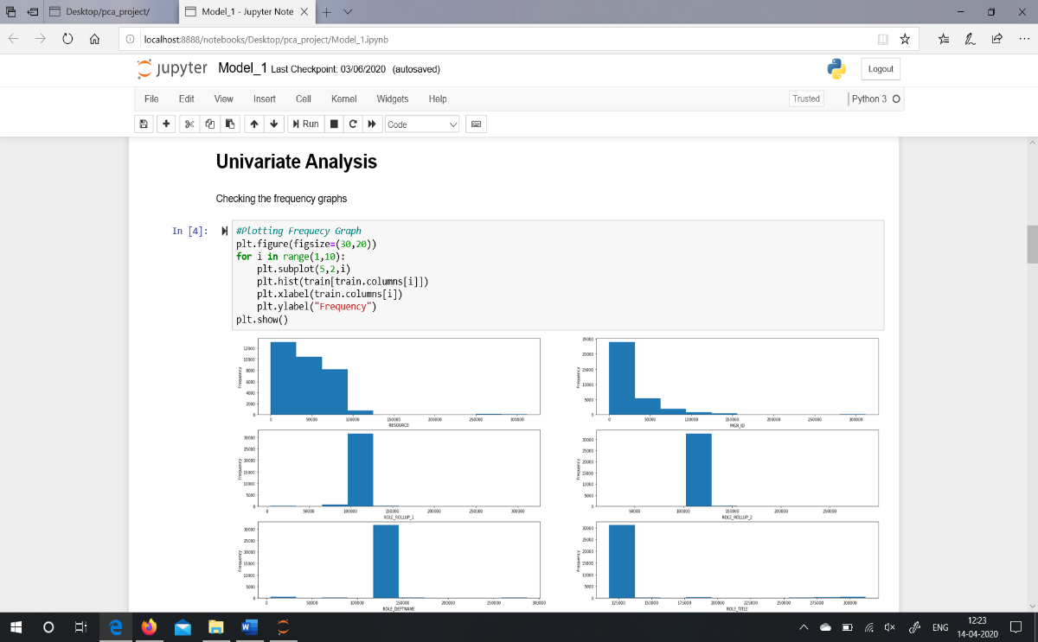
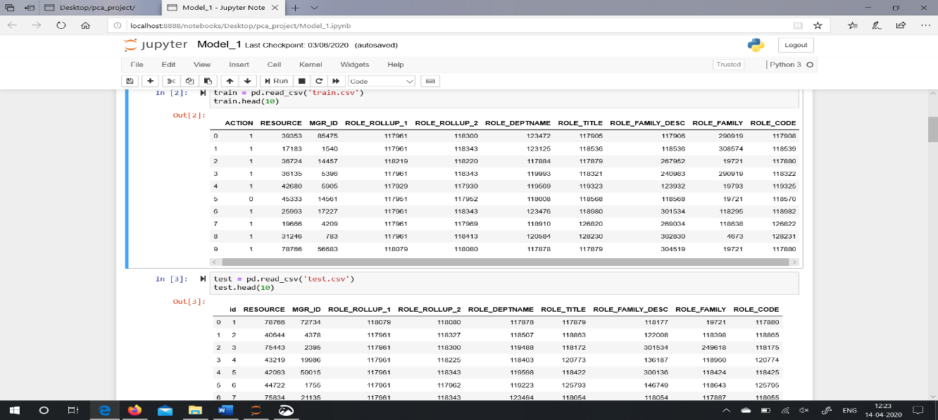
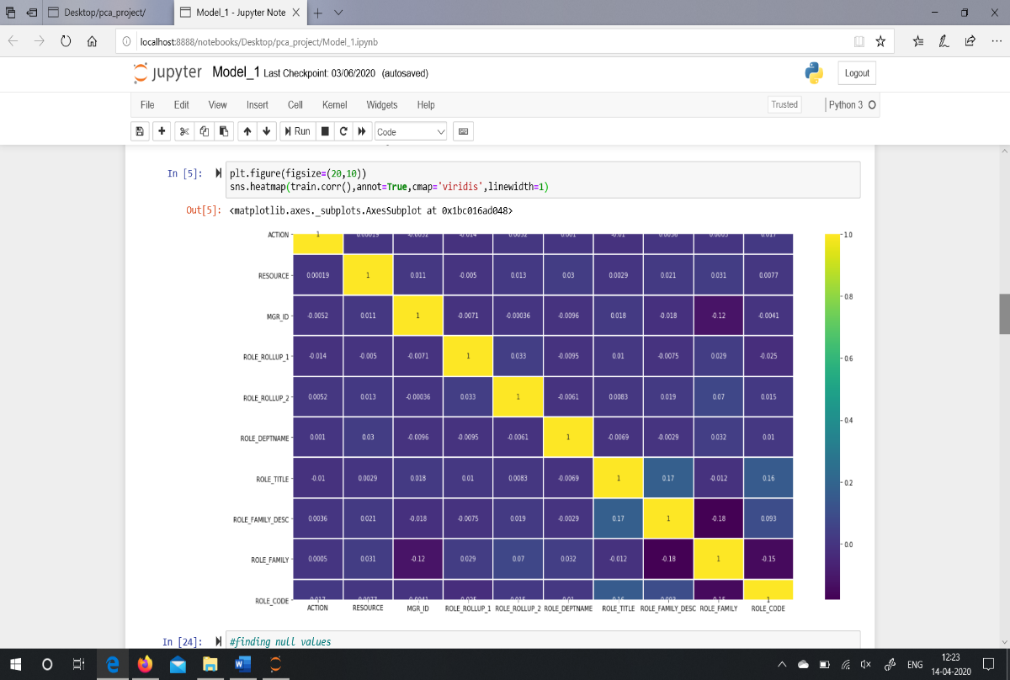
Importing Packages
Univariate Analysis

Slide 17
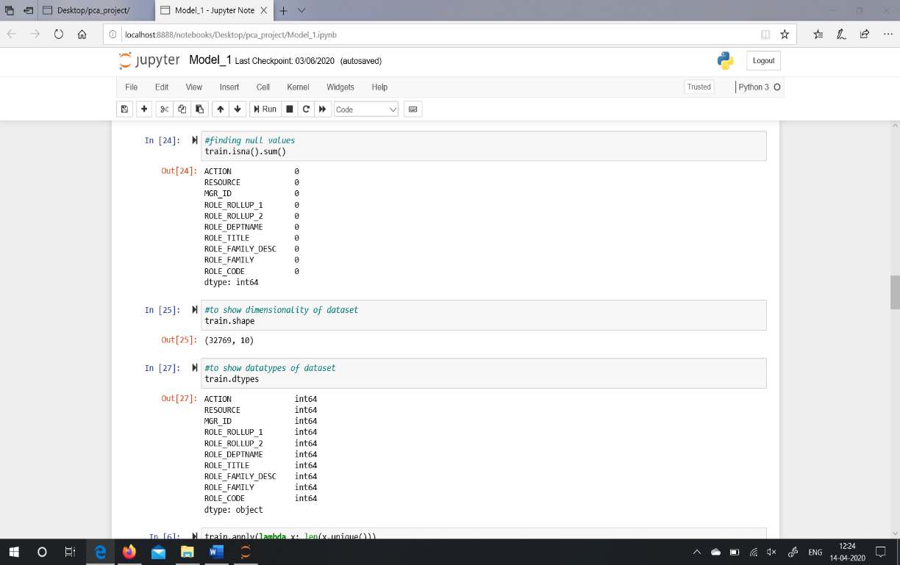
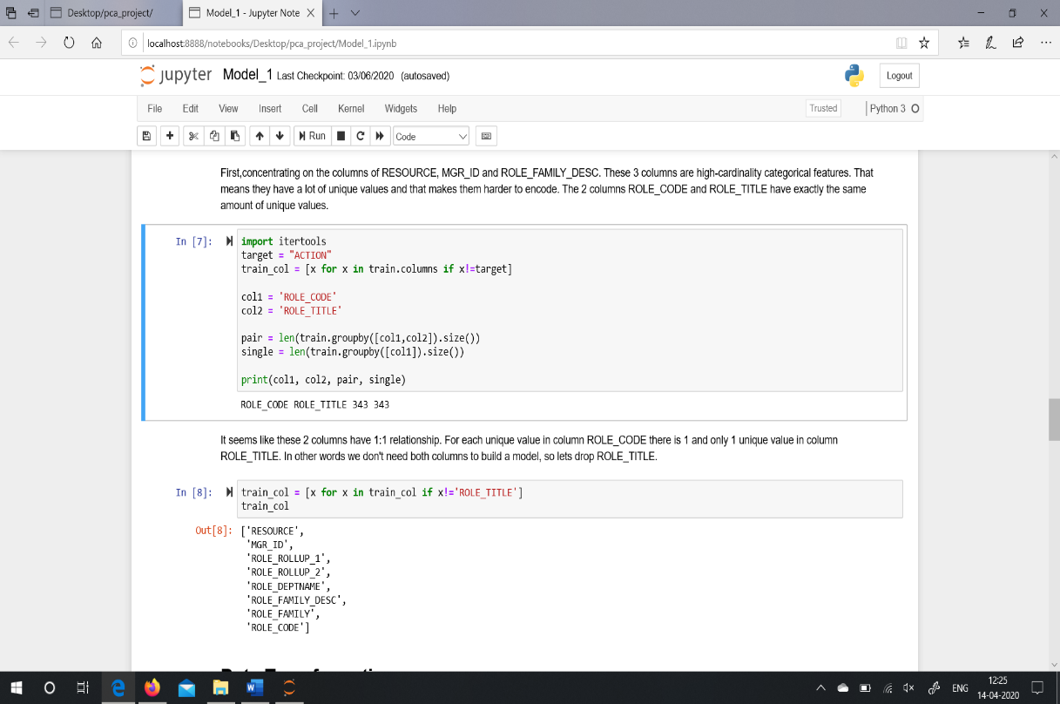
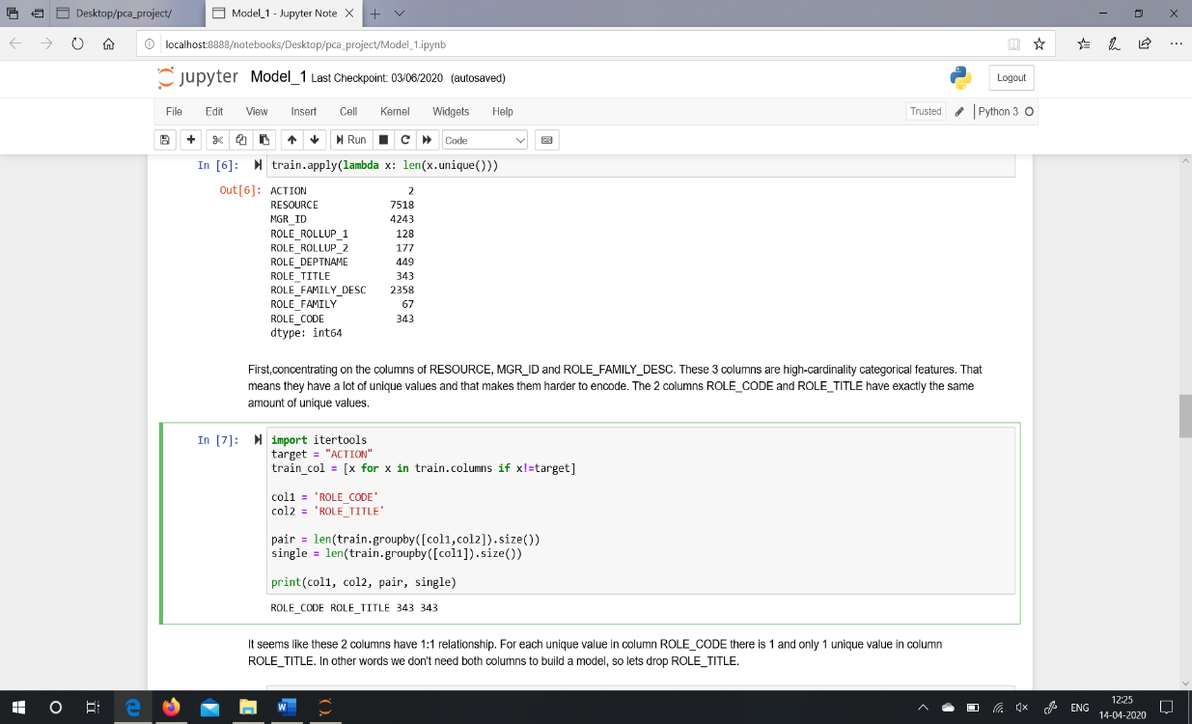

Slide 18
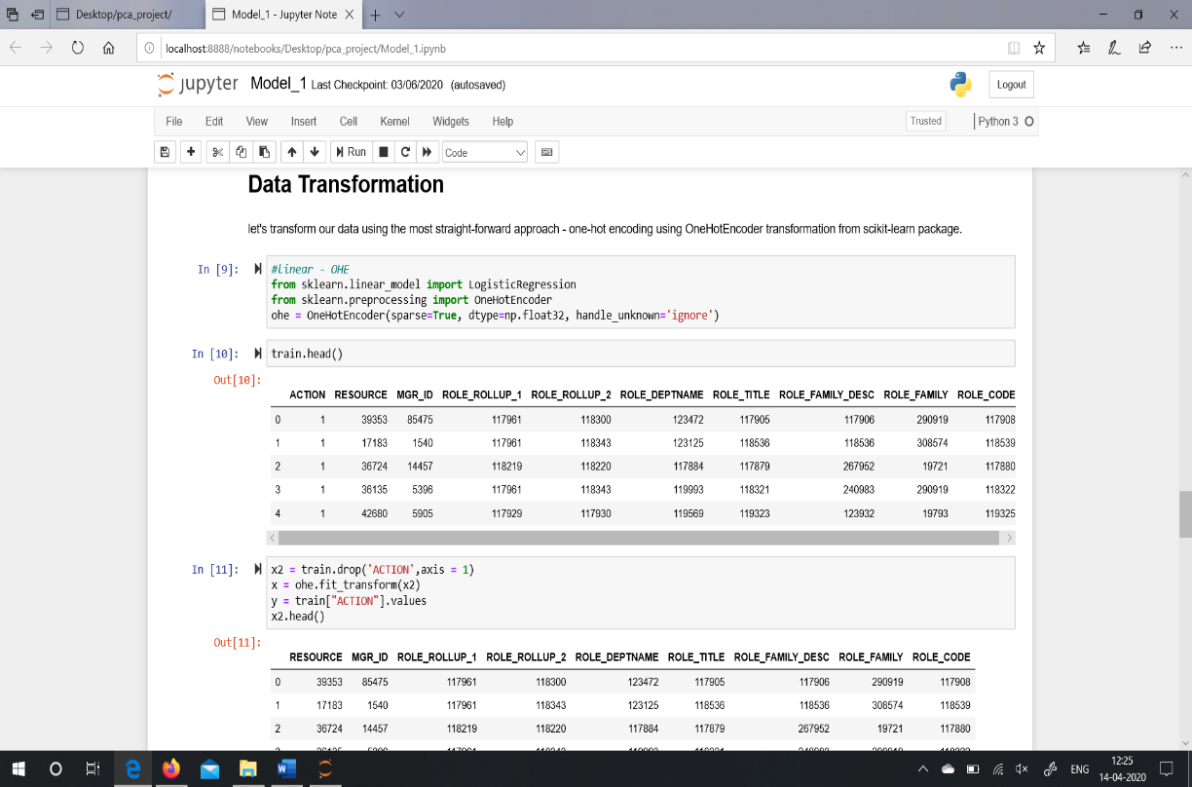
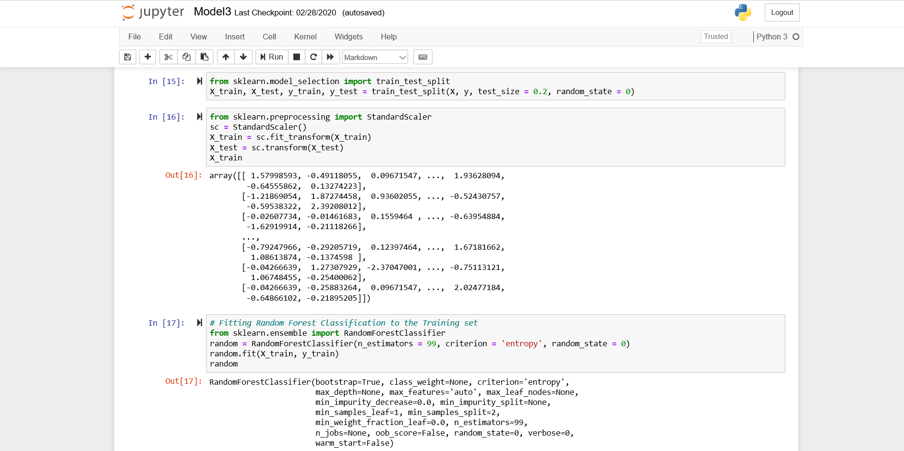
Data Transformation

Slide 19
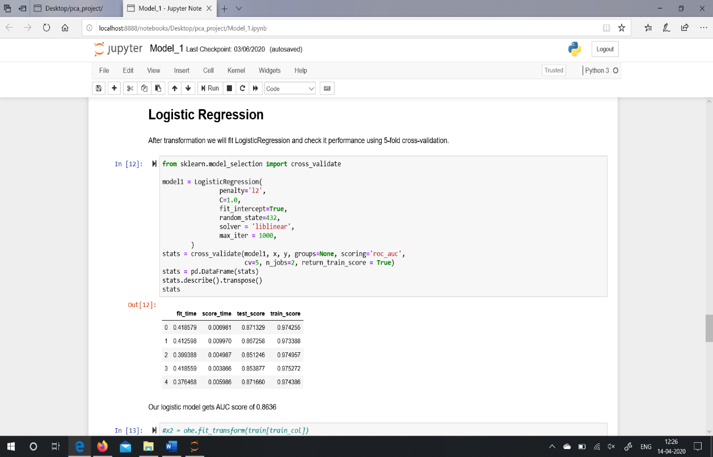
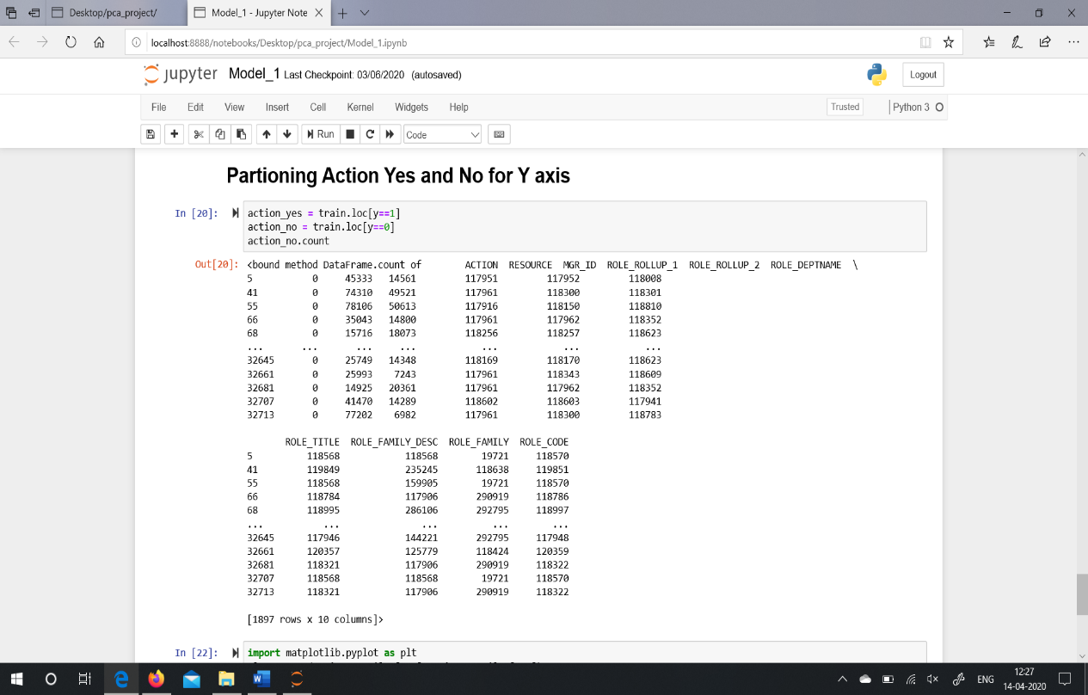
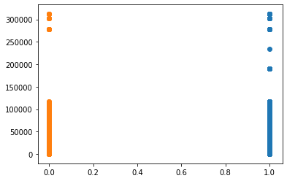
Logistic Regression

Slide 20
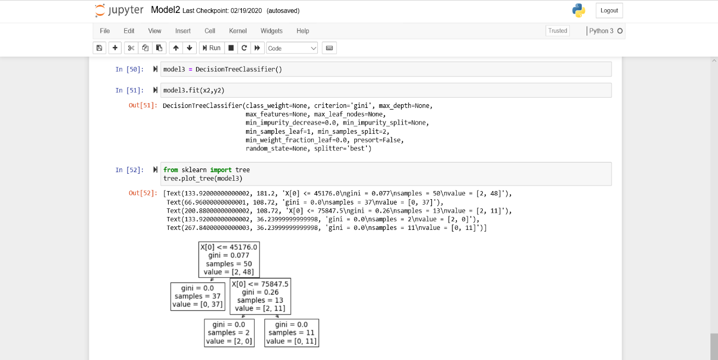
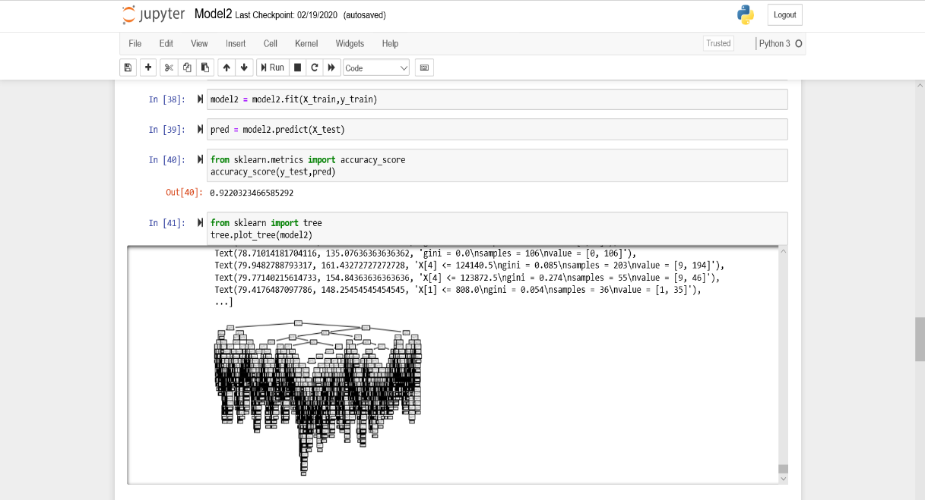
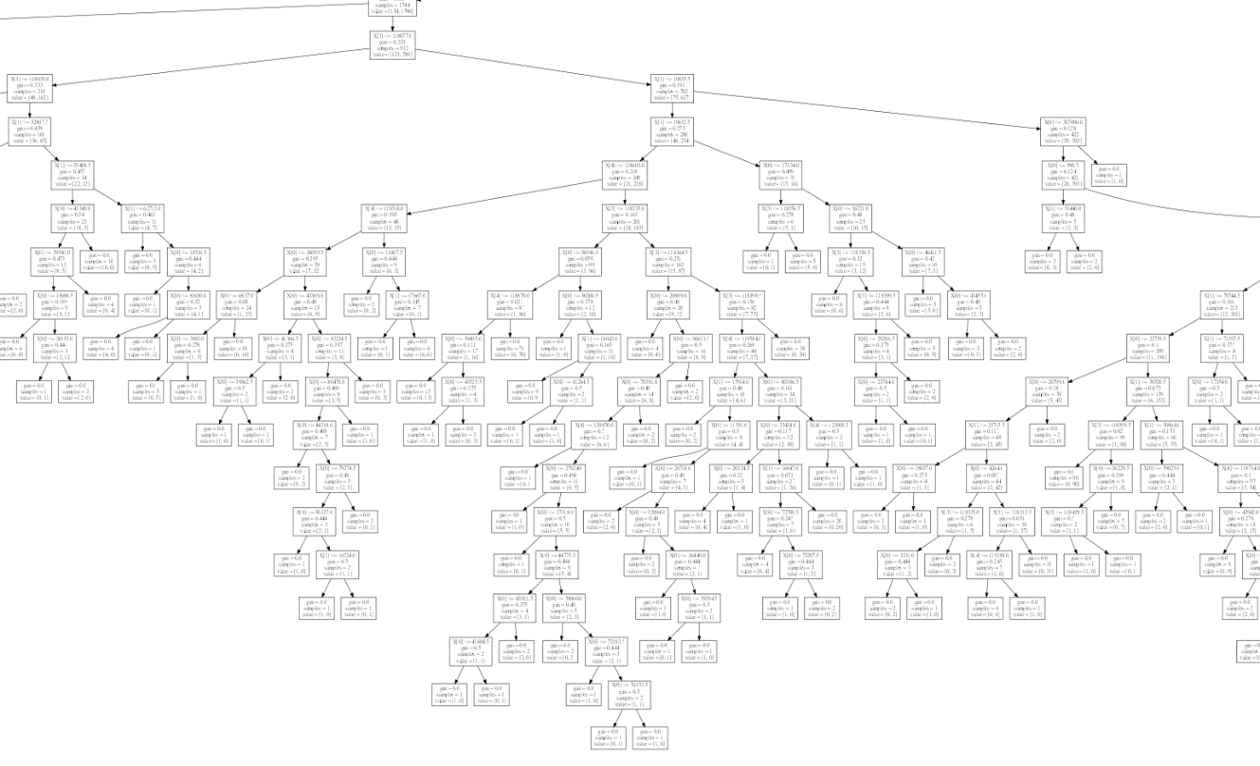
Decision Tree Algorithm

Slide 21
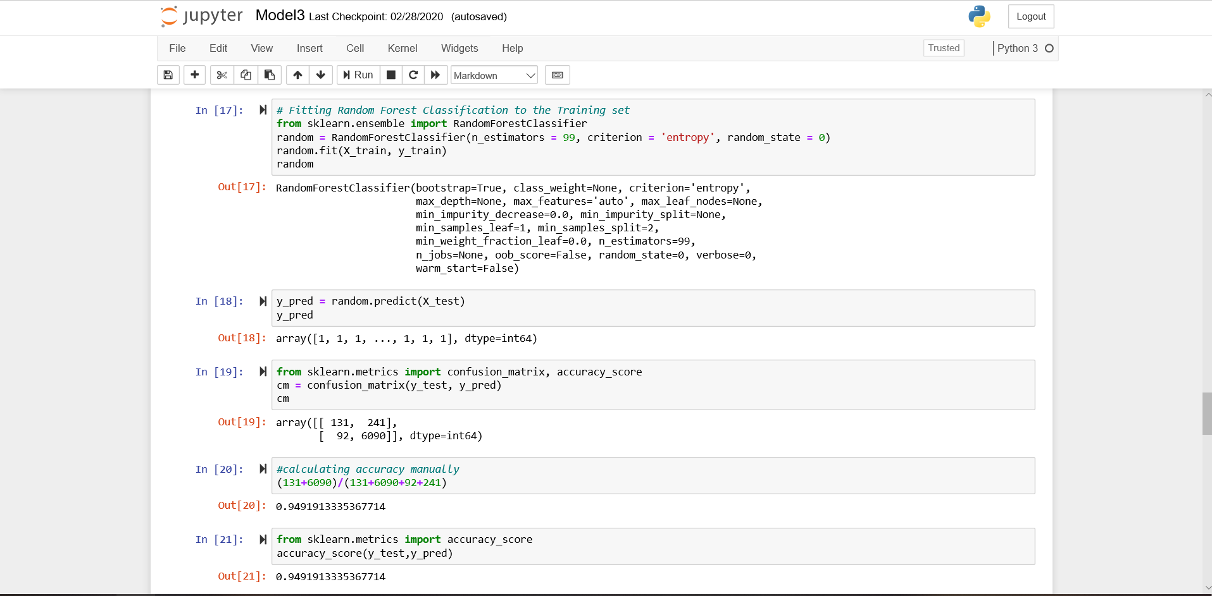
Random Forest Algorithm

Slide 22
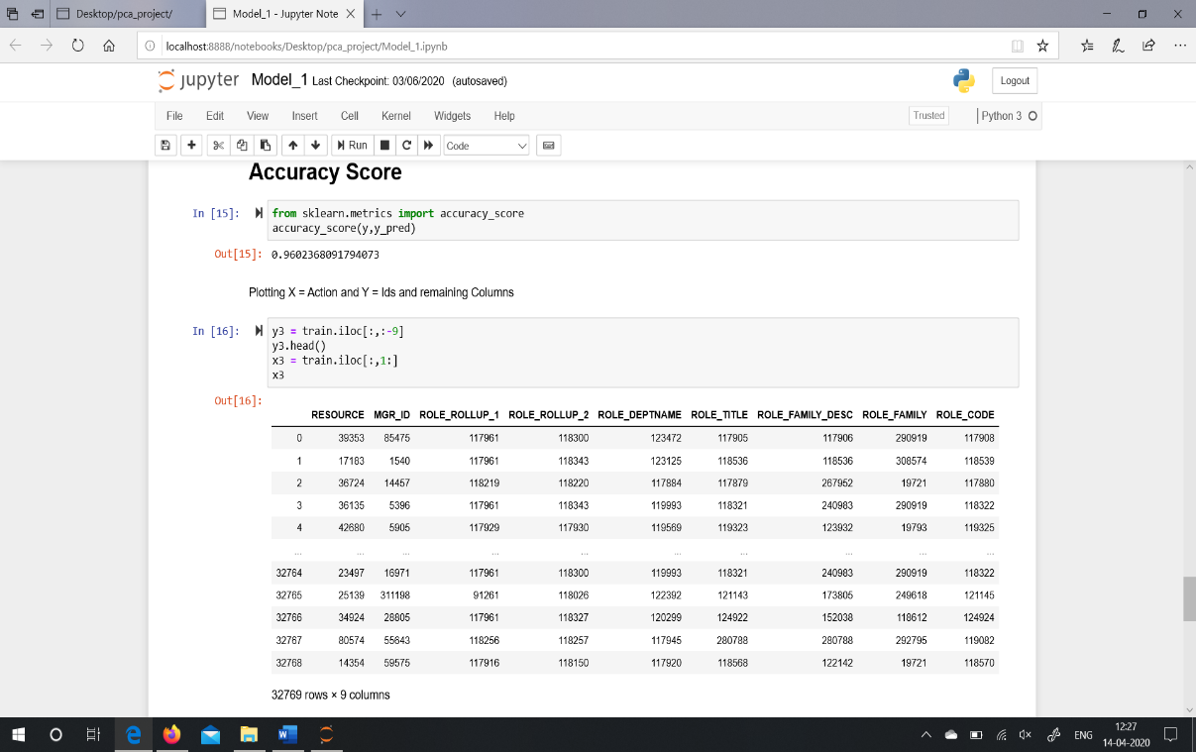
Accuracy Score of Logistic Regression
Accuracy Score of Decision Tree Algorithm

Slide 23
Accuracy Score of Random Forest Algorithm

Slide 24
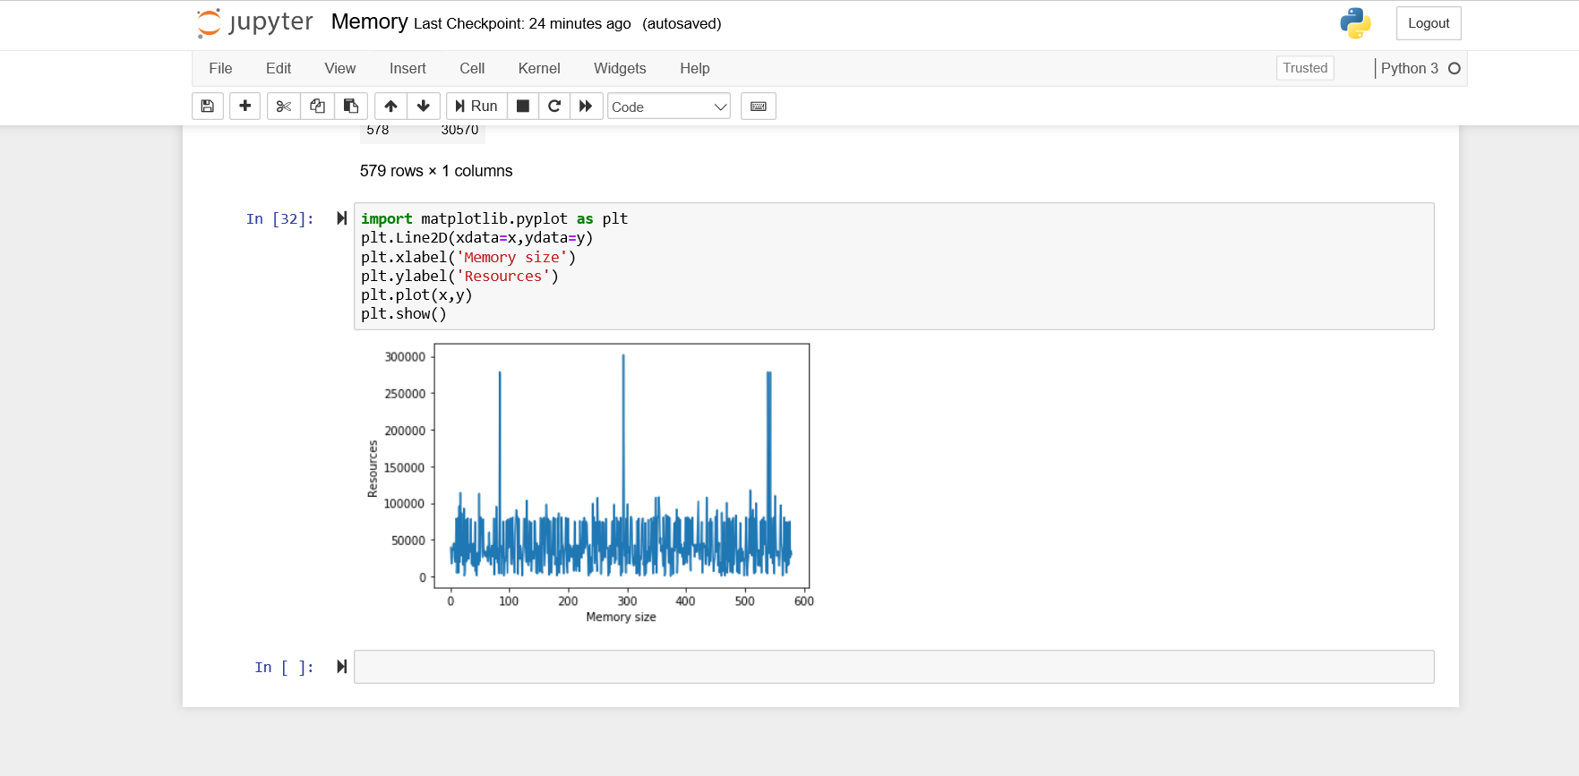
Displaying Memory Size

Slide 25
TESTING
Blackbox Testing:
Blackbox testing is testing the functionality of an application without knowing the details of its implementation including internal program structure, data structures, etc.
Test cases for Blackbox testing are created based on the requirement specifications. Therefore, it is also called as specification-based testing.
When applied to Machine Learning models, Blackbox testing would mean testing Machine Learning models without knowing the internal details such as features of the Machine Learning model, the algorithm used to create the model, etc.
Model Performance
Testing model performance is about testing the models with the test data/new data sets and comparing the model performance in terms of parameters such as accuracy/recall etc., to that of pre-determined accuracy with the model already built and moved into production. This is the most trivial of different techniques which could be used for Blackbox testing.

Slide 26
Metamorphic Testing
In metamorphic testing, one or more properties are identified that represent the metamorphic relationship between input-output pairs. For example, hypothetically speaking, an ML model is built that predict the employee access needs required based on different variables like Manager Id, Resource Id, Employee Id, Action and Target, etc.
Dual Coding
With dual coding technique, the idea is to build different models based on different algorithms and comparing the prediction from each of these models given a particular input data set.
Let's day, a classification model is built with different algorithms such as random forest, logistic regression, decision tree. All of them demonstrate a comparative accuracy of 94% or so with random forest showing the accuracy of 97%. This results in the selection of random forest.

Slide 27
Test cases | Pre-Conditions | Step to be Executed | Expected Result | Actual Result | Pass/Fail
Necessary Packages installed? | Packages for ml models and performing data analysis are required. | Install using command on your respective coding ground. | Success | Success | Pass
Check whether historical dataset is in same directory. | csv file should be in same directory. | If not in same directory, transfer it into it and then run the command pd.read_csv | File should be read and displayed. | Appropriate message displayed. | Pass
Testing of Uni-variate analysis. | Checking all the necessary steps of univariate analysis. | Checking null value, data types of dataset, count of entries in dataset, number of rows and columns in dataset, etc | Null value checked, datatypes checked, entries count checked, rows and columns checked. | Success and displayed result. | Pass
Check transformed data. | Checking the transformed data and eliminating columns which are not required. | Using itertools, fit_transform, standard scalar, etc | Columns eliminated and ready for training. | Success | Pass
Test if the models are fitted properly to the dataset. | Checking how many percent of data is taken from train set and test set and adding necessary parameters. | Importing packages from Scikit.learn of logistic regression, decision tree and random forest algorithm. | Return success and cross validation score. | Success | Pass
Test if the accuracy score is correct. | Generating and checking accuracy score of each algorithm is correct and valid. | Generating accuracy score by importing packages called as accuracy_score or by constructing confusion_matrix and then finding accuracy. | Every algorithm should get the score in between 94-97%. | Success | Pass
Test if every algorithm generates result graphs | Generating right and valid graphs for each algorithm. | Importing packages for graphs like matplotlib and seaborn, etc. | Scatter plot and tree graphs are shown | Success | Pass

Slide 28
limitations
Each narrow application needs to be specially trained.
Learning must generally be supervised: Training data must be tagged.
Choice of selecting machine learning model
Out of three machine learning models like logistic regression, decision tree and random forest algorithm, Logistic Regression shows the best result and in the case of Decision Tree and Random Forest result tress are overlapped which result in not clear graph.

Slide 29
conclusion
Our main contribution is focused in providing data analysis and model building for the dataset.
Our project can be useful to develop a technology where it can predict an employee's access needs, such that manual access transactions (grants and revokes) are minimized as the employee's attributes change over time.
Out of three machine learning models like logistic regression, decision tree and random forest algorithm, Logistic Regression shows the best accuracy of 96% and the rest Decision Tree shows 92% and Random Forest shows 94% accuracy.
Our model is scalable and the datasets can be modified easily for different datasets accordingly.
Our project model can be a part of building new software technology application used in companies to keep a track on employee’s resources access and providing adequate amount of memory to the employees depending on the employee’s role.
Our model can also help in providing the information of unused resources access and auto-reset the whole computer access and provide to the new employees. This will help auto-access models to minimize the human involvement required to grant or revoke employee access.

Slide 30
references
https://www.kaggle.com/c/amazon-employee-access-challenge
https://www.kaggle.com/c/amazon-employee-access-challenge/data
https://docs.python.org/3.6/
https://scikit-learn.org/stable/modules/generated/sklearn.linear_model.LogisticRegression.html
https://towardsdatascience.com/preprocessing-with-sklearn-a-complete-and-comprehensive-guide-670cb98fcfb9
https://scikit-learn.org/stable/modules/generated/sklearn.ensemble.RandomForestClassifier.html
https://www.dezyre.com/project/hackerday-project/project-title/amazon-employee-access-needs#sub-about-hackerday
Intro to Machine Learning by Ethem Alpaydin
Hand on Machine Learning, O’Reilly

Slide 31

Thank You

