Slide 1
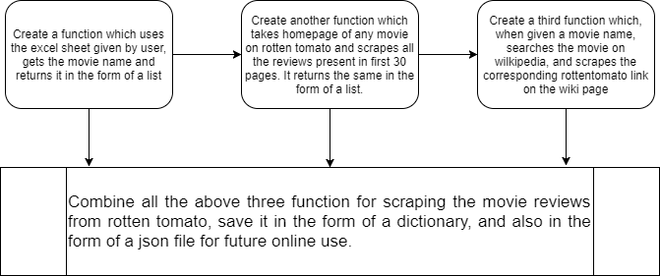
Scrape.py

Slide 2
Analysis.py
Using NLTK –
We are using Naïve Bayes classifier in the first part, for performing the sentimental analysis and checking weather the overall reviews are positive or not. Here, we are not using the complete sentences, rather predicting on the basis of each and every single word present in the review.
The Naive Bayes classifier, especially in the Nltk library, expects the input to be in this format: Every word must be followed by true.
The problem with sentiment analysis, as with any machine learning approach, is that your algorithm is only as good as your data. If your data is crap, your algorithm will be crap. This particular dataset is which I am using is a bit short. Also, some reviews are very informal, using a lot of swear words etc.
For description of Naïve Bayes, please visit –
https://stackoverflow.com/questions/10059594/a-simple-explanation-of-naive-bayes-classification

Slide 3
Using scikit –
The multinomial Naive Bayes classifier is suitable for classification with discrete features (e.g., word counts for text classification). The multinomial distribution normally requires integer feature counts. However, in practice, fractional counts such as tf-idf may also work.
scikit-learn provides several vectorizers to translate the input documents into vectors of features (or feature weights). Typically we want to give appropriate weights to different words, and TF-IDF is one of the most common weighting schemes used in text analytics applications. In scikit-learn, we can use the TfidfVectorizer. Some of the options of tf-idf are –
min_df=5, discard words appearing in less than 5 documents
max_df=0.8, discard words appering in more than 80% of the documents
sublinear_tf=True, use sublinear weighting
use_idf=True, enable IDF

Slide 4
The first call to fit_transform() will create the vocabulary (i.e. the list of words/features) and the feature weights from the training data. Secondly, we call simply transform() on the test data, which will create the feature weights for the test data, using the same vocabulary as the training data.
The movie_reviews dataset (the same used in NLTK) is loaded and used for training a Multimoda Naive Bayes classifier.
The trained model is then tested against all the reviews (sentence-by-sentence, where each sentence is one review - not word-by-word as in NLTK) and then a total value of 1 or 0 is predicted, where 1 is positive and zero is negative. Then the sum of all these values is divided by total no. of reviews and then multiplied by 10.
The resulting value is a rating between 0 – 10, where 0 indicates all negative reviews and 10 indicates all positive reviews.
Consequently, we can arrive at the conclusion that 10 means that the movie is very scary and 0 means that the movie is not scary at all.

Slide 5
References
http://pythonforengineers.com/build-a-sentiment-analysis-app-with-movie-reviews/
http://www.pitt.edu/~naraehan/presentation/Movie+Reviews+sentiment+analysis+with+Scikit-Learn.html
http://scikit-learn.org/stable/tutorial/text_analytics/working_with_text_data.html
https://appliedmachinelearning.wordpress.com/2017/02/12/sentiment-analysis-using-tf-idf-weighting-pythonscikit-learn/
http://gawron.sdsu.edu/python_for_ss/course_core/book_draft/text/text_classification.html
http://www.cs.cornell.edu/people/pabo/movie-review-data/

