Slide 1
DATA VISUALIZATION MINI PROJECT
Air Quality Dashboard for
Mumbai 2018-2020
Historical AQI analysis • Random Forest regression • Interactive Power BI dashboard
TEAM & CONTRIBUTIONS
Raghav Chandak (I012) — Ideation, presentation and report preparation
Shubham Jatania (I034) — Power BI dashboard
Kabir Goswami (I026) — ML notebook
1

Slide 2
01 · CONTEXT
Problem statement & objectives
Turn raw multi-pollutant readings into an interpretable analytical story.
PROBLEM
OBJECTIVES
Raw station-day data are difficult to interpret at a glance.
Missing values, multiple pollutants, time variation and station metadata complicate comparison.
The task: prepare, explore, estimate and communicate AQI patterns without overstating what the data can prove.
• Clean and validate the station-day dataset
• Explore AQI, pollutants, time and station differences
• Train a Random Forest regression baseline
• Evaluate held-out predictions using MAE/RMSE
• Deliver an interactive one-page Power BI dashboard
• Clearly report coverage and modelling limitations
2

Slide 3
02 · DATA
Dataset at a glance
Facts below describe the final Power BI CSV, not the full source archive.
3,872
10
103.1
323
station-day rows
station IDs
mean AQI
maximum AQI
DATE COVERAGE
SCOPE WARNING
07 May 2018 to 01 July 2020
Mean PM2.5: 36.67 | Mean PM10: 90.36
Final CSV contains Mumbai rows only. No historical Navi Mumbai observations are present, so a two-city comparison is not supported.
Source basis: Air Quality Data in India (Kaggle) + station metadata + coordinate table; coordinate precision varies by station.
3

Slide 4
03 · BACKGROUND
Existing research & rationale
The project combines established AQI communication standards with a practical tabular ML baseline.
CPCB · AQI FRAMEWORK
WHO · HEALTH CONTEXT
ML LITERATURE
AQI compresses pollutant sub-indices into a single number and six public-facing categories. The highest valid pollutant sub-index determines the reported AQI.
WHO's 2021 air-quality guidelines synthesise evidence for PM2.5, PM10, ozone, NO₂, SO₂ and CO. Monitoring matters; this project does not estimate health outcomes.
Survey research covers Random Forest, SVM, neural networks and time-series models. Tree ensembles are useful for structured nonlinear data; forecasting requires time-aware validation.
References: CPCB About AQI; WHO (2021); Méndez et al. (2023); Science of the Total Environment review (2025).
4

Slide 5
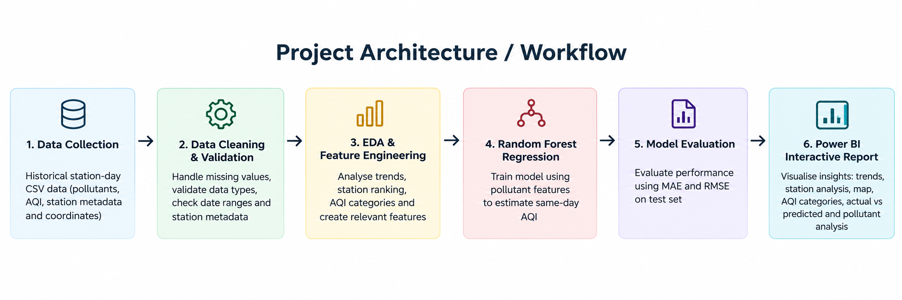
04 · METHOD
Workflow & model
A reproducible pipeline from raw observations to model evaluation and dashboard.
This is same-day AQI estimation, not future AQI forecasting.
5

Slide 6
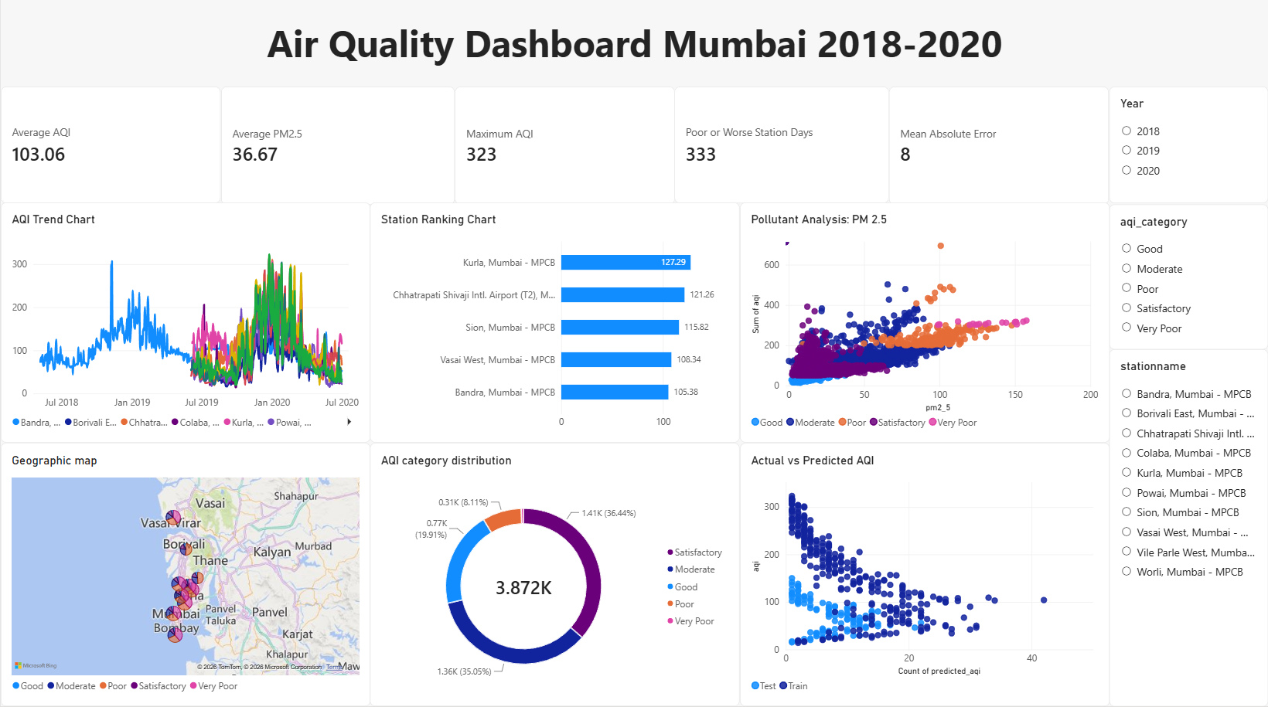
06 · DASHBOARD
Power BI: one-page analytical view
Designed to move from overall status to time, station, location and pollutant-level investigation.
7

Slide 7
07 · MODEL EVALUATION
Random Forest results
Metrics calculated from the supplied exported prediction/error columns; verify again if the model is retrained.
8.05
12.27
775
Mean Absolute Error (AQI points)
Root Mean Squared Error (AQI points)
Rows with stored predictions
INTERPRETATION & CAUTION
MAE is the average absolute error; RMSE penalises larger misses. Because AQI is itself derived from pollutant concentrations, predicting same-day AQI from those concentrations can yield optimistic performance and does not establish forecast skill.
8

Slide 8
08 · DISCUSSION
Limitations & future scope
The next iteration should improve geographic coverage and turn estimation into a genuine forecast.
LIMITATIONS
FUTURE WORK
• No Navi Mumbai observations in final CSV
• Coverage only May 2018–July 2020
• Missing values and uneven station coverage
• Some coordinates are approximate
• Same-day target dependency / leakage risk
• No causal source attribution
• Acquire official Navi Mumbai historical data
• Predict next-day AQI using lagged features
• Compare against simple baselines and boosted trees
• Add weather and traffic context
• Use rolling-origin validation and uncertainty
• Improve explainability and refresh automation
9

Slide 9
09 · WRAP-UP
Conclusion & individual contributions
An integrated data-to-dashboard prototype, with explicit boundaries on interpretation.
RAGHAV CHANDAK · I012
SHUBHAM JATANIA · I034
KABIR GOSWAMI · I026
Ideation
Presentation
Report preparation
Power BI dashboard
Visual design
Interactive reporting
ML notebook
Preprocessing & Random Forest
Evaluation and exports
Conclusion: The project integrates data cleaning, EDA, a regression baseline and interactive visual analytics. Its next major step is verified two-city data and leakage-aware forecasting.
10

Slide 10
10 · SOURCES
Selected references
Background and tools used to frame the project.
1. CPCB — About National Air Quality Index (AQI), official explainer.
https://www.airquality.cpcb.gov.in/ccr_docs/About_AQI.pdf
2. WHO (2021) — Global air quality guidelines for PM, ozone, NO₂, SO₂ and CO.
https://www.who.int/publications/i/item/9789240034228/
3. Méndez, Merayo & Núñez (2023) — Machine learning algorithms to forecast air quality: a survey.
https://link.springer.com/article/10.1007/s10462-023-10424-4
4. Science of the Total Environment (2025) — Review of machine learning for air-quality prediction and analysis.
https://www.sciencedirect.com/science/article/pii/S0048969725022338
5. Rohan Rao — Air Quality Data in India (2015–2020), Kaggle dataset.
https://www.kaggle.com/datasets/rohanrao/air-quality-data-in-india
6. scikit-learn — RandomForestRegressor documentation.
https://scikit-learn.org/stable/modules/generated/sklearn.ensemble.RandomForestRegressor.html
7. Web Dashboard
https://app.powerbi.com/view?r=eyJrIjoiZmVhYzA4MzgtZDlhNC00NmMzLWI4NzItNDVlNWViMTkzNWYwIiwidCI6ImQxZjE0MzQ4LWYxYjUtNGEwOS1hYzk5LTdlYmYyMTNjYmM4MSIsImMiOjEwfQ%3D%3D
8. Github Repo
https://github.com/shubhamjatania17/DV-Mini-Project
11

