Slide 1
Capstone Project-1
EDA on Airbnb booking analysis
Team members KAMALUDDIN SHAIKH AMOL RASAM SHUBHAM JHA

Slide 2
What is Airbnb?
Airbnb is an online marketplace connecting travelers with local hosts.
The platform enables people to list their available space and earn extra income in the form of rent.
Airbnb enables travelers to book unique homestays from local hosts, saving them money and giving them a chance to interact with locals.
Founded in San Francisco in 2008 as a start-up, the company has become a worldwide booking platform.
Airbnb is present in over 190 countries across the world.

Slide 3
Airbnb Services
Enables owners to list their space on the platform and earn rental money.
Airbnb provides insurance to listed properties.
Gives cheap options to travelers to stay with local hosts.
Facilitates the process of booking living space for travelers.
Rating and review system for hosts and guests.
User-friendly app and web based structure.

Slide 4
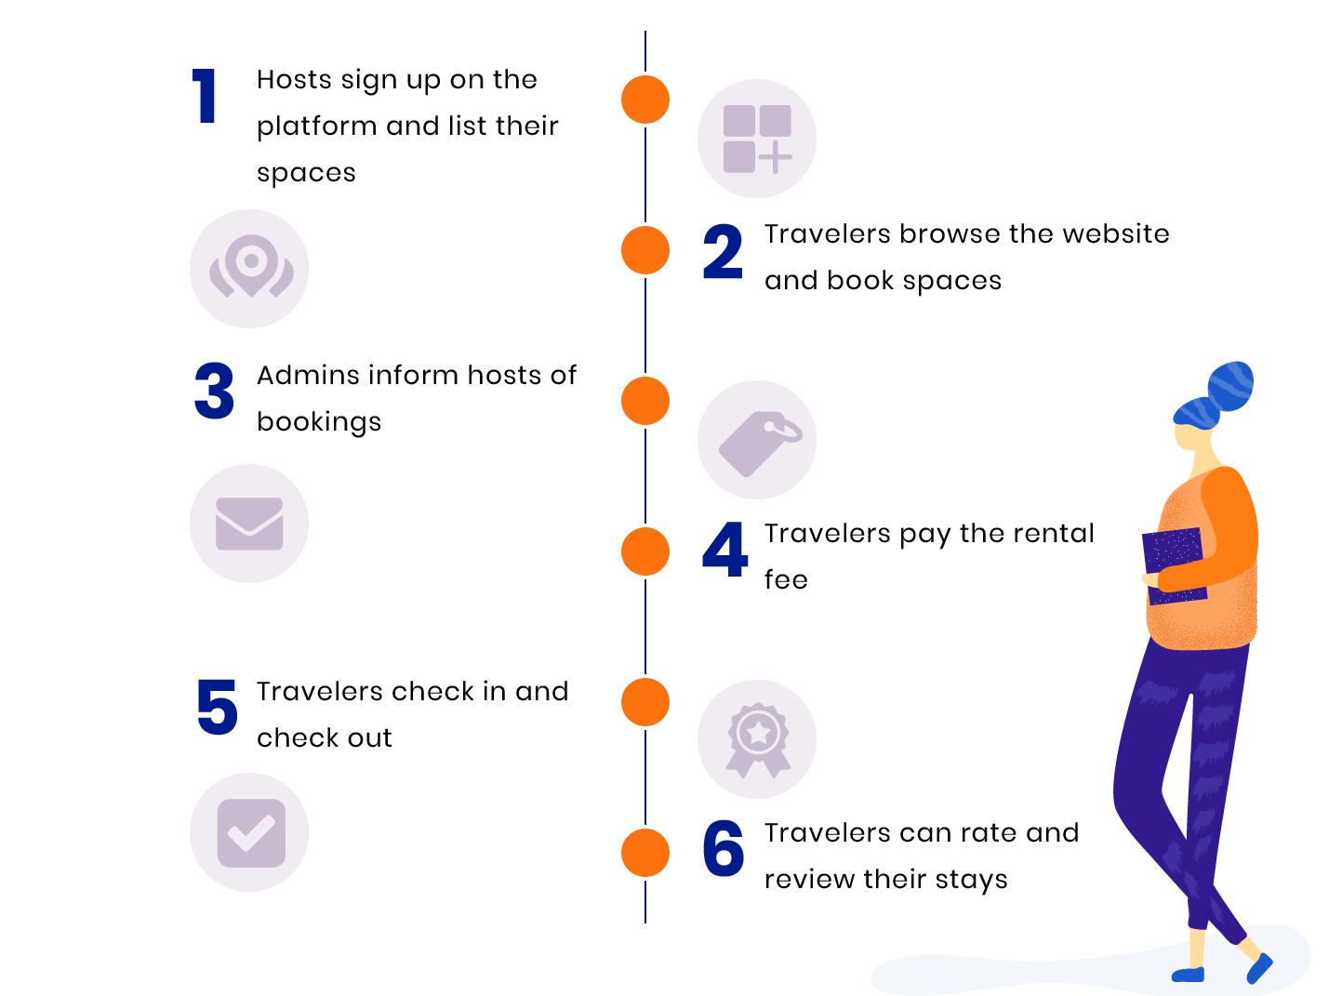
How Airbnb works?

Slide 5
1: What can we learn about different hosts and areas? •Neighborhood group
We can see Most properties are located in Manhattan and Brooklyn.
This clearly shows that Manhattan and Brooklyn are the most popular destinations at Airbnb in New York City.
Accommodation in the Bronx and Staten Island are rather marginal.

Slide 6
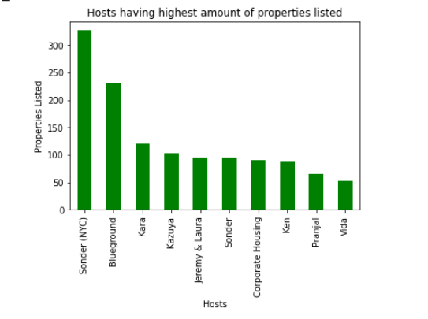
•Top Hosts by listing
We can that “Sonder(NYC)” has 327 no of properties listed which is the highest.
“Blueground” has 232 the second highest.
“Kara” with 121 no of listings the third highest and so on.

Slide 7
2:What can we learn from predictions?(ex: locations, prices, reviews, etc.)
In this part we will try to answer the following questions:
Which neighbourhood group has highest no of reviews. As compared to the listing of Neighbourhood group.
What is the preference of customer in respect to price and at what range of price most properties are listed.
Room type share and which type of room guest usually prefer.
Which are the most expensive Neighborhoods in our data set.

Slide 9
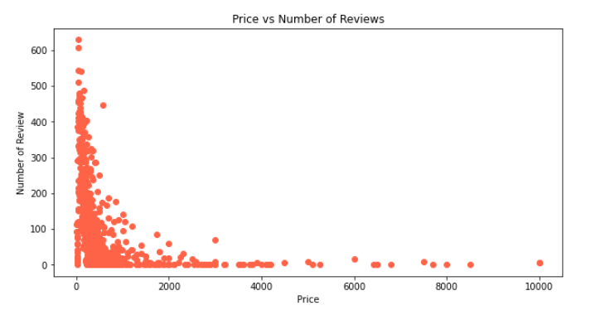
Price vs No of Reviews
By analyzing the price we can say that Most of the properties price are between 0 - 2000.
we can say that most people prefer to stay in place where price is less.

Slide 10
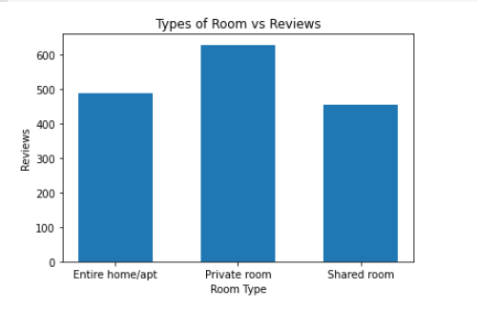
Analyzing Room Type
Room Type
Room Type VS Reviews
We can see in the Pie chart that the Entire Home/Apartment has the highest share of 52%, followed by the Private Room 46%, and the least preferred is Shared Room 2%.
We can see from graph that people usually like to stay in private room. thus it has highest no of Reviews.

Slide 11
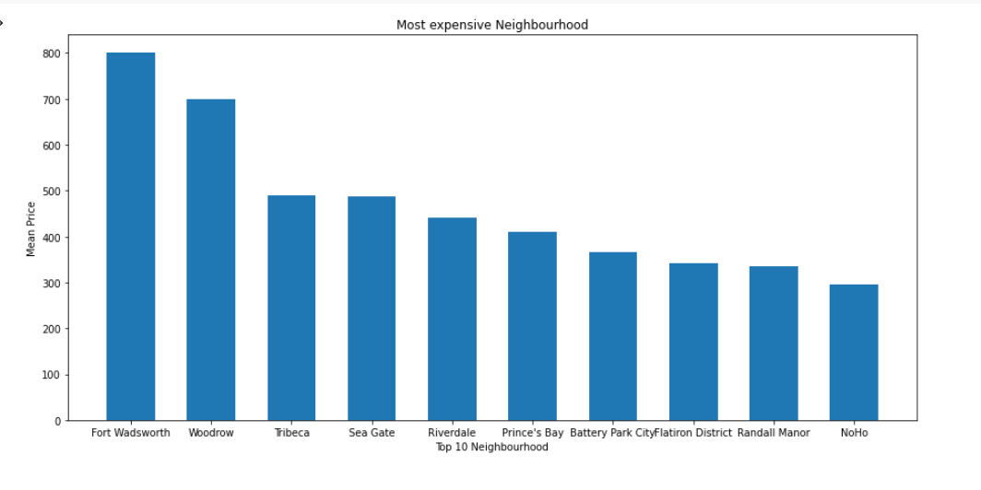
Most Expensive Neighborhoods
By comparing Neighborhoods with Average price we can see the Top 10 Most expensive Neighborhood.
Fort “Wadsworth” is most expensive Neighborhood with an average price of $800 followed by “Woodrow” price $700, “Tribeca” price $490.60 and so on.

Slide 12
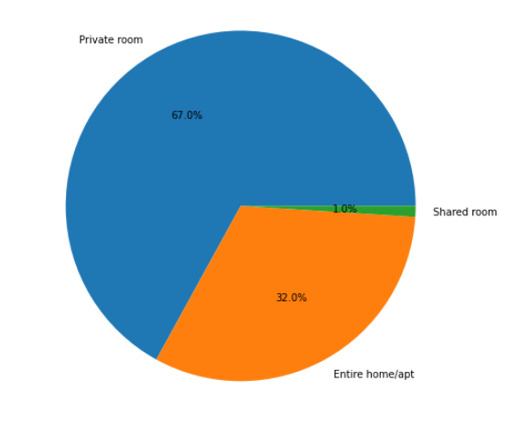
3:Now lets see which hosts are the busiest and why?
We will see the Top 10 Busiest hosts.
We can see from below Graph that “Dona” is the busiest host having 629 no of reviews followed by “Ji” having 607 no of reviews, then “Maya” – 543 and so on.
Taking a sample of first 100 busiest host to find their choices regarding room type we can say that most number of hosts are opting for 'Private room' than the rest.
almost 2/3rd of the hosts leaning towards 'private rooms' in the sample size of busiest host. This might be influential factor for most busiest hosts.
They are repetitive in terms of choosing private rooms.

Slide 13
4:Is there any noticeable difference of traffic among different areas and what could be the reason for it?
From the Bar plot we can see that Manhattan and Brooklyn has the highest traffic share followed by Queens, Bronx and Staten Island.
From previous analysis we know that most no of properties are listed in Manhattan and Brooklyn that's why it has most Traffic
We know that Manhattan and Brooklyn have many places of Tourist attraction like “Statue of Liberty and Ellis Island” in Manhattan, “Prospect Park, Cony Island” in Brooklyn.
Most guest prefer Entire home/apt and Private rooms. Manhattan and Brooklyn are tourist places therefore people are booking Entire home/apt and Private rooms for their family and friends.

Slide 14
Conclusion
Most properties are located in Manhattan and Brooklyn. This clearly shows that Manhattan and Brooklyn are the most popular destinations at Airbnb in New York City.
Sonder(NYC) is a Top Host, with 327 no of properties listed.
Queens has highest No of Reviews on Airbnb.
Most of the properties price are between 0 - 2000. people prefer to stay in place where price is less.
Entire Home/Apartment has the highest share of 52% in room type, followed by the Private Room 46%, and the least preferred is Shared Room 2%.
People usually like to stay in private room. it has highest no of Reviews among all room type.
Fort “Wadsworth” is most expensive Neighborhood with an average price of $800 followed by “Woodrow” price $700, “Tribeca” price $490.60 and so on.
Dona is the busiest host followed by “Ji” then “Maya” – 543 and so on.
Manhattan and Brooklyn has the highest traffic share followed by Queens, Bronx and Staten Island. Because Manhattan and Brooklyn have many places of Tourist attraction like “Statue of Liberty and Ellis Island” in Manhattan, “Prospect Park, Cony Island” in Brooklyn.

Slide 15
Thank You

