Slide 1

Vehicle Re-Identification and tracking
Presented by – Shubham Jiwtode

Slide 2

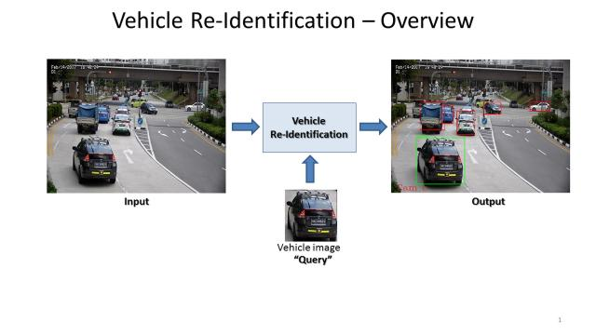
INTENT
Identifying a particular vehicle on road, based on few sample images and finally tracking the vehicle to determine its speed and direction

Slide 3

MOTIVATION
Automate video surveillance
Tracking using drones
Vehicle pursuit

Slide 4

Dataset
BMW_10 dataset from Stanford AI
https://ai.stanford.edu/~jkrause/cars/car_dataset.html

Slide 5
Proposed Architecture
Siamese n/w
Siamese n/w
Last
First
Check coordinates
Pretrained n/w
Speed
Median flow tracker
Direction

Slide 6
YOLO
Real time Object Detection
Pretrained network, to detect multiple car in the video frame. Model weight are from darknet website.
Heavy computation

Slide 7

Siamese Network
Network are trained to detect similarities between two networks
Two identical networks with same config and weights
One shot and triplet loss

Slide 8
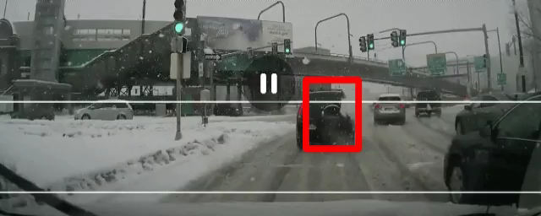
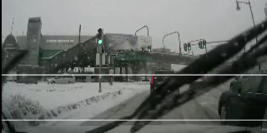
RESULT
Efficient use of computation power
Tracking at above 45 FPS

Slide 9
FUTURE WORK
Trained network for only cars, to reduce computations
Well trained Siamese network using triplet loss, with fully connected layers
Determining ETA based on vehicle speed and direction

Slide 10

THANKYOU

