Slide 1
Seatbelt Classification on low quality images using different models

Slide 2
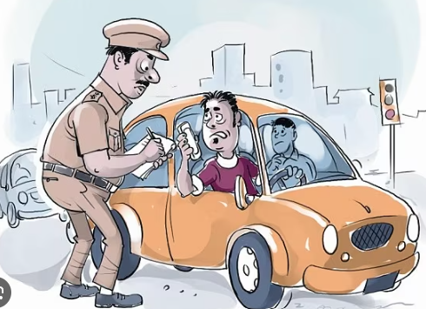
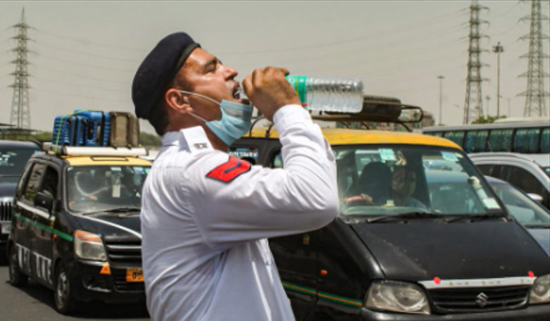
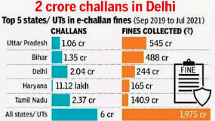
Motivation
Enforcing seatbelt usage while driving is very crucial as it could prevent a majority of casualties resulting from road accidents.
Thus the need for automated solutions to detect usage of seatbelts has been felt by authorities since manual enforcement is very inefficient and difficult particularly at night or summer.
Delhi Government fined Rs : 2.04 Cr per month.

Slide 3
OVERVIEW
In this project we will undertake the task of developing and training a Machine Learning model which can detect the usage of seatbelts while driving from the pre-processed input images
In this presentation we will see the following tasks and challenges faced in order to develop the seatbelt detection model.
Data Preprocessing
Implementation
Models used.
Results

Slide 4
Data Preprocessing
1

Slide 5
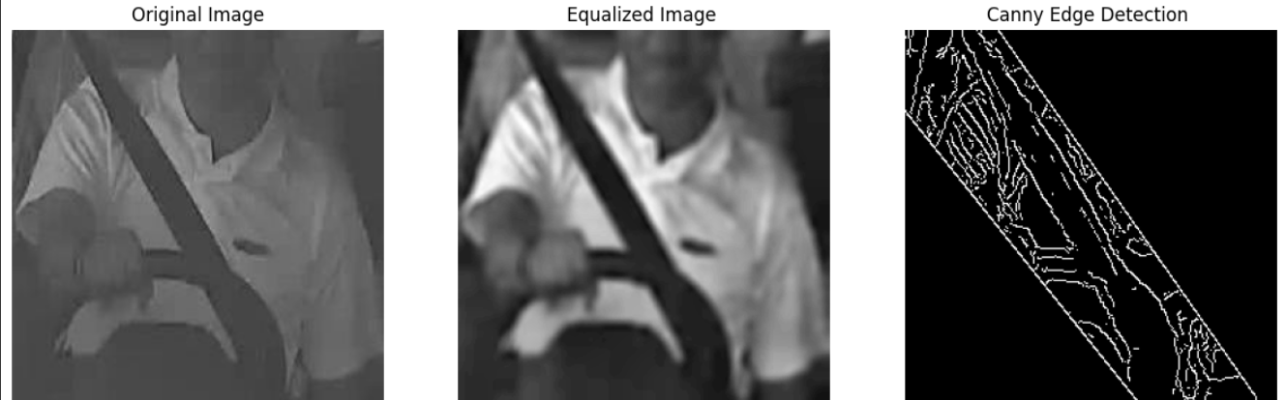
Data Preprocessing
In this project we first apply Resolution Standardisation to convert all input files into a single format and Noise Reduction is applied through use of Bilateral Filter, further to reduce complexity we turn all input images to grayscale from RGB format if there are any.
We aim to detect seatbelts through their outlines which can be obtained through the use of Canny Edge Detection while Adaptive Histogram analysis is used to reduce noise and improve contrast of image while implementing a Region of Interest (ROI) mask can help improve accuracy.

Slide 6
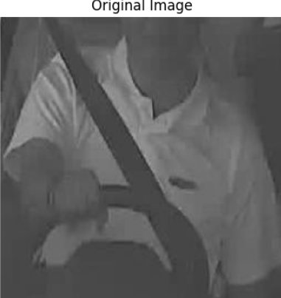
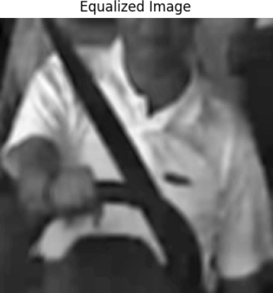
APPLICATION OF ADAPTIVE HISTOGRAM EQUALIZATION ON IMAGE
We apply Adaptive Histogram Equalization (AHE) on our input image to enhance the contrast of our input image by adjusting the intensity distribution in different regions of the image.
The effect of AHE on our input image is presented here where it improves the contrast of image and makes the features more distinguishable.

Slide 7
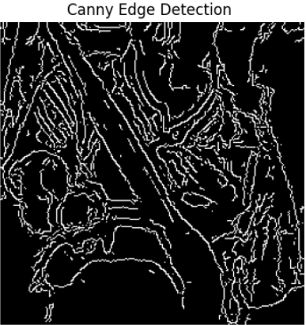
APPLICATION OF CANNY EDGE DETECTION ON IMAGE
Later we apply Canny edge detection on our input image highlighting the edges by the use of a binary image which is immensely crucial in detecting the outline of the seatbelts and identifying them.
Appropriate threshold values in Canny Edge Detection is crucial to achieve optimal results which we optimize for our data by the use of Hyperparameter tuning.

Slide 8
Data used
The data currently available for us to train a model which can classify seatbelt usage is a series of images with labels or annotations signifying whether the person is wearing a seatbelt or not, and the datasets available to us are
1. 600 images dataset: Format: Grayscale,
with 300 images of driver with seatbelt,
300 images of driver without seatbelt
used in CNN model
2. 2418 images for train dataset
779 images in test dataset
Used in YOLOv8 model

Slide 9
Implementation
3

Slide 10
Implementation
After the extraction of edge features from the pre-processed input images we proceed to train a CNN model using these edge features to classify whether the seatbelt usage is detected in input image or not.
Further we also have used a different dataset to train a YOLOV8 model which classifies whether the seatbelt usage is detected in input image or not.
We have utilized these two different models in order to compare the performance and advantages of both of them.

Slide 11
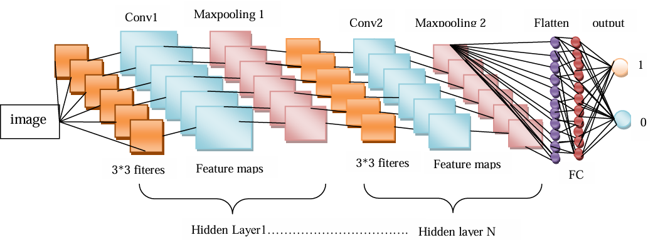
Convolutional Neural Network Model
We have utilized the 600 Image dataset which has been pre-processed to train the Convolutional Neural Network model to classify whether the seatbelt usage is detected in input image or not.
Image courtesy by Driver’s Seat Belt Detection Using CNN DS Bhupal Naik1, G Sai Lakshmi2, V Ramakrishna Sajja3, D Venkatesulu4,J Nageswara Rao5

Slide 12
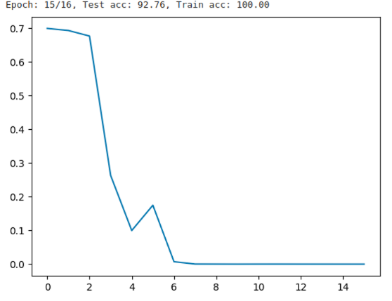
Performance of Convolutional Neural Network Model
Loss function and accuracy after training the model for 16 epochs.

Slide 13
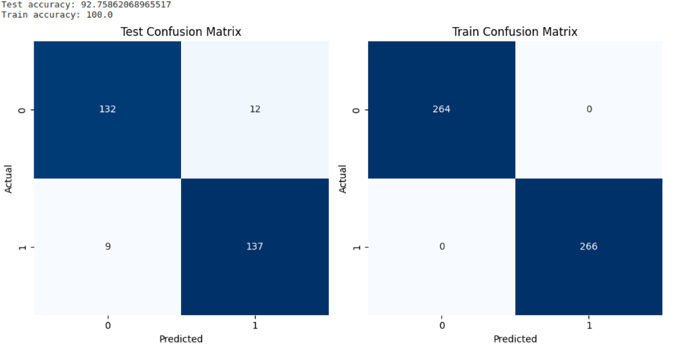
Performance of Convolutional Neural Network Model
Fig. Class-wise accuracy and confusion matrix

Slide 14
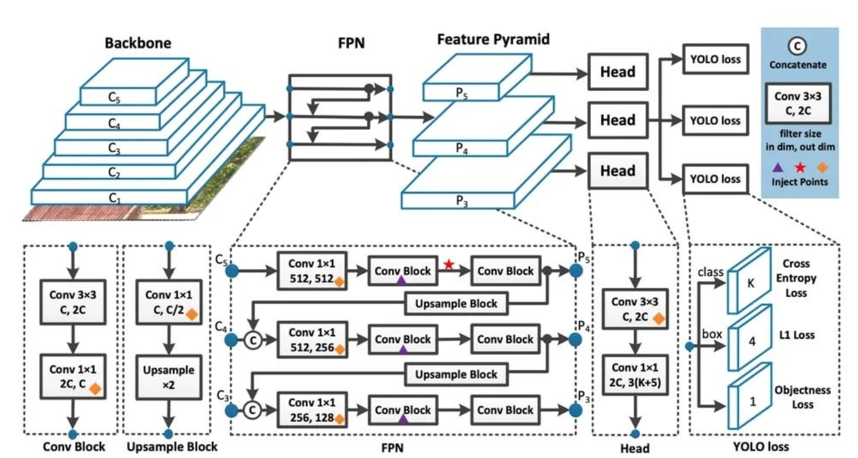
YOLOv8 model
We have implemented pretrained model of YOLO family from Ultralytics .

Slide 15
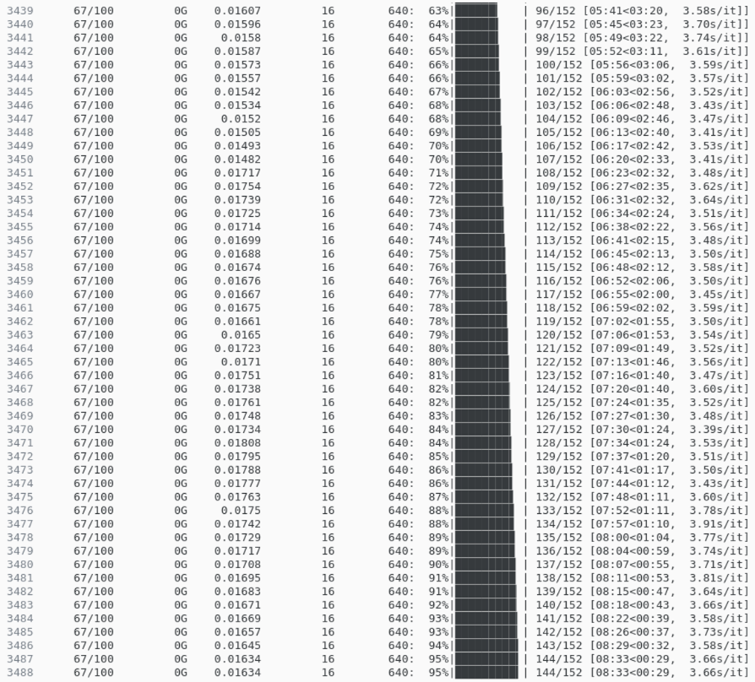
Performance of YOLOv8 model
We trained the model for 100 epochs with earlier stopping and our model segregated at 95% accuracy on unseen data

Slide 16
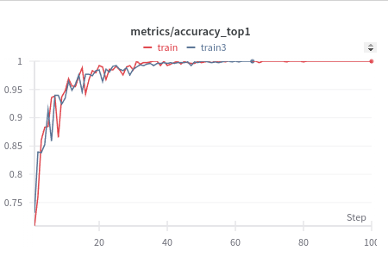
Performance of YOLOv8 model
Fig. Train and validation accuracy.

Slide 17
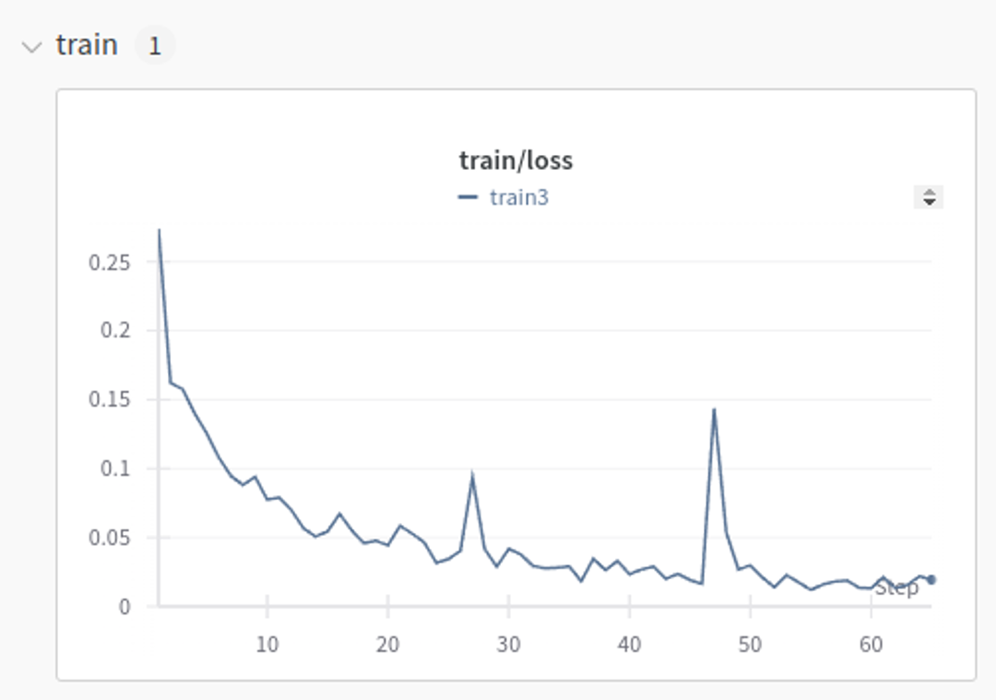
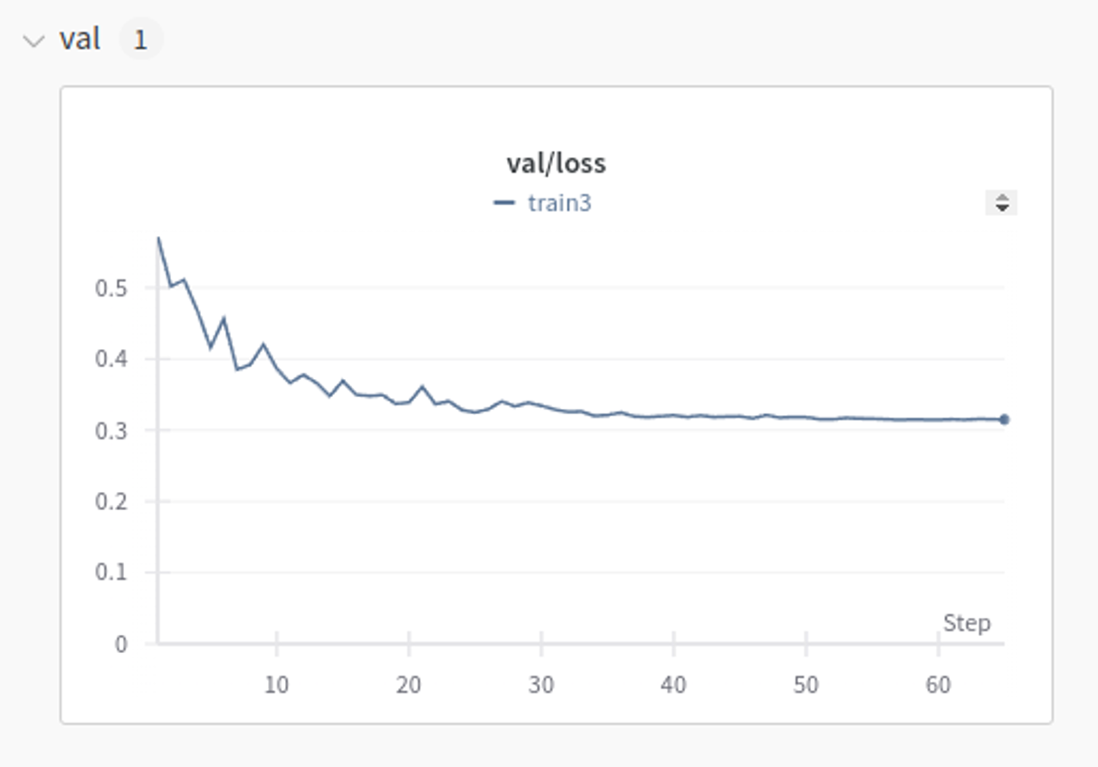
Performance of YOLOv8 model
Train loss and Val loss

Slide 18
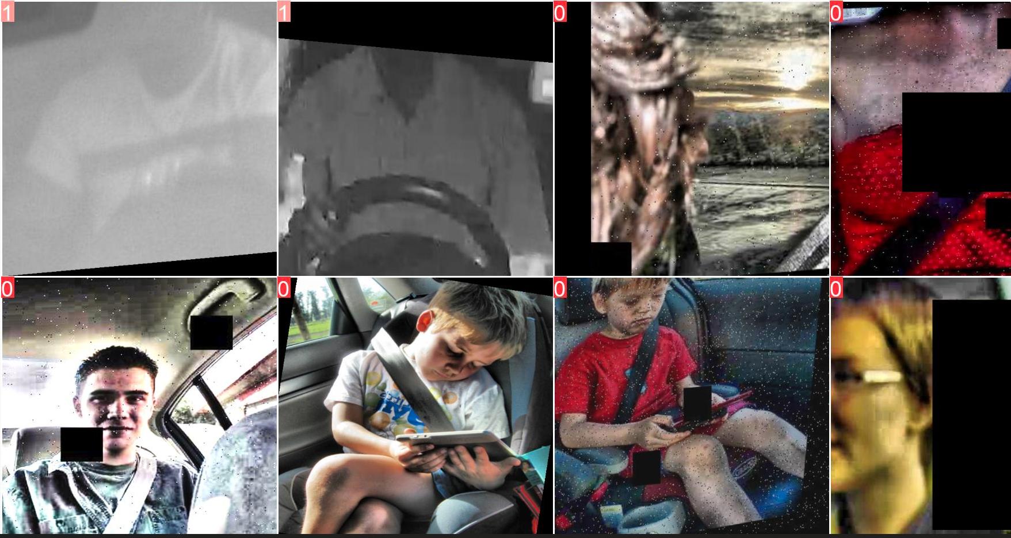
Performance of YOLOv8 model
Here 1 denotes no seatbelt while 0 denotes seatbelt.

Slide 19
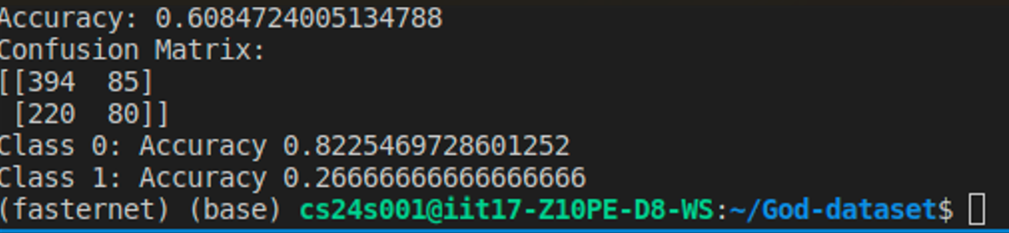
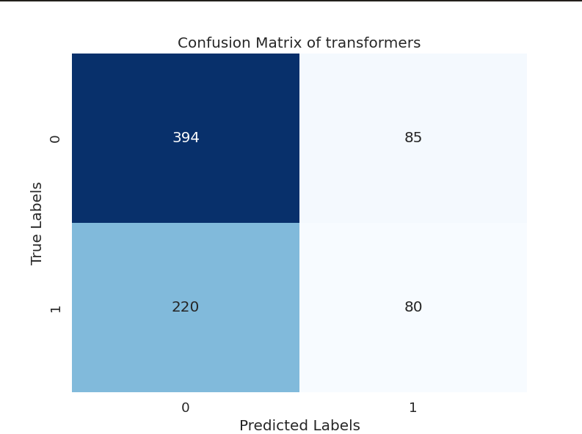
Performance of Vision Transformer (ViT)
We used Hugging Face pre-trained ViT Transformer but we couldn’t do fine tuning

Slide 20
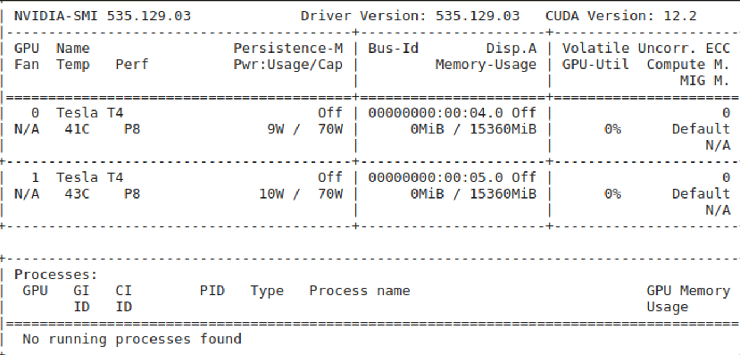
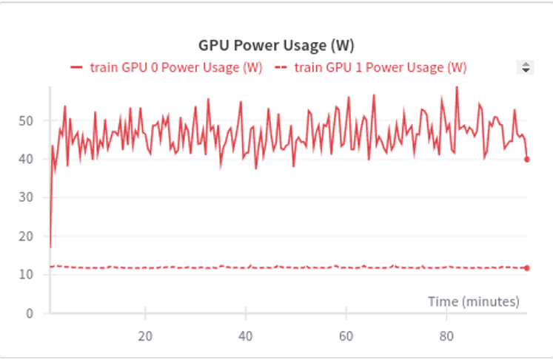
Hardware usage
This picture was taken after finishing the process
GPU was running at 50% and consuming memory of approximately 7 GB

Slide 21
Challenges faced
4

Slide 22
Challenges faced
1) Lack of good datasets
During the development of the model we had faced several challenges in its implementations of which the most severe was the poor quality and size of the datasets available for training the model
This was remedied by pre-processing the images to reduce noise and highlight features to optimise the dataset for training the model
The problem caused by the small size of the dataset can be mitigated by Data Augmentation along with generating similar images to expand dataset

Slide 23
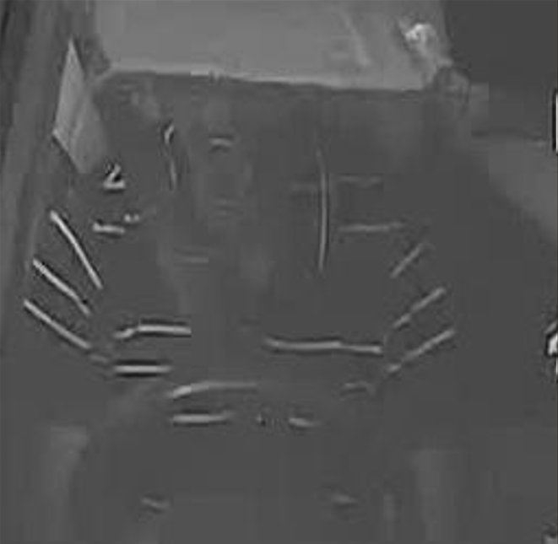
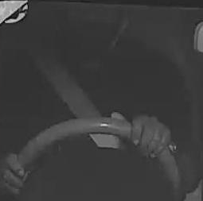
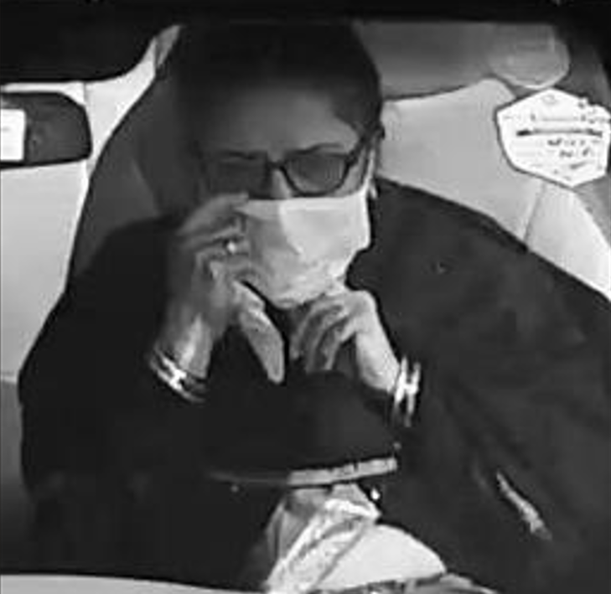
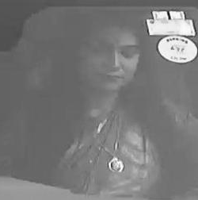
Challenges faced
Seatbelt images Non seatbelt images

Slide 24
Challenges faced
Comparision between two models
From above result we can infer that YOLOv8 model outperforms CNN model by a approximately 3%
MODEL | Train accuracy | Validation accuracy
CNN model | 100% | 92.7586%
YOLOv8 model | 100% | 95%
VIT transformer | 82.25% | 60.84%

Slide 25
Acknowledgement and References
To complete this project successfully we have referred to Rama Krishna Gorthi Sir’s lectures on Image Processing
IIT Guwahati video lectures on computer vision and Image Processing
Comparison of Image Classification and Object Detection for Passenger Seat Belt Violation Detection Using NIR & RGB Surveillance Camera Images Alperen Elihos, Bensu Alkan, Burak Balci
Seatbelt Segmentation Using Synthetic Images Sumit Jha
Image Based Seatbelt Detection by Huiwen Guo, Hu Lin
Driver’s Seat Belt Detection Using CNN DS Bhupal Naik1, G Sai Lakshmi2, V Ramakrishna Sajja3, D Venkatesulu4,J Nageswara Rao5
Fei Fei Li’s video lectures

Slide 26
Thank You

