Slide 1
MySQL is an opensource RDBMS
RDMBS- Relational Database Management System
Founder is
My in MySQL is daughter name Michal
Open source means free to use
My SQL logo is dolphin name of dolphin is “Sakila”

Slide 2
Terminologies
Data – Any information or facts
Database- Collection of Data
Database Management System (DBMS)- it is a software to manage data for e.g. Excel, here you cannot define the relationship.
RDBMS- Relational Database Management System – It is a DBMS on which you can define Relationship.

Slide 3
Table 1
Table 2
EMP
EID
ENAME
Salary
DEPTID
Dept
Deptid
DeptName
DeptLocation
Relationship can be with one or more column ,here it will not allow you to enter record in emp table if depid not present in Dept table

Slide 4
Table – Entity- any real world object
A set of rows(tuples/records) and columns(fields/attributes)
Table called as entity
EID | Ename | Salary
1 | A | 100
2 | B | 200
3 | C | 300
4 | D | 400

Slide 5
Popular RDBMS
Oracle – Owned by Oracle – Licensed ORDBMS
SQL Server – Microsoft- Licensed RDBMS
DB2 – IBM- Licensed RDBMS
Big Data RDBMS-MPP(Massively Parallel Processing) & DP (Distributed Processing)-
TeraData, Greenplum(EMC2), Snowflake, Amazon Redshift (AWS)
NoSQL Databases- MongoDB etc :: they do not support SQL language etc.
Postgres- Enterprise DB(owned by)- Opensource ORDBMS(Free)
MySQL – Oracle
Community Edition- Open Source(Free to use)
If mysql is embedded in some application and you are selling that application then you need to pay licensing to oracle for mysql
Enterprise Edition- Licensed by Oracle

Slide 6
RDBMS
Supports Relationship
All the data is stored in the form of tables (set of rows and columns)
Data can be access in RDMBS using one standard language SQL called as SQL (Structured Query Language)
Secured- only users with permissions can access your data
All RDBMS Supports Transaction

Slide 7
MySQL Client (client means you can connect to server you installed)
MySQL Workbench- it is Graphical User Interface to connect to MySQL Database (workbench takes more resources it shows many things)
Mysql Command Line- it is a command line utility to connect to MysqL Database . (it takes less resources)
Command line to connect : mysql -uroot –ptest@123 –P3306
Default Port for MySQL – 3306 (go to services.msc, every services need to be run on specific port on a machine )
Default Port for Oracle- 1521
Default Port for SQL Server- 1433
Default Port for Postgres- 5432

Slide 8
MySQL
Instance of MySQL
System Database (It created automatically when mysql is installed)
MySQL
Information Schema
Performance Schema
Sys
User Databases
Sakila (it is very popular sample database provided by mysql)
Your database for your applications

Slide 9
Table (Creating table minimum required below three things)
Table Name
Column Name
Column Data Type
E.g.
Create table t1 (c1 int, c2 v archar(100), c3 );
On windows sql is case insensitive

Slide 10
Select- is used to read data from table
*- all columns
E.g.
Select * from t1
Meaning get all the columns and all the rows from table t1
--single line comment
/* multi line comment*/

Slide 11
Insert – used to add records to the table
Syntax
Insert into table_name(c1,c2,c3..) values( give values)….
Date and string must be in single quote , giving column name is optional but order should be same as column.
Insert into t1 values (1, ’a’, ‘2022-02-27’);
---Multi row command
Insert into t1 (c1,c2,c3) values (1, ’a’, ‘2022-02-27’) , (2, ’b’, ‘2022-02-28’);
----for specific column
Insert into t1(c1,c2) values(10,’a10’);
--for c3 null gets inserted – null means value not yet defined ,NULL doesn’t mean blank or 0

Slide 12
Operators
= --equal to operator we are not assigning the value
!= or <> ----not equal to operator
>
<
>=
<=
In ----IN Operator lets YOU CAN PROVIDE LIST OF VALUES . Ex :- where c1 in (1,4,5);
Not in
Between --- get a range of values, between include boundary values . Ex: where c1 between 2 and 5
Not between
Is null
Is not null
>any or >all
<any or <all
<= any or <all
>=any or >= all
=any or =all
Like ------- is used to search values based on a pattern, --two ways to do search like using wildcard character -- % and (_ undersco)
Not Like ----% means any number of character,--_means exactly 1character

Slide 13
SQL Commands
Select- Read Data from Tables
Insert – to add new records
Update – to edit existing records
Delete – to remove existing records from the table
Alter table
Add columns --(alter table customers add column new_column varchar(100);)
Drop column --(alter table customers drop column new_column;)
Change data type –(alter table customers modify column c1 int , modify column c2 varchar(20); )
Change null to not null or vice versa
Add default value
Rename Table ----(alter table customers rename to customer_new;)

Slide 14
Constraints - some sort of restrictions- are used to enforce integrity of the data (6 Constraints)
Unique Key- means only unique value are allowed (no duplicates) but can have null values. One table can have more than one unique key
Primary Key- allows only unique values. Null value is not allowed Unique + Not Null. One table can have only 1 Primary key or composite pk.
Not Null – will not allow null values
Check Constraint-define what range of values will be allowed/not allowed for a column
Create table t_cc (id int, salary int check(salary>0); or check(gender in (‘M’ , ’F’);
Foreign Key- Parent Child Relationship – Referential Integrity Constraints
A value is allowed in the child table only if the value is present in the parent table
Column of the parent table which is being referred should be defined as Primary or Unique Key
Child table can have a null value in the foreign key column irrespective of whether parent table column is defined as Primary or Unique Key
Create table t_parent(deptid int primary key,deptname varchar(100));
Create table t_child (eid int , ename varchar(100) , deptid int, foreign key deptid references t_parent(deptid));
Default- defines what value column value will take if explicit value for the column is not provided while inserting the data, null is default values. Ex: create table t_def(id int, salary int default 1000);

Slide 15
--Composite foreign key
--for composite foreign key you need first create a table with either a composite unique or primary key
Create table t_parent_comp(c1 int .c2 int,c3 varchar(100),unique(c1,c2);
Create table t_child_comp(c1 int , c2 int, c4 varchar(100), foreign key(c1,c2) references t_parent_comp(c1,c2);
Deptid(PK or UK) | Deptname
1 | HR
2 | IT
EID | Ename | Deptid
1 | A | 3

Slide 16
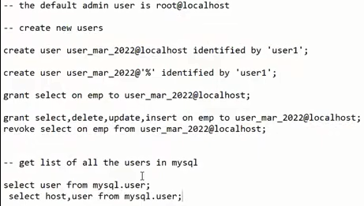
SQL – Structured Query Language --5 types of command
DDL- Data Definition Language
Create table
Alter Table
Drop Table
DML- Data Manipulation Language
Insert
Delete
Update
Merge- combination of update/Delete/Insert
DCL- Data Control Language
Grant
Revoke
TCL- Transaction Control Language
Commit --to execute the changes
Rollback --Undo the changes
DRL- Data Read Language
Select- use to read data

Slide 17
Joins- Joins are used to retrieve columns from multiple tables in the same query
Cross Join – Return maximum number of rows Cartesian product
Equi Joins
Inner Join
Outer Joins
Left Outer Join
Right Outer Join
Full Outer Join
Non-Equi Joins

Slide 18
T1
T2
C1 | C2
1 | A
2 | B
3 | c
C1 | c3
3 | X
4 | Y
5 | z
Cross Join- The tables are joined without any condition which means every row of 1 table will be joined with every other row of the second table
If T1 has X and T2 has Y rows then T1 cross join with T2 will give you X multiplied by Y
Return maximum number of rows as it is Cartesian product 3*3=9 rows
Ansi /new Syntax:- select * from t1 cross join t2’
Old Syntax:- select * from t1 , t2;

Slide 19
T1
T2
C1 | C2
1 | A
2 | B
3 | c
C1 | c3
3 | X
4 | Y
5 | z
Inner Join- In Inner Join we join the two tables based on some equality condition. Inner join returns only those rows which satisfy matching conditions.
-Equality Condition-T1.c1=T2.c1
Ansi / New Syntax :: select * from t1 inner join t2 on t1.c1=t2.c1;
Old Syntax:: select * from t1 ,t2 where t1.c1=2.c1;

Slide 20
T1
T2
C1 | C2
1 | A
2 | B
3 | c
C1 | c3
3 | X
4 | Y
5 | z
Left Outer Join- In Left Outer Join we join the two tables based on some equality condition. Left Outer join returns matching rows and also left over rows from the left table
Select * from
T1 Left Join T2 – Left Table T1 and Right Table T2
On
T1.c1=T2.c1;
-Equality Condition-T1.c1=T2.c1

Slide 21
T1
T2
C1 | C2
1 | A
2 | B
3 | c
C1 | c3
3 | X
4 | Y
5 | z
Right Outer Join- In Right Outer Join we join the two tables based on some equality condition. Right Outer join returns matching rows and also left over rows from the Right table
Select * from
T1 Right Join T2– Left Table T1 and Right Table T2
On
T1.c1=T2.c1
-Equality Condition-T1.c1=T2.c1

Slide 22
T1
T2
C1 | C2
1 | A
2 | B
3 | c
C1 | c3
3 | X
4 | Y
5 | z
Full Outer Join- In full Outer Join we join the two tables based on some equality condition. Full Outer join returns matching rows and also left over rows from both the Right table and left table
Not Supported in MySQL but there is workaround
Select * from
T1 Full Join T2– Left Table T1 and Right Table T2
On
T1.c1=T2.c1
--Equality Condition-T1.c1=T2.c1
Workaround of full join in My SQL
Select * from t1 left join t2 on t1.c1=t2.c1
Union
Select *from t1 right join t2 on t1.c=t2.c1;

Slide 23
Set Operators
Union
Union all
Intersect- Not supported in MySQL
Minus/Except– Not Supported in MySQL
--Work around for Intersect
Select * from t1 where c1 in (select c2 from t2)
--Work around for minus/except
Select *from t1 where c1 not in (select c1 from t2)

Slide 24
Two Sets A and B A={1,2,3} B={3,4,5}
A Union B= {1,2,3,4,5}– Need to perform sort to remove duplicates
B Union A= {3,4,5,1,2} – Need to perform sort to remove duplicates
A Union All B={1,2,3,3,4,5}- Doesn’t remove duplicates so no sort is required
B Union All A={3,4,5,1,2,3}-- Doesn’t remove duplicates so no sort is required
A Intersect B={3}– just the common elements
B Intersect A={3} – just the common elements
A minus B={1,2}– Elements of A which are not in B
B Minus A= {4,5}- Elements of B which are not in A

Slide 25
Pre-requisites for using Set Operators
Both the queries should have same number of columns
Corresponding data types of the columns in both the queries should be same/compatible
Select * from a
Union /union all /intersect/except
Select * from b;

Slide 26
Sub Queries- When we use a query instead of a value in the main query then it is called as a sub-query.
E.g
select * from t1 where c1 in (select c1 from t2);

Slide 27
Aggregate Functions
Count- works on all data types
Count(*)/count(1) will count number of records in the table
Count(col_name) will count the number of not null values in the column of that table
Sum- Works only with numeric data types
Max- works with all data types
Min- works with all data types
Avg- only numeric fields

Slide 28
Group by Clause is used to perform aggregation based on some columns
Select sum(salary) from emp;
Select ename,deptname, salary from emp join dept on emp.deptid=dept.deptid
Select deptname, sum(salary) from emp join dept on emp.deptid=dept.deptid
group by deptname;
Select deptname,count(eid) from emp join dept on emp.deptid=dept.deptid
group by deptname;

Slide 29
Having Clause is used to apply filter on aggregate columns
Select deptname, sum(salary) from emp join dept on emp.deptid=dept.deptid
group by deptname having sum(salary)>50000;
Having clause can only be used if you have group by clause and come after group by clause.

Slide 30
Order by Clause- sort the output in either descending or ascending order Order by is always the last clause in the query. Only limit clause can come after order by clause
Select deptname,ename,salary from emp join dept
On emp.deptid=dept.deptid
Order by deptname ,salary desc; or Order by salary desc;
Select deptname,ename,salary from emp join dept
On emp.deptid=dept.deptid
Order by deptname asc,salary desc;

Slide 31
Where vs Having
Where clause is used to apply filters on non-aggregate columns (table columns) and Having is used to apply filters on aggregate columns(sum,max,min avg etc.)
Where clause can be used without group by clause but having clause can be used only with group by clause
On Clause is used to specify the joining condition when you use inner or outer join in the ansi syntax of joins

Slide 32
Column Alias and Table Alias
Column Alias is name given to the column in the query output
Select ename as EmployeeName,salary as EmployeeSalary from emp;
Select ename EmployeeName,salary EmployeeSalary from emp;
It is only valid with the query.
Table Alias is used to give some name to your tables just for query purpose
Select ename,deptname,salary
From emp e join dept d
On
e.deptid=d.deptid;

Slide 33
Limit and Offset
Select ename,salary from emp order by salary desc limit 5;
---first 5 rows
Select ename,salary from emp order by salary desc limit 5 offset 1;
--give me first 5 rows after skipping 1 row

Slide 34
InLine Views
When you write a query instead of a table name in the from clause
Giving a table alias for the query is mandatory
E.g.
select * from (Select ename,salary from emp order by salary desc limit 5 ) as t order by salary;

Slide 35
Select Query Syntax
Select Column List(c1,c2…)
From
Table_List (t1,t2,t3)
On
Where
Group by Clause
Having Clause
Order by
Limit
offset
Query has to follows some syntax you
cannot change the order

Slide 36
Start transaction
Update
Delete
Insert
Update
..
….
Rollback

Slide 37
Select Query execution steps
Joins or where clause will be applied
If you have multiple conditions in where clause then depending the condition it will be applied
Group by clause
Aggregation will be performed (sum, max, min etc.)
Having clause application
Order by clause
Limit and offset

Slide 38
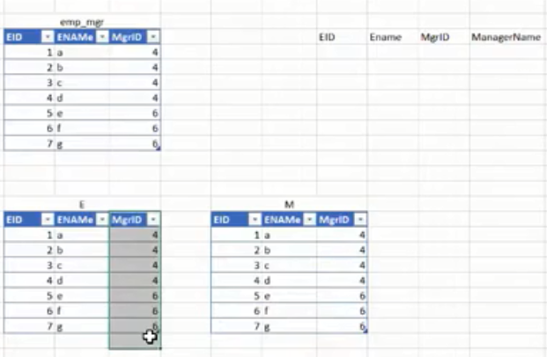

Self Join
In self join a table is joined with itself
--joining same table calling one table as e and another table as m

Slide 39

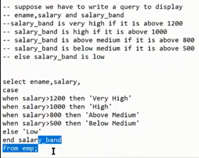
Case Statements- they are like switch statements
Case when cond1 then ..
When cond2 then ..
…
Else
End
It goes to second cond^n
Only if above cond^n not satisfied .

Slide 40
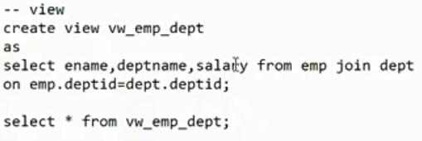
Views- a logical object , a saved query , a virtual table
Doesn’t store data in it
Views doesn’t occupy space for data
Advantages
Security- Hide specific columns or rows
Reusability- Once a view is created you can reuse it
Remember view is not storing any data every time you run view it is fetching data from each table.

Slide 41
Exists and Not Exists- operators
You write a query after these operators
If the query returns 1 or more than 1 row then the condition becomes TRUE else the condition is set to False.
Generally are used in context with a correlated sub query
--what value or column it return it doesn’t matter. Only matter it return any rows or not

Slide 42
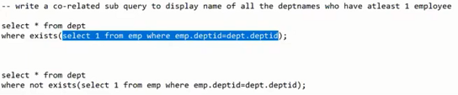
Correlated Subquery- Subqueries in which we define a relationship of a column from the outer query with the column of inner query
Correlated subqueries are generally very slow in performance because the correlated sub query gets executed as many times as you have number of rows in the outer query
Select … from outer_query
Where (some inner query where outerquery.column=innerquery.column)

Slide 43
DMLs on Views
DMLs on view are allowed with some restrictions
When DMLs are performed on views the changes happen on the base table
DMLs cannot modify multiple tables through view
Insert in views are not allowed if it don’t contain any of the not null column of the base table with no default values.
DML on views are not allowed with aggregate function or group by clause .

Slide 44
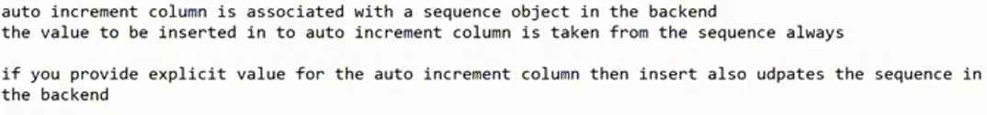
Autoincrement Columns
Autoincrement columns take value automatically through a sequence
Autoincrement column as to be defined as a primary key or unique key (does not have duplicate values)
Starting value by default of auto increment is 1,
It get max value through sequence from existing data and increment by 1
create table account (accountno int primary key auto_increment , accname varchar(100));
alter table account auto_increment=1001;

Slide 45
Truncate vs Delete
Truncate also delete data from the table but truncate doesn’t have any where clause which means truncate will remove all the records whereas delete can delete specific records using where clause
Truncate cannot be rollback but delete can be rollback
Truncate command doesn’t get logged but delete is a logged(row_level) command. Logging for truncate and other DDL commands happened only at the statement level. Row level logging happens for delete.
Truncate is faster in performance than delete.
Truncate resets the auto increment value to initial value 1 where as delete doesn’t reset the auto increment value.
Delete can have a trigger but truncate cannot have a trigger.
Delete can be executed on parent table having a foreign key but Truncate cannot be performed on parent table as it doesn’t check row by row.

Slide 46
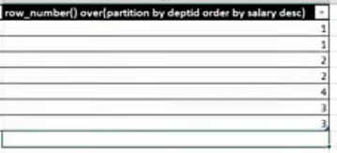
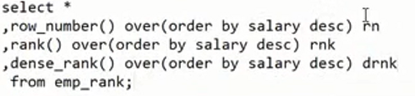
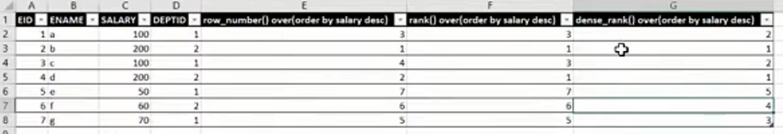
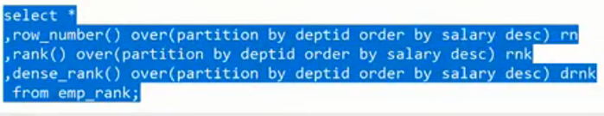
Analytical Functions- Ranking Functions
Ranking Functions are used to assign rank to the rows based on some condition.
They can be used only in 2 places-
Select column clause
Order by clause
They have two types of parameters that they can take
Partition by Clause – This is an optional parameter
Order by Clause – This is a mandatory parameter
Different types of Ranking Functions-
Row_Number
Rank
Dense_Rank

Slide 47
Built-in Functions Numeric deterministic function value will always remain same when ever you use
Round
Floor- Highest integer value lower than or equal to the given number
Ceiling-Lowest integer value greater than or equal to the given number
Power
SQRT
+,-,/,*
Mod
abs

Slide 48
Built-in Functions String
Substring –Part of string, pos start with 1. substring(‘abcd’,2,3) 2 is position and 3 is no character to print
Select mid(“abcded’,-2,2);
Instr –check the position of given string, gives pos of first occurrence only.
Replace-replace a part of string, case sensitive.Ex select replace(‘abcde’,’d’,’z’)
Left-that many character from left select left(‘abcde’,3)
Right-that many character from right . Ex select right(‘abcde’,3)
Ltrim-remove spaces from left
Rtrim-remove spaces from right
Trim-remove space from both side
Reverse-reverse the given string
Locate ---return 0 ifnot found. Ex: select locate(‘def’,’abcdef’); Always gives you first occerance

Slide 49
Built-In Functions Date and Time
Current_date(), curdate()- returns current date of the system
Current_time(), curtime()- returns current time of the system
Now()- returns current date time of the system
Year(date) – year of any date . Ex: select year(curdate());
Month(date)- To get month nameEx: monthname(curdate());
Day(date) --to get day of year Ex: Select dayofyear(curdate());
Hour(time)
Minute
Second
Weekday(date)- Week day number of the week
Week(date)- week number of the year
Last_day
DateDiff
Date_add-you can add date or time.
Date_format- to change date format

Slide 50
KEYS
Candidate Key- any column or a group of columns which can uniquely identify a row is called a candidate key
e.g. eid column of EMP table- minimum field required to uniquely identify a row
Super Key- A super key is a set of one or more attributes which can uniquely identify a row in a table
EID , ENAME-> this is not a minimum column key
Alternate Keys- all the candidate keys which are not primary key are called as an alternate keys
Natural Key- is a column or set of columns that already exists in the table (e.g. they are attributes of entity within the data model) and uniquely identify a record in the table
EMP
SSN, FN,LN
Surrogate Key- A surrogate key is a system generated value with no business meaning that is used to uniquely identify a record in a table
Address
AddressID- Auto increment or a sequence
Streetnumber
Streetname
City
State
Zipcode

Slide 51
Transaction – Unit of work (any work you do in DB transaction)
Properties of Transaction (ACID)
A- Atomicity- A transaction is either fully committed or fully rollback. Transaction should be treated as an atomic unit
You cannot do some part as commit and some rollback
C- Consistency- Database should always remain in a consistent state after any transaction irrespective of whether transaction is committed or rollback or not completed
RDBMS writes the changes first to the log file before change the changing the data in the buffer pool or data file and this process is called as Write Ahead Logging
Consistency is achieved by instance recovery done during the startup of the instance
RDBMS analyses the log file to identify all the transactions that were not committed but yet written to the disk(REDO) and also the transactions that were committed but were not written to the disk (UNDO / Rollback).
Redo all the transactions that were committed but not written to the disk
Undo or rollback all the transactions that were not committed but yet written to the disk
I- Isolation- No two users can update the same data at the same time RDBMS use locks to implement isolation
MVCC- Multi Version concurrency control- It means that users can read the data even if the same data is getting modified by some other session/user. In MVCC RDBMS takes snapshot (row versioning) of the last committed data.
D- Durability- Once the data is stored in the RDBMS it should remain forever even if the server is restarted unless the user deletes the data. Durability is implemented by storing the data on a non-volatile storage(disk).

Slide 52

No two people can modify the same data at the same time
Show variable like ‘%timeout%’; lock_wait_timout
Instead of table lock bank use row lock level can not be done in column level, If table lock then other row cannot be modified.
Data file contain actual data stored in non volatile disk
Show variables like ‘data dir’;

Slide 53
DBMS Architecture
Memory
Memory
LRU
Data File
Checkpoint
Buffer Pool
(Table/Index Data)
Log Buffer
(DDL/DML Changes)
1
1,2,101
Commit/Rollback
Log File
Data file contain actual data stored in non volatile disk , log file also stored in disk
Show variables like ‘data dir’;
When ever user read data it reads data from memory, mysql also reads data from memory In backend so if you want to change data fro1 to 2 it needs to load into memory first. So it needs to change the data from memory to disk happens in checkpoint process. But all rdbms also write all changes in memory in log buffer it writes old_value, new_value and transaction_number. And those changes from log buffer are written on dick on commit and rollback. RDBMS writes the changes first to the log file before change the changing the data in the buffer pool or data file and this process is called as Write Ahead Logging.
Log file can get overwritten.
1,2,101

Slide 54
Types of Files
Data File stored on a non-volatile storage
Actual data of the tables and Indexes
Changes from buffer(memory) is written to data file on checkpoint
Changes from log buffer to log file on disk is written on commit /rollback
Log file
Stores only changes made to the data. Changes are captured for both DML and DDL commands
Old and new values of the data change, ID of the transaction
Update emp set salary =salary*1.1;
EMP has 1 million rows (1000,000)
This update is taking around 30 mins to complete
Assume that the update ran for 10 mins and then suddenly the database server got restarted

Slide 55
Transaction- transfer 500Rs from Account A to Account B
Start transaction
Update Account set balance=Balance-500 where accountno=‘A’
Update Account set balance=Balance+500 where accountno=‘B’
Commit;

Slide 56
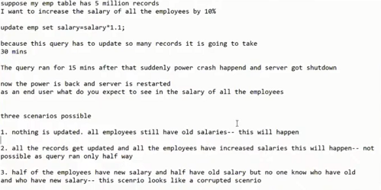

Slide 57
Blocking
When one session is waiting for another session to commit/rollback /for the query to finish so that the lock is released.
Waiting state is also called Blocking
When 1st session waiting for 2nd session and 2nd session waiting for1st session is called deadlock (in case ofupdate
Both session waiting for each other whenever this happens mysql detect this and rollback any one of them

Slide 58

Isolation Levels What is Isolation Level?
Isolation level defines what the select query will return if the same data is getting updated in another session
Read Uncommitted
Read Committed
Repeatable Reads
Serializable

Slide 59
Read Uncommitted
In Read Uncommitted isolation select query will be able to read uncommitted data
Uncommitted Data/Dirty Data – Data which has been modified but not yet committed/rollback
EID,ENAME,SALARY,DEPTID (Below is the data)
1, A,100,1
show variables like '%%isolation%’;
set transaction_isolation='read-uncommitted';
Session 1 | Session 2
set transaction_isolation='read-uncommitted'; --Step 1 Start transaction; Update emp set salary=200 where eid=1; | set transaction_isolation='read-uncommitted'; -- Step 2 Select * from emp where eid=1; Will return salary as 200 Update emp set salary=300 where eid=1;-- waiting

Slide 60
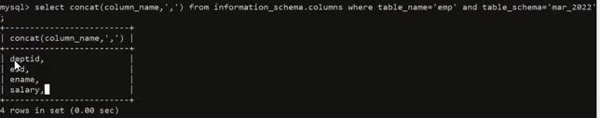
Repeatable Read
Reading the same data in a transaction even if the data has been modified and committed in another session

Slide 61
Read Committed
In Read committed isolation select query will be able to read last committed data
Uncommitted read(Dirty reads) is not possible in Read Committed Isolation
Repeatable Reads not happening
EID,ENAME,SALARY,DEPTID
1, A,100,1
show variables like '%%isolation%’;
set transaction_isolation=
'read-committed';
Session 1 | Session 2
set transaction_isolation='read-committed'; --Step 1 Start transaction; Update emp set salary=200 where eid=1; | set transaction_isolation='read-committed'; -- Step 2 Select * from emp where eid=1; Will return salary as 100 Update emp set salary=300 where eid=1;-- waiting

Slide 62
Repeatable Read Isolation
In Repeatable Read isolation select query will be able to read last committed data
Uncommitted read(Dirty reads) is not possible in Repeatable Read
Repeatable Reads is possible
EID,ENAME,SALARY,DEPTID
1, A,200,1-- initial
show variables like '%%isolation%’;
set transaction_isolation=
‘repeatable-read';
Session 1 | Session 2
set transaction_isolation='repeatable-read'; --Step 2 Start transaction; Update emp set salary=300 where eid=1; Commit; | set transaction_isolation='repeatable-read’; -- step 1 Start transaction; Select * from emp where eid=1; --return 1,A,200,1 -- Step 3 Select * from emp where eid=1; --Will return salary as 200 --Step 4 Commit; Select * from emp where eid=1; --Will return salary as 300

Slide 63
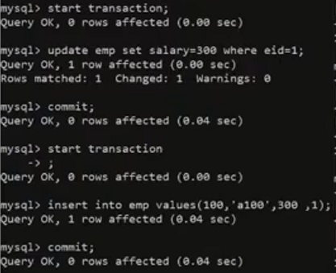
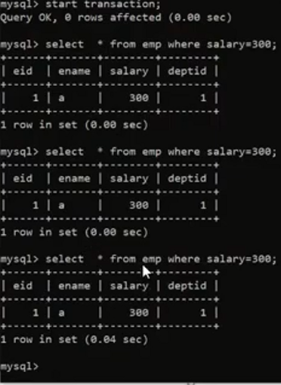
New record that coming up with select query is called phantom read
Whenever we do select in transaction the other person inserted new data and that record coming up in select query , when that data come in select is called phantom read.

Slide 64
Serializable
This isolation level solves the problem of phantom reads
Phantom Reads:- it occurs when in the course of a transaction, new rows are added or removed by another transaction of the record being read.
Everything is serialized even if you are doing select you cannot do DML in other.
Session 1 | Session 2
--step 1 start transaction; Select * from emp where eid=1; -- 1,a,300,1 -- step 3 Commit; -- 1,a,300,1 -- step 5 Select * from emp where eid=1; --1,a,300,1 --1,b,400,1 Phantom read (which will not come in serializable) | -- step 2 Start transaction; Insert into emp values(1,b,400,1);-- wait for lock to be released -- step 4 Commit;

Slide 65
Isolation
Isolation Level | Dirty Reads | Repeatable Reads | Non-Repeatable Reads | Phantom Reads | Strictness | Concurrency
Read Uncommitted | ✅ | ❌ | ✅ | ✅ | 1- (low) | 4(High)
Read Committed | ❌ | ❌ | ✅ | ✅ | 2 | 3
Repeatable Reads | ❌ | ✅ | ❌ | ✅(not in mysql) | 3 | 2
Serializable | ❌ | ✅ | ❌ | ❌ | 4(High) | 1

Slide 66
MySQL Programming
Procedures
Functions
Triggers
These are sqlprogramming language, you can write loops in these PL

Slide 67
Types of Function
Deterministic- if the function is expected to return same output for the same input value each time
Reads SQL Data- if the function is having select from table command
Funtion have sql queries inside
NO SQL – if the function doesn’t read data from SQL table

Slide 68
Function
Set of code/program which can take input through some parameters but has to return a value through a return clause. You can call functions inside queries
Create function func_name(param1 data_type, param 2 data_type..)
Returns data_type
Deteministic/non-deterministic
Begin
Declare var1 data_type;
Declare..
..
Set var=1;
…
If
Else
End if;
Loop;
Return statement;
End;
Function can be used anywhere .
Semicolon is the default command terminator i.e delimiter
Return is the last clause of function
We need to change delimiter to anything so it we can end statement with ;
Ex:
Delimiter $$
create function sf_check_even_odd(num int)
returns varchar(100) --return type offunction
DETERMINISTIC
begin ---body of function block start here so no need to;
if mod(num,2)=0 then
return (concat(num,’ is an even number’)); --if return here it exist from function
End if it will not move down
return (concat(num,’is an odd number’));
end; --here function block begins end here, so we need to ; to end the begin
$$
it create the function and store in DB
Select sf_check_even_odd(12)$$

Slide 69
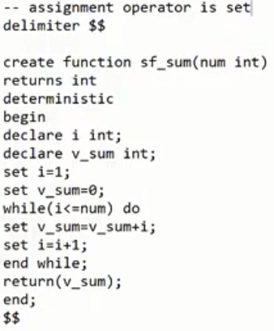
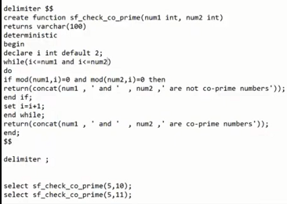
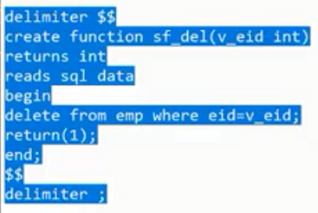
All function are store in information schema
Select routine_name from information _schema.routines where routine_schema=“sep2022”;
In mysql schema and databases are same thing. Assignment operator is set.
Although we can write DML in functions but to use we write select so it gives wrong impression (bad practice not recommended).

Slide 70
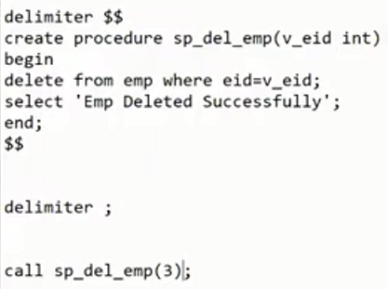
Procedures
Set of code/program which can take input through some parameters and can also return values through out parameters. You cannot call procedures inside queries
--Although we are able to perform dms in functions generally it is not recommended to use functions to performs dmls through function
Create procedure proc_name(param1 data_type, param 2 data_type..)
Begin
Declare var1 data_type;
Declare..
..
Set var=1;
…
If
Else
End if;
Loop;
End;
Select rand()*10000;
Select ascii(‘a’);
Select conver(char(97),char(10));

Slide 71
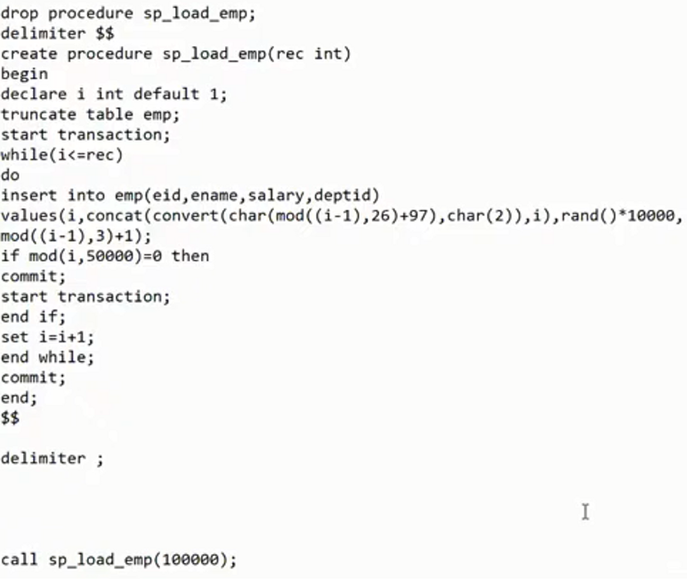

Slide 72
Our first Procedure – Hello World
Create procedure sp_helloworld(name varchar(100))
Begin
Print concat(‘hello ‘ , name);
End;
$$

Slide 73
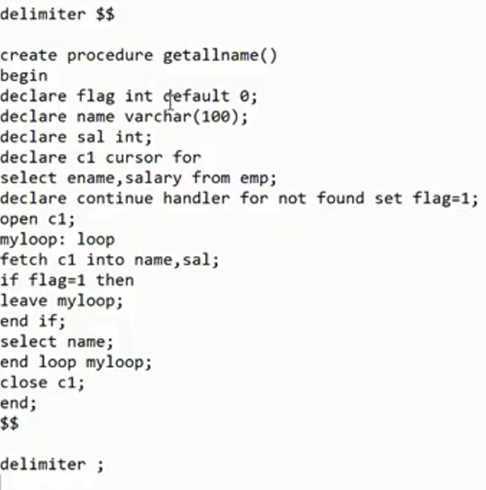
Cursors- is a pointer to a set of records and is used fetch data row by row
Steps to use cursor
Declare cursor
Declare not found handler for cursor
Open Cursor
Fetch data from cursor in a loop
Close cursor
Using cursor is a bad practice as it fetch data row by row
Which takes lots of time in million records

Slide 74
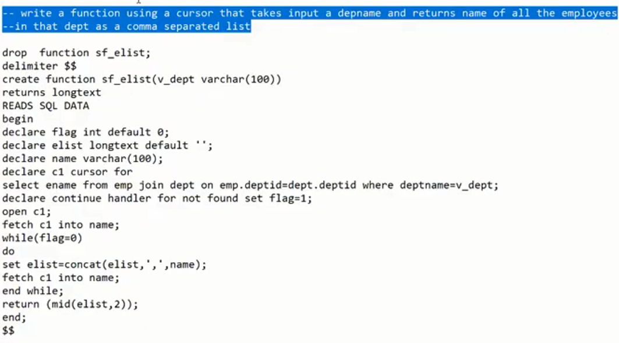
Trigger Example

Slide 75
Triggers- set of code that gets executed whenever a specific event occurs. Trigger is like a hidden code
Events
DML Commands
Insert, update , delete
Logon Triggers
System Commands
Startup, Shutdown
DDL Commands
Create , Drop, Alter
Usage of Triggers
Auditing
Automation
Some set of code executed automatically
In trigger body you get the functionality to get the old and new value,
Remember you cannot have commit and rollback in body of trigger

Slide 76
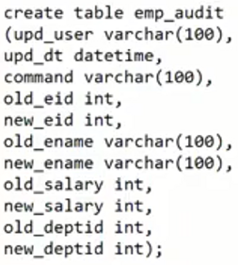
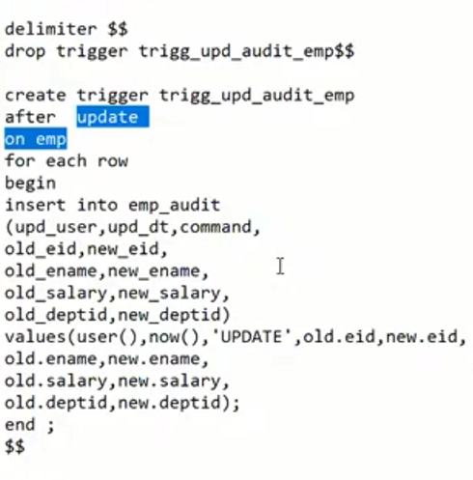

In insert old value become null
In delete new value becomes null
If we start transaction and do the update it rows got added in audit table then we do the rollback so transaction
Get rollback that means trigger didn’t run as it run when emp got updated . In Entire transaction both update emp and Insert audit ran so if rollback everything get undo ,it follows Atomicity of ACID either fully committed or rollback

Slide 77
Normalization Vs Denormalization
Normalization - Process of breaking big tables into multiple smaller tables to reduce data redundancy and eliminate DML anomalies. Disadvantage is select queries become slow because you would need to perform multiple joins. Generally, normalization is used for OLTP systems.
Denormalization- Process of combining multiple small tables into few big tables to increase data redundancy in order to increase the performance of select queries. Generally, denormalization is used for OLAP systems. Disadvantage is redundancy of data.

Slide 78
OLTP vs OLAP
OLTP- Online Transactional Processing
Database is optimized for transaction- DML Commands
OLTP databases are highly normalized may be up to 4th or 5th NF
OLAP- Online Analytical Processing- Datawarehouse
Database is optimized for mainly SELECT commands
They are only normalized up to 2nd or 3rd NF

Slide 79
Types of tables in OLAP
Dimensions
A dimension tables consists of dimensions of the fact. Data in dimension tables doesn’t change very frequently
Facts/Measures
Actual facts about your dimension. Data in the fact table changes very frequently

Slide 80
Retail Industry
Sales -- id , name, Measures
Store --id, name, doesn’t change frequently
Customer -- doesn’t change frequently
Salesperson -- doesn’t change frequently
Products -- doesn’t change frequently

Slide 81
OLAP – Datawarehouse Data Models
Dim_Store
StoreID
StoreName
Address
Star Schema- 2NF
You will have dimension and fact tables. The relationship will exists only between a dimension table and a fact table which means you cannot have a relationship between any two dimension or any two fact tables
Dim_Product
ProductID
ProductName
Price
Category
Subcategory
Fact_Sales
Sales
ProductID
SalespeopleID
CustomerID
StoreID
Qty
Dim_customer
CustomerID
CustFristName
lastName
Contact Details
Product id will determine sub-category and category is directly dependent on sub-category
Dim_salespeople
SalepeopleID
Name
Contact Details
JoiningDate

Slide 82
OLAP – Datawarehouse Data Models
Dim_Store
StoreID
StoreName
Address
Snowflake Schema- 3NF
You will have dimension and fact tables. The relationship can exists between a dimension table and a fact table and between any two dimension but not between any two fact tables
Dim_Category
SubCategory
Category
Fact_Sales
ProductID
SalespeopleID
CustomerID
StoreID
Qty
Dim_customer
Dim_Product
ProductID
ProductName
Price
Subcategory
Dim_salespeople

Slide 83
Star Schema | Snowflake Schema
Hierarchies for the dimensions are stored in the dimensional table. | Hierarchies are divided into separate tables.
It contains a fact table surrounded by dimension tables. | One fact table surrounded by dimension table which are in turn surrounded by dimension table
In a star schema, only single join creates the relationship between the fact table and any dimension tables. | A snowflake schema requires many joins to fetch the data.
Simple DB Design. | Very Complex DB Design.
Denormalized Data structure and query also run faster. | Normalized Data Structure.
High level of Data redundancy | Very low-level data redundancy
Single Dimension table contains aggregated data. | Data Split into different Dimension Tables.
Cube processing is faster. | Cube processing might be slow because of the complex join.
Offers higher performing queries using Star Join Query Optimization. Tables may be connected with multiple dimensions. | The Snowflake schema is represented by centralized fact table which unlikely connected with multiple dimensions.

Slide 84
Create a procedure which takes input a name of the database and returns the names of the tables inside the database along with the number of records in it

Slide 85
Indexes - are objects which are used to optimize search
Reading all the pages in table is called table scan or full table scan also(FTS)
ROWID- is the physical address of the row. It is available to read in Oracle but not in MySQL
ROWNUM-It is a sequential number assigned to result set

Slide 86
1,a1,100,1
2,a2,300,2
3,a3,400,3
4,a4,500,3
10
30
40
41
21
22
23
24
41
42
43,a43,600,4
44
51
52
53
54
61
62
63
64
57
58
59
60
81
82
83
84
90
91
92
93
76
77
78
79
301
44,201
79,202
93,203
Root
Select * from emp_load
Where eid=60
One Page here we stop
Non-clustered
B-Tree Index Level =3
201
202
203
4,101
23,102
41,103
44,104
54,105
60,106
64,107
79,108
84,109
93,110
No matter what you will search for only 3 page for any value here
One Page can store upto 8KB
Intermediate Levels
Leaf
106
107
108
109
101
102
103
104
105
110
1,RID
2,RID
3,RID
4,RID
10,RID
21,RID
22,RID
23,RID
24,RID
30,RID
40,RID
41,RID
41,RID2
42,RID
43,RID
44,RID
51,RID
52,RID
53,RID
54,RID
57,RID
58,RID
59,RID
60,RID
61,RID
62,RID
63,RID
64,RID
76,RID
77,RID
78,RID
79,RID
81,RID
82,RID
83,RID
84,RID
90,RID
91,RID
92,RID
93,RID

Slide 87
B-Tree Indexes
Clustered Index- Entire row of the table is stored in the leaf level of the Index. Since the entire row is stored in the leaf you cannot create more than 1 clustered index on a table
In MySQL, for INNODB tables when you create a primary key a unique clustered index is created on the table automatically
When a clustered index is created then internal structure of the table is dropped
Only way to create clustered index is primary key
Non-Clustered Index- only the ROWID is store along with index column in the leaf level. Table can have multiple non-clustered indexes. When ever you create a unique key in the table a unique non-clustered index is added automatically

Slide 88
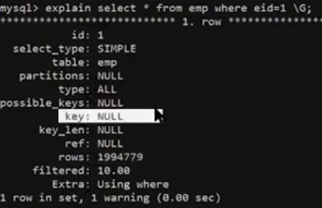
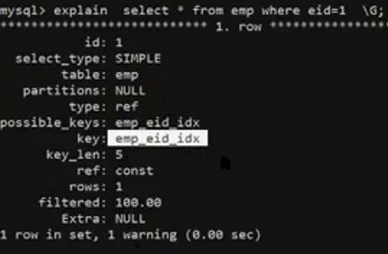

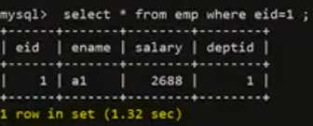
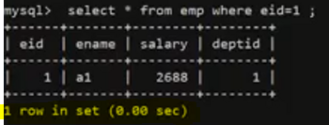

Explain –It show the query plan
Possible key – if it has index
In there is no key or key=NULL means its full table scan
Creating index will improve the performance

Slide 89
Table Storage Engines (MySQL) show table status like 'emp' \G;
InnoDB – Default Engine from Version 5.1
MyISAM- Default Engine prior to version 5.1
CSV
Archive
Memory
Select version()
Storage Engine is like type of table you create It will define what feature it will support

Slide 90
INNODB
Supports Transaction
Fully ACID Compliant
Foreign Key
Log file and Data File (Consistency and Durability
Clustered Indexes
Can perform Insert,update, delete etc.
Default Engine

Slide 91
MyISAM- create table t_myisam (id int) engine=myisam;
Doesn’t support Transaction
Doesn’t support Foreign Key
No Log file
Has Data File
Can perform Insert,update, delete etc.
No Clustered Indexes
Not Default Engine

Slide 92
CSV- create table t_csv (id int not null, name varchar(100) not null) engine=csv;
Doesn’t support Transaction
Doesn’t support Foreign Key
No Log file
Has Data File with CSV format
All columns should be defined as not null columns for CSV engine
Can perform Insert,update, delete etc.
No Clustered Indexes
Not Default Engine
Flush table table_name --- it flush/delete the cache memory of the table , will read the data again from data file
Repair table table_name to repair the corrupted file check table t_csv

Slide 93
archive- create table t_archive(id int,name varchar(100)) engine=archive;
Doesn’t support Transaction
Doesn’t support Foreign Key
No Log file
Has Data File
Can only perform Insert and select
Delete,update, truncate not allowed
No Clustered Indexes
Not Default Engine

Slide 94
Memory- create table t_memory(id int,name varchar(100)) engine=memory;
Doesn’t support Transaction
Doesn’t support Foreign Key
No Log file
No Data File which means data is removed when ever the server restarts
No Clustered Indexes
Can perform Insert,update, delete etc.
Not Default Engine

Slide 95
Codd’s Rules
• 1985
• Proposed to test DBMSs for confirmation to concept of Codd’s Relational model
• Hardly any commercial product follows all
• Oracle = 8 1/2 out of 12.
Rule Zero
• For a system to qualify as an RDBMS it must be able to manage its databases entirely through its Relational capabilities.
• The other 12 rules derive from this rule.
Rule 1: Information Rule
• All Information (including metadata) is to be represented as data stored in cells of tables. (Information schema store all the info about metadata-what tables how many tables, col etc)
• The rows and columns have to be strictly unordered.

Slide 96
Rule 2: Guaranteed Access
• Each unique piece of data (atomic value) should be accessible by : Table_Name + Primary Key (Row) + Attribute (Column)
• Violation: Ability to directly access via pointers
Rule 3: Systematic treatment of NULL
• NULLs may mean: Missing data, Not applicable, No value
• Should be handled consistently - Not Zero or Blank
• Primary keys — Not NULL
• expressions on NULL should give NULL
Rule 4: Active On-Line Catalog
• Database dictionary (Catalog) to have description of the Database (Catalog is nothing but information schema in mysql)
• Catalog to be governed by same rules as rest of the database
• The same query language to be used on catalog as on the application database

Slide 97
Rule 5: Powerful language
• One well defined language to provide all manners of access to data
• Example: SQL
• If file supporting table can be accessed by any manner except a SQL Interface, then a violation
Rule 6: View Updation Rule
• All views that are theoretically updatable should be updatable
• View = ”Virtual table”, temporarily derived from base tables
• Example: If a view is formed as join of 3 tables, changes to view should be reflected in base tables
• Not updatable: View does not have NOT-NULL attribute of base table
• Problems with computed fields in view e.g. Total Income = White income + Black income
Rule 7: Relational level operations
• There must be insert, update, delete operations at the level of Relations
• Set operations like Union , Intersection and Minus should be supported
Rule 8: Physical Data Independence
• The physical storage of data should not matter to the system
• If say, some file supporting table was renamed or moved from one disk to another, it should not effect the applications.
You can check data file from Show variables like ‘datadir’;

Slide 98
Rule 9: Logical Data Independence
• If there is change in the logical structure (table structures) of the database the user view of the data should not change
• implemented through views. Say, if a table is split into two tables, a new view should give result as the join of the two tables
• Difficult rule to satisfy
Rule 10: Integrity Independence
• The database should be able to enforce its own integrity rather than using other programs
• Integrity rules = Filter to allow correct data, should be stored in Data Dictionary
• Key and check constraints, triggers etc should be stored in Data Dictionary
• This also makes RDBMS independent of front end --in info schema you have table called check_constraint
Rule 11: Distribution Independence
• A database should work properly regardless of its distribution across a network
• This lays foundation of Distributed databases
• Similar to Rule8 only that applies to distribution on a local Disk
Rule 12: Nonsubversion Rule
• If low level access is allowed to a system it should not be able to subvert or bypass integrity rules to change data from file
• This may be achieved by some sort of locking or encryption
• Some low level access tools are provided by vendors that violate these rules for extra speed

