Slide 1
SHUBHAM KUMAR
SW TEST ENGINEER
AMDOCS (GURUGRAM)

Slide 2
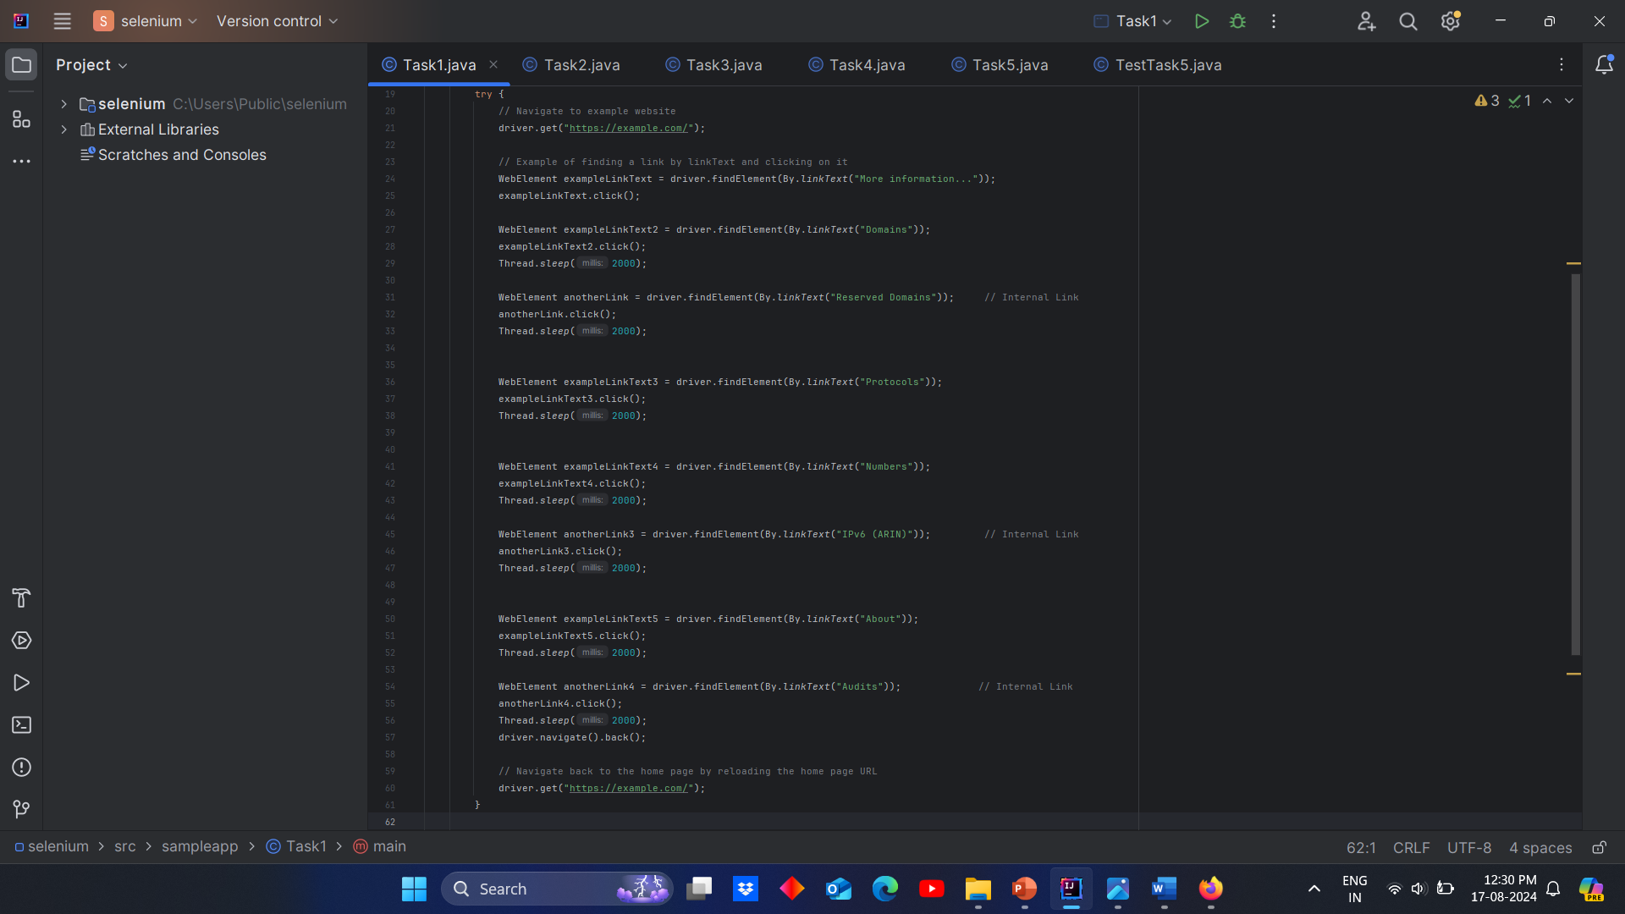
1.Example Website

Slide 3
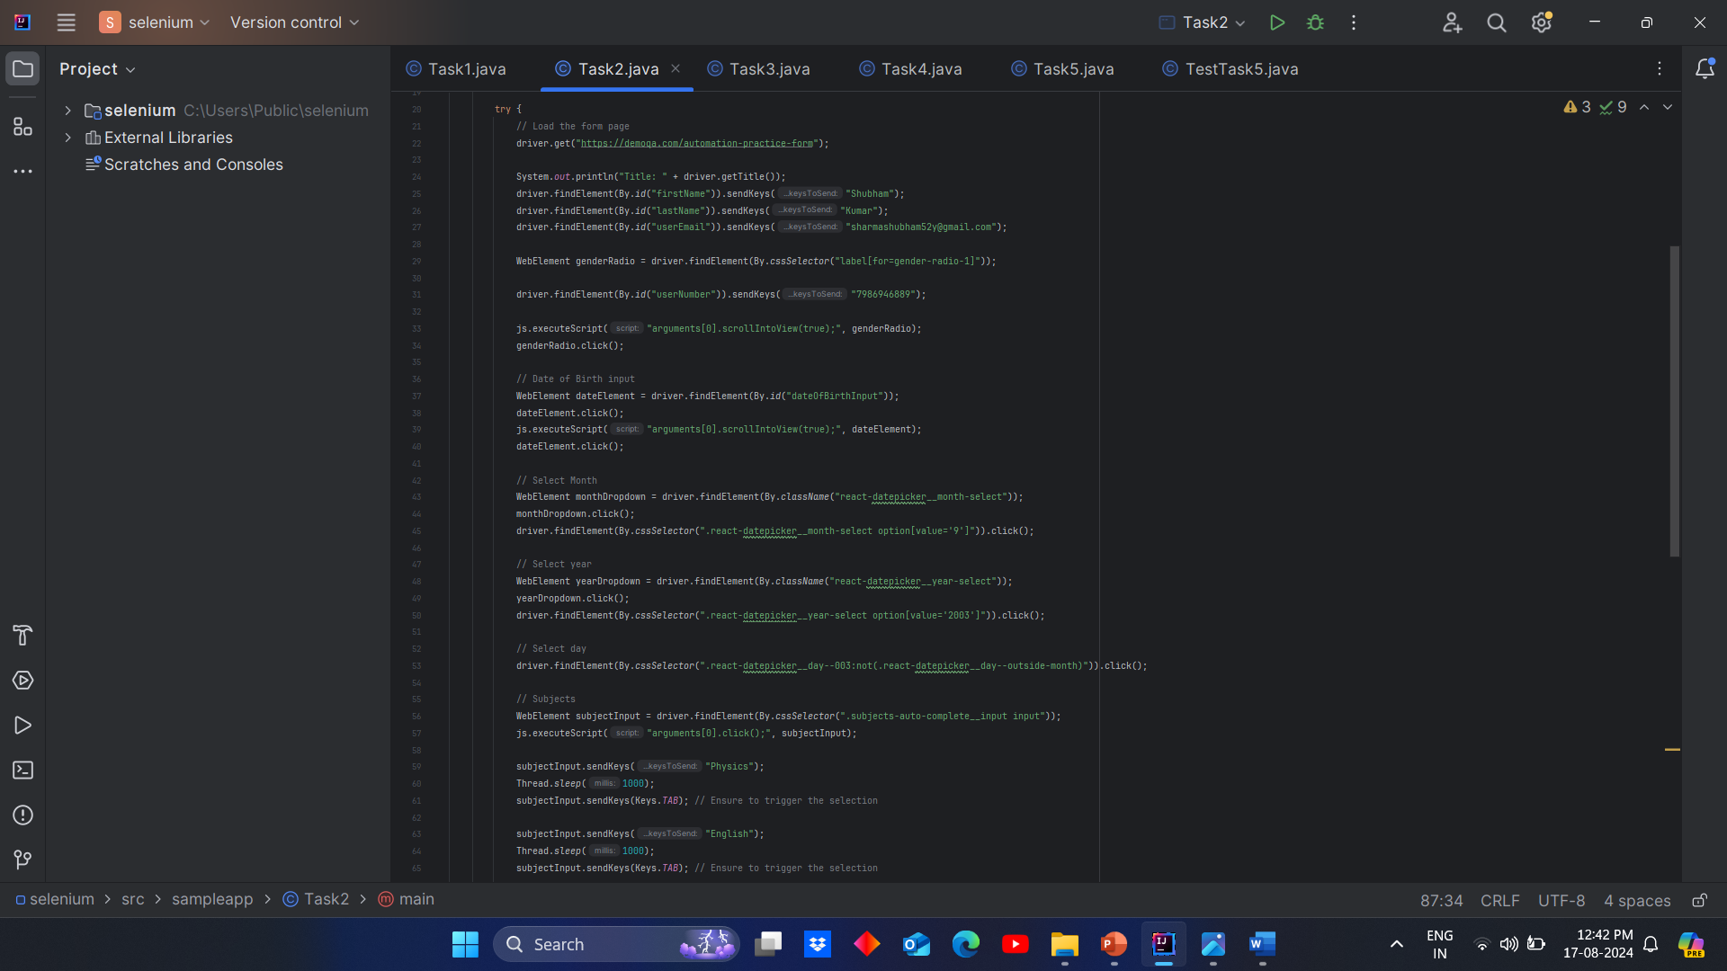
2.Demo QA Form Page

Slide 4
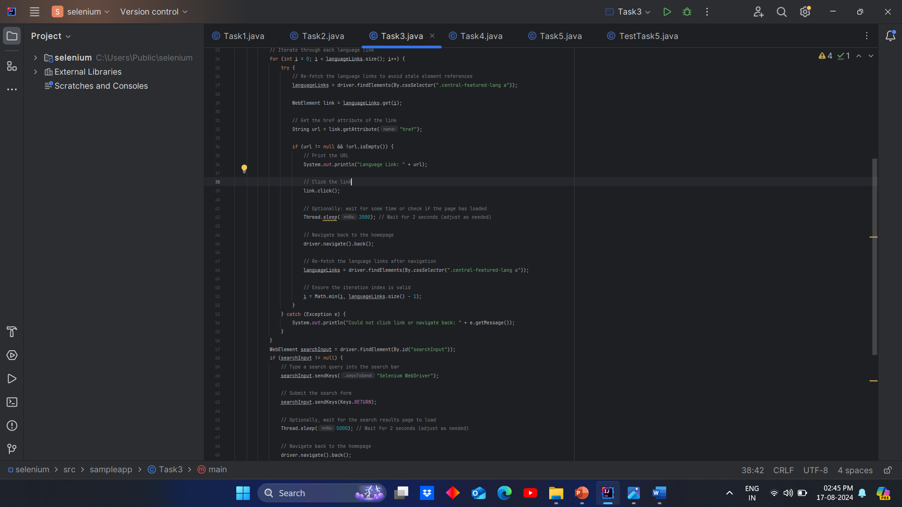
3.Wikipedia Main Page

Slide 5
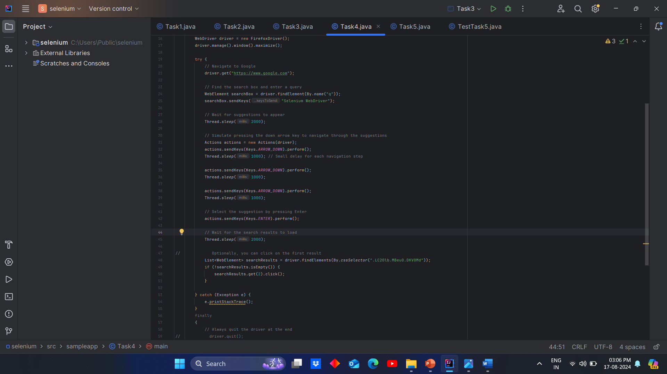
4.Google Search Page

Slide 6
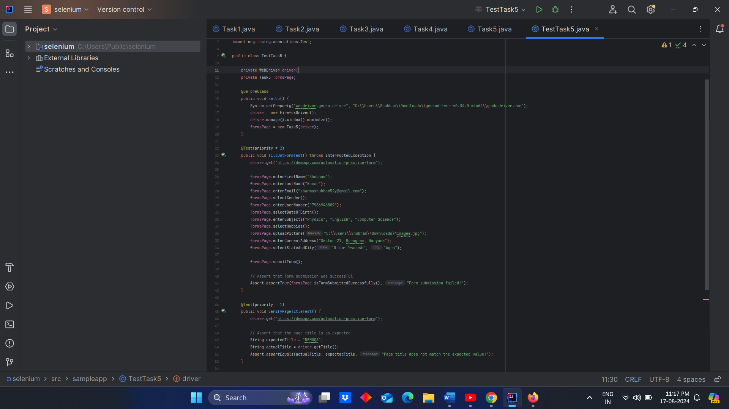
5.Demo QA Using POM

Slide 7
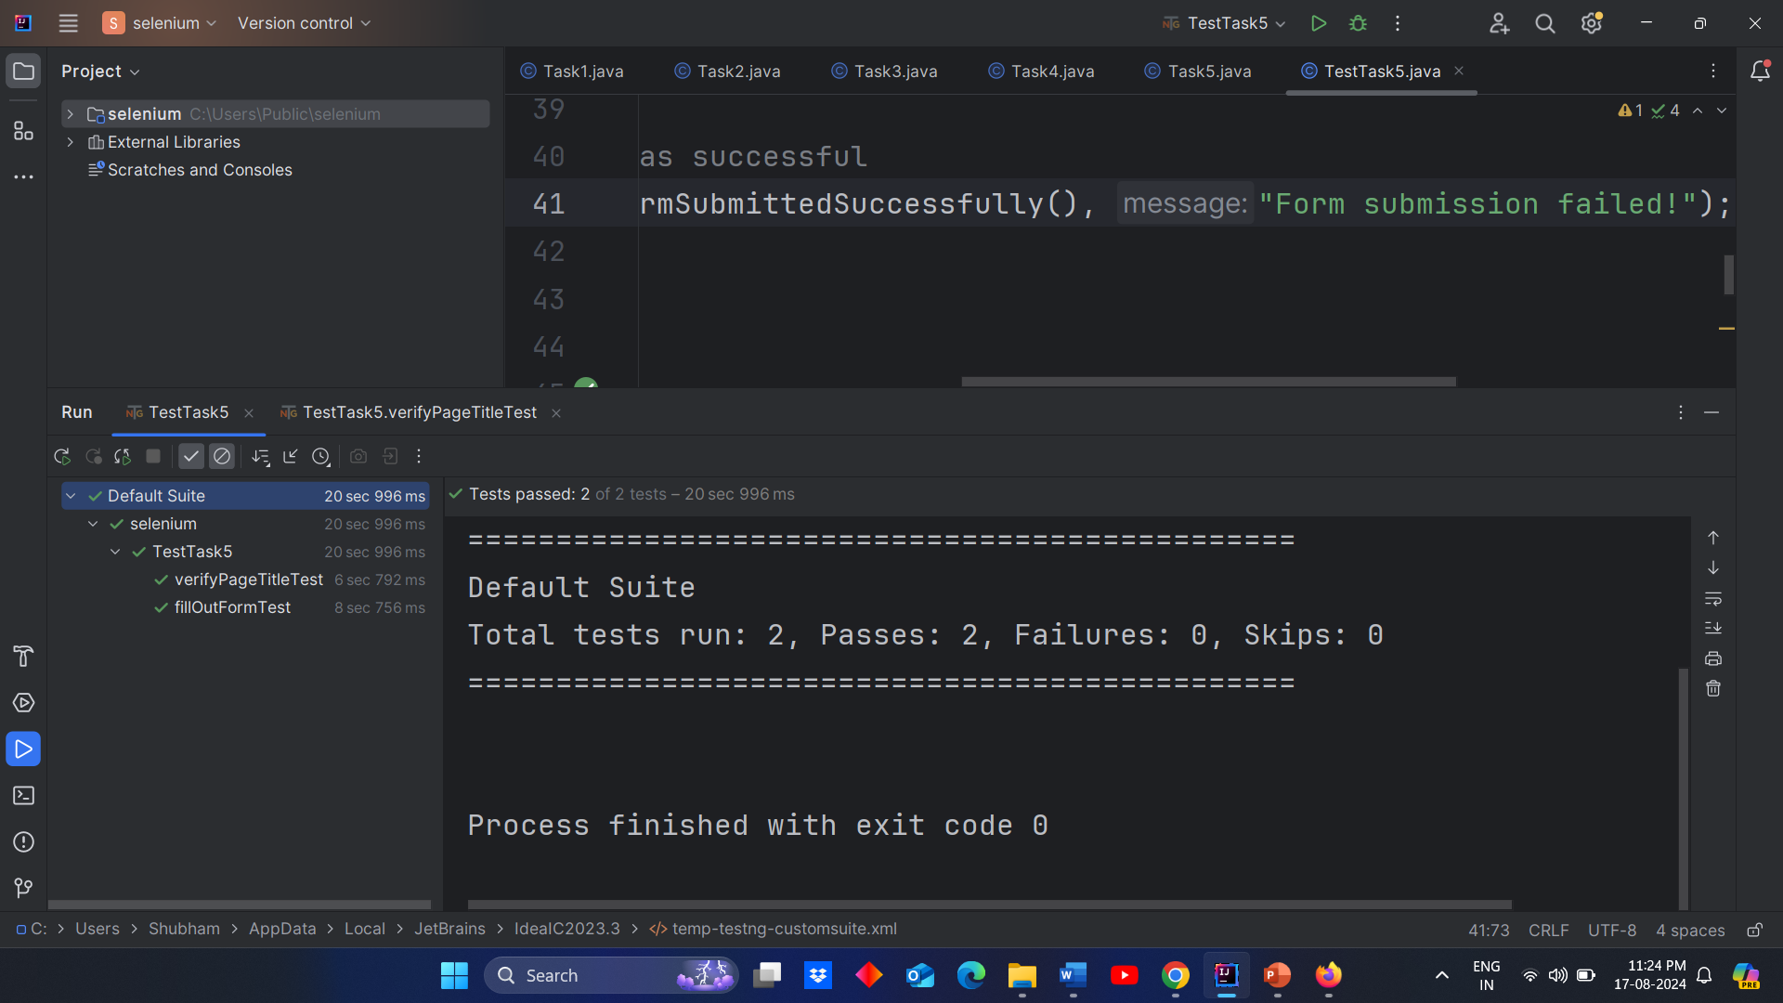
Output:

Slide 8
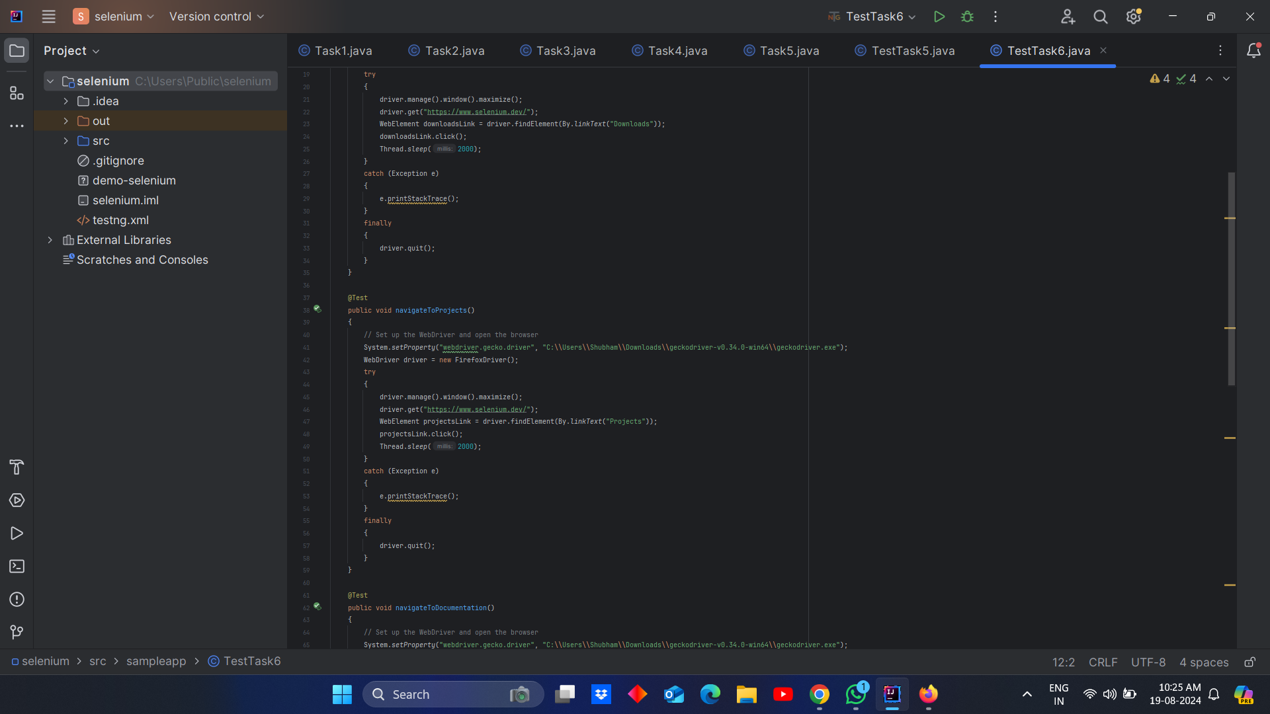
6.Selenium Debugging

Slide 9
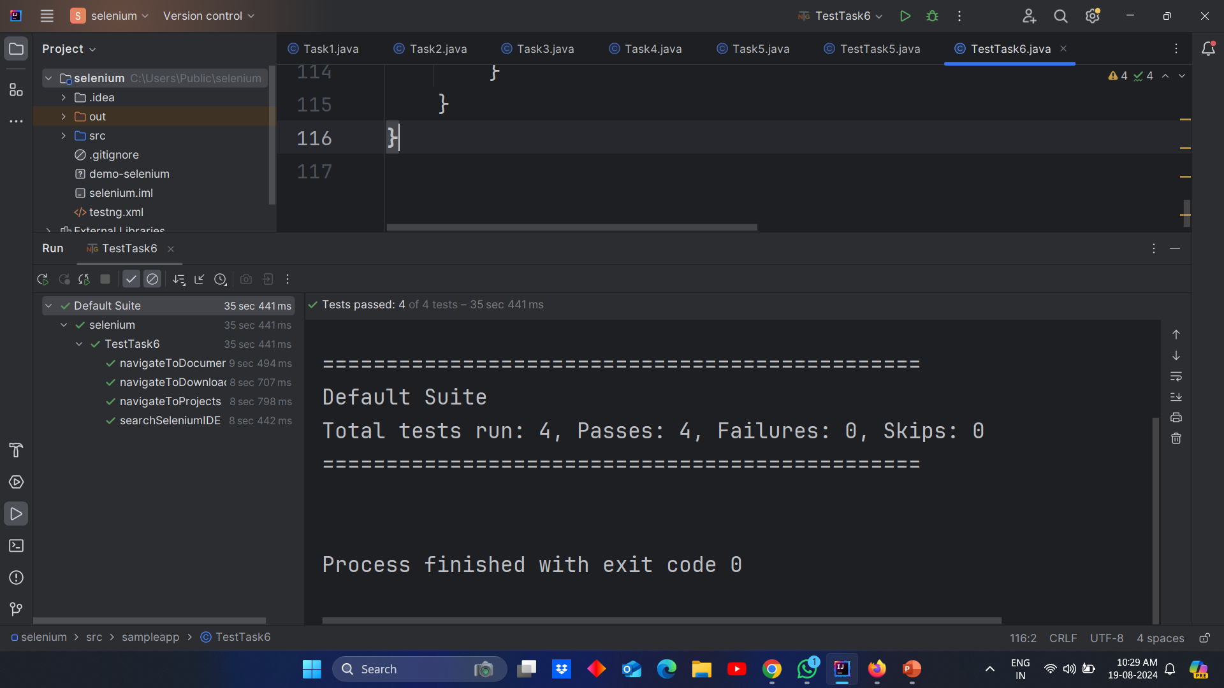
Output:

Slide 10
Thank You

