Slide 1

Seminar Report:-
Image Colorization
Using Deep Learning
By:- Shubh D Kawa
U21EC011
B.Tech III, 5th Semester
Guide:- Dr. Kishor Upla

Slide 2
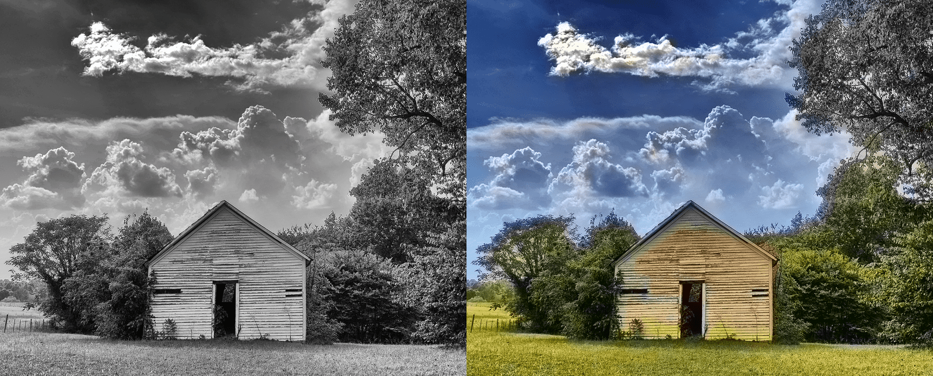
What is Image Colorization?
https://learnopencv.com/convolutional-neural-network-based-image-colorization-using-opencv/

Slide 3
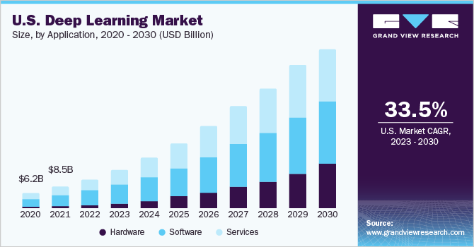
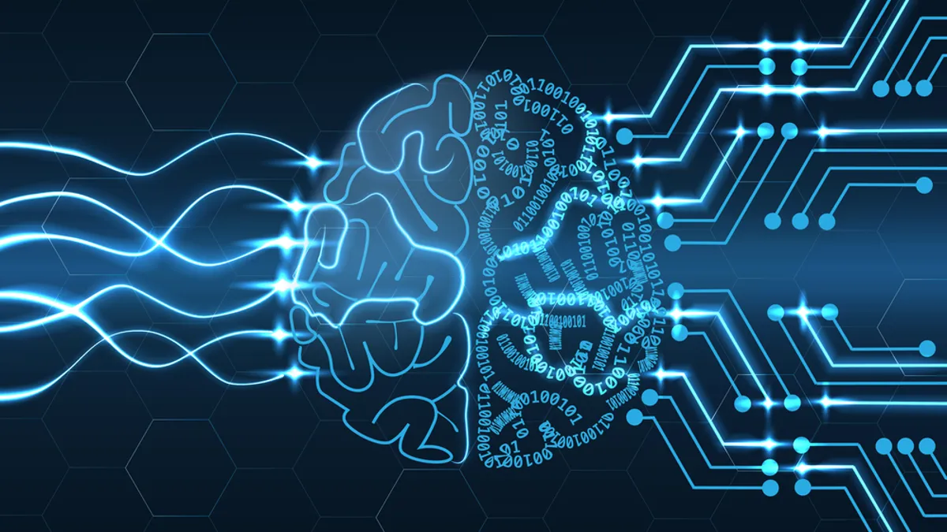
WHAT is Deep Learning?
https://www.grandviewresearch.com/industry-analysis/deep-learning-market
https://www.zdnet.com/article/deep-learning-the-interest-is-more-than-latent/

Slide 4
Recent Works
AUTOENCODERS
2.GENERATIVE ADVERSARIAL NETWORKS

Slide 5
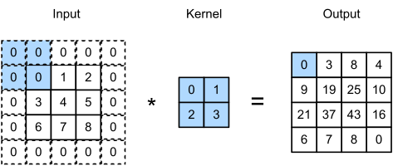
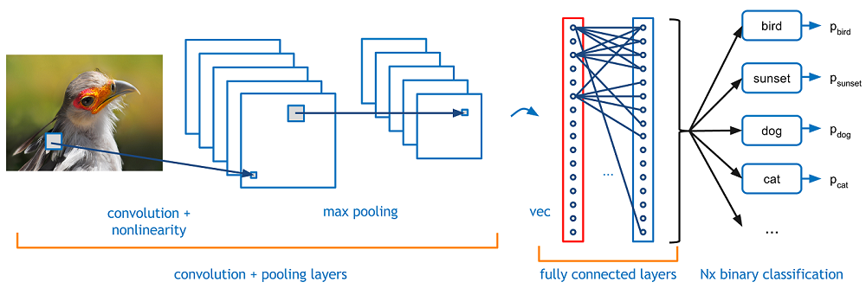
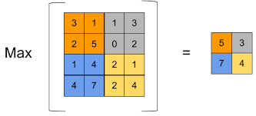
Convolutional Neural Networks:-
Example of Image Classification
https://towardsdatascience.com/covolutional-neural-network-cb0883dd6529
https://medium.com/codex/kernels-filters-in-convolutional-neural-network-cnn-lets-talk-about-them-ee4e94f3319

Slide 6
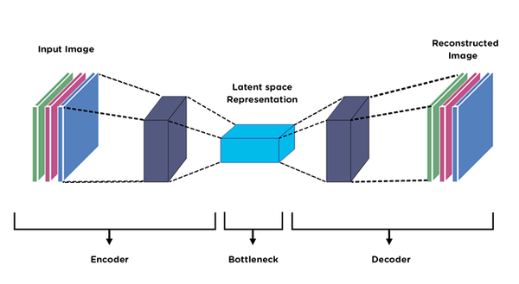
AUTOENCODERS:-
https://medium.com/@birla.deepak26/autoencoders-76bb49ae6a8f

Slide 7
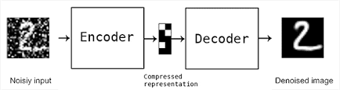
Applications of Autoencoders:-
1.Denoising Images
2. Anomaly Detection
3.Image Colorization
https://pyimagesearch.com/2020/02/24/denoising-autoencoders-with-keras-tensorflow-and-deep-learning/

Slide 8
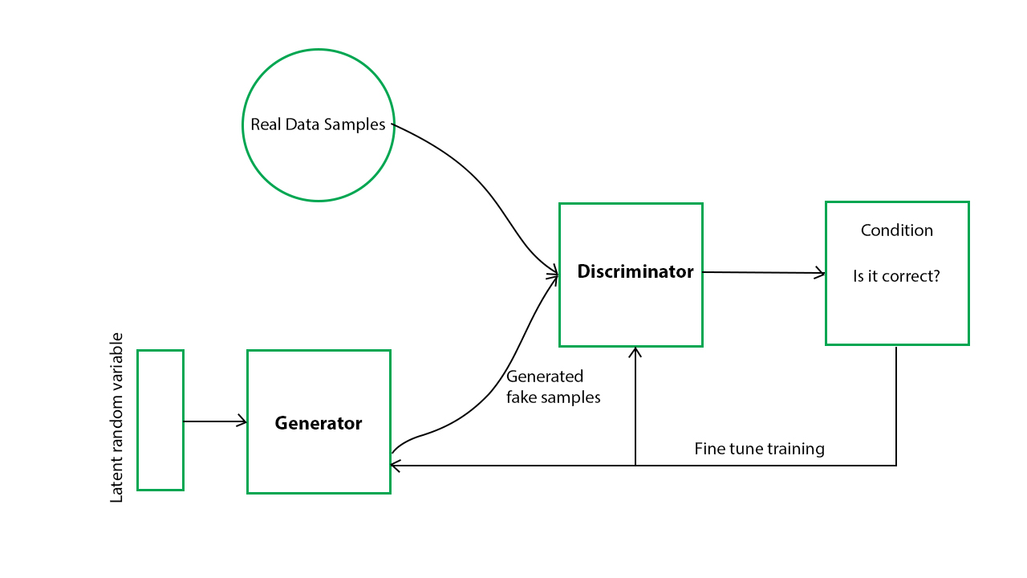
Generative Adversarial Networks:-
https://www.geeksforgeeks.org/generative-adversarial-network-gan/

Slide 9
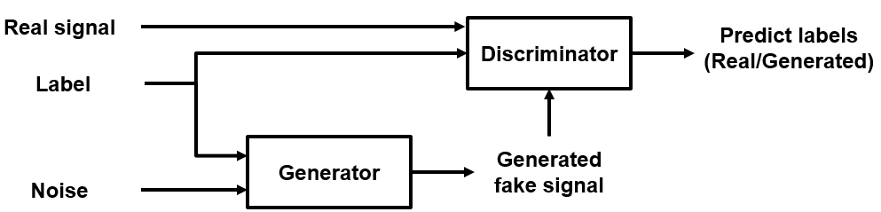
Conditional GAN:-
Takes advantages of the label that is provides
https://in.mathworks.com/help/deeplearning/ug/generate-synthetic-pump-signals-using-conditional-generative-adversarial-network.html

Slide 10

Implementation using Transfer Learning
https://www.flaticon.com/free-icon/implementation_8435960

Slide 11
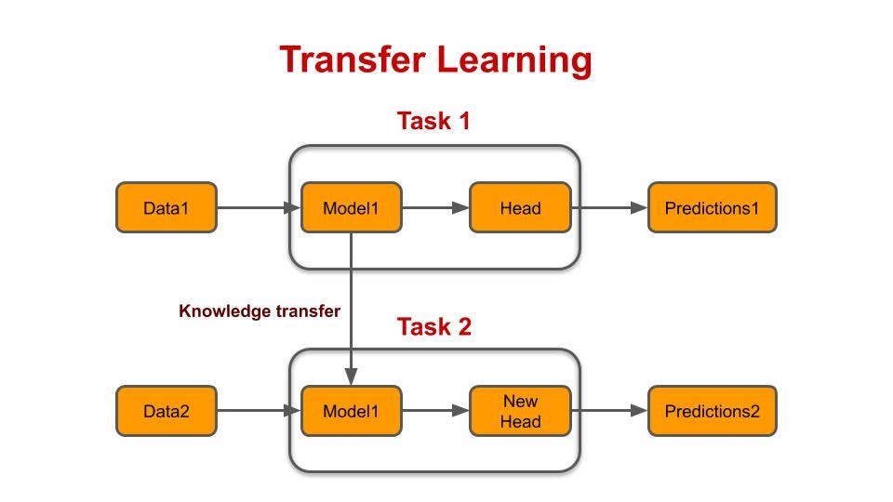
Transfer Learning:-
Why?
1.Speed and Efficiency
2.Limited Data Availability
3.Avoiding Cold Start
https://medium.com/modern-nlp/transfer-learning-in-nlp-f5035cc3f62f

Slide 12
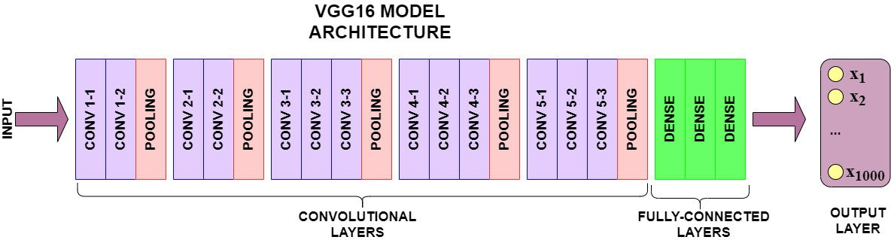
VGG-16
Deep Architecture
Uniform Architecture
Broad Applicability
https://www.learndatasci.com/tutorials/hands-on-transfer-learning-keras/

Slide 13
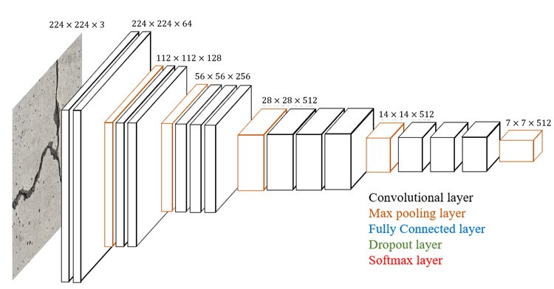
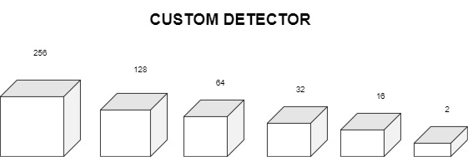
Model Architecture
https://www.researchgate.net/figure/Architecture-of-the-modified-VGG16-model_fig1_350828239

Slide 14
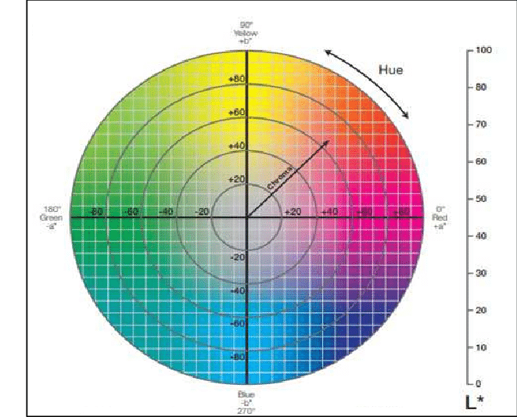
CIELAB:-
https://www.researchgate.net/figure/Theoretical-CIELAB-color-space-Hunter-1958_fig1_355763710

Slide 15
DATASETS:-
DATASET NO. | DESCRIPTION | NUMBER OF IMAGES
1 | Nature and Landscapes | 728
2 | Humans | 545
3 | Nature, Landscapes and Humans | 1273

Slide 16
Training Procedure
Model Specifications
Accuracy achieved for datasets
Optimizer | ADAM
Loss Function | Mean Squared Error
Metrics | Accuracy
Number of Epochs | 2000
DATASET | ACCURACY
Dataset 1 | 91.2%
Dataset 2 | 73%
Dataset 3 | 89.19%

Slide 17
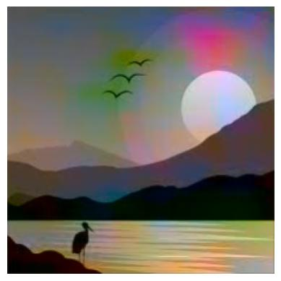
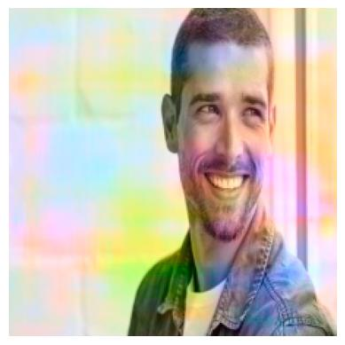
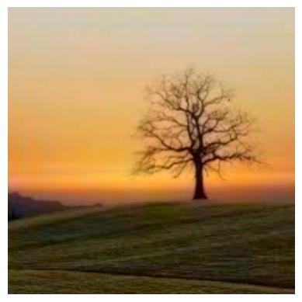
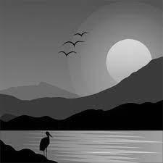
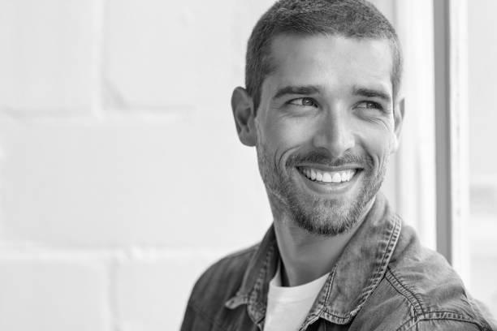
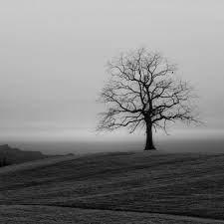
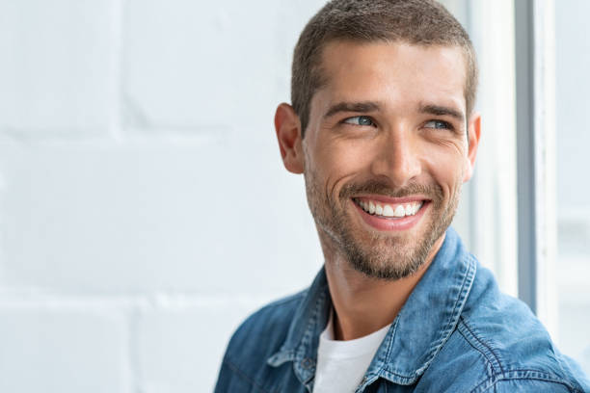
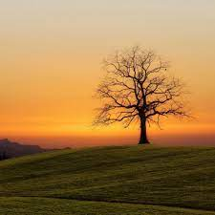
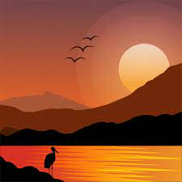
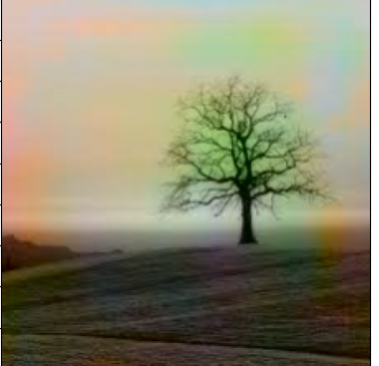
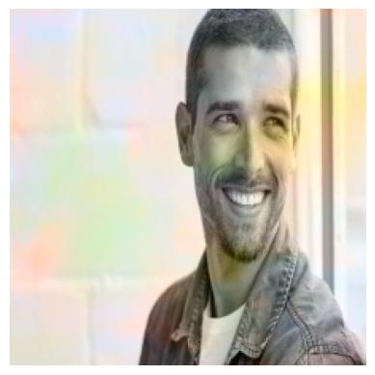
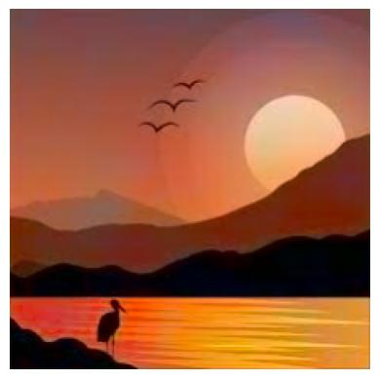
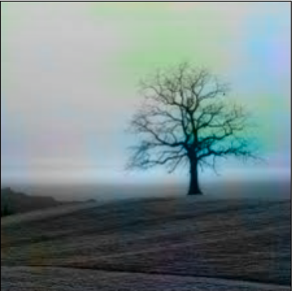
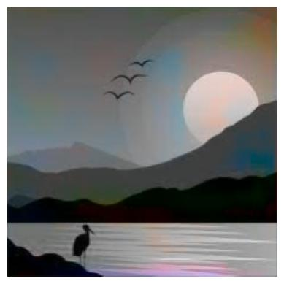
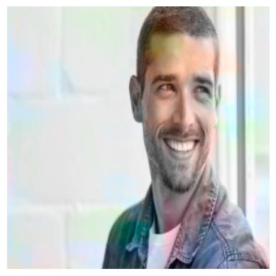
RESULTS:-
GrayScale Input | Dataset 1 | Dataset 2 | Dataset 3 | Ground Truth

Slide 18
Future Scope:-
Implementation on CIFAR-10
Implementation using GAN on CIFAR-10
Deploy on edge devices

Slide 19
Thank You!

