Slide 1
VLSID 2025 Design Contest Presentation
Hardware Software Co-Design of Multi Receiver Narrowband Spectrum Sensing for Cognitive Radio using Deep Learning
Microchip Platform
Team Sillycon
SVNIT, Surat

Slide 2
Presentation Flow
Spectrum Sensing Introduction
Dataset utilized and data preprocessing
Proposed CNN model
Hardware Platform
Hardware Design for CNN model
Driver Software implementation

Slide 3
Problem Statement
Hardware Software Co-Design of Multi Receiver Narrowband Spectrum Sensing for Cognitive Radio using Deep Learning

Slide 4
What is Spectrum Sensing?
Spectrum sensing is a process that detects the presence of licensed signals in a specific frequency band. It's a crucial step in cognitive radio-based dynamic spectrum management.
In this project, we focus on “Narrowband Spectrum Sensing”, which evaluates a single frequency and determines if a transmitter is active on that frequency.

Slide 5
Dataset utilized for this work
Our model is trained on the Simulation Training/Test Data for DS2MA Spectrum Sensing Model by Keunhong Chae, Sungkyunkwan University
Consists of QPSK modulated signals.
Samples 8 receivers, with sample length of 10000.
Signal present/absent labeled data is available for various SNR values.
Classified on the basis of noise present in signal (Gaussian/Impulsive)

Slide 6
Data Preprocessing
Our work utilizes the spectrum sensing scheme proposed by Keunhong Chae and Yusung Kim, Sungkyunkwan University
Initial data is (Nd, 8, Ns,2), Nd = length of dataset, Ns = Sample Length
Calculate Autocorrelation matrix [A], (Nd, 8, Ns, 2)
Calculate Cross Correlation matrix [C], (Nd, 28, Ns, 2)
Create [A C] matrix (Nd, 36, Ns, 2).
Further we randomly mixed and merged samples with gaussian and impulsive noise.
Samples with SNR -17dB were utilized for training and inference

Slide 7
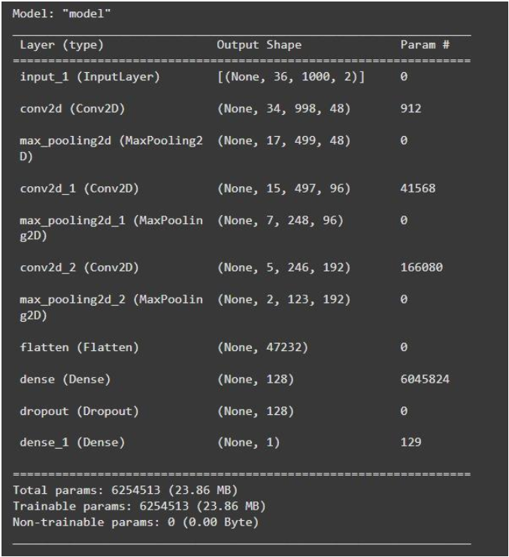
CNN Model Architecture

Slide 8
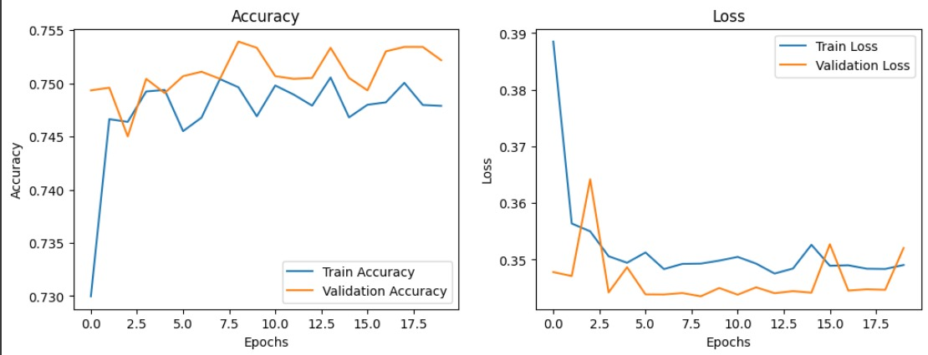
Model Training Results
After 20 epochs, achieved :
Training Accuracy upto 74.79% along with Train Loss of 34.84%.
Validation Accuracy upto 75.22% along with Validation loss of 35.21%.

Slide 9
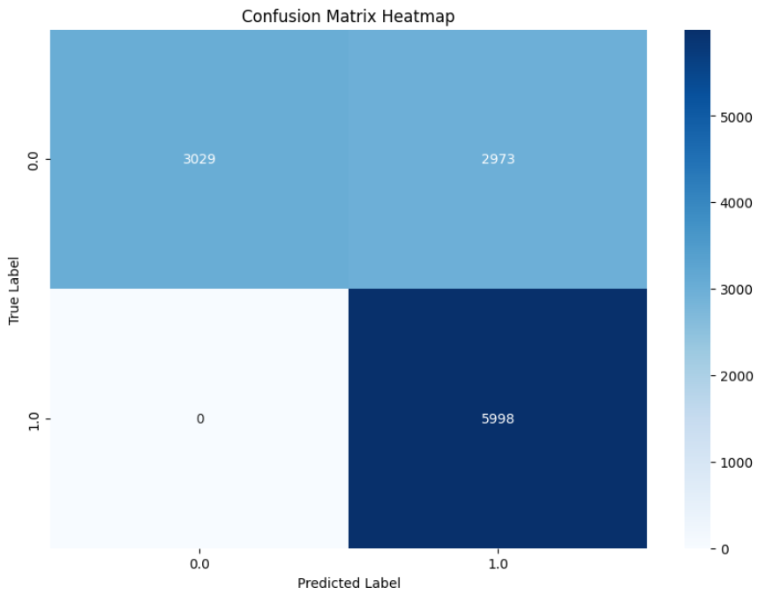
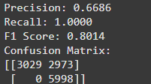

Validation metrices and Testing results:
Calculated metrices over validation set of 12000 samples:
Predicted over randomly chosen 100 test samples
Test Accuracy: 73.00%
Test Loss: 33.37%

Slide 10
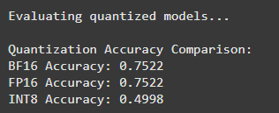
Model Quantization
The wide range of data in the dataset, ranging from 1 to e(-14), presents a unique challenge in quantizing the data
Traditional int8 quantization cannot preserve data and results in heavy loss in accuracy
We opted for BrainFloat (BF16), Floating Point(FP16), and INT8 quantization.
Preserves the 8bit Exponent of the FP32 format, resulting in same range of representable values.
Results in significant resource savings in terms of BRAM usage
Can be easily converted to and from FP32 format with low data loss

Slide 11
Hardware Platform
Microchip Icicle Kit with Polarfire® SoC
Onboard Microprocessor resources : 1xRV64IMAC core
4xRV64GC core
Onboard FPGA fabric resources : 254K logic elements
144 User IO
17.6 Mbit total RAM
784 Math Blocks

Slide 12
Hardware Design Goals
Accelerate the CNN by performing 3x3 Convolution operation on fabric using a custom 3x3 MAC unit.
IP should be able to run perform all operations in a CNN network upto the flatten layer including convolution and pooling with minimal control required from MSS side to reduce latency.
IP should be able to handle functions such as zero padding variable stride as specified by the model.

Slide 13
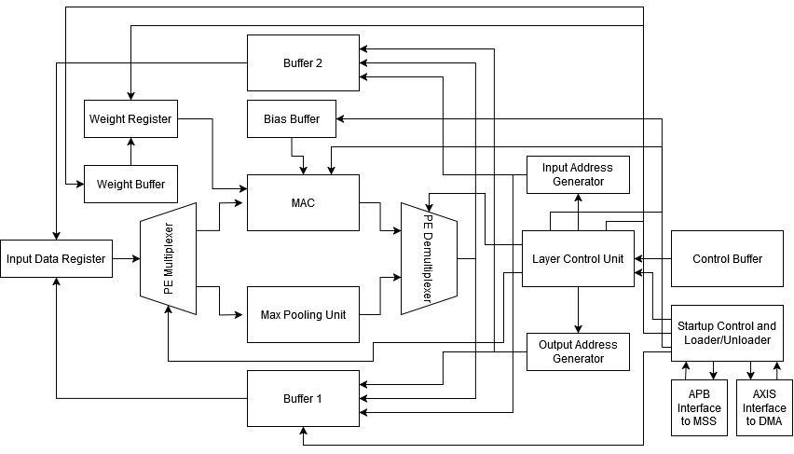
Design Iteration 1
Simplified Block Diagram, does not show all modules/connections

Slide 14
Design Iteration 1
Advantages:
Fully independent, once control, data, weight and bias buffers are loaded at startup, the design can run all successive layers specified in the control buffer without any further input from the MSS, freeing up MSS resources and reducing control latency
Limitations:
The use of 2 buffers that can completely store the input/output image, utilizes too much memory, and while can be used for smaller models, is unviable for our design

Slide 15
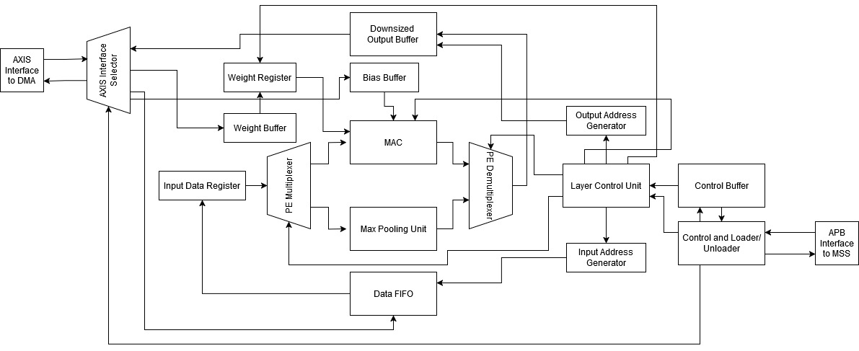
Design Iteration 2
Simplified Block Diagram, does not show all modules/connections

Slide 16
Design Iteration 2
Changes from Design Iteration 1:
Buffer 1 is replaced with a FIFO, and during computation, instead of the full input data being available, only a section of the input data is available at a time. Allows us to downsize it to (36x4)
Buffer 2 is fixed as output buffer, and is downsized to hold the output for 1 kernel only. Output buffer is flushed to DDR after computation for every kernel.
Weight buffer is loaded from DDR at start of every layer.
Design now requires DDR memory access and MSS control signals after computation of every kernel.

Slide 17
Design Iteration 2
Advantages of Design Iteration 2:
Significantly reduced BRAM requirements, which allows design to handle larger inputs and heavier models with more weights.
Limitations:
Since DDR access is required, it may increase latency due to memory delays causing the design to wait.
The maximum size of input is still restricted by the size of the fixed output buffer. While output from PE can be immediately flushed to DDR to avoid this issue, it creates another challenge in handling multiple input channels. However, it meets the requirements for our model.

Slide 18
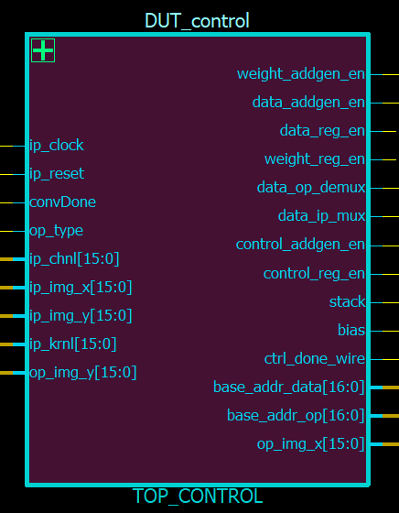
RTL Module Descriptions
We can now discuss the functionality of some key RTL modules of the design.
top_control: This module controls all address
generators and registers during the execution of a
layer. It loads the present layer configuration from
the control buffer and also signals the MAC unit
when to add the bias and signals the stacker unit
to stack the output

Slide 19
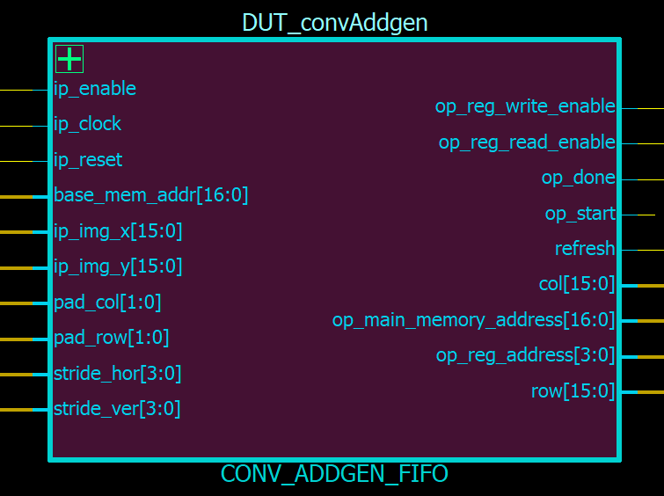
conv_addGen_fifo: This is the address generator
that is responsible for loading data from the
Buffer/FIFO into the data register. It can be
configured from the control buffer and can
handle varying stride lengths and padding for
Convolution, both of which can be adjusted independently for x and y axis. For pooling operations, the stride length is set to 3 for both x and y axis.

Slide 20
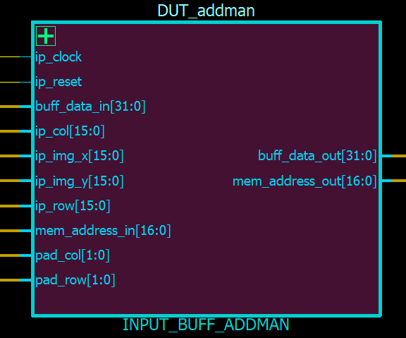
input_buff_addman: This module handles
Padding on the input side. While the address
generator generates the memory addresses
considering the zero padding for the image, the
image is not stored in the buffer with padding, thus the
generated address must be converted to correspond the actual address of the image data. The module accepts the image size in X and Y dimension, padding widths and the generated memory address and determines if the address belongs to the image or to a padded cell. It then either simply forwards 0 to the data register or converts the address and forwards the buffer value to the register

Slide 21
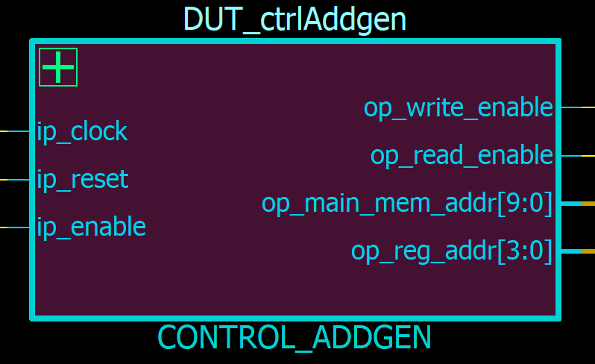
bias_addgen, weight_addgen, control_addgen:
These are similar modules are used to
transfer kernel bias, weights and layer
control information respectively to their
corresponding register (bias value is taken
directly from buffer, no register is present as it is not needed)

Slide 22
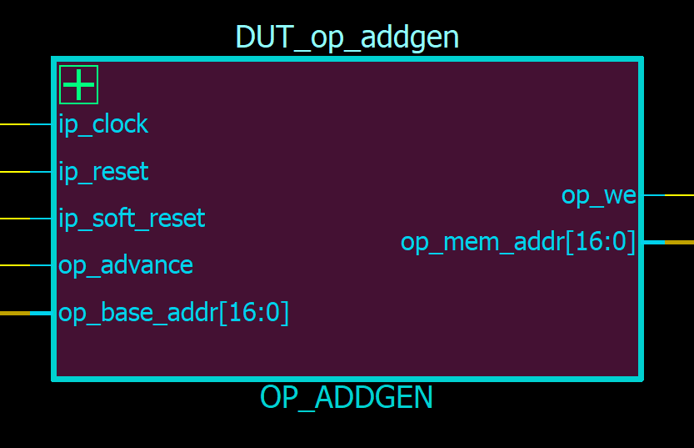
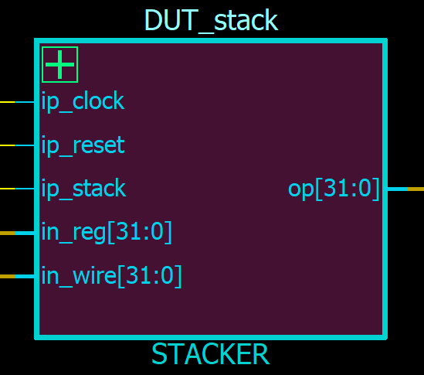
op_addgen: Handles writing the PE output to
the output buffer. It also forwards the write
Address to the stacker module.
stacker : In case of multiple input channels,
the convolution outputs of multiple channels
of the same kernel must be summed. Since the
best case throughput of the MAC is once every 3 clock cycles,
the module receives the write address two cycles before write data
is available, it then stores the existing data on the address, adds the
new data and then overwrites the write address with the sum

Slide 23
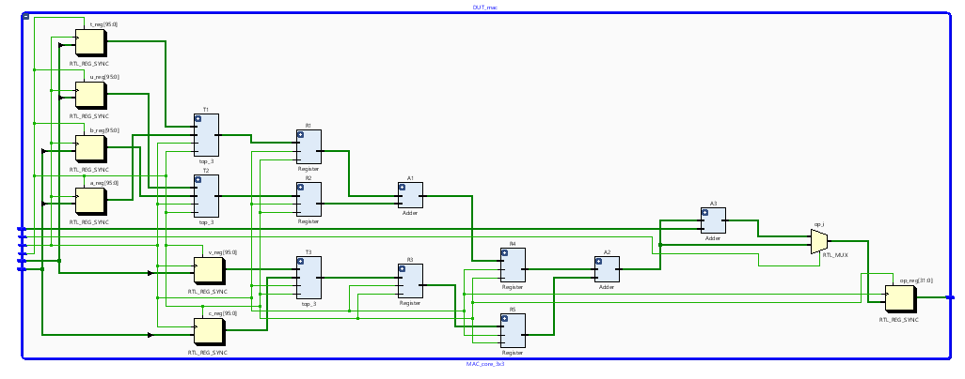
mac_core_3x3:

Slide 24
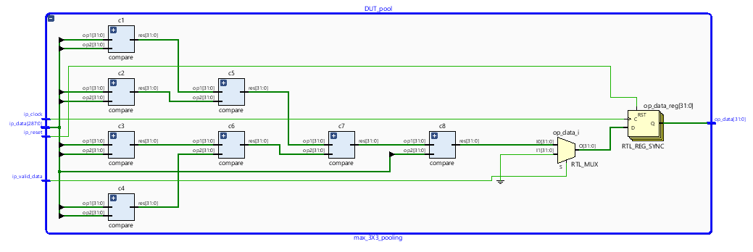
max_3x3_pooling:

Slide 25
Driver Software Implementation
The driver software for the module runs on the MSS application core. It utilizes the APB interface to send control signals to the module and the DMA instance to send data to the module via the AXIS interface.
The data to be sent to the module is initially included in the software in the form of .cpp files that are loaded into the DDR at the time of programming and debug. The application program itself is loaded into the L2 limited memory. The program is linked to the cpp files containing data through a header file.

Slide 26
Pseudocode
//pseudocode for loading control data, weights, biases and data
#define num_of_layers
#define layer_ip_channels
# define layer_kernels
DMA_init(base_address, instance address)
DMA_transfer(control_data_address, control_data_size, DDR_to_stream)
DMA_transfer(bias_data_address, bias_data_size, DDR_to_stream)

Slide 27
for(i=0;i<num_of_layers;i++){
DMA_transfer(weight_address, weight_size, DDR_to_stream)
for(j=0;j<layer_kernels[i];j++){
DMA_transfer(data_address, data_size, DDR_to_stream)
While(APB_module_statue!=Done){
wait
}
DMA_transfer(op_address, op_size, stream_to_DDR)
}
}

Slide 28
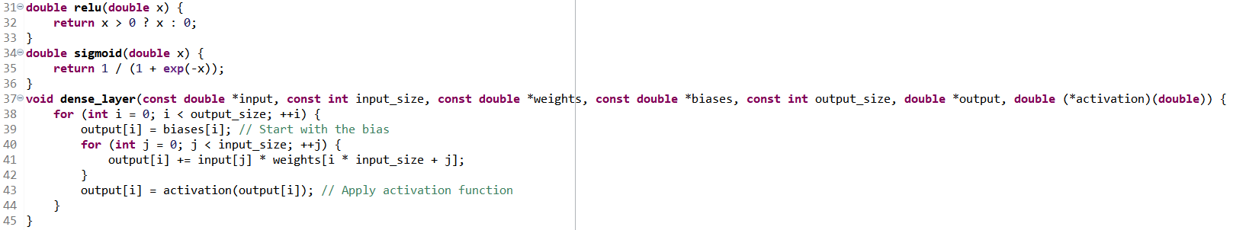
Dense Layer Implementation
Once the flatten layer output is calculated by the module, the dense layers are computed on the MSS. The relevant functions are implemented in C

Slide 29
Future Work
Implementing a multiple PE architecture to better utilize the parallelism available on FPGA
Implementing design macros that utilize the inbuilt DSP blocks present on the PolarFire SoC to improve resource utilization and efficiency

Slide 30
Thank You
Team Members:
Chaitanya Singh, BTech III, SVNIT
Shubham Kamble, BTech III, SVNIT
Samhita Patil, BTech III, SVNIT
Sohan Pagar, BTech III, SVNIT

