Slide 1
CREDIT EDA CASE STUDY
Shubham Kapur​

Slide 2
Categorical Univariate analysis for target 0

Slide 3
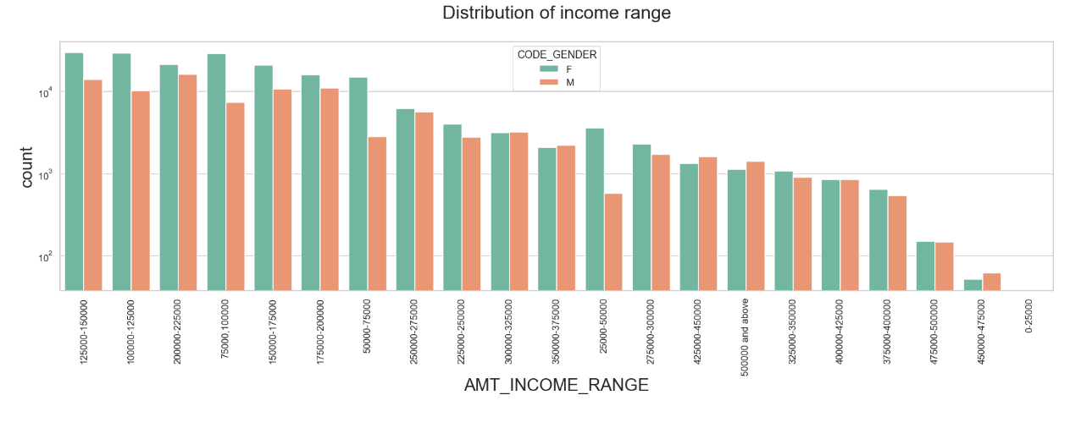
Distribution of Income range
Points to be concluded from the graph on the left side.
Female counts are higher than male.
Income range from 100000 to 200000 is having more number of credits.
This graph show that females are more than male in having credits for that range.
Very less count for income range 400000 and above.

Slide 4
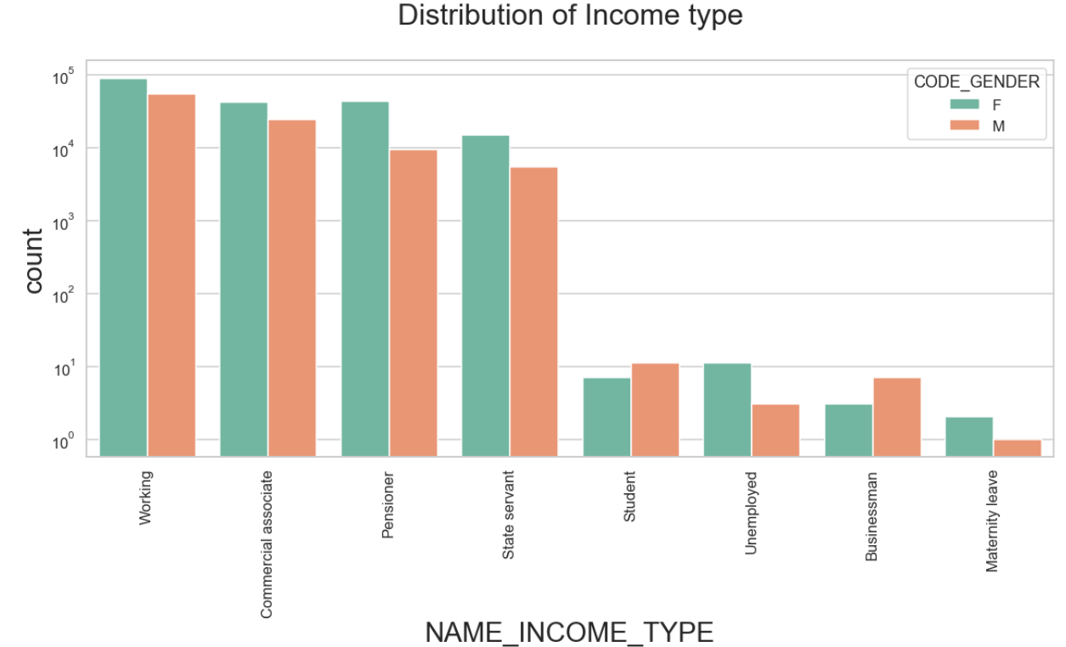
Distribution of income type
Points to be concluded from the graph on the left.
For income type ‘working’, ’commercial associate’, and ‘State Servant’ and ,’pensioner’, the number of credits are higher than others.
For this Females are having more number of credits than male.
Less number of credits for income type ‘student’ , ‘Businessman’ and ‘Maternity leave’ and ‘unemployed’

Slide 5
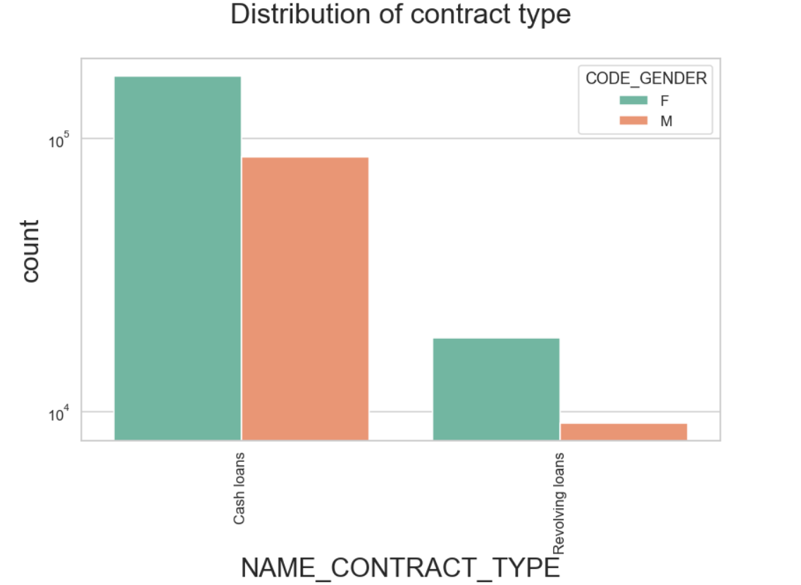
Distribution of Contract type
Points to be concluded from the graph on the left.
For contract type ‘cash loans’ is having higher number of credits than ‘Revolving loans’ contract type.
For this also Female is leading for applying credits.

Slide 6
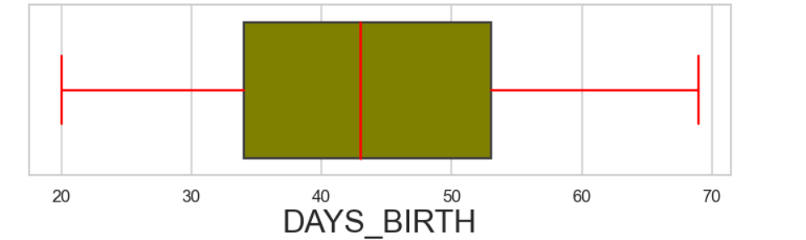
Distribution of Age Group
Points to be concluded from the graph on the left.
The age of clients is concentrated between 35 and 55.
With distribution of age between 20 – 68
The median age lies at 43

Slide 7
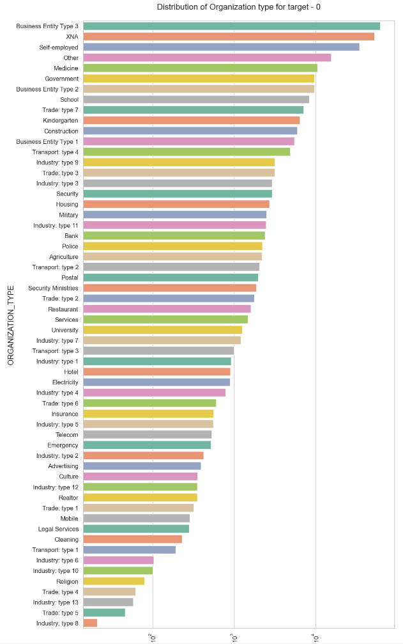
Distribution of organization type
Points to be concluded from the graph on the left.
The data is prepared for clients which don’t have any default payment history.
Clients which have applied for credits are from most of the organization type ‘Business entity Type 3’ , ‘Self employed’ , ‘Other’ , ‘Medicine’ and ‘Government’.
Less clients are from Industry type 8,type 6, type 10, religion and trade type 5, type 4.

Slide 8
Correlation of target 0

Slide 9
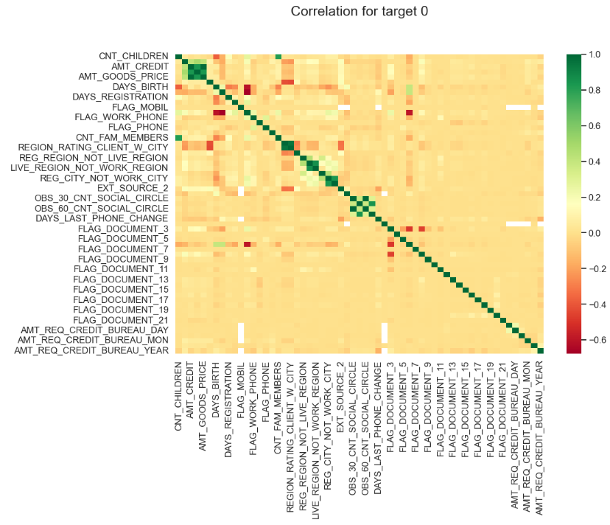
Correlation For target 0
Points to be concluded from the graph presented on left.
Credit amount is inversely proportional to the date of birth, which means Credit amount is higher for low age and vice-versa.
Credit amount is inversely proportional to the number of children client have, means Credit amount is higher for less children count client have and vice-versa.
Income amount is inversely proportional to the number of children client have, means more income for less children client have and vice-versa.
less children client have in densely populated area.
Credit amount is higher to densely populated area.
The income is also higher in densely populated area.

Slide 10
Bivariate analysis for type 0

Slide 11
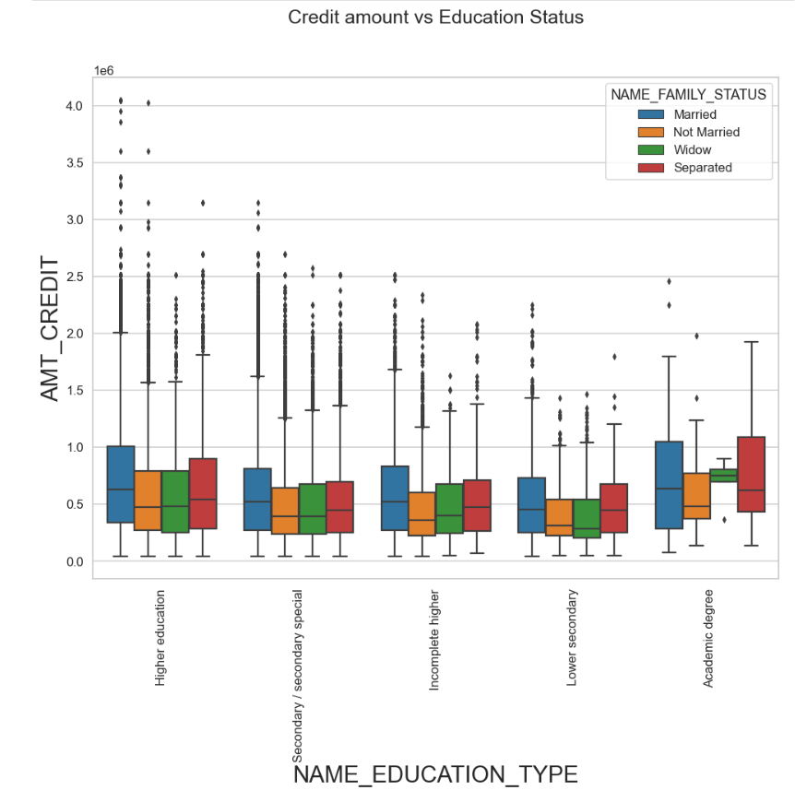
Credit amount vs Education Status
Few points can be concluded from the graph.
Family status of 'civil marriage', 'marriage' and 'separated' of Academic degree education are having higher number of credits than others.
Higher education of family status of 'marriage', 'single' and 'civil marriage' are having more outliers.
Civil marriage for Academic degree is having most of the credits in the third quartile.

Slide 12
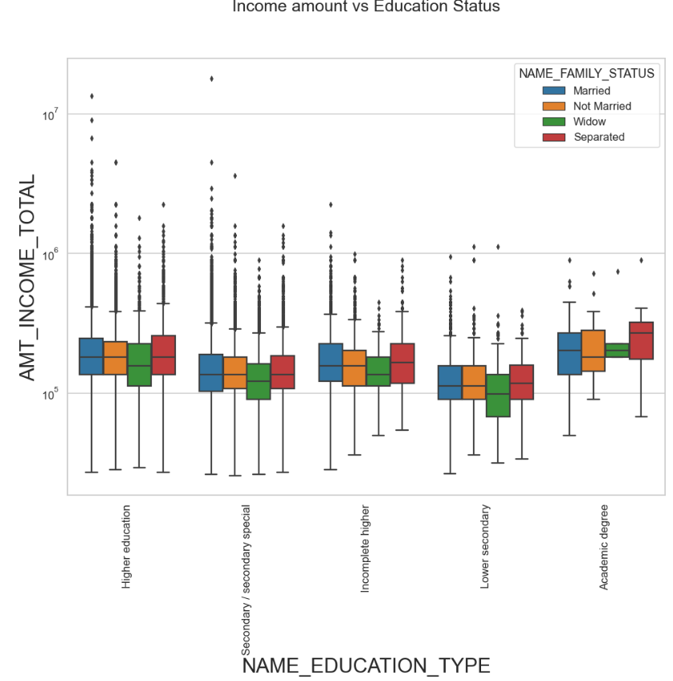
INCOME amount vs Education Status
Few points can be concluded from the graph.
For Education type 'Higher education' the income amount mean is mostly equal with family status. It does contain many outliers.
Less outlier are having for Academic degree but they are having the income amount is little higher that Higher education.
Lower secondary of civil marriage family status are have less income amount than others.

Slide 13
Bivariate analysis for type 1

Slide 14
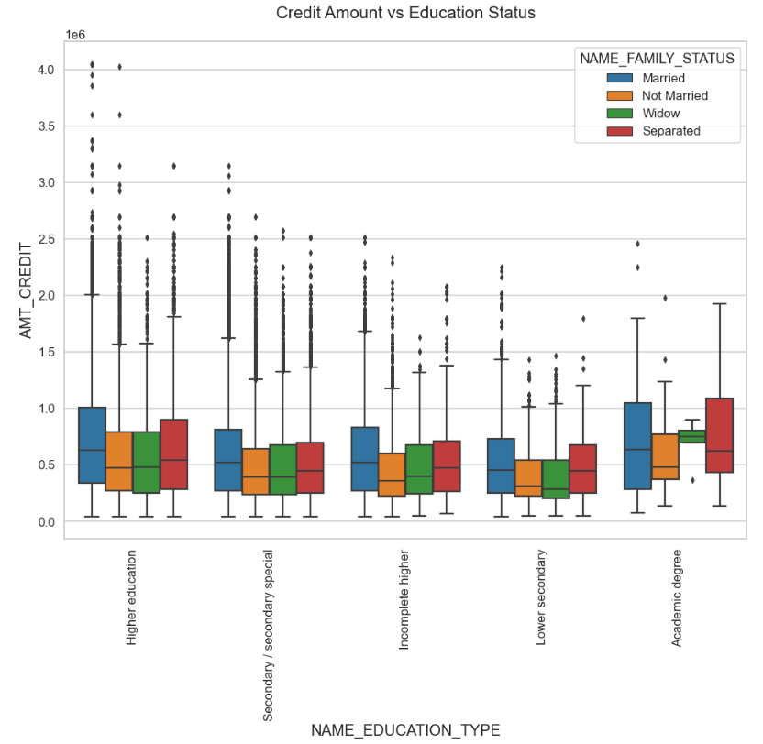
Credit amount vs Education Status
Few points can be concluded from the graph.
Quite similar from Target 0, we can say that Family status of 'civil marriage', 'marriage' and 'separated' of Academic degree education are having higher number of credits than others.
Most of the outliers are from Education type 'Higher education' and 'Secondary’.
Civil marriage for Academic degree is having most of the credits in the third quartile.

Slide 15
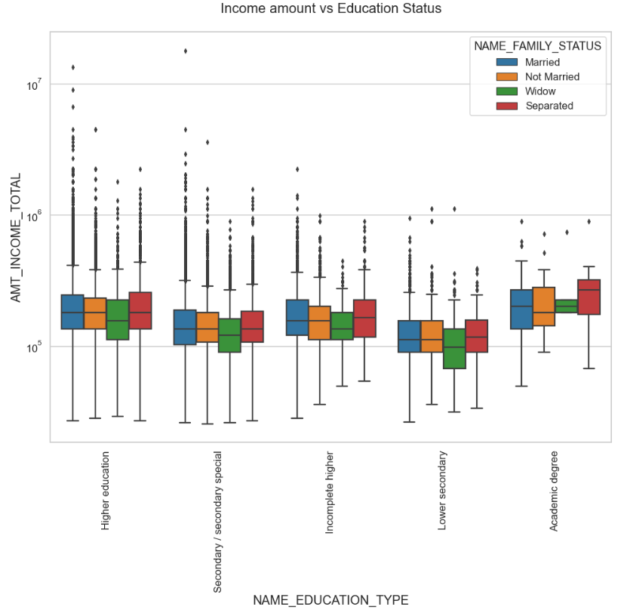
INCOME amount vs Education Status
Few points can be concluded from the graph.
Few points can be concluded from the graph.
Have some similarity with Target0, From above boxplot for Education type 'Higher education' the income amount is mostly equal with family status.
Less outlier are having for Academic degree but there income amount is little higher that Higher education.
Lower secondary are have less income amount than others.

Slide 16
Thank YOU

