Slide 1

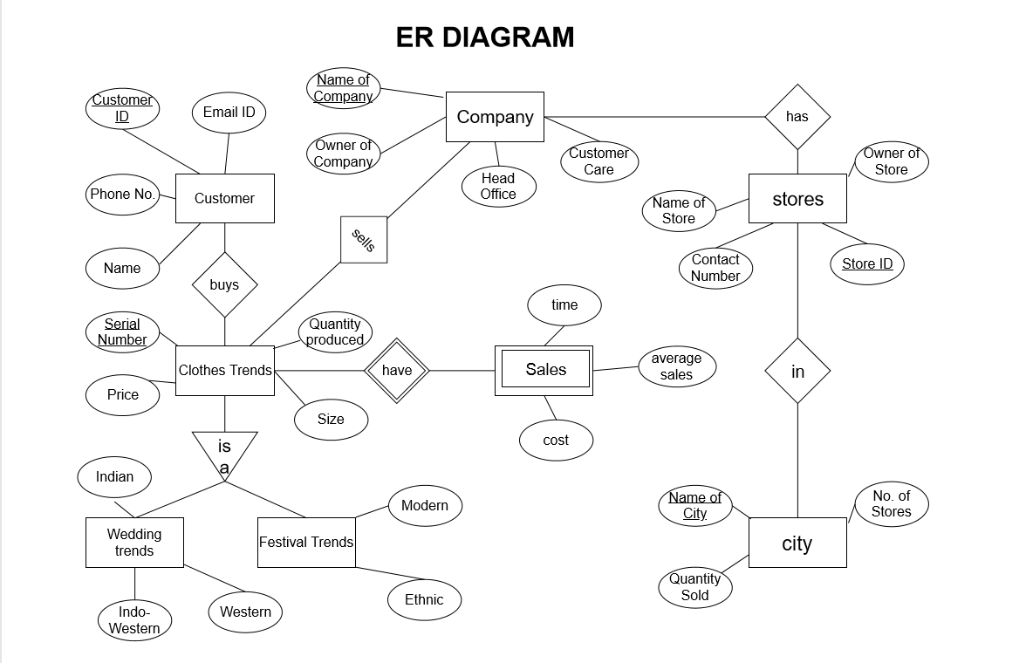
Clothing Sales Prediction Shubham Kejriwal & Vedant Mathur Sardar Patel Institute of Technology
Abstract
Project Scope
The previous year’s data is assessed on different aspects and the
coming year’s sales of different departments is shown. The sales prediction
are displayed depending on the cities and types of clothing. Each employee
can access this data from within work. The current topic is based on the data
from ‘MANYAVAR’ the traditional clothing company.
The given project shows us the monthly sales of different collections depending on seasons and occasions.
The projections shows are calculated using previous years data and any addition or removal will recalculate it.
Calculating further production and expenditure can be done easily with the given data.
Creating new data for any new editions is easily added and the changes are directly implemented to the collection library.
This application is exclusively made to lessen the expenditure of the company and make the analysis more efficient, Therefore, the scope of this project spreads to large extend as any product company in any stream can use it.
Inventory and raw materials depending on sales prediction to reduce excess expenditure
To automatically predict the data depending on any addition to product or edition or store
To check store profitability in a city
To set targets for the next year
To re-evaluate market strategies
The method to be used for basic sales prediction is the Regression
Analysis in which we are taking the sales as a dependent variable and
clothes, month and cities a the independent variable, since the changes in the sales is associated with change in time, clothes and city.
The database is used to see the changes in the independent variables
depending on their attributes. Also calculating the average sales due to a change in trend, month(occasion) or a particular region (city, stores).
The given site displays the different sales depending on the
independent variables of the previous years and is accessible to the
employees for any changes or updates in the pre-existing records or creating new ones. It will also show tentative sales forecasting for the company. All database is restricted to the employees only.
Technology Used
Front-end: HTML, CSS, JavaScript, Bootstrap
Middle-tier: PHP
Back-end: MySQL
https://www.manyavar.com/
https://www.kaggle.com/datasets
https://www.w3schools.com/

