Slide 1
Assignment 3 Agile Methodologies

Slide 2

User Story- Newspaper Management System
Shubham Jain(A00258743) Meet Mehta(A00258745) & Tarun Verma(A00258754)

Slide 3
1.
objective
Why did we focus so much resources in User Stories?

Slide 4
We believe that user stories are simple and beautiful way of clarifying product’s goal and functionality.
A collaboration of different parties-users, product owners, developers - gives a synergy effect and reveals users’ insights.

Slide 5
What was our aim while creating user stories
Delivering a product that the client really needs
Budget estimation
Time estimation
UI Design
In all we wanted to define use cases so that we could save time on coding and give clear tasks to developers

Slide 6


How we started
What we did first and how did we chose themes?

Slide 7
How we started
Reviewed Customer Requirements
Focused on each point listed in customer requirement document and tried to find out if there was something missing.
Interaction with customers.
Interacted with customers on more details questions on how the manual system was and who would work on system for what purpose and why.

Slide 8
Our process
Collected Customer Requirements
Present use cases to Customer
(NOW)
Review Requirements
Customer Interaction
Creating Account and Adding Team on Easy Backlog
Review Requirements and chose Themes
User Stories for each theme

Slide 9
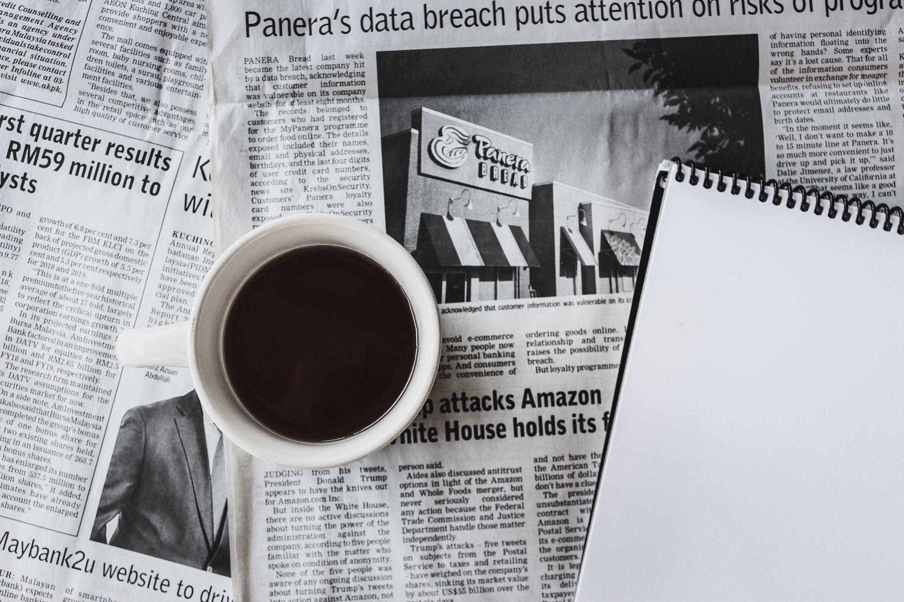
Creating
Backlogs

Slide 10
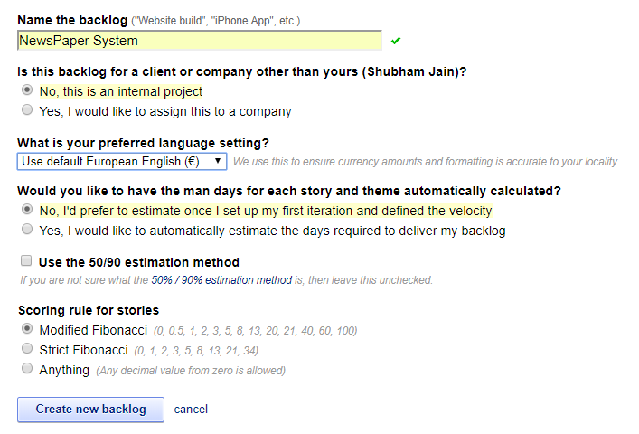
Step 1: Login to easy backlog and create a new one

Slide 11
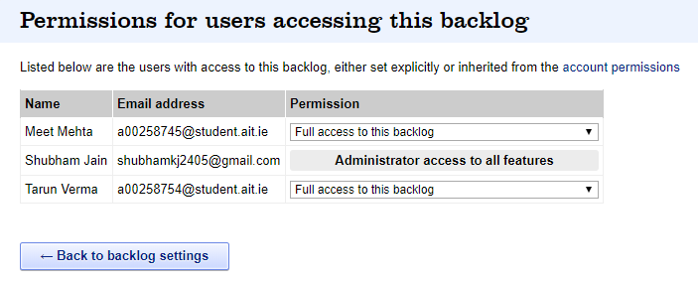
Step 2:Add Team Members to Backlog Account

Slide 12
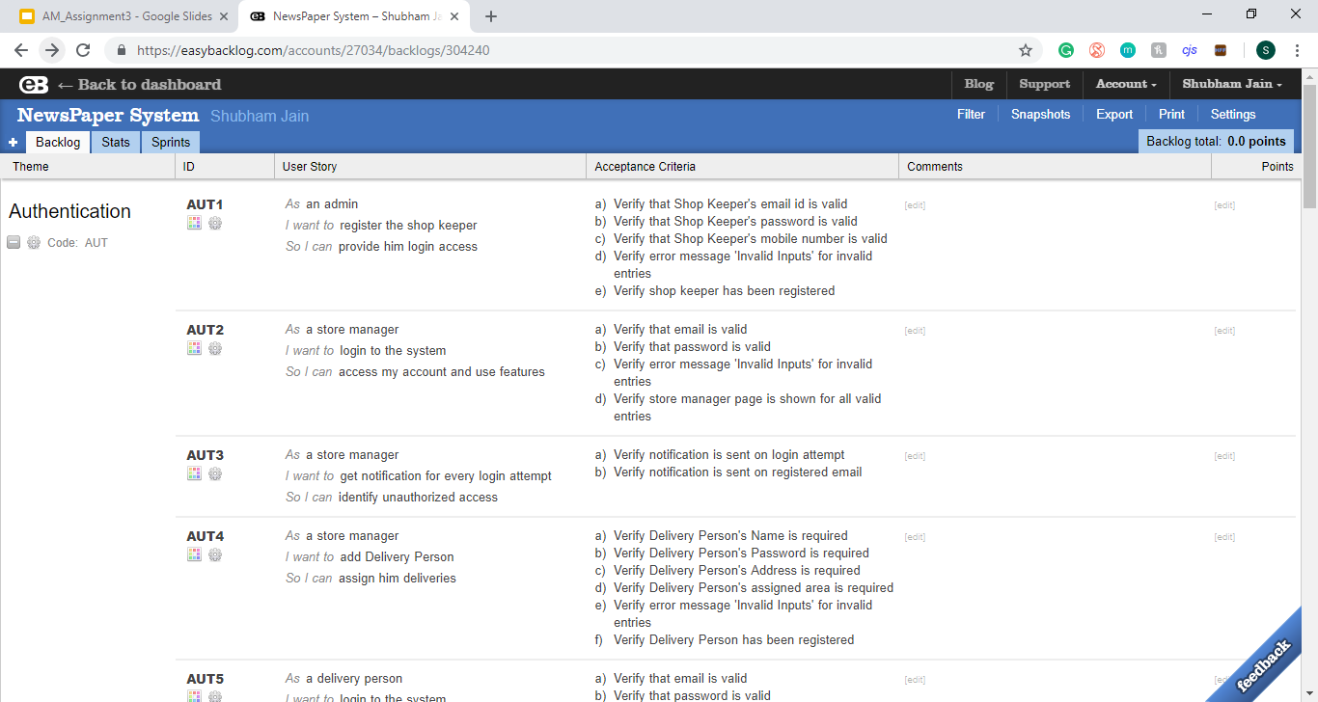
Step 3: Creating Backlogs

Slide 13
Choice of themes
Billing
Delivery
Book-Keeping
Authentication

Slide 14




Why These Themes?
Authentication
Need of a secure login feature
All registrations and login in this theme
Any feature related to login in this phase
Book-Keeping
A theme for converting all manual books in automated system.
All data which will be used for delivery or invoice or delivery status would be created and displayed in this theme
Delivery
All the use cases of system when delivery boy downloads docket
delivers subscriptions and
Updates delivery status could be recorded in this theme
Billing
We required a theme where all invoice generation related functions
Bill payment reminders or notices could be recorded

Slide 15

Creating
User Stories.

Slide 16
Formula We Followed
“I am as a user (role) want to (action) in order to (goal)”

Slide 17
Good Practices we applied
Start writing stories from epics and then break them into smaller stories step by step.
Identify user stories with numbers or letters.
Clarifying user stories from technical point of view (did not include technical features in the story!)
INVEST by Bill Wake(In detail in Learning Log)

Slide 18

GooD user Stories

Slide 19

GooD user Stories

Slide 20

GooD user Stories

Slide 21

GooD user Stories

Slide 22
Bad Practices we avoided
Using epics for tasks. Break them into substories.
Using the stories that were not approved by a customer group representative. Hold focus groups, ask for consultation.
Including technical requirements.
Creating non useful user stories.
Adding a user(who) with almost zero required interaction with the system.

Slide 23
We cannot say that any of our user stories are poorly written but we had them before review.
What if the good user stories in previous slides were poorly written then they would look like this-

Slide 24

Bad user Stories
Managing does not clear the feature that is to be created - it is also not independent as can contain multiple features

Slide 25

Bad user Stories
Updating invoice journal requires data from delivery docket which is in delivery book.
So creation and updation of delivery docket is required

Slide 26

Conclusion
The most important things to remember are
Keeping the story short and simple (who wants to do what and why).
Involving users, clients, developers, and setting detailed technical requirements and acceptance criteria.

Slide 27
Thanks For Your Time!
Hope we were up to your expectations!

