Slide 1
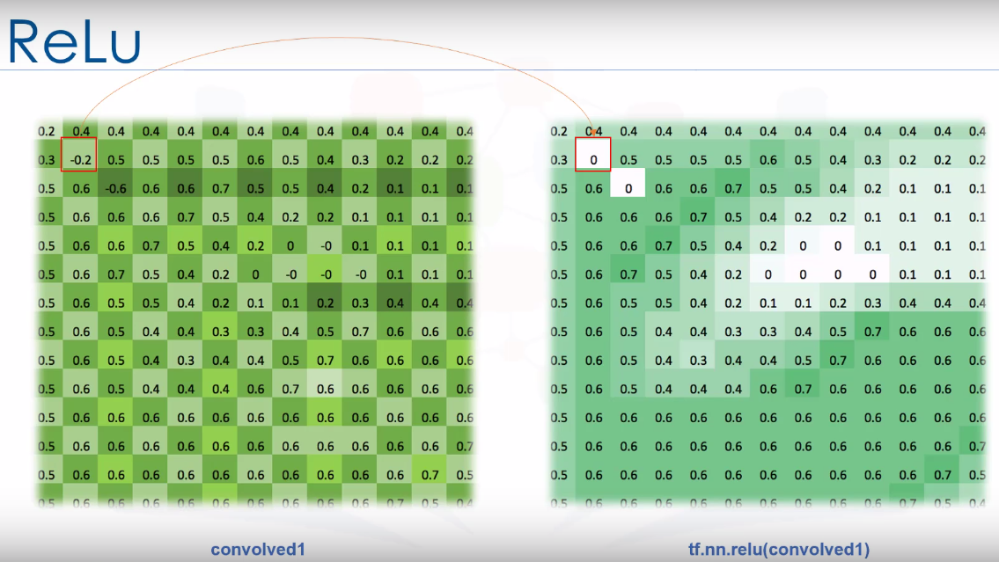
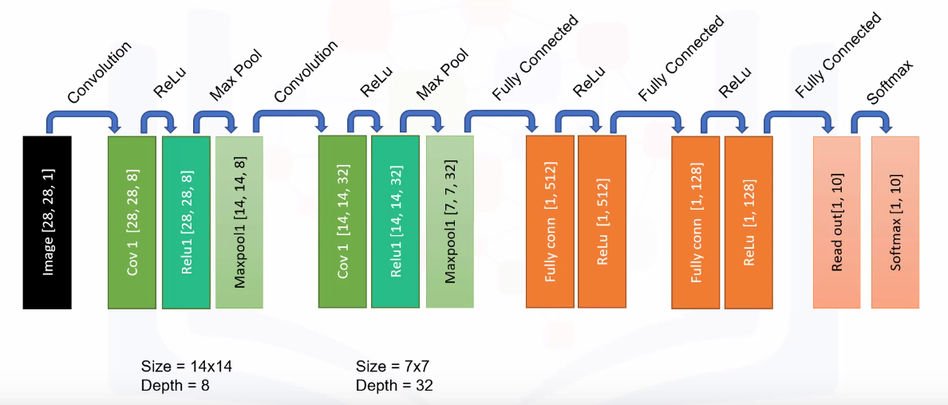
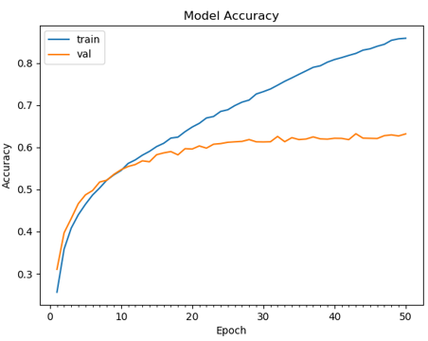
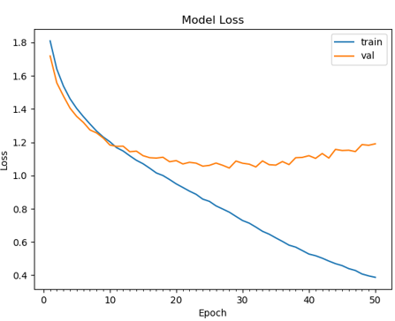
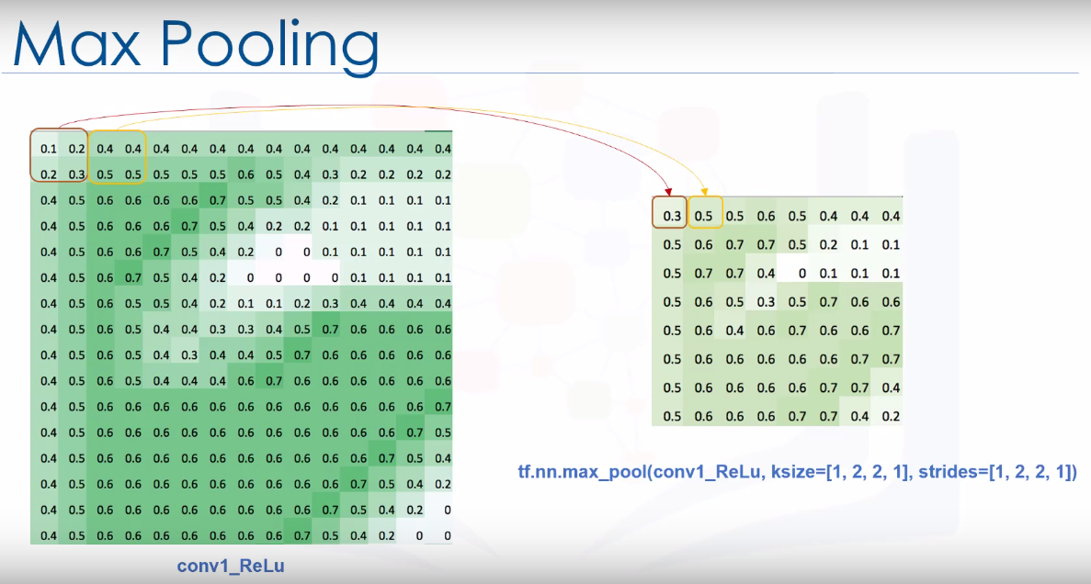
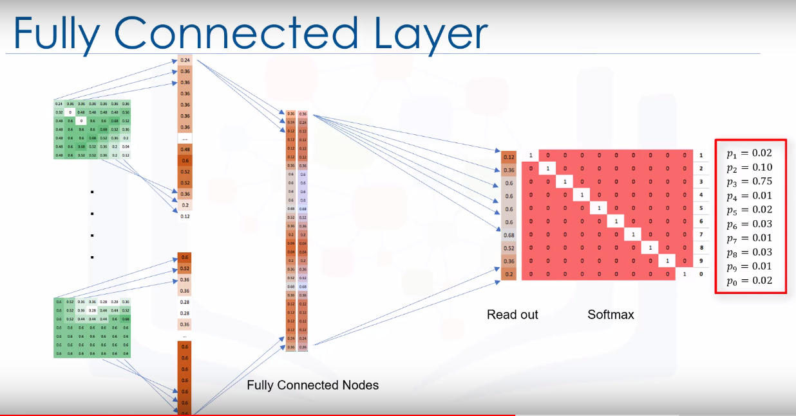
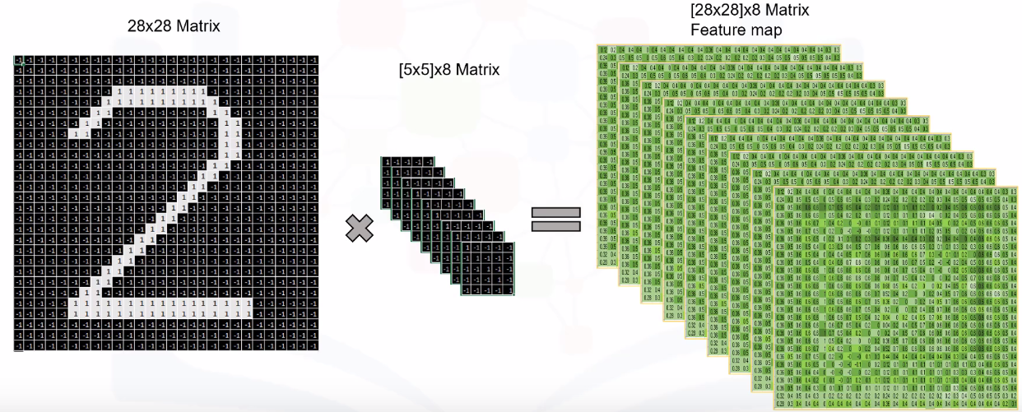
Department of Computer & Software Engineering
Object Detection using Convolutional Neural Network
Shubham Jain
Supervisor- Michael Thornton
ABSTRACT
Convolutional neural networks (CNNs) are widely used in pattern- and image-recognition problems as they have a number of advantages compared to other techniques. This project will discuss the various applications of implementing a Convolutional Neural Network for Image Detection such as Facial Emotional Detection and Sight Prediction. The architecture of ConvNet and different layers would also be outlined. Data loss and efficiency while training will also be discussed. The applicability of final model is portrayed in a website where an interactive web application trains data and generates predictions.
INTRODUCTION
A Convolutional Neural Network (ConvNet/CNN) is a Deep Learning algorithm which can take in an input image, assign importance (learnable weights and biases) to various aspects/objects in the image and be able to differentiate one from the other. The pre-processing required in a ConvNet is much lower as compared to other classification algorithms. While in primitive methods filters are hand-engineered, with enough training, ConvNets have the ability to learn these filters/characteristics.
The architecture of a ConvNet is analogous to that of the connectivity pattern of Neurons in the Human Brain and was inspired by the organization of the Visual Cortex. Individual neurons respond to stimuli only in a restricted region of the visual field known as the Receptive Field. A collection of such fields overlap to cover the entire visual area. One of the most popular uses of this architecture is image classification. For example Facebook uses CNN for automatic tagging algorithms, Amazon — for generating product recommendations and Google — for search through among users’ photos.
METHODOLOGY
ConvNet mainly has four operations Convolution, Non Linearity (ReLU), Max Pooling or Sub Sampling and Classification (Fully Connected Layer).
These operations are the basic building blocks of every Convolutional Neural Network, so understanding how these work is an important step to developing a sound understanding of ConvNets.
Figure 1: Convolve
Figure 2: ReLu
ReLU is an element wise operation (applied per pixel) and replaces all negative pixel values in the feature map by zero. The purpose of ReLU is to introduce non-linearity in our ConvNet.
Figure 3: Max Pooling
The pooling layer works with width and height of the image and performs a downsampling operation on them. As a result the image volume is reduced. This means that if some features (as for example boundaries) have already been identified in the previous convolution operation, than a detailed image is no longer needed for further processing, and it is compressed to less detailed pictures.
Figure 4: Fully Connected Layer
The Fully Connected layer is a traditional Multi Layer Perceptron that uses a softmax activation function in the output layer. The term “Fully Connected” implies that every neuron in the previous layer is connected to every neuron on the next layer. The output from the convolutional and pooling layers represent high-level features of the input image. The purpose of the Fully Connected layer is to use these features for classifying the input image into various classes based on the training dataset.
ARCHITECTURE
Figure 5: Layers of CNN
RESULTS
On the first plot it can be seen that the high accuracy is achieved after 10 epoch. In subsequent epochs on the plot the accuracy does not improve (and even decreases in interval 10–25 epochs). This means that after the 10th epoch the model can show the same result, but it will not be better.
CONCLUSION
The models are still not able to detect emotions or sight in low lightening conditions or without background elimination but with suitable working environment and hardware this can be changed. I have tested that this model works really well with a small number of photos. I measured how the accuracy depends on the number of epochs in order to detect potential overfitting problem. I determined that 10 epochs are enough for a successful training of the model. My next step would be to try this model on more data sets. I would also like to experiment with the neural network design in order to see how a higher efficiency can be achieved in various problems.
REFERENCES
[1] A. Krizhevsky, I. Sutskever, and G. E. Hinton. Imagenet classiﬁcation with deep convolutional neural networks. In Advances in neural information processing systems, 2012.
[2] OpenSourceComputerVision. Face detection using haar cascades. URL http://docs.opencv.org/master/d7/d8b/ tutorial_py_face_detection.html.
[3] TFlearn. Tﬂearn: Deep learning library featuring a higher-level api for tensorﬂow. URL http://tflearn.org/
[4] Tensorflow Machine Learning Library https://www.tensorflow.org/api_docs

