Slide 1
Cryptography
A Short History

Slide 2
Steganography
The secret message is hidden (on a messenger).
Greeks
  Message written on a shaved head.
  Hair let grow.
  And shaved when the messanger arrived.
  Required a certain lack of urgency!

Slide 3
Steganography (cont)
Invisible ink.
Known to Greeks in first century AD.
Milk of a plant.
When the parchment was heated, the writing reappeared.

Slide 4
Steganography (cont)
Second World War
  The microdot.
  Photographically shrink a page of text down to the size of a dot and hide it on top of a full stop.

Slide 5
Steganography (cont)
The problem is that if the message is discovered, the message is revealed.

Slide 6
Cryptography
The aim is to hide the meaning of a message (rather than hide the existence of the message.)
Two types
  Transposition
  Substitution (the one used)

Slide 7
Transposition
The letters are rearranged.
Effectively generating an anagram.
"For example consider this short sentence".
35 characters.
Number of arrangements of 35 different characters is 35!
35! is approximately 1 x 10⁴⁰

Slide 8
Transposition
In fact there are less than that as some letters are repeated, but the number of arrangements is still very large.
The problem is the algorithm needed to recover the original text.
Generally not used.

Slide 9
Substitution - Caesar Shift Key
Replace each letter by for example, the letter three places down in the alphabet.
This allows for 25 different substitutions.

Slide 10
General Substitution
First letter can be replaced by one of 25 other letters.
The second by 24 etc. etc.
25! = 1.5x10²⁵.

Slide 11
Substitution
Now see that in fact we have
Key
Key
Algorithm
Cipher
Text
Algorithm
Plain
Text
Plain
Text

Slide 12
The Key as a Number
120321…
A replaced by L
B replaced by C
C replaced by U etc. etc.

Slide 13
Kerckhoff's Principle (1883)
"The security of a crypto-system must not depend on keeping secret the crypto-algorithm. The security depends on keeping secret the key."
Modern cryptography algorithms work like this.

Slide 14
Cryptography – Size of Key Space
For a key to be useful, there must a large number of them.
(This is a necessary, but not a sufficient condition for a good cryptographic algorithm.)
For example, Caesars Shift Key has 25 different keys. Not good.
A general substitution has 1.5x10²⁵
Size of key space is a necessary but not sufficient condition for a good algorithm.
It means that the algorithm is not going to be broken using an exaustive search.

Slide 15
Frequency Analysis
First carried out in Arabia around 750AD.
Realized that the frequency of letters in text could be used to easily break a substitution cipher.
Each letter occurs with a known (within limits) frequency.
E, t, and a are the most frequently used letters.

Slide 16
Letter Frequency
are the most frequently used letters.
e – 7
t – 4
a – 1
r – 3
u – 2
But of course not always.

Slide 17
Other Patterns
E can appear before and after most letters.
T rarely appears before a lot of letter, b, d, g, k, m, q, v.
Some letters are a lot more friendly than others.
Some letters repeat. Others don't.
A word always has a vowel.
Words also have frequencies.

Slide 18
Other Patterns
"The" and "and" are the most frequent three letter words in English.
Frequently used text are a real gift for cryptanalysts.

Slide 19
The Black Chambers in Vienna
About 18th century.
All diplomatic messages into and out of embassies in Vienna were intercepted and copied.
A group of cryptanalysts worked round the clock on decrypting these.
100 a day.
Results used in Austria and sold to other countries.

Slide 20
Polyalphabetic Ciper

Slide 21

Polyalphabetic Ciper
Instead of a single (monoalphabetic) substitution, multiple substitutions are used depending on where in the message a letter occurs.
The main example is the Vignere cipher.

Slide 22
Vigenere Cipher
a bc de f g hi
ABCDEFGHI
BCDEFGHI J
CDEFGHI
DEFGHIJ
EFGHIJK
FGHIJKL
BAD B ADB AD (key)
Had a bad da (plaintext)
IAG B BDE DD (ciphertext)

Slide 23
Vigenere Cipher
Key is repeated above the plain text.
The key letter determines which row in square is to be used to encipher the plain text letter.

Slide 24
Vigenere Cipher
Not susceptible to frequency analysis.
Know as a poly-alphabetic cipher.
For a long time was though to be unbreakable.

Slide 25
Babbage - Breaking of Vigenere Cipher
1854, Babbage broke the Vigenere Cipher.
He used a weakness caused by the repetition of the keys.
He looked for frequent words like ″the″ and using this analysis was able to regenerate the key.
Working in intelligence for the government he never published solution.

Slide 26
Aside – Babbage’s Difference Engine
Mechanical Calculator
Designed to calculate polynomial functions
Polynomial functions can approximate most mathematical functions
Because most mathematical tables at the time were calculated by hand and contained many errors.
Caused many problems for engineering and science.

Slide 27
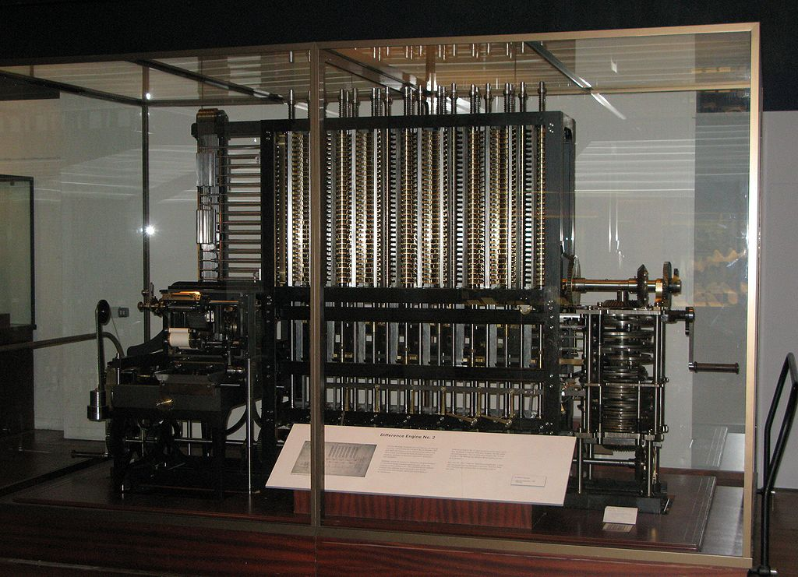
Babbage’s Difference Engine

Slide 28
Kasiski - Breaking of Vigenere Cipher
1863, Kasiski independently broke the Vigenere Cipher.
He published and the technique became known as the Kasiski test.

Slide 29
The Enigma Machine
Keyspace of the Enigma Machine

Slide 30
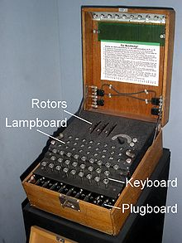
The Enigma Machine

Slide 31
The Enigma Machine
Letters were keyed into the keyboard.
Electrical signals passed through a number of rotors (scamblers), to a reflector and back through the rotors to the lampboard.
This converted plaintext to ciphertext.
On the receiving end the ciphertext was keyed in and the plaintext was recovered (lampboard).

Slide 32
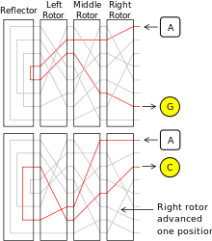
Rotors

Slide 33
Rotors
After every letter entered, the first rotor advanced one.
After 26 letters, the second also advanced one.
Resulting in a poly-alphabetic cipher.
The rotors (scramblers) were removable.

Slide 34
The PlugBoard
Allowed the swapping of 6 letters (with another 6)

Slide 35
Example Key
Plugboard
  A/L P/R T/D K/F O/Y Z/B
Scrambler (Rotor) arrangements
  2-3-1
Scrambler (Rotor) orientations

Slide 36
Number of keys
Scrambler arrangements
  3x2x1 = 6
Scrambler orientations
  26x26x26 = 17,576
Plugboard
  26x25x24x23x22x21x20x19x18x17x16x15/ 6
  = 4,626,053,752,320,000 /6 = 7 x 10¹⁴

Slide 37
Number of keys
Large number of keys.
Mainly because of plugboard settings.
But plugboard settings couldn't be used on their own.
That would give a mono-alphabetic substitution which could be broken using frequency analysis.
Hence the need for the scrambler wheels.

Slide 38
Use of the Machine
There was a day key for every day.
The day key was in turn used to encrypt a three letter key for each message which gave the scrambler orientations.
This was done twice and placed at the start of the message.
For example
  DWK-SHY

Slide 39
Use of the Machine (cont)
Field operators choose these keys.
They were transmitted twice to ensure there were no mistakes.
In effect a different key was being used for each message sent.
The scrambler arrangements and plugboard setting were not changed during the day, so only a part of the key was being changed.

Slide 40
Cryptanalysis - Poland
An early version of the enigma machine was broken by Marian Rejewski working in the Polish Cipher Bureau in the early 1930’s.
This was achieved by seperating the scrambler settings from the plugboard settings.
The scrambler settings were broken using an exhaustive search (6*17,576).
And the plugboard setting were obtained using a form of frequency analysis.

Slide 41
Cryptanalysis - Blechley Park
Later versions of the machine were eventually broken in Bletchly Park, England.
Alan Turing was one of the main scientists involved.
Bletchly Park had over 7,000 employees by the end of the war.
Had the resources to break the new cipher.
Eventually the machine had 12 scrambler wheels (known as the Lorentz machine).

Slide 42
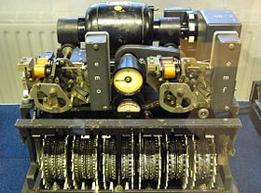
The Lorentz Machine

Slide 43
Aside - The Collossus
In order to break the cipher, the world′s first electronic, digital, programmable computer was built in Bletchley Park by Tommy Flowers, a telecoms engineer.
10 were in use by the end of the war.
Machines were classified and destroyed after the war.
Two went to GCHQ and were probably used there during the cold war.
Blueprints were burned by Tommy Flowers personally.

Slide 44
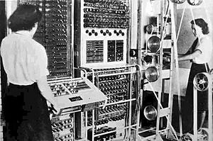
Collossus (Mk II)

Slide 45
Modern Encryption

Slide 46
DES – Data Encryption Standard
Modern encryption algorithms are built around results from mathematical number theory.
DES algorithm submitted by IBM in response to a request for an encryption algorithm.
DES was approved as a federal standard in November 1976.
[Initially there were suspicions about a NSA back door.]
Symmetric key encryption. 56 bit key.

Slide 47
The Key Distribution Problem
To communicate securely with a symmetric key both parties need the same key.
The key distribution problem was huge.
Literally tons of material, (paper, floppy disks, punch cards, tape) were transported every day by the US government.
All with very stringent security requirements.

Slide 48
Diffie/Hellman Key Exchange (1976)
Each party generates a pair of keys.
Known as a Diffie-Hellman key pair.
Each party keeps one key private and sends the other (public key)
Each takes their own private key and the others public key and generates a number.
The magic is that the generated number is the same and can be used as a symmetric key.

Slide 49
Diffie/Hellman
Bob Alice
publicB publicA
privateB privateA
publicA publicB
symmetric key == symmetric key

Slide 50
Diffie/Hellman
A solution.
Working in Stanford.
Requires the active participation of both parties.
(Used in SSL.)

Slide 51
RSA

Slide 52
RSA (1978)
Rivest, Shamir, Aldeman working in MIT.
Asymmetric encryption algorithm.
Keys are generated in pairs. Encrypt with one key. Decrypt with the other.
Is computationally expensive compared to symmetric key encryption.

Slide 53
Public Private Key Encryption
Keep one key private.
Make the other public.
I send you data by encrypting with your public key. (Only you can decrypt it.)
I can prove my identity (authentication) by encrypting with my private key.
When you decrypt it and it make sense, only I could have encrypted it.

Slide 54
Public Private Key Encryption
The final major piece of the jigsaw.
Leads to Digital Signatures and Digital Certificates.

