Slide 1
Symmetric Key Encryption

Slide 2

Encryption
Encryption - transforming plaintext into ciphertext using an algorithm (cipher)
The plaintext is the information we want to protect (maintain confidentiality.)
The ciphertext is unreadable unless you pocess a key.

Slide 3
Confidentiality and Encryption
Encryption algorithms depend on the secrecy of a numerical key used with a well known algorithm.
Decryption with the key is simple, without the key is difficult.

Slide 4
Symmetric v Asymmetric Encryption
With symmetric key encryption, the same key is used to encrypt and decrypt the data.
With asymmetric key encryption, different keys are used to encrypt and decrypt the data.

Slide 5
Symmetric-Key Encryption
The same key is used to encrypt and decrypt the data.
Computationally efficient.
Depends on the secrecy of the key.
Also known as Secret Key Encryption.

Slide 6
Uses of Symmetric Key Encryption
Transmission over an insecure channel.
Secure storage on insecure media.
Authentication
Integrity Checks

Slide 7
Transmission over an Insecure Channel.
Encrypt at one end.
Decrypt at the other.
Evesdroppers will only see unintelligible data.

Slide 8
Secure Storage on Insecure Media.
Store the encrypted data.
And don′t lose the key.

Slide 9
Authentication
[Authentication is normally associated with asymmetric key encryption, but can be also done with symmetric key encryption.]
It depends on being able to prove you know a secret without revealing it.
Alice sends Bob a random (a challenge.)
Bob encrypts it and send back the encrypted value which Alice checks.
This authenticates Bob.

Slide 10
Integrity Checks
An ordinary checksum (CRC) protects against accidental corruption of a message.
But not against an attacker.
A secret key is combined with the data before calculating the hash for the data.
If an attacker changes data, they will not be able to change the checksum.

Slide 11
Some More Detail

Slide 12
Cipher
An algorithm for performing encryption or decryption.
Usually depends on a key.

Slide 13

Symmetric Ciphers: definition
A cipher defined over (K, M, C) is a pair of “efficient” algorithms (E, D) where
  K - space of keys
  M - space of messages
  C - space of ciphers
  E - Encryption algorithm
  D - Decryption algorithm

Slide 14

Symmetric Ciphers: definition
E: K x M -> C (E: key + message to cipertext)
D: K x C -> M (D: key + ciphertext to message)
D(k, E(k, m)) = m
  When we encrypt and then decrypt, we get the original message back again.

Slide 15
The One Time Pad
First secure cipher.
M = C = {0,1}^{n} , K = {0,1}^{n}
  The message space and the cipher space is the set of binary values of length n.
  Keyspace is the same as the message space.
Key is as long as the message.
c = k ⊕ m
m = k ⊕ c

Slide 16
The One Time Pad
D(k, E(k, m)) = D(k, (k ⊕ m)) = k ⊕ (k ⊕ m) = (k ⊕ k) ⊕ m = 0 ⊕ m = m
[xor (⊕) is associative]
So the encryption and decryption work properly.
What is the value of k given m and c?
c = k ⊕ m
c ⊕ m = (k ⊕ m) ⊕ m = k ⊕ (m ⊕ m) = k ⊕ 0 = k
Ans: k = c ⊕ m
So if we know a message and the corresponding ciphertext we can easily obtain the key.

Slide 17
The One Time Pad
Because of the fact that the key (one time pad) is obtainable from a single message and the corresponding ciphertext, a one time pad should only be used once.
Hence the name.

Slide 18
The One Time Pad
Very fast encrypting and decrypting.
But long keys (as long as the message text).
And keys can only be used once.
This makes it impractical.

Slide 19
Perfect Secrecy
This says that if c is found, then it is equally likely to have come from m₀ and m₁.
The most powerful adversary learns nothing about m from c.
[It gives a formal way of analysing encryption algorithms for perfect secrecy. ]

Slide 20
The One-time Pad has Perfect Secrecy
It turns out that it is relatively easy to show that a one-time pad has perfect secrecy, which is good.
However it is impractical as seen above, which is bad.
What is required is an approximation of the one-time pad which is practical.
[It turns out that it will not have perfect secrecy but when used properly is good enough]

Slide 21
Stream Cipher

Slide 22
Stream Cipher
Replace a random key (one-time pad) with a pseudo-random key.
PRNG – Pseudo Random Number Generator
Generates a sequence of numbers whose properties approximate the properties of sequences of random numbers.
Maps a small seed space (s = 128) to sequences of pseudo-random numbers.

Slide 23
Stream Cipher
Use the PRNG to expand out a key to the size of the message.
XOR the message with this pseudo-random number.
As before
  c = E(k, m)) = k ⊕ m
  m = D(k, c ) = k ⊕ c
A stream cipher does not have perfect secrecy.

Slide 24
Predictable
A pseudo random number (stream) is predictable if there is some i so if that we know the first i bits of the stream we can find the rest of the stream.
The cipher would be unsafe.
For example all SMTP messages start with “From:”
XOR this with the cipher text to get the first 5 bytes of the key.
Use this to generate the rest of the key (stream).

Slide 25
Issues with Stream Ciphers

Slide 26
Issues with Stream Ciphers
Weak PRNGs
  Linear congruential generator
  gclib random()
Weak Stream Ciphers (RC4 (1987))
  Was used in HTTPS
  Used in WEP (wrongly)

Slide 27
Content Scrambling Systems
For encrypting DVDs.
Badly broken.
Hardware stream cipher (designed to be easily implemented in h/w.
Uses a linear feedback shift register (hardware) to generate random numbers.
“A LFSR is most often a shift register whose input bit is driven by the XOR of some bits of the overall shift register value.”
The bit positions that affect the next state are called the taps.

Slide 28
Linear Feedback Shift Register.
⊕

Slide 29
LFSR based Stream Ciphers
DVD encryption (CSS): 2 LFSRs
GSM encryption (A5/1,2): 3 LFSRs
Bluetooth (E0): 4 LFSRs
(All broken)
All implemented in hardware!!

Slide 30
Modern Stream CIphers

Slide 31
Modern stream ciphers
eStream project, 2008
  Salsa20 - designed for both software and hardware implementations.
  ChaCha (similar)
Often used where implementation is harware is required.
And used when input size is unknown (and often less that a block size in Block Ciphers)
Possibly not as widely used as Block Ciphers.

Slide 32
Block Ciphers

Slide 33
Block Cipher
A symmetric key cipher operating on fixed-length groups of bits, called blocks.
n = block size
3DES: n= 64 bits, k = 168 bits
AES: n=128 bits, k = 128, 192, 256 bits
AES: the larger the key, the more secure it is, but the slower it is.

Slide 34
Block Cipher (cont.)
Block Ciphers can be used to encrypt data larger that a block, by splitting the data into blocks (padding the last block) and encrypting each block in turn.
The repetition of applying the same key to repeated blocks of text would be a point of attack for cryptanalysis.
This can only be done safely when combined with suitable "modes of operation".

Slide 35
Modes of Operation
Suitable "Modes of Operation" randomize the procedure of applying the block cipher to each block of data.
Electronic Code Book (ECB) is a mode of operation that applies the block cipher to each block in turn and is not suitable.
Cipher-block chaining (CBC) - Each block of plaintext is XOR'ed with the previous block of ciphertext before applying teh cipher.
A random initialization vector is XOR'ed with the first block.

Slide 36
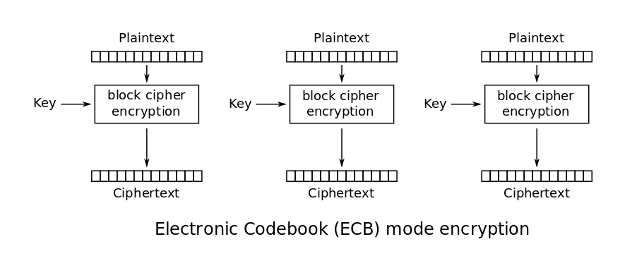
Electronic Code Book (Not Suitable)

Slide 37
Cipher-block chaining (CBC)
Each block of plaintext is XOR'ed with the previous block of ciphertext.
An initialization vector is XOR'ed with the first block.
[The repetition of applying the same key to repeated blocks of text would be a point of attack for cryptanalysis. ]

Slide 38
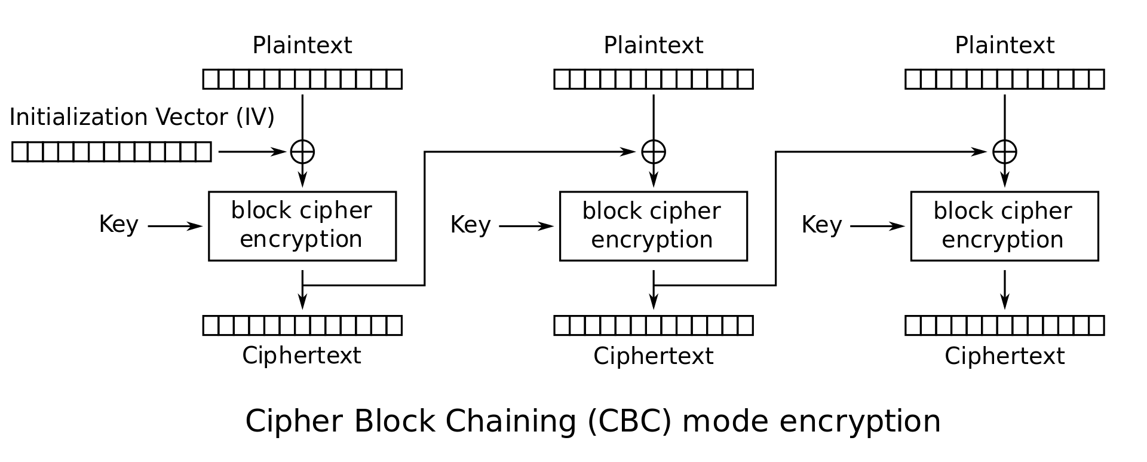
Cipher Block Chaining - Encryption
By WhiteTimberwolf (SVG version) - PNG version, Public Domain, https://commons.wikimedia.org/w/index.php?curid=26434096

Slide 39
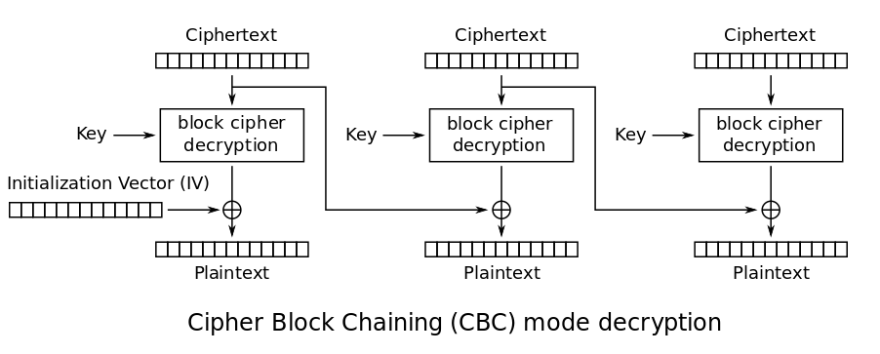
Cipher Block Chaining - Decryption
By WhiteTimberwolf (SVG version) - PNG version, Public Domain, https://commons.wikimedia.org/w/index.php?curid=26434096

Slide 40
CBC
p = plaintext, c = ciphertext
Consider first block
c = E(p ⊕ IV, key)
D(c, key) ⊕ IV = D(E(p ⊕ IV, key)) ⊕ IV = (p ⊕ IV) ⊕ IV = p

Slide 41
Examples of Block Ciphers
AES (Advanced Encryption Standard)
Blowfish,
DES, Triple DES, Serpent, Twofish

Slide 42
DES
Data Encryption Standard - 1977 (IBM)
Block size – 64 bits
Symmetric-key algorithm that uses a 56-bit key (now too short).
Suspicions initially about the existence of an NSA backdoor.
Broken in 1999 in 22 hours 15 minutes
Susceptible to brute-force attack.

Slide 43
Triple DES
Block size – 64 bits
Key size - 168, 112 or 56
In fact uses three DES keys, K1, K2 and K3, each of 56 bits

Slide 44
AES
Advanced Encryption Standard (1998)
Originally called Rijndael
Successor to DES
Selected in AES contest in 2001 [National Institute of Standards and Technology(NIST)]
Block size - 128 bits
Key sizes - 128, 192 or 256 bits

Slide 45
Blowfish
1993, alternative to DES
Block size - 64
Key length - varies from 1 bit up to 448 bits
No cryptanalysis has been found to date.
Not as widely used as AES.

Slide 46
Serpent
Serpent
  Second in the Advanced Encryption Standard (AES) contest.
Twofish
  Based on Blowfish.
  Another finalist in AES contest.

Slide 47
Symmetric Key Encryption
Java

Slide 48
Encryption – DES Example
String ALGORITHM = "AES" ;
KeyGenerator keygen = KeyGenerator.getInstance(ALGORITHM);
SecretKey key = keygen.generateKey();
Cipher eCipher = Cipher.getInstance(ALGORITHM);
// Initialize the cipher for encryption
eCipher.init(Cipher.ENCRYPT_MODE, key);
String s = "This is just an example";
System.out.println("Clear text: " + s);
byte[] cleartext = s.getBytes();
// Encrypt the cleartext
byte[] ciphertext = eCipher.doFinal(cleartext);
System.out.println("Cipher text: " + HexUtil.toString(ciphertext));

Slide 49
Encryption – DES Example
/////////////////////////////////////////////////
// Decrypt
Cipher dCipher = Cipher.getInstance(ALGORITHM);
dCipher.init(Cipher.DECRYPT_MODE, key);
// Decrypt the ciphertext
byte[] clearText1 = dCipher.doFinal(ciphertext);
String text = new String(clearText1);
System.out.println("Decrypted text: " + text);

Slide 50
Encryption – AES, BlowFish
Similar to above.
Use Strings AES and Blowfish.

Slide 51
java.crypto.SealedObject
SealedObject(Serializable object, Cipher c)
  Constructs a SealedObject from any Serializable object.
  Cipher should be initialized for encryption
Object getObject(Cipher c)
  Retrieves the original (encapsulated) object.
  Cipher should be initialized for decryption

