Slide 1
SSL

Slide 2
SSL
A protocol on top of TCP/IP
The SSL API is an extension to the TCP/IP API.
(SSL clients and servers are sometimes known as peers.)

Slide 3
SSL Capabilities
SSL Server Authentication
  Requires Digital Certificate
SSL Client Authentication
  Optional, usually not used
Encryption of data.
  Optional, usually used

Slide 4
SSL Handshake
Exchange of messages in order to
  Authenticate the server
  Optionally authenticate the client
  Allow client and server to select the cipher used.
  Generate shared secret (symmetric key)
  Optionally establish an encrypted SSL connection.

Slide 5
Generating Shared Secret
The Diffie Hellman algorithm is one option (considered the safest ) for key exchange.
A symmetric key can be generated by the DH algorithm and this used subsequently to encrypt the data.

Slide 6
Keytool

Slide 7
Keytool
A utility program for managing keys.
keytool.exe in JDK bin folder.

Slide 8
KeyStores and TrustStores
A Keystore is used to store private keys and associated certificates (which contains the public key).
A TrustStore is a keystore used to store certificates of trusted Certificate Authorities.

Slide 9
KeyStores and TrustStores
A Java program looks for TrustStores as follows.
  In the location given by the System property javax.net.ssl.trustStore
  In lib/security/jssecerts off Java Home
  In lib/security/cacerts off Java Home
The cacerts file (binary file) has a number of entries for Verisign/Thawte.

Slide 10
[[[Keytool arguments]
-genkey
  generate a self-signed private key/certificate pair (keystore pair)
-keystore
  create a new keystore with this name
-keyalg
  the encryption algorithm to be used
-alias
  unique name associated with keystore entry

Slide 11
Keytool arguments
-storepass
  password needed to access the keystore
-keypass
  password needed to obtain the private key associated with the alias
-certreq
  generate a certificate signing request
-file
  outputfile for certreq

Slide 12
Creating a (self-signed) keystore entry
keytool -genkey -keystore CERTS -keyalg rsa -alias paul -storepass serverkspw -keypass serverpw
You will be prompted for name, organization unit, organization, city, state or province, two-letter code.

Slide 13
Creating a (self-signed) keystore entry
Note that this Certificate is digitally signed by yourself, not a trusted Certificate Authority.
Signer and subject are the same.
You might want to set up a Certificate authority within an organisation.

Slide 14
Generate a Certificate Signing Request
keytool -certreq -keystore CERTS -alias paul -storepass serverkspw -keypass serverpw -file CERTREQ
This can be sent to an appropriate CA and a digital certificate sent back say DIGITALCERT.

Slide 15
Import the Digital Certificate back into the Keystore]]]
keytool -import -keystore CERTS -alias paul -file DIGITALCERT -truststore
Now the Digital Certificate is signed by Verisign.

Slide 16
Keytool – Eclipse Plugin

Slide 17
Update site
http://keytool.sourceforge.net/update
Help - Software Updates - Find and install - Search for new feature....
Click New Remote Site and add http://keytool.sourceforge.net/update in name and URL, and make sure its checked.
Hit Finish.
(1.4.2)

Slide 18
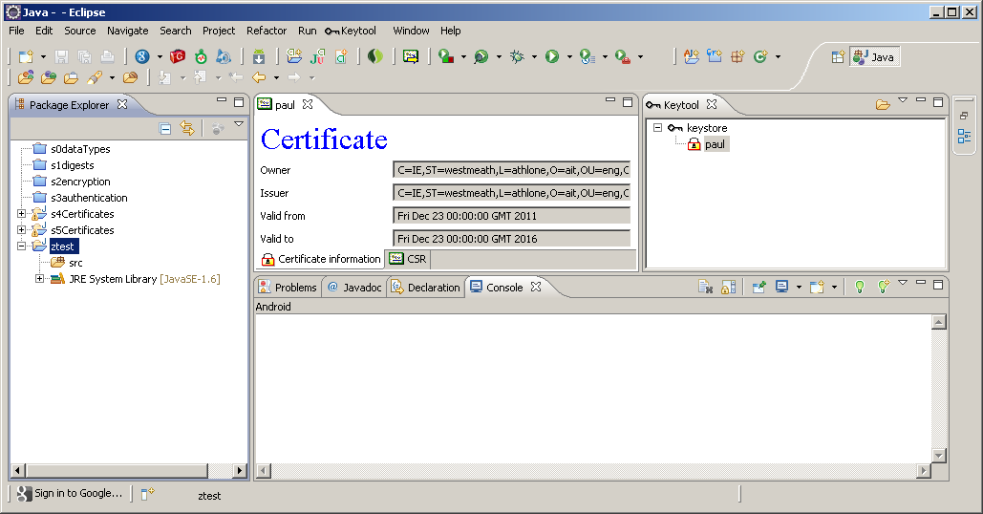
Keytool – Eclipse Plugin

Slide 19
keytool
Create a new certificate.
Choose – create a new keystore
Specify an alias (for the key)
Specify a key password (1234)
Specify information.
Specify a filename
And file password (file)

Slide 20
Keytool – Open a keystore
The keystore is created in the eclipse folder.
Copy it into your project.
Open the keystore.
Can see the certificate in it.
Note that the issuer and the subject are the same.
This is a "self signed certificate".

Slide 21
C1show.java
String keystoreFilename = "keystore";
char[] password = "file".toCharArray();
String alias = "paul";
FileInputStream fIn = new
FileInputStream(keystoreFilename);
KeyStore keystore = KeyStore.getInstance("JKS");
keystore.load(fIn, password);
Certificate cert = keystore.getCertificate(alias);
System.out.println(cert);

Slide 22
Export Certificate from keystore
RC- export certificate
Specify the name of the certificate file (say paul.cer)

Slide 23
C3PrintCert.java
FileInputStream fr = new FileInputStream("paul.cer");
CertificateFactory cf = CertificateFactory.getInstance("X509");
X509Certificate c = (X509Certificate) cf.generateCertificate(fr);
System.out.println("Read in the following certificate:");
System.out.println("\tCertificate for: " + c.getSubjectDN());
System.out.println("\tCertificate issued by: " + c.getIssuerDN());
System.out.println("\tThe certificate is valid from "
+ c.getNotBefore() + " to " + c.getNotAfter());
System.out.println("\tCertificate SN# " + c.getSerialNumber());
System.out.println("\tGenerated with " + c.getSigAlgName());

Slide 24
TrustStore- cacerts
Certificate Authority Certificates
Contains the (self-signed) certificates for the trusted Certificate Authorities.
In C:\Program Files\Java\jdk1.6.0_20\jre\lib\security

Slide 25
TrustStore- cacerts
Clients will use this to check Digital Certificates.
The Digital Certificates will be signed by a C.A.
Client looks up the TrustStore.
Gets the public key of the C.A.
Checks the digital signature on the Digital Certificate.

Slide 26
SSL Example
S1Server.java will accept SSL connections from clients.
It authenticates itself by means of a certificate stored in ″keystore″ (the original keystore).
It needs to know the password for the keystore as well as the password for the key (paul).
Now this certificate is self-signed by paul.

Slide 27
SSL Example
The only way it will be accepted by the client is if the client thinks that paul is a valid C.A.
We are going to fool the client by putting pauls certificate in the cacerts file (truststore).

Slide 28
SSL Example - E1Server.java
char[] KSPASSWORD = "kkkk".toCharArray();
char[] PASSWORD = "1234".toCharArray();
KeyStore keyStore = KeyStore.getInstance("JKS");
keyStore.load(new FileInputStream("keystore"), KSPASSWORD);
KeyManagerFactory keyManagerFactory = KeyManagerFactory
.getInstance("SunX509");
keyManagerFactory.init(keyStore, PASSWORD);
SSLContext sslContext = SSLContext.getInstance("TLS");
sslContext.init(keyManagerFactory.getKeyManagers(), null, null);
ServerSocketFactory ssFactory = sslContext.getServerSocketFactory();

Slide 29
SSL Example - E1Server.java
int port = 443;
ServerSocket ss = ssFactory.createServerSocket(port);
Socket socket = ss.accept();
// Create streams to securely send and receive data to the client
InputStream in = socket.getInputStream();
BufferedReader r = new BufferedReader(new InputStreamReader(in));
String name = r.readLine();
OutputStream o = socket.getOutputStream();
PrintWriter p = new PrintWriter(o);
p.println("Hello " + name);
p.close();

Slide 30
SSL Example – E2SSLClient.java
System.setProperty("javax.net.ssl.trustStore", "cacerts");
System.setProperty("javax.net.ssl.trustStorePassword", "changeit");
SSLSocketFactory factory = (SSLSocketFactory)SSLSocketFactory.getDefault();
SSLSocket socket = (SSLSocket)factory.createSocket("localhost", 443);
socket.startHandshake();
OutputStream o = socket.getOutputStream();
PrintWriter p = new PrintWriter(o) ;
p.println("paul") ; p.flush() ;
InputStream in = socket.getInputStream();
BufferedReader r = new BufferedReader(new InputStreamReader(in)) ;
String reply = r.readLine();
System.out.println("From Server " + reply);

Slide 31
Summary: SSL Server
Send
  Digital Certificate
  Random piece of text
  Digitally signed (encrypted one-way hash of text)
  Agree cipher
  Exchange DH public keys
  Genereate symmetric key
  Encrypt data

Slide 32
Summary: SSL Client
Verifies the Digital Certificate, i.e. checks the Digital Signature on the Certificate (using the CA’s public key).
Reads the Public Key of the sender from the Certificate.
Uses this to check the Digital Signature of the sender.
Agree cipher
Exchange DH public keys
Genereate symmetric key
Encrypt data

