Slide 1
OAuth

Slide 2
OAuth
Luxury cars often come with a valet key.
The car can be driven for a short distance.
Provides limited access to the car.

Slide 3
Printing Photos
You might want to give the printing service limited access to you Flickr account.
Or a social networking site limited access to your Google address book.
"OAuth provides a method for users to grant third-party access to their resources without sharing their passwords.
It also provides a way to grant limited access (in scope, duration, etc.).

Slide 4
Client Server v. OAuth
Client Server :
  Client provides access credentials.
  Allowed access to resources on the server.
OAuth introduces a third role to this model, the resource owner.
The client is now not the resource owner, but is acting on behalf of the resource owner.
The client requests access to resources owned by the resource owner and hosted by the server.

Slide 5
Client Server Authentication
Client
Server
username
password

Slide 6
OAuth Authentication
OAuth
back channel
Client
Server
front channel
Resource Owner

Slide 7
OAuth
The resource owner authorizes the client to access their resources on the Server.
This provides limited access to the resouces.
Limited access
  restricted scope
  limited lifetime

Slide 8
OAuth
OAuth based on
  Google AuthSub
  Yahoo BBAuth
  Flickr API
OAuth has built-in support for desktop applications, mobile devices, set-top boxes, as well as websites.

Slide 9
Terminology

Slide 10
Terminology
client (TwitterClient.java)
  Application (HTTP client) capable of making OAuth-authenticated requests
server (Twitter)
  An HTTP server capable of accepting OAuth-authenticated requests.
protected resource (users tweets)
  An access-restricted resource that can be obtained from the server using an OAuth-authenticated request

Slide 11
Terminology
resource owner (user)
  An entity capable of accessing and controlling protected resources by using credentials to authenticate with the server.
credentials
  A pair of
    a unique identifier (key or token).
    a matching shared secret.

Slide 12
Three types of Credentials
client credentials - identifies the application
  Consumer (or API) Key and Secret
request credentials (temporary credentials)
  Request Key and Secret
access credentials (token credentials)
  Access Key and Secret

Slide 13
Redirection-Based Authorization

Slide 14
OAuth Authentication
OAuth
back channel
Client
Server
front channel
Resource Owner

Slide 15
Redirection-Based Authorization
User is redirected by the client (application) to the server (Twitter)
Users authenticate directly with the server, instructing the server to given credentials to the client for use with the authentication method.

Slide 16
Redirection-Based Authorization
Visit photo printing site
  printer.example.com
Request some photos to be printed and mailed to someone.
Specify that photos are stored at
  photos.example.net (server)
User - paul

Slide 17
Redirection-Based Authorization
printer.example.com has previously registered with photos.example.net and obtained client credentials.
printer.example.com requests request credentials from photos.example.net and obtains these.
Customer redirected to photos.example.net.
Logon to photos.example.net.

Slide 18
Redirection-Based Authorization
Message that some printing service has request access to your photos. Do you want to allow such access. Yes.
Request credentials of printer.example.com marked as resource-owner-authorized.
Customer redirected back to Printing site.
printer.example.com obtains access credentials.
printer.example.com downloads the photos from photos.example.net and you are prompted which ones to print.

Slide 19
Access URLs
A number of (server) URLs required to make OAuth requests.

Slide 20
Access URLs - Example
Request URL
  Ask for request credentials, e.g.
  https://photos.example.net/initiate
Authorize URL
  For user authorization e.g.
  https://photos.example.net/authorize
Access URL
  Ask for access credentials, e.g.
  https://photos.example.net/token

Slide 21
Twitter Example

Slide 22
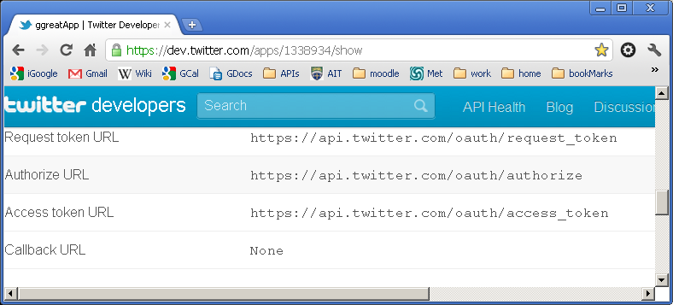
Twitter Access URLs

Slide 23
Register an Application (Twitter)
You will be provided with (over HTTPS)
  consumer key (API key)
  consumer secret (API secret)
You will specify a callback URL if you are accessing Twitter from a Web application.

Slide 24
Scenario – Web Application Client
Client asks for request credentials
Client redirects user to Server (authorize URL)
Server redirects user to client callback URL.
Client asks for access credentials.
Client requests resources.

Slide 25
Scenario – Desktop Client
Client asks for request credentials
Client asks user to go to Server (authorize URL) and get a PIN.
User logs on and gets PIN.
User enters it in to client.
Client asks for access credentials (sends PIN)
Client requests resources.

Slide 26
Example Requests

Slide 27
Client asks for Request Credentials
POST /initiate HTTP/1.1
Host: photos.example.net
Authorization: OAuth realm="Photos",
oauth_consumer_key="dpf43f3p2l4k3l03",
oauth_signature_method="HMAC-SHA1",
oauth_timestamp="137131200",
oauth_nonce="wIjqoS",
oauth_callback="http%3A%2F%2Fprinter.example.com%2Fready",
oauth_signature="74KNZJeDHnMBp0EMJ9ZHt%2FXKycU%3D"

Slide 28

Client asks for Request Credentials
Sends the consumer (API) key.
Authenticates the request by sending the HMAC signature calculated with consumer secret.
Timestamp and nonce sent to prevent replay attacks.

Slide 29
Server Responds
HTTP/1.1 200 OK
Content-Type: application/x-www-form-urlencoded
oauth_token=hh5s93j4hdidpola&oauth_token_secret=hdhd0244k9j7ao03&
oauth_callback_confirmed=true
Server responds with request credentials
  request key - hh5s93j4hdidpola
  request secret - hdhd0244k9j7ao03

Slide 30
Client requests Access Credentials
POST /token HTTP/1.1
Host: photos.example.net
Authorization: OAuth realm="Photos",
oauth_consumer_key="dpf43f3p2l4k3l03",
oauth_token="hh5s93j4hdidpola",
oauth_signature_method="HMAC-SHA1",
oauth_timestamp="137131201",
oauth_nonce="walatlh",
oauth_verifier="hfdp7dh39dks9884",
oauth_signature="gKgrFCywp7rO0OXSjdot%2FIHF7IU%3D"

Slide 31
Client asks for Request Credentials
Sends the consumer (API) key.
Also sends the request key.
Authenticates the request by sending the HMAC signature calculated with these secrets.

Slide 32
Server supplies access credentials
HTTP/1.1 200 OK
Content-Type: application/x-www-form-urlencoded
oauth_token=nnch734d00sl2jdk&oauth_token_secret=pfkkdhi9sl3r4s00
These are the access (token) credentials.
  access key: nnch734d00sl2jdk
  access secret: pfkkdhi9sl3r4s00

Slide 33
Client requests resources using Access Credentials
GET /photos?file=vacation.jpg&size=original HTTP/1.1
Host: photos.example.net
Authorization: OAuth realm="Photos",
oauth_consumer_key="dpf43f3p2l4k3l03",
oauth_token="nnch734d00sl2jdk",
oauth_signature_method="HMAC-SHA1",
oauth_timestamp="137131202",
oauth_nonce="chapoH",
oauth_signature="MdpQcU8iPSUjWoN%2FUDMsK2sui9I%3D"

Slide 34
Client asks for Request Credentials
Sends the consumer (API) key.
Also sends the access key.
Authenticates the request by sending the HMAC signature calculated with the corresponding secrets.

