Slide 1
OAuth - Twitter

Slide 2

Twitter Account
Create a Twitter account.
Next go to the Twitter developers page to register an application.
https://dev.twitter.com/

Slide 3

Create an Application
https://dev.twitter.com/apps/new
Website
  www.ait.ie/paul

Slide 4
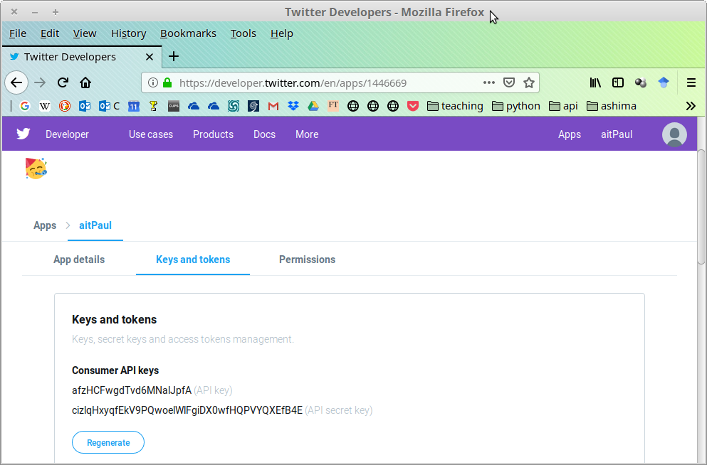
Application's OAuth Settings

Slide 5
OAuth Settings - Client Credentials
Consumer key
  afzHCFwgdTvd6MNalJpfA
Consumer secret
  cizlqHxyqfEkV9PQwoelWlFgiDX0wfHQPVYQXEfB4E

Slide 6
OAuth Settings – Access URLS
Request URL
  https://api.twitter.com/oauth/request_tokenAuthorize
Authorize URL
  https://api.twitter.com/oauth/authorize
Access URL
  https://api.twitter.com/oauth/access_token

Slide 7
Client Code

Slide 8
oauth-signpost
OAuth client library.
http://code.google.com/p/oauth-signpost/
API
  http://kaeppler.github.com/signpost/signpost-core-apidocs/index.html

Slide 9
Client
Add jars
  commons-codec-1.3.jar
  signpost-core-1.2.1.1.jar

Slide 10
[Scenario – Desktop Client]
Client asks for Request Credentials
Client asks user to go to Server (authorize URL) and get a PIN.
User logs on and gets PIN.
User enters it in to client.
Client requests access token (sends PIN)
Client requests resources.

Slide 11
class TwitterClient
//System.getProperties().put("proxySet", "true");
//System.getProperties().put("proxyHost", "192.168.8.3");
//System.getProperties().put("proxyPort", "8080");
DefaultOAuthConsumer consumer = new DefaultOAuthConsumer(
"afzHCFwgfTvd6MNalJpfA",
"cizlqHxyqfEkV9PQvoelWlFgiDX0wfHQPVYQXEfB4E"
);
DefaultOAuthProvider provider = new DefaultOAuthProvider(
"http://twitter.com/oauth/request_token",
"http://twitter.com/oauth/access_token",
"http://twitter.com/oauth/authorize"
);

Slide 12
class TwitterClient
// token and tokenSecret for resource owner
String pin, token, tokenSecret;
// 1. Client asks for Request Credentials
String authUrl = provider.retrieveRequestToken(consumer,
OAuth.OUT_OF_BAND);
Scanner scanner = new Scanner(System.in);
// 2. Client asks user to go authorize URL and get a PIN.
System.out .println("Get your PIN code from " + authUrl + " and enter it.");
// 4. Read in the pin
pin = scanner.next();
// 5. requests access token (sends PIN)
provider.retrieveAccessToken(consumer, pin);
// Can obtain keys and secrets if you wish
// token = consumer.getToken();
// tokenSecret = consumer.getTokenSecret();

Slide 13
class TwitterClient
// 6. requests resource (signs the request)
URLConnection connection = new URL(
"http://api.twitter.com/1/statuses/home_timeline.json")
.openConnection();
consumer.sign(connection);
// read response from input stream and print it out
Scanner r = new Scanner(connection.getInputStream());
String line;
while (r.hasNext()) {
line = r.nextLine() ;
System.out.println(line);
}

Slide 14
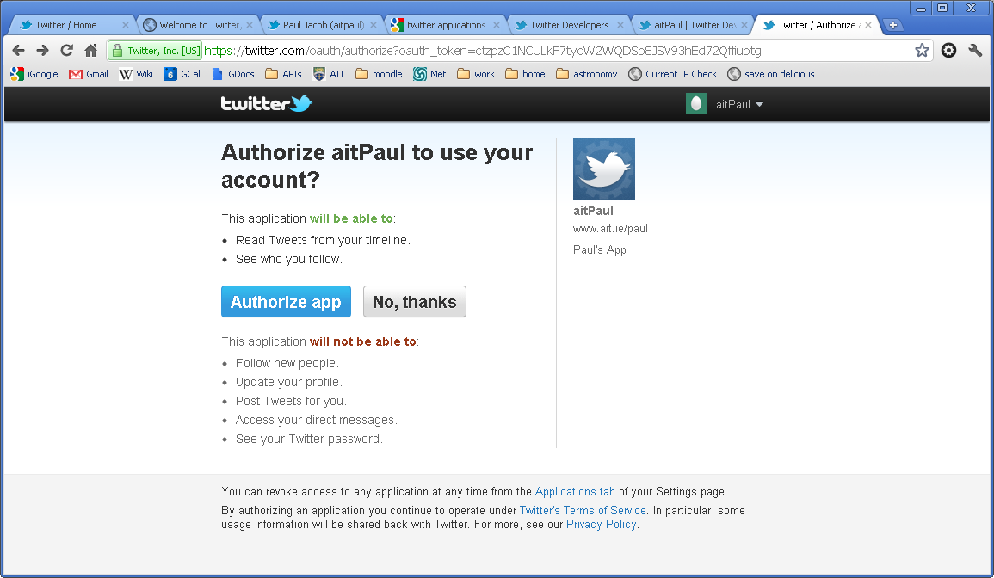
Authorization

Slide 15
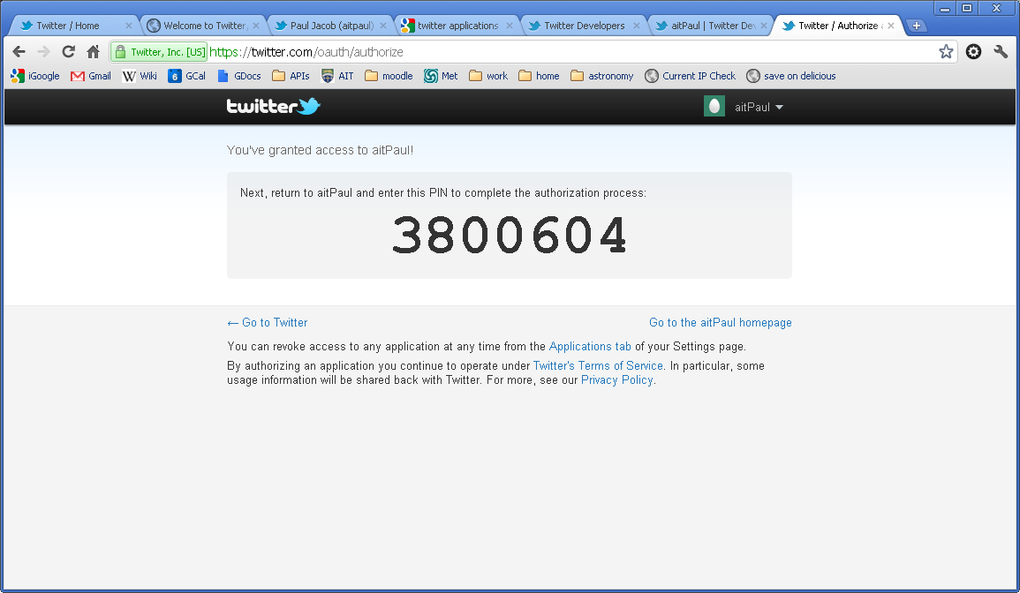
Granted Authorization

Slide 16
DefaultOAuthConsumer
DefaultOAuthConsumer(
String consumerKey, String consumerSecret)
DefaultOAuthProvider(String requestTokenEndpointUrl,
String accessTokenEndpointUrl,
String authorizationWebsiteUrl)

Slide 17
retrieveRequestToken()
def authUrl = provider.retrieveRequestToken(
consumer, OAuth.OUT_OF_BAND)
Passes
  consumer credentials.
  CallBack URL for notification OR
  OAuth.OUT_OF_BAND if none.
Returns the URL to which the user must be sent in order to authorize the consumer.

Slide 18
retrieveAccessToken()
provider.retrieveAccessToken(consumer, pin)
If a callback was provided previously, then pin is unnecessary.
Consumer (application) will have been provided with a request token.

Slide 19
getToken() & getTokenSecret()
token = consumer.getToken()
tokenSecret = consumer.getTokenSecret()
Retrieves the access token and access token secret.
(This is not necessary. Just if you want to see them.)

Slide 20
Sign the request
def request = new URL(
"http://api.twitter.com/1/statuses/home_timeline.json")
.openConnection()
consumer.sign(request)
This is the request for resources.
It must be signed, demonstrating that you have the access token secret.

Slide 21
Read the Response
Scanner r = new Scanner
(connection.getInputStream());
String line;
while (r.hasNext()) {
line = r.nextLine() ;
System.out.println(line);
}

Slide 22
Program Running
Get your PIN code from http://twitter.com/oauth/authorize?oauth_token=g1tqGMkroEq61ZeZ7uZrdDcL8u6SfXOqpuQPPN4kYY and enter it.

Slide 23
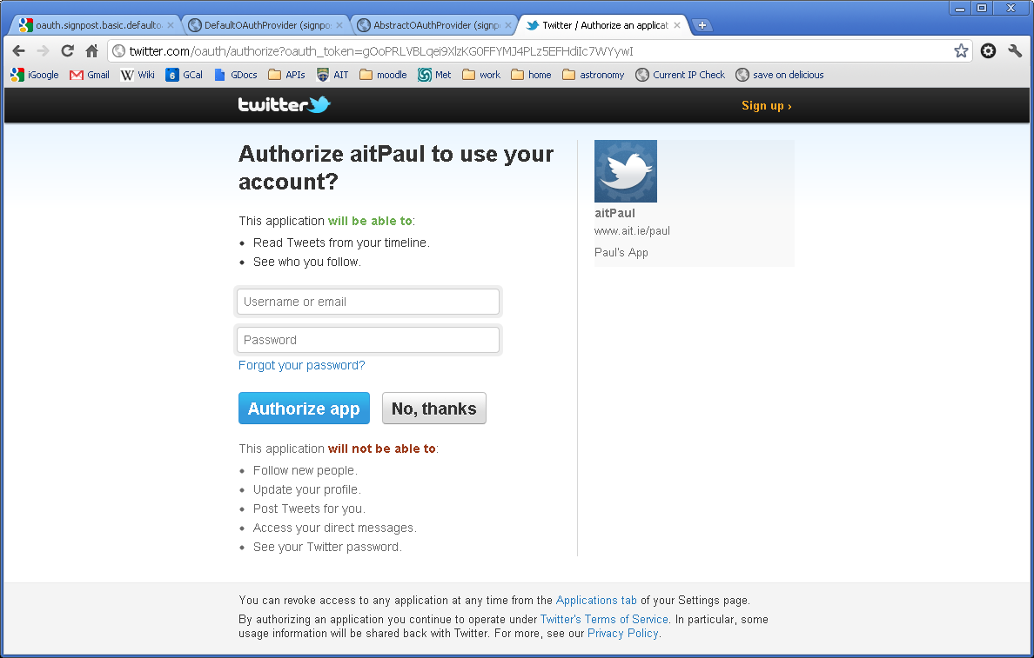
Resource Owner Authorization

Slide 24
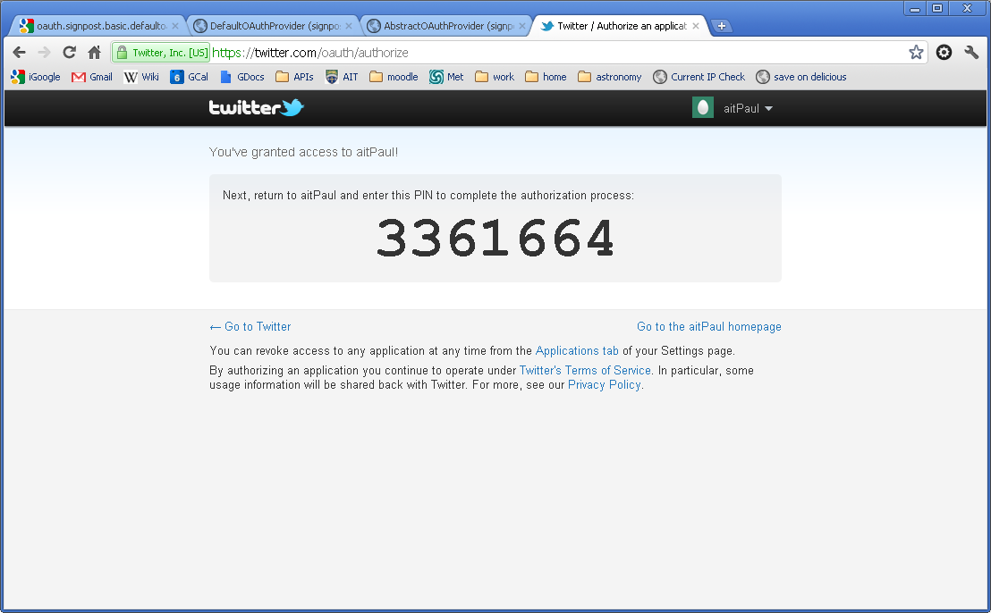
Get the PIN

Slide 25
Output of Resources (Tweets)
3361664
[{"in_reply_to_user_id":null,
"favorited":false,"place":null,
"created_at":"Fri Jan 06 14:06:06 +0000 2012"
……..

