Slide 1
BeyondCorp

Slide 2

BeyondCorp
Google Initiative
A new approach to Enterprise Security
http://research.google.com/pubs/pub43231.html
Going beyond
  perimeter security enforced by firewalls.
  where access from outside is supported by VPNs.

Slide 3

Because
Once through the perimeter firewall, an attacker has fairly easy access to coporate intranet
The perimeter is often no longer the physical location of the enterprise due to use of the cloud.
Access from outside the corporate network is becoming more and more necessary.
And is from a wide range of different devices.

Slide 4
The New Model
Gets rid of the privileged corporate network.
User access depends on the device and user credentials (and not exclusively on the location).
All access to resources is fully authenticated, authorised and encrypted.
No substantive difference in accessing the network from inside or outside the corporate network.

Slide 5
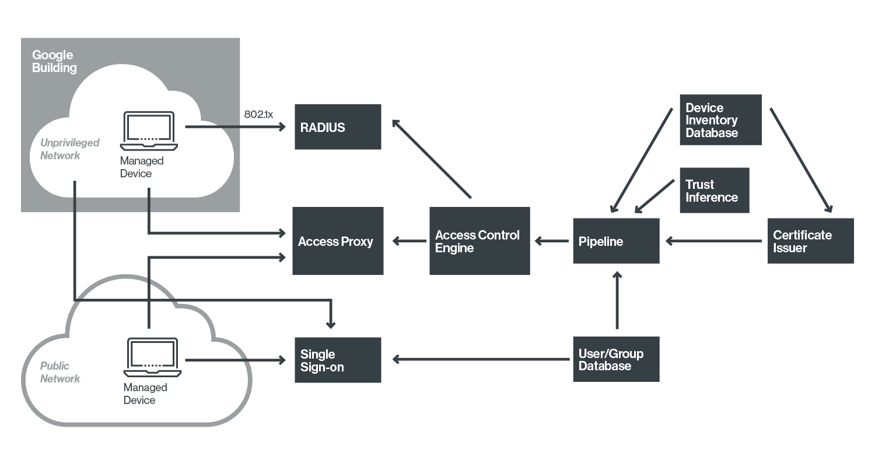
Components and Access Flow
Applications

Slide 6
Device Inventory Database
A 'Managed Device' is one procured and actively managed by the company.
Keeps track of changes (updates etc) made to these devices.
Devices are identified by certificates stored in a Trusted Platform Module (hardware) or certificate store.

Slide 7
User/Group Database
All information about users
Usernames, job categorization, group memberships etc.
Like users and groups in Unix.

Slide 8
Single Sign-On System
Central portal to support user authentication.
[Uses two factor authentication].
After authentication, tokens are issued which are used when requesting resources.

Slide 9
The Unprivileged Network
Clients with managed devices assigned to this network when in Google buildings.
Unmanaged devices assigned to a guest network.
RADIUS servers assign an IP address on the unprivileged network to a device.

Slide 10
Proxy
All applications accessed through a proxy.
Provides access control checks.
Load balancing.
Encrypts connection with the client.
DOS protection.

Slide 11
Access Control Engine
Supports the proxy.
Provides authorization based on device information, user credentials and trust model.
Level of access can change over time.
Based on device information, user and group information, location.
For example, a device without an important upgrade might lead to restricted access.

Slide 12

Pipeline
Feeds the appropriate information into the access control engine.
Dynamically obtains information from Device Inventory database.
Including
  Certificate whitelists
  Trust levels of devices and users
Can also carry out a certain level of trust inference.

