Slide 1
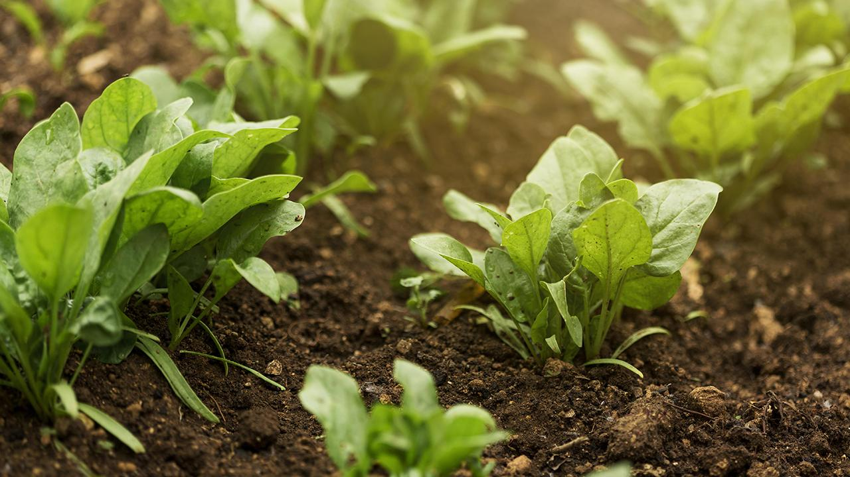

AI-based Crop Yield Prediction & Advisory System (AgroLens)
Team Members : 1.Shubham Kumar (Reg.. No. 2430010352)
2.Om S Shukla (Reg.. No. 2430010356)
3.Gopal Deswal (Reg.. No. 2430010363)
Guide : Dr. Abhishek Dwivedi
Department of Data Science & Engineering

Slide 2
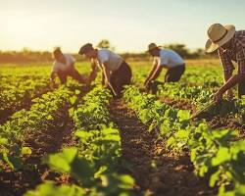
Abstract
Smallholder farmers often lack timely, localized, and actionable agronomic guidance, leading to unpredictable yields, inefficient input use, and reduced income. Our AI-powered platform integrates historical yield, weather, soil, and market data to predict seasonal crop yields and provide explainable, multilingual, and offline recommendations. This helps farmers optimize inputs, increase yields, and enhance both profitability and sustainability.

Slide 3
Problem
👨‍🌾 Farmer → 🌦 Weather + 🌱 Soil + 🐛 Pests → ❓ Uncertain Yield /💸 Income Loss
Unpredictable yields & income volatility
Smallholder farmers face large yield uncertainty because they lack timely, local forecasts and actionable planning guidance.
Limited access to personalized advisory
Traditional extension services are sparse and often give one-size-fits-all advice that ignores local soil, weather and crop history.
Inefficient input use and soil decline
Over/under-application of water and fertilizer wastes money, reduces profit, and degrades long-term soil health.
Low data & connectivity at field level
Sparse ground measurements and intermittent internet access make many digital tools unusable for day-to-day farm decisions.
Market & climate risks amplify losses
Price volatility and changing weather patterns increase financial risk for small farmers who cannot plan reliably.

Slide 4
Background & Gap
Existing Approaches:
• Traditional extension services provide general advice, often delayed and not crop/region specific.
• Digital platforms (apps/websites) exist, but most require continuous internet, are in English, or lack explainability.
• Machine learning has been explored for crop yield prediction in research, but mostly at large scale (state/national level) using coarse data.
Identified Gaps:
• Lack of localized, farmer-friendly systems that combine weather, soil, and market data for field-level recommendations.
• Limited support for regional languages and offline usage, restricting accessibility.
• Few systems provide explainable predictions that farmers can trust and act upon.
Our Focus:
• Develop an AI-powered, explainable, multilingual, offline-capable yield prediction and advisory platform designed specifically for smallholder farmers.

Slide 5
Diagram Layout Suggestion
(Existing Solutions)
📜 Traditional advisory → one-size-fits-all, delayed
📱 Digital apps → need internet, English-only
🤖 ML research → coarse, national-level predictions
(Research Gaps)
⚠️ N localized, farmer-friendly systems
⚠️ Limited regional language & offline support
⚠️ Lack of explainable, trusted predictions
(Proposed Solution)
🌾 AI-powered, explainable, multilingual, offline advisory platform
✅ Uses weather + soil + market data
✅ Tailored for smallholder farmers

Slide 6
Project Objectives & Scope
Objectives
Develop an AI-based platform to predict seasonal crop yields using historical, weather, soil, and market data.
Provide actionable recommendations on irrigation, fertilization, and pest control to improve productivity.
Ensure the system is explainable, multilingual, and offline-capable for accessibility to smallholder farmers.
Aim to improve crop productivity through data-driven decision support (to be validated in pilot trials).

Slide 7
Scope
Focus on selected crops and regions during initial development.
Build a mobile app prototype with farmer-friendly input/output interfaces.
Use open-source datasets and public APIs (NASA POWER, SoilGrids, Agmarknet).
Initial scope: yield prediction + simple advisory (not including on-field IoT sensor deployment).

Slide 8
Datasets & Inputs
1. Historical Crop Yield Data 🌾
Source: Government databases (e.g., data.gov.in, FAOSTAT, district-level production stats).
Use: Training & evaluating yield prediction models.
2. Weather Data 🌦
Source: NASA POWER API (temperature, rainfall, solar radiation, humidity)
Use: Seasonal climate features for crop growth modeling
3. Soil Data 🌱
Source: SoilGrids / Bhuvan (ISRO) – soil pH, organic carbon, texture, moisture
Use: Understanding soil fertility & crop suitability

Slide 9
4. Market Price Data 💹
Source: Agmarknet / data.gov.in – mandi prices
Use: Profitability estimation & revenue forecasts
5. (Optional/Pilot) Farm-Level Data
From local pilot farms (classmates/nearby fields)
Use: Validation & fine-tuning for local accuracy

Slide 10
Methodology
📊 Data → ⚙️ Preprocessing 🤖 Model → 💡 Recommendations → Web
Step 1 – Data Collection
Gather historical yield data, weather (NASA POWER), soil (SoilGrids/Bhuvan), and market prices (Agmarknet).
Step 2 – Data Preprocessing & Feature Engineering
Clean missing values, normalize data, and create features (e.g., seasonal rainfall, soil fertility indices).
Step 3 – Model Development
Train ML models (RandomForest, XGBoost) for yield prediction.
Evaluate with metrics: RMSE, MAE, R², MAPE.

Slide 11
Step 4 – Explainability & Advisory Layer
Use SHAP/feature importance to generate simple irrigation/fertilizer suggestions.
Step 5 – Backend API & Integration
Build Flask/Node API to serve predictions in real-time.
Step 6 – Frontend (Web)
Farmers input crop + location → App displays yield prediction, profit estimate, and recommendations in local language (with offline support).

Slide 12
Prototype & Tech stack
Prototype (MVP Features)
Input form : Farmers enter crop, location, planting date.
Prediction output: Seasonal yield (kg/ha) with confidence range.
Recommendations : Simple irrigation & fertilizer guidance (rule-based + model explainability).
Profit estimate : Yield × mandi price (Agmarknet data).
Mobile/web app: Multilingual interface, offline caching of last predictions.

Slide 13
Tech Stack
Data & ML
Python, pandas, scikit-learn, XGBoost
SHAP (explainability), TensorFlow Lite (mobile inference)
Backend / APIs
Flask / Fast API
NASA POWER (weather), SoilGrids/Bhuvan (soil), Agmarknet (prices)
Frontend
Java / React Native / Flutter (mobile app)
Multilingual UI + offline storage
DevOps / Tools
GitHub (version control), Docker (containerization), Google Colab (model training) , Android Studio (IDE)

Slide 14
Timeline & Milestones
Semester 3 – Project Initiation
Tasks
Team formation & mentor assignment
Literature review & refined problem definition
Dataset identification & initial collection (historical yield, weather, soil, market)
Baseline ML model (persistence/simple regression / RandomForest)
Project proposal submission
Deliverables
Proposal document + Gantt, dataset list with sample API pulls, baseline notebook (code + baseline metrics)

Slide 15
Semester 4 — Prototype Development
Tasks
Data preprocessing & feature engineering (time-aggregates, seasonal features)
Train & evaluate advanced ML models (RandomForest → XGBoost; time-aware CV)
Backend API for predictions (JavaScript, Python) + containerization (Docker)
Web prototype (basic input → prediction + offline caching)
Proof-of-Concept demo & validation on held-out years / sample pilot farms
Deliverables
Working prototype (API + web), model evaluation report (RMSE/MAE/R²/MAPE), demo video, code repo

Slide 16
Semester 5 — Patent & Paper
Tasks
Refine model (explainability with SHAP, ablation studies) and add market-price integration (Agmarknet)
Conduct prior-art / patent search and prepare patent draft (focus on system integration & offline advisory)
Write & submit research paper (conference/journal) with reproducible pipeline
Project showcase with demo web
Deliverables
Patent draft & filing plan, paper draft & submission receipt, explainability report, showcase materials

Slide 17
Semester 6 — Finalization & Dissemination
Tasks
Optimize model & app (multilingual UI, TF-Lite / offline inference, performance tuning)
Pilot testing with a small group of farms/users (collect ground-truth yields, feedback)
Revise patent & manuscript based on feedback; finalize documentation
Final report, poster, video demo, showcase at expo
Deliverables
Pilot evaluation report (including statistical comparison), final app build, patent prosecution documents, final report & presentation

Slide 18
Expected Outcomes & Evaluation
Expected Outcomes
Working prototype (mobile app) for crop yield prediction & advisory
Multilingual farmer-friendly interface with offline support 🌾
Integrated data pipeline (yield, weather, soil, market APIs)
ML models with explainability (SHAP/feature importance)
Patent draft & research paper submission (semester 5) 📝
Pilot testing & feedback from smallholder farmers (semester 6)
Evaluation 📊
Model Accuracy: RMSE, MAE, R², MAPE compared against baseline (persistence / last year yield)
System Usability: Web tested for offline access, local language support, ease of use
Practical Impact: Compare pilot farm results with control plots (target ~10% yield improvement, to be validated)
Novelty & Contribution: Patent filing + publication acceptance
Dissemination: Demo, project expo, and stakeholder feedback

Slide 19
Team Roles & Resource Needs
Team Roles
👨‍💻 M1 – Data & ML Lead
Dataset collection & preprocessing
Train & evaluate ML models (RF, XGBoost)
Model explainability (SHAP)
🖥️ M2 – Backend & API Engineer
Fetch data from APIs (NASA POWER, SoilGrids, Agmarknet)
Develop prediction backend (Flask/FastAPI)
Containerization & integration with frontend
📱 M3 – Frontend & UX Developer
Mobile app (React Native / Flutter)
Multilingual UI + offline support
Farmer-facing use cases & feedback collection

Slide 20
Resource Needs
Datasets & APIs: NASA POWER (weather), SoilGrids/Bhuvan (soil), Agmarknet/data.gov.in (market), govt crop stats
Tools & Software: Python, scikit-learn, XGBoost, TensorFlow Lite, Flask/FastAPI, React Native/Flutter, GitHub, Docker
Hardware/Compute: Google Colab / local laptops (GPU optional for small models)
Support: Faculty mentorship, domain experts (agriculture), possible access to 5–10 pilot farms for testing

Slide 21
References & Next Steps
References
NASA POWER API – Weather data (https://power.larc.nasa.gov)
SoilGrids / Bhuvan – Soil data (https://soilgrids.org / bhuvan.nrsc.gov.in)
Agmarknet / data.gov.in – Crop yield & market price datasets
Kaggle / FAOSTAT – Open agricultural datasets
Key papers: Crop yield prediction using ML (Google Scholar / PubMed Central)
Next Steps
Complete literature review and finalize problem scope
Fetch sample datasets (yield, weather, soil, market) for one region
Build baseline ML model (e.g., regression / RandomForest)
Draft and submit project proposal (Semester 3 deliverable)

Slide 22
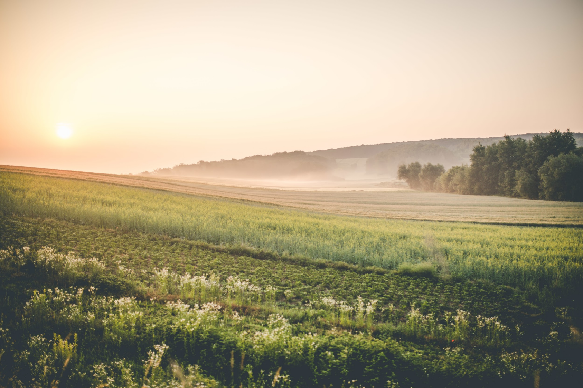
Thanks!

