Slide 1
HTML
BY:SHUBHAM KORAT

Slide 2
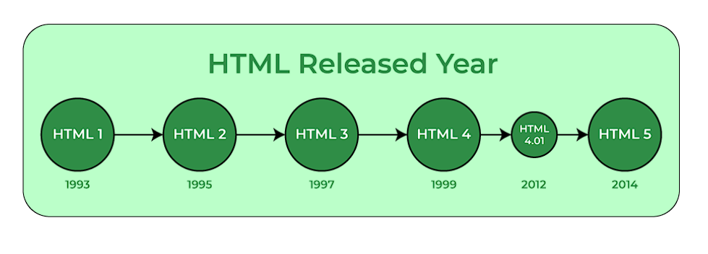
INTRODUCTION
HTML was created by Tim Berners-Lee in 1991.
HTML is an Hypertext Markup Language
It is used to design web pages using a markup language.

Slide 3
FEATURES AND ADVANTAGES OF HTML
FEATURES
It is easy to learn and easy to use.
It is platform-independent.
Images, videos, and audio can be added to a web page.
ADVANTAGES
HTML is used to build websites.
It is supported by all browsers.
It can be integrated with other languages like CSS, JavaScript, etc.

Slide 4
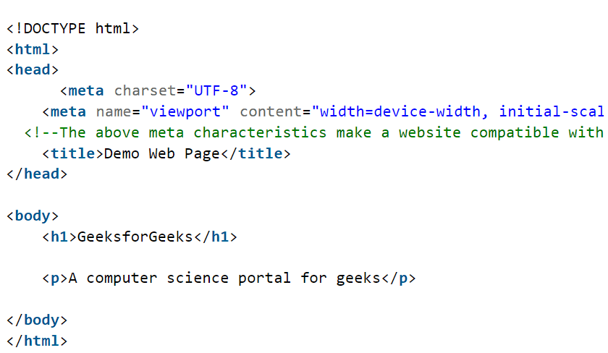
BASIC STRUCTURE OF HTML
THIS IS AN ENTRY POINT OF AN OUR WEBSITE .
IN THIS STRUCTURE WE CAN ADD OUR WEBSITE TITLE .

Slide 5
HTML TAGS
<head> <link>
<title> <form>
<body> <script>
<h1,h2,h3…> <img src> AND MANY MORE WE USE IN HTML
<p> <button>
<div> <hr>
<span> <br>

Slide 6
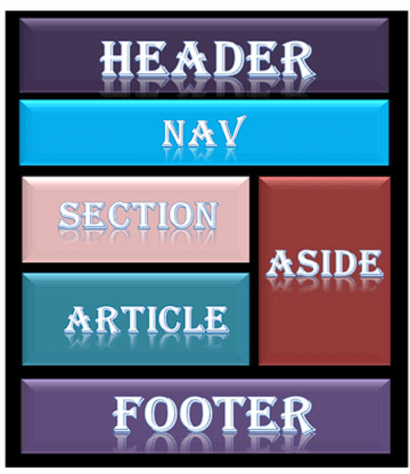
HTML LAYOUTS
HTML layouts provide a way to arrange web pages in well-mannered like header , navbar , section , part , article and last footer in web pages.

Slide 7
Descriptions of various layout elements
HTML <header>
header element is used to create header section of web pages and add an logo and etc……….
HTML <nav>
In html nav we can create navbar and add an many types of link like home,about,blog,categories,contact,support,help etc……..
HTML <section>
In section part we can add heading , paragraph , background image and also color and insort website important pages and many more…….
HTML<footer>
In HTML footer we can add address , contact , blog , map , contact no , email of companies and many more……….

Slide 8
HTML EDITOR
An HTML editor is a piece of software for creating and editing HTML code.
We can use editor like notepad , vs code , Atom , Sublime text etc…..
In this editor support to run an website in browser and check the how our website are going on and which changes to apply our website to make an efficient.
Mostly now vs code has best editor because they provide a syntax and suggestions and emmit to make an easy to develop an web pages and they provide an extra extensions like code runner or many other language extensions are there.

Slide 9
HTML COMMENTS
HTML comments are not displayed in the browser, but they can help document your HTML source code.
Html comments shown in <!-- paragraph or something -->
Comments can be used to hide content.
Comments are mostly used in while we are working on many parts and sections so we can type an strat sections or parts so whenever we try to update our code so that comments help to highlight our code.
So that’s why comments are used in html.

Slide 10
THANK YOU

