Slide 1

Shubham Kotal
Car Parking space availability Detection
Code Gladiators 2019

Slide 2
Executive Summary
Today, car parking lot issues have increased due to increase of cars in parking lots.
It has become very challenging to provide a good service to people in parking lots by providing them space for parking in timely manner.
It has also become very challenging to handle all parking availability issues with physical efforts due to the size of parking lots.
With the help of AI this can me managed in an automated way thereby cutting human efforts and reducing cost related to it.

Slide 3
Problem at hand
Detection of car parking space
Using Artificial Intelligence Technique for detecting the objects (car parking space) present in a video or an image.
For Detection of object, package used was Imageai Detection.
Using Open CV Resnet50
Instead of building a model which will require a huge training data, a pre-trained model is used which works on huge data set of different labels and can successfully identify cars in images.

Slide 4
Solution
Step1- Setting of working directory in Jupyter notebook.
Step2- Import required package for detecting objects in image.
Step3- Download pre trained model, i.e. Open CV Resnet50.
Step4- Combining object detection package with OpenCV to load a model.
Step5- Passing a direct image or snapshot of video to model to detect objects present in an image
Step6- Classifying counts of cars present in an image.
Step7- Subtracting total count of cars present in an image by actual number of car parking spaces available in parking lot, hence getting number of available spaces for parking cars.

Slide 5
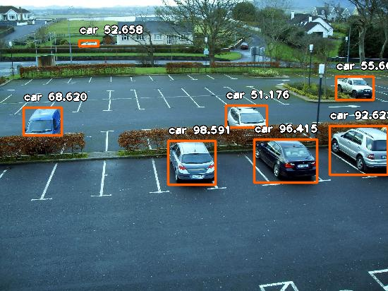
Demo
snapshots for reference – cars were successfully Identified.

Slide 6
Approach
I used a pre-trained model instead of training a model on a huge labeled data which would even require lots of computational power and thereby increasing cost factor and even collection of data is also a very complex task.
I focused on Detecting the cars instead of empty space as its very difficult to identify empty space specially when space don’t have parking lines and also I decided to go with detection of car because existing pre-trained model for detection of car were available.
Even complete detection of all empty space is not possible even if parking lines are given, because empty space can get hidden due to car in front of it or beside it.
I calculated the number of cars present in parking and subtracted it by actual total number of car parking space available in parking lot, this gave me a number which tells me how many parking spaces are available in the parking lot.

Slide 7
Technology Stack
Resent50
ResNet-50 is a convolutional neural network that is trained on more than a million images from the ImageNet database . The network is 50 layers deep and can classify images into 1000 object categories, such as cars and many more. As a result, the network has learned rich feature representations for a wide range of images. The network has an image input size of 224-by-224.
ImageAI Detection
ImageAI provides very convenient and powerful methods to perform object detection on images and extract each object from the image. The reason for using this package was it cleverly supports RetinaNet.

Slide 8
Why our team is the best!
This task was performed individually, but I would like to add 2 member if I get qualified for the next round.
Team Name- Data Diggers
Our team is best as we all have focus towards our goal and thus have a very good coordination and understanding, and thereby when working on same task it becomes easy to complete task in best possible way and it also becomes enjoyable which motivates us more towards our task and thereby increasing our chances to win
We also recently won one offline Hackathon thereby proving our team as the best team.

Slide 9
Associated attachments/ files
ipynb File – Jupyter notebook consisting of complete code for the project.

Slide 10
Challenges
Collecting the labeled data in image format was very difficult and also required a long duration of time to collect it. Even afterwards It required lots of computational power to execute thereby increasing coding complexity and also increasing cost factor.
This issue was overcome using a pre-trained model Resnet50 which requires very less computational power and also the task of collecting data got skipped which saved time and thereby reduced the efforts and complexity.

Slide 11
Possible Improvements
The next possible improvements that can be done over our solution is to bound the image to specific aspect ratio for better detection of objects so that the model don’t capture objects out of the specified ratio and exact numbers of cars get detected within the region so that the exact number of free parking spaces available can be determined.

Slide 12
Thank you!

