Slide 1
MidTerm Hackathon(MiTH)
By :- Shubham Kotal

Slide 2
Objective:
Predicting the Claim size of Liability Insurance claims
Background & Problem Statement:
Tort reform, to limit number and size of claims, is a contentious subject between consumer activists, claimants, Insurers and Lawyers. While there is a financial risk to the Society by way of wasting tax dollars or exodus of Insurers due to frivolous lawsuits, excessive court awards and exorbitant fees charged by Lawyers, leading to unsustainable Insurance rates, the ability and affordability of an individual or group of similar individuals affected for justice cannot be overlooked. The “failure to warn” related laws concerning dangers of using their products/services were introduced in each line of business as part of the reform and the liability was limited as a result of reform where the manufacturer/service provider warned in an approved way.
In this context, the data of liability claims involving bodily injury settled is studied for various factors that contribute to the size of the claim. The data includes claims for General liability, medical professional liability, other professional liability, commercial automobile liability lines of business and the liability portion of commercial multi-peril insurance from insurance companies and self-insurers. There may be occasions where there is the availability of some collateral sources of reimbursements to the injured person.

Slide 3
Data given : train(csv file) & test(csv file)
WORK FLOW
DATA UNDERSTANDING
DATA PREPARATION
DATA MODELING
EVALUATION
CHECKING ACCURACY

Slide 4
PROCESS
DATA UNDERSTANDING
Understanding data
Extracted the data from files
RESULTS/ OUTPUT
Interpreting results
DATA MODELING
EVALUATION
DATA PREPARATION
Applying supervised learning algorithms
Data pre-processing and cleaning
Converting parameters in proper format
Testing model accuracy

Slide 5
Data pre-processing approach
Step 1
Step 2
Step 3
Step 4
Data type conversion,
Checking missing
values
Splitting data
&
standardizing
Performing
Different models
Model Selection
Finding metrics
preprocess
Splitting data
Based on models

Slide 6
MACHINE LEARNING MODELS USED IN THE PROJECT:
1. Random Forest
2. Decision Tree
3. KNN
4. SVM

Slide 7


Slide 8
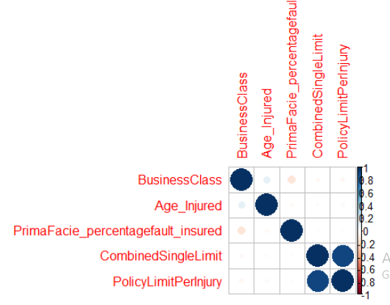
Correlation Plot

Slide 9
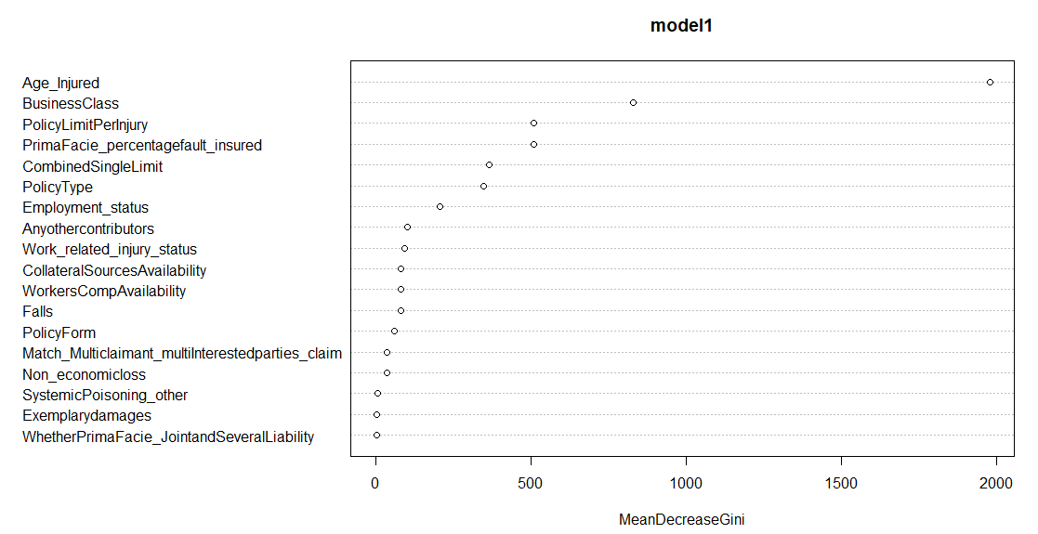
Variable Importance Plot

Slide 10
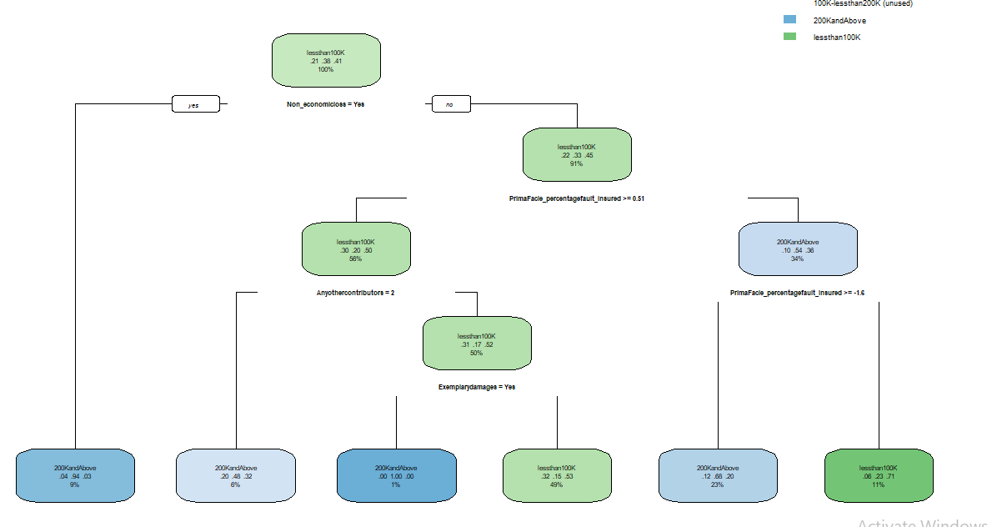
Decision Tree

Slide 11
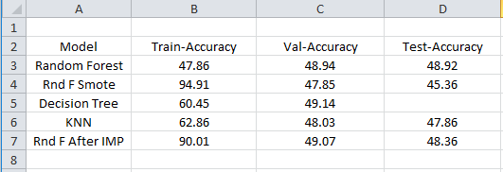
Metrics Accuracy

Slide 12
Conclusion:
Got accuracy for all models almost same.
But from all, Random forest after Mode Imputation is better as NA were replace by mode.

Slide 13
Thank you

