Slide 1
Secure data hiding in images using Steganography
CAPSTONE PROJECT
Presented By: Shubham Kumar
Student Name : Shubham Kumar
College Name & Department : Guru Nanak Institute of Technology, Kolkata
MCA Department.

Slide 2
OUTLINE
Problem Statement
Technology used
Wow factor
End users
Result
Conclusion
Git-hub Link
Future scope

Slide 3
Problem Statement
The goal of this project is to implement a Steganography system that allows users to securely hide a secret message within an image file. The system should:
Encrypt: Embed a secret message into an image without visibly altering the image.
Decrypt: Extract the hidden message from the image using a passcode for authentication.
Ensure Security: Prevent unauthorized access to the hidden message by requiring a passcode for decryption.
This project addresses the need for a simple, secure, and efficient method of covert communication using digital images.

Slide 4
Technology used
Python: Used for implementing the steganography algorithms.
OpenCV (cv2): For image processing (reading, modifying, and saving images).
Least Significant Bit (LSB) Method: Embeds the secret message into the least significant bits of pixel values.
Text Files: Used to store the passcode and metadata.(eg: encryption_info.txt
Cross-Platform: Works on Windows, macOS, and Linux.
Passcode Authentication: Ensures only authorized users can decrypt the message.

Slide 5
Wow factors
Steganography-based encryption – Instead of traditional encryption, the message is embedded within the pixel values of an image.
Ease of Use:– Simple command-line interface for encryption and decryption, making it user-friendly even for non-technical users.
Password protection - The message can only be decrypted with the correct password, adding a layer of security.
Scalable for Larger Messages:– The system can handle larger messages by using bigger images, making it adaptable for various use cases.

Slide 6
End users
Cybersecurity Enthusiasts – To explore encryption steganography techniques.
Journalists & Activists - Securely share confidential information without detection.
Students & Researchers - Learn about cryptography and image processing.
Photography & Designers – Protect copyright information within images.
General Users – Hide private messages or data securely within images.

Slide 7
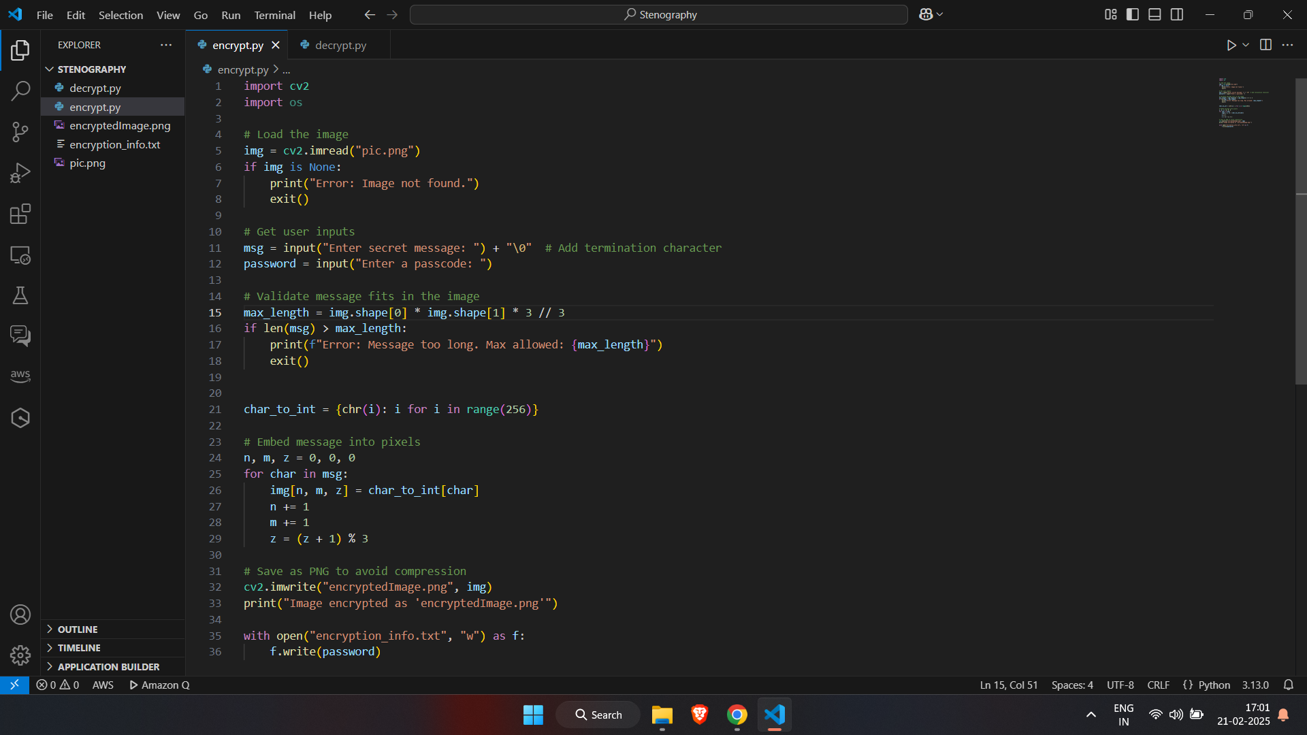
Results
Figure 1: Encryption Code

Slide 8
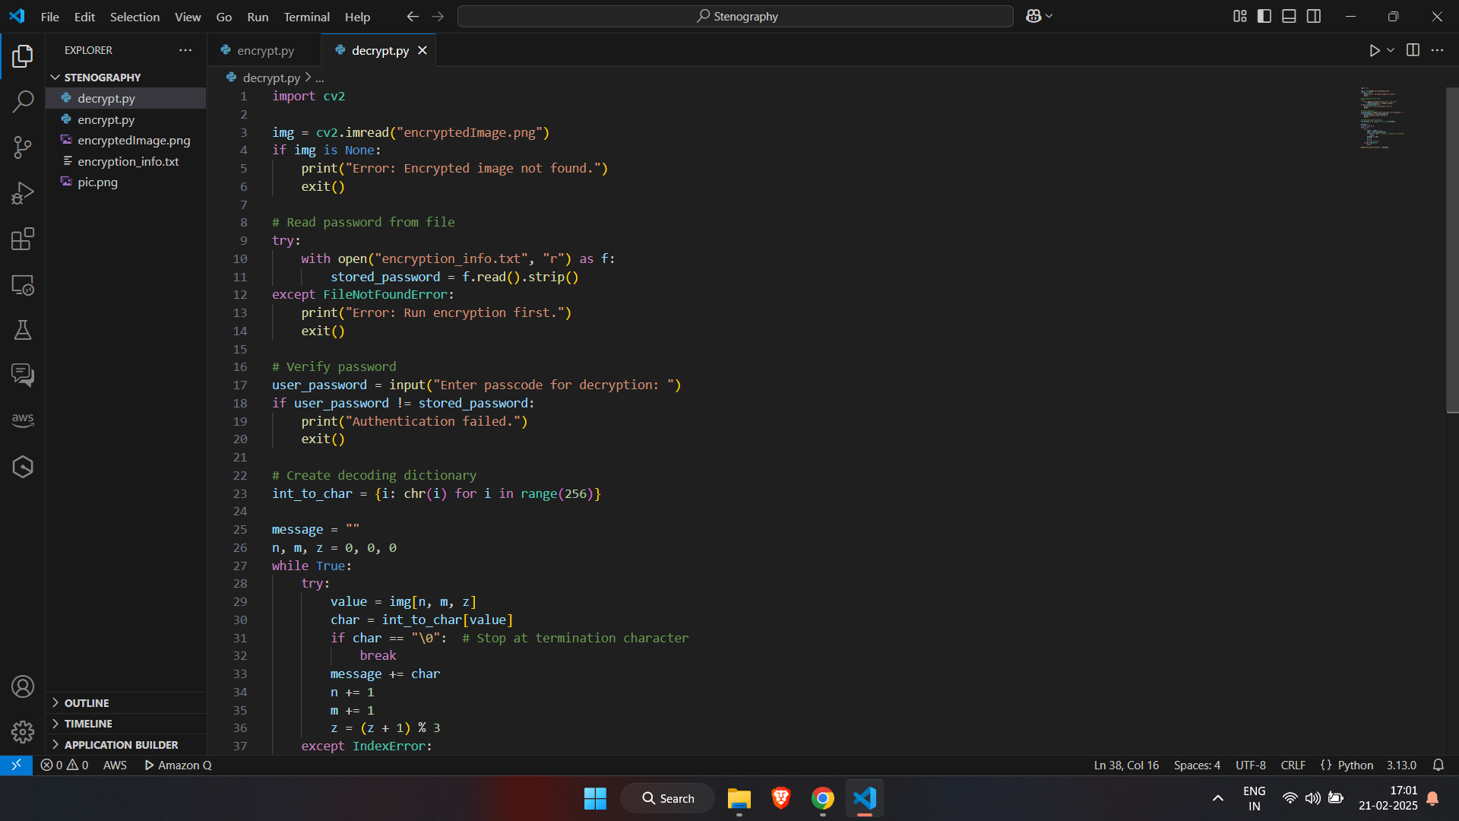
Figure 2: Decryption Code

Slide 9
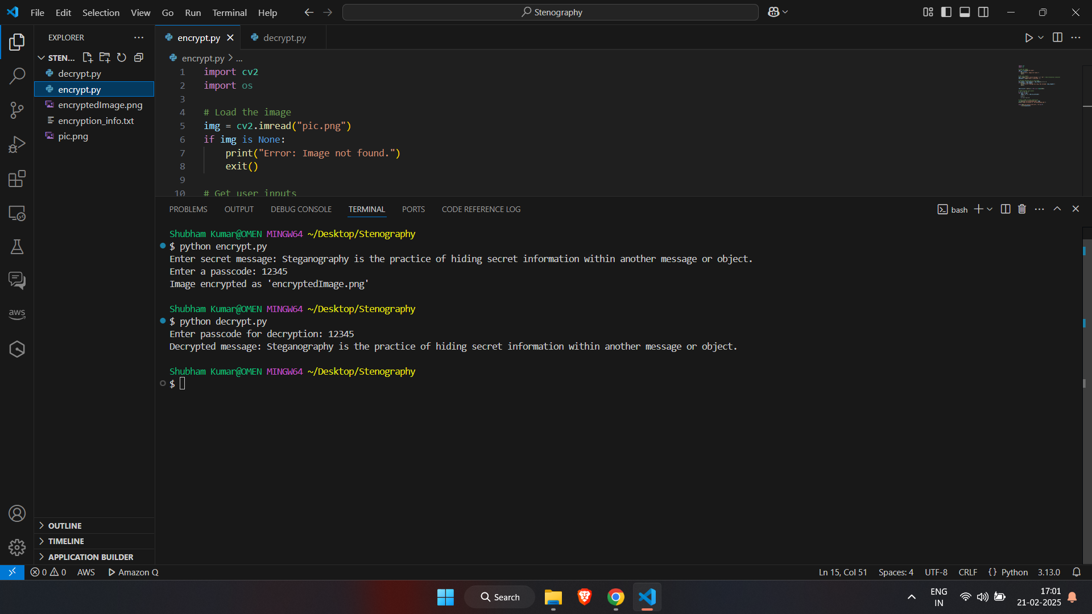
Figure 3: Output

Slide 10

Figure 4 : Encrypted Image

Slide 11
Conclusion
This steganography project provides a simple yet powerful way to securely hide secret messages within images using Python and OpenCV. By leveraging the Least Significant Bit (LSB) method, the project ensures that the embedded message remains invisible to the naked eye while maintaining the image's visual integrity. The addition of passcode authentication adds a layer of security, ensuring that only authorized users can decrypt the message. The project is cross-platform, user-friendly, and highly educational, making it an excellent tool for learning about steganography, image processing, and Python programming. this project demonstrates the potential of combining technology and creativity to solve real-world problems. Its simplicity, efficiency, and adaptability make it a standout example of how small-scale projects can have a significant impact.

Slide 12
GitHub Link
Link: https://github.com/shubhamkr0021/AICTE/tree/main

Slide 13
THANK YOU

