Slide 1
HACKATHON DECISION-SUPPORT DEMONSTRATION
TrialGuard
PUBLIC RECORD
BOUNDED COHORT
Evidence-linked operational review questions from public trial records
RELEASE GATE
For clinical operations and trial-review teams
IMPLEMENTED DEMONSTRATION
Notes:
Source: TrialGuard Development Plan, sections 1 and 15. TrialGuard is a bounded decision-support demonstration, not a clinical decision system.

Slide 2
02
The trial review problem
Operational review starts with fragments spread across public records
01
02
03
CONTEXT
COMPARABILITY
VERIFICATION
A trial status has little meaning without a bounded peer cohort.
Phase, condition, intervention, and design vary across candidate records.
Stop reasons must trace back to the exact source field and registry record.
A useful review keeps source links visible and leaves the decision with a qualified reviewer. Uncertainty stays explicit.
TRIALGUARD · PRESENTATION DECK
02
Notes:
Source: TrialGuard Development Plan, sections 1, 4, and 7. No external statistics appear on this template slide.

Slide 3
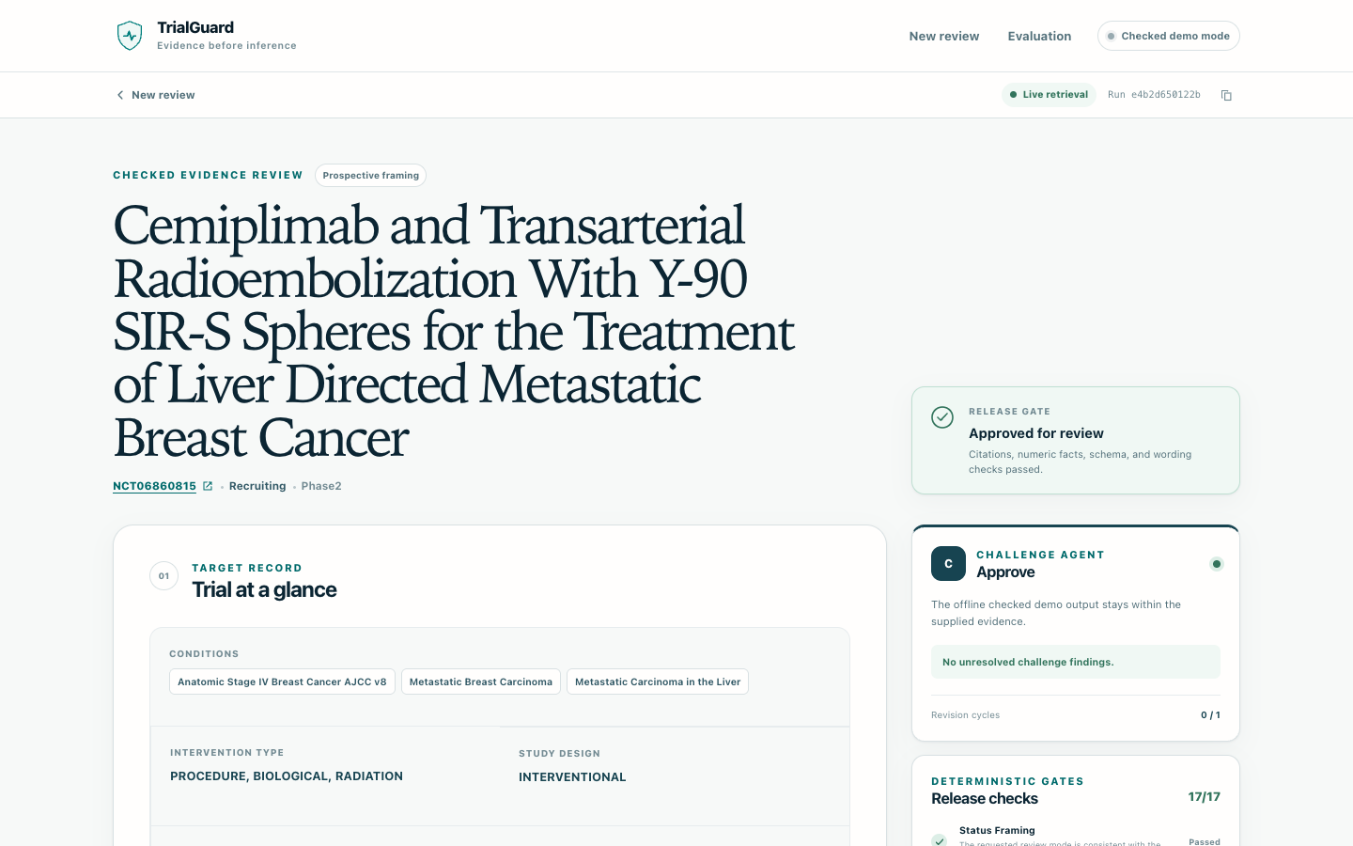
03
Product workflow
One NCT ID becomes a checked review brief with visible evidence
CHECKED DEMO REPORT
01
Validate
Confirm the NCT ID before any model call.
02
Retrieve
Load an allowlisted public trial record.
03
Compare
Build the cohort and rank stopped precedents.
04
Draft
Create evidence-linked review questions.
05
Release
Challenge the draft and apply deterministic checks.
TRIALGUARD · PRESENTATION DECK
03
Notes:
Source: TrialGuard Development Plan, sections 4 and 15. Product image: slides/assets/trialguard-report.png, captured from the implemented checked-report view.

Slide 4
04
System architecture
The intended AWS design keeps model output inside a deterministic release path
USER
AWS APP RUNNER
APPLICATION
DETERMINISTIC
OUTPUT
Browser
FastAPI
Bounded orchestrator
Release gates
Report
Public review UI
Container service
Call limits and one revision
Citation · numeric · language
Human review
READS
INVOKES
PUBLIC DATA
AMAZON BEDROCK · US-EAST-1
ClinicalTrials.gov
Allowlisted fields · bounded cohort
EVIDENCE
COORDINATOR
CHALLENGE
Grounded facts
Review questions
Adversarial review
IAM WORKLOAD ROLE
CLOUDWATCH METADATA-ONLY LOGS
No embedded credentials
Run ID, latency, token counts, and gate status only
TRIALGUARD · PRESENTATION DECK
04
Notes:
Source: implemented TrialGuard runtime and deployment package, 2026-09-26. This is the intended AWS production design. The current workshop role cannot provision App Runner. The diagram uses editable native PowerPoint shapes.

Slide 5
05
Evaluation results
Repeatable checks and one live smoke test show the current implementation boundary
AUTOMATED VALIDATION
LIVE SMOKE TEST · ONE SAMPLE
52/52
NCT06860815
Full release
14/14 checks passed
tests pass
7/7
3
10,821
1,758
11.77 s
BEDROCK CALLS
INPUT TOKENS
OUTPUT TOKENS
ELAPSED
synthetic offline evaluation behaviors matched
$0.001071
estimated Bedrock model cost
Cases cover invalid IDs, sparse evidence, prompt injection, fabricated citations, and numeric mismatches.
Nova Lite Standard: $0.06/M input and $0.24/M output
Rates verified 2026-09-26. One live sample, not a benchmark.
TRIALGUARD · PRESENTATION DECK
05
Notes:
Verified values supplied from the stable TrialGuard build on 2026-09-26: 52/52 tests pass; 7/7 synthetic offline behaviors matched; one NCT06860815 live smoke test produced a full release, 14/14 checks, 3 calls, 10,821 input tokens, 1,758 output tokens, and 11.77 seconds elapsed. Estimated cost uses Amazon Nova Lite Standard rates of $0.06 per million input tokens and $0.24 per million output tokens, verified 2026-09-26. One live sample is not a benchmark.

Slide 6
06
Limits and next steps
DEPLOYMENT STATUS
PUBLIC SHOWCASE
Static GitHub Pages
CURRENT BOUNDARY
Public data
Selected, allowlisted ClinicalTrials.gov fields only
PRODUCTION TARGET
FastAPI on AWS App Runner with Bedrock in us-east-1
Sensitive data
No PHI or confidential protocol uploads
CURRENT CONSTRAINT
Decision support
No prediction, design recommendation, or clinical advice
The workshop IAM role blocks App Runner provisioning
Accountability
A qualified reviewer makes the final decision
PACKAGE STATUS
Ready for deployment from an authorized AWS account
Hackathon decision-support demonstration. Not clinical, regulatory, legal, or medical advice.
TRIALGUARD · PRESENTATION DECK
06
Notes:
Source: TrialGuard Development Plan, sections 1, 3, 9, 17, and 18, plus deployment status verified 2026-09-26. The current public showcase uses static GitHub Pages because the workshop IAM role blocks App Runner provisioning. The App Runner package is ready for an authorized AWS account. Keep the intended-use boundary in the final deck.

