Slide 1
HACKATHON DECISION-SUPPORT DEMONSTRATION
TrialGuard
PUBLIC RECORD
BOUNDED COHORT
Evidence-linked trial review and grounded follow-up chat from public records
RELEASE GATE
For clinical operations and trial-review teams
IMPLEMENTED DEMONSTRATION
Notes:
Source: TrialGuard Development Plan, sections 1 and 15. TrialGuard is a bounded decision-support demonstration, not a clinical decision system.

Slide 2
02
The trial review problem
Operational review starts with fragments spread across public records
01
02
03
CONTEXT
COMPARABILITY
VERIFICATION
A trial status has little meaning without a bounded peer cohort.
Phase, condition, intervention, and design vary across candidate records.
Stop reasons must trace back to the exact source field and registry record.
A useful review keeps source links visible and leaves the decision with a qualified reviewer. Uncertainty stays explicit.
TRIALGUARD · PRESENTATION DECK
02
Notes:
Source: TrialGuard Development Plan, sections 1, 4, and 7. No external statistics appear on this template slide.

Slide 3
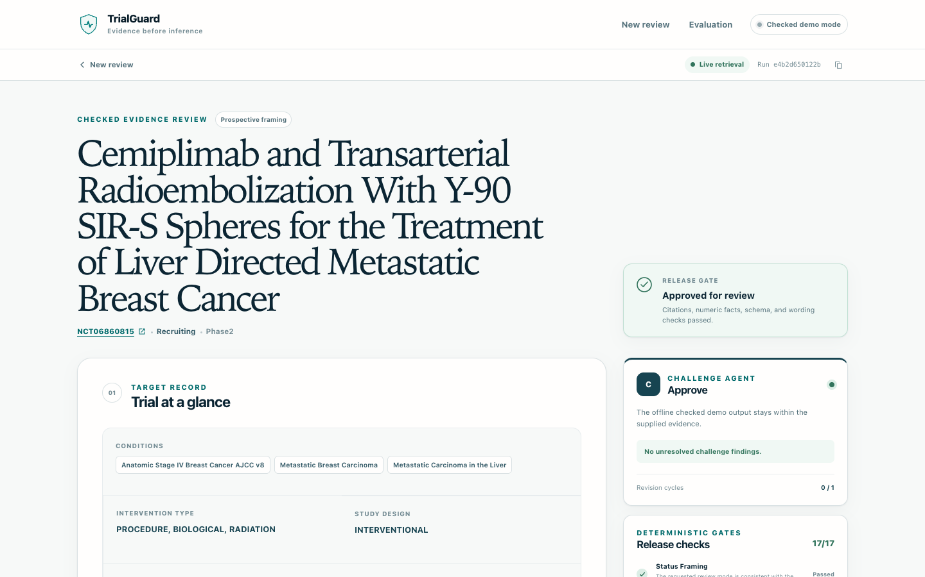
03
Product workflow
One NCT ID becomes a checked review brief with visible evidence
CHECKED DEMO REPORT
01
Validate
Confirm the NCT ID before any model call.
02
Retrieve
Load an allowlisted public trial record.
03
Compare
Build the cohort and rank stopped precedents.
04
Draft
Create evidence-linked review questions.
05
Release
Run release gates, then open bounded report-grounded chat.
TRIALGUARD · PRESENTATION DECK
03
Notes:
Source: TrialGuard Development Plan, sections 4 and 15. Product image: slides/assets/trialguard-report.png, captured from the implemented checked-report view.

Slide 4
04
Live hybrid architecture
Cloudflare exposes live Bedrock; Render provides the durable checked-demo fallback
USER
PUBLIC ROUTES
APPLICATION
DETERMINISTIC
OUTPUT
Browser
FastAPI
Bounded orchestrator
Release gates
Report + chat
Public review UI
Cloudflare + Render
Call limits and one revision
Citation · numeric · language
Human review
READS
INVOKES
PUBLIC DATA
AMAZON BEDROCK · US-EAST-1 · CLAUDE HAIKU 4.5 · GUARDRAIL
ClinicalTrials.gov
Allowlisted fields · bounded cohort
EVIDENCE
COORDINATOR
CHALLENGE
REPORT CHAT
Grounded facts
Review questions
Adversarial review
Bounded answers
AWS SESSION / IAM ROLE
CLOUDWATCH METADATA-ONLY LOGS
No embedded credentials
Run ID, latency, token counts, and gate status only
TRIALGUARD · PRESENTATION DECK
04
Notes:
Source: implemented TrialGuard runtime and deployment status verified 2026-09-26. The live route uses a Cloudflare quick tunnel to the local FastAPI process, which invokes Amazon Bedrock Claude Haiku 4.5 in us-east-1 with a configured Bedrock Guardrail. Render hosts a durable checked-demo fallback without AWS credentials. CloudWatch receives metadata-only logs and metrics. The diagram uses editable native PowerPoint shapes.

Slide 5
05
Verified build
Tests, fixed evaluations, live Bedrock, grounded chat, and observable traces
AUTOMATED VALIDATION
LIVE BEDROCK VALIDATION · ONE SAMPLE
80/80
NCT06513364
Full release
Grounded chat passed
tests pass
7/7
3
10,282
923
15.9 s
REPORT CALLS
INPUT TOKENS
OUTPUT TOKENS
ELAPSED
synthetic offline evaluation behaviors matched
PROMPT INJECTION
CLOUDWATCH
Blocked
Trace received
Cases cover invalid IDs, sparse evidence, prompt injection, fabricated citations, and numeric mismatches.
Token counts are measured; current Haiku price is not hard-coded.
TRIALGUARD · PRESENTATION DECK
05
Notes:
Verified values from the stable TrialGuard build on 2026-09-26: 80/80 tests pass; 7/7 fixed synthetic evaluations matched; NCT06513364 reached full release with five precedents and three review questions; report chat returned a checked source-linked answer; a separate prompt-injection test was blocked; CloudWatch received the metadata-only event. One recent report used three Bedrock calls, 10,282 input tokens, 923 output tokens, and about 15.9 seconds. One observation is not a benchmark. TrialGuard records measured tokens and applies configured per-million-token rates rather than hard-coding a current Haiku price.

Slide 6
06
Limits and next steps
DEPLOYMENT STATUS
LIVE BEDROCK
commerce-terminal-contamination-
chosen.trycloudflare.com
CURRENT BOUNDARY
Public data
Selected, allowlisted ClinicalTrials.gov fields only
DURABLE FALLBACK
trialguard-5erc.onrender.com
Two reviewed replay IDs
Safety boundary
No PHI uploads, prediction, design recommendation, or advice
ACCESS NOTE
Live allowance
15 shared assessment and model-backed chat operations per UTC day
Live route needs this laptop awake; Render may cold-start
Accountability
A qualified reviewer makes the final decision
NEXT PRODUCTION
Managed AWS compute plus shared storage and rate limits
Hackathon decision-support demonstration. Not clinical, regulatory, legal, or medical advice.
TRIALGUARD · PRESENTATION DECK
06
Notes:
Source: implemented deployment status verified 2026-09-26. Live Bedrock URL: https://commerce-terminal-contamination-chosen.trycloudflare.com/. It accepts arbitrary valid NCT IDs, uses ClinicalTrials.gov and Amazon Bedrock in us-east-1, and remains available only while the laptop, app process, and quick tunnel stay awake. Durable fallback: https://trialguard-5erc.onrender.com/. Render cannot currently retrieve ClinicalTrials.gov from its outbound address, so it serves clearly labeled reviewed replays for NCT06860815 and NCT06513364 with no AWS credentials or model calls. Free Render instances may cold-start after inactivity. Static fallback: https://shubhamkragrawal.github.io/TrialGuard/. Keep the intended-use boundary in the final deck.

